Slide 1
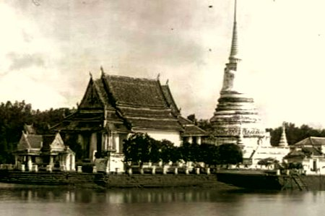
“Pre-historic Time”
TU111 Thai Civilization
Dr.Wankwan Polachan
Lecture 1

Slide 2
Today’s Outline: Pre-historic Time
Thai vs. Tai
Tai People before the 11th Century
Old Days of the Tai
Technological Core of S/E Asia Civilization
Major Linguistic
Tai Village & Müang

Slide 3
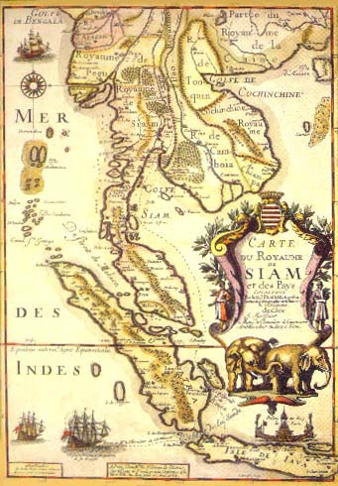
Thai vs. Tai
“Thai” as citizens of Thailand, subjects of the Thai King, a speaker of the Thai language
- was invented in 1939 (formerly called Siam)
Its capital, Bangkok, founded in 1782 in succession to an older city, Ayutthaya
“the people who brought the core elements of Thai identity, did not arrive in the Indochinese peninsula until a thousand years ago”

Slide 4
Thai vs. Tai
“Tai”: a cultural and linguistic term used to denote various Tai peoples in general
“Thai culture and identity” emerged as the product of interaction between
Indigenous
Mon,
Khmer
Tai
Immigrant
cultures
Chinese, Indian

Slide 5
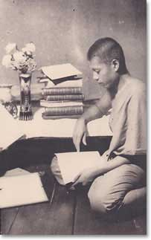
Tai People before the 11th Century
Today Tai people are widely spread over several million square kilometers of the southeastern corner of Asia
Their most visible representatives are the Thai (or Siamese) ≈ 27 to 30 million
Many speak related Tai languages & recognize themselves as “Tai” call their own ethnic and linguistic groups by other names…

Slide 6
Tai People before the 11th Century
More than 20 million Lao (live in N/E Thailand)
- 2.5 million in Laos
- 3 million Shans in N/E Burma
- 2.5 million; Lü of Yunnan province in China, and
Upland Tai (the Black Tai, White Tai, Red Tai of
Laos and northern Vietnam)
“Strongly influenced by Chinese culture and located to the east”
- Chuang people of Kwangsi (1.8 million)
- 70 million; groups in N/E India, and Chinese island of Hainan

Slide 7
Tai People before the 11th Century
The most obvious characteristic that serves to identify the “Tai” is their language
“Tai languages” are monosyllabic (made up of single syllables) and tonal
- máa (high tone) = horse
- măa (rising tone) = dog
- maa = to come
Tai share a great deal of their culture, their style of life and patterns of behavior, with other S/E Asian people…markedly different from the cultures of India and China…

Slide 8
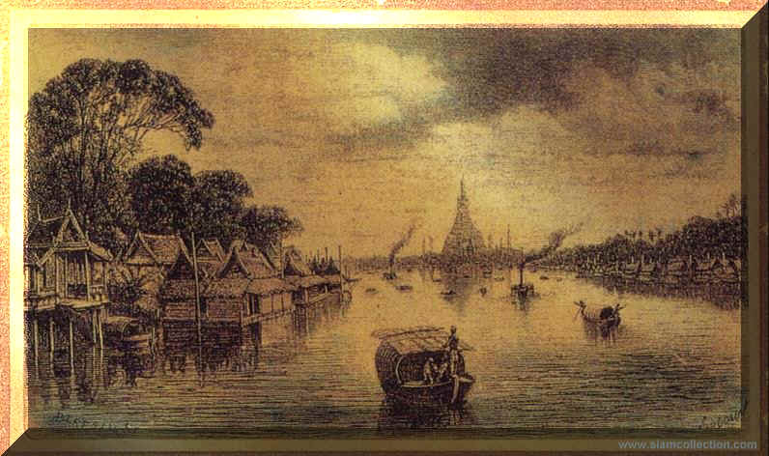
Old Days of the Tai
40,000 years ago, people in the area hunted and gathered food from the streams and forests, using sorts of wooden and bamboo tools
10,000-20,000 years ago, they had begun to engage in agriculture, cultivating peas and beans, and domesticating animals such as chicken
10,000 years ago, the individual ethnic groups of S/E Asia began to be differentiated, linguistically and culturally
This process took place on the basis of a common culture

Slide 9
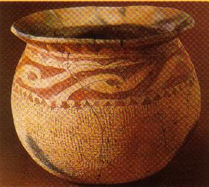
Technological Core of S/E Asia Civilization
Cattle were domesticated
Rice was cultivated
Invention of the outrigger canoe
Copper and bronze usage (found by excavation site at Ban Chiang)
Ironworking and pottery-making technology

Slide 10
Technological Core of S/E Asia Civilization
Tai conducted subsistence agriculture based on the rice cultivation, supplemented by fishing and gathering of forest products
Lived as nuclear families in small villages
Trade in metal tools, pottery, salt
The region was under populated, man power was highly valued

Slide 11
Technological Core of S/E Asia Civilization
Women enjoyed a relatively high status (by contrast with low social and economic status of Chinese and Indian women)
Sons and daughters receive equal shares of parents’ estates
Throughout the region, folk beliefs were consistent. World was regarded as being peopled with Good and Evil spirits that had the power to aid or harm human, thus had to be propitiated by ceremonies or offerings of food

Slide 12
Technological Core of S/E Asia Civilization
Tai = inhabitants of the valleys and lowlands (not the hillsides and uplands)
- usually have an economy based on wet rice cultivation
- cattle (buffalo) is significant = a measure of status and wealth
- living in houses raised on piles above the ground, in contrast to Chinese and Vietnamese
- free choice of marriage partners
- tattooing associated with the passage to the adulthood, was practiced widely among men

Slide 13
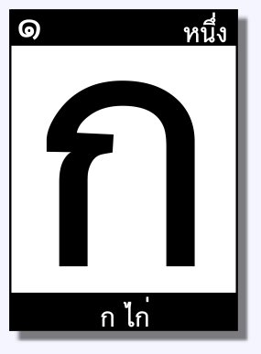
Major Linguistic
Island S/E Asia from the Philippines to the Malay Peninsula “Malayo-Polynesian” (Austronesian)
Mon and Khmer “ Austroasiatic” spoken in the central and southern portions of the Indochinese peninsula
Tibeto-Burman
Tai

Slide 14

Tai Village and Müang
Rural Tai were dependent to some degree on “trade” for salt or metal
“Müang” can mean both the town located at the hub of a network of interrelated villages and also the totality of town and villages, ruled by a single chao, “lord”
Because villagers could not live in isolation as they are highly vulnerable in time of war. “Müang” becomes the primary unit of political, economics, and social interrelationships above the simple village level

Slide 15
Tai Village and Müang
Tai villagers banded together for mutual defense under the leadership of the most powerful village or family, whose resources enable it to arm and supply troops
In return for protection, villages rendered labor service to their chao, or paid him local produce or handicrafts
Rice agriculture kept them to the lower-lying valleys, while the hills above were inhabited by various ethnic groups
Tai chao established relationships with such groups employing them as slaves and laborers and taking on their chiefs as “vassals”, just as Tai were “vassals” of the Chinese rulers
(State Building)

Slide 16
Tai Village and Müang
The successful müang defended itself militarily or diplomatically against neighboring müang, rude hill peoples, and major state like China and Vietnam
It maintained order in its own region and imposed some system of justice for punishment
A chao built up his own administrative apparatus for collecting tax revenues
He regularized the succession to his office, often by appointing his heir

Slide 17
Tai Village and Müang
This was a world that insecure where wealth such as cattle or metals might disappear overnight in warfare or a bandit raid
“Security, wealth, and life” depended upon the relations among individuals and families that provided for durable and effective leadership and order
Although müang society was hierarchical (patron-client relationship) but not the “one-sided”. Each party needed the other
“Pushed to a confrontation”
- chao rely upon superior force
- villagers resort to fight the surrounding wilderness or to a neighboring müang eager to gain his labor.
…“Compromise is needed here”…

