Slide 1
Economics of Marketing
Integrated Business Economics
EE.488

Slide 2
Outline
Economics of Marketing
What is Marketing?
Marketing Mix: 4Ps
  Product
  Price
  Place
  Promotion
Economics and Marketing

Slide 3
Year = 0 | 1 | 2 | 3 | 4 | 5
Sale (Revenue)= Price x Quantity | Growth?
Cost of goods sold (Expense) Production HR :
Gross profit
Operating cost
EBIT-DA
Depreciation
EBIT
Interest
Tax
Net Profit
Free Cash Flow

Slide 4
Demand Forecasting
Forecasting of demand is the art of predicting demand for a product or a service at some future data on the basis of certain present and past behavior patterns of some related events

Slide 5
Objectives of demand forecasting
It enable to produce the required quantities at the right time
Arrange well in advance for the various factors of production viz. raw materials, equipment, machine accessories, labour, building etc.
It is an important aid in effective and efficient planning
It can also help management in reducing its dependence on chance
It is helpful in allocation of national resources
Helpful in setting sales target
Arrangement of funds

Slide 6
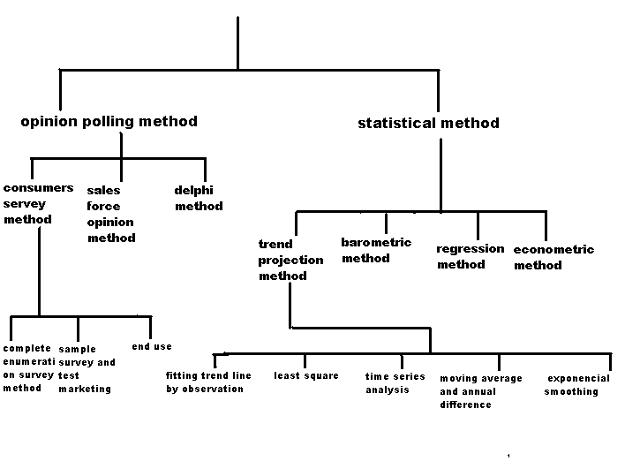
Methods Of Demand Forecasting

Slide 7
Empirical Estimation of Demand
Substitutes: b₂ is positive
Complements: b₂ is negative
Price
25
20
15
d₁
10
d₂
5
d₃
D
0
5
10
15
20
25
Quantity

Slide 8
Two-Part Tariff with Two Consumers
$/Q
The price, P*, will be
greater than MC. Set T*
at the surplus value of D_{2.}
T*
A
P*
MC
B
C
D₁ = consumer 1
D₂ = consumer 2
Q₂
Q₁
Quantity
Notes:
83

Slide 9
Consumer Surplus
Consumer surplus
Price
Price
Consumer surplus
Demand
MC
P_{A}
MC
P_{B}*
D
Product A
Product B
Notes:
79

Slide 10
price
price
p₂
p₁
0
q₁
q₂
quantity
D₁(s₁)
D₂(s₂)
quantity
0
q₀
q₁
q₂

Slide 11
Firm’s Value Creation and Profit
Cost
Total Value – Price –Consumer Cost = Consumer Surplus
Prices or tariffs;
User costs; Transaction costs; Search costs; Psychic costs
Profit
Profit
Firm
Value
Price
Buyers
Suppliers
Cost of Production
Value of Product/Service

Slide 12
Corporate
Marketing
Planning
Corporate Strategy:
Which products to offer
Which markets to serve
Product Mix Strategy:
What each product should
contribute to the firm
How resources should be
allocated across products

Slide 13
The Economics of Marketing
Points of Agreement
Points of disagreement
People face trade-offs
The cost of something is what you’re willing to give up to get it
People respond to incentives
Trade can may everybody better off
People are rational
Markets are efficient

Slide 14
What is Marketing?
Marketing is Advertising?
Marketing is Selling?
Marketing is
Satisfying Customer Needs

Slide 15
Needs
Wants
Demands
Products
Core Marketing
Concepts
Markets
Value
Satisfaction
Quality
Exchange
Transactions
Relationship)

Slide 16
The Evolution of Marketing
 | Transactional Marketing | Relationship Marketing | Collaborative Marketing
Time frame | 1950s | 1980s | Beyond 2000
View of value | The company offering in an exchange | The customer relationship in the long run | Co-created experiences
View of market | Place where value is exchanged | Market is where various offerings appear | Market is a forum where value is co-created through dialogue
Role of customer | Passive buyers to be targeted with offerings | Portfolio of relationships to be cultivated | Prosumers-active participants in value co-creation
Role of firm | Define and create value for consumers | Attract, develop and retain profitable customers | Engage customers in defining and co-creating unique value
Nature of customer interaction | Survey customers to elicit needs and solicit feedback | Observe customers and learn adaptively | Active dialogue with customers and communities
Adapted from Prahalad and Ramaswamy 2004

Slide 17

Marketing Mix
is the set of marketing tools that the firm uses to pursue its marketing objectives in the target market

Slide 18
PRODUCT
Economics of Marketing

Slide 19
Product
The first "P" of the marketing mix deals with the product.
The positioning, packaging, etc.
PRODUCT - what is it that you are going to sell.
Product Mix - range of PRODUCTS or SERVICES offered for sale
Product Features- color, packaging, quality, brand name
Product Support - maintenance, after-sales Service, pre-sale like advice and Quotations

Slide 20
The choices firms need to make on new product introductions
IMAGE/
POSITIONING
RISK
CHOICES
BRANDING
DIFFEREN-
TIATION
PRODUCT
DECISIONS
BRAND
EXTENSIONS
IDEAS
AND
EVALUATIONS
TEST
MARKETING
COMPETITIVE
RESPONSE
DISTRIBUTION
PRODUCT
LINES

Slide 21
Steering the product through the Product Life Cycle
FEATURES
DIFFEREN-
TIATION
BRAND
STRUCTURE
DIFFUSION
PRODUCT
IMAGE/
POSITIONING
AWARENESS
CATEGORY
BRAND
PRICE
COMPETITION
SUBSTITUTES
PARTNERSHIPS

Slide 22
Product Lines vs. Product Mix
Product Line: A number of similar or related products—e.g.,
  BIC writing utensils
  Boeing Commercial Aircraft (aircraft and parts)
  Nike shoes; Nike clothing
Product Mix: assortment of different products offered
  E.g., “KFC—we do chicken right!” (Only one product line)
  3M: Tapes, adhesives, Post-its, chemicals, computer disks, overhead projectors (things that are bonded together
Notes:
22

Slide 23
Types of New Products
New to the World (discontinuous innovations)
New product lines (to firm)
Additions to existing product lines
Improvements/revisions to existing products (continuous innovations)
Repositioned products
Lower priced products

Slide 24




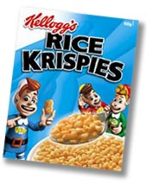



The case of Cereal Bars
Lateral Marketing Process
Cereals for breakfast market
New category
into
STREETS
=
Vertical Marketing Process
Cereal varieties

Slide 25


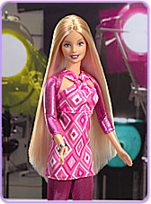

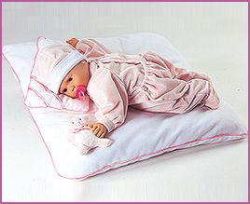
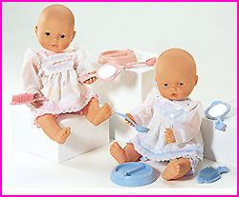
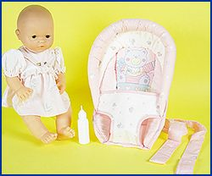
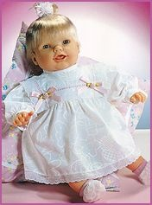
The case of Barbie
Lateral Marketing Process
Baby dolls market
Teenager
New category
To
feel
as...
=
Doll varieties
Vertical Marketing Process

Slide 26
NEW PRODUCT DEVELOPMENT SEQUENCE
STRATEGY
IDEA GENERATION
IDEA SCREENING
BUSINESS
ANALYSIS
DEVELOPMENT
TEST MARKETING
COMMERCIALIZATION

Slide 27
Idea Generation
Sources of new ideas
  Customer based
    Outright suggestions
    Observation of customer problems and tasks
    Market research on processes and problems
  Supplier suggestions
  Employee suggestions
  R&D Breakthroughs
  Competitive ideas
  Adaptation of products seen in foreign markets
Notes:
27

Slide 28
Screening
Internal screening
  Technical feasibility
  Consistency with strategic objectives
External screening
  Marketing research
    Questionnaires
    Conjoint analysis (determines importance of attributes)
Business analysis
  Financial feasibility
  Legal issues
  Impact on sales of existing products
  Financial projections
Development
  Design
  Prototypes
  Refinements
Notes:
28

Slide 29
Some Product Life Cycle Stage Examples
Color TVs: Maturity
Black and white TVs: Decline
HDTVs: Growth
VCRs: Decline
DVD players: Growth or maturity.
Jeans: Maturity
Fast food: Growth/maturity
Traditional photography: Decline
Digital photography: Growth
Fax machines: Decline
Internet access (U.S.)
  Dial-up: Decline
  DSL, Cable: Maturity
Travel agencies: Decline
Cranberry juice: Revitalization
Notes:
29

Slide 30

The International Life Cycle
Market for older technology tends to exist in less developed countries
  Manufacturing of older generation technology--e.g., computers
  Resale of capital equipment—e.g., DC 8 aircraft, old three part canning machines
Some countries tend to be more receptive to innovation than others
“Leap frogging”
  Going directly from old technology to the very newest, skipping intermediate step (e.g., wireless rather than wired technology)
Shortening of product life cycles
Notes:
30

Slide 31
Optimal Quality
Increasing quality ➔ increasing demand

Slide 32
PRICE
Economics of Marketing

Slide 33
Price
The second "P" of the marketing mix is price.
There are several options to consider regarding price: 1) price matching, 2) price making, 3) introductory penetration pricing, and 4) a competitive upgrade price strategy.
Pricing - not just how much you charge for a product but how the price fits your target market and the image you wish to develop.
Pricing Methods you choose depends on: competition in the market and your marketing strategies; demand for your product; controlled pricing; your costs; perceived value

Slide 34
Learning Objectives
Understanding price choices faced by managers, the constraints faced on these choices (e.g., legal), and the consequences of these choices
Understanding the “signaling” effects of product prices
Understanding the respective interests of manufacturers and retailers in product pricing
Ways to change the price:
  Sticker price
  Quantity—same sticker price but lesser quantity
  Quality—use of lower cost materials—e.g., “gooeye” stuff rather than chocolate in candy
  Terms e.g., support, accessories, payment terms, delivery

Slide 35
Value, Cost, and Price ➔Profit
Minimum
willingness to sell
Maximum
willingness to pay
A
B
Scope of Price
Value creation

Slide 36
Perceptions of Value
  Reference Price Effect
  Difficult Comparison Effect
  Switching Cost Effect
  Price-Quality Effect
  Expenditure Effect
  End-Benefit Effect
  Shared-cost Effect
  Fairness Effect
  The Framing Effect
Understanding price choices faced by managers, the constraints faced on these choices (e.g., legal), and the consequences of these choices
Understanding the “signaling” effects of product prices
Understanding the respective interests of manufacturers and retailers in product pricing

Slide 37
Views of Consumers and Price Response
Economics
  Assumed to have perfect information about
    Quality of all brands
    Prices of each brand at all locations
  Elasticity: A “down-sloping” demand curve means that a higher quantity will be demanded when the price is reduced
Marketing
  Consumer knowledge of product quality and prices is imperfect
  Due to imperfect information, a higher price may sometimes be used by consumers to infer greater quality
  Research suggests that actual product quality as rated by Consumer Reports accounts for about 25% of product price differences among brands

Slide 38
Price Discrimination
Explicit
  Only some customers are eligible for special pricing—e.g.,
    Student discounts on software
    Senior citizen discounts
    Geographic: Only customers in the 900**-935** zip code areas are eligible for discount Disneyland Admission
Implicit
  No outright rule, but discounted deal is unattractive to some customers
    Airlines: Saturday night stay-over or advance purchase requirement
    Daily special meal—one cheaper meal but no choice
    Periodic discounting (products going on and off sale)

Slide 39
Some Approaches to Pricing
Cost-plus: Add fixed percentage markup
Penetration pricing: low intro price ---> volume
Skimming: high intro price ---> take advantage of price insensitive consumers
Buyer-based
  perceived value
  going-rate (competition)
---> Balancing cost and market considerations
Notes:
39

Slide 40
Consumer Reference Prices
Consumers typically have some expectation of what they will pay. This is based on:
  previous experience
  common sense
  perceived fairness
Two kinds of reference prices:
  Internal: Based on consumer’s memory.
  External: Based on environment (e.g., signs, other products in the store)
Notes:
40

Slide 41
PLACE
Economics of Marketing

Slide 42
Place
The 3rd "P" of the marketing mix deals with product placement--The width of distribution
Distribution - How your products or services reach your customers
Distribution Methods: Customers come to you ; You take the product/service direct to the customer ; You use an agent merchant franchise etc. to reach your customer
LOCATION - the place of the business "locate your business where the market is".
Factors in Selecting an area: Customer accessibility ; Adequacy of transport/communication facilities ; Supply of skilled labor ; Population Trends

Slide 43
The Economics of Distribution
Intermediaries Tend to Reduce Costs and Add Value
Specialization of Labor
  Development of expertise in specific area
  Spreading of costs over more products
Overcoming Discrepancies
  Quantity
  Assortment
  Temporal

Slide 44
Intermediaries: Adding Value
Producer
Producer
Producer
Producer
Value added:
  Breaking bulk (quantity discrepancy reduced)
  Consolidating supplies (assortment discrepancy reduced)
  Holding inventory (temporal discrepancy reduced)
Agents/
Brokers
Wholesalers
Wholesalers
Retailers
Retailers
Retailers
Consumer
Consumer
Consumer
Consumer
Notes:
44

Slide 45
Approaches to Distribution
These strategies require tradeoffs:
  Wide--essential to low involvement goods
  Selective--desire to maintain image
  Exclusive--very high prestige needed or very high service requirements
Direct-to-Customer Sales
  High need for customization—especially if the work can be done by the customer
  Rapid decline in the value of inventory
  High value/bulk ratio
  Low need for customer to manually inspect the product
  Highly specialized product requiring a very large assortment of inventory
Notes:
45

Slide 46
Parallel Distribution Structures
MANUFACTURER
DISTRIBUTOR
RETAILER
MAJOR
CHAIN
(e.g., Wal-Mart)
DIRECT
MARKETING
FACTORY
OUTLET
Notes:
46

Slide 47
Retail
Retailers tend to enter as low cost providers
Gradually, more services are added, raising prices
New retailers enter with “no frills” offering, taking over the market abandoned by existing retailers
Divergence—growth in both low cost, low service and high cost, high service stores more than in the middle
Growth of
  Mega stores: large stores with a wide assortment (e.g., Wal-Mart)
  Category killers: stores emphasizing an area (e.g., electronics)
    Large buying power based on large volume purchases within select categories
    Tendency to make deals early on in order cycle
      Manufacturer gets a large quantity guaranteed sale
      Category killer gets a low price

Slide 48
PROMOTION
Economics of Marketing

Slide 49
Promotion
Our promotions are designed to create demand.
PR, Online Marketing, Advertising, Direct Marketing and Event Marketing.
ADVERTISING and PROMOTION - are aimed at Making potential customers aware of the existence of your business, your product and services and to encourage them to buy from you.
Different Methods of promoting your product or service
  Public Relations - establishing a favorable image ; Publicity - feeding media of information that is Of public interest (free advertisement) ; Sales Promotions ; Merchandising - point-of-sale display
Advertising - purpose is to inform people how best they can satisfy their needs and wants and how they can benefit by buying your goods and services.
Principle of AIDA: A - Attention ; I - Interest ; D- Desire ; A - Action

Slide 50
The Marketing Mix
Advertising Options
  Local Press
  General Press
  Brochures
  Catalogues/Letterbox drops
  Direct Mail
  Trade Journals
  Magazines
  Directories
  Yellow Pages Directory
  Radio
  Television
  Cinema
  Telephone
  Outdoor Advertising
  Billboards
  Business Cards
  Internet
Personal selling
Public relations
Direct marketing
Sales Promotion
  Sales
  Coupons
  Rebates
  Premiums

Slide 51
Promotion by Decision Stage
Prepurchase
  Influence decision, preference
  Samples to induce trial
Purchase
  Sales promotion
  Point-of-purchase (POP) displays
Post-purchase
  Increase repurchase propensity
Notes:
51

Slide 52
Channel Strategies
“Push” (similar idea to “Selling Concept”)
  Make product readily available to buyers
  “Hard” sell to
    Distributors
    Consumers
  Heavy sales promotions
  Retailers are encouraged to carry the product due to short term incentives
“Pull” (similar idea to “Marketing Concept”)
  Create demand for products
    “When you care to send the very best”
    “Snapple—made from the best stuff on earth”
  Retailers will want to carry products heavily demanded by customers and will then
    Pay higher prices
    Allocate more shelf space and other support
Notes:
52

Slide 53
Developing the Advertising Program
Identifying the target audience
Specifying advertising objectives
Setting the advertising budget
Designing the advertisement(s)
Measuring Advertising Effect
  Increase in sales (but it may be impossible to separate effects of different simultaneous ads)
  Lab studies:
    Recall
    Attitude toward product
    Preference
Notes:
53

Slide 54
Promotional Objectives Across the Product Life Cycle (PLC)
Introduction
  Advertising and public relations → awareness
  Sales promotion → trial
  Personal selling → distribution
Growth
  Advertising and PR → brand loyalty
  Less emphasis on sales promotion
Maturity
  Advertising→ persuasion, reminder
  Sales promotion → market share
Decline
  Reduction in advertising and PR
  More emphasis on sales promotions → temporary sales

Slide 55
Effects of Advertising
AR and MR when
the firm doesn’t advertise.
If the firm advertises,
its average and marginal
revenue curves shift to
the right -- average costs
rise, but marginal cost does not.
$/Q
MC
P₁
AR’
AC’
P₀
AC
MR’
AR
MR
Q₀
Q₁
Quantity
Notes:
136

Slide 56
Advertising
A Rule of Thumb for Advertising
Notes:
138

Slide 57
Advertising
A Rule of Thumb for Advertising
The proportion of sales revenue that a profit-maximizing monopolist spends on advertising is thus determined by a simple elasticity ratio.
The advertising intensity must equal the ratio of elasticities of demand with respect to advertising and price
The demand function is more price inelastic (i.e., when εP is smaller), a monopolist chooses a high advertising intensity and a large markup.
Notes:
139

Slide 58
Economics for marketing
How do agents (consumers, customers, governments and firms) really behave, and why?
How do markets really function and evolve, and why?
How do agents and markets really interact, and why?
How agents, markets and societies should interact in the real world, and why?
Developments in Economics with relevance for Marketing Science
Game Theory
Experimental Economics
Behavioral Economics and Economic Psychology
Q: Why should developments in Economics be taken into account when addressing fundamental issues of Marketing Science?
Marketing studies with a contemporary economic foundation
Valuing intangibles
Understanding transactional/social relationships and designing new markets
Policy analysis and institutional engineering

Slide 59
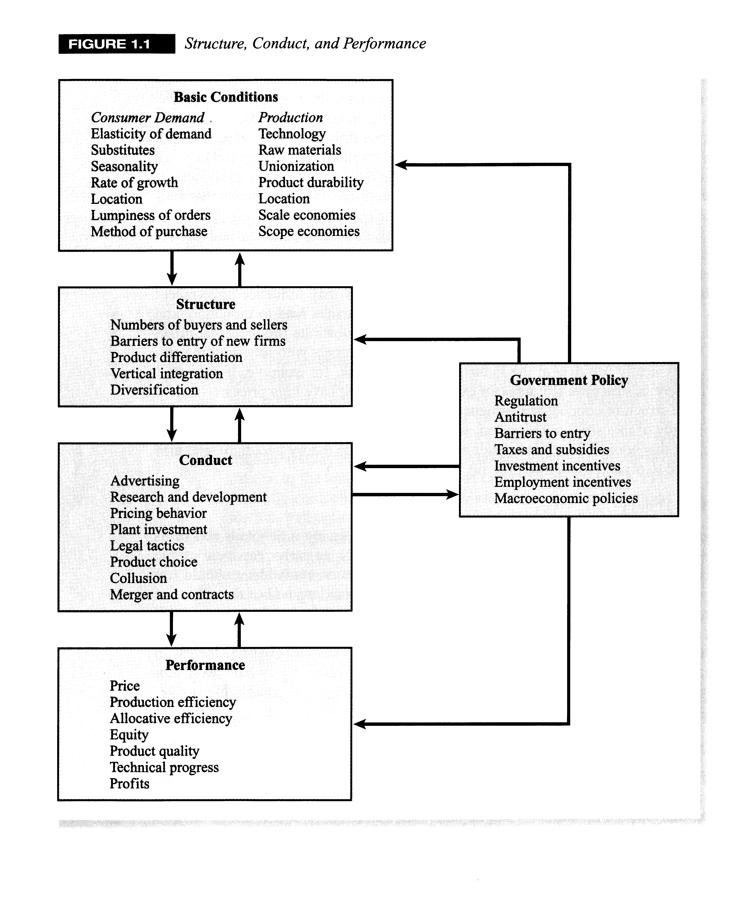
SCP

Slide 60


