Slide 1
Difference Dimension of Doing Business in Vietnam
Mr. Chanchai Ochapong
General Manager
Supergas Vietnam
ttps://import-export.societegenerale.fr/en/country/vietnam/presentation-geography

Slide 2
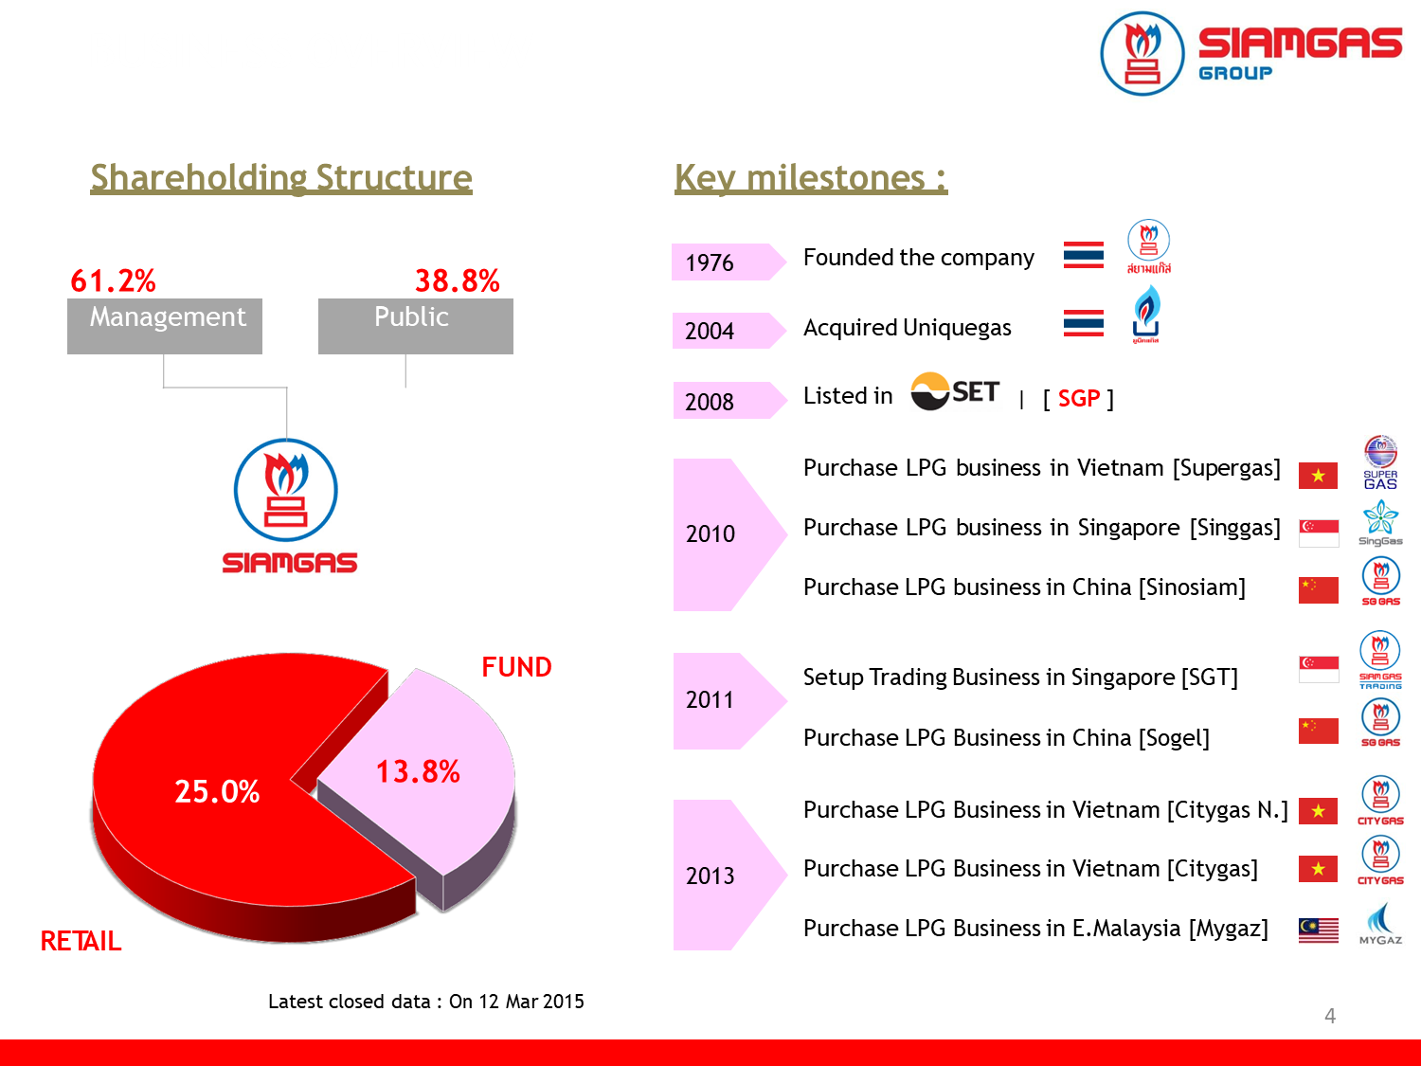
BUSINESS OVERVIEW

Slide 3
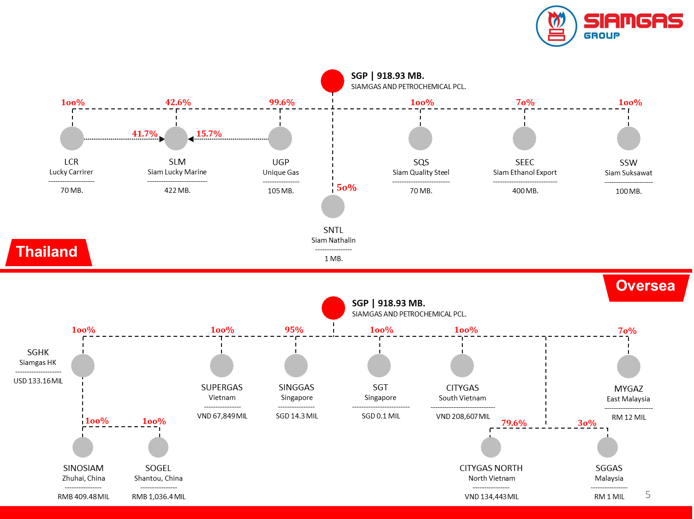
COMPANY STRUCTURE

Slide 4
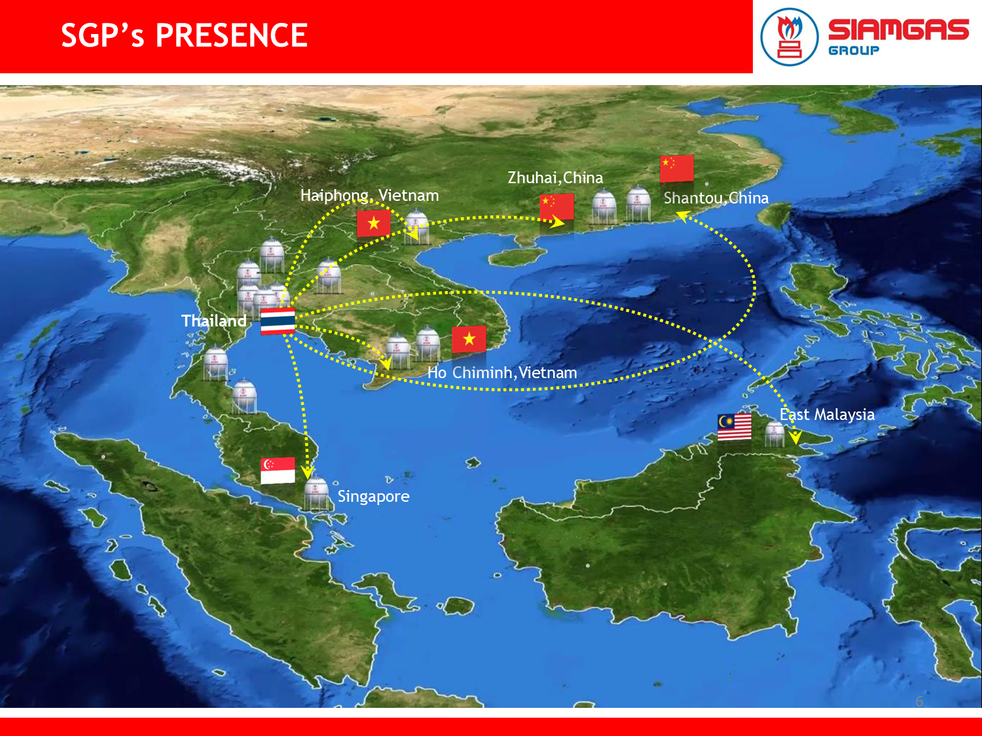

Slide 5
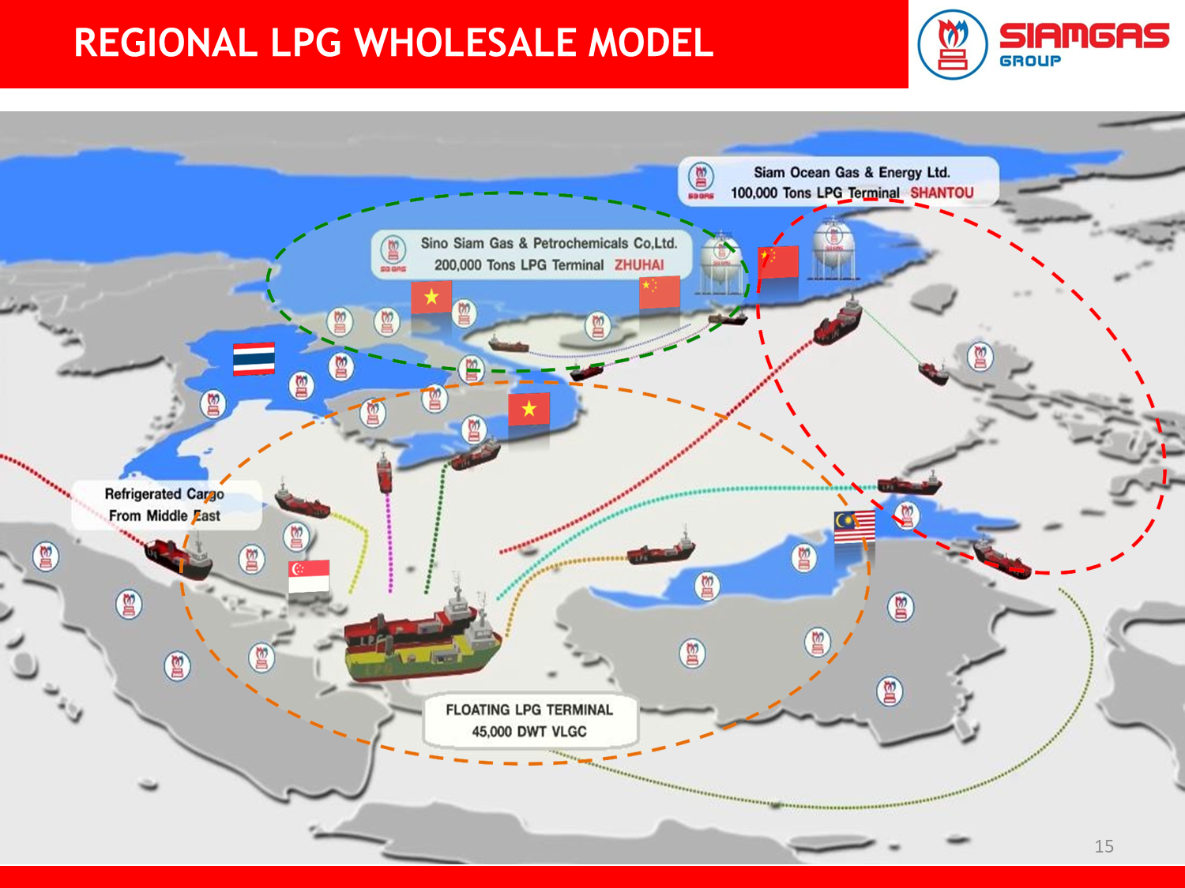

Slide 6
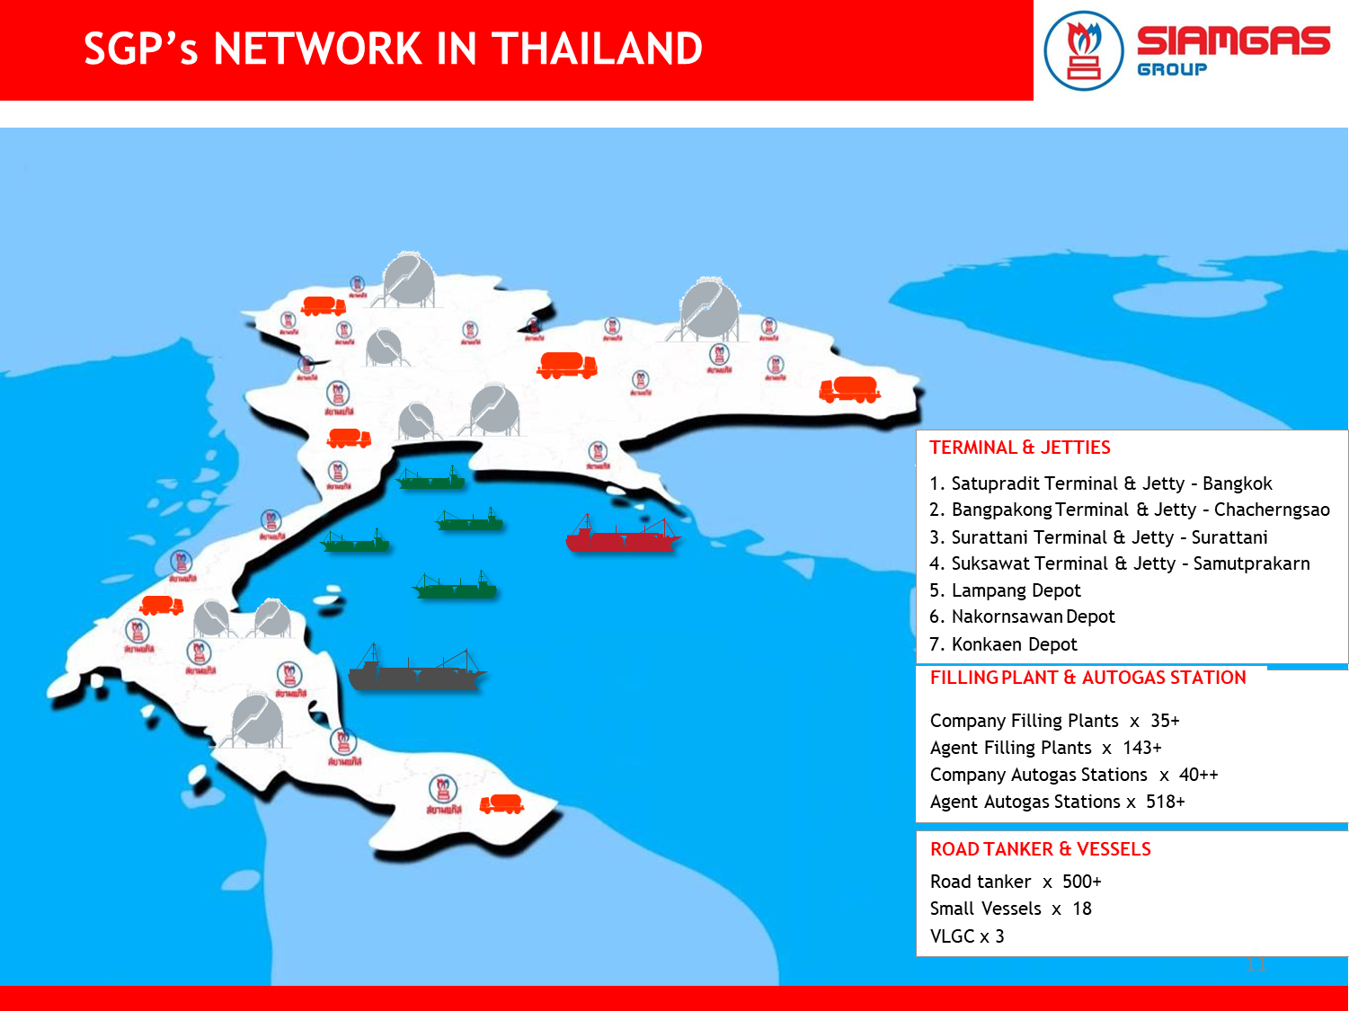

Slide 7
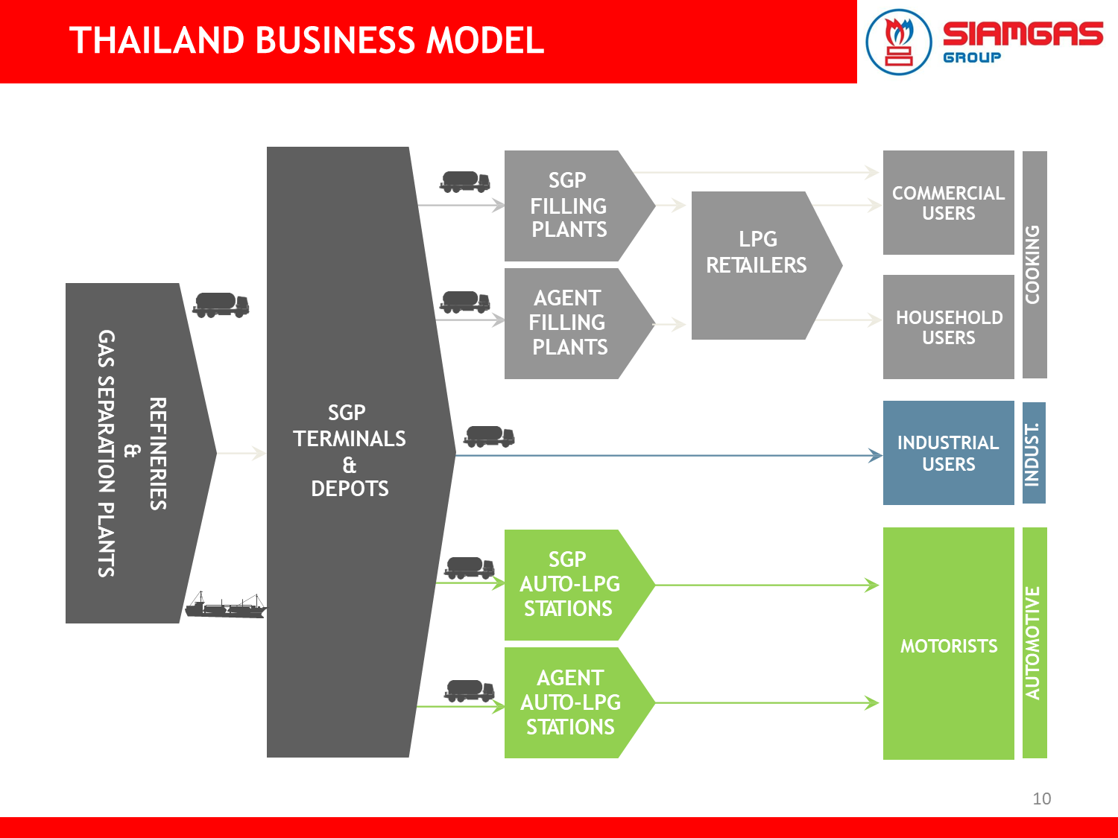
LPG

Slide 8
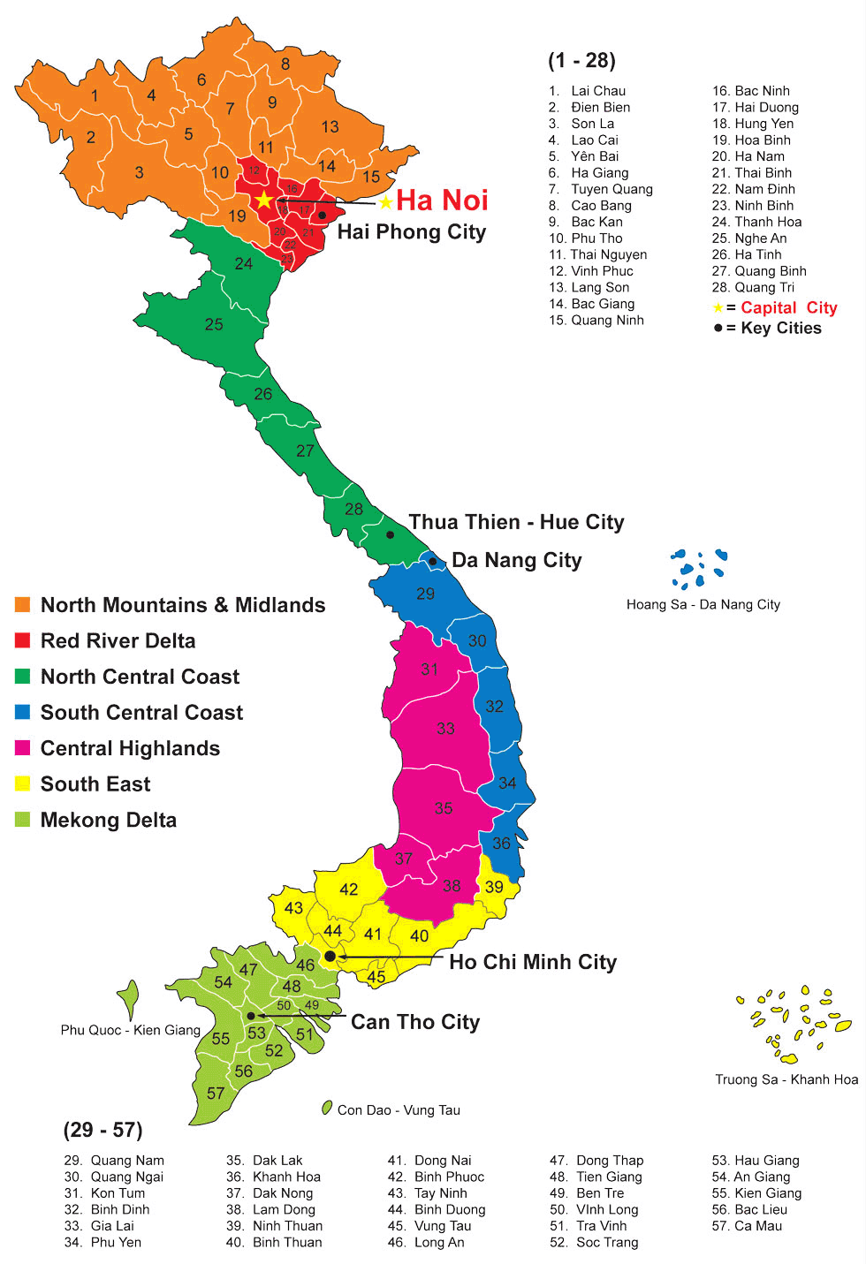
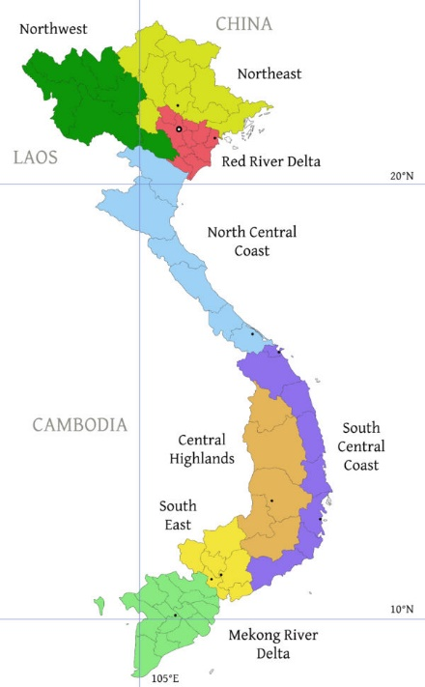


Slide 9
PRESENTATION OF VIETNAM : GEOGRAPHY
Country's official name : Vietnam
Capital: Hanoi
Population of main cities: Ho Chi Minh City (7,981,900) ; Hanoi (7,095,900) ; Danang (992,800);
Haiphong (1,946,000) ; Can Tho (1,007,700)
Area: 330,967 km²
Type of Climate :
Vietnam has a tropical climate. There are four seasons in the north
(spring, summer, autumn and winter)
but only two seasons in the south (designated as rainy and dry season).
In the north, temperatures range from 5°C in December, to more than 37°C in April.
They average temperature in the south throughout the year is 28°C.
Local Time: Same as Thailand
Summer Time Period: No
Official Language: Vietnamese
Other Languages Spoken: English, ChineseBusiness
Language(s): Vietnamese and English. Japanese, Korean, Chinese, German, French and Russian are used at times.

Slide 10
VIETNAM : DEMOGRAPHY
Total Population: 95,540,800
Natural Increase: 1.0%
Urban Population: 35.2%
Density: 308 Inhabitants/km²
Medium Age: 25.0 Years
Life Expectancy in Years : Men: 71.5 And Women: 80.9
Labour Force: 54,930,000 (Source: CIA – The World Factbook, 2015)
Rate of Activity: 78.4% (Source: ILO, Laborstat - Yearly Statistics, 2017)
Ethnic Origins:
There are more than 54 ethnic minorities throughout the country, but the Kinh (Viet) are purveyors of the dominant culture, representing about 85% of the population. Most ethnic minorities (about 15% of the population) such as the Muong, a closely related to the Kinh, are found mostly in the highlands covering two-thirds of the territory. The Hoa (ethnic Chinese) and Khmer Krom are mainly lowlanders. Other major groups groups include Tay, Thai, Nung, and Nung. (General Statistics Office of Vietnam)
Religion: Buddhists 85%, Christians 8%, Others 7%.

Slide 11
VIETNAM : ECONOMY
National Currency: Vietnamese Dong (VND) Exchange Rate on June 25, 2019:
1 USD = 23,210.6 VND, 1 EUR = 26,476.4 VND
Type of Economy: Developing economy
One of the fastest-growing economies of South-East Asia.
The second largest rice exporter in the world.
GDP 266.24 (Source: IMF – World Economic Outlook Database, 2019)
(billions USD) :
GDP 6.5 (Source: IMF – World Economic Outlook Database, 2019)
(Constant Prices, Annual % Change):
GDP per Capita 2,788 (Source: IMF – World Economic Outlook Database, 2019)
(USD) :

Slide 12
VIETNAM : ECONOMY
General Government Gross Debt 57.4 (Source: IMF – World Economic Outlook Database, 2019)
(in % of GDP) :
Unemployment Rate 2.2 (Source: IMF – World Economic Outlook Database, 2019)
(% of the Labour Force) :
Inflation Rate 4.0 (Source: IMF – World Economic Outlook Database, 2019)
(%) :
Employment By Sector Agriculture (39.6), Industry (25.3), Services (34.1)
(in % of Total Employment) : (Source: World Bank, Latest available data.)
Value Added Agriculture (15.3), Industry (33.4), Services (45.5)
(in % of GDP) : (Source: World Bank, Latest available data.)

Slide 13
PRESENTATION OF VIETNAM : TAXATION
Value Added Tax (VAT) 10%
Company Tax : Corporate tax: The standard rate is 20%
Oil, gas and natural resource industry: 32% to 50%
Preferential rate for encouraged investments: 10% and 17%
for 15 years and 10 years respectively
Withholding Taxes : Dividends: 0/5%, Interest: 5%, Royalties: 10%.
Social Security Contributions Paid By Employers :
22% of wages including
18% for social insurance,
3% for health insurance
and 1% for unemployment insurance.

Slide 14
Vietnam Background: War in all life
• 1887: France imposes a colonial system over Vietnam, calling it French Indochina. The system includes Tonkin, Annam, Cochin China and Cambodia. Laos is added in 1893.
• 1923-25: Vietnamese nationalist Ho Chi Minh is trained in the Soviet Union as an agent of the Communist International (Comitern).
• February 1930: Ho Chi Minh founds the Indochinese Communist Party at a meeting in Hong Kong.
• June 1940: Nazi Germany takes control of France.
• September 1940: Japanese troops invade French Indochina and occupy Vietnam with little French resistance.
• May 1941: Ho Chi Minh and communist colleagues establish the League for the Independence of Vietnam. Known as the Viet Minh, the movement aims to resist French and Japanese occupation of Vietnam.
• March 1945: Japanese troops occupying Indochina carry out a coup against French authorities and announce an end to the colonial era, declaring Vietnam, Laos and Cambodia independent.
• August 1945: Japan is defeated by the Allies in World War II, leaving a power vacuum in Indochina. France begins to reassert its authority over Vietnam.

Slide 15
• September 1945: Ho Chi Minh declares an independent North Vietnam and models his declaration on the American Declaration of Independence of 1776 in an (unsuccessful) effort to win the support of the United States.
• July 1946: Ho Chi Minh rejects a French proposal granting Vietnam limited self-government and the Viet Minh begins a guerrilla war against the French.
When Was the Vietnam War?
• March 1947: In an address to Congress, President Harry Truman states that the foreign policy of the United States is to assist any country whose stability is threatened by communism. The policy becomes known as the Truman Doctrine.
• June 1949: The French install former emperor Bao Dai as head of state in Vietnam.
• August 1949: The Soviet Union explodes its first atom bomb in a remote area of Kazakhstan, marking a tense turning point in the Cold War with the United States.
• October 1949: Following a civil war, Chinese Communist leader Mao Zedongdeclares the creation of the People’s Republic of China.
• January 1950: The People’s Republic of China and the Soviet Union formally recognize the communist Democratic Republic of Vietnam and both begin to supply economic and military aid to communist resistance fighters within the country.
• February 1950: Assisted by the Soviet Union and the newly Communist China, the Viet Minh step up their offensive against French outposts in Vietnam.

Slide 16
• June 1950: The United States, identifying the Viet Minh as a Communist threat, steps up military assistance to France for their operations against the Viet Minh.
• March-May 1954: French troops are humiliated in defeat by Viet Minh forces at Dien Bien Phu. The defeat solidifies the end of French rule in Indochina.
• April 1954: In a speech, U.S. President Dwight D. Eisenhower says the fall of French Indochina to communists could create a “domino” effect in Southeast Asia. This so-called domino theory guides U.S. thinking on Vietnam for the next decade.
The Geneva Accords
• July 1954: The Geneva Accords establish North and South Vietnam with the 17th parallel as the dividing line. The agreement also stipulates that elections are to be held within two years to unify Vietnam under a single democratic government. These elections never happen.
• May 1959: North Vietnam forces begin to build a supply route through Laos and Cambodia to South Vietnam in an effort to support guerrilla attacks against Diem’s government in the south. The route becomes known as the Ho Chi Minh Trail and is greatly expanded and enhanced during the Vietnam War.
• July 1959: The first U.S. soldiers are killed in South Vietnam when guerrillas raid their living quarters near Saigon.
• September 1960: Ho Chi Minh, facing failing health, is replaced by Le Duan as head of North Vietnam’s ruling communist party.

Slide 17
• December 1960: The National Liberation Front (NLF) is formed with North Vietnamese backing as the political wing of the antigovernment insurgency in South Vietnam. The United States views the NLF as an arm of North Vietnam and starts calling the military wing of the NLF the Viet Cong—short for Vietnam Cong-san, or Vietnamese communists.
• May 1961: President John F. Kennedy sends helicopters and 400 Green Berets to South Vietnam and authorizes secret operations against the Viet Cong.
• January 1962: In Operation Ranch Hand, U.S. aircraft start spraying Agent Orange and other herbicides over rural areas of South Vietnam to kill vegetation that would offer cover and food for guerrilla forces.
• August 1964: USS Maddox is allegedly attacked by North Vietnamese patrol torpedo boats in the Gulf of Tonkin (the attack is later disputed), leading President Johnson to call for air strikes on North Vietnamese patrol boat bases. Two U.S. aircraft are shot down and one U.S. pilot, Everett Alvarez, Jr., becomes the first U.S. airman to be taken prisoner by North Vietnam.
• August 1964: The attacks in the Gulf of Tonkin spur Congress to pass the Gulf of Tonkin Resolution, which authorizes the president to “take all necessary measures, including the use of armed force” against any aggressor in the conflict.
• March 1965: President Johnson launches a three-year campaign of sustained bombing of targets in North Vietnam and the Ho Chi Minh Trail in Operation Rolling Thunder. The same month, U.S. Marines land on beaches near Da Nang, South Vietnam as the first American combat troops to enter Vietnam.
• 1966: U.S. troop numbers in Vietnam rise to 400,000.
• June 1966: American aircraft attack targets in Hanoi and Haiphong in raids that are among the first such attacks on cities in North Vietnam.
• 1967: U.S. troop numbers stationed in Vietnam increase to 500,000.

Slide 18
• November 1967: In the Battle of Dak To, U.S. and South Vietnamese forces resist an offensive by communist forces in the Central Highlands. The United States forces suffer some 1,800 casualties.
• January-April 1968: A U.S. Marine garrison at Khe Sanh in South Vietnam is bombarded with massive artillery by communist forces from the People’s Army of North Vietnam (PAVN). For 77 days, the marines and South Vietnamese forces fend off the siege.
• January 1968: The Tet Offensive begins, encompassing a combined assault of Viet Minh and North Vietnamese armies. Attacks are carried out in more than 100 cities and outposts across South Vietnam, including Hue and Saigon, and the U.S. Embassy is invaded. The effective, bloody attacks shock U.S. officials and mark a turning point in the war and the beginning of a gradual U.S. withdrawal from the region.
• 1969-1972: The Nixon administration gradually reduces the number of U.S. forces in South Vietnam, placing more burden on the ground forces of South Vietnam’s ARVN as part of a strategy known as Vietnamization. U.S. troops in Vietnam are reduced from a peak of 549,000 in 1969 to 69,000 in 1972.
• January 1975: President Ford rules out any further U.S. military involvement in Vietnam.
• April 1975: In the Fall of Saigon, the capital of South Vietnam is seized by communist forces and the government of South Vietnam surrenders. U.S. Marine and Air Force helicopters transport more than 1,000 American civilians and nearly 7,000 South Vietnamese refugees out of Saigon in an 18-hour mass evacuation effort.
• July 1975: North and South Vietnam are formally unified as the Socialist Republic of Vietnam under hardline communist rule.

Slide 19
War with China
1978 -- Vietnam's treatment of the Hoa people - an ethnic Chinese group - becomes an issue when Hanoi institutes a crackdown on the Chinese community because of its pervasive role in domestic commerce in the South and its alleged subversive activities in the North. Vietnam's actions force an unprecedented exodus of thousands of Hoa across the border into China.
November 1978 -- Sino-Vietnam relations worsen when the Soviet Union and Vietnam sign a Treaty of Friendship and Cooperation that calls for mutual assistance and consultation in the event of a security threat to either country.
February to March 1979 -- In the Sino-Vietnamese Border War, China launches the offensive in response to Vietnam's invasion and occupation of Cambodia, which ends the reign of the China-backed Khmer Rouge. This becomes China's largest military operation since the Korean War.
1985 -- Throughout most of 1985 and into the early months of 1986, Vietnam's border provinces are subject to intense artillery and mortar shelling. China issues vague threats to Vietnam of a "second lesson" over the stalemate with Cambodia.
1988 -- China and Vietnam fight a naval battle just off the Spratly Islands. 70 Vietnamese sailors are killed.
November 1991 -- China and Vietnam normalize relations after more than a decade of hostility.

Slide 20
Why we want to investment to do business in Vietnam?
New open development country
New market
New generation of people
Big population big market
Wage and Tax are still cheap
6. Infrastructure cost still cheap
.
.
.

Slide 21
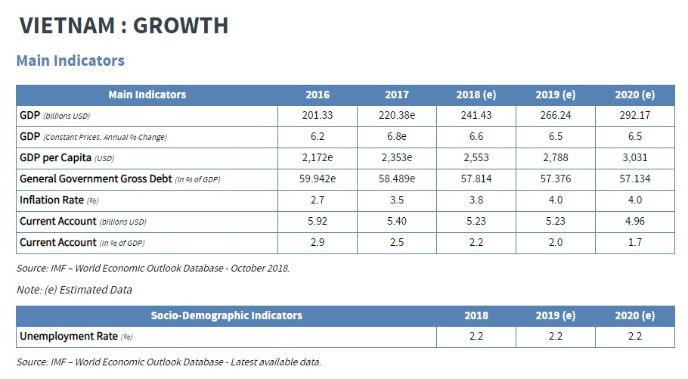
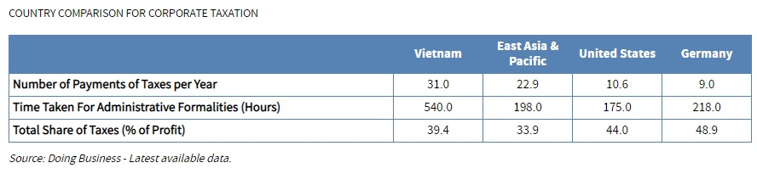

Slide 22
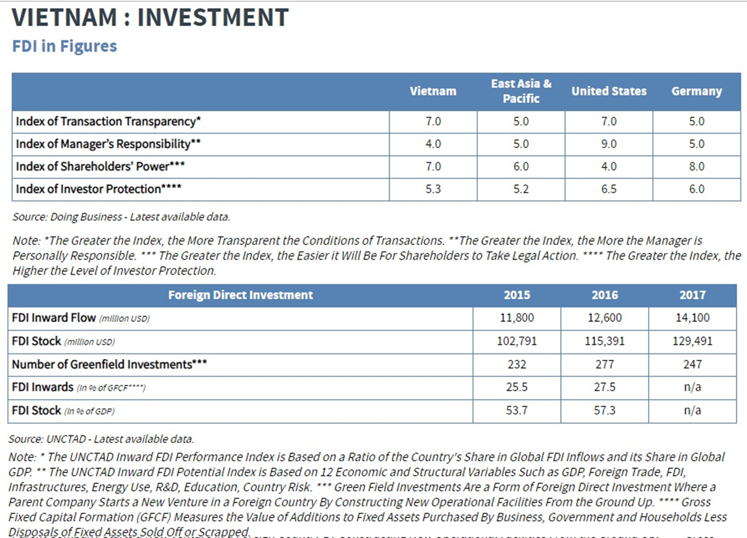

Slide 23
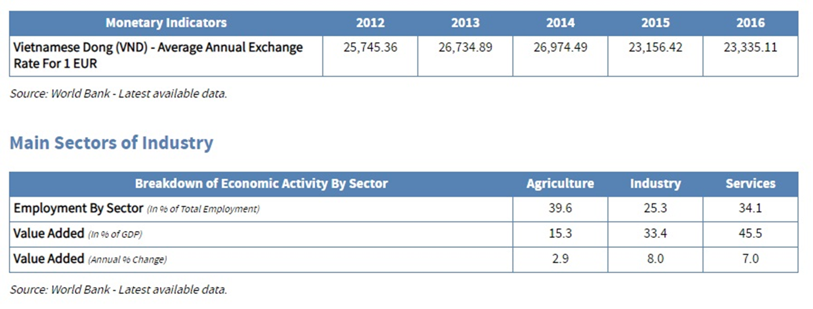
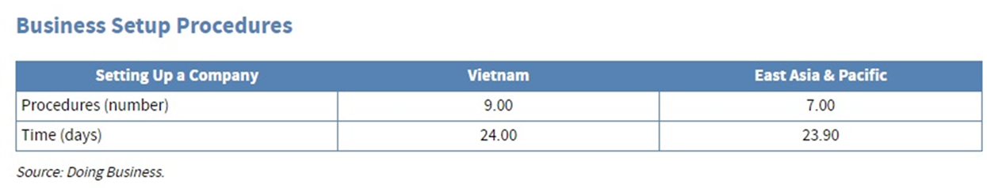

Slide 24
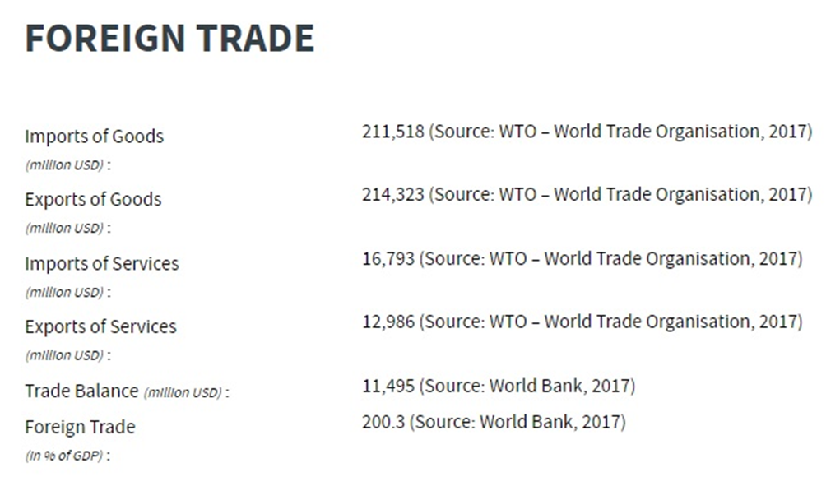
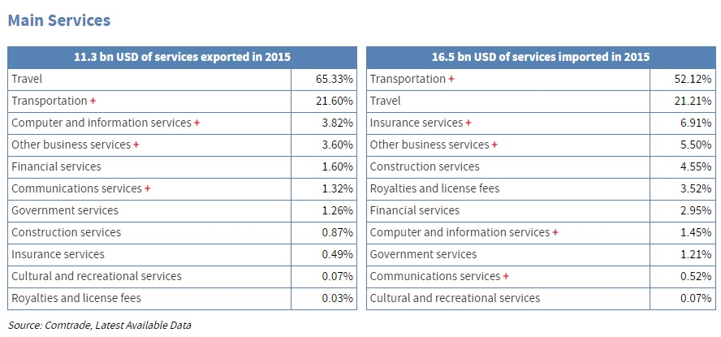

Slide 25
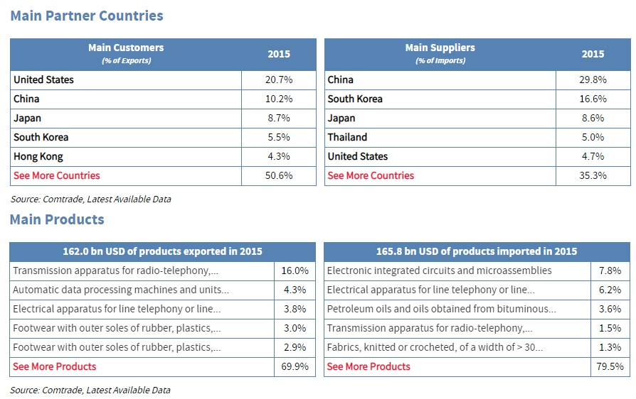

Slide 26
Difference Dimension to do business in Vietnam?
Law not clear
Government set the law and use the law
Standard living of people
Standard education of people
Hiding tax and Fee
Speculate and price war by not intense to quality
Relation include money
.
.
Case study
Hineken
SABECO
Pruksa Real Estate
Foreign Company in LPG – elf, Shell, Petronas, Origin

Slide 27
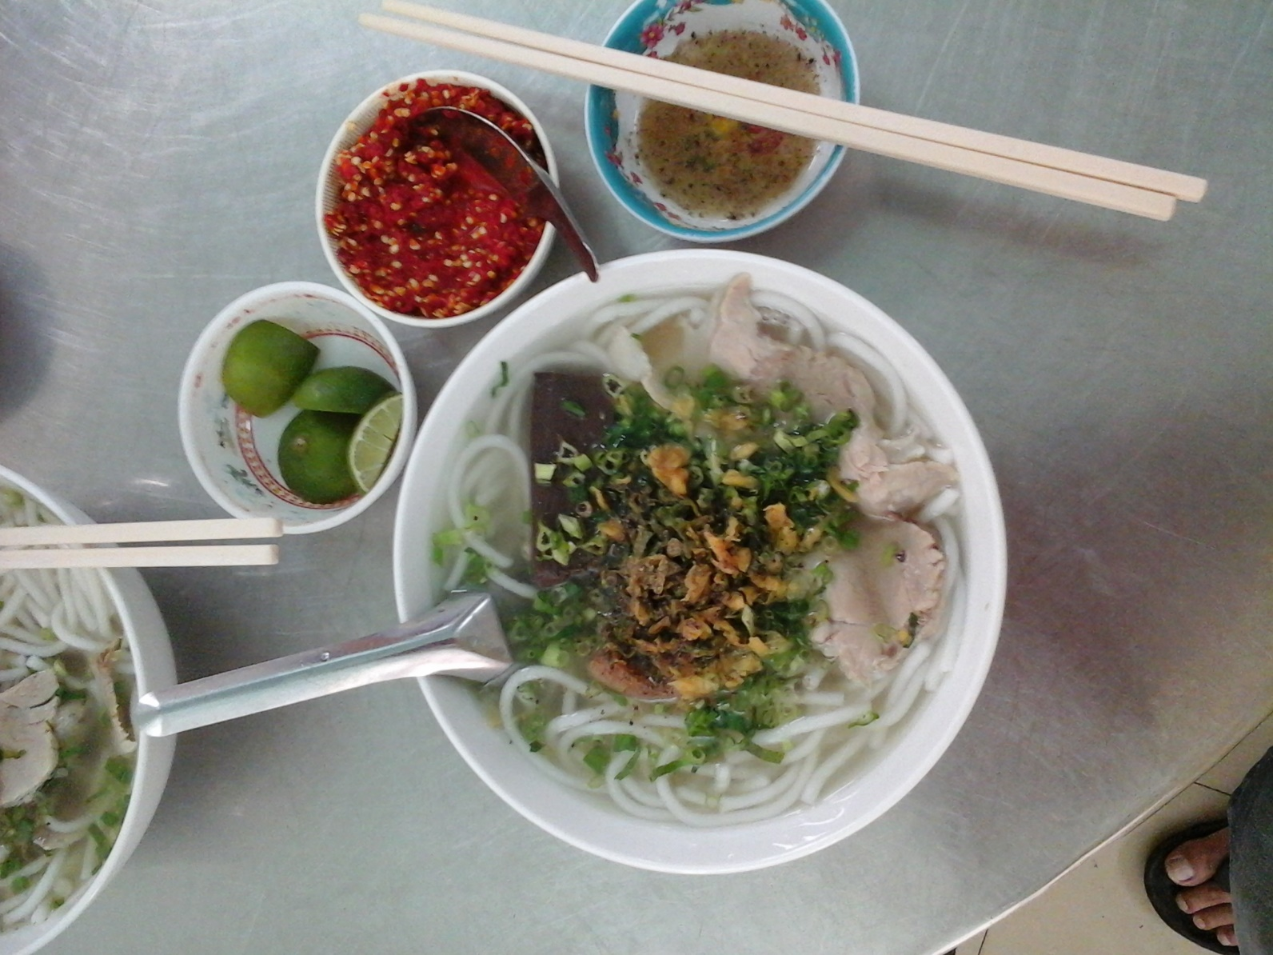
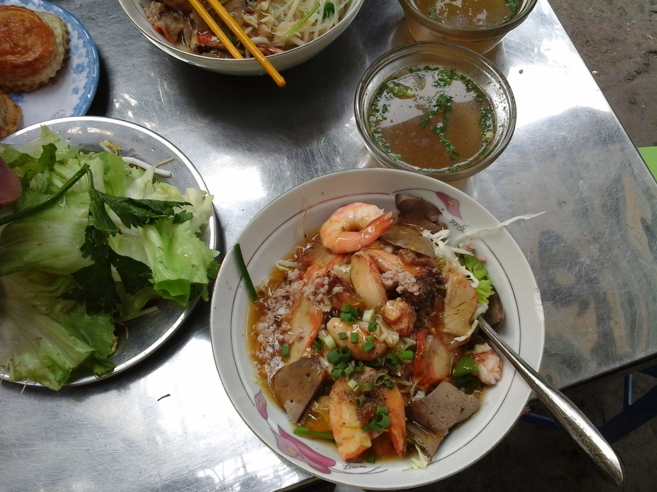
END of Presentation

