Slide 1
ABENomics
Monetary Policy and its Impact

Slide 2

Policies:
Aggressive QE
Increase in public spending
Structural Reform
Aims:
Ending stagnation
(meeting 2% inflation goal) and expand the economy
Overview of
Abenomics
Notes:
Abenomics is the name given to a suite of measures introduced by Japanese prime minister Shinzo Abe after his December 2012 re-election to the post he last held in 2007. His aim was to revive the sluggish economy with "three arrows": a massive fiscal stimulus, more aggressive monetary easing from the Bank of Japan, and structural reforms to boost Japan's competitiveness. The policy is aimed to end stagnation and stimulate the growth of the economy Keynesian theory of demand side macroeconomic changes are cited as partial inspiration for Abenomics.

Slide 3
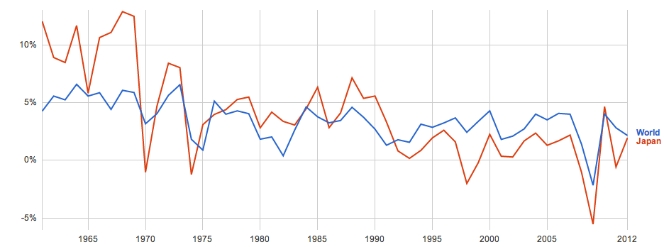
Background of Japan Economy
Japan’s GDP Growth Rate
1998
Tax-Hike
2009
World Econ. Crisis
2011
Tsunami
Data from World Bank
Notes:
Japan’s GDP growth has been lower than world GDP growth since 1990s, when the assets price bubble occurred.
During the global economic recession, Japan suffered a 0.7% loss in real GDP in 2008 followed by a severe 5.2% loss in 2009. In contrast, the data for world real GDP growth was a 3.1% hike in 2008 followed by a 0.7% loss in 2009.
There are some severe plunges, which are -2% in 1998 caused by increase in VAT from 3 to 5% in late 1997 which led to dramatic decrease in consumption. In 2009, the growth was – 5.53% because the effect of global economy crisis. And in 2011Japan economy was hit by earthquake and tsunami. The impact of tsunami caused hundreds of factories to shut down, causing the GDP growth to be negative at -0.57%.
Even without crises in specific years, Japan growth has continued to be sluggish since early 1990s with negative inflation.

Slide 4
ABEnomic Monetary Policy

Slide 5


Quantitative Easing
Aggressive buying of assets
Govt. Bonds
* Short-Term
* Long-Term
ETFs
etc.
Double the monetary base by the end of 2014.
Notes:
To stimulate the econ, BOJ abandon the previously used interest-rate target policy in favor of goals for the size of monetary-base.
BOJ conduct an aggressive quantitative easing by buying assets from the market, such assets include government bonds as well as ETF in order to increase the supply of Yen in the market. BOJ expects to double the monetary base by the end of 2014.

Slide 6
Impact on Japanese yen

Slide 7
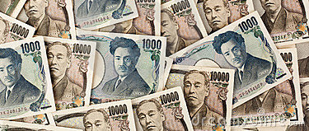
QE
Money and PPP
Supply
of Yen
e = P/P_{f}
= ( M^{S}/M^{S}_{f} ) * ( k_{f}/k ) * ( Y_{f}/Y )
Domestic
Price Level
e = Yens per a unit of foreign currency
Yen
Depreciates
Notes:
-Drastic QE causes the supply of yen to increase greatly, which consequently causes the domestic price level to increases and yen to depreciates. The more the yen in the market, the less valuable it becomes.
-According to the equation, holding the foreign factors constant, an increase in domestic money supply must be accompanied by the increase in domestic price level in order for the equation to hold. Hence, e increases, meaning that the value of yen relative to other currency decreases.

Slide 8
Empirical data

Slide 9
Japan’s Trading Partners
Exports
Imports
2012 Data
Notes:
Here are the charts of Japan’s export and import partners from 2012 data. As we can see, the 2 largest trading partners of Japan is China and U.S. respectively. 18% of Japan’s export was to China and it imported 21.3% from China. For the US, Japan exported 17.7% and imported 8.8%.
Exchange rate is a relative term. So in order to determine the value of yen, we must look at it in term of other currencies. Here are Japan’s major trade partner. We are going to look at the 2 largest trade partners of Japan, which are China and the US.

Slide 10
Historical Exchange Rate
Notes:
The grey line indicates the time which Mr. Abe assumed the office. You can see that yen has devalued relative to USD.

Slide 11
Historical Exchange Rate
Notes:
Same with previous slide, just change from dollar to yuan.

Slide 12
Impact on Price Level

Slide 13
Historical Japanese CPI
Notes:
The graph above shows Japan consumer price index, which is the overall price level in the economy. The data is from 2010 to 2012. As you can see that from the second quarter to the fourth quarter of 2012 , consumer price has been falling quite significantly. Again, the grey line indicates the time the quantitative easing measures started. You can see that unlike the exchange rate, price level didn’t increases instantly, there was some traces of sticky price for few months until the price level started to response to the increase in money supply in the economy.
The year on year inflation rate for September is 1.1%, whereas the core inflation rate, which excludes the energy and food prices, is 0.7%.

Slide 14
Impact on
Exports & Imports

Slide 15
Export Data
Notes:
As the yen has depreciated, the price of Japanese exports are relatively lower as it requires less foreign currency than before to buy the same amount of goods and services. With lower price, Japanese export of goods and services has become more competitive. As you can see from the chart, the monthly exports in 2013 are mostly higher than export in 2012.

Slide 16
Import Data
Notes:
On the other hand, yen depreciation also causes the import price to be higher. This should induce Japan to import less but large part of Japan import is fossil fuel which is rather inelastic as Japan become more reliant on energy imports since the Fukushima incident. This causes the import to increase from 2012 to 2013

Slide 17
YOY Percentage Change
Notes:
Exports rose 11.5 percent in September from a year earlier, the Ministry of Finance's trade data showed, less than a median market forecast for a 15.6 percent increase and slower than a 14.6 percent growth in August.
The data also showed exports were down 0.3 percent from the previous month on a seasonally adjusted basis.
Exports to the United States, the European Union and Asia all continued to increase in September from a year earlier but at a slower pace than in August.
A notable slowdown was in exports to Asia, which rose just 8.2 percent in September after growing 13.5 percent in August.
"The positive effect of the weak yen may have run its course. We might not see a marked improvement in exports from here if the recovery in overseas growth does not pick up," said Junko Nishioka, chief Japan economist at RBS Securities.
Imports rose 16.5 percent in September from a year earlier, less than the median forecast of a 20 percent increase.
With the weak yen inflating the cost of importing fuel, Japan logged a trade deficit of 932 billion yen ($9.5 billion) in September, running a negative balance for the 15th straight month.

