Slide 1

D
BA 291 – Planning and strategic management
by Parichat Jantori

Slide 2

“Planning is bringing the future into the present so that you can do something about it now”
“He who fails to plan, plans to fail”
“Expect the best, plan for the worst, and prepare to be surprised.”
“To be prepared is half the victory.”

Slide 3
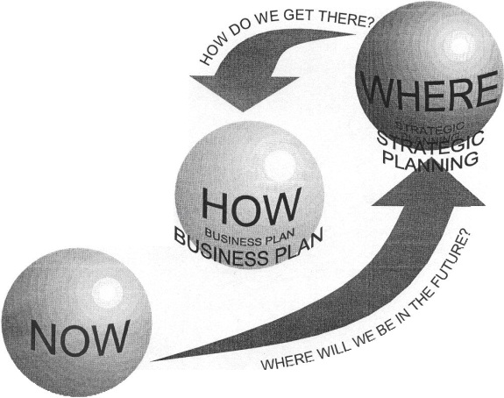
What is planning?
Planning: Defining the organization’s goals, establishing an overall strategy for achieving those goals, and developing plans for organizational work activities.
Provide direction (where are the goals and how to get there?)
Resource allocation (how to use existing resource to achieve goals)
Reduce uncertainty (scenario analysis, find Plan B)
Minimize waste and redundancy
Use as standard in controlling process

Slide 4
Goal
Goals provide a clear, engaging sense of direction and specify what is to be accomplished
S…………..
M………….
A…………..
R………….
T…………..

Slide 5
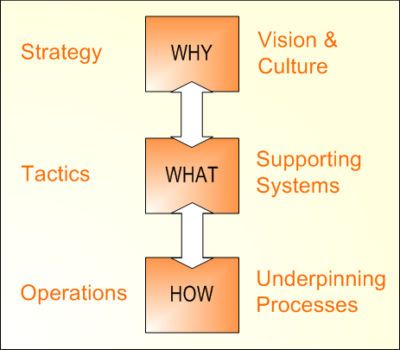
Planning type
Long-term vs. short-term plans
Single-use vs. standing plans
Top-down vs. bottom-up
Strategic, tactical and operational plan

Slide 6

Example: Planning type at GM
Strategic plans
To get the company back to the track
To prevent company from bankruptcy
Tactical plans
Increase the number of advertising and PR activities
Buying ads on website
Sponsoring the events
Operational plans
Process 150 sales each week
Achieve 90% of deliveries on time. Reduce takt time
Increase customers show room visit
Train the sales personnel and improve dealer service quality

Slide 7

Strategic Management
Strategic management: The set of decisions and actions used to formulate and implement strategies that will be provide a competitively superior fit between the organization and its environment so as to achieve organizational goals.
Notes:
Where is the organization now?
Where does the organization want to be?
What changes are among competitors?
What courses of action will help us achieve our goals?

Slide 8

Strategy
Strategy is a plan of action that prescribes resource allocation and other activities for dealing with the environment, achieving a competitive advantage, that help the organization attain its goals
Where is the business trying to get to?
In which market should business compete?
How to perform better than competitor?
Which resources are required?
What are the expectations of customers and stakeholders?

Slide 9

Exploit Core competencies
Core competence: the singular capability among a portfolio of capabilities that can lend the company a distinctive and sustainable competitive advantage. A core competence is something a company does especially well in comparison to its competitors.
A core competence should be:
Valuable
Rare
Difficult to imitate

Slide 10

Build Synergy
Synergy: The condition that exists when the organization‘s parts interact to produce a joint effect that is greater than the sum of the parts acting alone

Slide 11
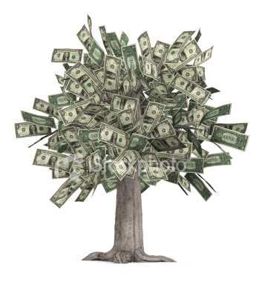
Creating Value
Delivering value to the customer is at the heart of the strategy
Value can be defined as the combination of benefits received and cost paid.
Choose the right business model, which is a strategic design for how a company intends to profits from its strategies, work processes and activities.

Slide 12
The Strategic Management Process
External environment analysis
Identify organization’s mission, vision and goals
SWOT Analysis
Strategy formulation and implementation
Strategic control
Internal environment analysis

Slide 13
Environmental analysis
Environmental analysis
Industry and market analysis
Competitor analysis
Political and regulatory analysis
Social analysis
Labor analysis
Macroeconomic analysis
Technological analysis
Notes:
PESTEL, Environmental, chance & risk analysis

Slide 14
Internal environmental analysis
Management and Organization
Marketing
Human Resources
Distribution channels
Employee experience, education
Management quality
Staff quality
Market share
Degree of centralization
Advertising efficiency
Union status
Organization charts
Customer satisfaction
Turnover, absenteeism
Planning, information, control systems
Product quality
Service reputation
Work satisfaction
Grievances
Sales force turnover
Finance
Production
Research and Development
Profit margin
Plant location
Basic applied research
Debt-equity ratio
Machinery obsolescence
Laboratory capabilities
Inventory ratio
Purchasing system
Research programs
Return on investment
Quality control
New-product innovations
Credit rating
Productivity/efficiency
Technology innovations

Slide 15
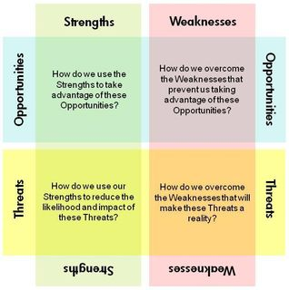
SWOT Analysis

Slide 16
Types of organizational strategies
Corporate-Level Strategy:
What business are we in?
Corporation
Business-Level Strategy:
How do we compete?
Textiles Unit
Chemicals Unit
Auto Parts Unit
Functional-Level Strategy:
How do we support the business-level strategy?
Finance
R&D
Manufacturing
Marketing

Slide 17
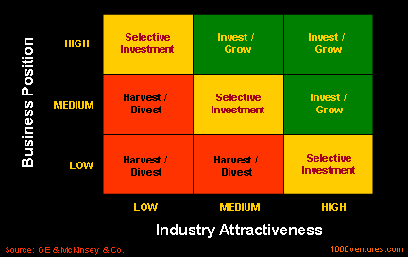
Grand corporate strategy
Notes:
Growth, stability, renewal

Slide 18
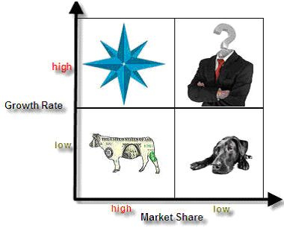
Corporate portfolio analysis
Portfolio strategy: The organization‘s mix of strategic business units and product lines that fit together in such a way as to provide the corporation with synergy and competitive advantage
Notes:
http://www.brandage.com/Modules/DesktopModules/Article/ArticleDetail.aspx?tabID=7&ArticleID=5997&ModuleID=701&GroupID=1388

Slide 19
Example: General Electric (GE)
GE has been reshuffling the corporation‘s mix of business in a way that will give GE a better position in the long run. GE is investing heavily in its stars and question marks to ensure that its portfolio will continue to include cash cows in a future that might be very different from today‘s world.
What are stars, question mark, cash cow? What do you think?

Slide 20
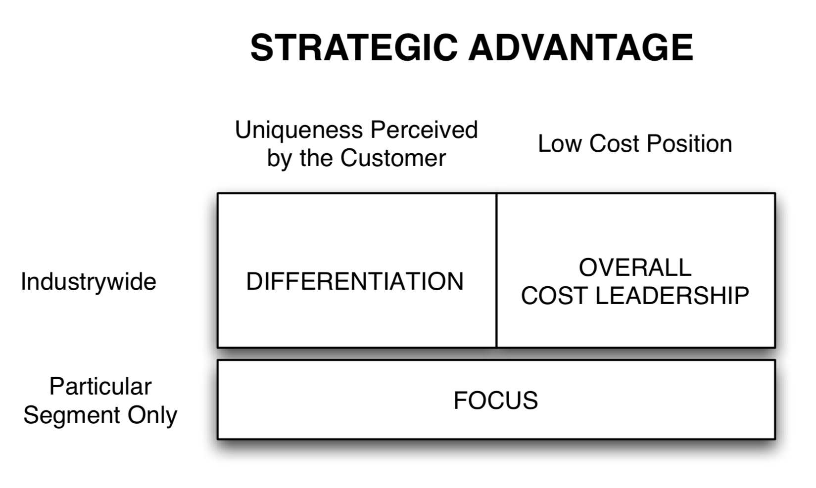
Business Level Strategy

Slide 21
Cost leadership
An integrated set of actions designed to produce or deliver goods or services at the lowest cost relative to competitors.
Cost saving actions required by this strategy:
building efficient facilities, lower waste in manufacturing process
tightly controlling production costs and overhead
minimizing costs of sales, R&D and service
monitoring costs of activities provided by outsiders
Simplifying production processes (mass production, mass customization) – economies of scale

Slide 22




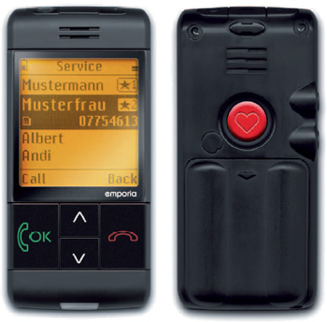
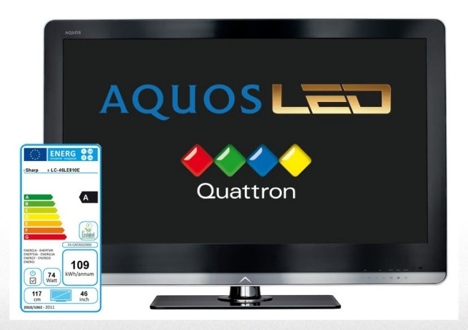
Differentiation
attempt to distinguish products or services from that of competitors
(think “out of the box”)
Notes:
ตัวอย่าง US post จะล้มละลาย
Unique taste
Krispy Kreme
Unique design
Porsche Design, LV bag, Cartier, Mini
Multiple features
Microsoft Windows and Office
Wide selection and one-stop shopping
Home Depot and Amazon.com, Department store
Reliable, superior service
FedEx, the oriental hotel, Thai airways
Spare parts availability
Japanese car
High technology
Internet TV, Audi

Slide 23
Focus strategy
A focus strategy must exploit a narrow target’s differences from the balance of the industry by:
isolating a particular buyer group
isolating a unique segment of a product line
concentrating on a particular geographic market
finding their “niche”

Slide 24
Focus strategy
Factors driving focus strategy
Large firms overlook small niches
Firm may lack resources to compete in the broader market
May be able to serve a narrow market segment more effectively than can larger industry-wide competitors
Focus may allow the firm to direct resources to certain value chain activities to build competitive advantage

Slide 25
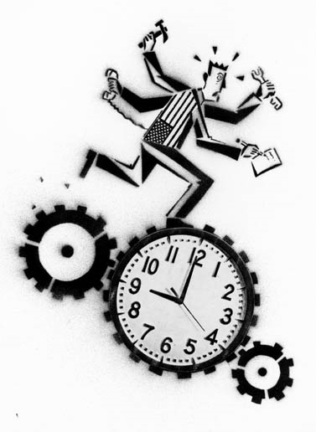
Functional Level Strategy
Functional –level strategies are the action plans adopted by major department to support execution of business level strategy.
- concerned with coordinating the functional areas of the organization (marketing, finance, human resources, production, research and development, etc.)

Slide 26
Strategy implementation
Strategy Implementation: stage of strategic management that involves the use of managerial and organizational tools to direct resources toward achieving strategic outcomes
Leadership
■ Persuasion  Motivation  Culture/values
Organization
Structural Design  Organization Chart  Teams  Centralization
Decentralization,
Facilities, task design
Human Resources  Recruitment/selection  Transfers/promotions
■ Training
■ Layoffs/recalls
Strategy
Performance
Information and Control Systems
■ Pay, reward system  Budget allocations  Information systems  Rules/procedures

