Slide 1
Covid-19, Labour & CLMVT
Kiriya Kulkolkarn, Faculty of Economics, Thammasat University
kiriya@econ.tu.ac.th
28.06.2020

Slide 2
Outline
Impact
Inequality
Gig
Policy

Slide 3
Does Covid-19 crisis differ from other crises?
How has your family been affected by Covid-19 in terms of employment and salary? How do they deal with the crisis?
Impact
Type your answer in our zoom chat box. (3-4 sentences)

Slide 4

Differences
Similarities
#1. Process: The current economic downturn has been triggered by a deliberate lockdown and not by imbalances in the system. The current exogeneous sanitary shock has affected, first, the real sector and the supply of production, then the demand side. In 2007-08 the endogenous financial shock affected the demand side first, and then morphed into the Great Recession of 2009.
#2. Size Speed and Shape: Much bigger (the whole world), deeper and faster drop in economic activity than at any time in the past 75 years. And it will not recover very soon. “Omega shape” recovery.
Reactions: To limit such shocks,monetary and fiscal policies have in both cases provided massive support.

Slide 5
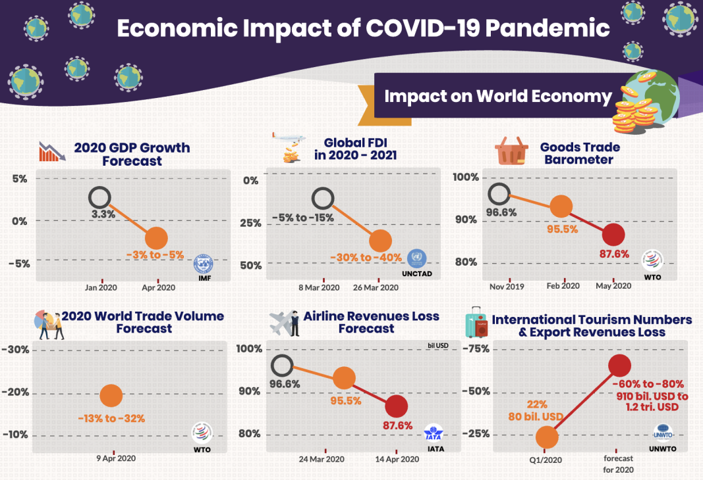

Slide 6
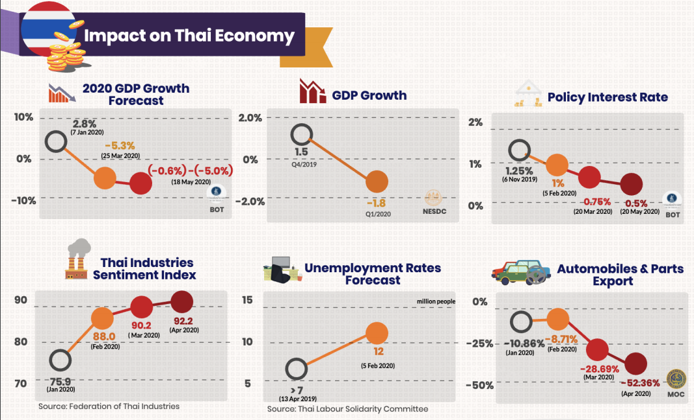
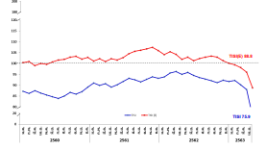

Slide 7
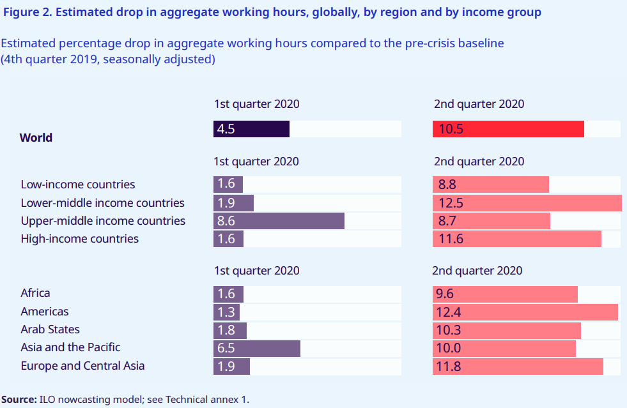

Slide 8
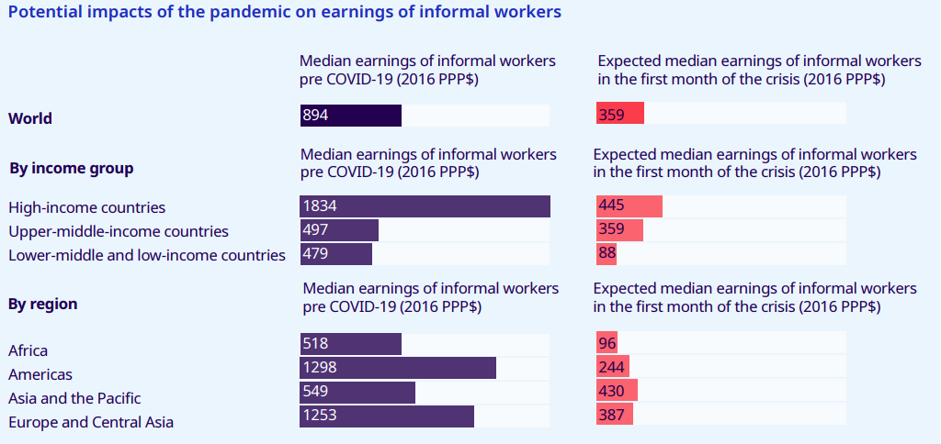

Slide 9
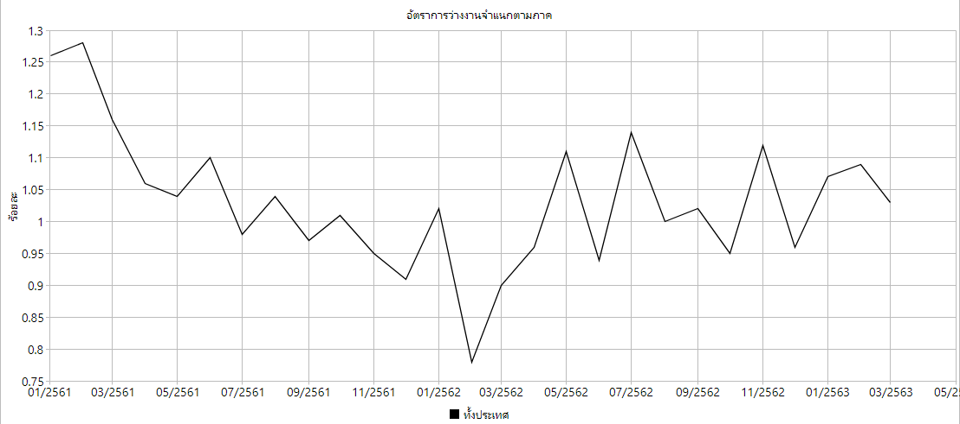

Slide 10
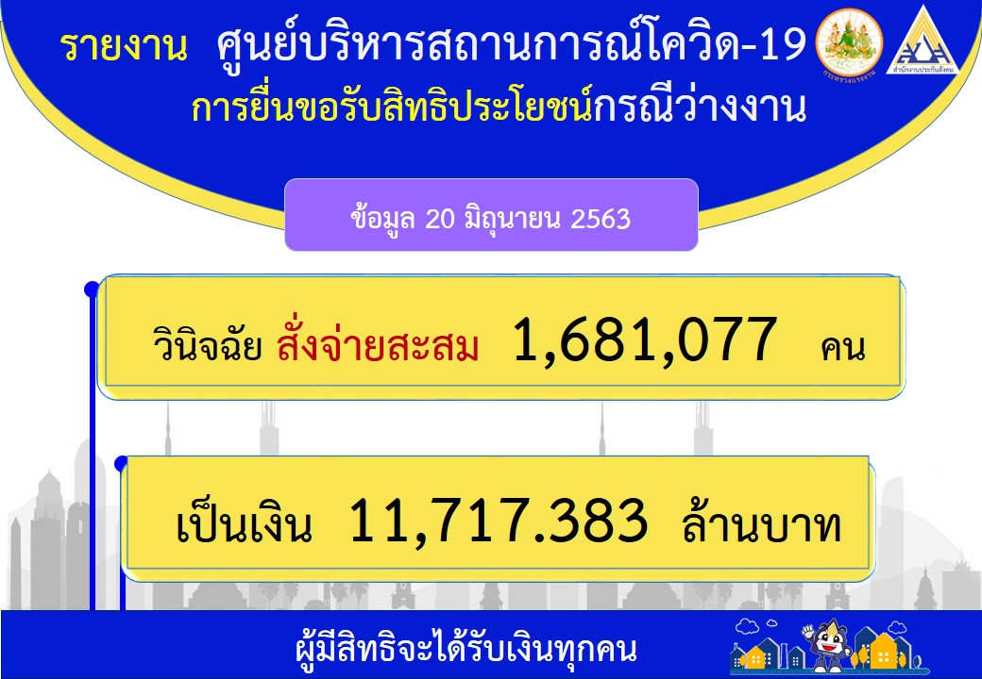

Slide 11
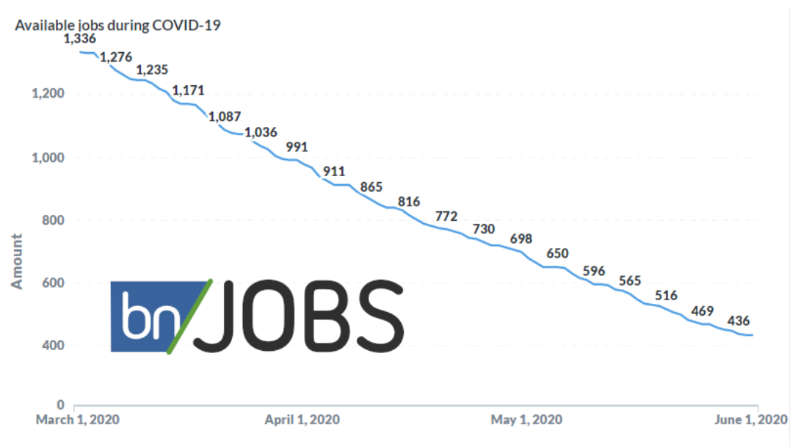
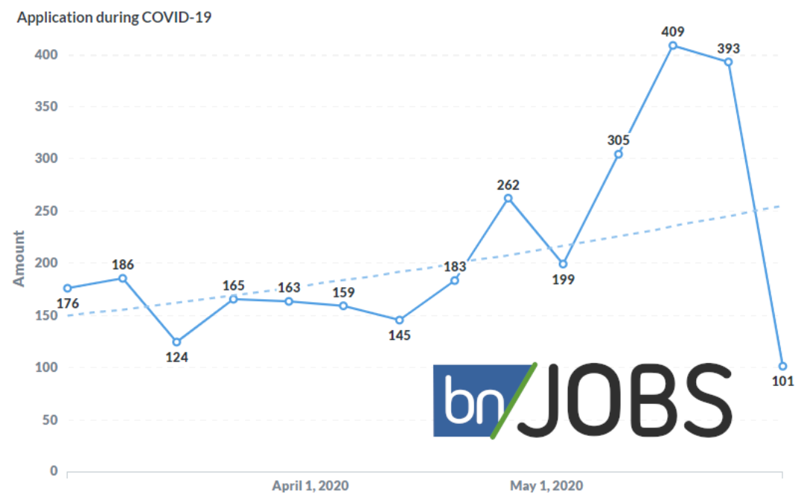
IT available jobs declined by 3 times.
IT job application rose by 2 times.
Source: Blogone Jobs (March 1 - June 1, 2020)

Slide 12
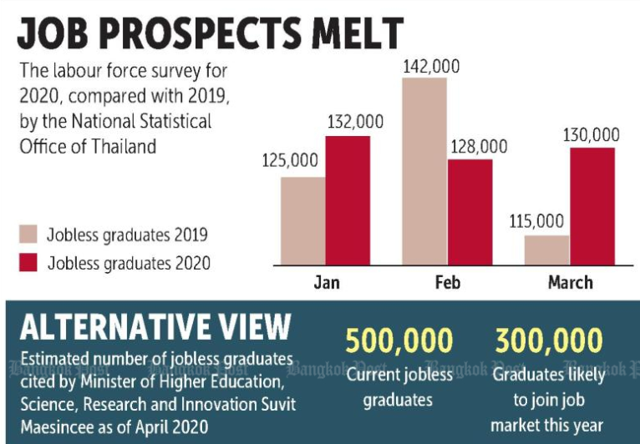

Slide 13
Have workers been affected equally by Covid-19?
2. Inequality
How will you categorize them?

Slide 14
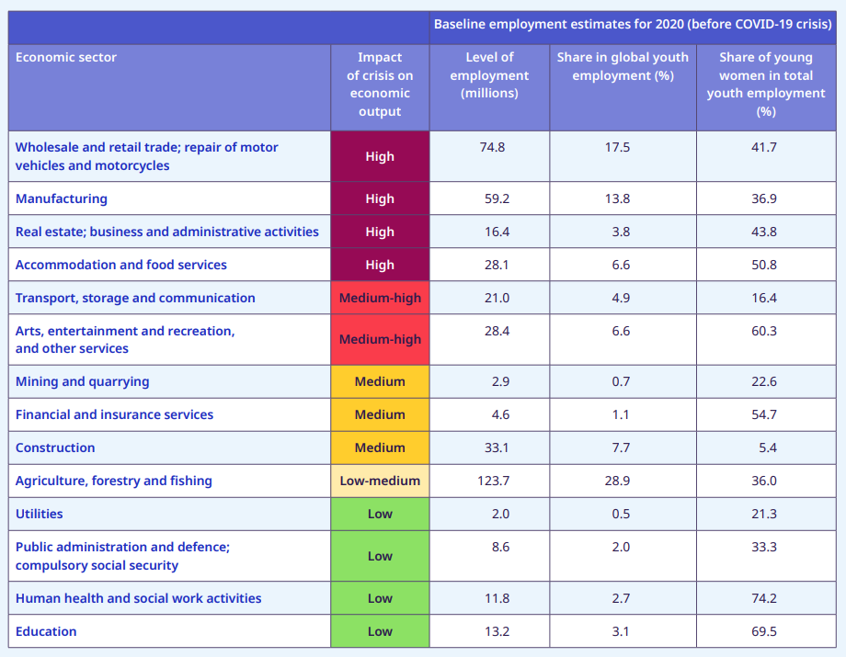

Slide 15
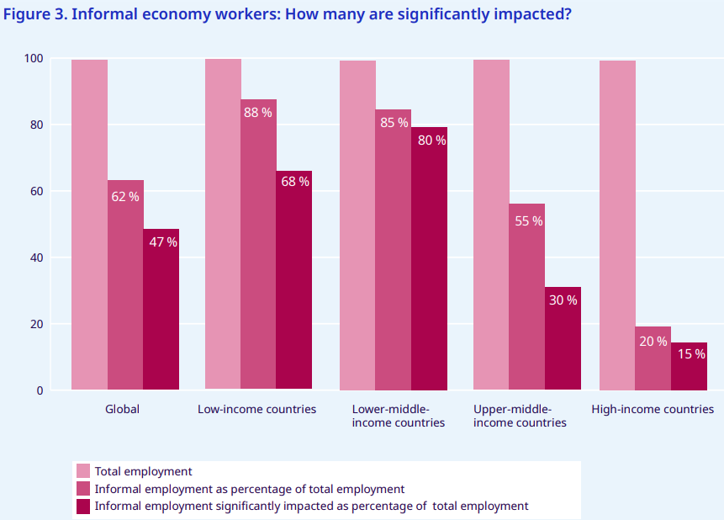

Slide 16
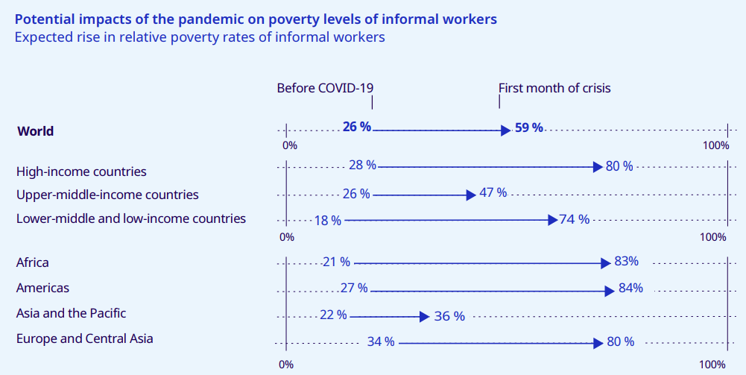

Slide 17
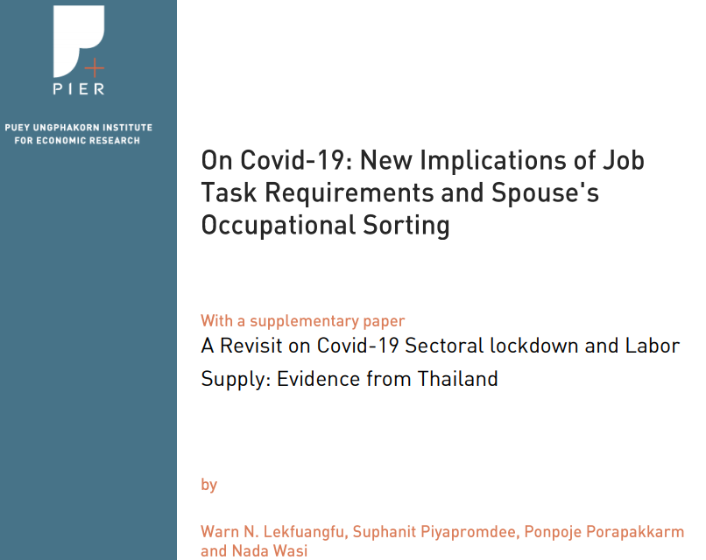

Slide 18
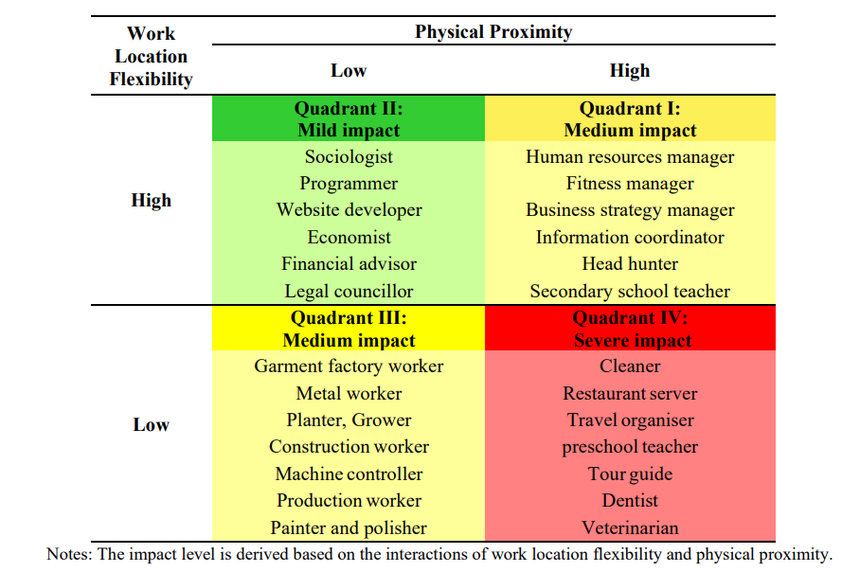

Slide 19
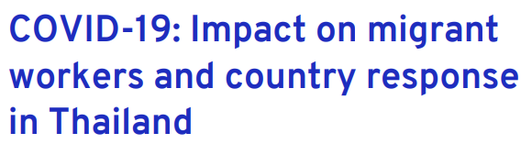
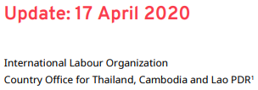
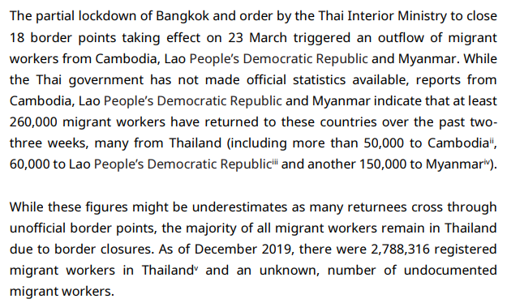

Slide 20
A gig is a job that lasts a certain period of time, often the life of a project or as long as the company has that specific need.
Gig workers are independent contractors, online platform workers, contract firm workers, on-call workers and temporary workers. Gig workers enter into formal agreements with on-demand companies to provide services to the company's clients.
3. Gig

Slide 21
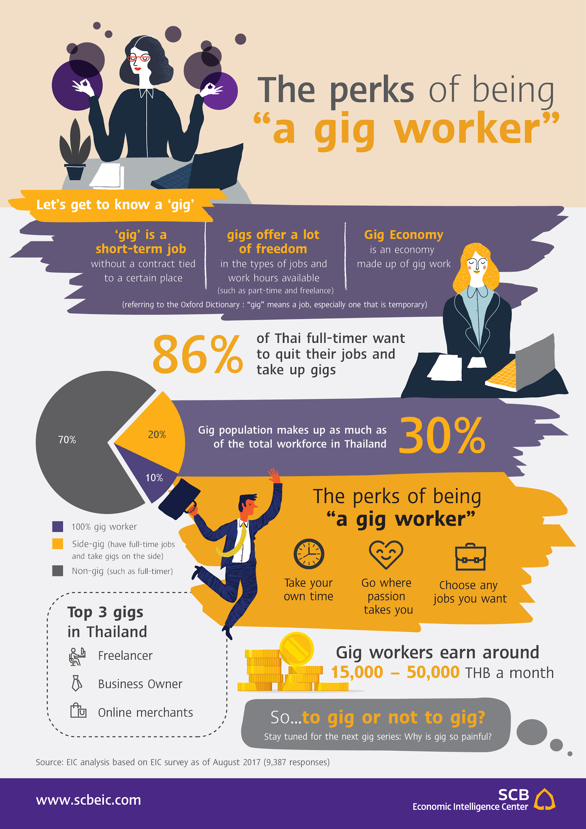
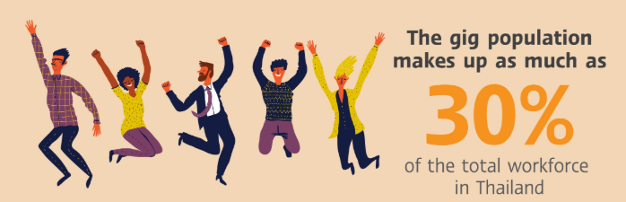
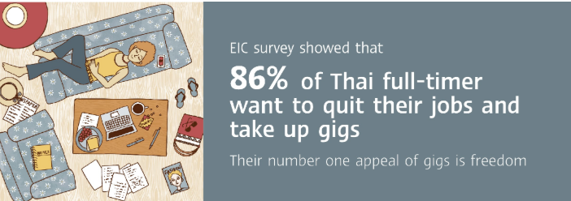

Slide 22
Many Americans are making extra money renting out a spare room,...even driving their own car. This on demand or so called ‘gig’ economy is creating exciting opportunities and unleashing innovation, but it’s also raising hard questions about workplace protections and what a good job will look like in the future,”
--- Hillary Clinton, CNBC, 13 July 2015

Slide 23
Based on our discussion this morning, give policy recommendations.
4. Policy

