Slide 1
FN 221: Personal Finance
Thanachote Rungsitivat, CFA, FRM

Slide 2
Choosing Sources of Credit
Inexpensive Loans – Parents or family members are often the source of the least expensive loans. However, such loans can complicate family relationships. All loans to or from family members should be in writing and state the interest rate, if any repayment schedule, and the final payment date.
Medium-priced loans – Often you can obtain medium-priced loans from commercial banks. New car loans and Used car (slightly more expensive) are included.
Expensive Loans – Convenient to obtain, from finance companies or bank through credit cards.

Slide 3
The Cost of Credit
Finance Charge and Annual Percentage Rate (APR)
Finance charge: the total amount you pay to use credit (this includes interest cost and sometimes other costs such as service charges, credit-related insurance premiums or appraisal fees.
Annual Percentage Rate (APR): percentage cost of credit on a yearly basis. The APR is key to comparing credit costs, regardless of amount od credit or how much time you have to repay it.

Slide 4
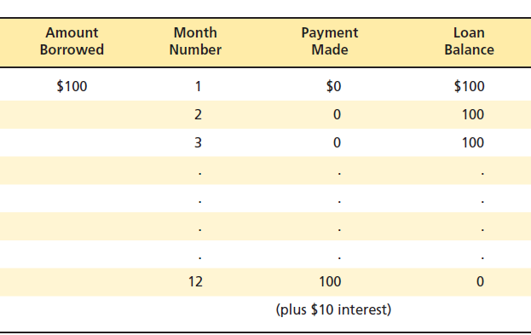
APR
APR is 10%

Slide 5
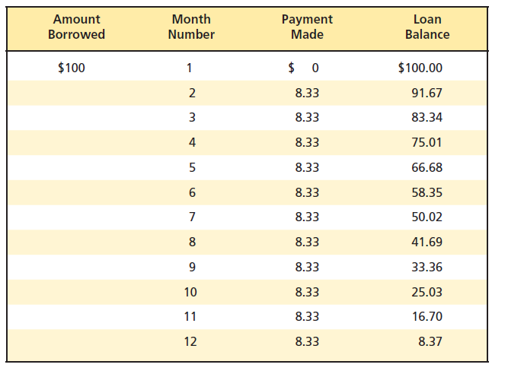

APR
APR here is 18.5% because you pay 10% of 100 but you get to use less than 100 each month. Normally, to approximate the APR is to use the average balance.

Slide 6
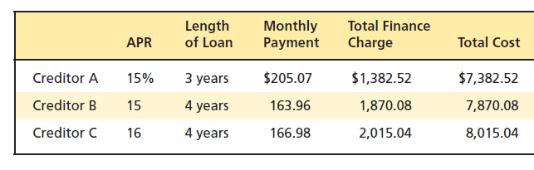
Trade-Offs
Term Versus Interest Costs
  Many people choose longer-term financing because they want smaller monthly payments. But the longer the term for a loan at a given interest rate, the greater the amount you must pay in interest charges.
  Suppose you are buying a USD 7,500 watch and you need to borrow USD 6,000

Slide 7
Trade-Offs
Lender risk versus Interest Rate
You may prefer financing that requires low fixed payments with a large final payment or only a minimum of up-front cash. But both of these requirements can increase your cost of borrowing because they create more risk for your lender.
Variable Interest Rate – based on fluctuating rates in the banking system. With this type of loan, you share the interest rate risks with the lender. Therefore the lender may offer a lower initial interest rate than it would with a fixed-rate loan.
A Secured Loan – If you pledge property as collateral, you’ll probably receive a lower interest rate on your loan.
Up-Front Cash – many lenders believe you have a higher stake in repaying a loan if you pay cash for a large portion of what you are financing. This may reduce the credit cost charged to you.
A Shorter Term – The shorter the period of time for which you borrow, the smaller the chance that something will prevent you from repayment and the lower the risk to the lender.

Slide 8
The Situation
Samantha jones wants to borrow $5,000 to buy a used car. She has several options when it comes to getting a loan, but needs to decide which option id the best in this situation. She has never taken out a loan before and is not certain she will be qualified for a loan.

Slide 9
Inexpensive Loan: A Loan from Her Grandmother
Samantha knows that her grandmother will not charge her very much interest, just enough to cover her own costs.
Samantha is worried that if things go wrong she could ruin her relationship with her grandmother.
Samantha knows this loan will not help her establish a good credit history, since there will be no record of it.

Slide 10
Medium – Priced Loan: A Loan from the Local Credit Union
She knows a loan from a credit union will be a little more expensive but still reasonable.
She knows that if she has payment problems, they will work with her to overcome those problems.
The credit union will offer personalized service on the loan.
Credit unions provide free credit life insurance.
She will begin to establish a good credit history.

Slide 11
Expensive Loan: A Loan from a Finance Company
Samantha knows that a loan from a finance company is likely to have a very high interest rate.
Finance companies often lend to people without an establish credit history, so she should have no trouble getting the loan.
Samantha knows they will also process her credit application quickly, so she can take her car home very soon.

Slide 12
Samantha’s Decision
Samantha decides to apply for a loan with the credit union. She has had saving and checking accounts there since she was a kid. They know her, and she thinks they will be willing to lend her the money. She does not want tot take a chance and ruin the relationship she has with her grandmother and she is not comfortable with the interest rate the finance company will charge her.

Slide 13
The Terms of a Loan
Samantha faces several trade-offs between the terms she wants on the loan and the cost of her loan. The terms often loan will affect the finance charge, as well as the annual percentage rate (APR). If she is willing to take steps to reduce the lender’s risk, then she can reduce the interest rate she will have to pay on the loan.

Slide 14
Variable versus Fixed Rate Interest
If Samantha is willing to take a variable rate loan, then the interest rate on the loan will start out lower. However, Samantha may face higher payments later on if interest rates rise.

Slide 15
A Secured Loan versus an Unsecured Loan
If Samantha is willing to pledge property or other assets as collateral for the loan, then the loan cost will likely be lower. The collateral can be seized by the credit union in the event that Samantha were to default on the loan.

Slide 16
Up-Front Cash
The larger the down payment that Samantha is willing to pay up front in cash for the purchase of her car, the lower the interest rate is likely to be on the loan.

Slide 17
A Shorter Term versus a Longer Term Loan.
Samantha also needs to decide what time period she wants the loan for. A longer time period will make her payments more affordable, but it will mean that she will pay more in total interest charges. If she uses a shorter term loan, then her payments will be higher but the credit union likely to give her a lower interest rate.

Slide 18
Samantha’s choice
Samantha chooses a fixed rate loan, because she does not want her payments to rise over the life of the loan.
Samantha does use the car she is purchasing as collateral for the loan.
Samantha has saved some money and decides to put $1,000 in cash towards the purchase od the car which means she will only borrow $4,000.
Samantha chooses a two-year loan rather than a longer term one.

Slide 19
Calculating the Cost of Credit
Simple Interest
Simple Interest on the Declining Balance
Add-on Interest

Slide 20
Simple Interest
Simple interest is calculated on principal only and without compounding
Interest = Principal x Rate of Interest x Time
= P x r x T
If Samantha wants USD 5,000 loan for 1 year at 5% interest rate, then her total interest will be USD250 (5,000 x 0.05 x 1) since she will have to use the USD 5,000 for the entire year

Slide 21
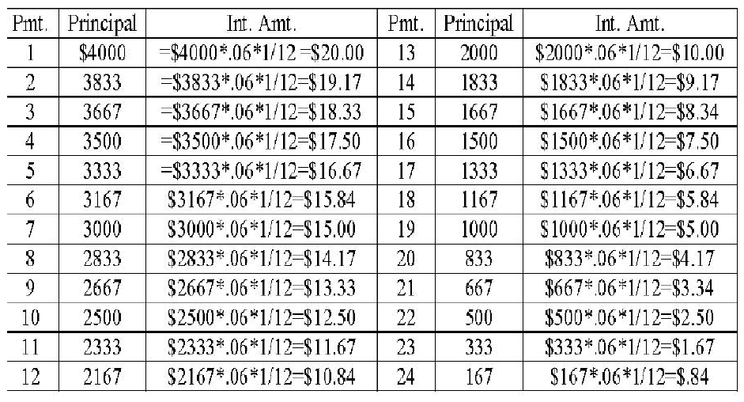
Simple Interest on Declining Balance

Slide 22
Simple Interest on Declining Balance
Samantha will make monthly payments for two years of this loan. If the payment amount is calculated using simple interest on the declining balance. Then each payment includes a different amount of interest. Samantha will pay interest only on the amount of original principal that she has not yet paid. While the annual interest rate on the loan is 6%, this equates to a monthly interest rate of 1/12 of 6%. Therefore, the first payment will be the principal amount of USD 166.67 (USD 4,000 / 24 months) plus the interest owed on the principal left. At this point, the USD 4,000 is the principal left and so the interest portion of the payment is USD 20. The total payment in the first month is therefore USD 187.67. As each payment is made, the amount of principal left goes down by the principal payment and the amount of interest paid is a bit smaller each month.

Slide 23
Add-On Interest
USD 4,000 * 0.6 * 2 = USD 480
(USD 4,000 + USD 480) /24 = USD 186.67
In an add-on interest loan, the interest is based on the full amount of the original principal times the interest rate times the number of years of the loan. This interest amount is then added to the principal and divided by the number of payments. This determines the monthly payment on the loan. In the case of Samantha’s loan, the add-on payment amounts would be USD 186.67 per month. Since the interest is paid on the beginning principal over the life of the loan, the amount of interest pad is high.

Slide 24
Cost of Open-End Credit
Some creditors add finance charges after subtracting payments made during the billing period – this is called the adjusted balance method
Others give you no credit for payments made during the billing period – this is called previous balance method
He fairest method is the average daily balance method – creditors add your balances for each day in the billing period then divide by the number of days in the period. The average daily balance may include or exclude new purchases during the billing period.

Slide 25
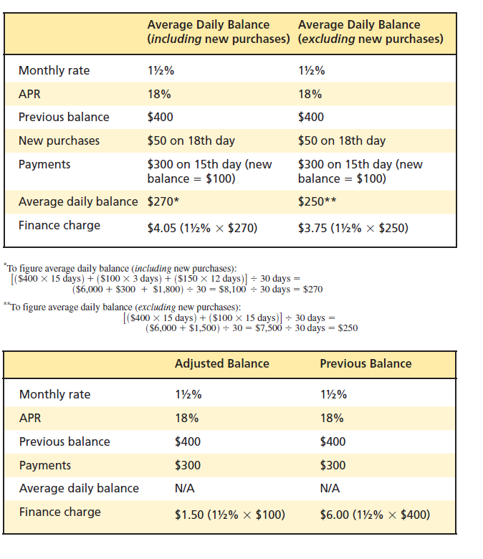
Cost of Open-End Credit

Slide 26
Example
Jack has a credit card with a balance at the beginning of the month of THB 20,000
On the 15th day of the month, Jack purchase THB 5,000 worth of stereo equipment using his credit card
On the 20th day of the month, Jack makes a payment on his credit card of THB 10,000
Jack’s annual interest rate on his credit card is 18%
Jack knows he has incurred a finance charge of THB 250 on his credit card but is not sure how his bank has calculated this finance charge.

Slide 27
Adjusted Balance Method
THB 20,000 – THB 10,000 = THB 10,000
THB 10,000 * .015 = THB 150
The payments that are made during the month are subtracted from the balance at the beginning of the month before finance charges are calculated. Jack’s interest rate is 18% for the year or 1.5% for each month. Therefore, after subtracting out Jack’s payment of THB 10,000 from his beginning balance of THB 20,000, his total finance charge for the month would be THB 150 under this method.

Slide 28
Previous Balance Method
THB 20,000 * .015 = THB 300
Any payments that Jack made are not included. The interest rate is 1.5% for the month, in this case, finance charge would be at THB 300 for the month.

Slide 29
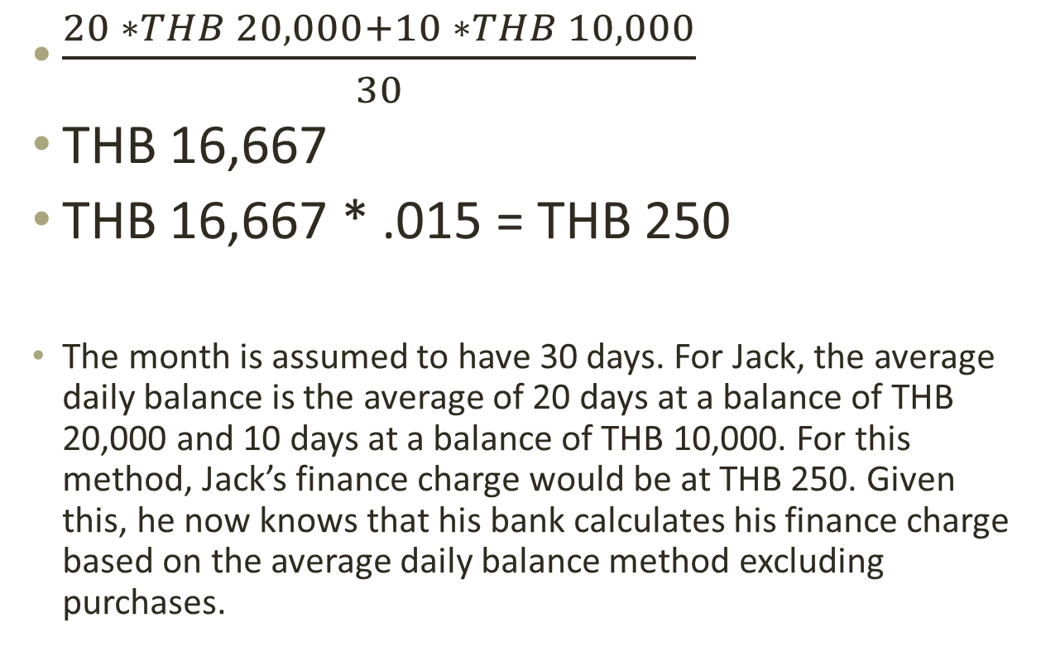
Average Daily Balance (Purchases Excluded)
$\frac{20 ∗THB 20,000+10 ∗THB 10,000}{30}$
THB 16,667
THB 16,667 * .015 = THB 250
The month is assumed to have 30 days. For Jack, the average daily balance is the average of 20 days at a balance of THB 20,000 and 10 days at a balance of THB 10,000. For this method, Jack’s finance charge would be at THB 250. Given this, he now knows that his bank calculates his finance charge based on the average daily balance method excluding purchases.

Slide 30
Avoid the Minimum Monthly Payment Trap
You purchase a USD 2,000 laptop using a credit card with 19 percent interest and a 2 percent minimum payment. If you pay just the minimum every month, it will take you 265 months – over 22 years – to pay off the debt and will cost you nearly USD 4,800 in interest payments. Doubling the amount paid each month to 4% of the balance owed would allow you to shorten the payment time to 88 months from 265 months (7 years as opposed to 22 years). You also save USD 3,680.

Slide 31
Practice
Page 230 on your textbook

Slide 32
Credit Insurance
Credit insurance ensures the repayment of your loan in the event of death, disability, or loss of property. The lender is named the beneficiary and directly receives any payments made on submitted claims.

Slide 33
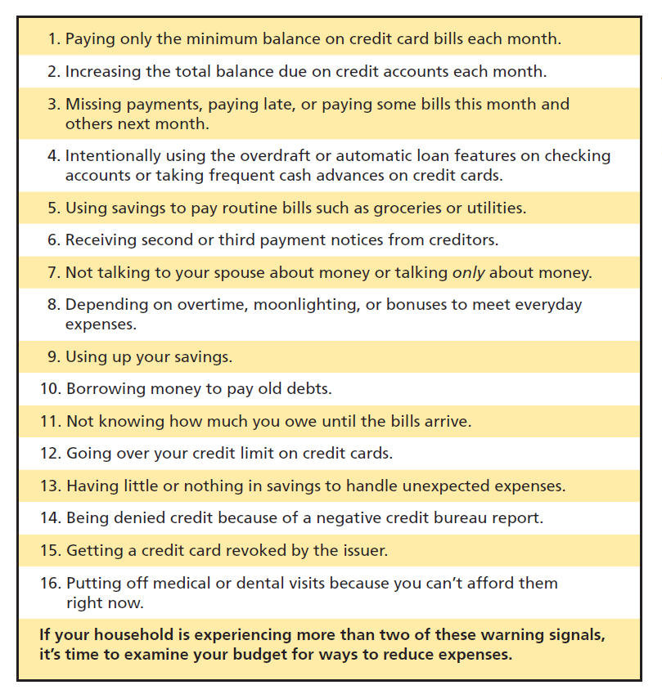
Danger signals of potential debt problems

Slide 34
Managing your Debts:
Reasons for Excessive Debt
Emotional problems
The use of money to punish
The expectation of instant comfort
Keeping up with the neighbors
Overindulgence of children
Misunderstanding or lack of communication

Slide 35
Charlie Smith’s Debt Problems
Charlie Smith has a mortgage on his house of $85,000.
He is leasing a brand new Lexus Convertible and has lease payments of $560 per month.
He has maxed out three credit cards with a total line of credit of $40,000.
He also has borrowed money from the local consumer electronic store to purchase a big screen TV.
Charlie is beginning to think he has a problem with overindebtedness.

Slide 36
Danger Signs of Debt Problems
Paying Only the Minimum Payment on Credit Cards
Missing Payments or Paying Some Bills This Month and Others Next Month
Intentionally Using Overdraft Protection on Checking Account
Using Savings to Pay Routine Bills
Receiving Second or Third Payment Notices Getting A credit Card Revoked by an Issuer
Not talking about Money with Your Spouse
Depending on Overtime to Meet Everyday Expenses
Using up Savings Completely
Borrowing Money to Pay Old Debts
Going Over Credit Limits on Credit Cards
Having Nothing in Saving Handle Emergencies
Putting off Medical Visits Because you can’t afford Them

Slide 37
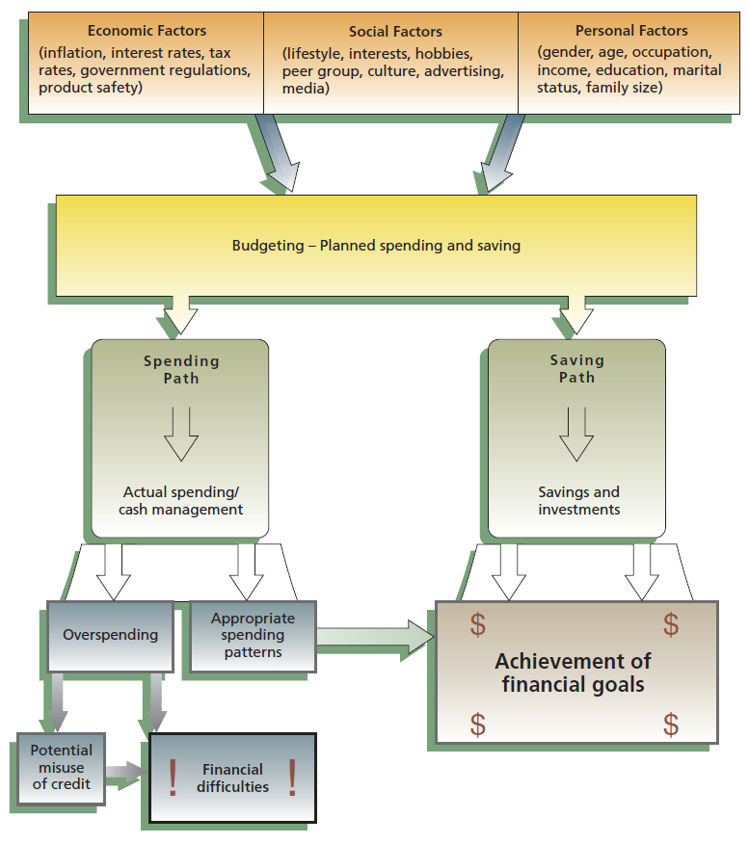
Purchase Decisions
Financial Implications of Consumer Decisions

Slide 38
Financial Implications of Consumer Decisions
Nok has a tendency to make impulse purchases. This has caused her to get into some financial difficulty. She would like to make better purchases in the future and has found several practical purchasing strategies that she thinks will help her avoid making poor decisions in the future.

Slide 39
Practical Purchasing Strategies
Timing Purchases
Store Selection
  Location, convenience vs Price (Cash and Carry)
Brand Comparison
  Starbucks?
Price Comparison
  Unit pricing

Slide 40
Timing Purchases
  Certain items go on sale at the same time each year
  Weather reports might give information about prices of certain food products
  News reports may be important
    Changing economic conditions
    Political difficulties around the world
Nok has always shopped when clothes first appear in the store. She realizes that by waiting just a few months she might be able to get much better prices on the same clothes. She has never paid much attention but realizes that changing economic conditions might change the interest rate she would have to pay on a loan or that political turmoil in China might raise the prices of goods imported from there.

Slide 41
Store Selection
Specialty Shops
Superstores
Online Stores
Cooperatives
Nok knows that there are many different places she can make purchases these days, and this increased competition combined with new technology gave given her greater choices and often lower prices.

Slide 42
Brand Comparison
Nok knows that there are many different brands available and that there can be important differences in price and quality for the different brands. She knows that national brands include Tylenol, Sony, Kellogg’s, Levi and many others which are household names. They often have higher prices that other brands but have gotten to be nationally known brands because of their consistent quality. i-Mobile, on the other hand, sells its own brand of phones while Big C sells its own brand of various durable goods. These products are often produced by same companies that produces the national brand. The quality is often similar to national brands, but the prices can often be lower.

Slide 43
Price Comparison
More store convenience (location, hours, sales staff) generally means higher prices
Ready-to-use products have higher prices.
Large packages are usually the best buy. However, unit pricing allows the comparison of prices of packages of different sizes.
A ‘sale’ might not always mean saving money.
Consider promotional offers.

Slide 44
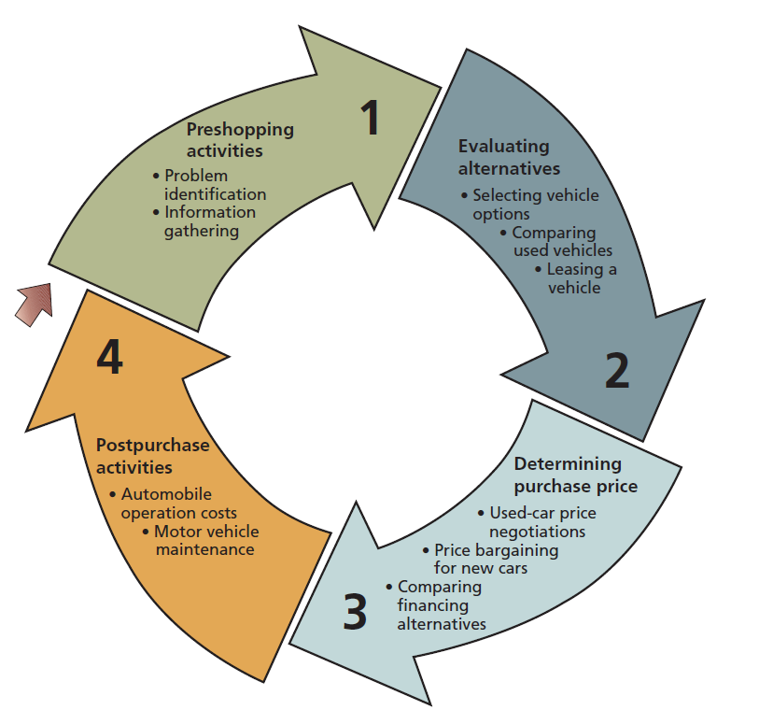
Purchasing a Car

Slide 45
Leasing a Motor Vehicle
Advantages
  Only a small security deposit might be necessary up front
  Monthly lease payments are often smaller than financing payments
  Detailed records for business purposes
  Can often obtain a more expensive car than otherwise
Disadvantages
  No ownership interest in the vehicle
  Qualifying credit requirements the same as financing a purchase
  Additional costs may be incurred for extra mileage, repairs, turning car in early, or moving to another province

Slide 46
The True Cost of a Lease
Capitalized Cost – the price of the vehicle in the leasing agreement
Money Factor – the interest rate being paid on the capitalized cost
The monthly payment and number of payments
The residual value – the expected value of the car at the end of the lease

Slide 47
Thank you

