Slide 1
Integrated Business Economics
EE488
Wanwiphang Manachotphong
Peera Charoenporn
sarinee Achavanuntakul

Slide 2
Course Description
Prerequisite: EE311, EE312 and EE325 (or EE425)
Economic theories and tools used to analyze business problems and business situations.
The analysis includes understanding competition and financial strategies adopted by firms in different industries
Forecasting economic and industrial conditions in the future.

Slide 3
Instructors
Dr. Wanwiphang Manachotphong
Office: Room 525, Faculty of Economics
Email: wanwiphang@econ.tu.ac.th
Office hours: Wednesdays 14.30 – 15.30 hrs. or by appointment
Dr.Peera Charoenporn
Office: Room 445, Faculty of Economics
Email: peera@econ.tu.ac.th
Office hours: Wednesdays 11.00 – 12.00 hrs. or by appointment

Slide 4

Aj.Sarinee Achavanunthakul
Email: sarinee@gmail.com
Office hours: by appointment
She is a writer, translator, lecturer (TBS)
  B.A. in Economics from Harvard University
  MBA from NYU Stern
  Used to work as a banker at Deutsche Bank, SCB

Slide 5
Aj.Sarinee Achavanunthakul’s works
Translation works
Fault Lines (รอยเลือยเขย่าเศรษฐกิจโลก)
The Value of Nothing (ค่าของความว่างเปล่า)
Justice (ความยุติธรรม)
Here comes everybody (พลังกลุ่มไร้สังกัด)
Creative Capitalism (ทุนนิยมสร้างสรรค์)
The Logic of Life (เศรษฐศาสตร์แห่งชีวิต)
etc.

Slide 6
Aj.Sarinee Achavanunthakul’s works
Writings
ทุนนิยมที่มีหัวใจ
ความเหลื่อมล้ำ
การเงินปฏิวัติ
รู้ทันตลาดทุน
ฯลฯ

Slide 7
Readings
No main textbook
Readings will be assigned class-by-class
Knowledge is everywhere
  Textbooks
  Newspaper (กรุงเทพธุรกิจ, ฐานเศรษฐกิจ)
  Books
  Business magazine (Brandage, Harvard Business Review)
  Business journals
  Academic journals
  etc.

Slide 8
Grading
Case Presentations 30%
  (3 presentations, 10% each)
Business Plan 30%
  (report (20%), presentation (10%))
Final Exam 30%
Class Participation 10%
  (can miss 1 class, after that -1% every time you miss)
Total 100%

Slide 9
Part1: Lecture
Introduction: Business Economics, SCP and Business Plan
Macroeconomic Analysis/Globalization
Economics of Strategy/Marketing
Industrial Analysis/Competition Policy and Regulation
Economics of Production/Organization/ and HRM
Finance and Economics

Slide 10
Part II: Case Studies
Manufacturing sector
  Automobile, Electronics, Food, Fashion
Non-financial service sector
  Tourism, Airline, Hotel
Financial sector
  Banking, Security Broker, Non-Bank Financial Institutions
Retail sector
  i.e. grocery stores, modern trade, online shopping.
Globalization and international business
  MNCs, out-sourcing, Google, IBM, etc.
Regulated industries
  Telecom, Energy, Mining, etc.

Slide 11
Part III: Business Plan
Business Plan
  Write a business plan report (no more than 8,000 words)
  Present your business plan

Slide 12
What you will study in MBA?
Functional Skill
BA.611 Accounting for Decision Making
BA.621 Financial Management
BA.631 Marketing Management
BA.641 Human Resource Management
BA.642 Leadership and Change
BA.651 Logistics and Operations Management
Modern Management Concepts and Practices
BA.605 Innovative Creation for Competitive Advantage
BA.606 Corporate Governance and Social Responsibility
BA.701 Performance Management and Value Creation
BA.702 Seminar in Contemporary Strategic Management

Slide 13
Business Economics
Business economics as a field in applied economics uses economic theory and quantitative methods to analyze business enterprises and the factors contributing to the diversity of organizational structures and the relationships of firms with labour, Capital and product markets.
Business economics is concerned with economic issues and problems related to business organization, management, and strategy. Issues and problems include: an explanation of why firms emerge and exist; why they expand: horizontally, vertically and spacially; the role of entrepreneurs and entrepreneurship; the significance of organizational structure; the relationship of firms with the employees, the providers of capital, the customers, the government; the interactions between firms and the business environment

Slide 14
Business Economics
Ambiguity in the use of term
The term 'business economics' is used in a variety of ways. Sometimes it is used as synonymously with industrial economics/industrial organisation, managerial economics, and economics for business.
One view of the distinctions between these would be that business economics is wider in its scope than industrial economics in that it would be concerned not only with "industry" but also businesses in the service sector.
Economics for business looks at the major principles of economics but focuses on applying these economic principles to the real world of business.
Managerial economics is the application of economic methods in the managerial decision-making process.
Program at Harvard University uses economic methods to analyze practical aspects of business, including business administration, management, and related fields of business economics

Slide 15
Industrial Organization
Industrial organization is the field of economics that builds on the theory of the firm in examining the structure of, and boundaries between, firms and markets.
The subject has been described as concerned with markets that "cannot easily be analyzed using the standard textbook competitive model."Industrial organization adds to the perfectly competitive model real-world frictions such as transaction costs, limited information, and barriers to entry of new firms that may be associated with imperfect competition. It analyzes determinants of firm and market organization and behavior as between competition and monopoly, including from government actions.
There are different approaches to the subject. One is descriptive in providing an overview of industrial organization, such as measures of competition and the size-concentration of firms in an industry. A second uses microeconomic models to explain internal firm organization and market strategy. As to strategic firm interaction, non-cooperative game theory has become the standard unifying method of analysis. A third aspect is oriented to public policy as to economic regulation and antitrust law.

Slide 16
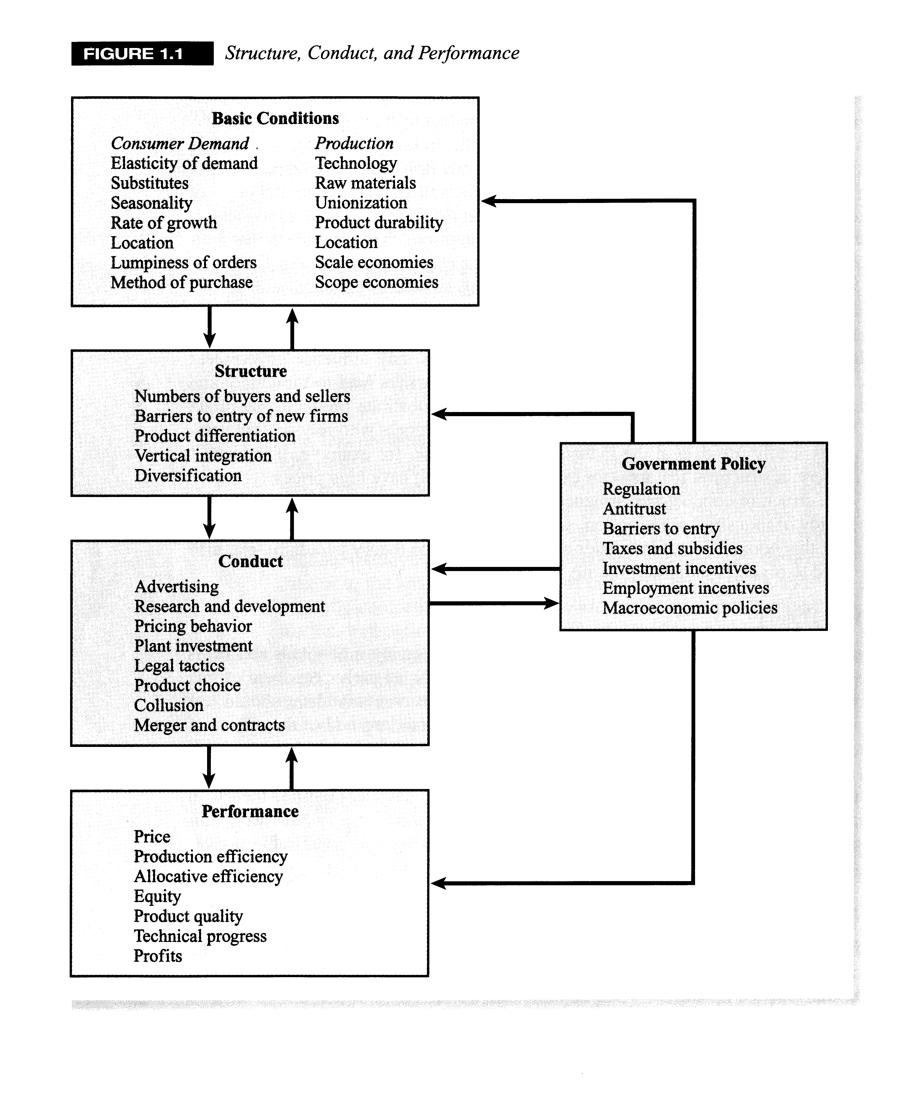

Slide 17
Managerial Economics
Managerial economics as defined by Edwin Mansfield is "concerned with application of the economic concepts and economic analysis to the problems of formulating rational managerial decision.” It is sometimes referred to as business economics and is a branch of economics that applies microeconomic analysis to decision methods of businesses or other management units. As such, it bridges economic theory and economics in practice. It draws heavily from quantitative techniques such as regression analysis and correlation, calculus. If there is a unifying theme that runs through most of managerial economics, it is the attempt to optimize business decisions given the firm's objectives and given constraints imposed by scarcity, for example through the use of operations research, mathematical programming, game theory for strategic decisions, and other computational methods.

Slide 18
Managerial Economics
Managerial decision areas include:
assessment of investible funds
selecting business area
choice of product
determining optimum output
determining price of product
determining input-combination and technology
sales promotion
Risk analysis - various models are used to quantify risk and asymmetric information and to employ them in decision rules to manage risk.
Production analysis - microeconomic techniques are used to analyze production efficiency, optimum factor allocation, costs, economies of scale and to estimate the firm's cost function.
Pricing analysis - microeconomic techniques are used to analyze various pricing decisions including transfer pricing, joint product pricing, price discrimination, price elasticity estimations, and choosing the optimum pricing method.
Capital budgeting - Investment theory is used to examine a firm's capital purchasing decisions

Slide 19
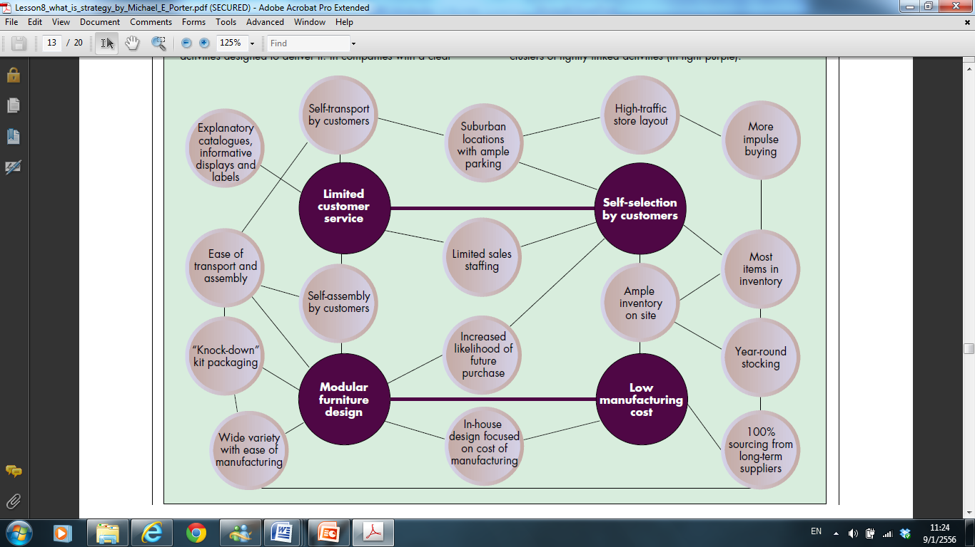

Slide 20
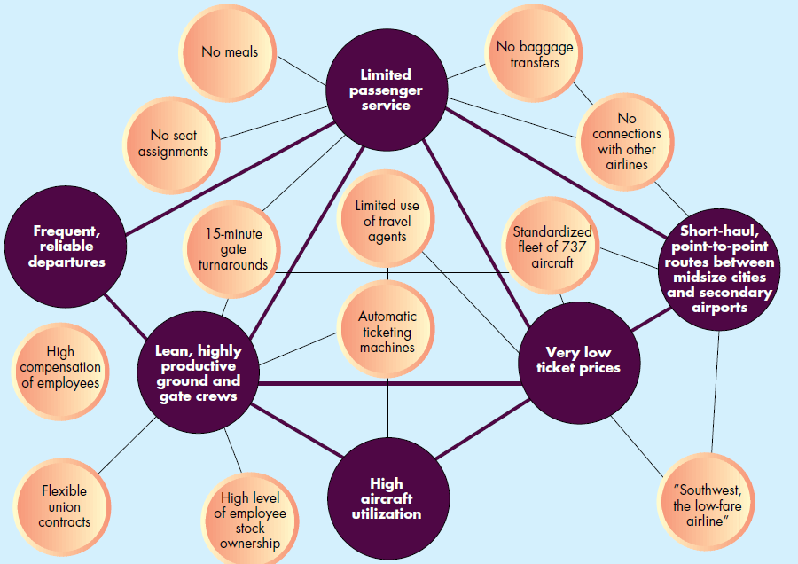

Slide 21
Half-time Break
After the break
Case Study Assignments
Business Plan assignments

Slide 22
Part II: Case Studies
Case studies are group works
  (3 students/ group)
3 groups present each week

Slide 23
What to present?
  Pick an industry or a firm
  Review the market structure-conduct-performance (SCP)
  If you were to enter this industry, what would you do? and how?
    Could pretend to be one of the firms, a new competitor, or take the government role
  Can research on firms or industries that would be beneficial to your business plan assignment

Slide 24
Part II: Case Studies Schedule
Manufacturing sector
  Automobile, Electronics, Food, Fashion
Non-financial service sector
  Tourism, Airline, Hotel
Financial sector
  Banking, Security Broker, Non-Bank Financial Institutions
Retail sector
  i.e. grocery stores, modern trade, online shopping.
Globalization and international business
  MNCs, out-sourcing, Google, IBM, etc.
Regulated industries
  Telecom, Energy, Mining, etc.

Slide 25

Which company produces the first PC in the world?

Slide 26
Apple vs. S&P 500 source: created by me using data from yahoo finance.
Apple’s Share Price vs. S&P 500 Index
On 9/Jan/2012: Apple = $419.81, S&P500 = $1289.09.

Slide 27
Apple vs. S&P 500 (April 1984 = 1) source: created by me using data from yahoo finance.
Apple’s Share Price vs. S&P 500 Index
On 9/Jan/2012: Apple = $13,900.99, S&P500 = 784.26.

Slide 28
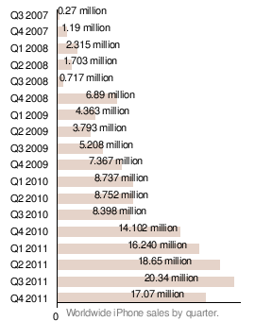
Example 1: Apple Inc. (Smartphone)
iPhone’s Global Market Share
iPhone 22%
Samsung 26%
Source: http://www.velositor.com

Slide 29
Example 1: Apple Inc. (Smartphone)
SCP analysis
  Structure
    Number of competitors – Samsung, Blackberry, etc.
    Barriers to entry?
      Technological secret?
      Economy of scale?
      Customer loyalty? etc.
    Product differentiation?
  Conduct
    R&D, Price competition, Non-price strategies, Product Positioning
  Performance
    Profitability (stock price, etc.), Market Share, etc.

Slide 30

Example 1: Apple Inc. (Smartphone)
  If you were to enter this industry, what would you do? and how?
  Suppose you work for Blackberry
  What should blackberry do in order to gain market share in this market?
  Should it aim to continue fighting in this market or do something else?
  How feasible is your suggestion?

Slide 31

Example 1: Apple Inc. (Smartphone)
  If you were to enter this industry, what would you do? and how?
  OR suppose you work for Apple
  What should Apple do in order to maintain its high profitability and large market share?
  How feasible is your suggestion?

Slide 32
Example 2: Healthcare (Thailand)
SCP analysis (Private hospital in Thailand)
  Structure
    Number of competitors – Private hospitals in Thailand, Singapore, etc.
    Barriers to entry?
    Technological secret?
    Economy of scale?
    Customer loyalty?
    Product differentiation?
  Conduct
    Tie-in? Price competition, Non-price strategies, Product Positioning
  Performance
    Profitability (stock price, etc.)

Slide 33

Example 2: Healthcare (Thailand)
  If you were to enter this industry, what would you do? and how?
  Suppose you work for Bamrungrad Hospital
  What should you do in order to gain market share in this market?
  How feasible is your suggestion?

Slide 34
Example 2: Healthcare (Thailand)
  Or suppose you work for the Thai government
  Why should the government care about the healthcare industry in Thailand?
  The “doctor : population” ratio in Thailand is 5 times LESS than that of a developed country
  How should medical schools be supported?
    Government? (tax money)
    Private?
What should be Thailand’s long-term plan?

Slide 35
Part III: Business Plan
Business Plan Assignment
  Write a business plan report (no more than 8,000 words)
  Present your business plan

Slide 36
Writing an Effective Business Plan
THE NEED FOR PLANNING
➢ Discuss the company’s goals for the near-term and long-term future
➢ Show how the goals can be achieved
➢ Demonstrate that realization of the plan will satisfy the reader’s requirements.
E X T E R N A L U S E S F O R T H E P L A N
➢ The track records of the company, the market, and the key executives
➢ The feasibility of achieving the forecasts
➢ The uniqueness of the product and its technology
➢ The quality of the management.
Question:
➢ What are the long-term goals of your company? The near-term?
➢ What do you wish to gain from your business plan (e.g., funding, reconciled internal vision, etc.)?
➢ What are the likely needs and requirements of the readers?

Slide 37
THE PROCESS OFWRITING A BUSINESS PLAN
GATHERING THE RIGHT DATA
➢ Company Description
Name
Legal form
Location
Financial highlights
Shareholders
➢ Management and Organization
Organization chart
Key management
Board of Directors
Consultants and advisors
Compensation and other employee agreements
Other shareholders, rights and resolutions
➢ Market and Competitors
Market statistics
Competitor data
Market and customer surveys
➢ Product or Services
Product literature and technical specifications
Contracts and/or purchase orders
Competitive advantages
Patent, license, and trademarks
Regulatory approvals or industry standards
Operations plan
Research and development plans
➢ Marketing and Sales
Marketing plan
Marketing vehicles
Marketing materials
➢ Financial Information
Financial statements for up to past5 years
Financial forecasts and projections/assumptions
Amount and timing of needed funding

Slide 38
Does the Executive Summary demonstrate?
➢ that the business has been thoroughly planned and researched?
➢ a business proposition that makes sense?
➢ an accurate understanding of the value proposition of your product or service?
➢ that the business proposition offers real competitive advantages?
➢ a knowledge of the industry and target market?
➢ a sense of enthusiasm for the business?
➢ a realistic picture of the risks inherent in the business?

Slide 39
The Company, Strategy, and Management Team
➢ What business are you in?
➢ What is the purpose of your business?
➢ What are your products and/or services? How are they related to your mission?
➢ What benefits do your products and/or services provide to your customers?
➢ What led you to develop your business, its products or services?
➢ What is your vision for your business? How large do you want to become?
➢ Is your vision statement based in reality and is it aligned with realistic growth objectives?
➢ Why are you uniquely qualified to be in this business?
➢ How you are distinctive from your competition?
➢ What is the legal name of your business?
➢ What is your legal structure and is it appropriate for your future plans?
➢ Where are you located?
➢ What stage are you presently at? Conceptual phase? Start-up? Mature business?
➢ What is your current financial position?
➢ What are your company’s weaknesses and how are you addressing them?
➢ Who are the key members of your management team?

Slide 40
MANAGEMENT AND ORGANIZATION
➢ Why is the CEO qualified to lead the company?
➢ Do the strengths and experience of the management team match the goals and strategies of the business?
➢ Does the management team have both technical and business acumen?
➢ Are your compensation arrangements aligned with the goals and objectives of the business?
➢Do you have any strategic alliances that give you access to talent that is not resident in your management team? If your management team is not complete, what is your action plan to add the necessary talent? What impact is this having on current operations?
➢Are your compensation programs competitive enough to attract and retain the right human resources?
➢ How will you address the ongoing development needs of your workforce?
➢ Who are your outside experts and what will it cost to retain them?
➢Does your Board of Directors or advisors bring relevant experience to your management team?

Slide 41
THE MARKET AND COMPETITORS
➢ In which industry or industries do you operate?
➢ How are these industries changing? How fast?
➢What changes will affect the need for your product or service?
➢Are there changes in the political or regulatory landscape, or social values, that affect the need for your product or service?
➢ How will changes in technology change your industry?
➢ What is/are your specific target market(s)?
➢Who are your customers today and are they in the identified target market(s)?
➢What market trends/changes may affect your customers’ ability to afford your product or service?

Slide 42
THE MARKET AND COMPETITORS
➢ What is the approximate size and geographic spread of your target market(s)?
➢ What is the approximate growth rate of your target market(s)?
➢ Which companies and which types of companies make up your competition?
➢ What are the barriers to entry for your competition?
➢Have you honestly analyzed your competitors’ strengths and weaknesses?
➢What are the key factors motivating customers to buy your product or service?
➢How does your product or service integrate with other products or services? Does the sale of your product or service depend on the sale of another product or service?

Slide 43
THE MARKET AND COMPETITORS
➢Is it costly for your customer to change product or service providers? Are they loyal to your competitors?
➢ Is your product or service vulnerable to substitution?
➢How is your product or service differentiated from the competition’s on a basis other than price?
➢Is your market price sensitive? If so, where is your product or service positioned on the price curve?
➢ Is there perceived value in higher prices?
➢How are you pricing related items such as service and support? What are your credit terms?
➢How will your competition respond to your pricing strategy?

Slide 44
The Product or Service
➢ What are the key milestones in the research and development process? At what stage are you in that process? When will your product be ready to sell?
➢ What are costs to complete the development of the current product? What are the ongoing costs?
➢ Are you capable of monitoring the need for product improvements and changing the production cost structure as the industry, competitor products, and customer needs change?
➢ How much are you spending on research and development? How much is the competition spending?
➢ How do you select new products for research and development?
➢ Do you have any intellectual property?
➢ Is your product or product name registered with appropriate governmental bodies? If your business is expected to be global, have you taken into account international patent, intellectual property and other legal influences?

Slide 45
The Product or Service
➢ How much manufacturing space will you need?
➢ What type of capital equipment will you require? What impact will changing technology have on your equipment needs?
➢ Will you build all of the product in house or subcontract out a portion of the production process?
➢ Are there any critical processes that have not been developed?
➢ Are any parts or supplies difficult to get, or do they require long-lead times? How reliable are key suppliers?
➢ Are there any parts that can be obtained only from a single source or only from overseas?
➢ What are the backup sources for these materials?
➢ How will you monitor quality? How can customers contact you if they have comments or problems?
➢ Have you identified business risks and developed a risk management strategy to address them?

Slide 46
MARKETING AND SALES
➢ How are you positioning your product or service?
➢ What are the key messages that you want to convey in your marketing materials?
➢ What types of marketing media will you use to promote your product or service?
➢ What is your marketing plan? What mix of media will you use? How much will you spend? How do these compare to similar efforts deployed by the competition?
➢ How will you use public relations to help promote your product or service?
➢ What distribution channels are you using and what selling methods are appropriate for each channel?
➢ Do you need your own sales force? Dealers? Representatives?
➢ What is your commission structure?
➢ Do you have any strategic alliances that will allow you to reach your target market(s) efficiently and cost effectively?

Slide 47
THE FINANCIAL INFORMATION
➢ Have you carefully analyzed your current and historical financial statements in order to explain your results to investors and to form the foundation for your projections?
➢ Are your assumptions consistent with the results of your market analysis and the other sections of the business plan?
➢Have you completed several different financial projections to understand the impact of different scenarios on the key financial metrics of your business?
➢ How much capital do you need and over what period of time?
➢ What form of investment are you seeking?
➢ How will you use the funds obtained?
➢ How do you plan to finance further company growth?
➢ What is the exit/payback strategy for lenders and investors?

Slide 48
What to expect from your business plan?
➢ Is the business concept solid and feasible? Can it be implemented in a reasonable time frame?
➢ Is your product or service viable? Does it add significant value to the customer?
➢ Does a real market exist?
➢ Are your strategies consistent with your evaluation of the marketplace and your capabilities?
➢ Is your strategy ethical and legal?
➢ Have you thoroughly evaluated different strategies? Can you defend your choices among the alternatives identified?

Slide 49
What to expect from your business plan?
➢ What are the target markets and are they large enough to support the business plan?
➢ Is the target market growth potential high?
➢ Have you thoroughly and honestly evaluated your competition?
➢ Are your goals focused, tied to the strategy, measurable, specific, and understandable?
➢ Is the financial plan realistic?
➢ Does the funding request match the investors’ criteria?
➢ Is management experienced and capable?
➢ Do you have a detailed and realistic timetable and set of benchmarks by which to measure progress?
➢ How and when will the investors get their investment back?

Slide 50
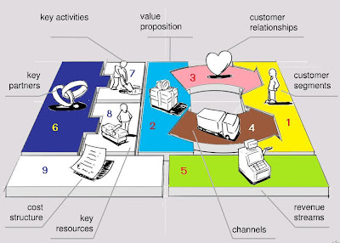

Slide 51
Outline of Business Plan
Company Description
Management and Organization
  Organization chart
  Key management
  Compensation plans and policies
  Staffing plan by department
Market and Competitors
  General description
  Market statistics
  Customer data (Demographics; Needs; Loyalty; Buying behavior and purchasing criteria)
  Competitor data (Type and number; Location; Strengths and weaknesses; Turnover ;Barriers to entry ; Strategy; Potential future competitors)
  Market and customer surveys (Pricing; Sensitivity; Segmentation)

Slide 52
Outline of Business Plan
Product or Services
  Product literature and technical specifications
  Competitive advantages
  Current development stage
  Product life span information
  Impact of technology
  Patent, license, and trademarks
  Regulatory approvals or industry standards
  Business risks
  Operations plan (Production process; Facilities; Capacity; Security of supply channels; inventory requirements)
  Research and development plans
  Quality control plans
  Customer service plans

Slide 53
Outline of Business Plan
Marketing and Sales
  Marketing plan
  Marketing vehicles
  Marketing materials
  Strategic alliances
  Distribution channels
  Sales force
Financial Information
  Financial statements from the past five years
  Financial forecasts, projections, and assumptions
  Amount and timing of needed funding

Slide 54
“The highest reward from your working
is not what you get from it
but what you become by it.”
(Sydney Harris)

