Slide 1

MK 322 Retail Management
Chapter 11: Customer Relationship Management Part I
By Ajarn Suwalya K.

Slide 2

The CRM Process

Slide 3
Customer Loyalty
Customer Loyalty means that customers are committed to buying merchandise and services from a particular retailer
Loyalty is more than liking one retailer over another
Loyalty means that customers will be reluctant to switch and patronize a competitive retailer
Loyal customers have a bond with the retailer based on an emotional connection that is more than just having a positive feeling about the retailer
This emotional bond is a personal connection
They feel the retailer is a friend
The goodwill toward the retailer encourages them to make repeat purchases and recommend to their friends and family
Notes:
1

Slide 4
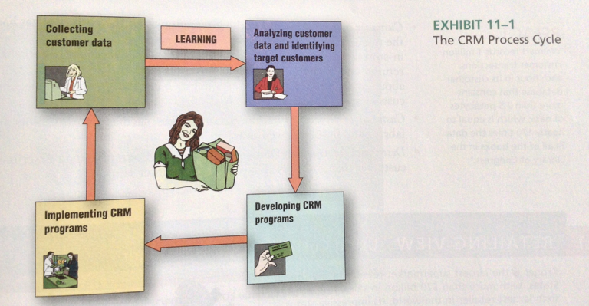
The CRM Process
Notes:
1

Slide 5

Collecting Shopping Data

Slide 6
Identifying Information
Identifying Information
1. Ask for Identifying Information- address,email,mobile, telephone no.
2. Connect Internet and Store Purchasing Data- credit card for online purchase
3. Offer Frequent-Shopper Programs or loyalty programs
4. Use Biometrics- measuring human chatacteristics such as fingerprints, voice, person's hands
5. Place RFID chips on merchandise
Notes:
1

Slide 7
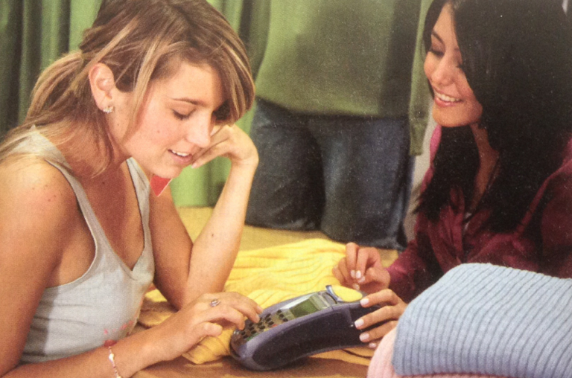
Customer Database
Customer transactions are collected from POS terminal and stored in a customer database.
Notes:
1

Slide 8
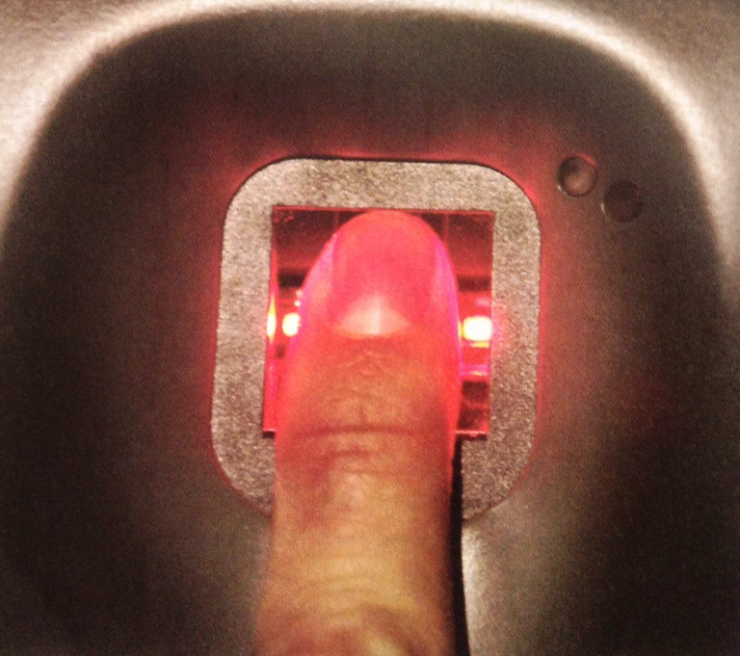
Customer Database
Notes:
1

Slide 9

Analyzing Customer Data and Identifying Target Customers

Slide 10
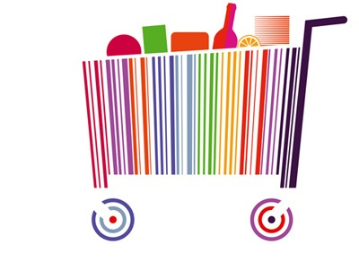
Identifying the Best Customers
One if the goals of CRM is to identify and cater to the retailer's most valuable customer
Retailers often use information in their customer database to determine how valuable each customer is to the firm
Notes:
1

Slide 11
Identifying the Best Customers
The value of a customer, called customer lifetime value (CLV) is the expected contribution from the customer to the retailer's profits over the entire relationship with the retailer
Retailers use past behaviors to forecast their CLV
Notes:
1

Slide 12
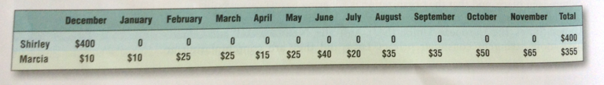
CLV- 12 Months Purchase Histories
Notes:
1

Slide 13
Retail Analytics
Retail Analytics are applications of statistical techniques and models that seek to improve retail decisions through analysis of customer data
Data mining is an information processing method that relies on search techniques to discover new insights into buying patterns of customers,using large database
Notes:
1

Slide 14
Data Mining
3 most popular applications
Market Basket Analysis
Targeting Promotions
Assortment Planning
Notes:
1

Slide 15
Market Basket Analysis
A data mining tool determines which products appear in the market basket that a customer purchases during a single shopping trip
This analysis can suggest where stores should place merchandise and which merchandise to promote together based on merchandise that tends to show up in the same market basket
Notes:
1

Slide 16
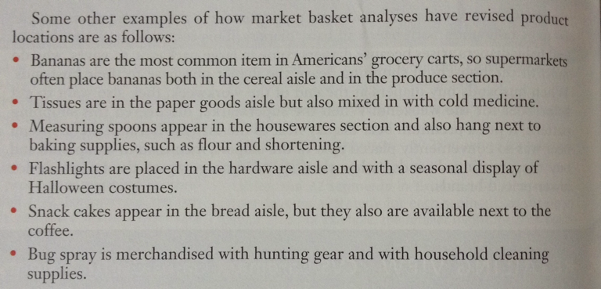
Market Basket Analysis
Notes:
1

Slide 17
Targeting Promotions
Market Basket Analysis help provide insights into assortment decisions and promotions
Retailers might discover that customers typically buy a specific brand of conditioner and shampoo at the same time
With this information, the retailer might offer a special promotion on conditioners, anticipating that customers will also buy(the higher margin) shampoo at its full price
Notes:
1

Slide 18
Assortment Planning
Managers have to make decisions about what merchandise to carry in each category
Customer data also can be mined to help with these assortment decisions
By analyzing which products the retailer's most valued customers purchase, the manager can ensure that they are available in the store at all times
For example, an analysis might discover that customers in its highest CLV segment are very loyal to a brand of gourmet mustard
Notes:
1

Slide 19

Developing CRM through Frequent-Shopper Programs

Slide 20
Effectiveness of Frequent-Shopper Programs
Useful for building customer database, but not long-term loyalty
Perceived value is low, perceive liitle difference among competing retailers
Discounts appealing to price-conscious shoppers, but maybe not to CLV shoppers
Loyalty programs are difficult to revise or correct once they become part of customer shopping experience
Notes:
1

Slide 21

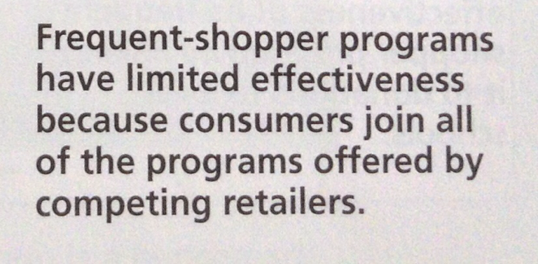
Effectiveness of Frequent-Shopper Programs
Notes:
1

Slide 22
Making Frequent-Shopper Programs More Effective
Frequent shopper programs seek to encourage repeated purchase and develop customer loyalty
Offer Tiered Rewards – silver,gold,platinum
Treat High CLVs as VIPs – treat customers special
Incorporate Charitable Contributions
Notes:
1

Slide 23
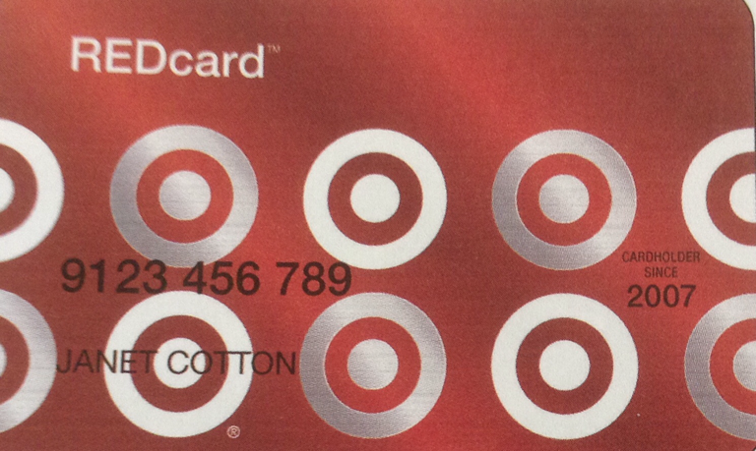
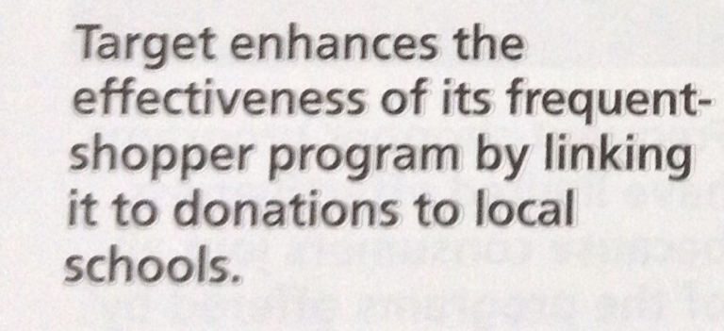
Making Frequent-Shopper Programs More Effective
Notes:
1

Slide 24
Making Frequent-Shopper Programs More Effective
Offer choices – earned points to attend special events, vouchers,etc
Reward All transactions- Sephora, once they spend 100 USD, get free sample size product
Make transparent and simple – easy for customers to keep track of spending and available rewards
Notes:
1

Slide 25
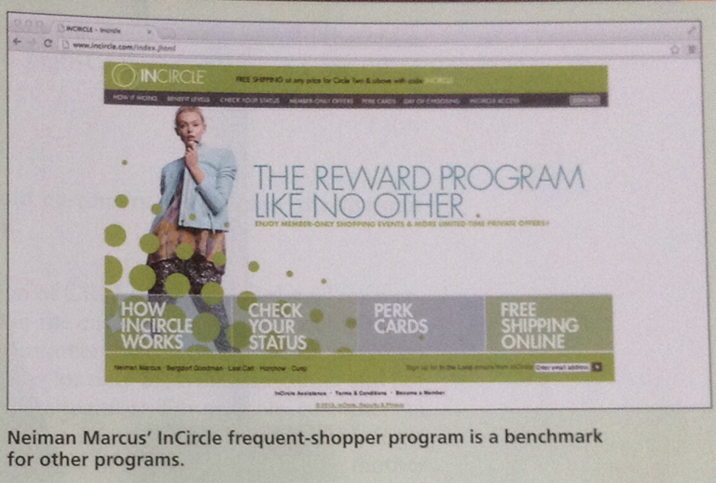
Making Frequent-Shopper Programs More Effective
Notes:
1

Slide 26


