Slide 1
EE401 Political Economy
Chapter 2 Pre-capitalist Society and Absolutist Political Institution
i. Pre-capitalist Society
and the Rise of Capitalism
Ploy Thammapiranon 2/2017
BE, Thammasat University

Slide 2
1. Pre-capitalist society
1.1 Extractive economic institutions
based on the extraction of the ‘surplus’
  The surplus = production beyond subsistent necessities.
  through extractive economic institutions forced by absolutist political institutions.
Organization of economic activities
  Lack of economic freedom, mobility, secure private property.
  Personal bondage and political coercion
  Concentration of wealth and luxury consumption in the ruling class.

Slide 3
1. Pre-capitalist society
1.2 Cycles of growth, stagnation, decay
new inventions were utilised to establish absolutist political institutions.
  Agriculture, metal tools, engineering.
  Initial growth, expansion and prosperity.
  Imposition of extractive economic institutions to extract the surplus.

Slide 4
1. Pre-capitalist society
1.2 Cycles of growth, stagnation, decay
Absolutism obstructs technology progress.
  Absolutist political institutions requires social immobility.
  ‘Creative destruction’ by new inventions disrupts existing social orders and stratification.
Political instability, social, economic and technology stagnation.
  Infighting.
  Growth collapse, decay, destruction by neighbors.

Slide 5
Primitive society
Agriculture, metal tools, engineering
Surplus production
Growing population
Decay, infighting, destruction by neighbors
Rise of a ruling class
Villages, towns.
State apparatus (army, police)
Technology and production stagnation
Absolutist political institutions (kingdoms, empires)
Extractive economic institutions:
Surplus extraction from population
Plundering neighbors

Slide 6
1. Pre-capitalist society
1.3 Growth spurts around the world
Egypt
Greece and Rome
Ancient China and India
Ancient Americas
SE Asia: Annam, Khmers, Thais, Burma.

Slide 7
1. Pre-capitalist society
1.4 Creative destruction
New technology improves labor productivity, enhances output and growth.
  New skills and occupations emerge and prosper.
  Social groups with obsolete technology lose out.
New technology usually encounters resistance

Slide 8
1. Pre-capitalist society
1.5 Technology and growth
Before 1800, technological progress was sporadic and slow.
  New technology was adopted by new rulers to create empires
  Absolutist political institutions based on extractive economic institutions.
  Then innovation was banned
  Stagnation, decay, infighting and collapses.

Slide 9
2. The rise of market economy
2.1 Origin of capitalsm
Democratic revolutions in Britain, the US and France brought about first pluralist political institutions in human history.
  Capitalist market economy.
  Economic freedom, private property.
  Market competition, rule of law, public infrastructures.
  Technological progress and economic growth.
  The pre-capitalist pattern is first disrupted in Western Europe

Slide 10
2. The rise of market economy
2.1 Origin of capitalism
The new era of capitalism:
  The development of the market system.
  The rise of pluralist political institutions.
  Sustained growth from c.18.
The transition: feudalism to mercantilism.

Slide 11
2. The rise of market economy
2.2 European feudal society
Extractive economic institution: through master-serf relationship.
Absolutist political institutions: feudal lords under a nominal monarchy.
  weak absolutism.
Basic units are local manors.

Slide 12
2. The rise of market economy
2.2 European feudal society
European Feudalism
Protection and rules
Feudal lords
Serfs (peasants)
Tributes and services

Slide 13
2. The rise of market economy
2.2 European feudal society
a) The Manor
  Community of agriculture and handicrafts ruled by feudal lords.
  Labor services and tributes from serfs (peasants and craftsmen).
  Serfs were bonded to masters.
  Rigid class structure, customs and tradition of obligations.

Slide 14
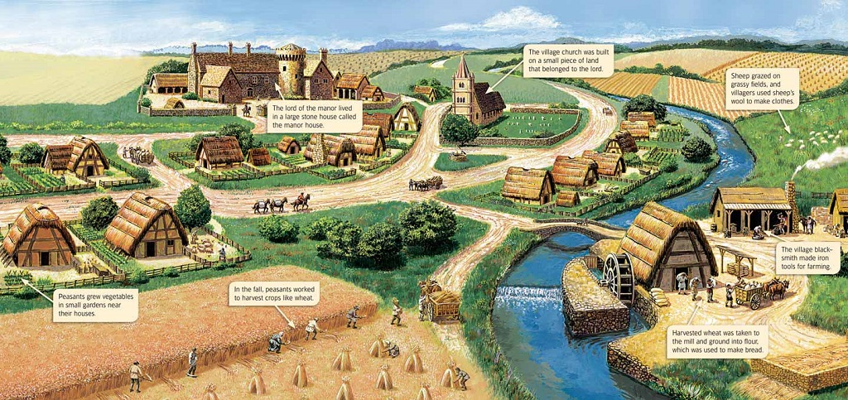

Slide 15
2. The rise of market economy
2.2 European feudal society
b) The Catholic Church
The largest landlord.
Loyalty to Pope in Rome.
Spiritual power over the masses.
Influence over kings and princes.

Slide 16
2. The rise of market economy
2.2 European feudal society
c) The Towns
Craftsmen organized in ‘guilds’ producing manufactured goods.
Masters and apprentices.
Trade with manors and distant places.
Monopoly of production, sale and prices.
Power base of merchants.

Slide 17
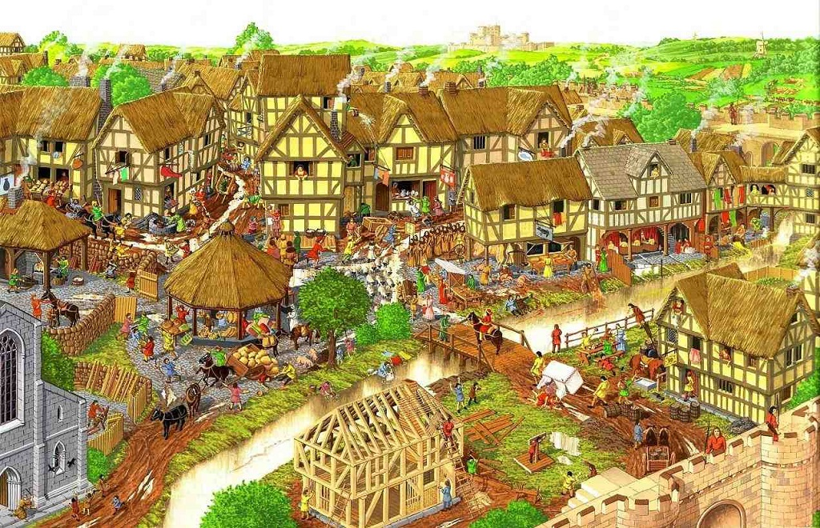

Slide 18
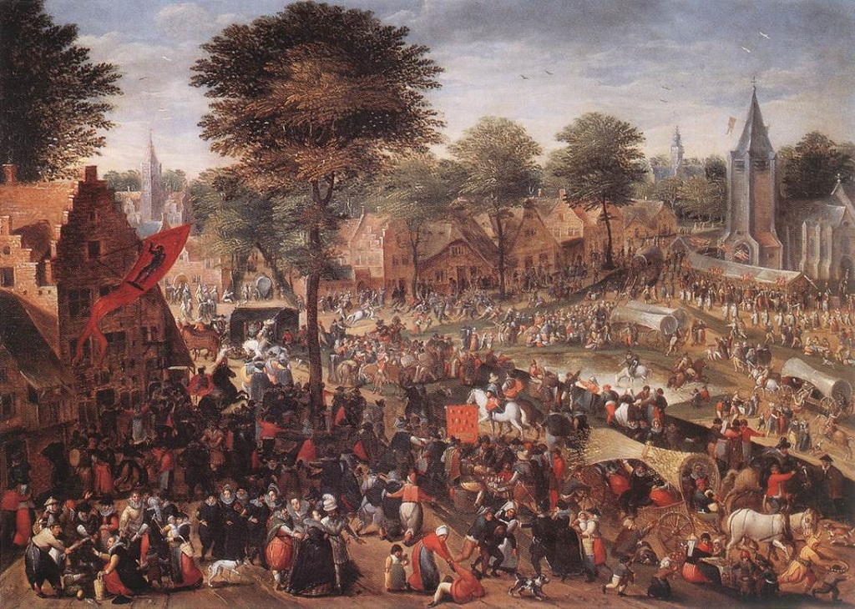

Slide 19
2. The rise of market economy
2.3 Why no European decay?
No unified power before c.15.
  Wide distribution of power among local lords.
  Conflicts among local lords leaves room for merchants and town folks to share the surplus.
- Trade
- Saving
- Investment
Technology Progress
- Stagnation overcome
- Feudalism undermined
- Industrial Revolution

Slide 20
2. The rise of market economy
2.3 Why no European decay?
The 1346 ‘Black Death’ resulted in severe labor shortages.
  Labor unrests, peasant revolts, dissolution of serfdom --- labor mobility.
Pluralist political institutions evolves slowly.
  Councils or ‘parliaments’ of nobilities to counter the monarchy.
  Expanded to broader representation over time.

Slide 21
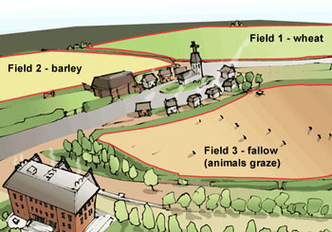
3. The decline of feudalism
Increases in agricultural productivity.
  Two-field system replaced by three-field system (c.11).
  Oxen replaced by horses.
Two-wheel carts replaced by four-wheel carts --- reduction in transport cost.
More food supply and rapid population growth

Slide 22
3. The decline of feudalism
Increased urban concentration
  Larger towns, more specialization.
  Increases in manufacturing productivity.
Increased long-distant trade (c.11).
  The Christian crusades and expansion of commerce
  Trade with the Arabs and Far-East.
Growth of cities with manufacturing sector divorced from agriculture (c.11-c.15).

Slide 23
4. Birth of capitalist production
4.1 The putting-out system (c.16).
The decline of guilds.
Craftsmen became waged laborers.
Merchants became capitalist employers.
Production decision made by merchants, not workers.
  Growth of textile industry.
Money (contract) relation replaced feudal-bond relation.
Emergence of capitalist farmers employing agricultural workers.

Slide 24
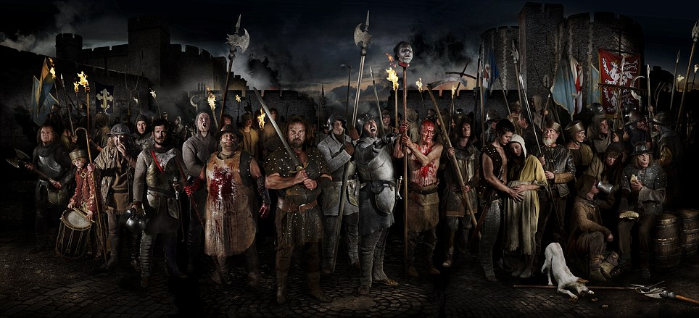
4. Birth of capitalist production
4.2 Destruction of manors (c.14-c.15).
  Wars among lords and princes.
  Peasant revolts.
  Plagues, epidemics, famine.
The Peasant Revolt of 1381, London

Slide 25
4. Birth of capitalist production
4.2 Destruction of manors (c.14-c.15).
goods
towns
products
tenant farmers
landowners
money rent

Slide 26
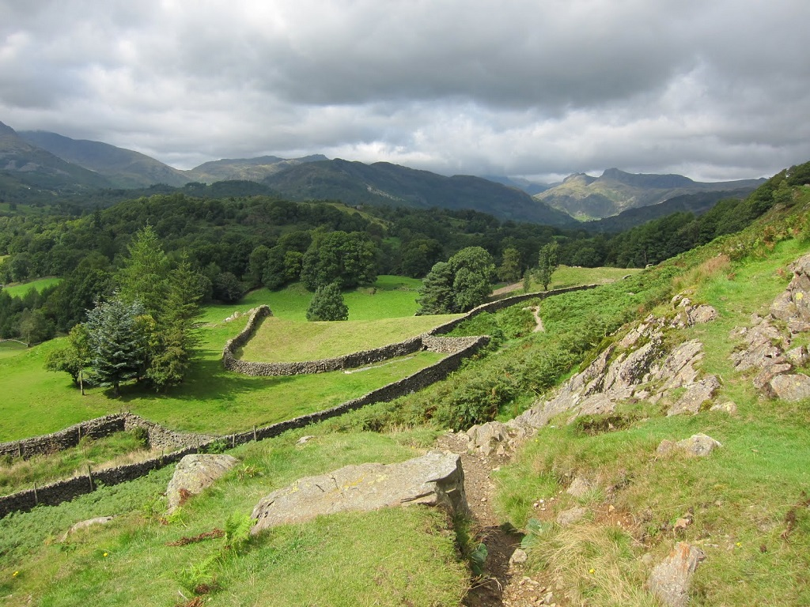
4. Birth of capitalist production
4.3 The enclosure movement (c.13-c.16).
Boom of wool and textile industries.
High price of wool.
Clearance of land and expulsion of peasants, tenants, replaced by sheep.
Vagabonds, beggars, the homeless.
The Poor Laws forcing them into factories.
The creation of the working class

Slide 27
4. Birth of capitalist production
4.4 The rise of world trade.
Improved navigation techniques (c.16).
Reduction in transport cost with better shipbuilding
Exploration and new trade routes.
The rise of naval power and colonialism.
  Colonization of the Americas and Africa.
Opium and spice trade in Asia.
Britain became world power in place of Spain (c.16)

Slide 29
4. Birth of capitalist production
4.5 The emergence of nation states
Creation of domestic markets
Political conflict between the monarchy and the nobilities.
  ‘Nation-building’ by the monarchy.
The rise of absolute monarchy in Europe:
Concentration of power in the capital.
Creation of ‘central government’
The monarch is ‘the nation’ and ‘the state’.
Nobilities
+ merchants
Nation state
& Nationalism
Centralized
and bureaucracy

Slide 30
4. Birth of capitalist production
4.5 Emergence of nation states
Divine rights of King
  The authority is derived from divine sources.
  The right to rule from God’s will.
  The authority and power is absolute.
  ‘No rights to revolution’.
Nationalism as a modern phenomenon.
How to make ‘the sovereign and the nation’ strong?
  Political power
  Military power
  Economic power = ‘wealth’

