Slide 1
Politics of Sarit’s Era
Thai Economic History
Thorn Pitidol
1/2018

Slide 2
Topics
Thailand in the Cold War
Businessmen and generals
The restoration of the monarchy

Slide 3
The Cold War and SE Asia
Between 1945 and 1950, South-East Asia emerged as one of the key arenas of the cold war.
  March 1947, President Truman proclaimed US intention to block communism at all cost
  The initial attempt by Thai military to press for aid was refused by the US.
  But as communism won in China and gained strength in Vietnam and Malaysia, the US changed their strategy

Slide 4
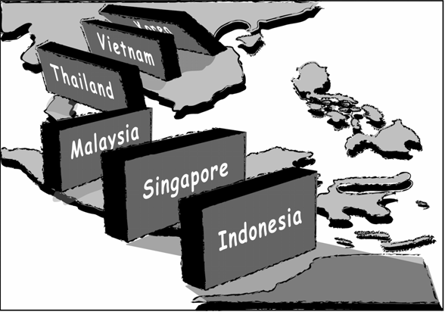
The Cold War and SE Asia
  "Domino Theory"
  Thailand became US's front-line state.

Slide 5
Thailand in the Cold War
Korean War provided the opportunity for the Thai army
From 1950, US started supplying arms and equipment to the Thai army
  US military advisory set up in Bangkok to provide training
  US military aids rose to 2.5 times the Thai military budget

Slide 6
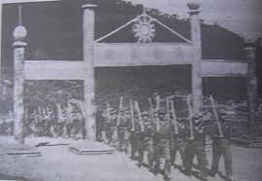
Thailand in the Cold War
The CIA also became the main supporter of the Thai police
  Supplying arms and training
  CIA also trained paramilitary unit and Border Patrol Police
KMT unit 93

Slide 7
Thailand in the Cold War
US became even more involved in wars in Indo-China. Thailand grew as their base.
  US increased their aids and supply of weapons, help building roads.
  US stationing of their troops in Thailand.
  Thailand became the base for US air-strikes
  The number of US personnel and hardware in Thailand escalated from 1964.

Slide 8
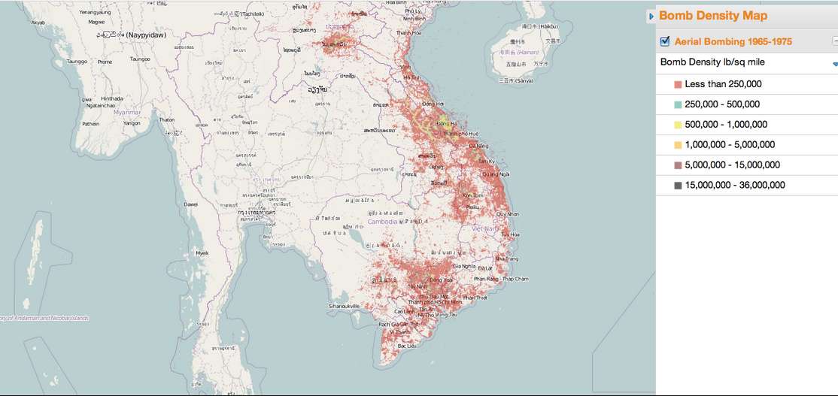
US Bombing of Indochina
Source: http://mangomap.com/maps/user/bomb%20density%20map

Slide 9
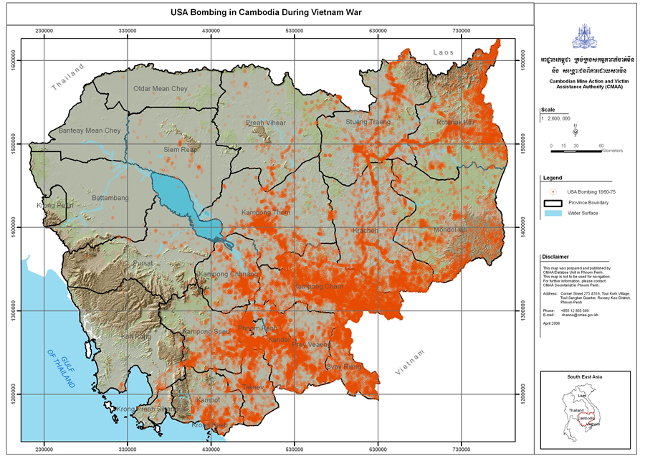
US Bombing of Cambodia
The U.S. dropped 160,000 tons of bombs on Japan during World War Two. The Pentagon data records the bombardment of Cambodia to have been at least three times heavier (around 500,000 tons), perhaps much more.
Source: Kiernan and Owen 2010 (http://www.japanfocus.org/-ben-kiernan/3380)

Slide 10
Thailand in the Cold War
The US also increased its support to the Thai police in response to the spread of communism
  From 1962, US provided arms, ammunition, vehicles, and aircrafts to the Border Patrol Police
  Paramilitary and provincial units also gained supports
  B/w 1965-1968, Thai police force increased from 51,000 to 80,000.
  50% of US economic aid estimated to be channeled to the police

Slide 11
Thailand in the Cold War
US support made Thai army and police highly powerful.
  The more US involvement in Indo-China, the more that Thai military can bargain for more.
  From 1951-1972, US military assistance were more than 50% of Thai military budget
  Thai military domestic defense budget increased more than 10 times.
Additional aid provided to Thai police and through USAID (development aid).

Slide 12
Businessmen and Generals
In 1930s and 1940s, the businessmen and generals were on opposing sides.
But in 1950s, they turned to share profits with the businessmen.
  The new alignment paved way for the Sarit’s change of economic policies
  The US oversaw the change, but the basis of change also came from the growth of private capitals.

Slide 13
Businessmen and Generals
The generals used the state power to amass their private fortunes and political funds.
  Generals sat on the board, made money from directors' fees, patronage contracts, and various illicit techniques.
Post 1947 Coup saw the increase in the number of state enterprises.
  Board of these enterprises filled with military and politicians.
  State enterprises already showed sign of inefficiency.

Slide 14
The Generals’ Businesses
The military’s way of making profits
  Sarit’s control of Lottery Bureau
  Companies set up to conduct business with gov't departments.
    Construction contracts. Other source income were mining and mineral concessions, purchases of arms, and the recreational services.
  Military's logging businesses assisted by the construction of damn and highways.
  The construction of highways also allowed military leaders to gained ownership of land along the newly constructed roads.

Slide 15
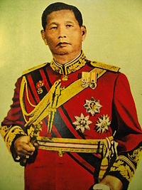
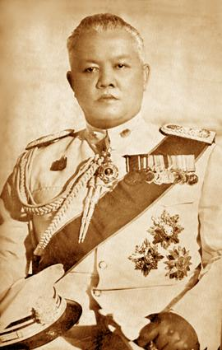
Sarit and Phao
สฤษดิ์ ธนะรัชต์
เผ่า ศรียานนท์

Slide 16
The Generals’ Businesses
The military leaders involved in illegal activities, most notably the opium trade.
  The "golden triangle"
  Thailand became the main exporting point of opium.
  Sarit and Phao competed in trafficking opium.

Slide 17
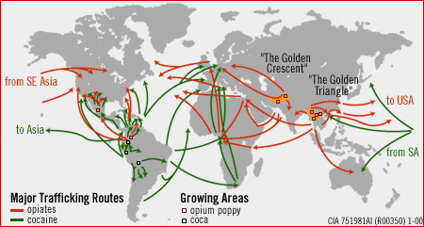
International Drug Route
Source: http://en.wikipedia.org/wiki/Heroin

Slide 18
Generals New Roles in Capitalism
In 1950s, the generals turned toward a more sophisticated role in Thailand's capitalism.
  Like Pridi, they developed reciprocal partnership with bankers and businesses.
    The military sit also in all range of private companies. Phao sat on 26 boards. Prapart sat on 44, Krit, on 50.
  The new roles provided the basis for the subsequent change in economy strategy toward the promotion of market and growth, supported by the US.

Slide 19
The Restoration of the Monarchy
From 1935-1950, when Rama IX ascended to the throne, Thailand had been without resident monarch.
  But there remain a strong royalist element within the bureaucracy
  From late 1940s, the bureaucrats and the generals allied to form a new social force with a new set of ideas.

Slide 20
The Restoration of the Monarchy
Apart from Phibun, the leaders of the 1947 Coup had a close relationship with the royalists.
  They returned to the idea of defending "Nation, Religion, King".
  They increased the formal powers of the King in constitution.
  And they handed back to the monarch the control over the royal property.
    Crown Property Bureau grew in wealth from their land holding in BKK and investment in numerous businesses.

Slide 21
Sarit’s special relations
In 1957 Coup, Sarit was made "Defender of the Capital".
Under Sarit leadership, the monarch was restated as the symbolic head of the nation.
  National day changed.
  Rak-na-kwan ceremony restored.
  The King and Queen tour of the rural area, visits to foreign countries.
  The government promoted the display of these events.

Slide 22
The Restoration of the Monarchy
Raising the visibility of Royal Family.
  Rise in number of ceremonies, functions, and audiences attended by the King.
  Establishing relationships numerous groups including business communities, middle-class, and army.
  Playing part in fund-raising. Royal sponsorship for marriages. Royal presence in degree ceremonies.
New projected image of Royal Family

Slide 23
The Restoration of the Monarchy
Restoring the importance of Monarchy to the military
  King and queen as honorary commanders. Sarit talked of the army as "the army of the King".
The King's role as the patron of Buddhism
  Royal Kathin ceremony revived.
  The importance of Thammayut Sect was restored.
  Sarit supported monks roles in rural development, and in preventing the spread of communism.

Slide 24
New Political Ideology
Luang Wichit’s continued his role as chief ideologist
  But the military no longer projected as the sole power. They became "army of the King”
Reviving of absolutist ideas, with the King at the center, but now with the "government headed by the King".
  The traditional ideological role of the King was divided, with the King assuming the passive role of spiritual and moral leadership, while the military dictator took active role in governing the polity.
  The army has responsibility in controlling politics and governance. The army is portrayed as brave, clean hearts, worthy of honours

Slide 25
New Political Ideology
The invention of "Thai Style Democracy"
  Farang democracy, emphasizing on “representatives”, have been misguidedly promoted in Thailand since 1932.
  The assembly full of military appointees was justified by stressing the importance of honesty and scholastic competence, without the influence from political party or the desire to win elections.

Slide 26
New Political Ideology
The new political ideology left no room for civilian politicians.
  Military officers as "Rattaburut (Statesman)" and not Nak-Karnmuang
  Politicians think of elections, while the statesman think about the future of the nation.
Promoted the theme that bureaucrats and soldiers were more suited to rule the country
  Because of the lack of personal interests

Slide 27
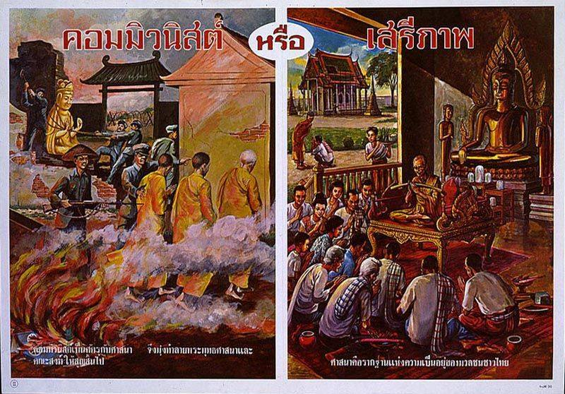
New Political Ideology
The military turned justification of its rule to fighting internal threats. That internal threat was summed up as "Communism"

