Slide 1

CLMVT strategy
Prewprae CHUMRUM
Executive Director
Bureau of Trade in Services and Investment Negotiations, Department of Trade Negotiations, Ministry of Commerce

Slide 2

What to share
Overview of CLMVTChallenges
Key issues for cooperation
Thai Strategy

Slide 3
Region of Growth
Country Name | GDP (billions of current US$) | GDP Growth rate (annual %) (Based on GDP in constant 2010 US.) | GDP per capita (current US$) | Population (millions of people) | Land area (sq. km)
Cambodia | 22 | 7.10 | 1,384 | 16.01 | 176,520
Lao PDR | 17 | 6.89 | 2,457 | 6.86 | 230,800
Myanmar | 67 | 6.76 | 1,257 | 53.37 | 653,080
Vietnam | 224 | 6.81 | 2,342 | 95.54 | 310,070
Thailand | 455 | 3.91 | 6,595 | 69.04 | 510,890
CLMVT | 785 | 5.06 | 3,260 | 240.81 | 1,881,360
Brunei Darussalam | 12 | 1.33 | 28,291 | 0.43 | 5,270
Indonesia | 1,015 | 5.07 | 3,846 | 263.99 | 1,811,570
Malaysia | 315 | 5.90 | 9,952 | 31.62 | 328,550
Philippines | 314 | 6.68 | 2,989 | 104.92 | 298,170
Singapore | 324 | 3.62 | 57,714 | 5.61 | 709
ASEAN | 2,765 | 5.17 | 4,271 | 647.39 | 4,325,629
World | 80,935 | 3.15 | 10,749 | 7,529.72 | 127,354,641
CLMVT Share of ASEAN (%) | 28.40 | - | 76.34 | 37.20 | 43.49
CLMVT Share of World (%) | 0.97 | - | 30.33 | 3.20 | 1.48

Slide 4
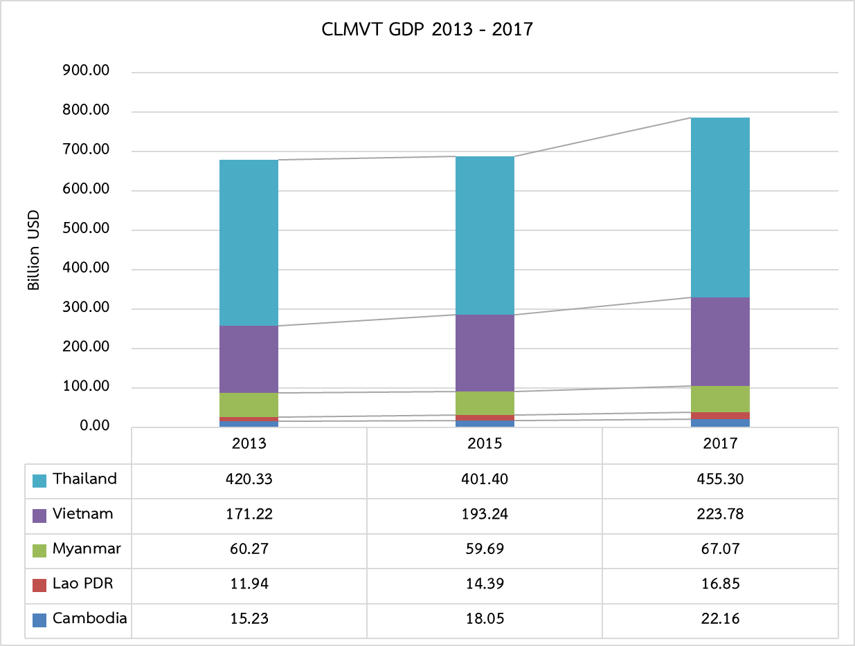
Region of Growth

Slide 5
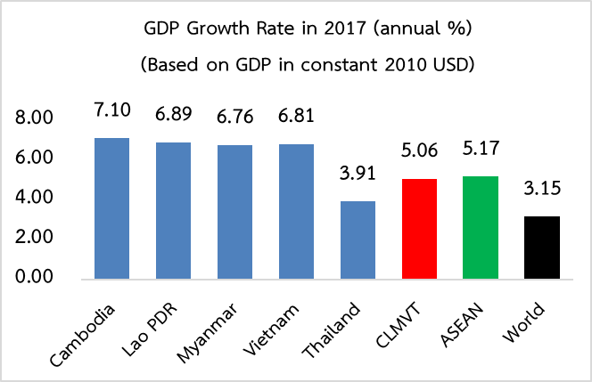
Data: World Bank (Retrieved on 25 May 2019)

Slide 6
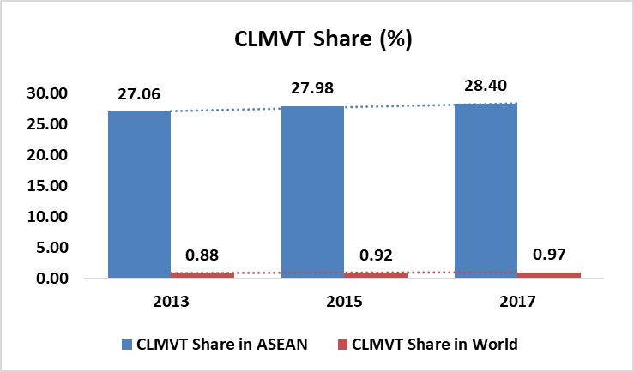

Slide 7
Region of Growth
 |  |  |  | Estimates | Projections
Country Name | 2013 | 2015 | 2017 | 2018e | 2019p | 2020p | 2021p
Cambodia | 7.36 | 7.04 | 7.10 | 7.1 | 6.8 | 6.8 | 6.7
Lao PDR | 8.03 | 7.27 | 6.89 | 6.5 | 6.6 | 6.7 | 6.6
Myanmar | 8.43 | 6.99 | 6.76 | 6.2 | 6.5 | 6.6 | 6.8
Vietnam | 5.42 | 6.68 | 6.81 | 6.8 | 6.6 | 6.5 | 6.5
Thailand | 2.69 | 3.02 | 3.91 | 4.1 | 3.8 | 3.9 | 3.9
World | 2.65 | 2.86 | 3.15 | 3.0 | 2.9 | 2.8 | 2.8
Data: World Bank (Retrieved on 25 May 2019)

Slide 8
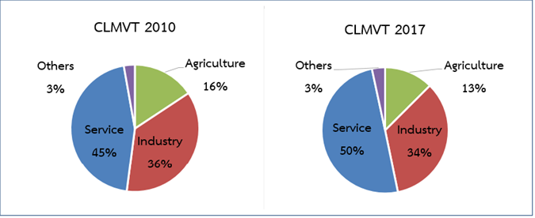
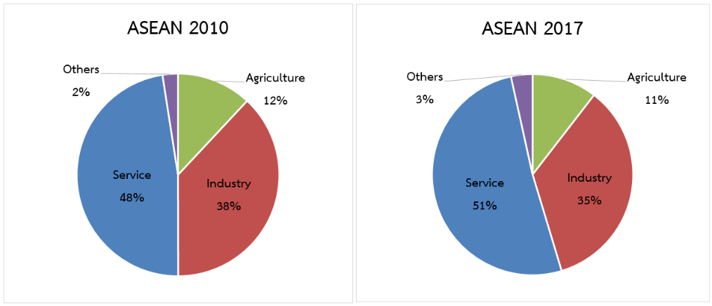
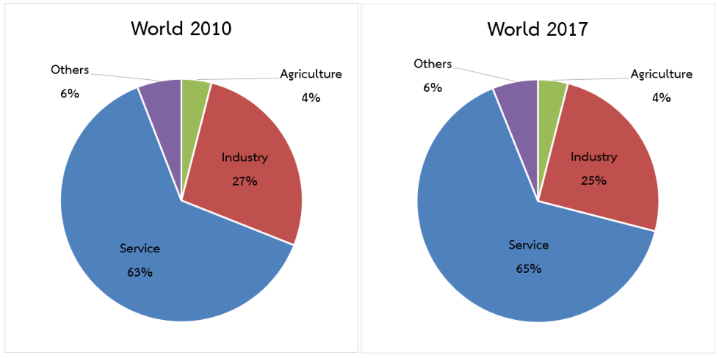
CLMVT economic structure
Data: World Bank (Retrieved on 25 May 2019)

Slide 9
Population and Labor Force in 2017
Country / Region | Population (Million) | Labor Force (Million) | % of Labor Force to Population
Cambodia | 16.01 | 8.91 | 55.65
Lao PDR | 6.86 | 3.60 | 52.42
Myanmar | 53.37 | 24.32 | 45.57
Vietnam | 95.54 | 56.97 | 59.62
Thailand | 69.04 | 38.70 | 56.05
CLMVT | 240.81 | 132.48 | 55.02
Brunei Darussalam | 0.43 | 0.22 | 50.34
Indonesia | 263.99 | 128.81 | 48.79
Malaysia | 31.62 | 15.42 | 48.74
Philippines | 104.92 | 42.80 | 40.79
Singapore | 5.61 | 3.27 | 58.21
ASEAN | 647.39 | 322.99 | 49.89
World | 7,529.72 | 3,432.00 | 45.58
% of CLMVT Share in ASEAN | 37.20 | 41.02
%of CLMVT Share in World | 3.20 | 3.86
Data: World Bank (Retrieved on 25 May 2019)

Slide 10





ที่มา : ASEANStatsDataPortal

Slide 11


ที่มา : ASEANStatsDataPortal

Slide 12
ที่มา : ASEANStatsDataPortal

Slide 13
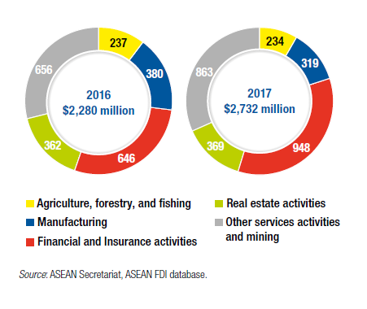
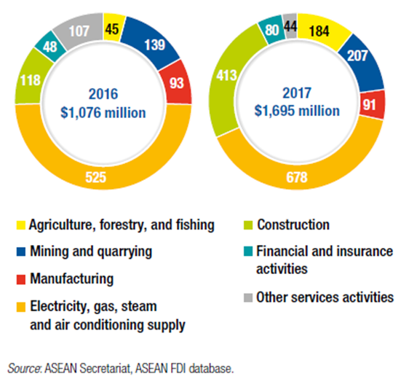
FDI in CLmvt
Cambodia: ASEAN and China account for 45% of total FDI (finance, insurance, real estate and manufacture)
Laos: China is major investor accounting for 78% of total FDI (infrastructure and energy)

Slide 14
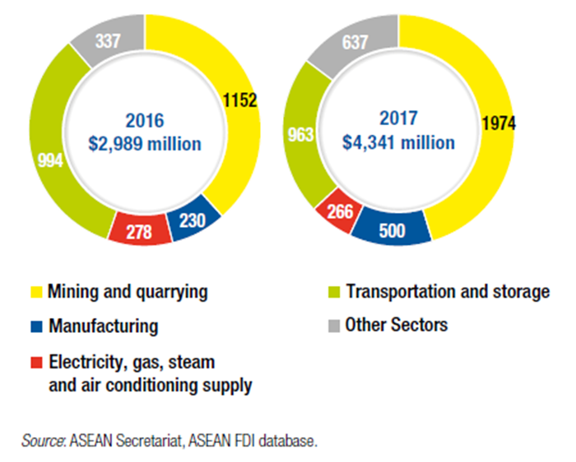
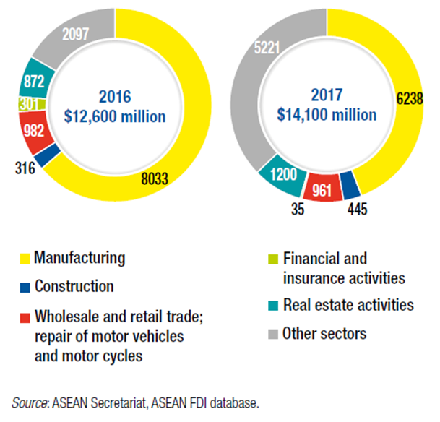
FDI In clmvt
Myanmar: South Korea is largest investor accounting for 48% of total FDI (mining, transportation and warehouse, manufacture.
Vietnam: Japan, South Korea and ASEAN are key investor account for 67% of total FDI (manufacture)

Slide 15
Fdi in thailand
Japan and ASEAN are key investors in Thailand (finance, insurance, real estate and manufacture.

Slide 16
New fdi trends
Model (JV & MA)
No employment
Whole supply chain
Government policy and support
Demand for high tech HR

Slide 17
Key forums
GMS: Greater Mekong Sub-region
Mekong-Lancang
Mekong-Japan
Mekong-Korea
ACMECS: Ayeyawady – Chao Phraya – Mekong Economic Cooperation Strategy

Slide 18

Issues for cooperation
Security issues
Economics
Social issues
Sustainable development

Slide 19
Future challenges
Geopolitical stability and regional relationships (US-TH, BREXIT, EU-VN FTA)
Governance challenges for business
New business models
Changing demographics
Inclusive growth and sustainable development
Regional digital economy
Economic integration

Slide 25


Slide 27
Thailand’s strategy
Strategic location
Infrastructure
Skilled labour
Political stability
Economic policies
Thailand 4.0
Digital Economy
10 S-Curve
Thailand plus one
Hub for R&D
Hub for regional HRD
EEC

Slide 28
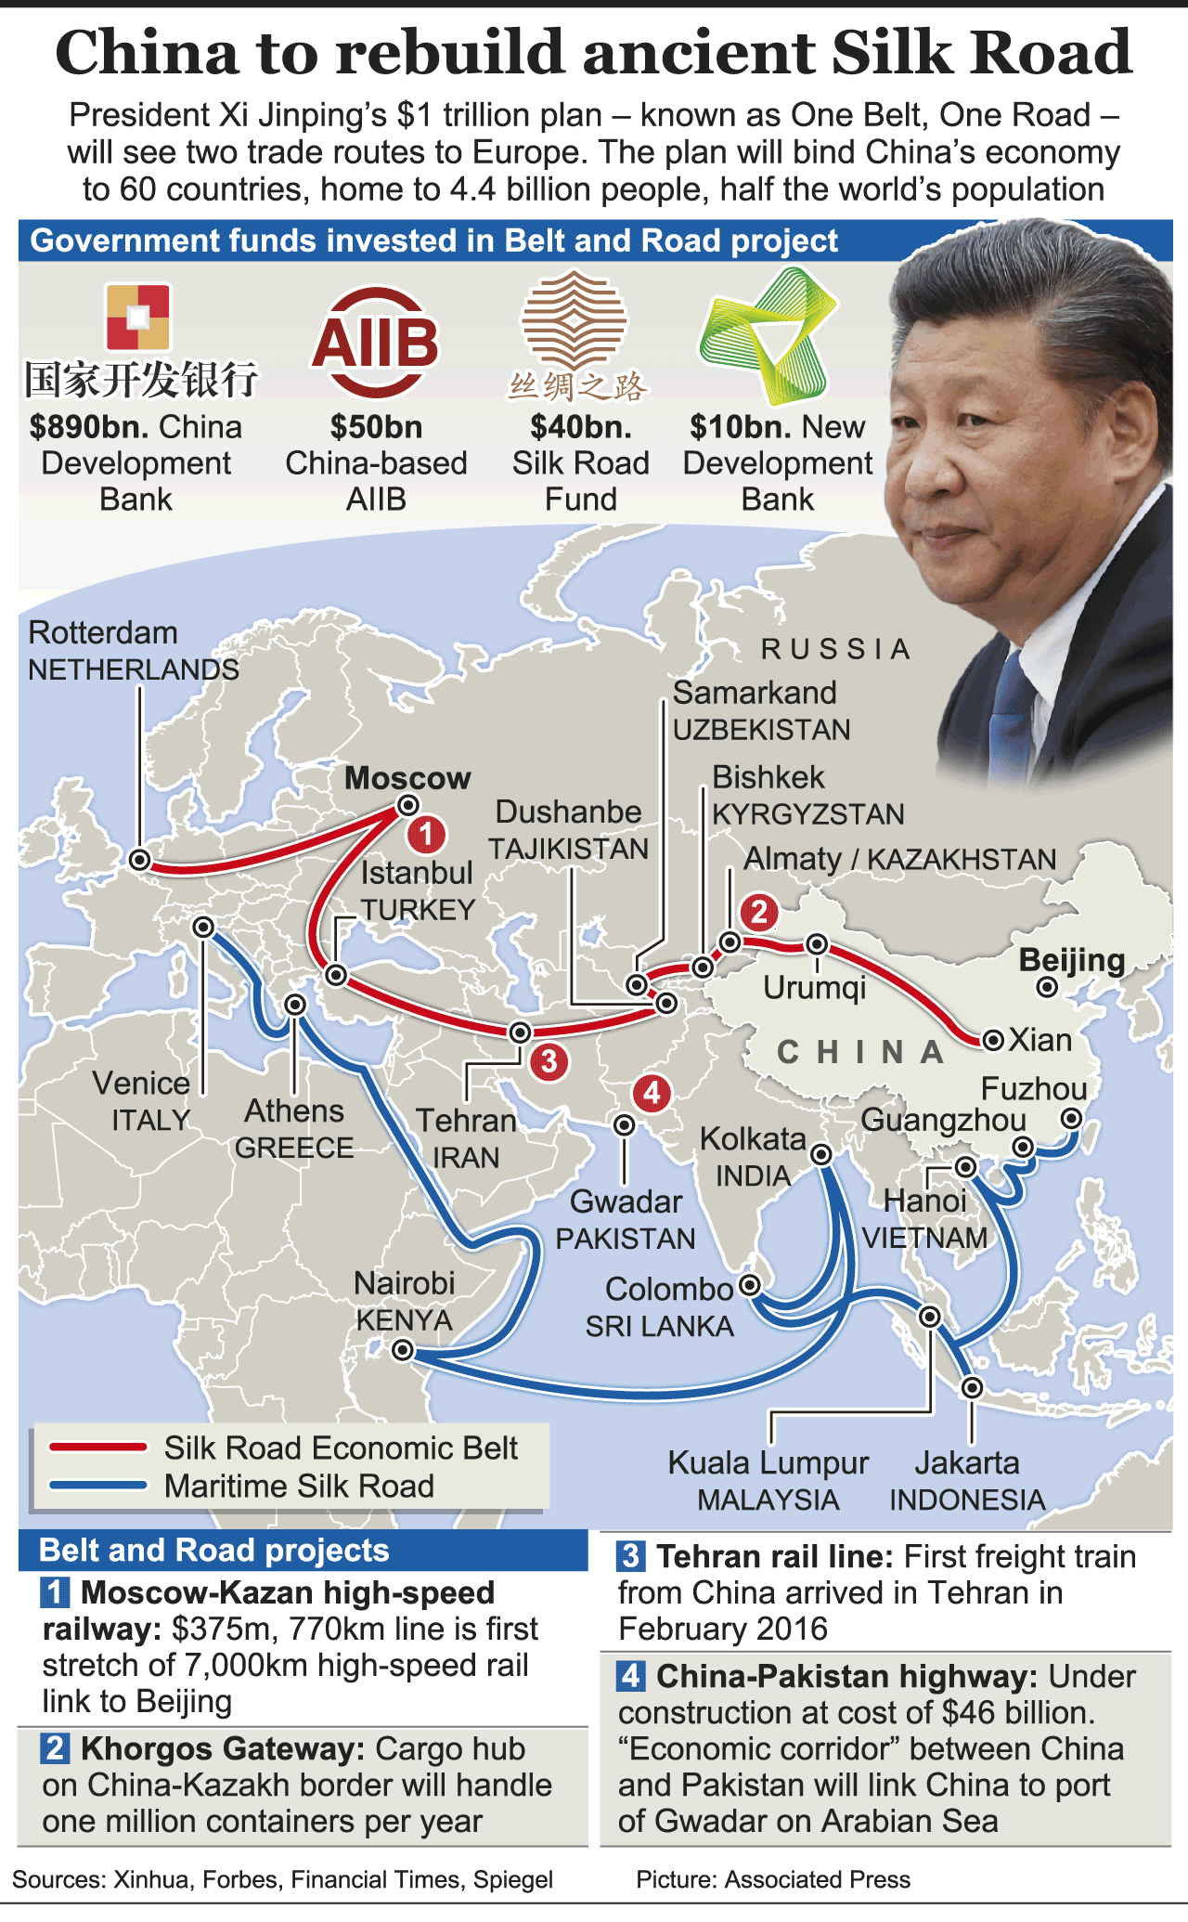
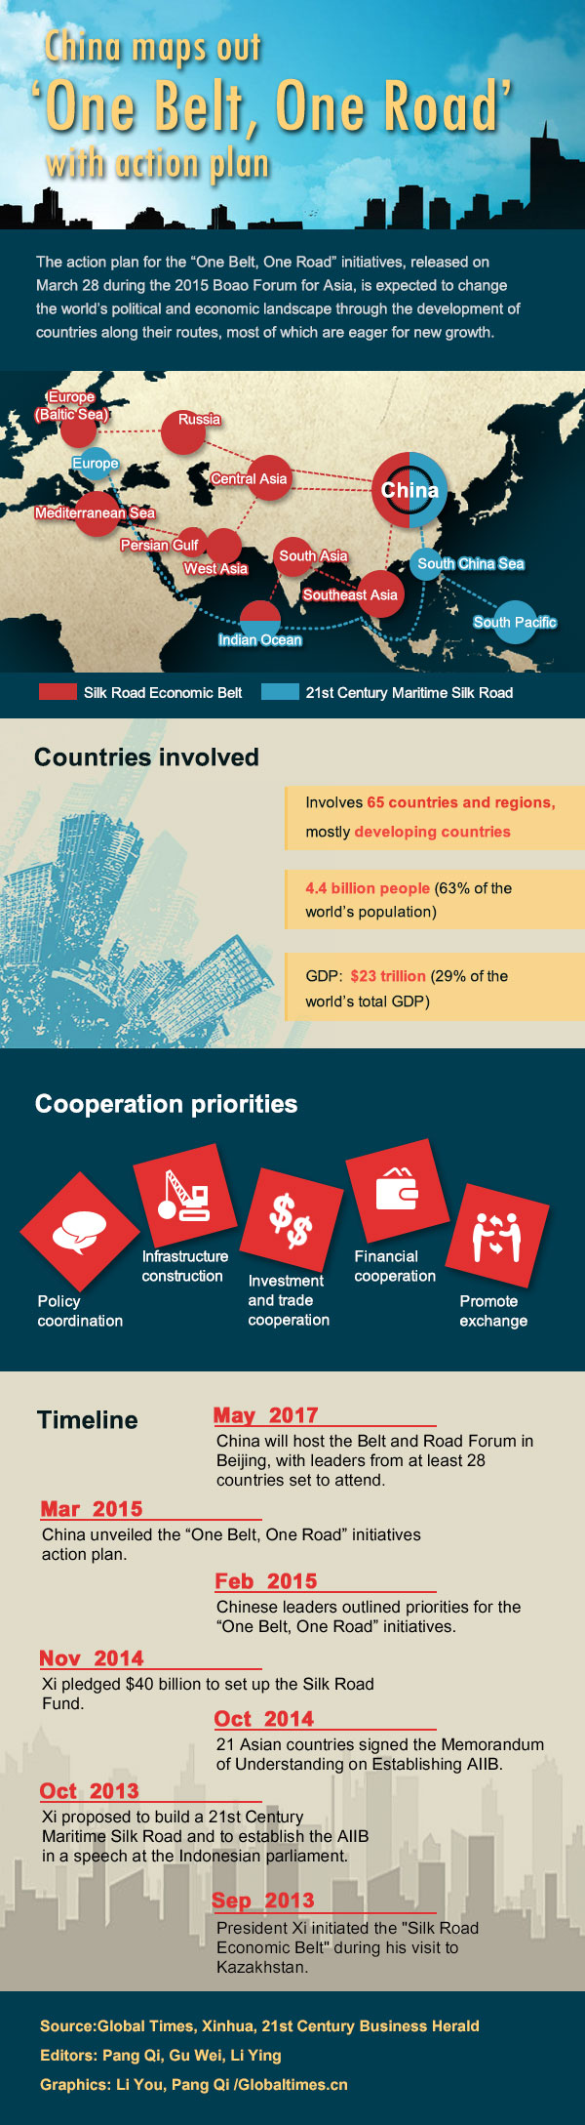

Slide 29
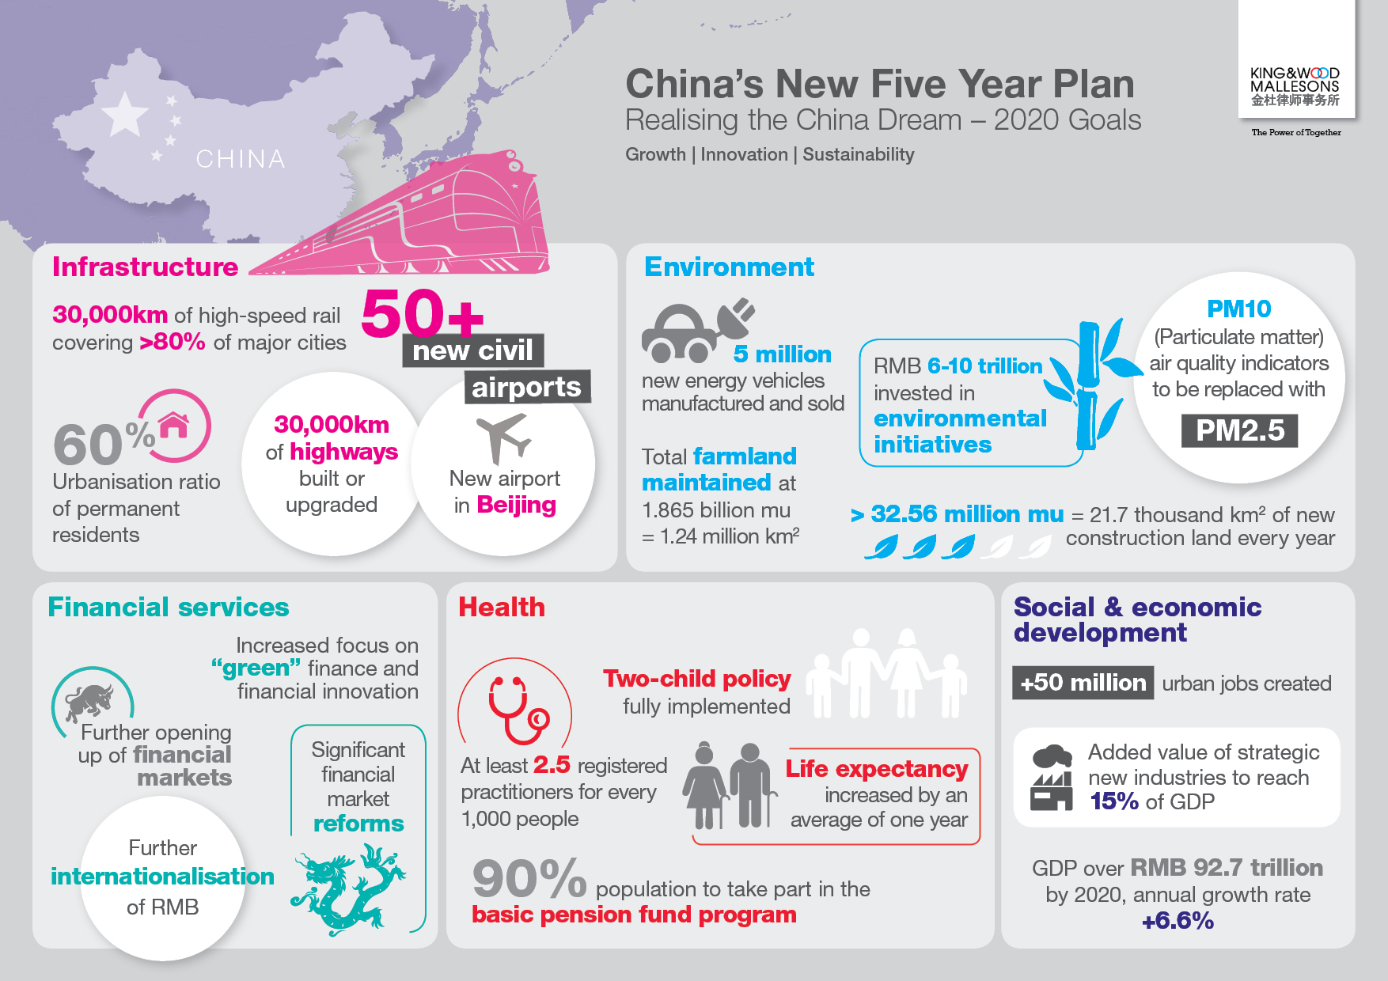

Slide 30
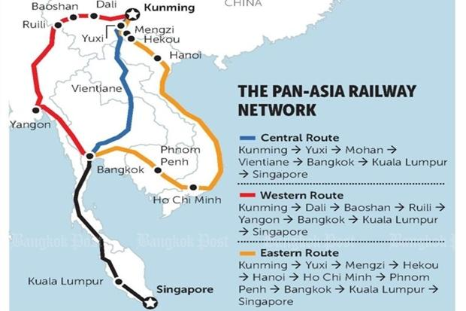
China: BRI
India: Act East
Japan: Indian Mkt.

Slide 31
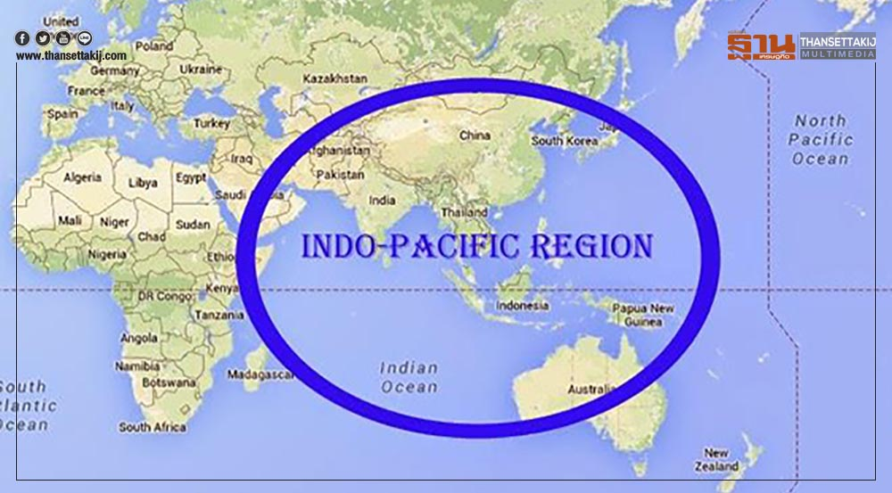

Slide 32
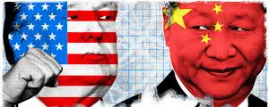
Pros and cons to thailand

Slide 33
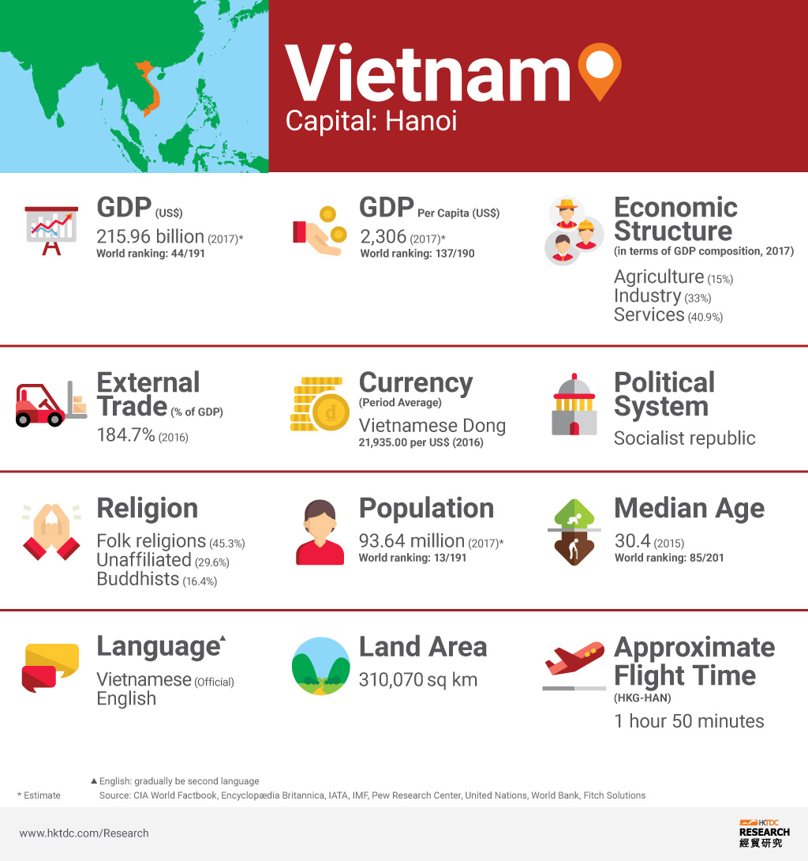
Viet nam as fdi destination
Political stability
Strong economic growth
Policy towards FTAs
STEs
Empowerment
BOI plus model

Slide 34

AEC Blueprint 2025
Master Plan on ASEAN Connectivity
E-ASEAN Framework Agreement

Slide 35

Digital ASEAN
Digital single market
Enabling e-commerce
Cross-border data flows
Building and enabling digital eco-system
Digital entrepreneurship
Digital human capital
Digital identity
Digital policy
Infrastructure and digital access
Digital infrastructure
Digital literacy

Slide 36
CLmv in negotiations
flexibility
Vietnam
LDCs
CLM
TA/CB
CLMV

Slide 37

Thank you
prew@moc.go.th
prewprae@gmail.com

