Slide 1
Bernard L. Madoff
FN323 presentation

Slide 2
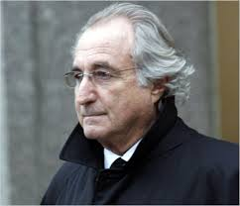
Profile
Name: Bernard Lawrence Madoff
Born: April 29, 1938 Queens, New York, US
Age: 75 year olds now

Slide 3
Profile
  Young Madoff showed no interest in finance during at first
  Madoff's interest was the school swim team. His coach hired him as lifeguard.
  After graduating from high school in 1956, Madoff headed to University of Alabama, where he stayed for one year before transferring to Hofstra University.
  In 1959, he married high school sweetheart Ruth, who was attending Queens College with a focus on finance.

Slide 4
Profile
  In 1960, Madoff earned his bachelor's degree in political science from Hofstra. Ruth also graduated, and landed a job on the stock market in Manhattan.
  Bernard began to study law at Brooklyn Law School.
  Using the $5,000 he earned from his summer lifeguarding job, Madoff and his wife founded Bernard L. Madoff Investment Securities LLC on Wall Street in 1960.

Slide 5
Achievement
  He served as the Chairman of the Board of Directors and on the Board of Governors of the NASD
  a self-regulatory securities industry organization in1984
  His company is one of the five most active companies in the development of Nasdaq.
  In 1990, Bernard Madoff served as president of the board of directors for the NASDAQ stock exchange.

Slide 6
Achievement
  Madoff was known as a philanthropist and business expert. He served on the boards of several nonprofits
  - including Robert I. Lappin Charitable Foundation
  - The PIcower Foundation the JEHT Foundation
  - He donated $6 million to lymphonma research
  He set up the Madoff Foundation, contributing to educational, cultural, and health charities.
  Madoff Securities was the sixth largest market maker on Wall Street in 2008.

Slide 7
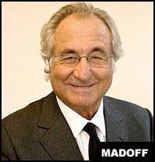
Former NASDAQ president
Philanthropist !!

Slide 8
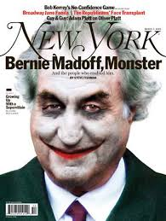

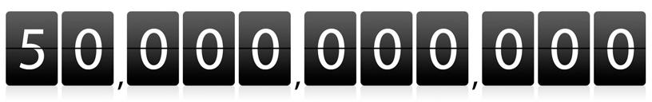
The LARGEST financial fraud in U.S. history

Slide 9

  Derivative-based hedge fund
  High and constant return (10-12%), even economic is in downturn
  People invest huge amount of money due to his reputation and goodness.

Slide 10
Bernard Madoff’s strategy
  He claimed that he use splite-strike or bull-spread strategy, but maybe something more complicate.
  “Even knowledgeable people can’t really tell you what he’s doing”
  But some one doubt that this high and constatnt return is impossible, it can be some illegal activity such as front run or ponzi scheme.

Slide 11
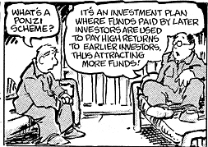
Ponzi Scheme

Slide 12

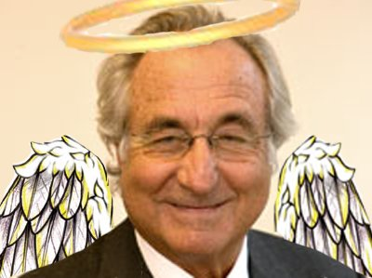
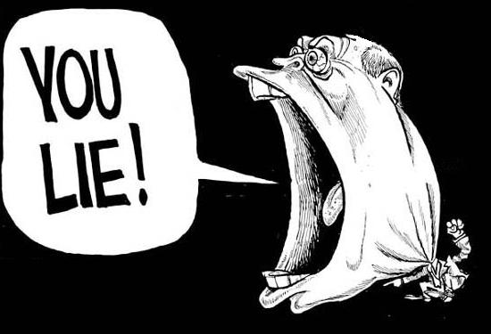
Why investor still invest with Madoff’s fund

Slide 13
He is a good marketer
  “Too complicated for outsiders to understand”
  “jewish circuit”, they trust madoff because he is Jewish.
  Refused to meet directly with investors, which gave him an “oz” aura and increased the allure of the investment.
  he select a new customers, which make them think that they are specially selected .

Slide 14
Reveal of ponzi scheme
  Reveal on 11 December, 2008
  Hambueher crisis, cash is an important
  $7 billion dollar withdrawal
  Ponzi scheme collapse, and every is just “a big lie”.
  17 years, 65 billion, some red flags

Slide 15

  Don’t have any financial regulator ?
  Don’t have any inspection ?

Slide 16
Securities and Exchange
Commission (SEC)
  Many investigations in 1999, 2000,2004,2005, and 2006
  The results were there is no enough evidence
  to prove that he committed fraud.

Slide 17
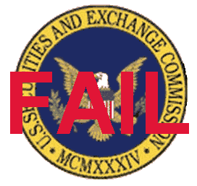
Why SEC CANNOT capture Bernard Madoff
  It is the failure of SEC itself

Slide 18
Madoff said he was “ASTONISHED" that the SEC's investigation hadn't exposed his fraud
  Third party that SEC did not check on it
  Fake account number (DTC account)
  Contradicted words he gave during the investigation

Slide 19
How he was ARRESTED?
December 2008, Bernard Madoff had to pay $7 billion, he discussed his dilemma with his sons.
Next 2 days, Bernard Madoff told his sons that he made huge profit and wants to give early bonus about $173 million.
His sons asked for the explanation and later on, the confession from Bernard Madoff took place hear. He told his son that he committed a “giant Ponzi scheme”.

Slide 20
How he was ARRESTED?
He finally got caught in December 2008. He was trapped after he confessed about his dishonesty to his very own sons.
His sons now reported his father’s fraud to the Federal Bureau of Investigation. Even though Bernie confessed that he committed a fraud in the 1990’s, but they believed that it started before that.

Slide 21
Harry Markopolos
  He is a Quantitative Analyst for a security firm.
  He is assigned to design a investment plan that generate
  high return as Bernard Madoff
  According to Markopolos, anyone who understood the underlying
  math of the markets would have known that they were impossible to create high and constant return even considered the market’s best condition.

Slide 22
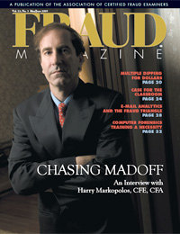
Harry Markopolos
  In 2001, 2005, 2007, and 2008, Markopolos alerted the U.S. Securities and Exchange Commission (SEC) of the fraud, but they ignored him. Eventually, In 2008, the stock market crumbled, investors rushed in to redeem their investments, and Madoff ran out of cash and turned himself in.

Slide 23

Harry Markopolos
  It took five minutes after reading his strategy paragraph to determine that he wasn’t really using the described strategy to earn the returns he said he was.
  Under existing securities law, if you tell clients that you are using Strategy A to invest their money but, in fact, you use an undisclosed Strategy B to really invest their money, you’ve committed fraud.

Slide 24
Harry Markopolos
  After admitting to operating the largest Ponzi scheme in history, Madoff was sentenced in 2009 to 150 years in prison. In 2010, Markopolos's book on uncovering the Madoff fraud was published, titled “ No One Would Listen: A True Financial Thriller” which show the incompetent of the financial regulator, SEC.

Slide 25
Nightmare Under Crisis
  In 2008, Hamburger crisis also occurred
  Happened from the failure of U.S. financial institution
  Careless control in credit management of the mortgage
  and the investment banker

Slide 26
Effect From Hamburger Crisis
  Most Financial Institution faced huge loss and bankrupt
  Lot of stocks were sold due to the panic of investors
  Stock market were close during this period
Notes:
Hamburger crisis affected US economy depression
People had big amount of debt due to the deflation effect around the world
It due to the lack of liquidity. Affect the stability on the most of financial institution

Slide 27
Effect From Madoff’s Collapses
  Widespread destruction of wealth
  Bankruptcies for weaker and smaller banks
  Financial devastation
Notes:
พูดเริ่ม : with the already occurred of Hamburger crisis. Combine with the collapse of Madoff secrurity fund. It became a big loss to whom invested
in Madoff fund.
Madoff’s emergence reveals another dimension of danger to already shaken global financial markets.
It due to the lack of liquidity. Affect the stability on the most of financial institution

Slide 28

How Severe?

Slide 29
Top 10 investors
In Madoff’s Securities
Madoff investors | Investor type | Potential Exposure
Fairfield Greenwich Group | US investment firm | $7.5 billion
Grupo Santander | Spanish bank | $3.5 billion
Kingate Management | Bermuda hedge fund | $3.5 billion
Rye Investment Management (Tremont Group) | US hedge fund | $3.1 billion
Bank Medici of Austria | Austrian bank | $2.8 billion
Ascot Partners | US hedge fund | $1.8 billion
Access International Advisors | US hedge fund | $1.4 billion
Fortis Bank Nederland | Dutch bank | $1.35 billion
Thema Fund | Irish hedge fund | $1.1 billion
HSBC | British bank | $1 billion

Slide 30
Part of Recover After Fraud
  Irving Picard, the trustee in charge of liquidating Madoff’s investment firm, Bernard L. Madoff Investment Securities, has sent victims of the scam another $2.48 billion in recovered funds
  About 44% of Madoff’s customers will ultimately be fully compensated for the losses.
Notes:
Research from the news that wrote on September last year
Investors who lost money in the Ponzi scheme perpetrated by Bernard Madoff will get some more money back.

Slide 31

Suggestion
  Company visit

Slide 32

Suggestion
  Diversification (don’t put all eggs in one basket)

Slide 33

Suggestion
  Quantitative analysis

Slide 34
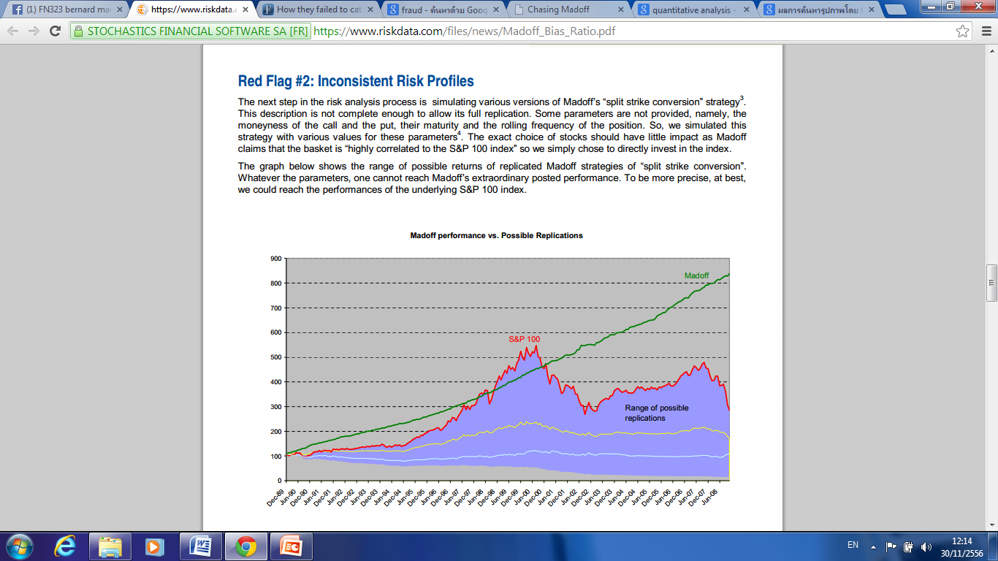
Suggestion
  Quantitative analysis

