Slide 1

EE390
Economics of Agricultural and Rural Development
Lecture 1: Introduction
Kiatanantha Lounkaew
Email: klounkaew@econ.tu.ac.th
Line: k_lounkaew
ที่มาของรูป https://www.hexagongeospatial.com/industries/natural-resources/agriculture

Slide 2

Care for a talk?
Let’s get familiar.

Slide 3


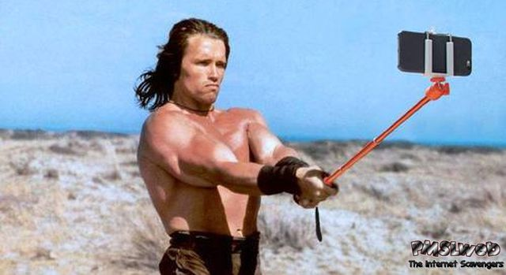

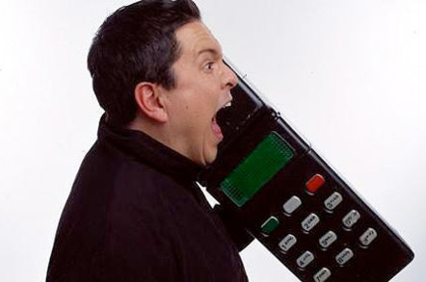
First things first
Midterm: 30%
Final: 40%
Quizes: 20%
Group works: 10%
Enrollment key: 7047
Selfie is OK
Phone is OK
Chat is OK

Slide 4
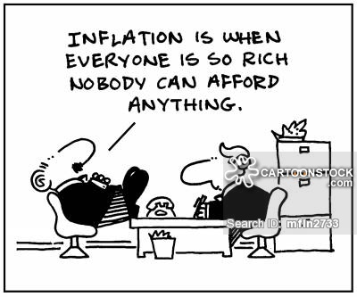
Why?

Slide 5
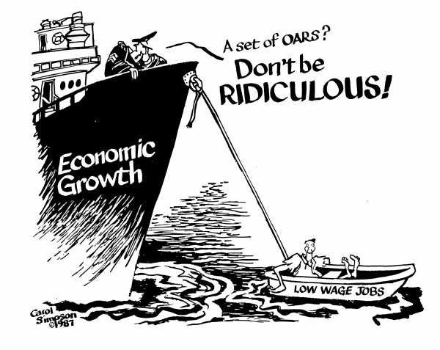
What does the captain mean?

Slide 6
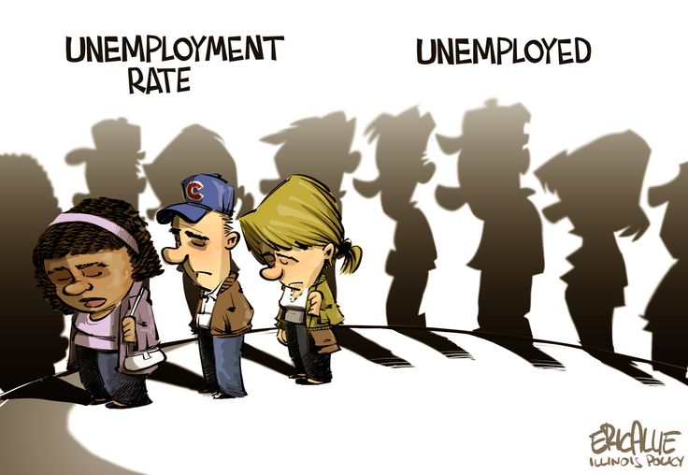
Any words on this?

Slide 7
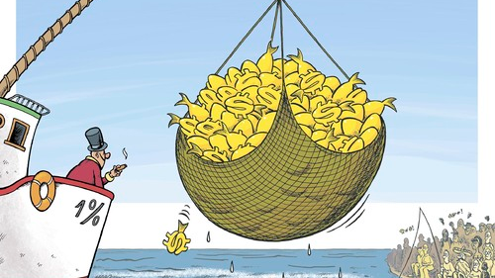
What does this picture says?

Slide 8
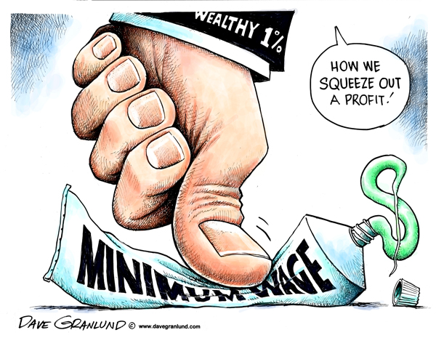
What is the implication of this?

Slide 9
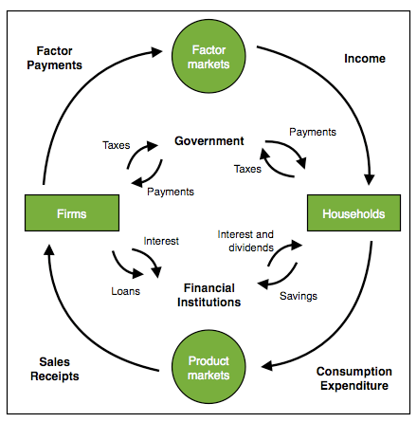

Slide 10

Choose three pictures to best capture what you think are the key features of rural communities

