Slide 1

D
BA 291 – Strategic Management
by Parichat Jantori

Slide 2
If you know your enemies and know yourself, you will not be imperiled in a hundred battles; if you do not know your enemies but do know yourself, you will win one and lose one; if you do not know your enemies nor yourself, you will be imperiled in every single battle
Sun Tzu, The Art of War

Slide 3

Strategic Management
The set of decisions and actions used to formulate and implement strategies that will be provide a competitively superior fit between the organization and its environment so as to achieve organizational goals
Notes:
Where is the organization now?
Where does the organization want to be?
What changes are among competitors?
What courses of action will help us achieve our goals?

Slide 4

Strategy
Strategy is a plan of action that prescribes resource allocation and other activities for dealing with the environment, achieving a competitive advantage, that help the organization attain its goals
Where is the business trying to get to?
In which market should business compete?
How to perform better than competitor?
Which resources are required?
What are the expectations of customers and stakeholders?

Slide 5

Exploit Core competencies
Core competence: the singular capability among a portfolio of capabilities that can lend the company a distinctive and sustainable competitive advantage. A core competence is something a company does especially well in comparison to its competitors.
A core competence should be:
Valuable
Rare
Difficult to imitate

Slide 6

Build Synergy
Synergy: The condition that exists when the organization‘s parts interact to produce a joint effect that is greater than the sum of the parts acting alone

Slide 7

Creating Value
Delivering value to the customer is at the heart of the strategy
Value can be defined as the combination of benefits received and cost paid.
Choose the right business model, which is a strategic design for how a company intends to profits from its strategies, work processes and activities.

Slide 8
The Strategic Management Process
External environment analysis
Identify organization’s mission, vision and goals
SWOT Analysis
Strategy formulation and implementation
Strategic control
Internal environment analysis

Slide 9
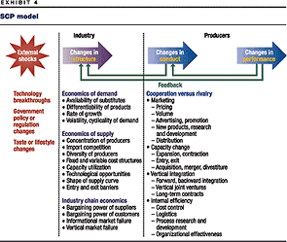
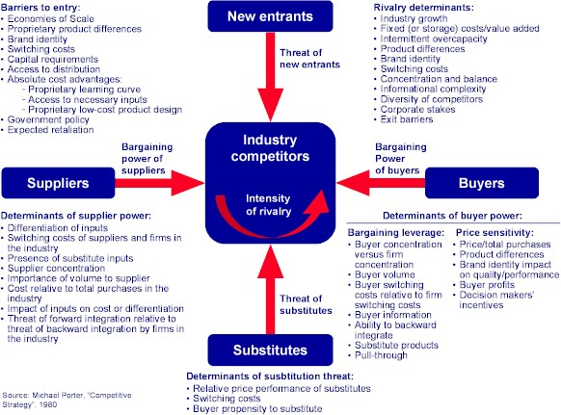
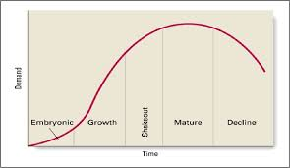
Industry Analysis
Notes:
PESTEL, Environmental, chance & risk analysis

Slide 10
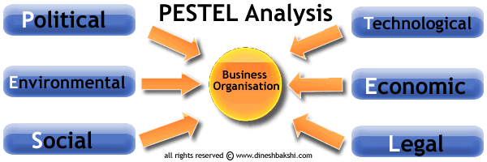
Macro Environment Analysis

Slide 11
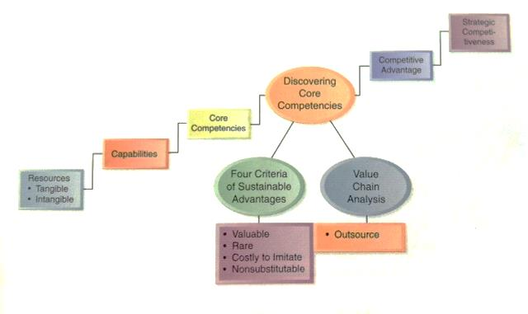
Internal Analysis

Slide 12
Analysis Firm’s Resources
Tangible resources
Financial resources
The firm’s borrowing capacity
The firm’s ability to generate internal funds
Organizational resources
The firm’s formal reporting structure and its formal planning, controlling and coordination systems
Physical resources
Sophistication and location of a firm’s plant and equipment
Access to raw material
Technological resources
- Stock of technology, such as patents, trademarks, copyrights and trade secrets
Intangible resources
Human resources
Knowledge
Trust
Managerial capabilities
Organizational routines
Innovation resources
Ideas
Capacity to innovate
Reputational resources
Reputation with customers
Brand name
Perception of product quality, durability and reliability
Reputation with suppliers

Slide 13
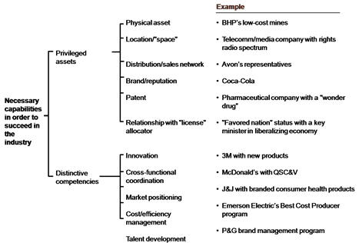
Analysis Firm’s Capabilities

Slide 14
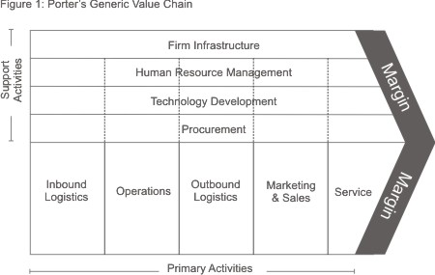
Value Chain Analysis

Slide 15


Strategy tools

Slide 16
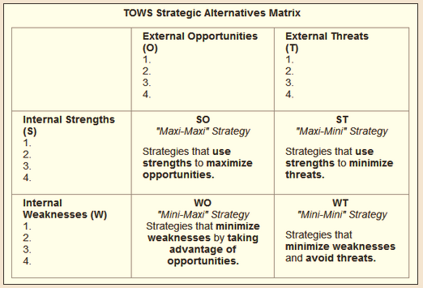
Strategy tools
TOWS Matrix
ที่มา: http://www.mindtools.com

Slide 17
Types of organizational strategies
Corporate-Level Strategy:
What business are we in?
Corporation
Business-Level Strategy:
How do we compete?
Textiles Unit
Chemicals Unit
Auto Parts Unit
Functional-Level Strategy:
How do we support the business-level strategy?
Finance
R&D
Manufacturing
Marketing

Slide 18
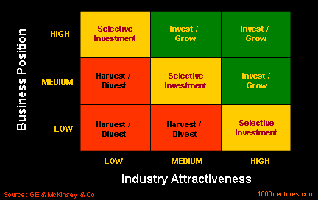
Grand corporate strategy
Notes:
Growth, stability, renewal

Slide 19
Horizontal Integration
When a firm’s long-term strategy is based on growth through the acquisition of one or more similar firms operating at the same stage of the production-marketing chain, its grand strategy is called horizontal integration
Such acquisitions eliminate competitors and provide the acquiring firm with access to new markets

Slide 20
Vertical Integration
When a firm’s grand strategy is to acquire firms that supply it with inputs (such as raw materials) or are customers for its outputs (such as warehouses for finished products), vertical integration is involved
The main reason for backward integration is the desire to increase the dependability of the supply or quality of the raw materials used as production inputs

Slide 21
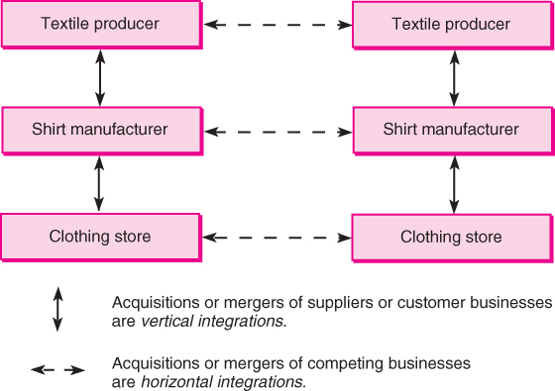
Vertical and Horizontal Integration

Slide 22
Concentric Diversification
Concentric diversification involves the acquisition of businesses that are related to the acquiring firm in terms of technology, markets, or products
With this grand strategy, the selected new businesses possess a high degree of compatibility with the firm’s current businesses
The ideal concentric diversification occurs when the combined company profits increase the strengths and opportunities and decrease the weaknesses and exposure to risk

Slide 23
Conglomerate Diversification
Occasionally a firm, particularly a very large one, plans acquire a business because it represents the most promising investment opportunity available. This grand strategy is commonly known as conglomerate diversification.
The principal concern of the acquiring firm is the profit pattern of the venture
Unlike concentric diversification, conglomerate diversification gives little concern to creating product-market synergy with existing businesses

Slide 24
Turnaround
The firm finds itself with declining profits
Among the reasons are economic recessions, production inefficiencies, and innovative breakthroughs by competitors
Strategic managers often believe the firm can survive and eventually recover if a concerted effort is made over a period of a few years to fortify its distinctive competences. This is turnaround.
Two forms of retrenchment:
  Cost reduction
  Asset reduction

Slide 25
Divestiture
A divestiture strategy involves the sale of a firm or a major component of a firm
When retrenchment fails to accomplish the desired turnaround, or when a nonintegrated business activity achieves an unusually high market value, strategic managers often decide to sell the firm
Reasons for divestiture vary

Slide 26
Bankruptcy
Liquidation bankruptcy—agreeing to a complete distribution of firm assets to creditors, most of whom receive a small fraction of the amount they are owed
Reorganization bankruptcy—the managers believe the firm can remain viable through reorganization
Two notable types of bankruptcy
  Chapter 7
  Chapter 11

Slide 27
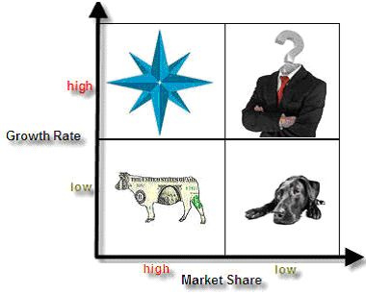
Corporate portfolio analysis
Portfolio strategy: The organization‘s mix of strategic business units and product lines that fit together in such a way as to provide the corporation with synergy and competitive advantage
Notes:
http://www.brandage.com/Modules/DesktopModules/Article/ArticleDetail.aspx?tabID=7&ArticleID=5997&ModuleID=701&GroupID=1388

Slide 28
Example: General Electric (GE)
GE has been reshuffling the corporation‘s mix of business in a way that will give GE a better position in the long run. GE is investing heavily in its stars and question marks to ensure that its portfolio will continue to include cash cows in a future that might be very different from today‘s world.
What are stars, question mark, cash cow? What do you think?

Slide 29
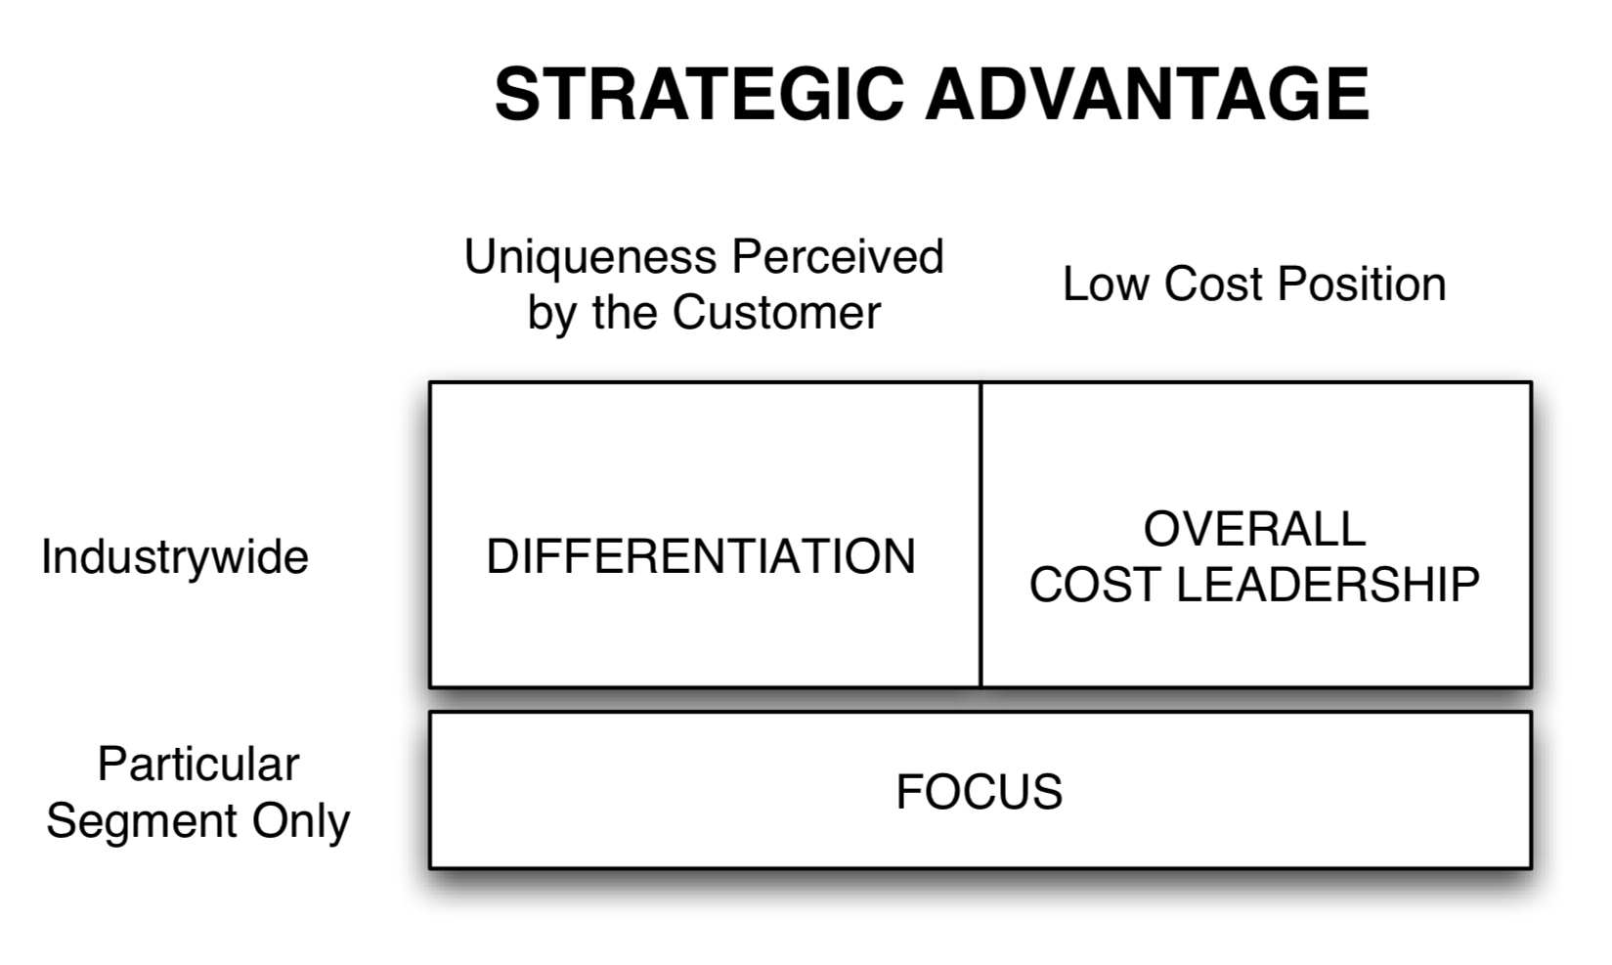
Business Level Strategy

Slide 30
Cost leadership
An integrated set of actions designed to produce or deliver goods or services at the lowest cost relative to competitors.
Cost saving actions required by this strategy:
building efficient facilities, lower waste in manufacturing process
tightly controlling production costs and overhead
minimizing costs of sales, R&D and service
monitoring costs of activities provided by outsiders
simplifying production processes (mass production, mass customization) – economies of scale

Slide 31




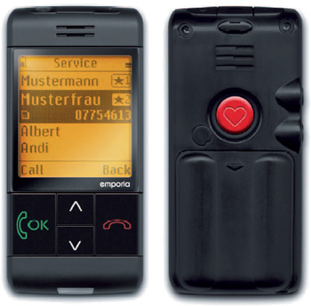
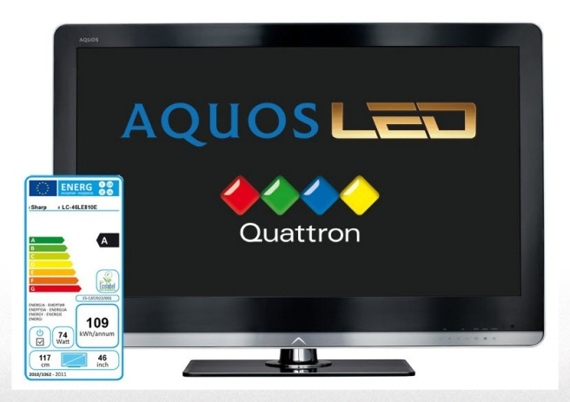
Differentiation
The attempt to distinguish products or services from that of competitors
(think “out of the box”)
Notes:
ตัวอย่าง US post จะล้มละลาย
Unique taste
Krispy Kreme
Unique design
Porsche Design, LV bag, Cartier, Mini
Multiple features
Microsoft Windows and Office
Wide selection and one-stop shopping
Home Depot and Amazon.com, Department store
Reliable, superior service
FedEx, the oriental hotel, Thai airways
Spare parts availability
Japanese car
High technology
Internet TV, Audi

Slide 32
Focus strategy
A focus strategy must exploit a narrow target’s differences from the balance of the industry by:
isolating a particular buyer group
isolating a unique segment of a product line
concentrating on a particular geographic market
finding their “niche”

Slide 33
Focus strategy
Factors driving focus strategy
Large firms overlook small niches
Firm may lack resources to compete in the broader market
May be able to serve a narrow market segment more effectively than can larger industry-wide competitors
Focus may allow the firm to direct resources to certain value chain activities to build competitive advantage

Slide 34

Functional Level Strategy
Functional –level strategies are the action plans adopted by major department to support execution of business level strategy.
- concerned with coordinating the functional areas of the organization (marketing, finance, human resources, production, research and development, etc.)

Slide 35
Strategy implementation
Strategy Implementation: stage of strategic management that involves the use of managerial and organizational tools to direct resources toward achieving strategic outcomes
Leadership
■ Persuasion  Motivation  Culture/values
Organization
Structural Design  Organization Chart  Teams  Centralization
Decentralization,
Facilities, task design
Human Resources  Recruitment/selection  Transfers/promotions
■ Training
■ Layoffs/recalls
Strategy
Performance
Information and Control Systems
■ Pay, reward system  Budget allocations  Information systems  Rules/procedures

