Slide 1
Personal Finance
Class 1: Planning Your Personal Finances
Personal finance basics and time value of money. Financial aspects of career planning.

Slide 2
The Financial Planning Process
What is Personal Financial Planning? …..
The process of managing your money to achieve
personal economic satisfaction

Slide 3
The Financial Planning Process
Advantages of Personal Financial Planning are:
Increased effectiveness in obtaining, using,
and protecting financial resources
Increased control of one’s financial affairs
Improved personal relationships
Sense of freedom from financial worries

Slide 4
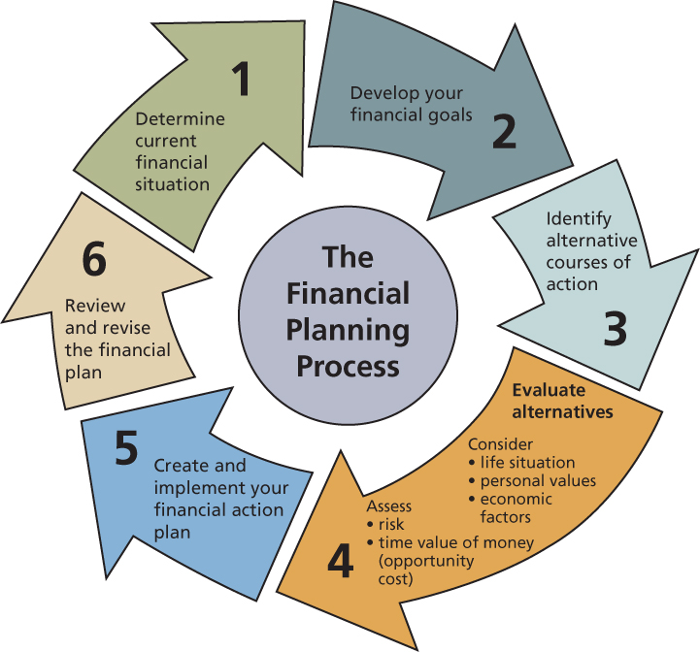
Six Steps in the
Financial Planning Process

Slide 5
Six Steps in the
Financial Planning Process
Step 1:
DETERMINE YOUR CURRENT FINANCIAL SITUATION
Evaluate income, savings, living expenses, and debts
Prepare a list of current asset and debt balances and amount spent for various items
Match financial goals to current income and potential earning power

Slide 6
Six Steps in the
Financial Planning Process
  Step 2:
  DEVELOP YOUR FINANCIAL GOALS
Identify feelings about money and the reasons for those feelings
Determine the source of your feelings about money
Determine the effects of the economy on your goals and priorities
Make sure that your goals are your own and are specific to your situation

Slide 7
Six Steps in the
Financial Planning Process
  Step 3:
  IDENTIFY ALTERNATIVE COURSES OF ACTION
Possible courses of action can be:
  Continue the same course of action
  Expand the current situation
  Change the current situation
  Take a new course of action

Slide 8
Six Steps in the
Financial Planning Process
  Step 3:
  IDENTIFY ALTERNATIVE COURSES OF ACTION (continued)
Creativity in decision making is vital to effective choices
“Do nothing” can be a dangerous alternative

Slide 9
Six Steps in the
Financial Planning Process
Step 4:
EVALUATE YOUR ALTERNATIVES
CONSEQUENCES OF CHOICES
  Opportunity cost
  What you give up when you make a choice
  The cost or trade-off of a decision cannot always be measured in dollars. Sometimes the cost is your time

Slide 10
Six Steps in the
Financial Planning Process
Step 4:
EVALUATE YOUR ALTERNATIVES
EVALUATING RISK
  Uncertainty is a part of every decision
  FINANCIAL PLANNING INFORMATION SOURCES
    Best way to analyze and minimize risk is to gather information from financial planning information sources

Slide 11
Six Steps in the
Financial Planning Process
Step 5:
CREATE AND IMPLEMENT YOUR FINANCIAL ACTION PLAN
  Develop an action plan that identifies ways to achieve financial goals
  Possible action plans can be increasing savings, reducing spending, or making provisions for taxes
  To implement action plans you may need assistance from others

Slide 12
Six Steps in the
Financial Planning Process
Step 6: REVIEW AND REVISE YOUR PLAN
Financial planning decisions need to be assessed regularly
Complete review should be done at least once a year
More frequent reviews may be required for changing personal, social, and economic factors
Regular reviews of decision-making process can help in making priority adjustments to achieve financial goals

Slide 13
Influences on Personal Financial Planning
LIFE SITUATION AND PERSONAL VALUES
Adult life cycle stage
Marital status, household size, and employment
Major events
  Graduation, engagement, career change, children, retirement, etc
Values influence spending and saving decisions

Slide 14
Influences on Personal Financial Planning
THE FINANCIAL SYSTEM (how money flows)
Providers of funds (savers and investors)
Financial Intermediaries
Financial Markets
Users of funds (borrowers and spenders)

Slide 15
Influences on Personal Financial Planning
ECONOMIC FACTORS
Forces of Supply and Demand on setting prices
Economics is the study of how wealth is created and distributed
The economic environment includes different institutions
Federal Reserve Bank and it’s role in the economy

Slide 16
Influences on Personal Financial Planning
GLOBAL INFLUENCES
Global marketplace influences financial activities
American companies compete against foreign companies for US dollars
Balance of exports and imports
Foreign investments and their role in the US Money Supply
The level of Money Supply affects interest rates

Slide 17
Influences on Personal Financial Planning
CHANGING ECONOMIC CONDITIONS
Consumer prices
Consumer spending
Interest rates
Money Supply
Unemployment
Housing Starts
Gross domestic product (GDP)
Trade balance
Stock market indexes

Slide 18
Influences on Personal Financial Planning
SELECT A PATH TO FINANCIAL SECURITY
Save for emergencies and the future
Maintain a low level of debt
Have a risk management plan
Avoid investment scams
Communicate with others

Slide 19
Developing Personal Financial Goals
TYPES OF FINANCIAL GOALS
a) Can be influenced by the time frame in which you want to achieve your goals

Slide 20
Developing Personal Financial Goals
TYPES OF FINANCIAL GOALS
b) Can be influenced by the financial need that drives your goals

Slide 21
Developing Personal Financial Goals
TYPES OF FINANCIAL GOALS
TIMING OF GOALS
  Short-term, intermediate, and long-term goals
  Long-term goals should be planned in coordination with short-term and intermediate goals
GOALS FOR DIFFERENT FINANCIAL NEEDS
  Consumable-product goals
  Durable-product goals
  Intangible-purchase goals

Slide 22
Developing Personal Financial Goals
GOAL-SETTING GUIDELINES
Goals should be SMART:
  Specific: know what your goals are to create a plan
  Measurable: with a specific amount
  Action-oriented: identify the personal financial activities
  Realistic: utilizing your income and life situation
  Time-based: identify the time frame to achieve the goal

Slide 23
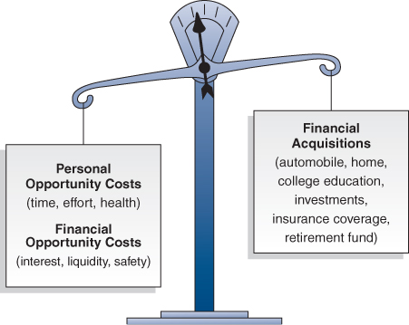
Opportunity Costs and the Time Value of Money

Slide 24
Opportunity Costs and the Time Value of Money
Every financial decision involves giving up something to obtain something else
PERSONAL OPPORTUNITY COSTS
Time
Other personal opportunity costs can be related to health, leisure etc.
Personal resources like financial resources require careful management

Slide 25
Opportunity Costs and the Time Value of Money
FINANCIAL OPPORTUNITY COSTS
  Time Value of Money
Increases in an amount of money as a result of interest earned
Saving today means more money tomorrow. Spending means lost interest
Saving and spending decisions involve considering the trade-offs. Current needs can make spending worthwhile

Slide 26
Opportunity Costs and the Time Value of Money
  Time Value of Money (continued)
INTEREST CALCULATIONS
    Three amounts are required to calculate the time value of money
  Principal (the amount of savings)
  Interest rate (annual)
  Time

Slide 27
Opportunity Costs and the Time Value of Money
  Time Value of Money (continued)
COMPUTING SIMPLE INTEREST
=Amount in savings x annual interest rate x time period
=interest amount
For Example:
=$100 x 5% x 1 (1 year)
=$100 x .05 x 1
=$5.00
In one year, you have $100 in principal plus $5.00 in interest for a total of $105 at the end of the year.

Slide 28
Opportunity Costs and the Time Value of Money
1) FUTURE VALUE OF A SINGLE AMOUNT
Future value is the amount to which current savings will increase based on a certain interest rate and a certain time period
Future value is also call compounding - earning interest on previously earned interest
2) FUTURE VALUE OF A SERIES OF DEPOSITS
Future value can be computed for a single amount or for a series of deposits called an annuity

Slide 29
Opportunity Costs and the Time Value of Money
3) PRESENT VALUE OF A SINGLE AMOUNT
Present Value is the current value of a future amount based on a certain interest rate and a certain time period
Present value calculations are also called discounting
The present value of the amount you want in the future will always be less than the future value
4) PRESENT VALUE OF A SERIES OF DEPOSITS
Present value can be computed for a single amount or for a series of deposits

Slide 30
Opportunity Costs and the Time Value of Money
METHODS FOR COMPUTING TIME VALUE OF MONEY
Formulas
Time value of money tables
Financial calculators
Spreadsheet software
Time value of money web sites

Slide 31
Career Choice Factors
TRADE-OFFS OF CAREER DECISIONS
Career choice alternatives have risks and opportunity costs
Career choices require periodic evaluation of trade-offs related to personal, social, and economic factors

Slide 32
Career Choice Factors
CAREER TRAINING AND SKILL DEVELOPMENT
Level of formal training affects financial success
Training may be viewed in two main categories:
  Technical Skills
    refers to specialized career training for a specific profession
  General Skills
    are traits adaptable to most work situations
    some can be acquired at school while others require experience

Slide 33
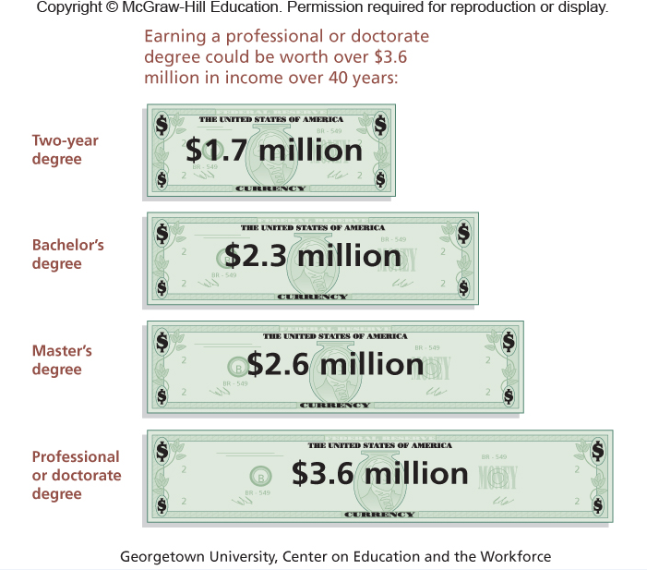
Career Choice Factors
Education and Income

Slide 34
Career Choice Factors
PERSONAL FACTORS
Aptitudes
Interests inventories
Your personality
Do you perform best in low-pressure or high-pressure working environments?
Personal SWOT analysis

Slide 35
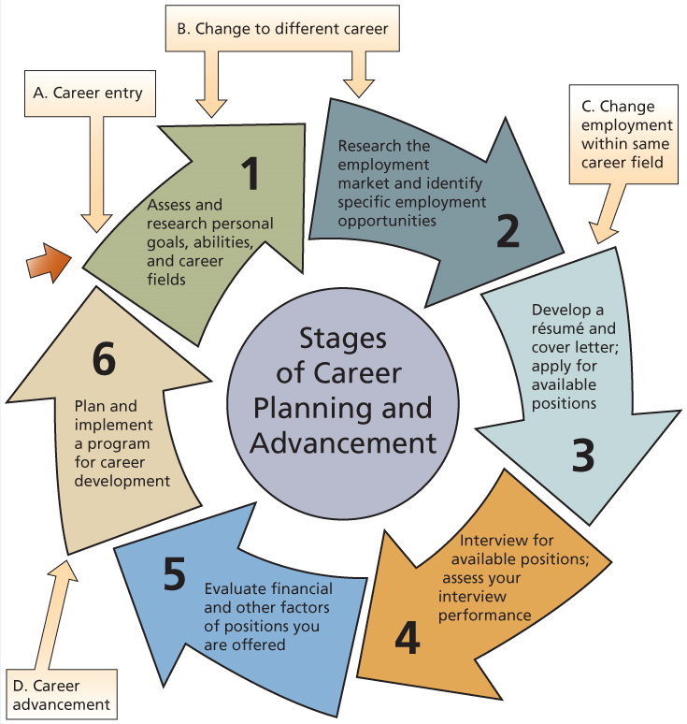
Career Choice Factors
CAREER DECISION MAKING

Slide 36
Career Opportunities
Now and in the Future
SOCIAL INFLUENCES
Demographic trends
Geographic trends
Where jobs are; salaries, and living costs
Working Parents | More food service and child care
Leisure time | More interest in health and recreation
Longer life spans | Demand for travel, health care, and retirement facilities
Employment training | Demand for teachers, trainers, and related careers

Slide 37
Career Opportunities
Now and in the Future
ECONOMIC CONDITIONS
Career Opportunities are affected by:
  High interest rates
  Price increases
  Decreased global demand for goods and services

Slide 38
Career Opportunities
Now and in the Future
INDUSTRY TRENDS
Service Industries
Greatest Employment Potential
Information technology
Health care and Medical technology
Environmental services
Business services
Social services
Sales and Retailing
Hospitality and Food services
Management and Human resources
Education
Financial services

Slide 39
Employment Search Strategies
OBTAINING EMPLOYMENT EXPERIENCE
Part-time employment | develop contacts
Volunteer work | develop organizational skills
Internships | experience helps obtain employment
Campus projects | obtain career skills

Slide 40
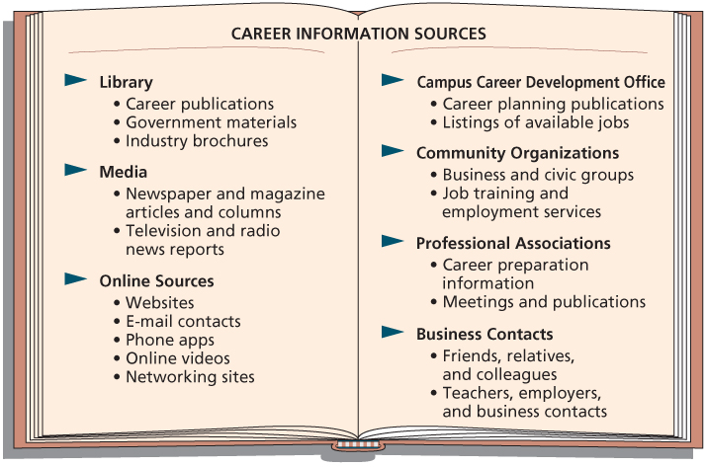
Employment Search Strategies
USING CAREER INFORMATION SOURCES

Slide 41
Employment Search Strategies
Career Development Office
Networking is the process of making and using contacts to obtain and update career information
main sources of networking:
  Community Organizations
  Professional Associations
  Business Contacts

Slide 42
Employment Search Strategies
Effective networking means:
  Preparing a 30-second summary of abilities
  Volunteering for committees and events of professional organizations
  Asking questions to get others to talk about themselves and their experiences

Slide 43
Employment Search Strategies
IDENTIFYING JOB OPPORTUNITIES
Job advertisements
Career fairs
Employment agencies
Job creation
Visit organizations
Internet searches
Be in contact with alumni in your field

Slide 44
Employment Search Strategies
APPLYING FOR EMPLOYMENT
Resume
Cover letter
Interview

Slide 45
Financial and Legal
Aspects of Employment
ACCEPTING AN EMPLOYMENT POSITION
Research the job and the company before
accepting an employment position
THE WORK ENVIRONMENT
  Corporate culture
  Company policies and procedures
FACTORS AFFECTING SALARY
  Education, training, company size, and salaries for comparable positions

Slide 46
Financial and Legal
Aspects of Employment
EVALUATING EMPLOYEE BENEFITS
  Nonsalary benefits include: child care, leaves of absence, and elder care
  Cafeteria-style benefits allow workers benefit credits that they can choose to meet their needs
  Flexible spending and medical-spending accounts
  Compare job offer benefits based on market value or future value
  YOUR EMPLOYMENT RIGHTS

Slide 47
Long-Term Career Development
A career can be for a lifetime
Skills and attitudes that can lead to a fulfilling work life:
  Communicate well with others
  Flexible and open to new ideas
  Develop efficient work habits
  Use lists, goal setting, and time management techniques
  Anticipate problems and areas for actions
  Creativity and a willingness to assist others

Slide 48
Long-Term Career Development
TRAINING OPPORTUNITIES
Continue to learn about new technology, diverse cultures, and the global economy
Formal methods for expanding knowledge:
  company programs, webinars, seminars, and college courses
Informal methods:
  reading and discussions with colleagues
  meetings with employees from other companies

Slide 49
Long-Term Career Development
CAREER PATHS AND ADVANCEMENT
Career choices must be evaluated in light of changing values, goals, and economic conditions
A mentor is an experienced employee who serves as a teacher and counselor for a less experienced person
  Mentors are attracted to those who show initiative
  Mentors should be receptive to assisting others, and help in both technical and social areas of their careers

Slide 50
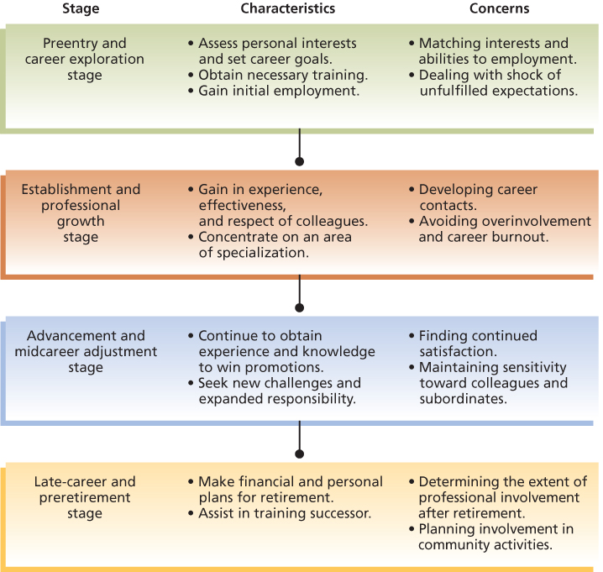
Stages of Career Development

Slide 51
Long-Term Career Development
CHANGING CAREERS
About 10 million career moves occur each year
Changing jobs can be more difficult than selecting the first job
Carefully assess the financial and personal costs and benefits of changing careers
Determine whether a career change will serve your needs and goals

Slide 52
Long-Term Career Development
  To cope with job termination while seeking new employment, you should:
    Maintain appropriate eating, sleep, and exercise habits
    Involve yourself in family and community activities
    Improve your skills through classes and volunteer work
    Target your search towards high growth industries
    Consider opportunities with non-profit organizations
    Target your skills to the needs of an organization

