Slide 1

BA 291 – Business ethics and social responsibility
By Aj. Parichat Jantori

Slide 2
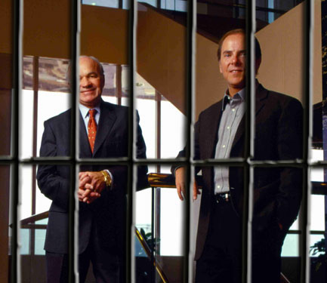
The Enron scandal
Enron Corporation is an energy trading, natural gas, and electric utilities company based in Texas. In just 15 years, Enron grew from nowhere to be America's seventh largest company, employing 21,000 staff in more than 40 countries.
Enron lied about its profits and stands accused of a range of shady dealings, including concealing debts so they didn't show up in the company's accounts.
As the depth of the deception unfolded, investors and creditors retreated, forcing the firm into Chapter 11 bankruptcy in December.
Notes:
Enron Corporation is an energy trading, natural gas, and electric utilities company based in Houston , Texas that employed around 21,000 people by mid-2001, before it went bankrupt.
http://clockworkaccounting.com/enron-scandal-summary/
http://www.investopedia.com/articles/stocks/09/enron-collapse.asp#axzz1X3VkwJsf

Slide 3
Ethics
Ethics is concerned with what is good for individuals and society and is also described as moral philosophy
Ethics covers the following dilemmas:
how to live a good life
our rights and responsibilities
the language of right and wrong
moral decisions - what is good and bad?
The concepts of ethics have been derived from religions, philosophies and cultures

Slide 4
Ethics
The person who participates in (Holy Battles) in Allah’s cause and nothing compels him do so except belief in Allah and His Apostle, will be recompensed by Allah either with a reward, or booty ( if he survives) or will be admitted to Paradise ( if he is killed). Al Bukhari vol 1:35
Notes:
http://en.wikipedia.org/wiki/Corporate_social_responsibility

Slide 5

Law
Law refers to a system of rules and guidelines, usually enforced through a set of institutions.
Laws are the forcible means by which a government achieves its goals. Laws contain sanctions for those who do not obey. Subsidies, fines, and imprisonment are examples of mechanisms that may be used as the forcible sanction of a law

Slide 6
Different between law and ethics
Ethics are rules of conduct. Laws are rules developed by governments in order to provide balance in society and protection to its citizens
Ethics comes from people’s awareness of what is right and wrong. Laws are enforced by governments to its people
A law is something you must obey. Ethics is how society expects you to behave
Laws carry with them a punishment for violations , ethics does not
Ethics comes from within a person’s moral sense and desire to preserve his self respect, laws does not
People obey the laws in order to avoid the consequences, people behave ethically because they believe, it is a good way to do so.

Slide 7

Many people believe that if you are not breaking the law, then you are behaving in an ethical manner.
Are they right?

Slide 8
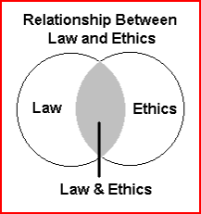
In some instances, law and ethics overlap and what is perceived as unethical is also illegal. In other situations, they do not overlap.

Slide 9
Decision making process
Identifying and diagnosing the problem
Generating alternative solution
Evaluating alternative
and making the choice
Implementation
Evaluating the decision

Slide 10
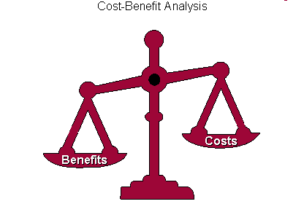
Factors influenced decision making
Benefits
Cost
Timeliness
Acceptability
What about ethical soundness?

Slide 11

An ethical dilemma is a situation that arises when all alternative choices or behaviors are deemed undesirable because of potentially negative consequences, making it difficult to distinguish right from wrong.

Slide 12
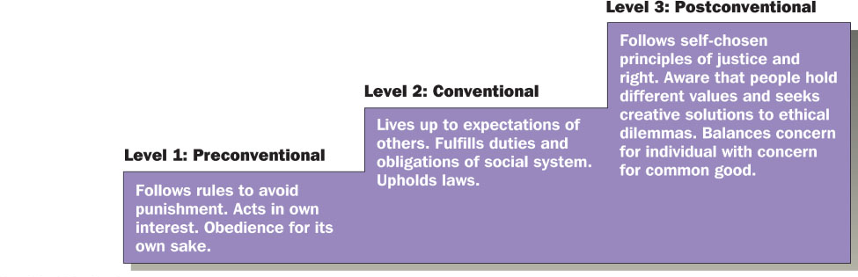
Levels of personal moral development

Slide 13
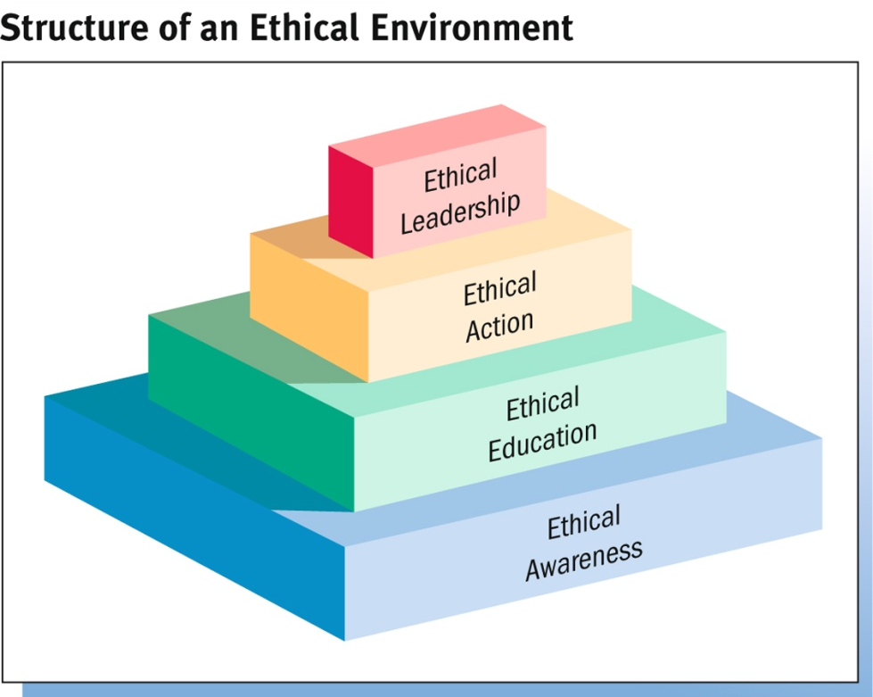
Building ethical environment
Ethical Awareness
Code of Conduct : Formal statement that defines how the organization expects and requires employees to resolve ethical questions
Ethical Education
Codes of conduct cannot detail a solution for every ethical situation, so corporations provide training in ethical reasoning.
Ethical Action
Helping employees recognize and reason through ethical problems and turning them into ethical actions.
Ethical Leadership
Executives must demonstrate ethical behavior in their actions.
Notes:
http://en.wikipedia.org/wiki/Corporate_social_responsibility

Slide 14
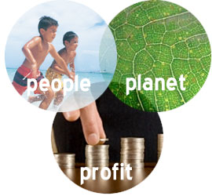
Corporate Social Responsibility
CSR – A concept whereby companies integrate social and environment concern in their business operations and in their interaction with their stakeholders on a voluntary basis.
"The idea is to balance the needs of people, the planet and the company's profits to create long-term share-holder value."

Slide 15
Triple bottom line
"People" pertains to fair and beneficial business practices toward labor and the community and region in which a corporation conducts its business.
"Planet" refers to sustainable environmental practices, do no harm and minimize environmental impact, reduces its ecological footprint, carefully managing its consumption of energy and non-renewables and reducing manufacturing waste
"Profit" is the economic value created by the organization after deducting the cost of all inputs.

Slide 16
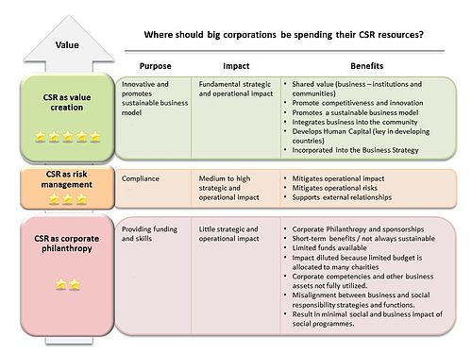
CSR approach
Strategic CSR
Responsive CSR
Philanthropy
Notes:
http://en.wikipedia.org/wiki/Corporate_social_responsibility

Slide 17
Benefits from CSR
Win new business
Increase customer retention
Develop and enhance relationships with customers, suppliers and networks
Attract, retain and maintain a happy workforce and be an Employer of Choice
Save money on energy and operating costs and manage risk
Differentiate yourself from your competitors
Generate innovation and learning and enhance your influence
Improve your business reputation and standing
Provide access to investment and funding opportunities
Generate positive publicity and media opportunities due to media interest in ethical business activities

Slide 18
Benefits from CSR
“88% of consumers said they were more likely to buy from a company that supports and engages in activities to improve society”
(UK Small Business Consortium)
“2,215 workers around the globe, found that employees are more likely to be “proud” of their company if it’s engaged in good corporate behavior”
“Employees are more likely to decide to work for companies that are environmentally responsible”
“Employees are more likely to accept lower pay or a small role in an organization with sound corporate reputation”
(Kelleyservices, 2010)
Notes:
http://www.kellyservices.com.sg/web/sg/services/en/pages/sociallyresponsible.html

Slide 19
Responsibilities to the General Public
Public Health Issues. What to do about inherently dangerous products such as alcohol, tobacco, vaccines, and steroids.
Protecting the Environment. Using resources efficiently, minimizing pollution.
Recycling. Reprocessing used materials for reuse.
Developing the Quality of the Workforce. Enhancing quality of the overall workforce through education and diversity initiatives.
Corporate Philanthropy. Cash contributions, donations of equipment and products, and supporting the volunteer efforts of company employees.

Slide 20
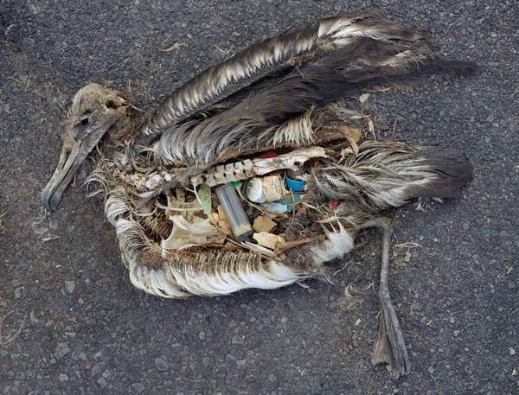
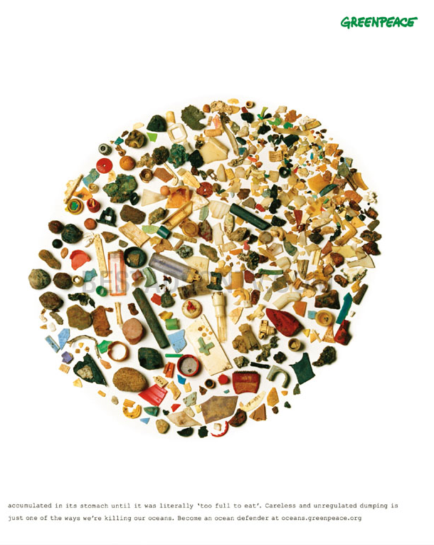
Notes:
http://en.wikipedia.org/wiki/Corporate_social_responsibility

Slide 21
Responsibilities to Customers
The Right to Be Safe. Safe operation of products, avoiding product liability.
The Right to Be Informed. Avoiding false or misleading advertising and providing effective customer service.
The Right to Choose. Ability of consumers to choose the products and services they want.
The Right to Be Heard. Ability of consumers to
express legitimate complaints to the appropriate parties.

Slide 22
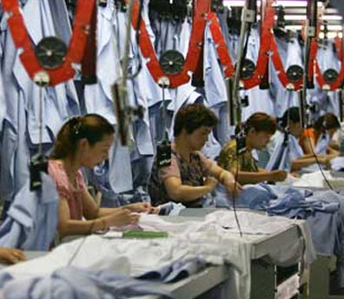
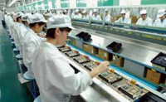
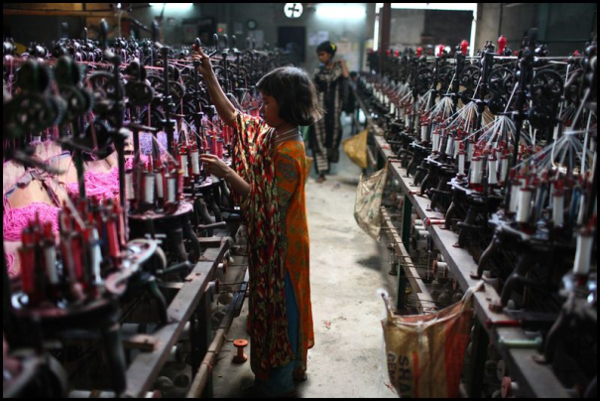
Responsibilities to Employees
Workplace Safety
Quality-of-Life Issues. Balancing work and family through flexible work schedules
Ensuring Equal Opportunity on the Job
Sexual Harassment and Sexism: Avoiding unwelcome actions of a sexual nature; equal pay for equal work without regard to gender.
Adequate compensation
Fair treatment
Notes:
http://www.economist.com/node/187886 sweatshop
Poor Working condition, child labor
Example: Foxcom, Francetelecom

Slide 23
Responsibilities to Investors
Obligation to make profits for shareholders.
Expectation of ethical and moral behavior.
Investors protected

Slide 24
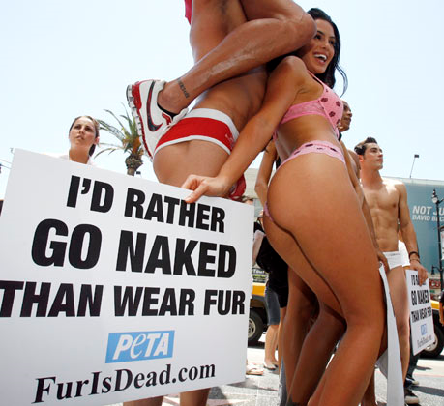

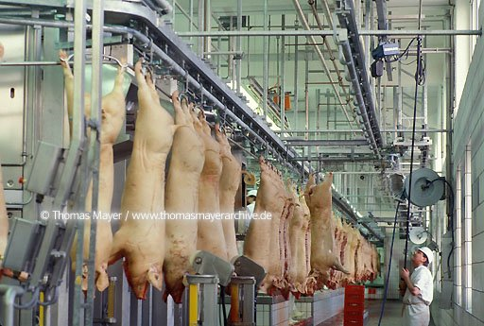
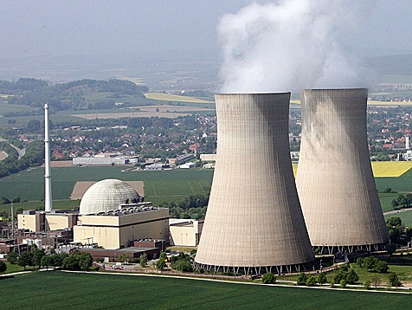
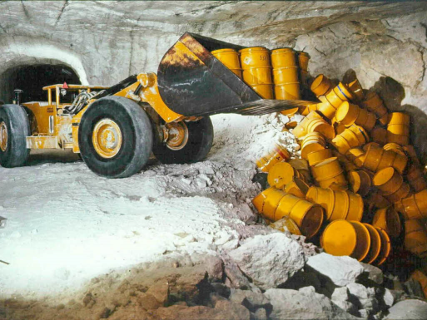
Responsibilities to Environment
Animal Rights
Pollution
Going Green
Notes:
http://www.youtube.com/watch?v=nr00arV2XIw
http://www.youtube.com/watch?v=pNmJ2jflh20

