Slide 1
Roadmap After Midterm
Factors of Health Service Production:
  Hospital Behavior
  Physician’s Practice
  Labor Market
  Pharmaceutical Industry
Efficiency and Equity in Health Care Market
Market Failure and Government Intervention
Evaluation of Health Care Projects
Health Care Systems
Health Care Reform

Slide 2
Factors of Health Service Production
EE 474 Health Economics
Semester 2/2017

Slide 3
Hospitals

Slide 4
Topics
Some Statistics about Hospitals in Thailand
Models of Non-Profit Hospital Behavior
  The Quality-Quantity Nonprofit Theory
  The Profit-Deviating Nonprofit Hospital
  The Hospital as a Physicians’ Cooperative
Alternative: The Hospital as Two Firms

Slide 5
Hospitals in Thailand (2010)
Source: Bureau of Policy and Strategy, Ministry of Public Health

Slide 6
Hospitals as Non-Profits?
The majority of hospitals in Thailand are public hospitals.
  Largely subsidized by the government
  Often receive a large amount of “donations”
  Are they non-profits?
Examples of hospitals operated by non-profit organizations in Thailand:
  King Chulalongkorn Memorial Hospital (Thai Red Cross)
  Hua Chiew Hospital (Poh Teck Tung Foundation)

Slide 7
What Exactly is a Nonprofit Firm?
Criteria for a nonprofit firm is the nondistribution constraint.
  No one has a legal claim on the nonprofit’s residual (i.e. _____________)
Other distinctions between for profits and nonprofits:
  Nonprofits are exempt from corporate income taxes and often from property and sales taxes.
  Donations to nonprofits receive favorable tax treatment.

Slide 8
Why are Nonprofits Prevalent in Health Care?
Weisbrod (1975):
  Nonprofits arise to provide for unmet demands for public goods, most notably in cases where there are significant external benefits to the provision of a good.
Hansmann (1980):
  Nonprofit firms play a role in cases of contract failure (cases where it is difficult to observe the good’s provision or quality).
  For-profit firms tend to have a conflict of interest, and so nonprofit ownership is perceived as a signal of higher quality.

Slide 9
I. The Quality-Quantity Nonprofit Theory
Economists start the analysis with the objective of the hospital decision makers.
Newhouse (1970) proposed a utility maximizing model that approximate the altruistic firm.
  The hospital decision makers have altruistically internalized the community benefit in providing quantity of care.
  An increase in quality might increase demand.
The hospital administrator chooses the combination of quality and quantity that maximizes his or her utility.

Slide 10
The Quality-Quantity Nonprofit Theory
P_{M}
Hospital increases quality.
P = AC_{q2}
AC_{q1}
P = AC_{q1}
D
M*_{q2}
M*_{q1}
M

Slide 11
The Quality-Quantity Nonprofit Theory
P_{M}
Hospital that increases quality, and increases quantity as a result.
AC_{q2}
P = AC_{q2}
AC_{q1}
P = AC_{q1}
D_{q1}
M*_{q1}
M*_{q2}
M

Slide 12
The Quality-Quantity Nonprofit Theory
Eventually, quality increases Do Not produce increases in demand
P_{M}
P = AC_{q3}
AC_{q2}
P = AC_{q2}
AC_{q1}
P = AC_{q1}
D_{q1}
D_{q2}, D_{q3}
D_{q2}
M*_{q3}
M*_{q1}
M*_{q2}
M

Slide 13
Hospital Administrator’s Options
P_{M}
AC_{q3}
P₃ = AC_{q3}
AC_{q2}
P₂= AC_{q2}
AC_{q1}
P₁ = AC_{q1}
D_{q1}
D_{q2}, D_{q3}
M*_{q3}
M*_{q1}
M*_{q2}
M

Slide 14
Hospital Administrator’s Options in Terms of Quality and Quantity
QUALITY
AC increases
monotonically with quality.
q₃
q₂
q₁
M*_{q3}
M*_{q1}
M*_{q2}
Quantity (M)

Slide 15
Hospital Administrator’s Utility Maximization
Quality
q*
U₁
U₀
Quality-Quantity Frontier
M*
M

Slide 16
II. The Profit-Deviating Nonprofit Hospital
Lakdawalla and Philipson (2006) view the nonprofit as a mix of altruism and profit motives:
  Altruistic firms can be analyzed as if they were pure profit-maximizers with a cost advantage.
  For-profit firms are the “marginal ones” responding to changes in regulatory and market conditions.
Hospital’s objective: Max U = U(q, π)
  Nonprofit’s profit: π^{N} = π_{S} + D
  For-profit’s profit: π^{F}
Reservation utility (minimum required utility): U*=U(0,0).
Operating constraints:
  For-profit:_________
  Profit-deviating nonprofit: _________

Slide 17
“Traditional” Market Model:
Entry Condition
P
P
D
S
P*
P_{F}
q
Q
q*
Firm
Market

Slide 18
Profit Deviating Model
P
P
D
S
LRAC
U*=U(0,0)
P_{F}
P*
Break-even:
LRAC – D/q
q
Q
q*
Firm
Market

Slide 19
III. The Hospital as a Physicians’ Cooperative
Mark Pauly and Michael Redisch (1973) describe the nonprofit hospital as a “physicians’ cooperative”.
  The hospital is controlled by a physician staff who operate the hospital so as to maximize their net incomes.
Hospital objective: Max (NR/M)
  where NR = Net revenue = total revue – all factor payments
  M = Number of physicians
Two types of staff:
  “Close” staff hospitals: Physicians can limit the size of the staff.
  “Open” staff hospitals: Physicians are free to enter.

Slide 20
Physician Cooperative Model
Physician Income
($)
B
Y_{max}
C
S
Net Average Revenue (NAR)
M*
M₀
M

Slide 21
Comparing the Quantity-Quality and the Physicians’ Cooperative Theories
Hospital and physician’ revenues:
R = R(K,L,M₀)
Hospital residual revenue:
HR = R(K,L,M₀) – wL – rK – sM₀ + D₀ + G₀
where D₀ = donation, G₀ = government subsidies, and physician supply price = s.
Pauly-Redisch model ➔ Max HR
Newhouse’s model ➔ Max U(q, M) s.t. HR = 0.

Slide 22
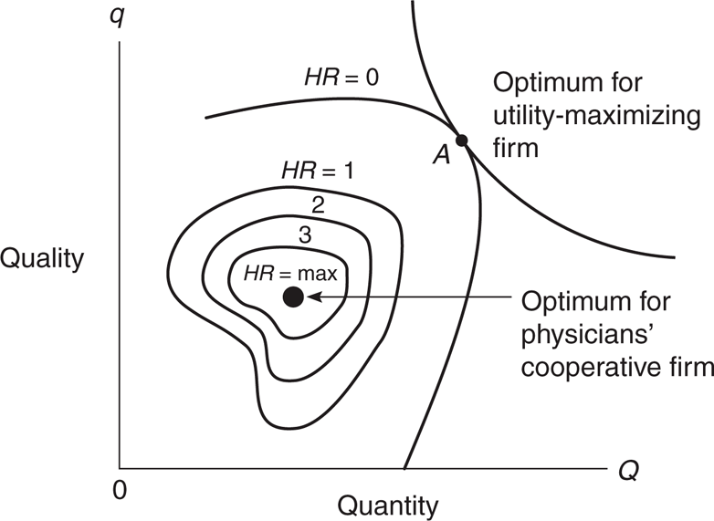
The Quantity–Quality vs.
The Physicians’ Cooperative Theories

Slide 23
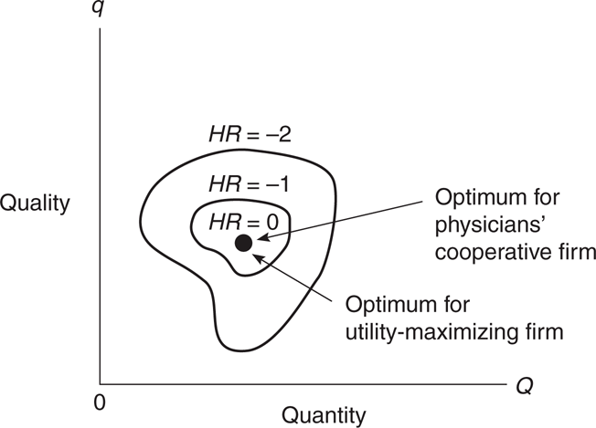
Effects of Increased Competition

Slide 24
Summary of Hospital Behavior Model
Newhouse: The hospital administrator chooses the best combination of quantity and quality of care. (Utility maximization model)
Lakdawalla-Phillipson: Nonprofit preferences include altruism and profit maximization.
Pauly-Redisch: Optimal physician staff size maximizes the pecuniary gain to physicians. (Profit maximizing model)
Question: Which model do you think apply to hospitals in Thailand?

Slide 25
Physician’s Practice

Slide 26
Topics
Benchmark Model of The Physician’s Practice
Physician Agency and Supplier-Induced Demand
The Target Income Hypothesis
Diffusion of Information and Small Area Variations
Malpractice

Slide 27
I. Benchmark Model of The Physician’s Practice
McGuire and Pauly (1991) describe physicians as utility maximizers.
Physician’s utility depends:
  Net income (π)
  Leisure (L)
  The degree of inducement (I): Physician’s own efforts to induce patients to buy more care than appears medically necessary.
Physician’s Utility function:
U = U(π, L, I)

Slide 28
Supply of Physician Labor
Income
Wage Rate
W₃>W₂
W₂>W₁
W₃
C
B
W₂
W₁
A
W₁
Leisure
Labor
Labor-Leisure Tradeoff
Backward-Bending Supply Curve

Slide 29
Physician’s Response to Reduced Rate of Profit
Physician income line:
m= physician’s profit rate,
Q₀=quantity without inducement
π
U₁
mQ₀+mI
E₁
U₂
m'Q₀+m’I, m’<m
A
E₂
B
I₁
I₂
Inducement (I)
m’<m: ______________________________________________

Slide 30
II. Physician Agency and Supply-Induced Demand
In medicine, we identify the physician as the agent, and the patient as the principal.
When two parties have unequal knowledge, the problem in called ‘asymmetric information.’
Policy concern is when self-interest physicians may violate their role as agents.
  “Perfect agents” are the agents who make choices and recommendations on the behalf of principals that the principals themselves would have made if they had the same information.

Slide 31
Original Situation
$/M
S
P₀
D
M₀
M

Slide 32
Some Exogenous Change in the Supply of Physicians Occurs (S increases)
$/M
S
P₀
D
M
M₀
Increase in S caused by an increase in the supply of physicians per person
in the market.

Slide 33
Supply Induced Demand (SID)
S
$/M
S’
P₀
P₂
P₁
D
M₀
M₁
M₂
M

Slide 34
III. The Target Income Hypothesis
Economists expect physicians to respond to the financial incentives, but the theoretical puzzle is why physicians would wait until supply had increased to induce demand.
  We need some theory other than profit maximization to explain the behavior
Target income hypothesis suggests that they have a certain level of income that they do not want to fall below.
  This is an extreme case of the benchmark model.

Slide 35
The McGuire-Pauly Synthesis of SID Benchmark Models
Target Income Behavior
Profit-maximizing Behavior
π
π
U₁
U₁
mQ₀+mI
mQ₀+mI
E₁
E₁
m'Q₀+m’I
A
m'Q₀+m’I
A
B
B
C
C
I₂
I₁
I₁
I₂
I’₂
I
I₁=I’₂
I
Income Effect
No income effect

Slide 36
The Benchmark Model as a Synthesis
The McGuire-Pauly synthesis tells us that the size of the income effect is critical to understanding and identifying SID behavior.
A lower profit rate, m, has two offsetting effects on inducement:
  Income effect: Decreased income would make inducement more desirable.
  Substitution effect: If inducement is less profitable (smaller m), providers would do less inducement, that is, substitute away from it.

Slide 37
IV. Small Area Variation (SAV)
Another type of information problem related to physician’s practice is where neither the physician nor the patient know the best treatment.
Patient assumes that the physician knows and is giving good information. But the physician may not know either.
This leads to an area of inquiry known as small area variation or small area analysis.
  There are substantial variations in medical and surgical utilization rates across and within small geographic areas (e.g. zipcodes, hospital markets, etc.).

Slide 38
Different Views on the Variability
The Physician Practice Style Hypothesis:
  Practice style probably varies among physicians due to an incomplete diffusion of information on medical technologies (Wennberg, 1984).
Formulation of Practice Style:
  Physician’s practice style are more influenced by his peers in the same hospitals and in other hospitals in his region (Epstein and Nicholson, 2009).
Education, Feedback, and Surveillance:
  Information programs directed at physicians can alter their behaviors and thus presumably their practice styles (Wennberg & Fowler, 1977).

Slide 39
Small Area Variation and the Social Cost of Inappropriate Utilization
The most important issue in the SAV literature is the proposition that substantial variation in utilization rates is an indication of inappropriate care.
It is necessary to determine the variability due to economic, social, demographic and chance reasons, in order to determine the residual portion that is due to physician decisions
What is the economic cost of this variability (i.e. physician misinformation)?

Slide 40
Variation Causes Welfare Loss
MB_{correct}
MB, MC
Excess value that is forgone
because too little is produced.
P=MC
P
Costs in excess of value from producing and
consuming too much.
0
R₁
R₂
R₃
Rate of Utilization

Slide 41
V. Malpractice
Medical malpractice occurs when a negligent act or omission by a physician or medical professional results in a damage or harm to a patient.
Many malpractice judgments are very large and malpractice insurance premiums can be very high (at least in developed countries).
The high likelihood of malpractice suits lead to what is called “negative defensive medicine” which occurs where physicians refuse to perform risky procedures to avoid lawsuits.

Slide 42
Labor Markets

Slide 43
Topics
The Demand for and Supply of Health Care Labor
Factor Productivity and Substitution Among Factors
Shortages of Health Professionals
Licensure and Monopoly Rents

Slide 44
I. Demand for and Supply of Labor
Health care labor is an important input in the production of health care. But how many of each labor input should the firm (e.g. hospital) demand?
The firm hires workers as long as the cost of the additional worker is less than what the firm is able to sell the output that the input produces for.
Example:
  It costs the firm $100 to hire another worker (L) for a day
  The worker produced 10 more units of output: MP_{L}= 10
  Marginal product the firm was able to sell for $20 each: MR = $__
  Additional profits: ________________________.

Slide 45
Demand for Labor
Thus, the firm’s demand for labor (or any other input) is related to:
  The input’s marginal product (what output the input can produce)
  The output’s marginal revenue (what the firm can sell the additional output for on the market)
Specifically, the firm’s demand for an input is its marginal revenue product (MRP) curve, where MRP is the additional revenue that results from employing one additional worker.
MRP = MP_{L}*MR
It is assumed that the MP_{L} is decreasing with labor, so the MRP curve is also decreasing with labor.

Slide 46
The Firm’s Marginal Revenue Product (MRP) Curve for Labor
Wage
($/N)
MRP
Labor (Ns)

Slide 47
MRP as the Firm’s Demand for Labor
The firm’s demand for labor is the relationship between the wage rate and the quantity of labor demanded.
The wage rate represents the cost to the firm of purchasing a unit of labor.
As long as the wage rate is less than the MRP, the firm will continue to hire workers.
The firm will hire workers up to the point where:
MRP = w.
The relationship between wages and quantity of labor is therefore the MRP curve.

Slide 48
Firm Demand for Labor
Wage
($/L)
w₁
w₂
Labor (Ns)
Notes:
If the wage rate is w₁ then there would be L₁ workers who would produce output that is sold for revenues that at least covers the wage rate.
If the wage rate is w₂ then there would be L₂ workers who would be hired .

Slide 49
Market Demand for Labor With Many Firms
Wage
($/L)
Market Demand for
Labor = ∑MRP_{j}
Labor (Ns)

Slide 50
The Supply of Labor
The higher the wage rate, the greater the quantity of work that will be supplied by the existing workers in the labor force. (ie. Upward-sloping curve)
  Some workers who are already working will work longer hours.
  Similar workers maybe attracted into the market from elsewhere.
    Movement along labor supply curve
  New workers that have recently joined the labor force would add more workers at each wage rate (add another s_{i} to the Σ).
  Labor supply curve shift

Slide 51
Market for Labor With Many Buyers and Sellers
Wage
($/L)
Supply of
Labor = ∑s_{i}
Demand for
Labor = ∑MRP_{j}
Labor (Ns)

Slide 52
Market for Labor with Many Buyers and Sellers
Wage
($/L)
Supply of
Labor = ∑s_{i}
MRP_{L0}
E
w_{L0}
Would this worker be hired?
Demand for
Labor = ∑MRP_{j}
L₀
L*
Labor (Ns)

Slide 53
Equilibrium in Competitive Market for Labor
Wage
($/L)
Equilibrium in a competitive labor market
Supply of
Labor = ∑s_{i}
E
w*
Demand for
Labor =
∑MRP_{j}
L*
Labor (Ns)

Slide 54
II. Factor Productivity and Substitution among Factors
Productivity of labor input is a major determinant of supply.
  Productivity improvements increase output (i.e. same level of output can be produced with fewer inputs).
The productivity of an input factor can be measured as the average product (AP) of the factor: AP_{L} = Q/L.
In measuring factor productivity labor, one needs to estimate the incremental output resulting from the additional unit of that labor in the production process. This is the marginal product (MP) of the factor:
MP_{L} = ∆Q/∆L

Slide 55
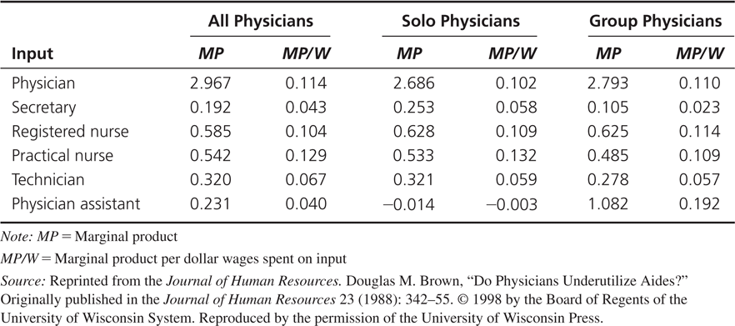
Marginal Products and Efficiency of Input Use

Slide 56
III. Shortages of Health Professionals
Wage
($/L)
S
w*
w₁
D
Ls
Ld
Labor

Slide 57
Rate of Return and Shortage
The internal rate of return is the discount rate that equates the present value of the stream of costs to the stream of revenues from education.
Let R = internal rate of return, then R satisfies:
when B_{t} = Revenue at time t and C_{t} = Cost at time t.
High rates of return may occur because the supply of labor fails to responds quickly to changes in demand. In some cases, this is a result of barriers to entry faced by potential health professionals.
  Ex: Licensure Law

Slide 58
Role of Monopsony Power: Shortages of Labor
A monopolist is a single seller of a product in a market.
A monopsonist is a single buyer of an input in the market.
The monopsonist is able to use its market power to reduce the prices it pays for inputs.
Examples:
  Hospitals are monopsonists in the market for nurses.
  Health plans are monopsonists in the market for physicians and hospitals – e.g. Canada’s single-payer health system

Slide 59
Monopsonistic Labor Market
A monopsony exists if there is a single purchaser of an input in the market.
The market then has a single MRP curve that represents the demand for a factor or input.
The monopsonist faces the entire supply of labor.
  Just like the monopolist faces the entire demand for its output
Because the monopsonist faces the entire supply curve, it recognizes that if it wants to hire another worker, it must pay that worker a higher wage rate and also a higher wage rate to all those who would have worked for less.

Slide 60
Monopsony Model
Wage
MFC
Supply of
Labor
$17
$15
MFC of the 7th worker = ________
$11
$10
MFC of the 6th worker = ________
$9
5
6
7
Labor (Ns)

Slide 61
Monopsony Model
MFC
Wage
Supply of
Labor
MRP_{L}⁰
Would the firm hire
the L⁰th worker?
MFC_{L}⁰
D= MRP
L⁰
Labor (Ns)

Slide 62
Monopsony Model
Wage
MFC
MFC_{L}^{e}
Supply of
Labor
MRP_{L}⁰
MRP_{L}^{e}
Would the firm hire
the Leth worker?
MFC_{L}⁰
MRP
L⁰
Le
Labor (Ns)

Slide 63
Monopsony Model
Wage
MFC
Supply of
Labor
M
E
w^{e}
w*
MRP
L⁰
L*
Le
Labor (Ns)

Slide 64
Monopsony Model
MFC
Wage
Supply of
Labor
w^{e}
w*
MRP
L*
Le
Labor (Ns)

Slide 65
Monopsony Model: Reported Shortages
Wage
MFC
Supply of
Labor
w^{e}
w*
MRP
L*
Le
L^{D}
Labor (Ns)
There is not enough nurses willing to at the low wage rate that monopsonist hospitals are willing to pay.

Slide 66
IV. Licensure and Monopoly Rent
Controversies on the role of health professional licensure:
  Self-interest theory: Organized medicine has used control of licensure for self-interest by limiting entry.
  Public-interest theory: Regulatory measures, such as licensure, are demanded as a result of the limited information patients have about quality and the relatively high costs of obtaining information.
Some economists argue that licensure and professional control over medical education creates “economic rents” for physicians.
  Payment to factors over and above those necessary to induce them to provide their services.

Slide 67
Pharmaceutical Industry

Slide 68
Topics
The Production of Health and Substitutability
Structure and Regulations in Pharmaceutical Industry
Drug Pricing and Profits
  Monopoly pricing
  Price discrimination
R&D and Innovation
Cost Containment

Slide 69
Overview
Types of drugs:
  Over-the-counter (OTC) drugs vs. prescription drugs
  Original drugs vs. generic drugs
Main characteristics of the pharmaceutical industry:
  Significant barriers to entry and regulations
  Substantial opportunities for price discrimination
  Higher-than-normal profits for pharmaceutical firms
  Large research and development spending
  Large spending on drugs requires ‘cost containment’ strategies

Slide 70
I. The Production of Health and Substitutability
Consider the following health production function:
HS = f(D,M)
where HS is health status, D is drugs and M is other health inputs.
Three possibilities of the relationship between drugs and other medical inputs:
  They may have to be used in fixed proportions.
  They may be perfect substitutes for one another.
  They may be able to be substituted for one another but subject to diminishing marginal rate of technical substitution (MRTS).

Slide 71
Substitution Between Drugs (D)and Other Medical Inputs (M)
M
J
I
D and M can be substituted for one another subject to diminishing MRTS.
F
G
H
D

Slide 72
Least-Cost Production
HS
M
Suppose P_{D} = $50, P_{M} = $100, D₁= 4, M₁ = 6.
Total cost at point E is:
C = __________________________.
M₁
E
M = C/P_{M} - (P_{D}/P_{M})D
→ Slope = - (P_{D}/P_{M})=__________
D
0
D₁
Notes:
Patients and providers will choose the combination of inputs that produces the level of health desired at least cost.
As prescription costs rise, rational consumers will substitute the now relatively cheaper other medical inputs into the production of health.

Slide 73
Insurance and Substitutability
Consider 2 different insurance policies:
1. 20% coinsurance on both D and M
  Out-of-pocket payment for 1 unit of D = 0.2*$50 = $10
  Out-of-pocket payment for 1 unit of M = 0.2*$100 = $20
  Slope of the new budget line = _______
2. 20% coinsurance on M only and a deductible of $5 (fixed copayment) for each D
  Out-of-pocket payment for 1 unit of D = ______
  Out-of-pocket payment for 1 unit of M = _______
  Slope of the new budget line = _______
If insurance policies more generously cover D than they do for M, consumers will replace D for M in the production process.
Notes:
1. Slope remains the same. → Same optimal D and M but 80% of the cost ($640) is transferred to the insurer.

Slide 74
Insurance and Substitutability
Insurance II:
Suppose at P’_{D} = $5 and P’_{M} = (0.2*$100)=$20, D₂= 5, M₂ = 5.75.
Slope =-0.25
Cost_{consumer} = _______________________
Cost _{insurance}= _______________________
  Total Cost = _______
HS
M
Slope =-0.5
M₁
E
E’
M₂
Slope = -(P’_{D}/P’_{M})
= -0.25
D
0
D₁
D₂
Notes:
Patients and providers will choose the combination of inputs that produces the level of health desired at least cost.
As prescription costs rise, rational consumers will substitute the now relatively cheaper other medical inputs into the production of health.

Slide 75
II. Structure and Regulation
Pharmaceutical industry is dominated by significant barriers to entry.
A barrier to entry is any factor that impedes the entry of new firms into an industry or product market.
3 major types of barriers to entry:
1. Patent protection:
  Patent gives firm exclusive rights to produce a drug for up to 20 years
2. Brand loyalty (or first mover) advantage:
  Patent creates name recognition and prescribing.
  This makes it harder for a generic to penetrate a market.
3. Drug regulation:
  FDA approval process for a new drug is costly and time consuming.

Slide 76
Drug Regulation
The pharmaceutical industry is one of the most heavily regulated of all industries.
The Thai Food and Drug Administration (FDA) was originated to control the widespread counterfeit and contaminated products.
In other countries, e.g. USA, the FDA plays a very important role in the pharmaceutical industry, as it is responsible for the approvals of new drugs (which could take ~14 years). This process involves trade-offs:
  Consumer protection: Gain in safety and efficacy
  Rapid innovation: Cost of delaying patients from utilizing useful drugs.

Slide 77
Drug Regulation
  Two types of drug approval errors:
    Type I errors: FDA rejects drug that is actually safe and effective
    Type II errors: FDA approves unsafe, ineffective drug
  What are the incentives?
    FDA has incentive to commit Type I error because all costs are external to the FDA from a Type I error.
    Pharmaceutical firms may have had an incentive to commit Type II error, as long as the costs remain external to the firm.
  So, the major unanswered question is whether the government (FDA) side or the private side (pharmaceutical firms) make the fewest and least costly errors.

Slide 78
III. Monopoly Pricing
P
AC is downward sloping b/c of high fixed cost of R&D
AC
MC
MR
D
Q
Q_{M}
Notes:
The profit-maximizing output occurs where MC equals MR. The monopolist then charges the highest price the market will bear, which is given by the demand curve. If price exceeds average cost a profit will be earned.

Slide 79
3rd Degree Price Discrimination
P
P
Price is higher for relatively inelastic Demand.
P_{US}
P_{THA}
MC
MC
D_{THA}
MR_{US}
D_{US}
MR_{THA}
Q
Q
Q_{US}
Q_{THA}
Notes:
With monopoly power, pharmaceutical companies may be able to engage in third degree price discrimination. That is, segmenting the market according to differing elasticity of demand and charging higher prices to those segments with the more inelastic demand.

Slide 80
Monopsony Pricing and Price Controls
Price discrimination is not the only possible explanation for price differentials.
Prices in some countries can be lower because their governments regulate prices or their national health plan serves as a monopsony buyer.
In the previous example, if the Thai government imposes price controls but the US government fails to do so, consumers in the US will be worse off.

Slide 81
Price Discrimination & Price Regulation
P
P
P_{US}
P_{THA}
AC
AC
MC
MC
D_{THA}
MR_{US}
D_{US}
MR_{THA}
Q
Q
Q_{US}
Q_{THA}
Notes:
With monopoly power, pharmaceutical companies may be able to engage in third degree price discrimination. That is, segmenting the market according to differing elasticity of demand and charging higher prices to those segments with the more inelastic demand.

Slide 82
Competition and Generic Entry
Once a patent expires, other firms (generic drug companies) can enter the market.
We would expect to see lower prices and smaller market share for the branded-drug companies after generic entry. But this is often not the case. Why?
Branded producers can still retain some monopoly power by taking advantage of the market segmentation between the brand-loyalty customers and other customers.
  Brand-loyalty customers don’t see generic drugs as close substitutes of branded drugs.
    Relatively __________ demand.

Slide 83
IV. R&D and Innovation
Product innovation is an important issue in the pharmaceutical industry.
  New drugs can be very effective in improving quality of life and extending lives→ improve society’s welfare
  Drug companies use the costs of innovation (R&D) to justify the large profits that pharmaceutical firms have earned.
Patents provide protection for pharmaceutical companies so they are able to recover these R&D expenditures.
  The decision to develop a new drug depends on the expected revenues of the drug minus the expected costs of the drug innovation process.

Slide 84
Investment Decisions
Net present value is:
  where R_{t} and C_{t} represent the revenue and costs in time t, r is the cost of capital and T is the life of the project
Pharmaceutical R&D projects can be broken into 3 parts:
  a. The research, testing, and review period
  ➔ No revenue & large costs
  b. The effective period of patent protection
  ➔ Highest revenue & moderate cost
  c. The post-patent period
  ➔ Diminishing revenue & increasing costs

Slide 85
Investment Decisions
t=0
t= T
a
b
c
m
n
s
Firms’ decision to investment in R&D depends on:
  Regulations and testing procedures
  The length of the research, testing, and review period
  Firms’ ability to charge high price in period b
  Firms’ ability to create ‘brand recognition’ after patent expiration → First-mover advantage!
  Risk of the projects

Slide 86
Prices, Price Regulation, and Innovation
Most important issue related to drug policy is the effects of prices on innovation.
  Higher drug prices and potential markets encourage more R&D and innovation.
  But if prices are too high, there’s a need for regulation.
Drug price regulation effects innovation and the availability of drugs.
  Price regulations reduces investment in R&D, the rate of innovation, and the number of new drugs.
Thus, drug policy maker needs to address the trade-offs between controlling price and stimulating innovation.

Slide 87
V. Cost Containment
The rapid growth in drug expenditures has led to great policy interest in cost containment (i.e. to restrain expenditure).
One solution is to exercise monopsony power.
Three cost-containment strategies:
  Higher copayments: Shift a larger share of the cost burden to the patient and to decrease consumption of marginally beneficial drugs.
  Use of generic drugs: Lower prices for the equivalent therapeutic components.
  Adoption of drug formularies: Use drug-utilization review program, or develop a list of approved drugs.

Slide 88
Thai Pharmaceutical Industry
Is there any monopoly?
  Government Pharmaceutical Organization (GPO)
    Gov’t requires public hospitals to use to give GPO preferences in purchasing medicine.
Cost-containment strategies?
  Encourage the use of generic drugs
  Use of drug formularies: Under certain health schemes (UCS and SSS), hospitals are required to prescribe drugs based on the National List of Essential Drugs (NLED)

