Slide 1
Industrialization and Globalization
EE 460

Slide 2
Topics
Industrial Revolution
Industrialization
Colonization
Globalization

Slide 3
Industrial Revolution
1. The first IR began was a period of major industrialization that took place during the late 1700s and early 1800s. It began in the Great Britain and quickly spread throughout the world
2. Economic Impacts
  Transportation cost
  Factory system and Mass production
  International Trade
  Capitalism and colonization
3

Slide 4
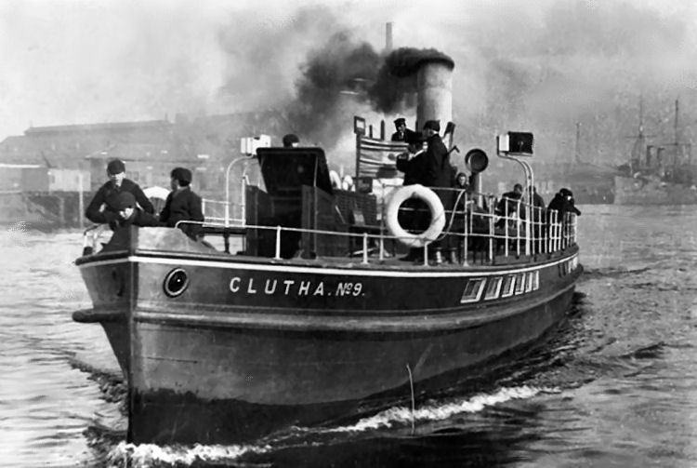
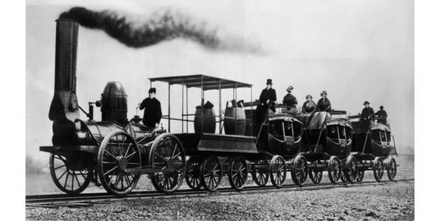
Transportation cost
Reduce in transportation costs led to the possibility of international trade

Slide 5

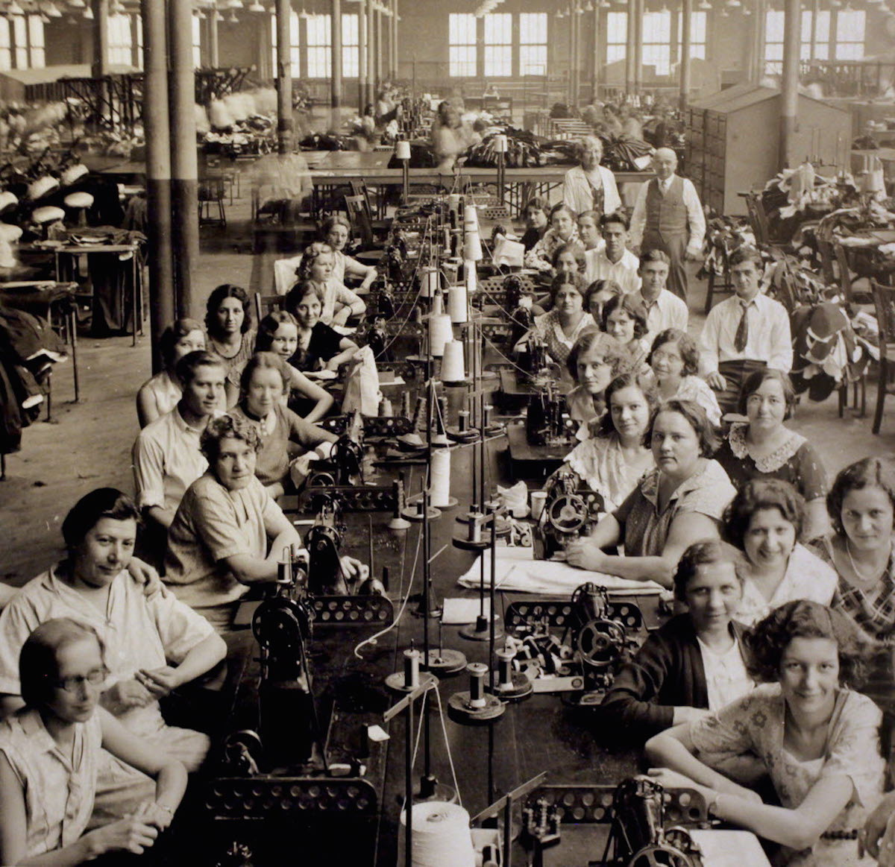

Factory in 1800s
Steam engine made factory system possible
Technology improvement created labor surplus in agricultural sectors.
Labor movement and urbanization
Mass Production

Slide 6
2. The second IR ( the America IR, Technological IR) was a phrase of rapid industrialization during 1870-1914.
  Steel Industry ( J.P. Morgan, Andrew Carnegie)
  Automobile Industry (Karl Benz, Henry Ford)
  Rubber (Charles Goodyear, John Dunlop)
  Telecommunication (A. G. Bell, Marconi)
  Electricity (Mechael Faraday’s electric motor, Edison’s power plant)
  Petroleum Industry (Edwin Drake)
  Assembly Line (Ford)

Slide 7
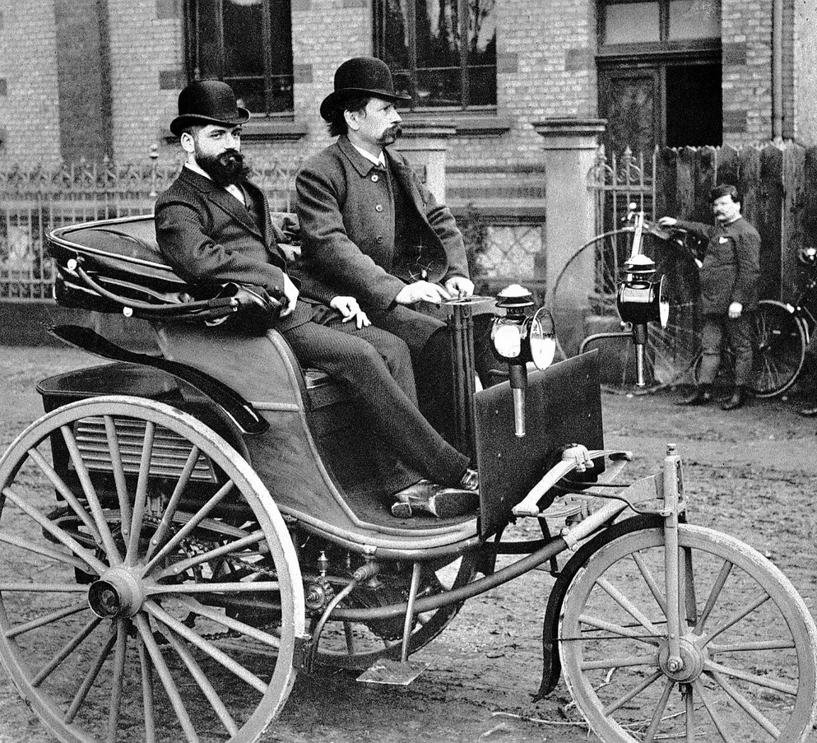
Benz in 1886

Slide 8

3. The third industrial revolution
  Manufacturing is going to digital
  Society is going to digital
  AI

Slide 9
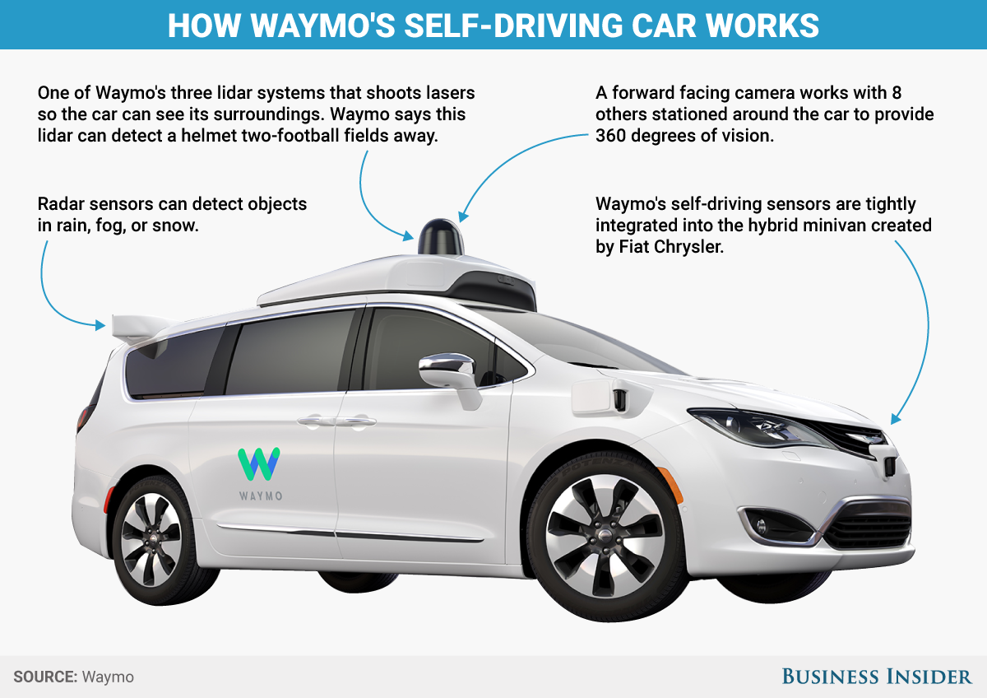
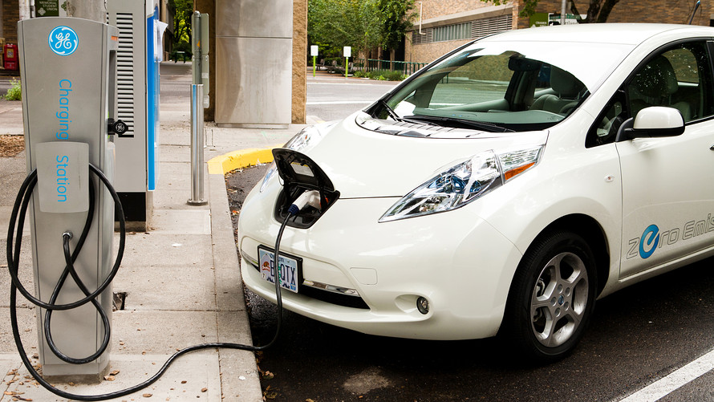
EV

Slide 10
Economic impacts of IR
1. lower transaction costs
2. Factory system and Mass Production
3. International trade and Industrialization
4. Capitalism and Imperialism
5. Globalization

Slide 11
Industrialization
1. industrialization is a process by which an economy is transformed from primarily agriculture to one based on the manufacturing of goods. Individual labor is replaced by mechanized mass production and craftsmen are replaced by assembly lines.

Slide 12
Imperialism and Colonialism
British Imperialism in India
Western Imperialism in China
Imperialism in South-east Asia

Slide 13
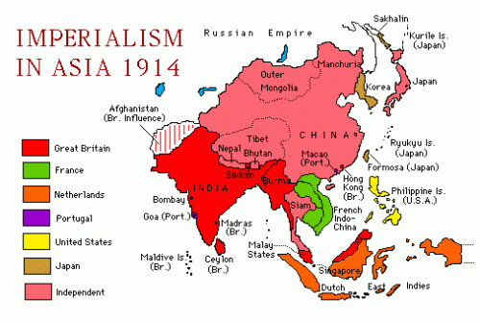
Motivations
Raw Materials
Land for plantation
Large market for Western products
Monopolize the sea ports
IMPACTS
Introduced Western ideas of nationalism , democracy and Christianity
Industrialization and infrastructure development
Improved social services and public administrations
Resource exploitation and elimination of local industries
Political unity
Feudalism

Slide 14
Feudalism
What is Feudalism?
Feudalism in Thailand

Slide 15
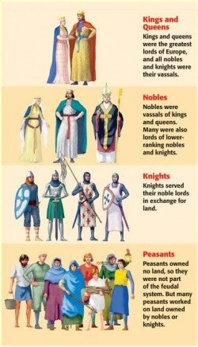
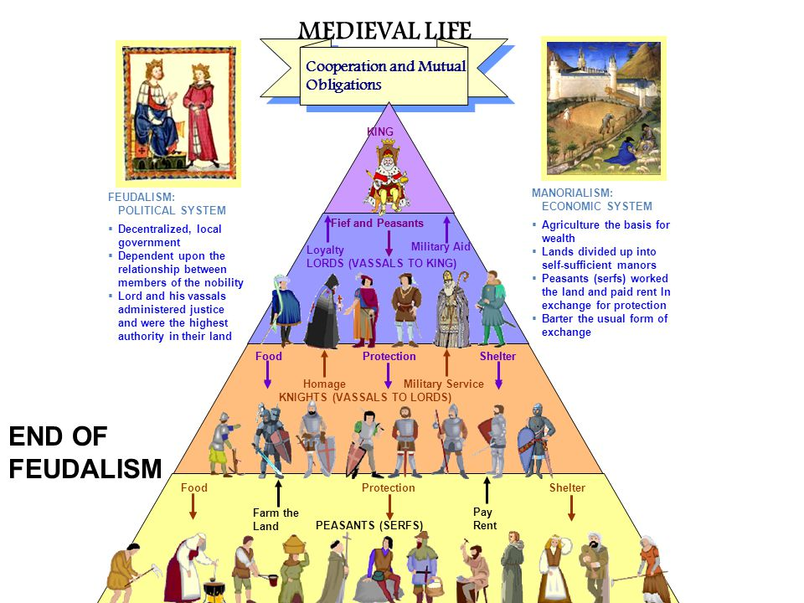
Feudal System

Slide 16
Feudal system in Thailand
Sakdina system
Kin Moung system

Slide 17
Sakdina system
1.Status as shown by land
2. King Borromatrailokkanart (1448-1488) established the sakdina system (Law on the Civil Hierachy).
3. The Kong granted the land to nobles according to their ranks. The king granted a temporary right over an amount of land to aristocrats and officials (instead of granting slaves, animals, money). The land had to be returned to the king when the grantees died or were disposed.
4. Sakdina system separated people according to status (titles). Commoners (Phrai) were able to remain to farm in the land of nobles but the male adults had to spend 6-8 months a year working for or fighting in battles under the command of the noblemen. Later on; especially, after Bowring treaty, Phrai may offer agricultural products instead of providing labor services.
5. The king had absolute rights to grant titles. However, the commoners could attain up to the ranks of muen and khun; Chinese up to Phraya; westerners may be promoted up to Chaophraya.

Slide 18
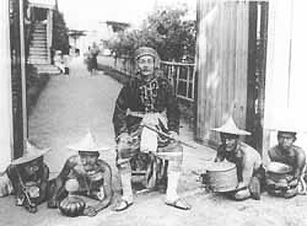
Kin Moung

Slide 19
Globalization
1. globalization is the process of international integration arising from the interchange of views on politics, economics, and culture. Advance of transportation and telecommunications are the major factors in globalization
2. the term globalization has been increasing used since the mid-1980s. In 2000, the IMF identified four basic aspects of globalization: trade and transactions, capital and investment movement, migration and movement of people, and the dissemination of knowledge.
3. economic globalization is the increasing economic interdependence of national economies across the world through a rapid increase in cross-border movement of goods, service, technology and capital. Economic globalization comprises the globalization of production, markets, competition, technology, and corporations.
4.Colonization stimulated globalization
5.Globalization creates new world order system and/or world capitalist system.

