Slide 1
Linear Models and Matrix Algebra III
Pawin Siriprapanukul
CW Ch.5

Slide 2
Outline
Conditions for Nonsingularity of a Matrix
Test of Nonsingularity by Use of Determinant
Basic Properties of Determinants
Finding the Inverse Matrix*
Cramer’s Rule*
Application to Market and National-Income Models*
Leontief Input-Output Models*

Slide 3
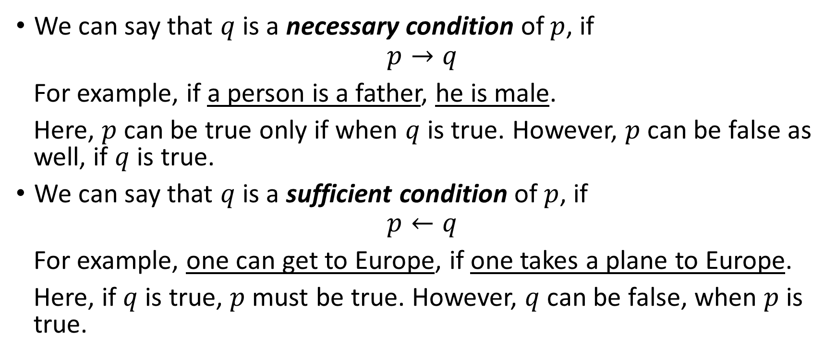
Necessary Vs Sufficient Conditions
We can say that $q$ is a necessary condition of $p$, if
$$p→q$$
For example, if a person is a father, he is male.
Here, $p$ can be true only if when $q$ is true. However, $p$ can be false as well, if $q$ is true.
We can say that $q$ is a sufficient condition of $p$, if
$$p←q$$
For example, one can get to Europe, if one takes a plane to Europe.
Here, if $q$ is true, $p$ must be true. However, $q$ can be false, when $p$ is true.

Slide 4
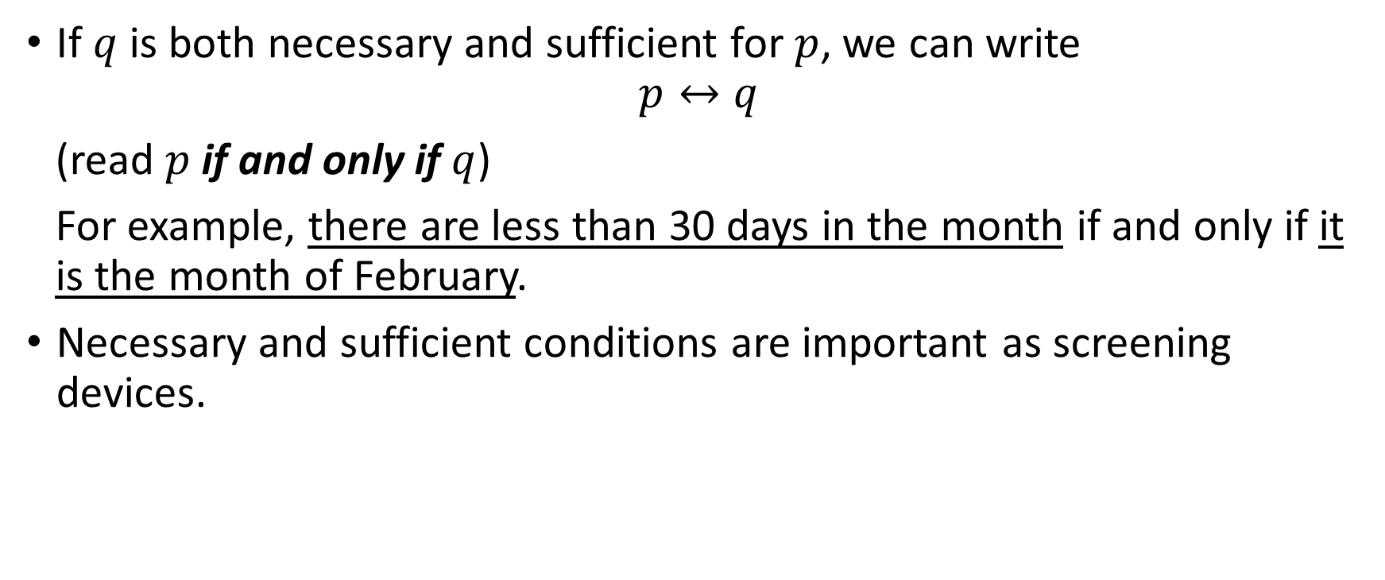
Necessary Vs Sufficient Conditions
If $q$ is both necessary and sufficient for $p$, we can write
$$p↔q$$
(read $p$ if and only if $q$)
For example, there are less than 30 days in the month if and only if it is the month of February.
Necessary and sufficient conditions are important as screening devices.

Slide 5
Conditions for Nonsingularity
The squareness condition (the matrix must be square matrix) is a necessary condition for nonsingularity.
A sufficient condition for the nonsingularity of a matrix is that its rows be linearly independent.
When the dual conditions are satisfied together, they constitute the necessary-and-sufficient condition for nonsingularity.

Slide 6
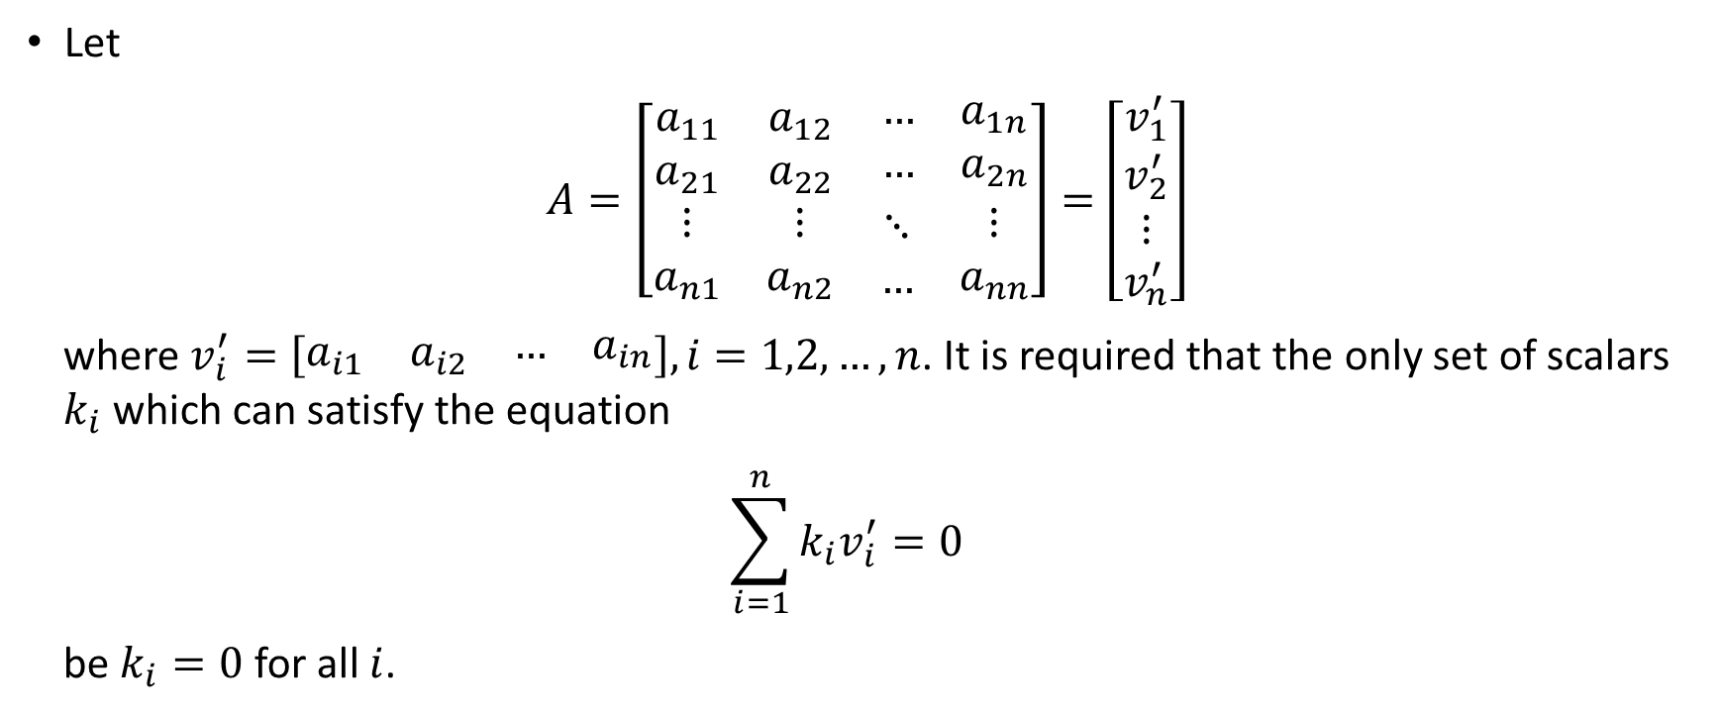
Conditions for Nonsingularity
Let
$A=\left[\begin{matrix}a_{11} & a_{12} & \begin{matrix}… & a_{1n}\end{matrix} \\ a_{21} & a_{22} & \begin{matrix}… & a_{2n}\end{matrix} \\ \begin{matrix}⋮ \\ a_{n1}\end{matrix} & \begin{matrix}⋮ \\ a_{n2}\end{matrix} & \begin{matrix}\begin{matrix}⋱ \\ …\end{matrix} & \begin{matrix}⋮ \\ a_{nn}\end{matrix}\end{matrix}\end{matrix}\right]=\left[\begin{matrix}v_{1}^{′} \\ v_{2}^{′} \\ \begin{matrix}⋮ \\ v_{n}^{′}\end{matrix}\end{matrix}\right]$
where $v_{i}^{′}=\left[\begin{matrix}a_{i1} & a_{i2} & \begin{matrix}… & a_{in}\end{matrix}\end{matrix}\right], i=1,2,…,n$. It is required that the only set of scalars $k_{i}$ which can satisfy the equation
$$\sum_{i=1}^{n}{k_{i}v_{i}^{′}}=0$$
be $k_{i}=0$ for all $i$.

Slide 7
Conditions for Nonsingularity
From the discussion of system of linear equations, recall that we said it is not sufficient to have the same number of equations as unknowns. In addition, the equations must be consistent and functionally independent.
It can be tied the “same number of equations and unknowns” to the “squareness” condition.
The “consistent and functionally independent” is taken cared of by the “linearly independence among the rows” of the matrix.

Slide 8
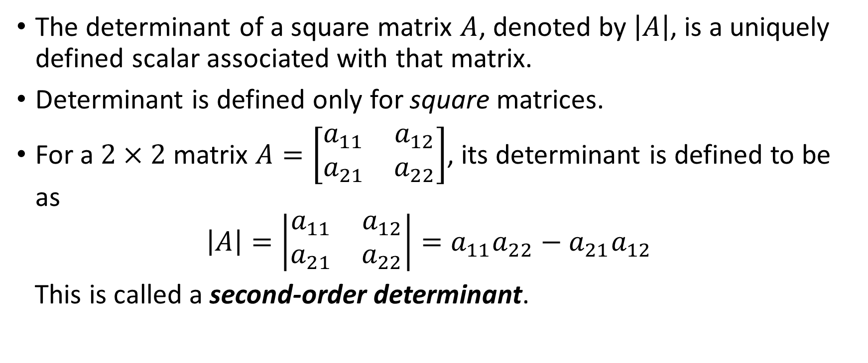
Test of Nonsingularity by Use of Determinant
The determinant of a square matrix $A$, denoted by $\left|A\right|$, is a uniquely defined scalar associated with that matrix.
Determinant is defined only for square matrices.
For a $2×2$ matrix $A=\left[\begin{matrix}a_{11} & a_{12} \\ a_{21} & a_{22}\end{matrix}\right]$, its determinant is defined to be as
$$\left|A\right|=\left|\begin{matrix}a_{11} & a_{12} \\ a_{21} & a_{22}\end{matrix}\right|=a_{11}a_{22}−a_{21}a_{12}$$
This is called a second-order determinant.

Slide 9
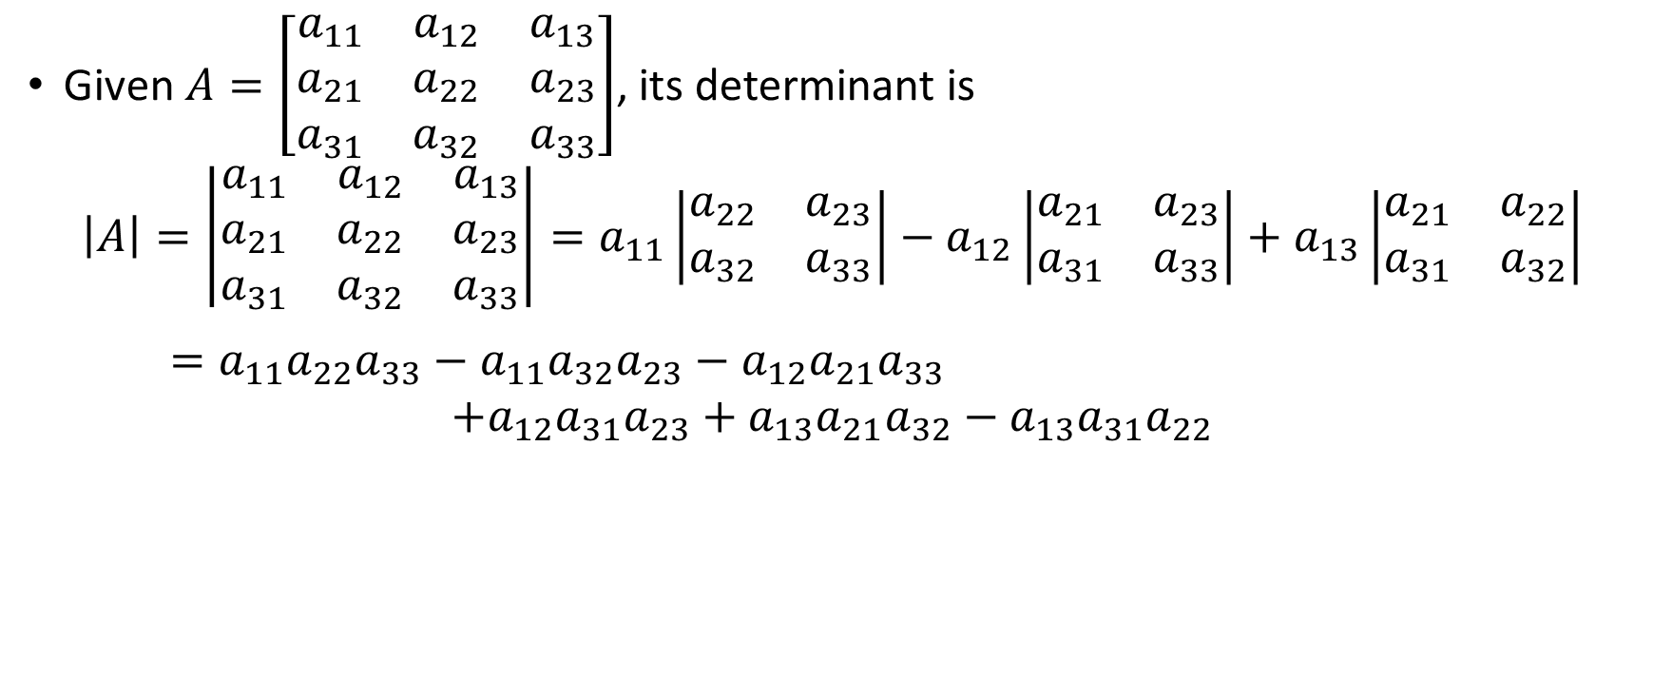
Evaluating a Third-Order Determinant
Given $A=\left[\begin{matrix}a_{11} & a_{12} & a_{13} \\ a_{21} & a_{22} & a_{23} \\ a_{31} & a_{32} & a_{33}\end{matrix}\right]$, its determinant is
$$\left|A\right|=\left|\begin{matrix}a_{11} & a_{12} & a_{13} \\ a_{21} & a_{22} & a_{23} \\ a_{31} & a_{32} & a_{33}\end{matrix}\right|=a_{11}\left|\begin{matrix}a_{22} & a_{23} \\ a_{32} & a_{33}\end{matrix}\right|−a_{12}\left|\begin{matrix}a_{21} & a_{23} \\ a_{31} & a_{33}\end{matrix}\right|+a_{13}\left|\begin{matrix}a_{21} & a_{22} \\ a_{31} & a_{32}\end{matrix}\right|$$
$=a_{11}a_{22}a_{33}−a_{11}a_{32}a_{23}−a_{12}a_{21}a_{33}$
$$+a_{12}a_{31}a_{23}+a_{13}a_{21}a_{32}−a_{13}a_{31}a_{22}$$

Slide 10
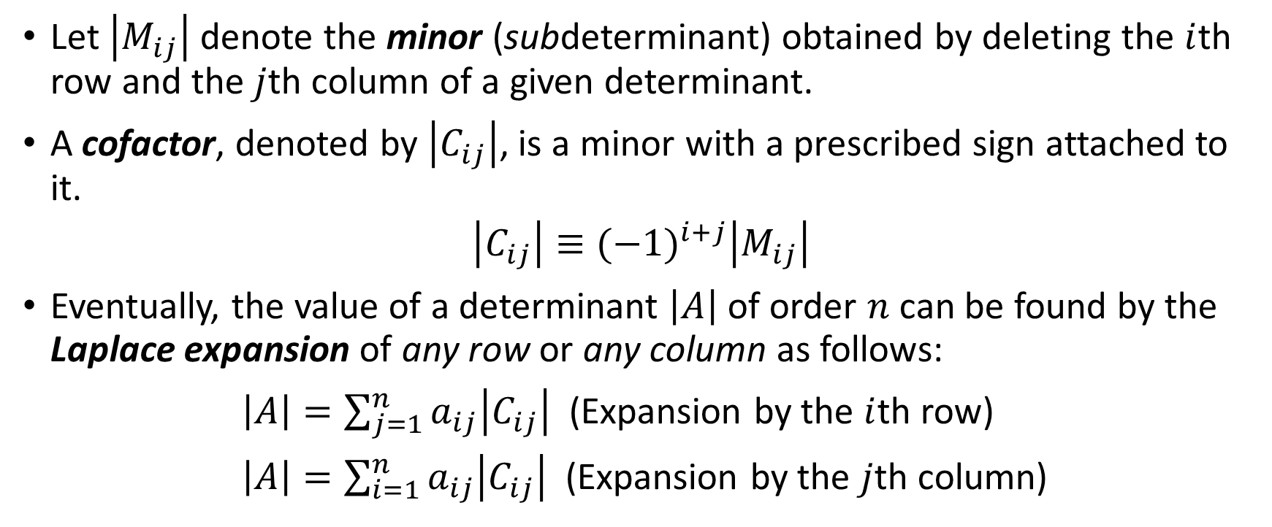
Evaluating an nth-Order Determinant
Let $\left|M_{ij}\right|$ denote the minor (subdeterminant) obtained by deleting the $i$th row and the $j$th column of a given determinant.
A cofactor, denoted by $\left|C_{ij}\right|$, is a minor with a prescribed sign attached to it.
$$\left|C_{ij}\right|≡{(−1)}^{i+j}\left|M_{ij}\right|$$
Eventually, the value of a determinant $\left|A\right|$ of order $n$ can be found by the Laplace expansion of any row or any column as follows:
$\left|A\right|=\sum_{j=1}^{n}{a_{ij}\left|C_{ij}\right|}$ (Expansion by the $i$th row)
$\left|A\right|=\sum_{i=1}^{n}{a_{ij}\left|C_{ij}\right|}$ (Expansion by the $j$th column)

Slide 11
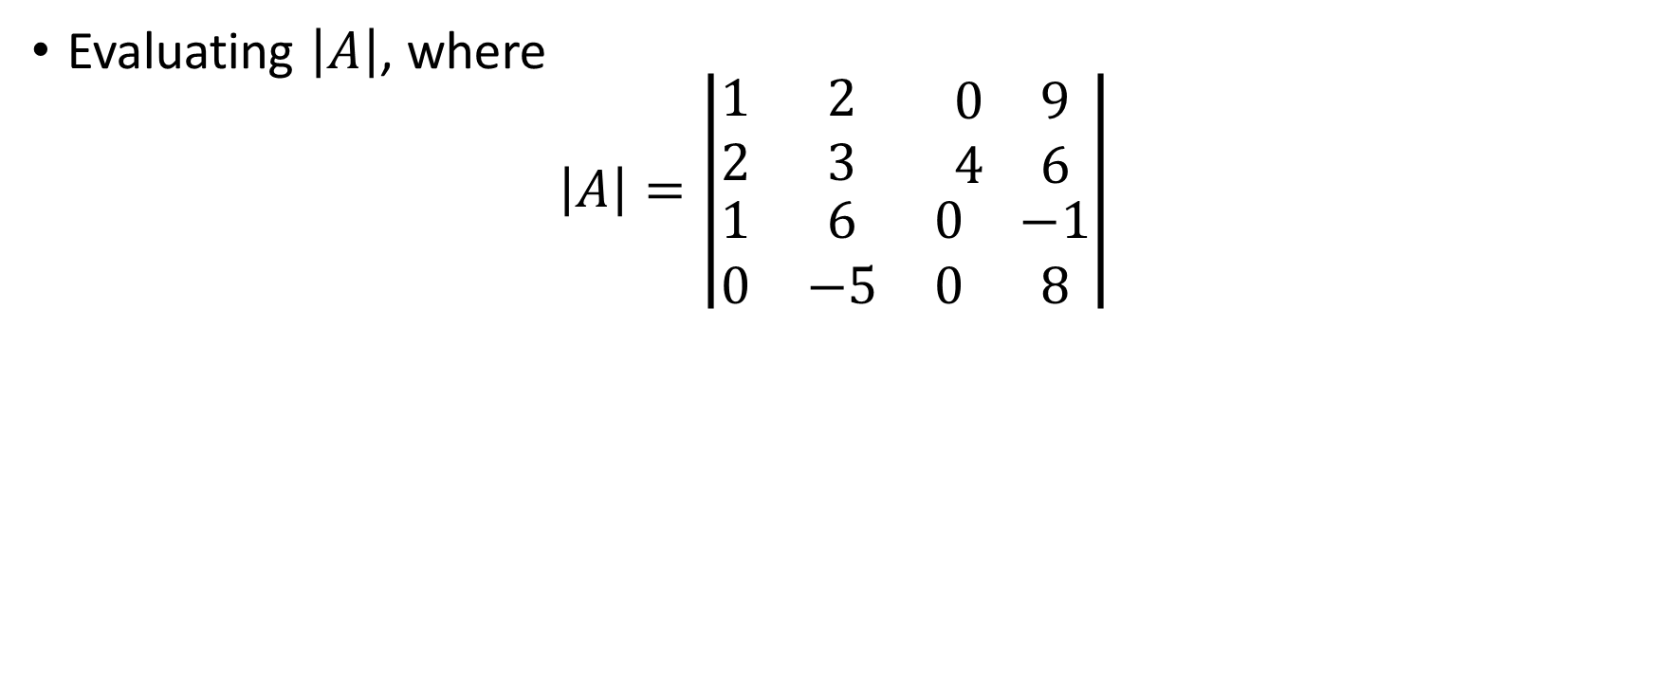
Example
Evaluating $\left|A\right|$, where
$$\left|A\right|=\left|\begin{matrix}1 & 2 & \begin{matrix}0 & 9\end{matrix} \\ 2 & 3 & \begin{matrix}4 & 6\end{matrix} \\ \begin{matrix}1 \\ 0\end{matrix} & \begin{matrix}6 \\ −5\end{matrix} & \begin{matrix}\begin{matrix}0 \\ 0\end{matrix} & \begin{matrix}−1 \\ 8\end{matrix}\end{matrix}\end{matrix}\right|$$

Slide 12
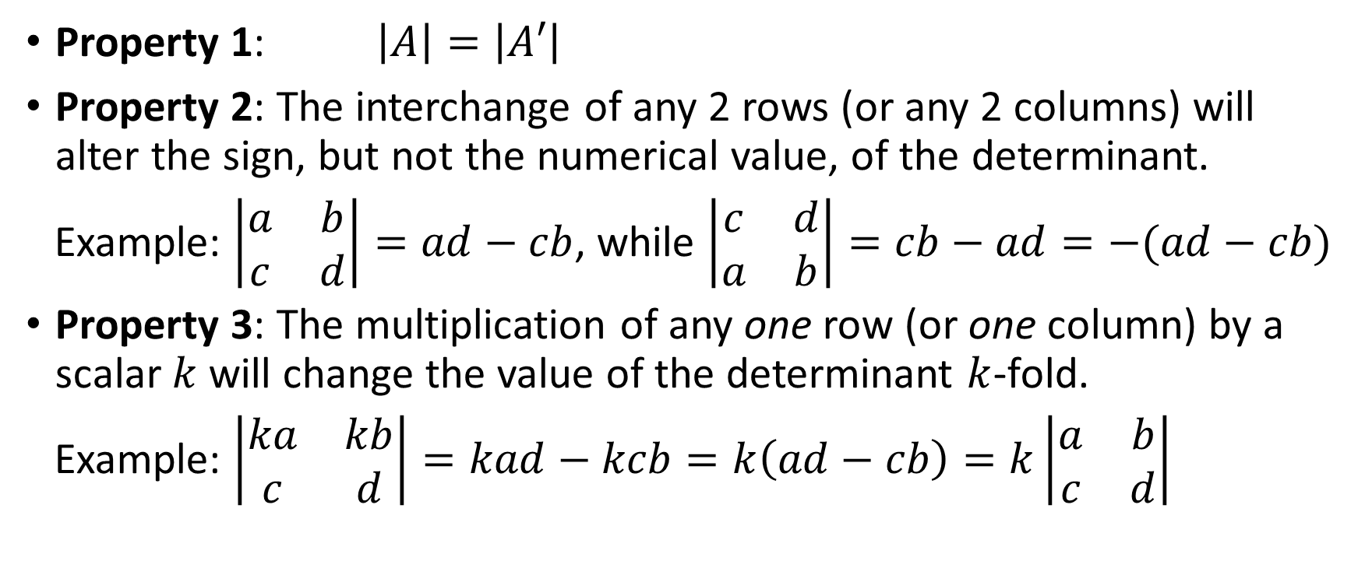
Basic Properties of Determinants
Property 1: $\left|A\right|=\left|A′\right|$
Property 2: The interchange of any 2 rows (or any 2 columns) will alter the sign, but not the numerical value, of the determinant.
Example: $\left|\begin{matrix}a & b \\ c & d\end{matrix}\right|=ad−cb$, while $\left|\begin{matrix}c & d \\ a & b\end{matrix}\right|=cb−ad=−(ad−cb)$
Property 3: The multiplication of any one row (or one column) by a scalar $k$ will change the value of the determinant $k$-fold.
Example: $\left|\begin{matrix}ka & kb \\ c & d\end{matrix}\right|=kad−kcb=k\left(ad−cb\right)=k\left|\begin{matrix}a & b \\ c & d\end{matrix}\right|$

Slide 13
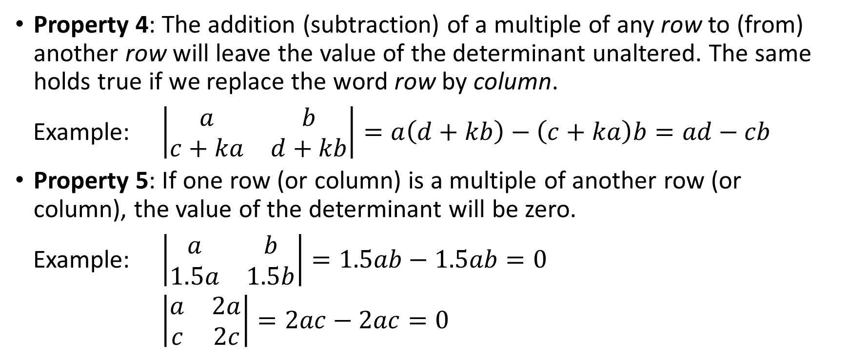
Basic Properties of Determinants
Property 4: The addition (subtraction) of a multiple of any row to (from) another row will leave the value of the determinant unaltered. The same holds true if we replace the word row by column.
Example: $\left|\begin{matrix}a & b \\ c+ka & d+kb\end{matrix}\right|=a\left(d+kb\right)−\left(c+ka\right)b=ad−cb$
Property 5: If one row (or column) is a multiple of another row (or column), the value of the determinant will be zero.
Example: $\left|\begin{matrix}a & b \\ 1.5a & 1.5b\end{matrix}\right|=1.5ab−1.5ab=0$
$\left|\begin{matrix}a & 2a \\ c & 2c\end{matrix}\right|=2ac−2ac=0$

Slide 14
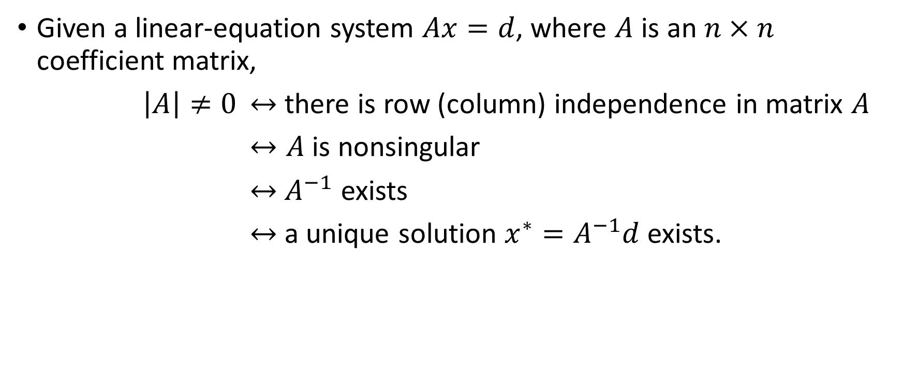
Determinantal Criterion for Nonsingularity
Given a linear-equation system $Ax=d$, where $A$ is an $n×n$ coefficient matrix,
$\left|A\right|≠0$ $↔$ there is row (column) independence in matrix $A$
$↔A$ is nonsingular
$↔$ $A^{−1}$ exists
$↔$ a unique solution $x^{∗}=A^{−1}d$ exists.

