Slide 1
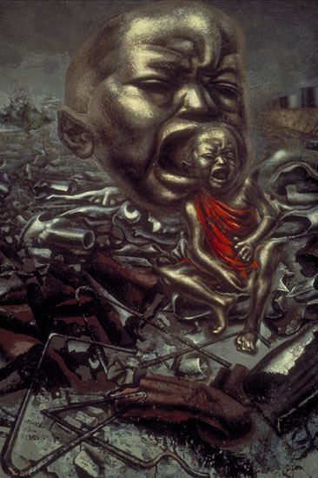
The echo of scream

Slide 2
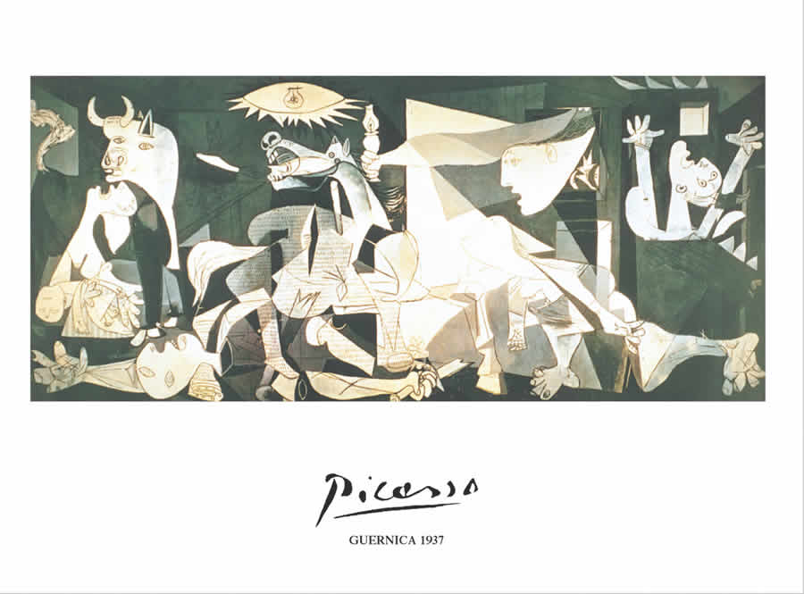
Picasso Guernica

Slide 3
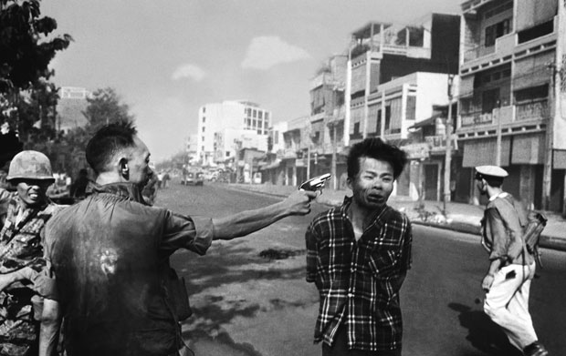
The execution in Saigon

Slide 4
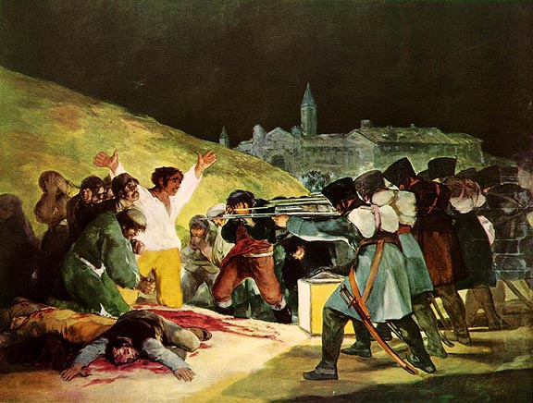
Goya, 3. May

Slide 5
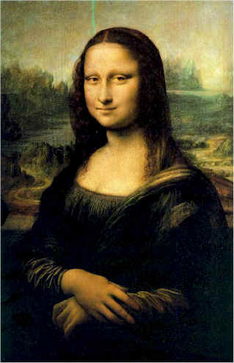
Leonardo da Vincci
Mona Lisa

Slide 6
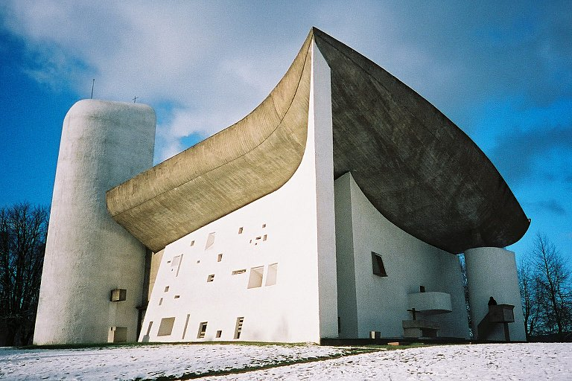

Slide 7
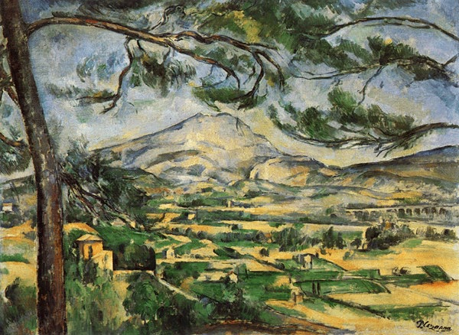
Paul Cezanne
Mt. Saint Victoire

Slide 8
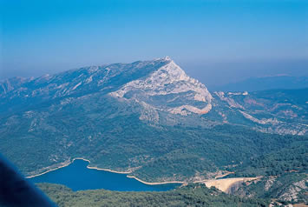
Mt. Saint Victoire

