Slide 1
2 July 2015, Economics Department, Thammasart
An Integrated Labour Market in ASEAN and CLMV Migrant Workers in Thailand
(Part 1 A: Free flow of labour in ASEAN)
Srawooth Paitoonpong, Ph.D.
Senior Research Fellow, Thailand Development Research Institute

Slide 2
An integrated labour market in ASEAN is….
…the labour market where workers can move freely from one country to another in ASEAN.
Why?
To achieve the goal of AEC, the single market and production base, there is a need for free flow of skilled labour to facilitate the free flows of goods, services, investment and capital.

Slide 3
ASEAN, AEC and Free Flow of skilled Labour
Notes:
What does ASEAN stand for?
And, what is AEC?

Slide 4
ASA
1961 Association of Southeast Asians- (Thailand Philippines Malaysia) Ending 1963
ASEAN
1967: Indonesia, Malaysia, Philippines, Thailand, Singapore, Brunei(1984)
End of Cold War 1991; AFTA 1992; ASEAN Regional Forum (ARF) 1994
Vietnam (1995) Laos, Myanmar (1997) Cambodia (1999)
2003 Bali Declaration on ASEAN Community 2020
3 Pillars of ASEAN -2015
2005 at KL change to 2015
2006 : AEC Blueprint
2007: Cebu Declaration to confirm AEC;
ASEAN Charter
2012 (Nov): @ Phnom Penh changed to 31 December 2015
ASC
AEC
ASCC
ASC ASEAN Security Community
AEC ASEAN Economic Community - (2015)
ASCC ASEAN Socio-culture Community
Notes:
1961 Association of Southeast Asians Nations- (Thailand Philippines Malaysia- Ending 1963 (conflicts between Malaysia and Indonesia and Thailand and Cambodia). Normalization of the relations between Malaysia and Indonesia in 1966 led to the formation of ASEN in 1967. a bulwark against Communism.
America withdrew from Vietnam in 1975, End of Cold War in 1991, AFTA 1992, ARF 1994. 2003 formed ASEAN Community.
Bangkok Declaration 1967 – Formulation of ASEAN 5.
ก่อนจะมาถึง AEC ก็มี ASEAN Regional Forum: ARF (1994) และ ASEAN Charter (2007)
ในปี 2002 (2545) โก๊ะ จก ตง ริเริ่มให้ตั้ง AEC (Singh) ซึ่งมีความต่อเนื่องกับการประชุมผู้นำอาเซียนในพนมเป็ญ ในพฤศจิกายน 2545
แนวคิดดังกล่าวสืบเนื่องมาถึงการประชุมสุดยอดในบาหลีในปีต่อมา 2546 ซึ่งBali Concord II กำหนดเป้าหมายเป็นปี 2563 (Singh)

Slide 5
AEC Blueprint
AEC Blueprint, signed by ASEAN Leaders at the 13th ASEAN Summit on November 20, 2007, lays the foundation for realising the goal of ASEAN as an integrated economic region by 2015.
The AEC is characterised by four pillars:
  single market and production base, *
  highly competitive economic region,
  a region of equitable economic development, and
  a region that is fully integrated with the global economy.
Notes:
(AEC Scorecard 2012, 1)

Slide 6
AEC is a matter of free trade agreement
4 Pillars of AEC
Single Market and Production Base
AEC 2015
Free Flow of:
Goods
Services
Investment
Capital
Skilled Labor
Competitive Economic Dev.
Equitable Economic Region
Integration into Global Economy
Notes:
Which pillar is directly concerned with free flow of services and skilled labour?
The formal establishment of the ASEAN Economic Community (AEC) at the end of
2015 will ceremonially mark a milestone in the process of economic integration in
Southeast Asia. The ambition of the AEC is that it will “transform ASEAN into a region
with free movement of goods, services, investment, skilled labour, and freer flow of
capital.” The ASEAN Economic Community Blueprint, launched in 2008 outlines the
vision for the AEC and the steps towards its realization (ASEAN 2008).2 ASEAN is
committed to the achievement of “Free Flow of Skilled Labour” under Pillar A (“Single
Market and Production Base”). Despite the ambition, actions required to be
undertaken of member states in pursuit of this are relatively limited when compared to
the extensive actions and commitments given in relation, for example, to trade in
goods and services, or trade facilitation. (Huelser & Heal 2014, 5)

Slide 7
How to achieve free flow of labour?

Slide 8
Cross-border movement of labour in ASEAN
Skilled labour
Low-skilled labour
WTO/GATS
1995
AFAS (1995)
ACIA
2012
CLMV
(Investors)
4 Modes of supply
(Article V)
Irregular
MRAs
Registration
Mode 4
NV
AMNP
2012
MOU
For skilled workers, there are 3 ways for cross-border movement of labour legally: GATS Mode 4, AFAS (AMNP and MRAs), and ACIA
The low-skilled workers are not the concern of AEC.
Notes:
(Fukunaga & Ishido, 2015); (nccr, 2015, 9) – Mobility of lower-skilled labour;
ACIA = ASEAN Comprehensive Investment Agreement grants entry, temporary stay, and work authorization to investors, executives, managers, and board members of corporations in the process of “committing a substantial amount of capital or other resources.(Sugiyarto & Agunias 2014, 4)
Irregular migration is defined by the International Organization for Migration as “Movement that takes place
outside the regulatory norms of the sending, transit and receiving countries.” This policy brief follows that usage.
Usage of the term illegal migration is usually restricted to cases of smuggling of migrants and trafficking in persons.(Huelser & Heal 2014, 2)

Slide 9
WTO/GATS Mode 4

Slide 10
WTO/GATS Mode 4
The General Agreement on Trade in Services (GATS), entered into force in 1995.
Under GATS, services can be traded internationally in four different ways — known as the four modes.
Mode 1: Cross-border supply
Mode 2: consumption abroad
Mode 3: Commercial presence
Mode 4: Movement of natural persons. (An extension of Mode 3. It is considered as facilitating business visits & movement of high-level personnel within multinational corporations (Orbeta 2013, 13)).
Notes:
Ref: (nccr, 2015); (Orbeta, 2013)

Slide 11
Mode 4 refers to the presence of persons of one WTO member in the territory of another for the purpose of providing a service.
It does not concern persons seeking job in the host member, nor does it affect measures regarding citizenship, residence or employment on a permanent basis.
Winters et al (2003) proposed extension to medium and less skilled workers (Orbeta 2013, 13)

Slide 12
Country A
Country A
Country B
Cross-border service
Supplier
User in B
Mode 1
Consultant trips abroad to improve services provided from abroad; auditing services through internet, Skype, etc.
supplier
Consumption abroad
Mode 2
User from B
Travel agents and tour-guides servicing their country people in destination country
Supplier
Commercial presence
User in B
Mode 3
Inter-country transfer, business migration and temporary movement of highly skilled professionals
Presence of a natural person
User in B
Mode 4
Temporary travel for a limited period by workers to perform a specific service abroad in connection with other foreign funded
ที่มา: รณรงค์ พูลพิพัฒน์. Free Flow of Services. กรมเจรจาการค้าระหว่างประเทศ.
Notes:
Ref.: (Manning & Bhatnagar 2004, page 4-5)
เช่น 1) Accounting/auditing, designing; 2) ไปทำจมูก ดึงเหนียงที่เกาหลี 3) เข้ามาตั้งบริษัทที่ปรึกษาในไทย 4) สถาปนิกเข้าไปทำงานให้บริษัทต่างประเทศในประเทศ ก

Slide 13
Visa facilitation for Natural Persons
Independent foreign natural persons e.g.
  Business visitors
  Service sellers
  Independent contractual service supplier
Foreign natural persons who are employed at home and sent abroad to supply a service:
  for the ‘same’ company which has commercial presence in another Member’s territory (Intra-corporate Transferees)
  to a consumer in the territory of another Member. The contract is made between the home and host companies (juridical contractual service supplier)

Slide 14
Commitment of Thailand on Mode 4 (GATS/WTO)
1. Business visitors
Qualification
Natural persons
Duration of stay
90 days – 1 year
Purpose of visit:
Meeting, business
Negotiation on Services contract
Business visit or related activities
สำนักเจรจาการค้าบริการ
กรมเจรจาการค้าระหว่างประเทศ

Slide 15
Commitment of Thailand on Mode 4 (GATS/WTO):
2. Intra-corporate Transferees
Qualification:
Manager, Executives, specialists or working with the company more than a year; qualified under “management needs” of the Department of Employment, MOL
Duration of stay:
1 year, extendable to 3 years
Thai regulation on work permit
Qualified under Management needs of DOE –
1. Size of registered capital
2. Employment generation
3. FDI
4. Export promotion
5. Technological transfer and
6. Special needs of the management
สำนักเจรจาการค้าบริการ
กรมเจรจาการค้าระหว่างประเทศ

Slide 16
Movement of skilled labour under AEC

Slide 17
Pillar 1: Single market & production base
5 core elements
Free flow of goods
1
Skilled labour can work in AMS under 2, 5 and 3
Free flow of services
2
Free flow of investment
3
Free flow of capital
4
Free flow of skilled labour
5
Notes:
It is Pillar 1 that is concerned with free flow of services and skilled labour.
There 5 elements that are concerned with movement of skilled labour

Slide 18
Cross-border movement of labour in ASEAN
Skilled labour
Low-skilled labour
WTO/GATS
1995
AFAS (1995)
ACIA
2012
CLMV
(Investors)
4 Modes of supply
(Article V)
Irregular
MRAs
Registration
Mode 4
NV
AMNP
2012
MOU
For skilled workers, there are 3 ways for cross-border movement of labour legally: GATS Mode 4, AFAS (AMNP and MRAs), and ACIA
The low-skilled workers are not the concern of AEC.
Notes:
(Fukunaga & Ishido, 2015); (nccr, 2015, 9) – Mobility of lower-skilled labour;
ACIA = ASEAN Comprehensive Investment Agreement grants entry, temporary stay, and work authorization to investors, executives, managers, and board members of corporations in the process of “committing a substantial amount of capital or other resources.(Sugiyarto & Agunias 2014, 4)
Irregular migration is defined by the International Organization for Migration as “Movement that takes place
outside the regulatory norms of the sending, transit and receiving countries.” This policy brief follows that usage.
Usage of the term illegal migration is usually restricted to cases of smuggling of migrants and trafficking in persons.(Huelser & Heal 2014, 2)

Slide 19
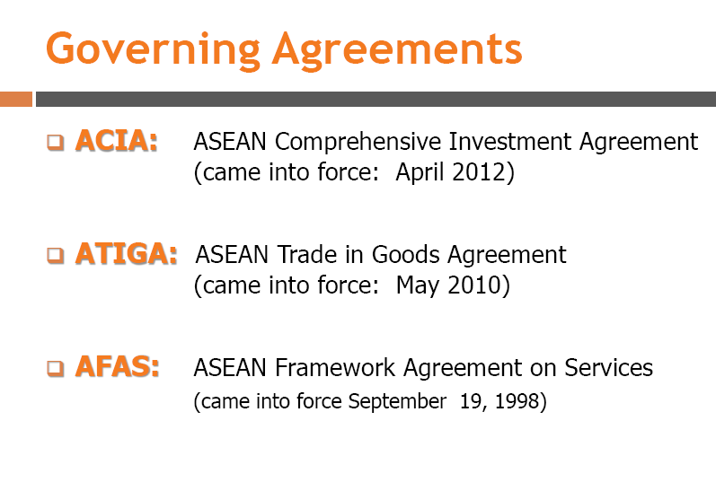
The 5 core elements are facilitated by these
Notes:
(AEC Scorecard 2014)
First of all, ASEAN sets up agreements among AMS to pursue the 5 core elements, two of which are applied to the free flow of skilled labour.
We will skip other elements but elements2 and 5.

Slide 20



The 5 core elements are facilitated by agreements
AMNP: ASEAN Agreement on Movement of Natural Persons
(Signed on 19 November 2012)

Slide 21
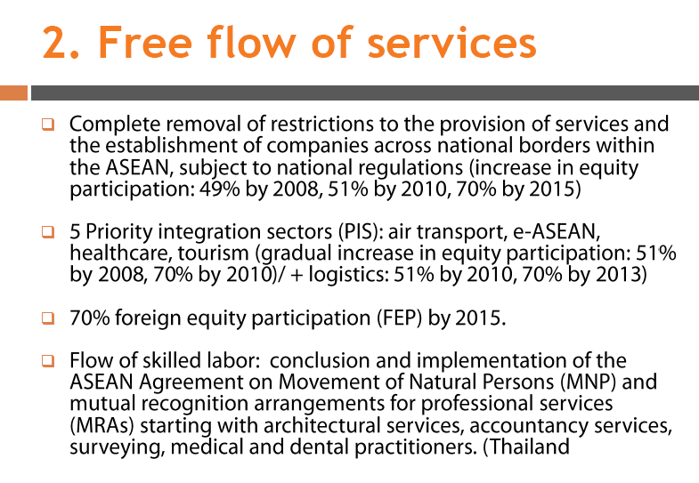
Under AFAS

Slide 22
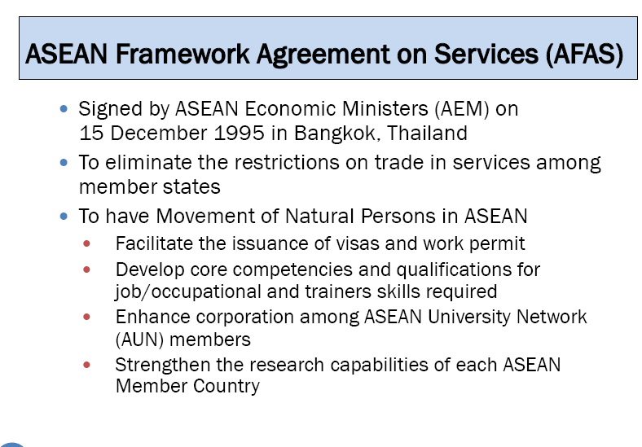

Slide 23
AFAS Article V: Mutual recognition
Each Member State may recognise the education or experience obtained, requirements met, or licenses or certifications granted in another Member State, for the purpose of licensing or certification of service suppliers.
Such recognition may be based upon an agreement or arrangement with the Member State concerned or may be accorded autonomously.

Slide 24
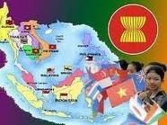
AEC agreements on cross-border movement of natural persons
There are 2 means for working in other AMS.
Movement of professional
ASEAN Framework Agreement on Services
(AFAS)
Mutual Recognition Arrangements
(MRAs)
(Article V of AFAS)
Movement of business men or staff with trade and /or investment
Notes:
จัดทำข้อตกลงการยอมรับคุณสมบัติวิชาชีพที่กำลังเจรจาอยู่ให้แล้วเสร็จ ซึ่งรวมบริการ
สถาปัตยกรรม บริการด้านบัญชี คุณสมบัติผู้สำรวจ บุคลากรด้านการแพทย์ ภายในปี 2008 (2551) และ
บุคลากรด้านทันตกรรมภายในปี 2009 (2552)
(จากสุวรรณา PPT 9อุตสาหกรรม เสนอที่ กพร ปช)

Slide 25
What is MRA?
MRA is an arrangement among ASEAN countries designed to facilitate the free movement and employment of qualified and certified personnel between ASEAN Member States.
Through MRAs, ASEAN members may recognize the
education or experience obtained, requirements met, and certification or licensing granted by other ASEAN members.
MRAs have been completed in accountancy, engineering, medicine, dentistry, and nursing. MRA frameworks (which provide the agreed platform for negotiation of a future MRA) are expected by 2015 in architecture
Notes:
(Huelser & Heal, 2014, 6)
and surveying. Negotiation of MRAs can be complicated by wide variations in
educational standards and practices. There are further problems related to
determining the equivalence of on-the-job training and formal training in some
professions e.g. chefs or IT workers. Further, implementation of these MRAs does not
equate to market access; permission to work is still subject to domestic rules and
regulations which, as seen above, are highly restrictive in many ASEAN members.
While the ASEAN ‘scorecard’ for 2011 judged that ASEAN has ‘fully implemented’
required measures on the free flow of labour, no assessment or report has been
undertaken on the implementation of MRAs or their effectiveness (Chia, 2013).

Slide 26
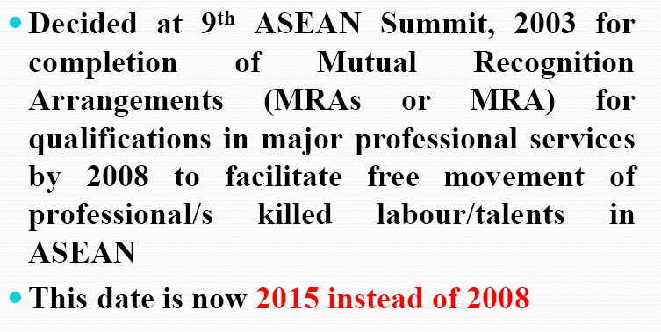
Bali Concord II

Slide 27
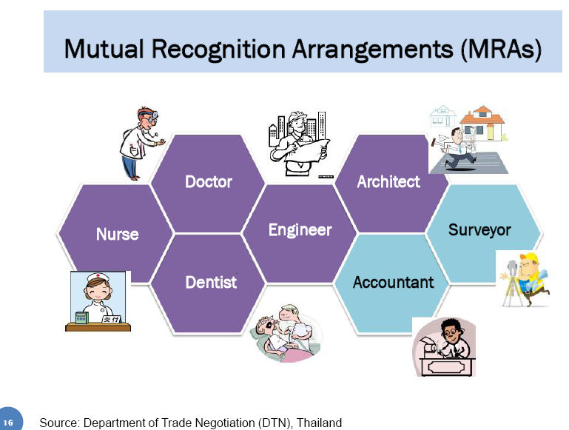
Tourism
professionals

Slide 28
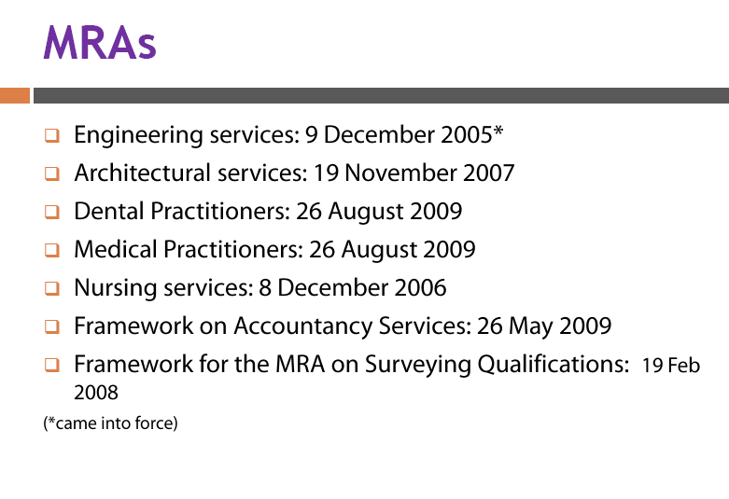
Under AFAS Article V
Tourism Profession 9 November 2012
(Scorecard 2014)

Slide 29
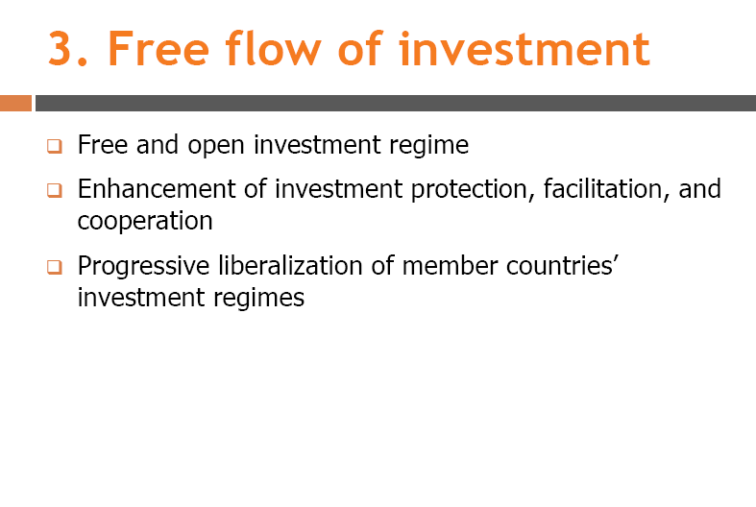

Slide 30
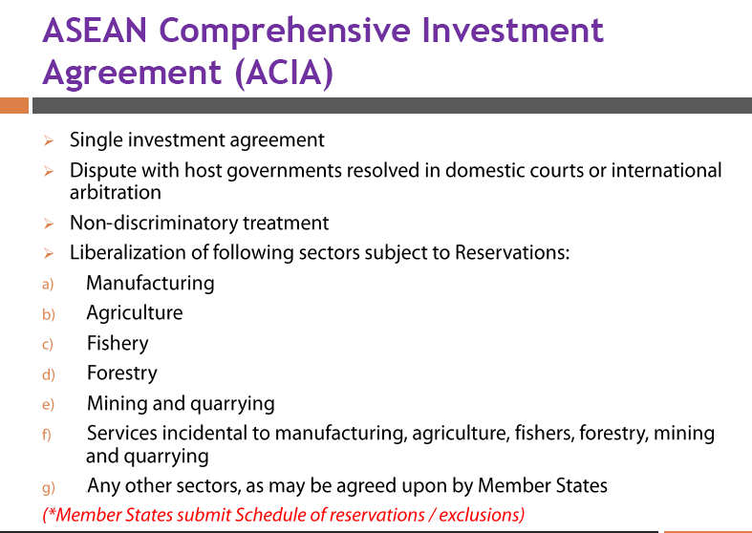
ACIA grants entry, temporary stay, and work authorization to investors, executives, managers, and board members of corporations in the process of committing a substantial amount of capital or other resources (Sugiyaro 2014)

Slide 31
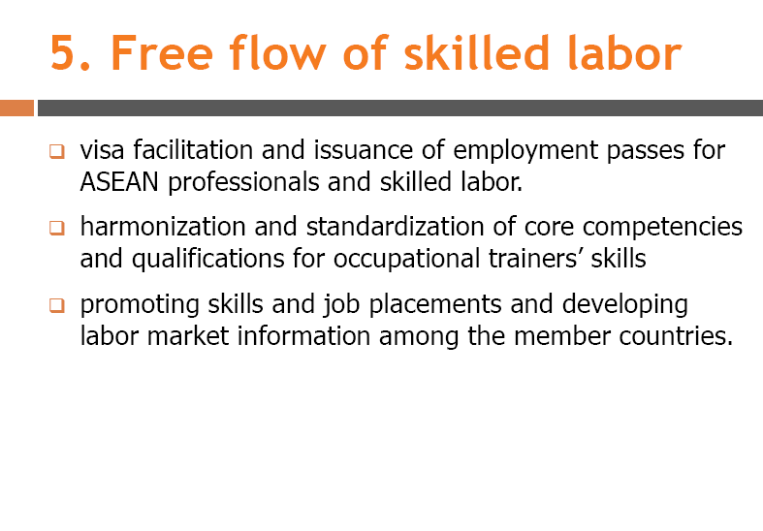
These procedures are linked with AFAS, AMNP (as well as GATS Mode 4) and MRA but also deal with competency standard, accreditation, and labour market information

Slide 32
MRA requirements

Slide 33
In order for a Professional (in 8 disciplines) to be recognised by other AMS and to be eligible to work in a host country, they will need to possess a valid competency certificate as well as other requirements as specified by the Professional Certification Board (PCB) in an AMS.
In general, the mechanism for certifying qualification (as in the case of Tourism Professionals) consists of
  Professional Monitoring Committee (MC)
  Professional Registration System (RS)
  National Professional Board (PB)
  Professional Certification Board (CB)

Slide 34
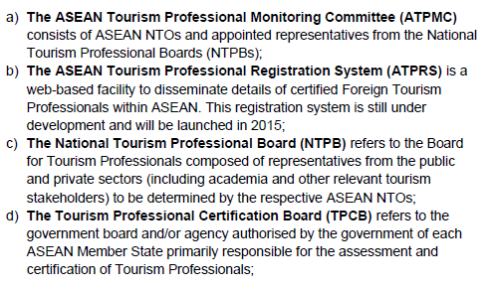
Example of competency certifying mechanism for Tourism Professionals
NTO= National Tourism Organizations

Slide 35
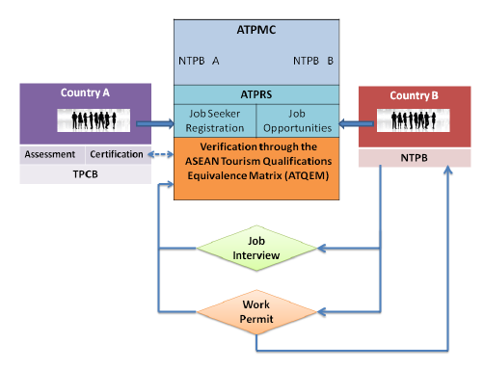
Registration sys
ASEAN-TP competency certifying Mechanism
DOE, MOL

Slide 36



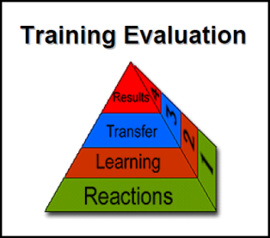
Framework of Thailand’s preparation for MRA-TP
ASEAN ON LINE Database is being developed for (i) members (ii) employers (iii) trainers and (iv) assessors.
Pass
Send to TPCB for approval for ASEAN MRA certification (MC)
MRA Training
MRA Assessment
To receive ASEAN MC, workers must take ASEAN MRA courses both technical and practice (emphasizing skill & competency of selected subject
Trainees
Curriculum
MOT or Training institute/assessment
Trainer must be MOT (Master of Trainer) or MOT graduates
Must be ASEAN MRA only. Min of Tourism/Sports will provide curriculum and toolbox
Academic institute teaching tourism and hotel services
Gov or private institute or agency as juristic person related to tourism and hotel services
Having qualifications required by TPCB sub committee
Apply for permission from TPCB
Notes:
Source: Ministry of Tourism and Sports, 2/7 May 2014 Reports of the Meeting of TPCB 1/2557
MC= MRA Certification

Slide 37

Framework of Thailand’s preparation for MRA-TP
TP Register & apply for certification in country A
Contact MOTS, Thailand
Employer/Thailand sends contract to employee in A &
Thai embassy
TPCB –Country A
MOFA/Embassy checks
Yes
Issued non-immigrant visa B
NTPB Thailand
Employer submits Form-3
Employee comes to Thailand
No
Report to Immigration for working visa
Report to DOE within 30 days for WP
MRA-TP facilitates the cross-border recruitment process by screening the competency of prospective employees.
Notes:
Form tt-3 to apply for work permit on behalf of the prospective employee. In theory, WP authority will follow MRA-TP and TP- certification

Slide 38
Accountant
Qualifications to Apply to be an ASEAN Chartered Professional Accountant (ACPA)
A Professional Accountant is eligible to apply through the Monitoring Committee of his or her Country of Origin, to be registered as an ASEAN Chartered Professional Accountant (ACPA) on the ASEAN Chartered Professional Accountant Register (ACPAR) provided that he or she possesses the following qualifications:

Slide 39
an accredited accountancy degree or professional accountancy examination programme recognised by the National Accountancy Body (NAB) and/or Professional Regulatory Authority (PRA) of the CO or HC, or has been assessed and recognised by the NAB and/or PRA as having the equivalent of such a degree;
current and valid professional registration certificate in the CO issued by the NAB) or PRA;
practical experience of not less than 3 years;
complied with the Continuing Professional Development (CPD) policy of the CO;
no record of any serious violation of technical, professional or ethical standards,

Slide 40
Engineering MRA requirements
To be registered as ASEAN Chartered Professional Engineer (ACPE)
completed an accredited engineering degree recognized by the professional engr accreditation body in Country of Origin (CO) or HC or assessed & recognised as equivalent degree .
2. possess a current & valid prof’l reg. or licensing cert to practice eng in CO Origin by Profession Regulatory Authority (PRA) of AMC
3. acquired practical & diversified experience of not less than seven (7) years after graduation, at least two (@) years in responsible charge of significant eng work
4. Compliance with Continuing Professional Development(CPD) policy, Country of Origin at a satisfactory level
5. obtained cert , Professional Regulatory Authority (PRA), Country of Origin with no record of serious violation on technical, prof’l or ethical standards, local & international, for the practice of engineering.
Notes:
(Tansinsin 2014)

Slide 41
His/Her application include a sworn statement undertaking to :
a. bound by local & int’l codes of prof’l conduct in accordance with policy on ethics and conduct established & enforced by the CO.
b. Bound by the prevailing laws & regulations of the HC.
c. Work in collaboration with local Prof’l Eng in the HC subject to domestic laws & regulations of HC governing the practice of engineering.
Upon approval , RFPE (Registered Foreign Professional Engineer), not in independent practice, but in collaboration with designated prof’l Eng in HC, with area of his own competency as recognized & approved by PRA of HC.

Slide 42
Nurse MRA
3.1 Granted a Nursing Qualification
3.2 Possession of valid prof’l registration and/or license from CO & current licence or cert or any relevant certifying documents
3.3 Minimum practice experience not less three (3) yr
3.4 Compliance satisfactory CPD as mandated by NRA of the CO
3.5 Certification CO of no record or pending investigation of having violated any technical, prof’l or ethical standards, local & international, practice of nursing
3.6 Submit medical examination or undergo an induction program or competency assessment, as imposed by NRA OR any relevant authority of HC s continuous yrs prior to application

Slide 43
Eligibility of foreign Nurse -Complying to domestic laws & regulations
Undertaking of a Foreign Nurse –
1. conduct in accordance to policy on ethics the practice of HC
2. observance of prevailing domestic laws & regulations of HC & the practice of nursing
3.3 Subscribe to any requirements for an insurance liability scheme of the Host Country
3.4 Respect the culture and religion of th Host Country

Slide 44
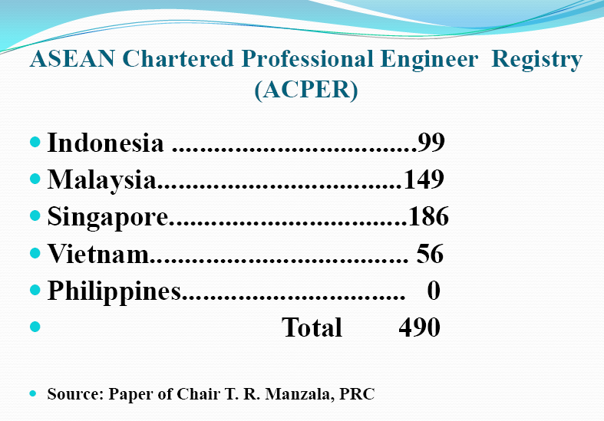
No Thai?
Tansinsin (no date)

Slide 45
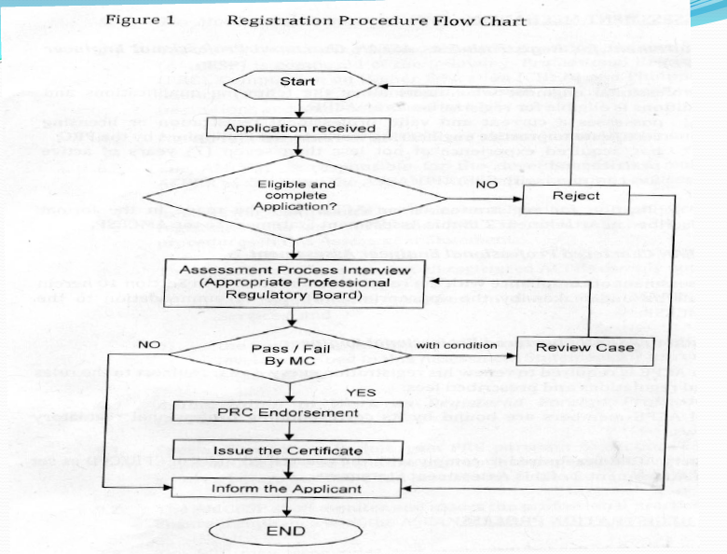
Tansinsin (no date)
Notes:
MC= Monitoring Committee; PRC = Professional Regulatory Committee?

Slide 46
Progress of MRAs 2015 (Fukunaga 2015)
MRAs on Architectural and Engineering Services have made steady progress, incl. the setting up of regional registration systems. (Not resulted in a large-scale movement of these professionals- existence of alternative legal schemes and small additional benefits of MRAs).
MRA on Nursing Services has facilitated movement of nurses in only a few countries.
Further efforts being made on : Agreement on the Movement of Natural Persons (AMNP), MRAs on Accountancy Services and Tourism Professionals, and ASEAN Qualifications Reference Framework (AQRF)

Slide 47
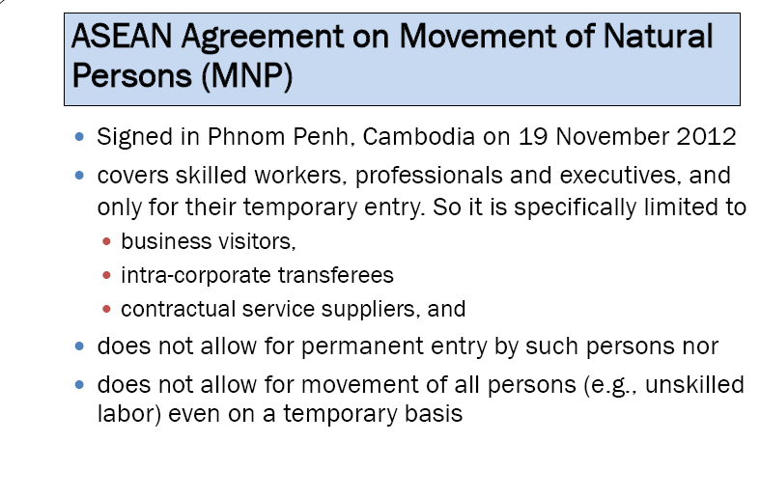
(Sineenat 2014)
Notes:
(Fukunaga & Ishido, 2015, 2)

Slide 48
ASEAN started negotiations on its own MNP Agreement in 2010 and the Agreement was signed in November 2012. In 2015, only 7 countries have either ratified or notified completion of necessary domestic procedure, and thus the agreement has not come into force. (Fukunaga & Ishido, 2015, 3)

Slide 49
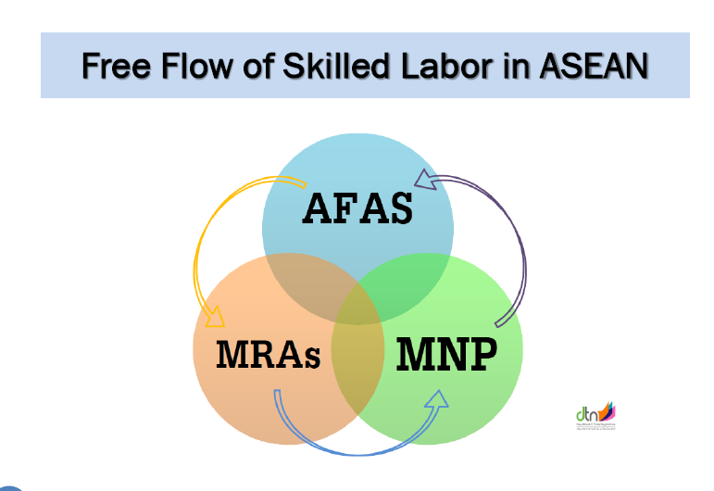
Notes:
(Sineenat: 2014)

Slide 50
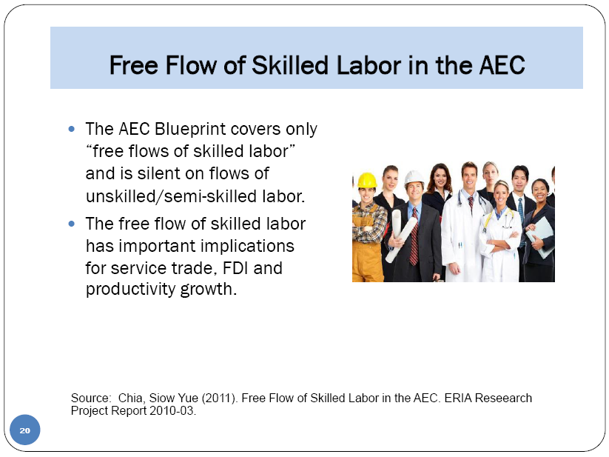
(Sermcheep 2014)

Slide 51
Conclusion
The AEC targets the free movement of ‘skilled’ labour across AMS.
It does not include provisions for unskilled labour migration, its impact on improving labour conditions will be limited.
AEC will only allow the temporary movement of skilled workers across companies within the region. Permanent workers’ relocation is not yet permitted.
Given the still large differences in existing regulations across ASEAN member countries, policies are needed to facilitate the issuance of visas and employment passes for skilled workers engaged in intraregional trade and investment flows.
(Capannelli 2014)

Slide 52
A clear definition of core competencies for occupational skills is also urgently required, especially in services.
Eventually, ASEAN leaders should expand the AEC beyond skilled labour to include proper management of unskilled labour movement. Creating MRAs for jobs in sectors such as construction, garments, fishing, and plantations could be the next logical step.
(Giovanni Capannelli is the Principal Economist of the Central and West Asia Department of the Asian Development Bank.)

Slide 53
End of Part A (slide 1-52).

