Slide 1

INTEGRATED BRAND COMMUNICATION
Massimiliano La Franca
Lesson 7
YAWP

Slide 2
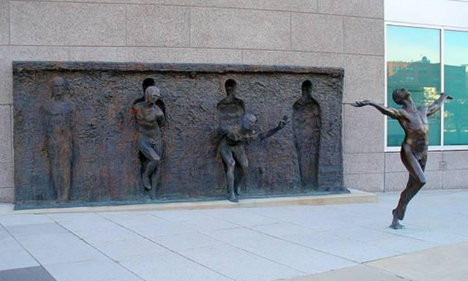

Slide 3
Last session recap
What is the brief; why is the brief important?
What’s in it
Jobs to be done
Marketing/Communication Objectives
SMART objectives

Slide 4
Into the details of the standard brief

Slide 5
Today we will focus on:
A. What is the Job-to-be-Done (Brand Task) and resulting marketing objective? ▲ B. What is the measurable communication objective for this Job to be Done? ▲
What insight drives this brief? ▲
Who is our target audience? ▲
A. If Briefing for a Campaign Idea: Initial recommendation on required channels to reach and engage our target and why: ▲ B. If Briefing for an Execution: What is the role of this execution within the Channel Strategy?
What do they think and do now? (in relation to our brand and its product category) ▲
What would we like them to think and do in response to the communication? ▲
What is the single most important point to communicate? ▲ Why should they believe it? ▲
Section 1: Objectives
Section 2: Insight
Section 3: Target
Section 4: Channels
Section 5: Key point

Slide 6
Target: the starting point of any promotional activity
?
why

Slide 7
Why?
Remember communication process? Encoding and decoding the message
Talk to relevant people that are interested in what the brand wants to say
What we will say in the communication depends on what we know about them
Talk differently and in different channels to different people

Slide 8
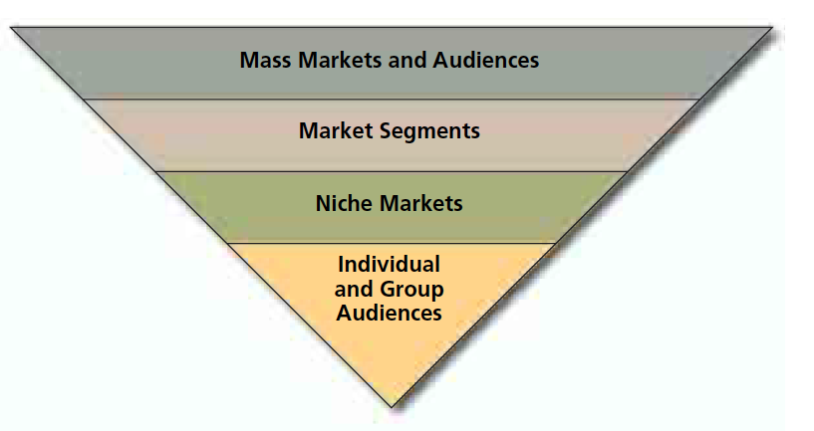
The big picture
General
Audience
Segments with similar needs
Narrowly defined groups
One to one

Slide 9
How are they defined?
Geography: we might need to address the specific needs of a specific area (for example: think sim-cards in BKK and upcountry)
Demographic: gender, age, lifestages, Birth Era (Gen Y, Z),
Socioeconomic: income, education, occupation
Psycographic: personality (extroverted, ambitious), values (achievers, gregarious), attitudes (rejectors, lovers)
Behaviour: heavy or light users of a product, loyal, non-users
Lifestyle

Slide 10
Define the Key Target
Target describes the chooser of the brand, who may be the buyer or the user. This is the person for whom the brand is – or wants to be – the first choice.
The ‘chooser’ should be defined in terms of attitudes, behaviour and values as well as in socio-economics. Sometimes it can also be helpful to specify the situation in which the brand will be the first choice.

Slide 11
An abused term
There’s a lot of confusion with the word target: be clear what you mean.
The most important:
Target users/buyers
Communication target (bulls eye)
Media target
Watch out: The 3 above might not be the same for the same category

Slide 12
Users - Buyers
Those people who actually buy and use the product/service
Information coming from market data and analysis (scan, loyalty cards, researches)
The ones who use the product are not always the same than the one who buy it (wives buying shampoo for husbands)
Can be quantified

Slide 13
Communication target
Those people which we want to communicate to
They’re not always the same than those who use the product
  Influencers - Bull’s eye target: a very narrowly defined group of people who are the key influencers or motivators for the decision of the mass
  Aspirational
  Rejuvenating / refreshing activities
Mainly used in the communication brief, they tend to be defined more in terms of psychographic values and attitudes more than figures.

Slide 14
Media target
The group of people that use a specific media that a brand want to target
  men 18-24 at futsal
Media agencies provide data and detailed description of who use a specific media, how much and when.
It becomes relevant to decide what channels are more relevant to reach a specific group of people with a specific message.

Slide 15
So, where to start?
Start from the key users: who are them?
Once defined them, ask yourself:
  Are they the main source of business? Who else could you get? Who would you most like to get?
  Are they the key people to focus our communication on?
Once defined the target group you want to talk to, describe them in an inspiring way for the agency to develop communication to influence them.
Media target gets relevant at the end of the process when you want to define what media to buy.
Users or others?
Comms
Media

Slide 16
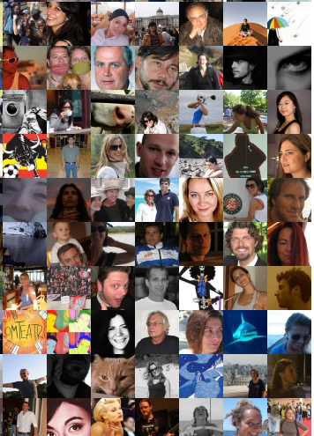
Remember…
How could you describe them in a meaningful way?
  Demographics are important but not enough
  What’s their behavior: current users, non users, rejectors, loyal, light or heavy users?
  No marketing jargons, we’re talking about people…
What insight do we know about them?
  What does explain their behavior?
  Remember insight answer the question, why do they behave this way?
Focus
  The more precise is the target the biggest the chances of success
  You can’t please everyone all the time but you must please your key target

Slide 17
Some useful exercises
What is our Target ‘For’ and ‘Against’?
  Draw up a list what our core target consumers are ‘For’ and ‘Against’ so that we understand them in the wider context of their lives.
24-hour clock – a day in the life to understand them holistically, tracking:
  Time of day?
  Doing what?
  Where?
  Brand messages exposed?
  Impact?
  Receptiveness to message?

Slide 18
Some example
Successful business men who spend about 1/8th of their waking life in their car
14-25 year-old men, fairly cool but still limited in experience of women. Chasing girls, getting chased by girls, getting girls is a way of defining themselves as individuals and men. Peer group approval is critical
14-65 years old who like drinking beer (too broad, who are them? when do they drink? Why do they drink?)
Shoppers who have the member card and shoppers who don’t (need to choose, we can’t talk to both with the same message)

Slide 19
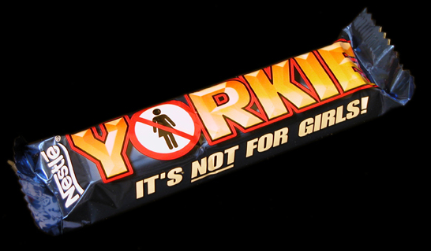
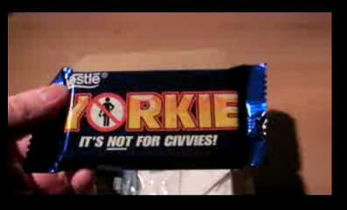
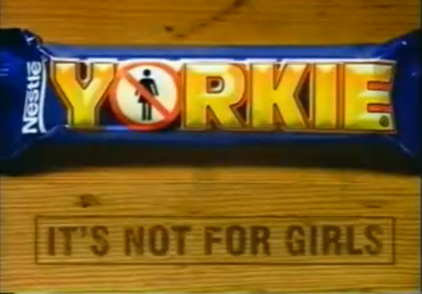
THE POWER OF CHOOSING
YORKIE IN UK

Slide 20
Today we will focus on:
A. What is the Job-to-be-Done (Brand Task) and resulting marketing objective? ▲ B. What is the measurable communication objective for this Job to be Done? ▲
What insight drives this brief? ▲
Who is our target audience? ▲
A. If Briefing for a Campaign Idea: Initial recommendation on required channels to reach and engage our target and why: ▲ B. If Briefing for an Execution: What is the role of this execution within the Channel Strategy?
What do they think and do now? (in relation to our brand and its product category) ▲
What would we like them to think and do in response to the communication? ▲
What is the single most important point to communicate? ▲ Why should they believe it? ▲
Section 1: Objectives
Section 2: Insight
Section 3: Target
Section 4: Channels
Section 5: Key point

Slide 21
The insight

Slide 22
Insight
A penetrating understanding of a complex situation or problem.
“
”
“
The ability to perceive clearly or deeply the inner nature of things.
”

Slide 23
Insight
Insight: deep understanding of consumers’ on which the brand builds a unique proposition.
A Deeply Felt Human Truth That Bonds Our Consumer To Our Brand
Foundation on which a communication strategy is built
Can come from observation of a behavior but must answer the question WHY?
  Observation = How do people behave?
  Insight = Why do people behave this way?
Can come in the form of an unmet need (ex. I wish I could eat chocolate without getting fat)

Slide 24
Insight
Insight is different from observation or fact
Observation
Insight
WHY?
Driving a high performance
car is a clear signal to others
that I am on the road to
success
I enjoy driving
high performance
cars

Slide 25
The word insight
Insight is a word with many meanings depending on what is associated with.
It is about understanding something in depth. Providing an explanation of something that is not obvious in the surface.
It is powerful because it is universal, most people can recognise it. It’s like we know but we’re not conscious.
And it has a “wow” effect.
That’s why is so used in advertising:
  its surprising but not completely
  it’s simple and easy to relate to; and mostly everyone can relate to it
  it’s relevant because it says something about the way we live

Slide 26
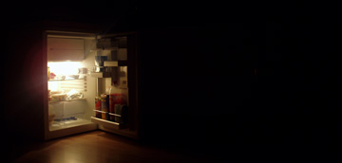
Someone said…
Insight is like a refrigerator because the moment you look into it, a light comes on.

Slide 27

Facts, insights and observation
FACT: people feed pets twice a day
OBSERVATION: people feed pets during lunch and dinner time
INSIGHT: people feel guilty eating in front of their pets

Slide 28
How do we use insights?

Slide 29
Consumer and execution insight
Consumer insight: a profound understanding of the consumers, their needs, wants, expectations, frustrations…
  Comes from deep understanding of the way the consumers relate to the category and the products.
Execution insight: the element upon which the communication is built on.
  Comes from a deep understanding of how people relate to the product AND understanding of culture, trends, society, people…

Slide 30
Shopper, product and media insight
Shopper insight: a profound understanding of the shopper (as person who shops in the point of sale)
Product insight: that key element of the product that makes it unique and different
Media insight: that specific element of that media channel that makes it unique and different

Slide 31
Our focus
Consumer insight: that deep understanding of the underlying reasons of people’s behaviors
  Used as a leverage to try and change behaviors
  Related to how people relate to the brand
Execution insight: directly related to a specific execution (example: something related to local culture or usage of a specific media)
  The insight that is at the core of the creative idea

Slide 32
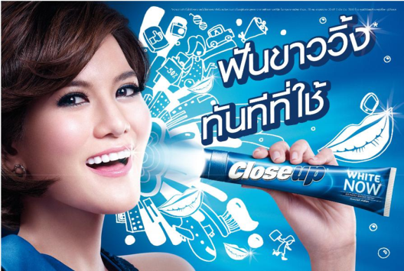
White teeth are as important as my make-up or hair - its part of looking fantastic and turning heads.

Slide 33
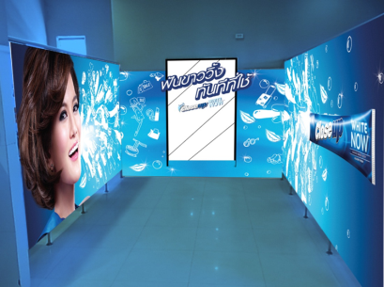

Ladies room is where girls transform, check their look and adjust make up…
Bright smile is a seduction weapon.

Slide 34
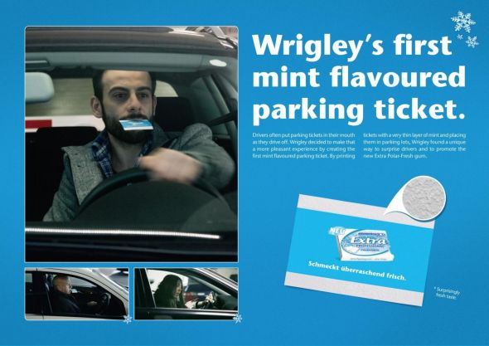
MEDIA Insight

Slide 35
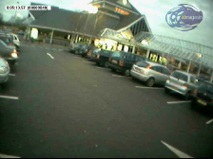
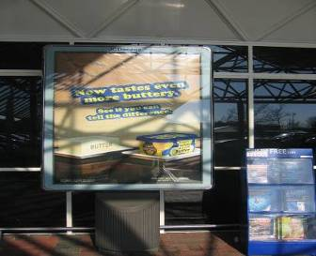
MEDIA insight
When shoppers are approaching the store, they are observed to be looking for parking, fixing their things.
Thus, communication approaching the store is generally ignored.
At most, 1% of shoppers look at them.
IMPLICATION: Do NOT invest in communication outside the store.
*source: tesco shopper study

Slide 36
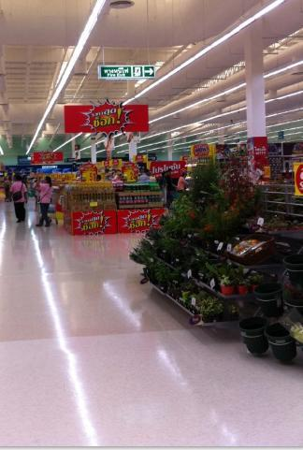
Shopper Insight
Shopper Insight:
People do not usually start shopping until they are a few meters in the store
Implication:
Leverage the landing strip to disrupt shopper and make them adjust to shopping mode quickly
Examples:
Exclusive/innovative items (imagine use iPhone5!) to surprise shopper
Create shocking savings “check price carts” and place them in the landing strip
Landing strip

Slide 37
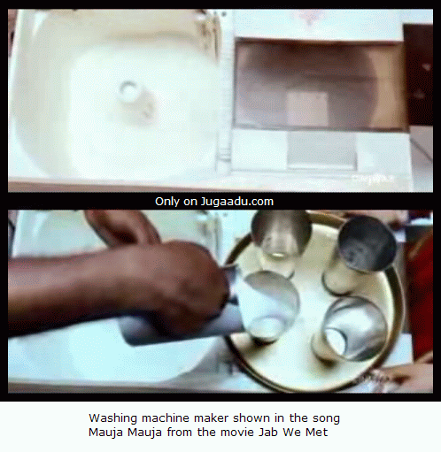
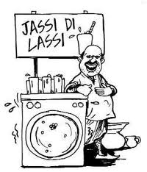
Product Insight

Slide 38
Let’s learn how this is used in advertising

Slide 39
Fact
Milk Goes With Many Things

Slide 40
Insight
You Only Notice Milk When It Isn’t There

Slide 41
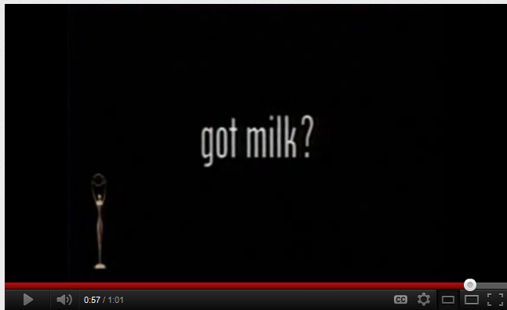
A famous case

Slide 42
Fact
Men think about sex every 3 seconds

Slide 43
Insight
when it comes to girls, I whish they would make the first move
Notes:
Separate into text boxes and hav them come in together

Slide 44
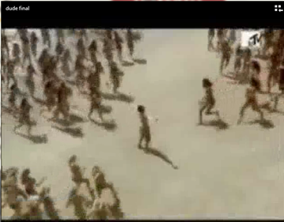

Slide 45
examples
Volvo interception: https://www.youtube.com/watch?v=xZe1rVgT0WE
Same executional insight: pepsi max and telecom argentina
True
Dtac Disconnect to connect
Reebok sofa
Snickers You’re not you
Novartis shoelace

Slide 46
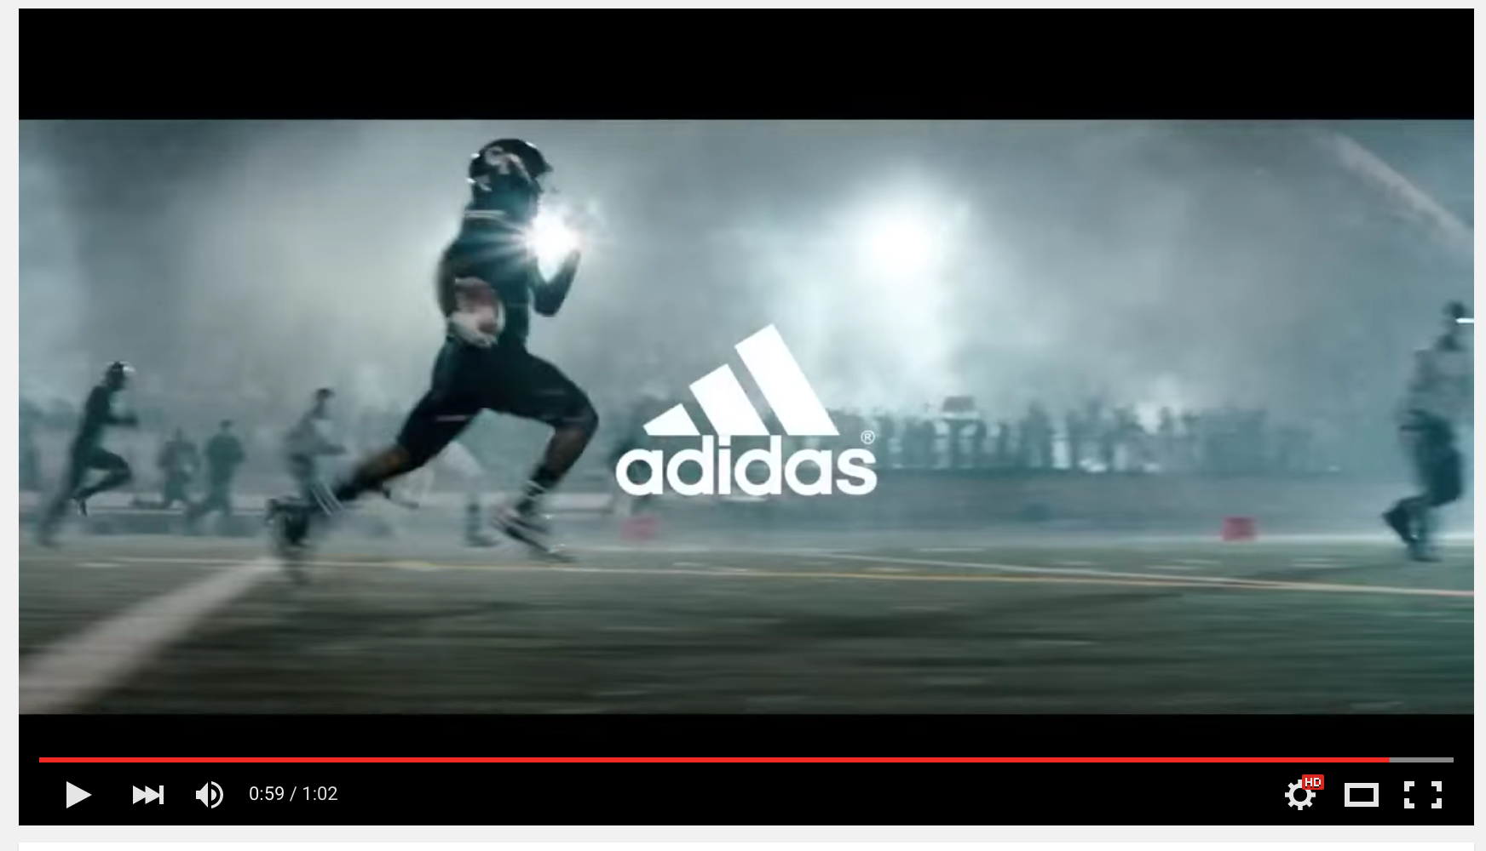
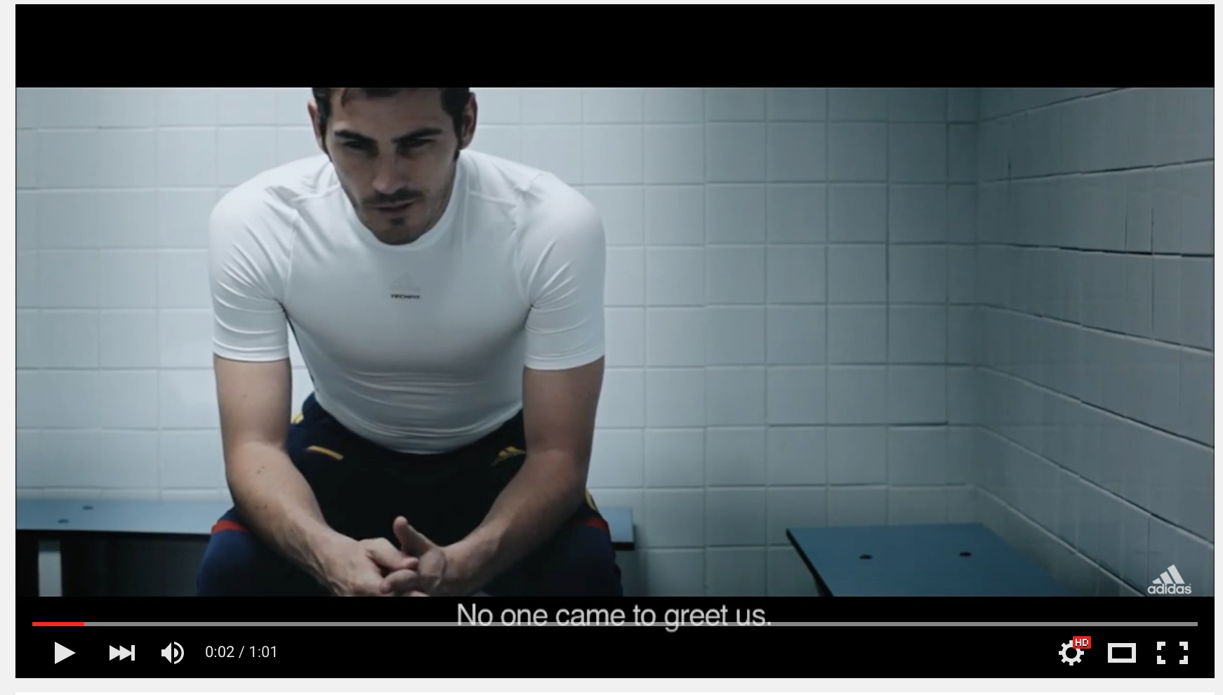
A powerful insight lasts long
The past doesn’t count
https://www.youtube.com/watch?v=ZURapJovVJU
Today is for grab
https://www.youtube.com/watch?v=bXRnfX7JQD8

Slide 47
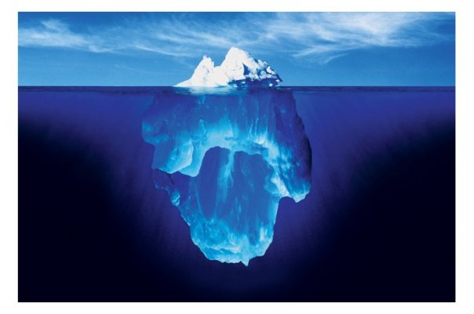
Facts are Cold!
Insights are electrifying!

Slide 48
How do we know we have a good consumer insight?
RIGOUR: Is it based on a deep understanding of consumer behavior, emotion or attitudes?
RELEVANCE: Is it relevant to the brand and communication challenge?
HUMAN TRUTH: Will it “Ring True” in the minds of our target consumer?
  Will it feel personally relevant?
  Will it move them closer to the brand?
  Is it simple and single minded, so that it can be easily understood and assimilated?
SPRINGBOARD POTENTIAL: Will it challenge the agency to come up with breakthrough creative ideas?

Slide 49
Where do we look for insights
RESEARCHES
SOCIAL MEDIA
TRENDS
EVERYWHERE
NEWS
NEWS
POP CULTURE
ASK THE EXPERTS AND THE NAIVE
CONSUMERS BEHAVIOURS

Slide 50
Some practical questions
Does our Insight describe a relevant human truth and how it opens the door to the brand?
Is it fresh and is it inspiring for us?
Is this just an observation or a deeper Insight?
Does it create some sort of tension?
Does it hook back into the brand?
Is it enduring?
Keep asking why people use the brand / category and ‘so what?’ until we get to a deep level of understanding of why the brand is important to consumers.

Slide 51
Dig deeper to get to a real insight. Probe for meaning
WHY BECAUSE TOOL
Keep probing: why why why
So…….?
Well, I work really
hard
Why?
I feel the need to
reward myself!!
The longer the day goes on, the more tempted I am to snack
And?
I often reward myself
with ‘bad’ snacks
…..but they are
usually bad for
the figure
So what?
Well, they are usually
tasty and fulfilling
What else?
The longer the day goes on, the more tempted I am to reward myself with something
nice to eat, often something naughty, and my figure suffers!
Notes:
Learning to see behind an event- to its fundamental drivers
DRIVERS
TRENDS
MANIFESTATIONS

Slide 52


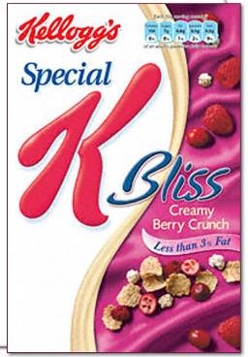
Pleasure that can enjoy anytime
The longer the day goes on, the more tempted I am to reward myself with something nice to eat.
Unfortunately, nice is often naughty and my figure often suffers!
Kellogg’s Special K Bliss are crunchy rice and wheat flakes with strawberries and smooth dark chocolate flakes.
A delicious treat served with ice cold milk, but low in calories and fat at the same time.
Spoil yourself and not your figure.

Slide 53

Electra Silent Air-Conditioning - Hear every little sound

Slide 54
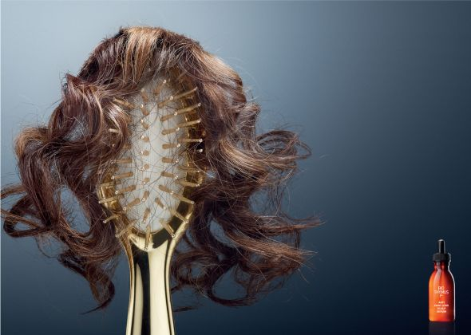
Biothymus F Anti Hair Loss Scalp Serum

Slide 55
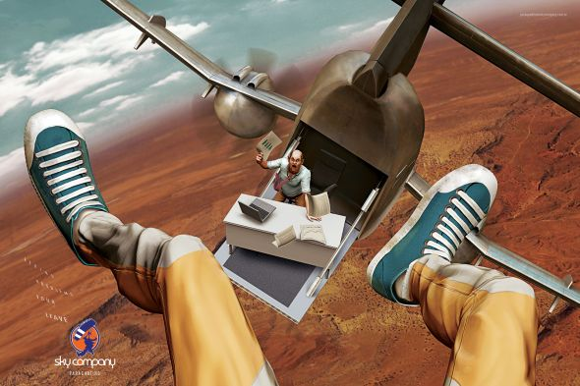
SKY DIVING COMPANY
Leave your problems behind.

Slide 56
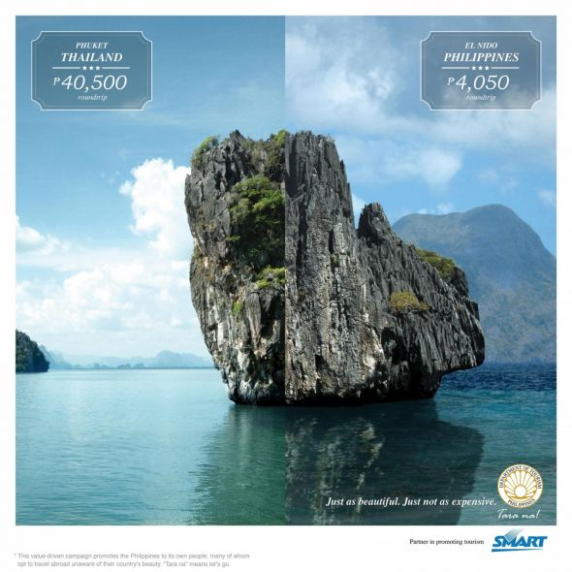
Department Of Tourism Philippines: Limestone
Just as beautiful. Just not as expensive.

Slide 57
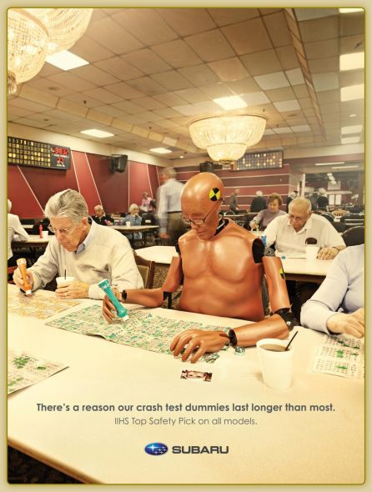
There's a reason our crash test dummies last longer than most

Slide 58
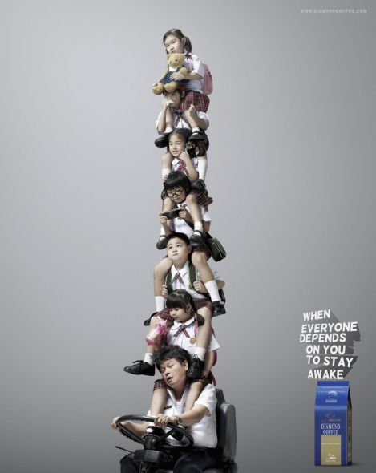
Diamond Coffee
When everyone depends on you to stay awake

Slide 59
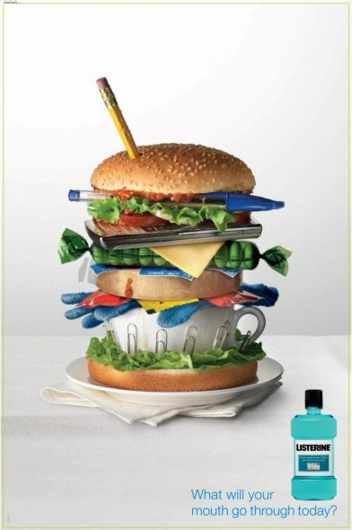
Listerine

