Slide 1


MK 201 Principles of Marketing
Consumer Behavior
Session 4
By Ajarn Suwalya K.
Section 2

Slide 2
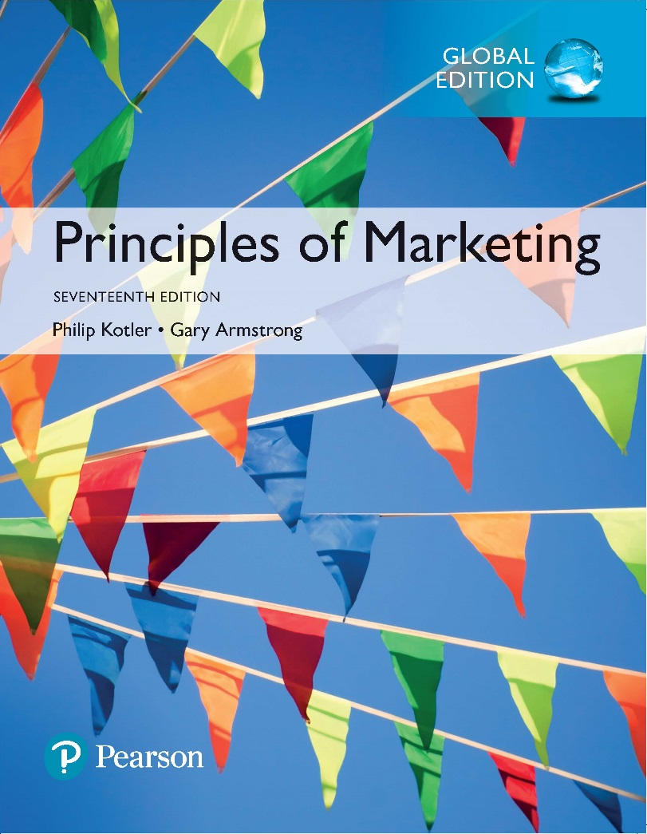
Principles of Marketing
Seventeenth Edition
Chapter 5
Consumer Markets and Buyer Behavior
Copyright © 2018 Pearson Education Ltd. All Rights Reserved.

Slide 3
Learning Objectives
5-1 Define the consumer market and construct a simple model of
consumer buyer behavior.
5-2 Name the four major factors that influence consumer buyer
behavior.
5-3 List and define the major types of buying decision behavior and
the stages in the buyer decision process.
5-4 Describe the adoption and diffusion process for new products.

Slide 4
Learning Objective 1
Define the consumer market and construct a simple model of consumer buyer behavior.

Slide 5
Consumer Markets and Buyer Behavior
Consumer buyer behavior is the buying behavior of final consumers—individuals and households that buy goods and services for personal consumption.
Consumer markets are made up of all the individuals and households that buy or acquire goods and services for personal consumption.

Slide 6
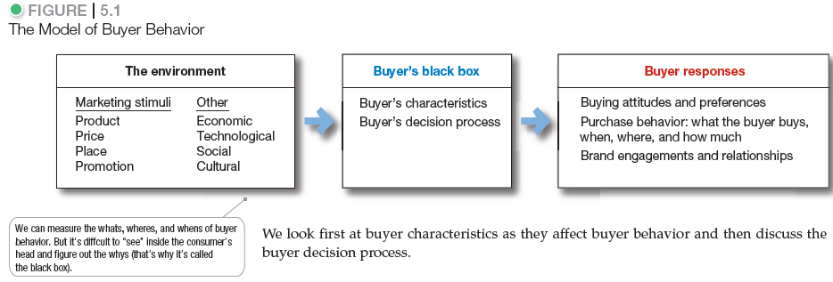
Consumer Markets and Buyer Behavior

Slide 7
Learning Objective 2
Name the four major factors that influence consumer buyer behavior.

Slide 8
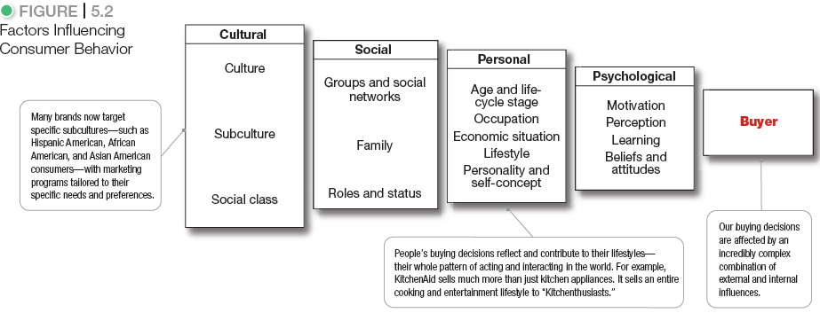
Characteristics Affecting Consumer Behavior

Slide 9

Characteristics Affecting Consumer Behavior
Cultural Factors
Culture is the set of basic values, perceptions, wants, and behaviors learned by a member of society from family and other important institutions.

Slide 10
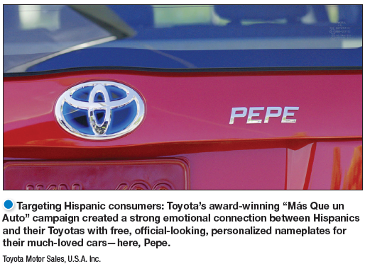
Characteristics Affecting Consumer Behavior
Cultural Factors
Subcultures are groups of people within a culture with shared value systems based on common life experiences and situations.

Slide 11

Characteristics Affecting Consumer Behavior
Cultural Factors
Social classes are society’s relatively permanent and ordered divisions whose members share similar values, interests, and behaviors.
Measured as a combination of occupation, income, education, wealth, and other variables

Slide 12
Characteristics Affecting Consumer Behavior
Cultural Factors
Major American Social Classes
    Upper Class
    Middle Class
    Working Class
    Lower Class

Slide 13
Characteristics Affecting Consumer Behavior
Social Factors
Groups and Social Networks
Membership Groups
Groups with direct influence and to which a person belongs
Aspirational Groups
Groups an individual wishes to belong to
Reference Groups
Groups that form a comparison or reference in forming attitudes or behavior

Slide 14
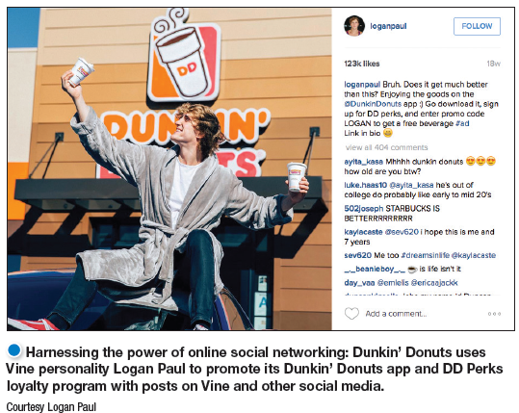
Characteristics Affecting Consumer Behavior
Groups and Social Networks
Online social networks
Buzz marketing
Social media sites
Virtual worlds
Word of mouth
Opinion leaders

Slide 15

Characteristics Affecting Consumer Behavior
Social Factors
Family is the most important consumer-buying organization in society.

Slide 16

Characteristics Affecting Consumer Behavior
Social Factors
Role and status can be defined by a person’s position in a group.

Slide 17
Characteristics Affecting Consumer Behavior
Personal Factors
Age and life-cycle stage
PRIZM Lifestage Groups system
  66 segments
  11 life-stage groups

Slide 18
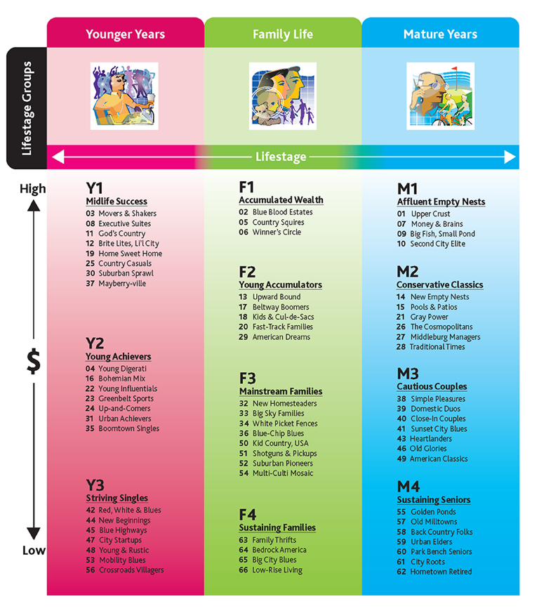

Slide 19
Characteristics Affecting Consumer Behavior
Personal Factors
Occupation affects the goods and services bought by consumers.
Economic situations include trends in:
Personal income
Savings
Interest rates
Spending

Slide 20
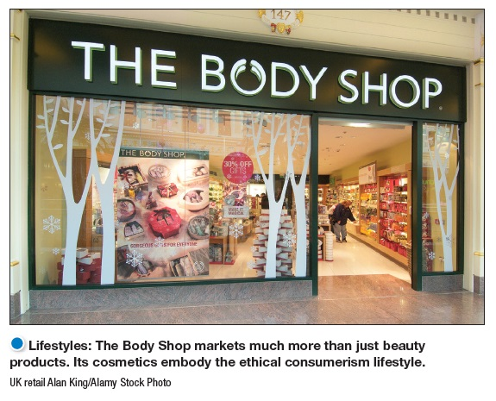
Characteristics Affecting Consumer Behavior
Personal Factors
Lifestyle is a person’s pattern of living as expressed in his or her psychographics.

Slide 21

Characteristics Affecting
Consumer Behavior
Personal Factors
Personality refers to the unique psychological characteristics that distinguish a person or group.

Slide 22
Characteristics Affecting Consumer Behavior
Brand Personality Traits
Sincerity
Excitement
Sophistication
Ruggedness
Competence

Slide 23





Dimensions of Brand Personality
Brand personality
Sincerity
Down to Earth
Honest
Wholesome
Cheerful
Excitement
Daring
Spirited
Imaginative
Up to Date
Competence
Reliable
Intelligent
Successful
Sophistication
Upper class
Charming
Ruggedness
Outdoorsy
Tough

Slide 24
Developing Marketing Information
Psychological Factors
Motivation
Perception
Learning
Beliefs and attitudes

Slide 25
Characteristics Affecting Consumer Behavior
Psychological Factors
A motive (or drive) is a need that is sufficiently pressing to direct the person to seek satisfaction of the need.
Motivation research refers to qualitative research designed to probe consumers’ hidden, subconscious motivations.

Slide 26
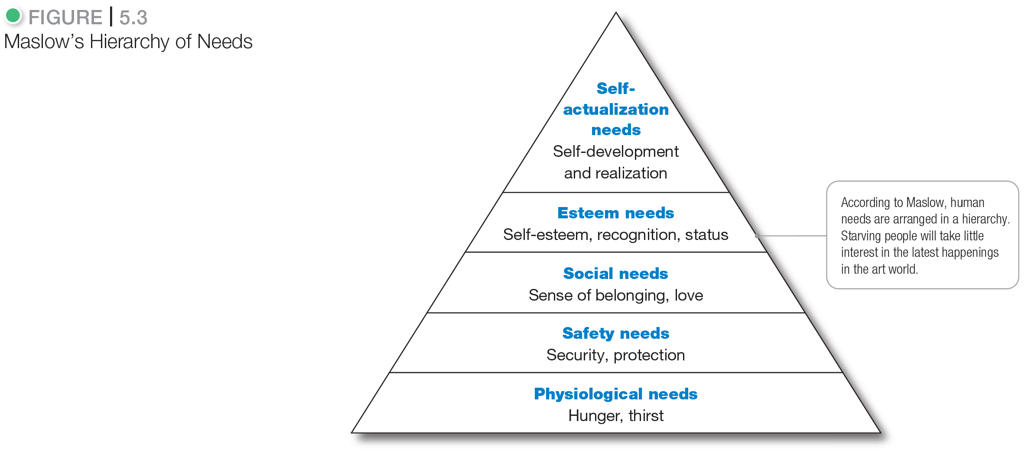
Developing Marketing Information

Slide 27
Characteristics Affecting Consumer Behavior
Psychological Factors
Learning is the change in an individual’s behavior arising from experience and occurs through the interplay of:
Drives
Stimuli
Cues
Responses
Reinforcement

Slide 28
Characteristics Affecting Consumer Behavior
Psychological Factors
A belief is a descriptive thought that a person has about something based on:
  knowledge
  opinion
  faith
An attitude describes a person’s relatively consistent evaluations, feelings, and tendencies toward an object or idea.

Slide 29
Learning Objective 3
List and define the major types of buying decision behavior and the stages in the buyer decision process.

Slide 30
Types of Buying Decision Behavior
Complex buying behavior
Dissonance-reducing buying behavior
Habitual buying behavior
Variety-seeking buying behavior

Slide 31
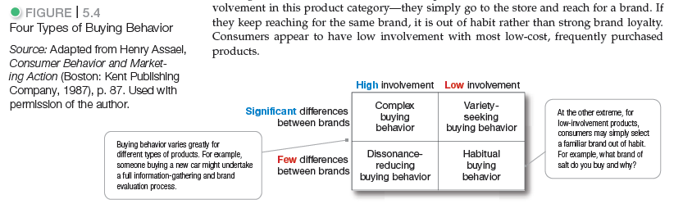
Types of Buying Decision Behavior

Slide 32
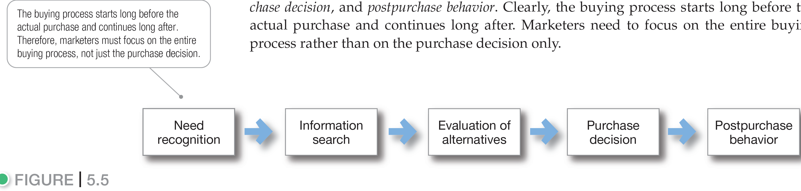
Figure 5.5 The Buyer Decision Process

Slide 33

The Buyer Decision Process
Need Recognition
Need recognition is the first stage of the buyer decision process, in which the consumer recognizes a problem or need triggered by:
  Internal stimuli
  External stimuli

Slide 34

The Buyer Decision Process
Information Search
Information search is the stage of the buyer decision process in which the consumer is motivated to search for more information.
Sources of information:
  Personal sources
  Commercial sources
  Public sources
  Experiential sources

Slide 35
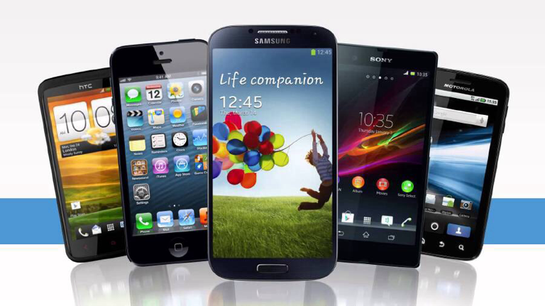
The Buyer Decision Process
Evaluation of Alternatives
Alternative evaluation is the stage of the buyer decision process in which the consumer uses information to evaluate alternative brands in the choice set.

Slide 36

The Buyer Decision Process
Purchase Decision
Purchase decision is the buyer’s decision about which brand to
purchase.
The purchase intention may not be the purchase decision due to:
  Attitudes of others
  Unexpected situational factors

Slide 37

The Buyer Decision Process
Postpurchase Behavior
Postpurchase behavior is the stage of the buyer decision process in which consumers take further action after purchase, based on their satisfaction or dissatisfaction.

Slide 38
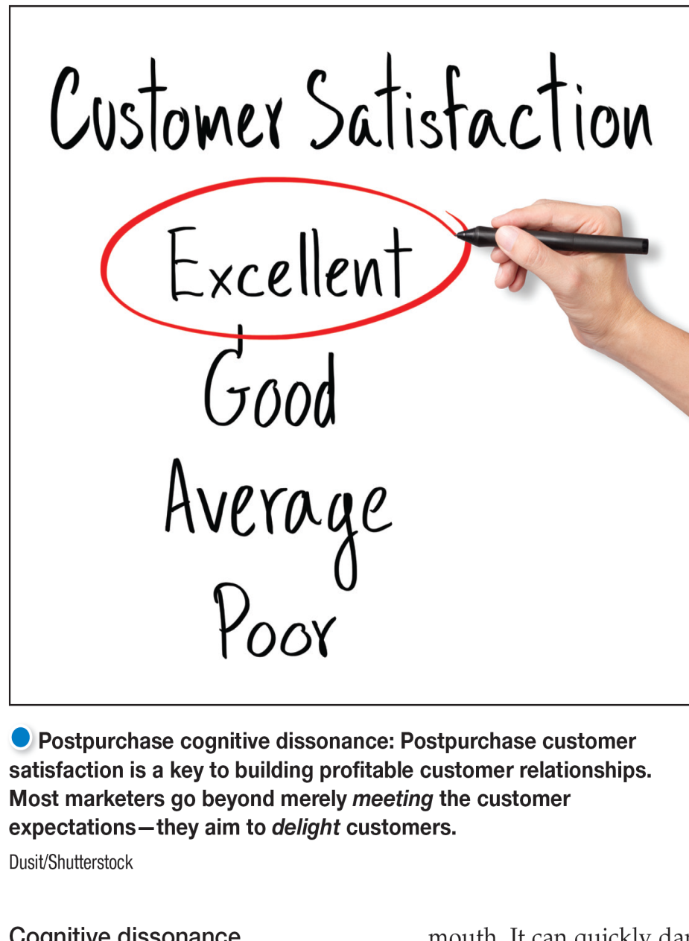
The Buyer Decision Process
Postpurchase Behavior
Cognitive dissonance is buyer discomfort caused by postpurchase conflict.

Slide 39
Learning Objective 4
Describe the adoption and diffusion process for new products.

Slide 40
The Buyer Decision Process for New Products
The adoption process is the mental process an individual goes through from first learning about an innovation to final regular use.
Stages in the adoption process include:
Awareness
Interest
Evaluation
Trial
Adoption

Slide 41

The Buyer Decision Process for New Products
Individual Differences in Innovativeness
Innovators
Early Adopters
Early Mainstream
Late Mainstream
Lagging Adopters

Slide 42
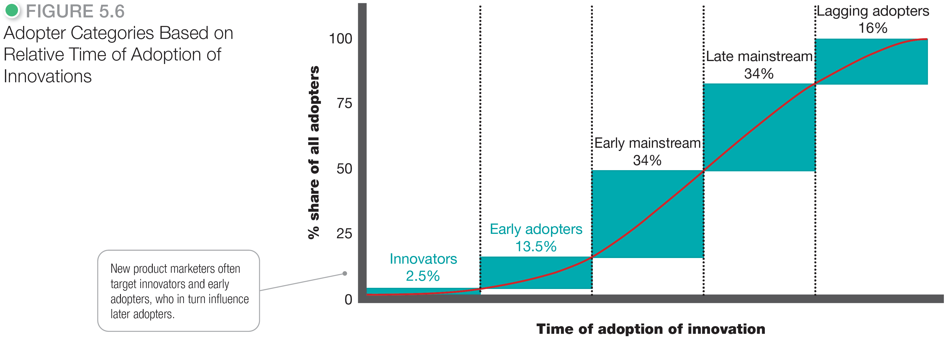
The Buyer Decision Process for New Products

Slide 43


