Slide 1

Group Assignment 7- In class
RETAIL FOCUS GROUP PREPARATION
March 23, 2021

Slide 2
MK 322 Group Assignment
Research Aim, Objectives, and Questions
Each group is the write down your research aim.
Then write down 3 objectives in doing your research
Then you are to write 5 questions for each objective
with total of 15 questions
Please think through which questions are value added and feel free to use your MK 312 Brand Mgt lessons to incorporate in this research ie. Customer Journey, brand persona, CBBE etc. to find out insights from customers who are loyal vs. non-loyal, users vs. non-users, etc. Remember, you final project challenge is to grow your retail business by “ diversification” strategy.
Please submit 3 ppt slides by 6 pm today. I will take a look for green light to conduct your focus group which will be conducted during the week for your next group assignment 8.

Slide 3

RESEARCH…simple …
Research Aim: What do we want to find from this research?
Research Objectives: What ways can we achieve our aim?
Research Questions: What questions to ask consumers to achieve our objectives? (open ended questions)

Slide 4

Research Aim: What insights we want to find from this research?
Example: To launch fashion products the meet the needs of Thais Gen Z

Slide 5

Research Objectives: What ways can we achieve the aim?
Research Aim: To launch fashion products the meet the needs of Thais Gen Z
Research Objectives:
Example:
1. To identify Gen Z shopping habits
2. To find what types of fashion influences Gen Z
3. What is the lifestyle of Gen Z

Slide 6
Research Questions: What questions to ask to achieve our objectives?
Research Objective: To identify Gen Z shopping habits
Research Questions:
1. Where do you normally shop?
2. When you shop what promotions do you look for?
3. What type of clothing and accessories do you normally buy?
4. When you go shopping do you go alone or with your friends, who do you go with?
5. How much do you spend when you go out shopping?

Slide 7
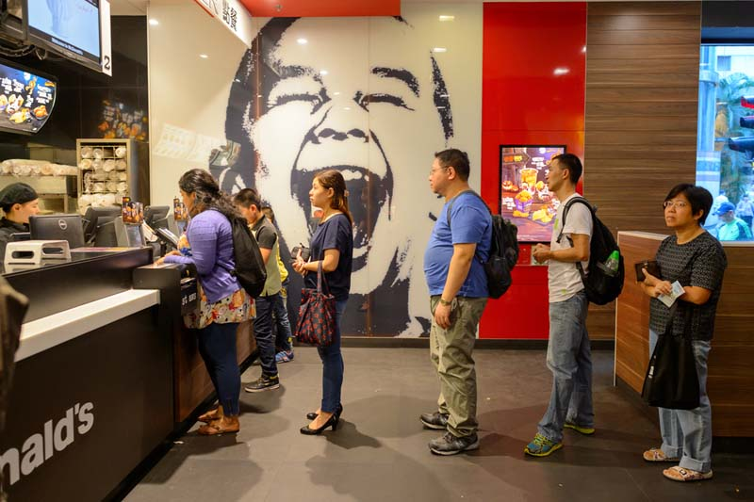
https://www.intotheminds.com/blog/en/4-retail-problems-that-focus-groups-cannot-solve/

