Slide 1
Community-based
Resource Management

Slide 2
State
Community
Market

Slide 3
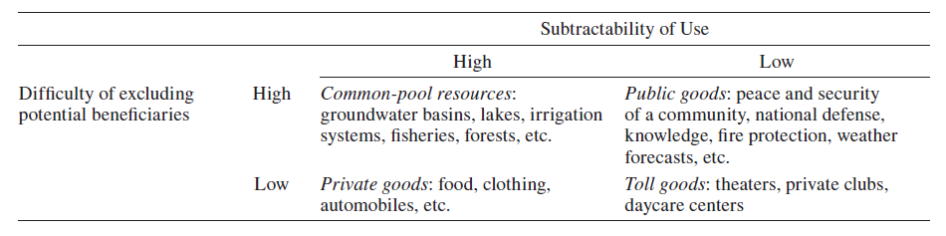
Type of Goods

Slide 4
Market-based management
Most natural resources –> “Common-pool resources”
Non-excludable & Non-rivalrous
Forest, Fish stocks, Open water → Renewable resources
Global CPR → Ocean, Ozone layer

Slide 5
Market-based management
Market Failure
Open access → over-exploitation/ pollution
No management incentives
“Tragedies of the Commons” by Garrett Hardin in 1968

Slide 6
Market-based management
Graze land → Open Access to All
Sheepherders → free access but future cost from land degradation
Equal share of this cost
If sheepherders are rational → maximize benefits today before degradation

Slide 7
Market-based management
Game with Prisoner Dilemma (PD)
2 herders with their own sheep
Land carrying capacity → L sheep
If each herders bring L/2 sheep, each gains 10 units of benefit
But if one of them increases the number of sheep, both tend to maximize number of their sheep,
Then, over-exploitation → both gain nothing
Other example: over-fishery

Slide 8
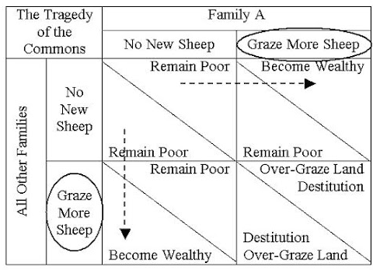
Market-based management

Slide 9
Management by state
Market-failure → well-defined property rights
Policy makers → No common-pooled resources should be left ‘open’, but state-owned
State-owned property → with cost privatization through taxes or other mechanism

Slide 10
Management by state
1. Direct governance
  Protected areas, public irrigation, world heritages
  Assumption: government have better information and have perfect enforcement
2. Concession
  Assumption: Private sector has good incentives in resource management

Slide 11
Management by state
  Government failure
  Lack of efficiency
    Limited capacity: human resources/ budgets
    Rent-seeking behavior/ conflict of interest
    No incentives for monitoring the performance of concession contract

Slide 12
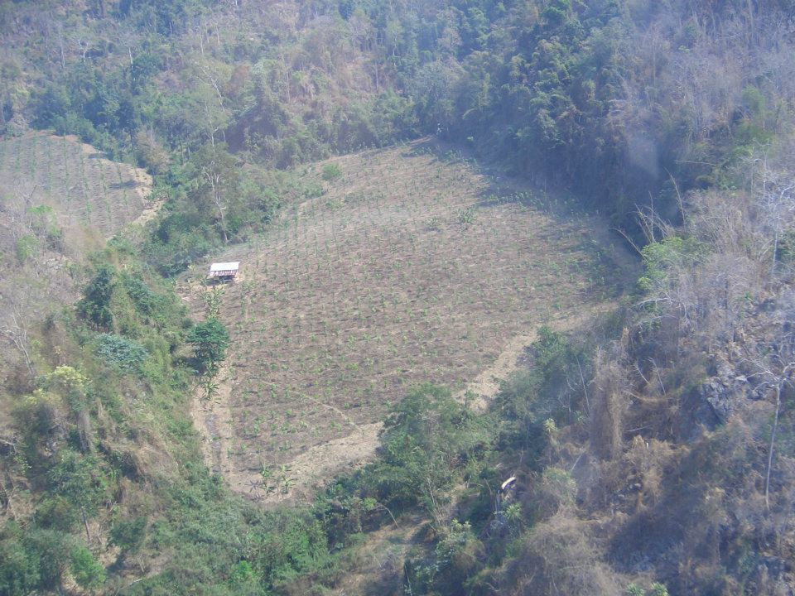
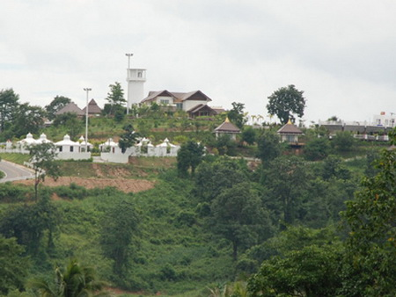
Management by state
Khao lam, Karnchanaburi
Tublan, Korat

Slide 13
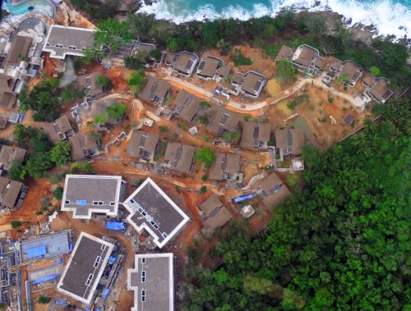

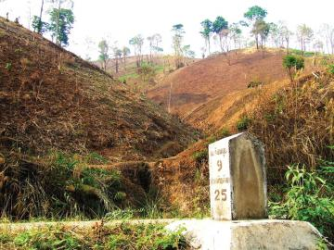
Management by state
Sirinat, Phuket
Phrae

Slide 14
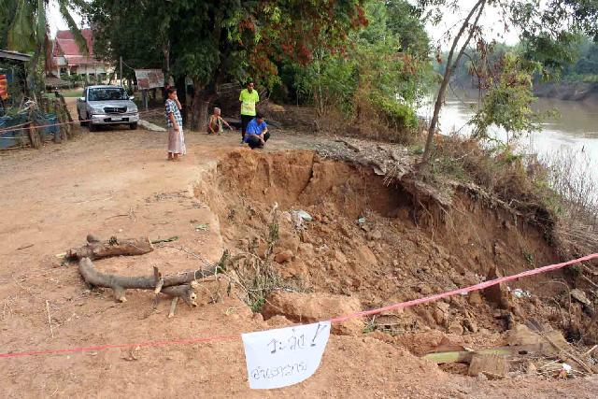
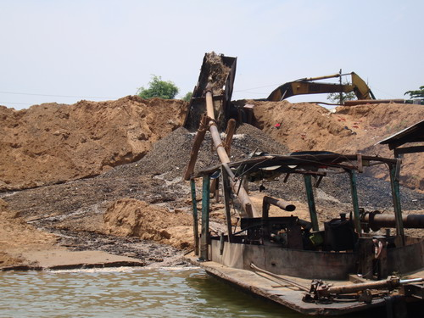
Management by state
Sand exploitation, Kalasin

Slide 15

Community-based management
Elinor Ostrom : “Governing the Commons” (1990)
Community rights can successfully manage the ‘Common-pooled resources’ without the centrally-controlling government or resource privatization

Slide 16

Community-based management
The traditional understanding has some limited assumptions;
Rationality
Perfect Information
Ecological certainty
Which are far from the reality.

Slide 17
Community-based management
Why community?
  More knowledge
  Norms! → members’ behaviors
  Monitoring and Social Sanction with relatively low enforcement costs
  ‘Learning’ from actions/experiences → more information on costs/outcomes from actions → better alternatives

Slide 18

Community-based management
Laboratory & field experiments
  more communication → more collaboration
  The samples are willing to pay some costs for monitoring & enforcement
  The enforcement from outside → reduce the level of voluntary cooperation

Slide 19
Community-based management
Community rules: 3 levels
  Operational Rules
    - When/how many resources to be utilized / by which mean
  2) Collective-Choice Rules
  - how the resources be manage
  3) Constitutional Rules
- who have rights to participate the rules-making

Slide 20
Community-based management
More details in community rules
Resource System vs. Resource Unit
  System → could be shared
  Unit → cannot be shared
Appropriator, Provider, Producer)

Slide 21
Community-based management
Level of rights
1) Rights to Access
2) Withdrawal Rights
3) Management Rights → adapting the system / rules
4) Exclusion rights
5) Transfer rights

Slide 22
Community-based management
  Community failures
  Market forces
  Rent-seeking behaviors
  Population growths
  Inappropriate rules

