Slide 1
Cost Curves
(Chapter 8)

Slide 2
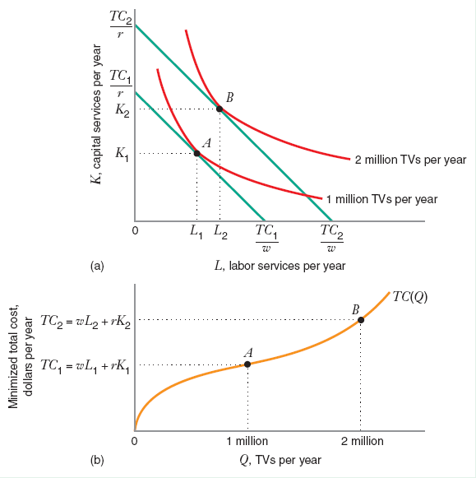
Long Run Cost Functions
As output increases from 1 million to 2 million, with input prices (w, r) constant, cost-minimizing input combination moves from TC₁ to TC₂ which gives the TC(Q) curve.

Slide 3
Long Run Cost Functions
Definition: The long run total cost (LRTC) function relates minimized total cost to output, Q, and to the factor prices (w and r).
TC(Q,w,r) = wL*(Q,w,r) + rK*(Q,w,r)
Where: L* and K* are the long-run input demand functions.

Slide 4
Long Run Cost Functions

Slide 5
Long Run Total Cost Curve
A movement along the TC curve is a result from changing output.
As we produce more, we face higher TC.
What happens when input prices changes?
The TC curve will shift.
Let’s consider two cases:
  When r (price of K) rises.
  When both r and w rises equally.

Slide 6
Long Run TC Curve – Higher r
Given higher r, we opt for a cheaper input, L.
C₂ = $50m BUT few K can be bought, so C₂ is not sufficient for producing 1m TVs.
C₃ is sufficient to produce the required output.

Slide 7
Long Run TC Curve – Higher r
With higher r, producing 1m TVs now requires $60m, instead of $50m

Slide 8
Long Run TC Curve – Higher r & w
When both r and w rise in the same proportion, the cost-minimizing K* and L* do not change.
We cannot opt for a cheaper input because both input prices rise.
Note that the TC will rise in the same proportion.

Slide 9
Long Run TC Curve – Higher r & w
Here, r and w rise by 10%.
TC also rises by 10%.

Slide 10
Long-Run AC and MC Functions
Definition: The LR Average Cost (AC) function is the long run total cost function divided by output, Q. That is, the LRAC function tells us the firm’s cost per unit of output.
AC(Q,w,r) = TC(Q,w,r)/Q
Definition: The LR Marginal Cost (MC) function measures the rate of change of total cost as output varies, holding constant input prices. It is also the slope of TC(Q).
MC(Q) = ∆TC(Q)/∆Q

Slide 11
Long-Run AC and MC Functions

Slide 12
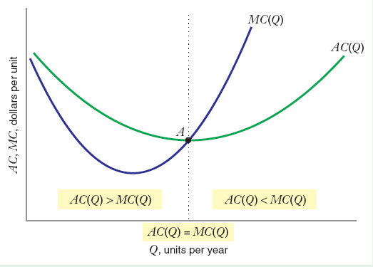
Relationship between AC and MC
Suppose that w and r are fixed.
If MC(Q) > AC(Q), AC(Q) increases in Q.
If MC(Q) < AC(Q), AC(Q) decreases in Q.
If MC(Q) = AC(Q), AC(Q) is flat with respect to Q, and is minimized.

Slide 13
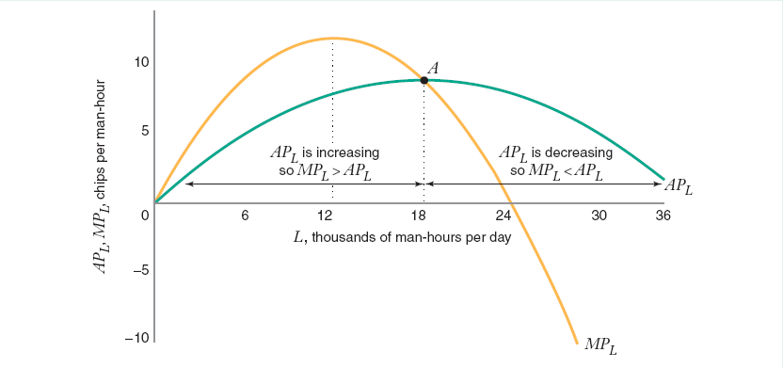
ANALOGY: AP & MP vs AC & MC

Slide 14
Economies & Diseconomies of Scale
Definition: If LRAC decreases as output rises, all else equal, the LRAC function exhibits economies of scale.
Definition: if LRAC increases as output rises, all else equal, the LRAC function exhibits diseconomies of scale.
Definition: The smallest quantity at which the LRAC curve attains its minimum point is called the minimum efficient scale (MES).

Slide 15
Economies & Diseconomies of Scale
Q’ is the smallest quantity where LRAC is minimized.
Q’ is called “MES”.
From 0 to Q’, we have “economies of scale”.
From Q’’ onwards, we have “diseconomies of scale”.

Slide 16
Economies & Diseconomies of Scale
Economies of Scale (lower AC when Q increases)
Specialization / Division of Labor
Quantity Discount / Bulk Buying
Indivisible Inputs (e.g. large machine)
Cost-Saving
Diseconomies of Scale (higher AC when Q increases)
Managerial Diseconomies
Coordination Problems
Principal-Agent Problem
Cost-Dissaving

Slide 17
Returns to Scale & Economies of Scale
When the production function exhibits increasing returns to scale, the LRAC function exhibits economies of scale so that AC(Q) decreases with Q, all else equal.
When the production function exhibits decreasing returns to scale, the LRAC function exhibits diseconomies of scale so that AC(Q) increases with Q, all else equal.
When the production function exhibits constant returns to scale, the LRAC function is flat: it neither increases nor decreases with output.

Slide 18
Returns to Scale & Economies of Scale

Slide 19
Output Elasticity of Total Cost
Definition: the output elasticity of total cost, ε_{TC,Q} measures the responsiveness of total cost when output changes.
ε_{TC,Q} = (ΔTC/TC)(ΔQ /Q) = (ΔTC/ΔQ)/(TC/Q) = MC/AC

Slide 20
Output Elasticity of Total Cost

Slide 21
Short Run Cost Functions
Definition: The short run total cost (SRTC) function tells us the minimized total cost of producing a given quantity, when (at least) one input is fixed.
Definition: The total variable cost function (TVC) is the minimized sum of expenditures on variable inputs from the short-run cost-minimizing input combinations.
Definition: The total fixed cost function (TFC) is constant and equal to the cost of the fixed input(s).
STC(Q,K₀) = TVC(Q,K₀) + TFC(Q,K₀) = wL + rK₀
Where: K₀ is the fixed input and w and r are fixed

Slide 22
Short Run Cost Functions

Slide 23
Short Run Cost Functions

Slide 24
Relationship between LR and SR Costs
The firm can minimize costs at least as well in the long run as in the short run because it is “less constrained”.
Hence, the short run total cost curve lies everywhere above the long run total cost curve.
However, some inputs combination solves both SR cost-minimization and LR cost-minimization. At such inputs, SRTC = LRTC.

Slide 26
Short-Run AC and MC Functions
Definition: The SR Average Cost (SRAC) function is the SRTC function divided by output. The SRAC function tells us the firm’s short run cost per unit of output.
SRAC(Q,K₀) = SRTC(Q,K₀)/Q
Definition: The SR Marginal Cost (SRMC) function measures the rate of change of SRTC as output varies, holding constant input prices and fixed inputs. It is also the slope of SRTC(Q).
SRMC(Q,K₀) = ΔSRTC(Q,K₀)/ΔQ

Slide 27
Short-Run AC and MC Functions

Slide 28
Relationship between LRAC and SRAC
Recall that the SRTC curve lies everywhere above the LRTC curve. Thus, SRAC also lies above LRAC.

Slide 29
Relationship between LRAC and SRAC
At Q where SRAC = LRAC, we also have SRMC = LRMC.

Slide 30
Economies of Scope
Economies of Scope – a production characteristic in which the total cost of producing given quantities of two goods in the same firm is less than the total cost of producing those quantities in two single-product firms.
TC(Q₁, Q₂) < TC(Q₁, 0) + TC(0, Q₂)
Ex1: A satellite owner hosts movie and news channels.
Ex2: Coke makes another soft drink, using its factory.
Stand-alone Costs – the cost of producing a good in a single-product firm, e.g. TC(Q₁, 0) or TC(0, Q₂).

Slide 31
Economies of Experience
Economies of Experience – cost advantages that result from accumulated experience or learning-by-doing.
Econ. of Scale is usually great in capital-intensive production.
Econ. of EXP is usually great in labor-intensive production.
Experience Curve:
a relationship between AVC and cumulative production volume.
Smaller slope = Lower AVC

Slide 32
Estimating Cost Functions
Total Cost Function – a mathematical relationship that shows how TC vary with factors that influence it.
Cost Driver – A factor that influences or “drives” total or average costs. These factors usually include Q, w, r, and material costs.
Economists then use “regression analysis” to estimate the magnitude of how these factors affect TC.

