Slide 1
Review on economics of money and banking
Pawin Siriprapanukul (pawin@econ.tu.ac.th)

Slide 2
What is Money?
Money is anything generally accepted in payments for goods or services or in the repayment of debts.
Since money is anything accepted for payments, it includes:
  Currency
  Cheques
  Debit cards etc.
There are various definitions of money supply, E.g. M1, M2, M2a, M3 etc.

Slide 3
Money and Our Lives
We use money in our daily life.
Why do we use money?
  Without money, we would go back to barter trade, which is very inefficient.
  We may use money to store our wealth as well.
We will see that money affects our lives in various aspects.

Slide 4
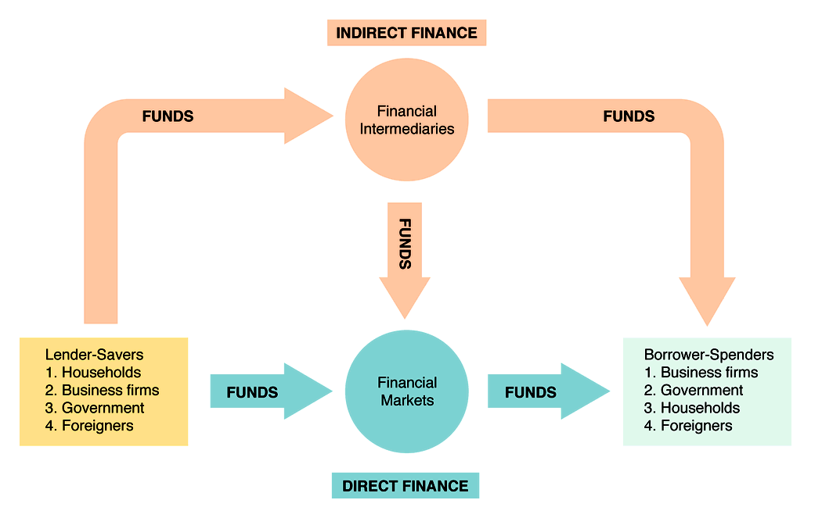
Flow of Funds Through the
Financial System

Slide 5
Financial Markets:
Where Lenders Meets Borrowers
Debt Market
  Short-term (maturity < 1 year) → Money market
  Intermediate-term (maturity 1 – 10 years) (→ Capital market)
  Long-term (maturity > 10 years) (→ Capital market)
Equity Market (→ Capital market)
  Common stocks
    Pays dividends.
    Don’t have maturity date (hence, long-term).
    Can vote on issues related to the firm.
Corporations must pay all its debt holders before it pays its equity holders.

Slide 6
Bond Market

Slide 7
Bond Market
A security is a claim on the issuer’s future income or assets.
A bond is a debt security that promises to make payments periodically for a specified period of time.
An interest rate is the cost of borrowing for the rental of funds.

Slide 8
Measuring Interest Rates
In economics, the yield to maturity is the most accurate measure of interest rates.
To measure (or calculate) these interest rates, we need to know the concept of present value.
1 baht at different time has different value.
The formular is based on the concept of compound interest:

Slide 9
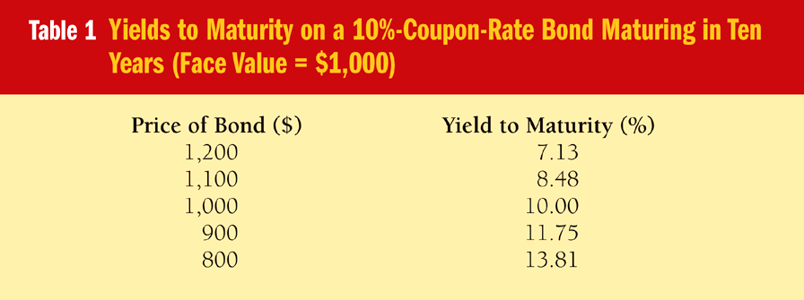
Relationship between bond price and interest rate
Three Interesting Facts in Table 1
1. When bond is at par, yield equals coupon rate.
2. Price and yield are negatively related.
3. Yield greater than coupon rate when bond price is below par value.

Slide 10
Nominal Interest Rate Vs Real Interest Rate
Real Interest Rate can be thought of as interest rate in term of goods and services (real term).
It more accurately reflects true cost of borrowing.
When real rate is low, greater incentives to borrow and less to lend

Slide 11
Source: http://www.bot.or.th/English/Statistics/FinancialMarkets/InterestRate/Pages/StatInterestRate.aspx

Slide 12
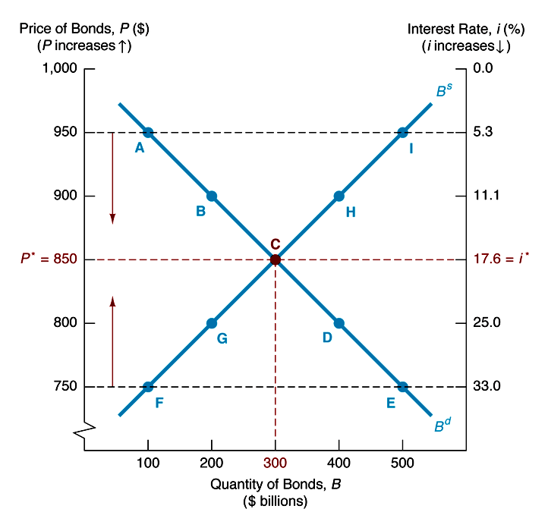
Movement of the Interest Rate

Slide 13
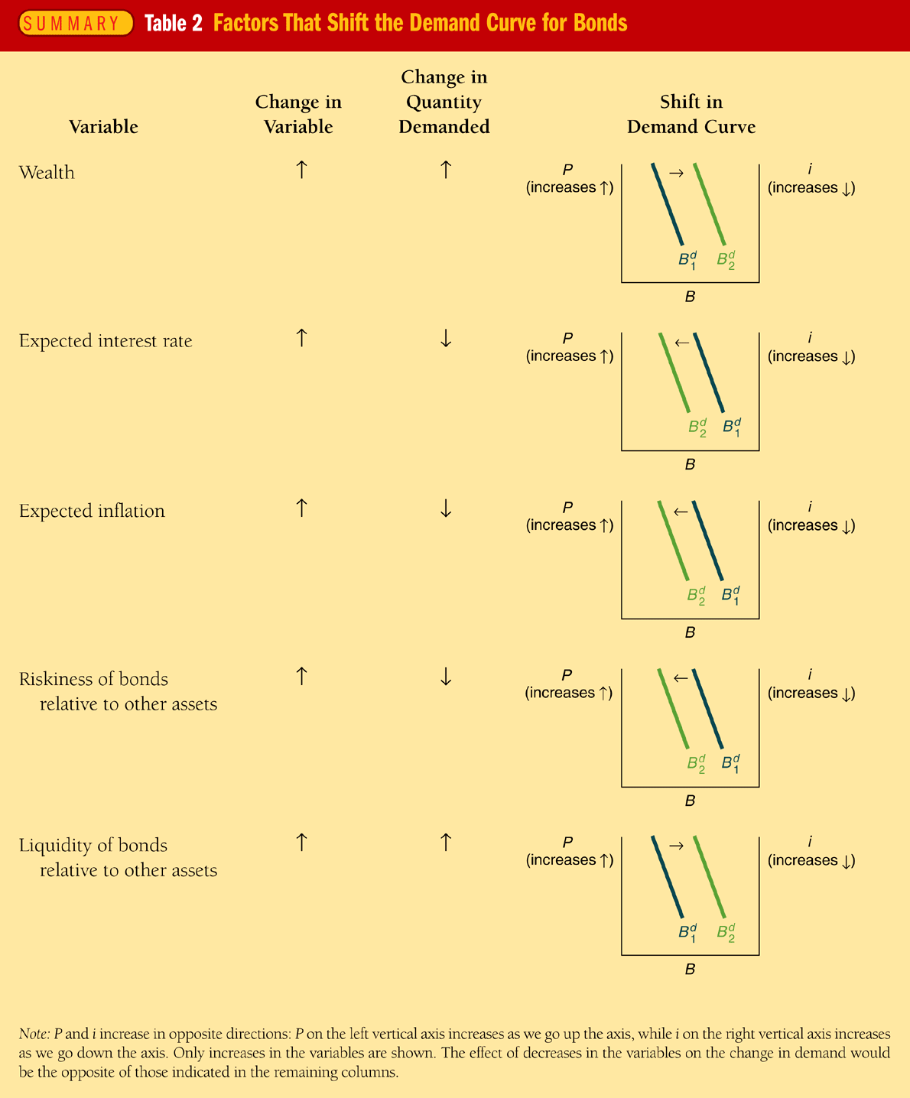
Factors that Shift Demand Curve for Bonds

Slide 14
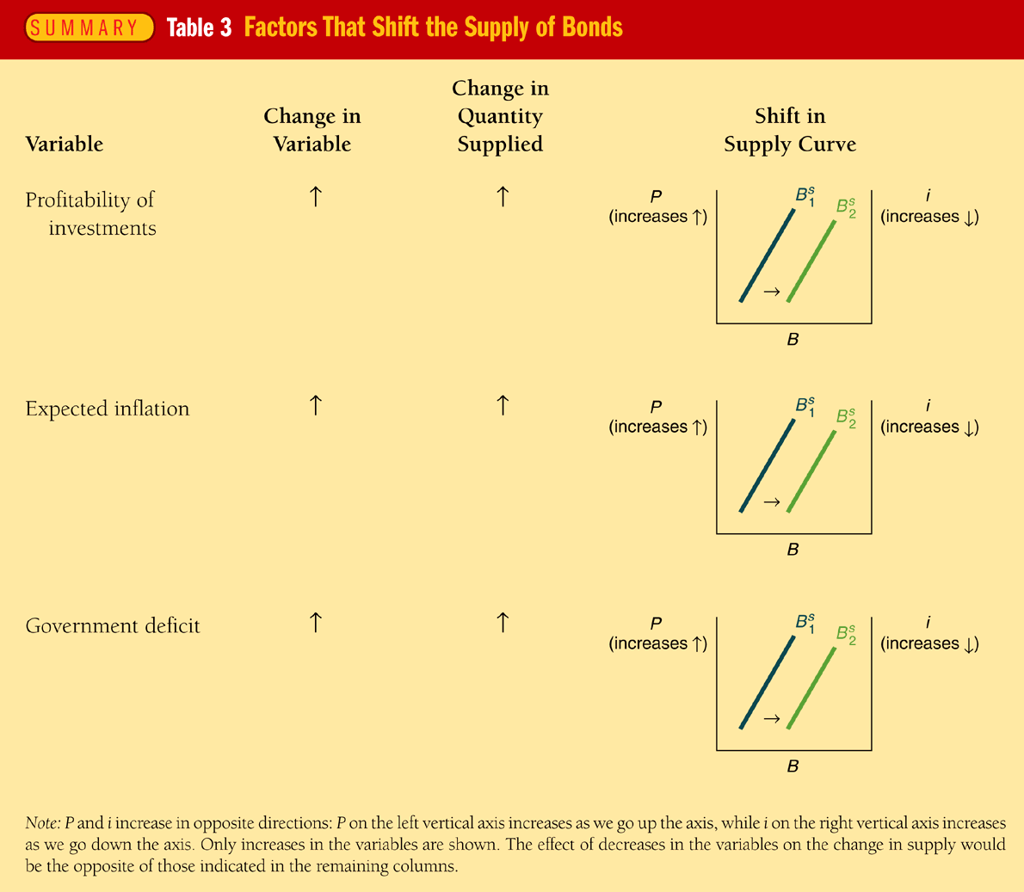
Factors that Shift Supply Curve for Bonds

Slide 15
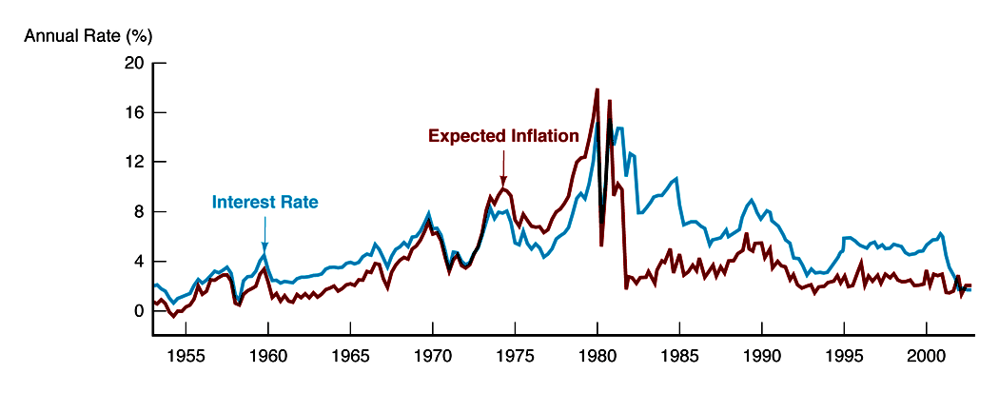
Fisher Effect in the United States

Slide 16
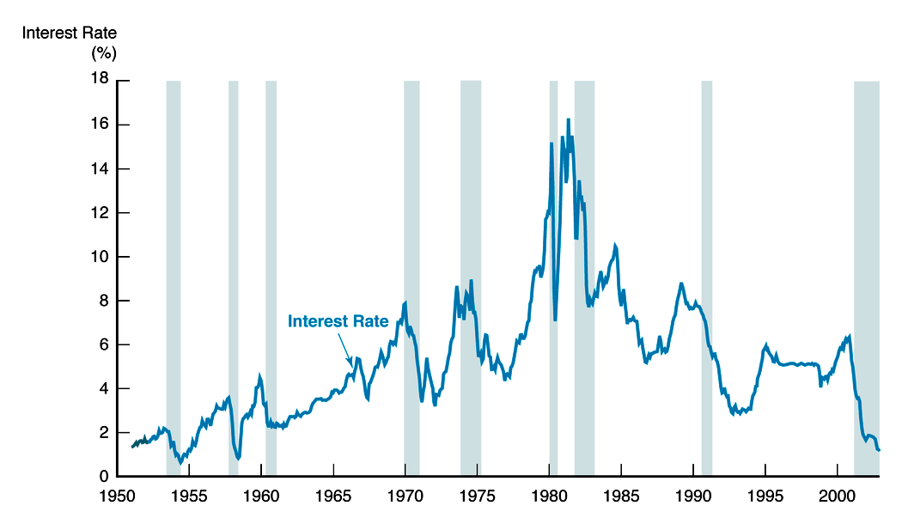
Business Cycles and Interest Rates

Slide 17
Source: http://www.bot.or.th/English/Statistics/FinancialMarkets/InterestRate/Pages/StatInterestRate.aspx

Slide 18
Risk Structure of Interest Rates
Default Risk
  Default occurs when the issuer of the bond is unable or unwilling to make payments when promised.
  Corporate suffering big losses might be more likely to suspend interest payments on its bonds. This means its bonds have high default risk.
  Treasury or BOT bonds are usually considered to have no default risk. They are called default-free bonds.
  The spread is called risk premium.
Liquidity
  A liquid asset is one that can be quickly and cheaply converted into cash.
  The more liquid an asset is, the more desirable it is (holding everything else constant).

Slide 19
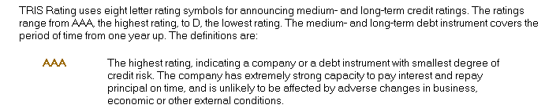
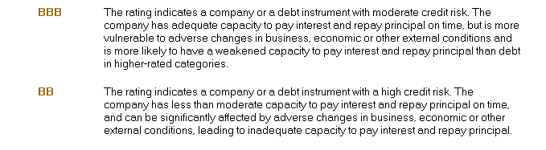

Slide 20
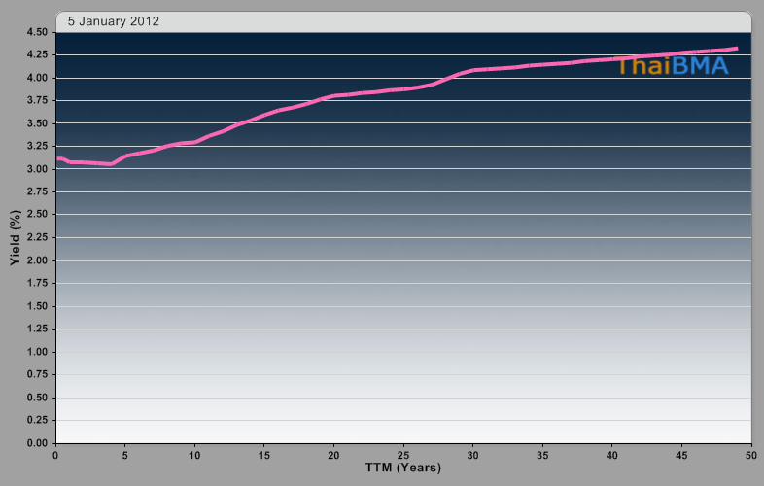
Term Structure of Interest Rates
Government Bond Yield Curve

Slide 21
Interest Rate Vs Return
Recall that our interest rate is the yield-to-maturity.
If you do not hold an asset to its maturity date, rate of return on the asset may not be equal to the interest rate.
where g is the capital gains (or losses).

Slide 22
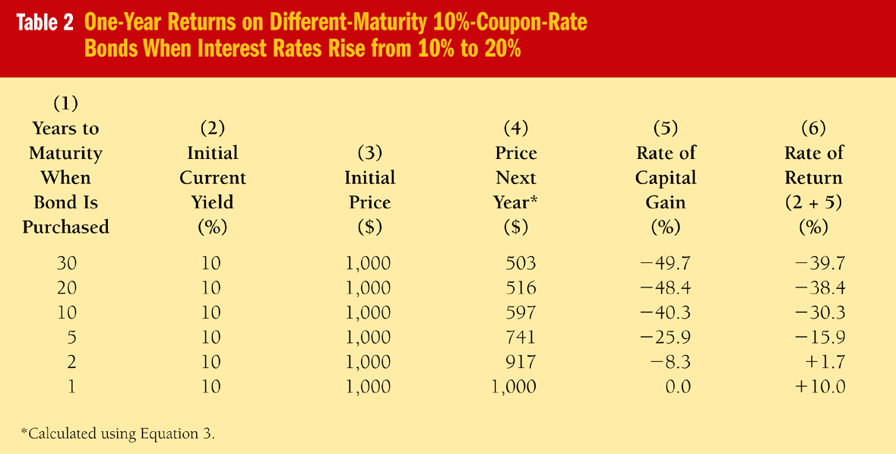
Interest Rate Risks

Slide 23
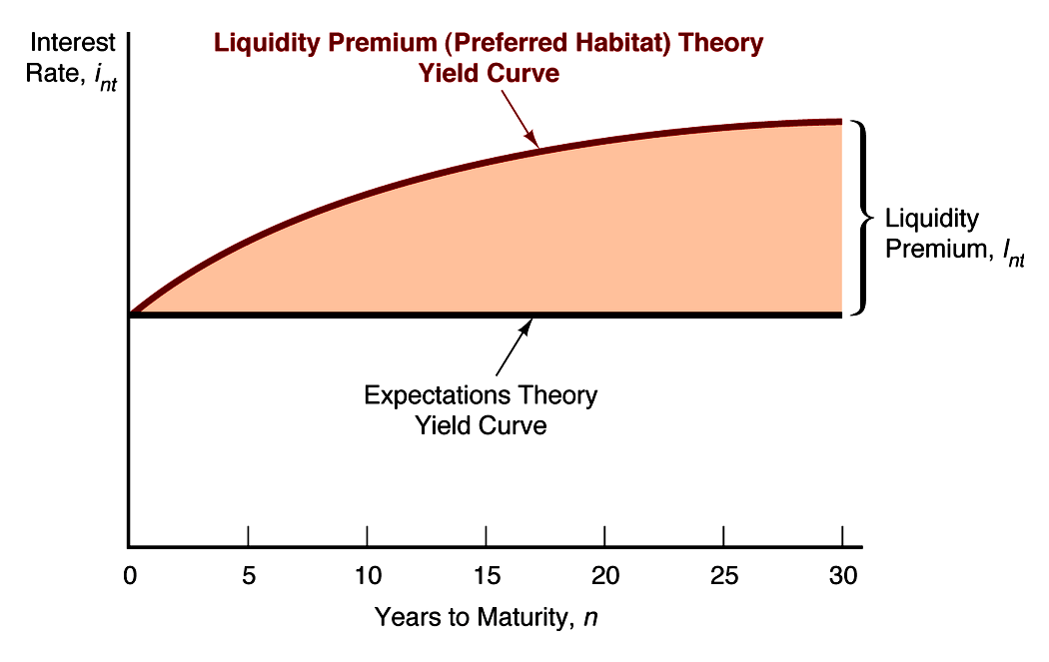
Liquidity Premium Theory

Slide 24
Stock Market

Slide 25
Stock Market
Basic Principle of Finance
    Value of Investment = Present Value of Future Cash Flows
Gordon Growth Model
When new information is released about firms (or, maybe, macroeconomic conditions), expectations change and prices change.
New information may cause changes in expectations about the level of future dividends or the risk of those dividends

Slide 26
The Stock Exchange of Thailand
Total nominal return 2518-2552
Unit: index (point); assumed that initial investment in year 2517 = 1000
Source: SET analysis at end of December 2009

Slide 27
Behavioral Finance
A relatively new field that uses sociological and psychological factors in explaining economic decisions of individuals and institutions
According to “conventional” financial theory, the world and its participants are, for the most part, rational “wealth maximizers”
The results are:
  CAPM
  Efficient Market Hypothesis
However, there are some “anomalies” (i.e., irregularities) that conventional financial theories have failed to explain

Slide 28
Anomalies:
The Equity Premium Puzzle
$1,000 in 1925 would become
  $12,720 at the end of 1995 with Treasury bills
  $842,000 at the end of 1995 with a (value-weighted) portfolio of stocks
The difference in returns, 3.7 percent vs. 10.1 percent, is strikingly large
This cannot be explained in the conventional framework

Slide 29
Foreign Exchange Market

Slide 30
Foreign Exchange
Exchange rate: price of one currency in terms of another
Foreign exchange market: the financial market where exchange rates are determined
Spot transaction: immediate (two-day) exchange of bank deposits
  Spot exchange rate
Forward transaction: the exchange of bank deposits at some specified future date
  Forward exchange rate

Slide 31
Reference Exchange Rate
(Baht/U.S. Dollar)

Slide 32
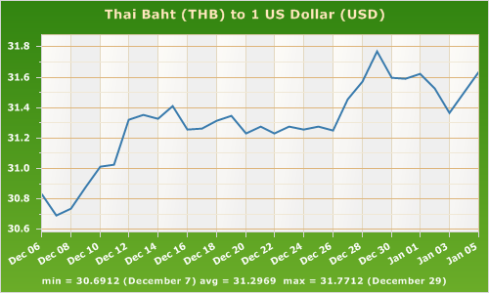
Source: http://www.exchange-rates.org

Slide 33
Exchange Rates in the Long Run
Law of one price:
  If two countries produce an identical good, and transportation costs are very low, the price of the good should be the same
Theory of Purchasing Power Parity (PPP):
  Exchange rates between any two currencies will adjust to reflect changes in the price levels of the two countries

Slide 34
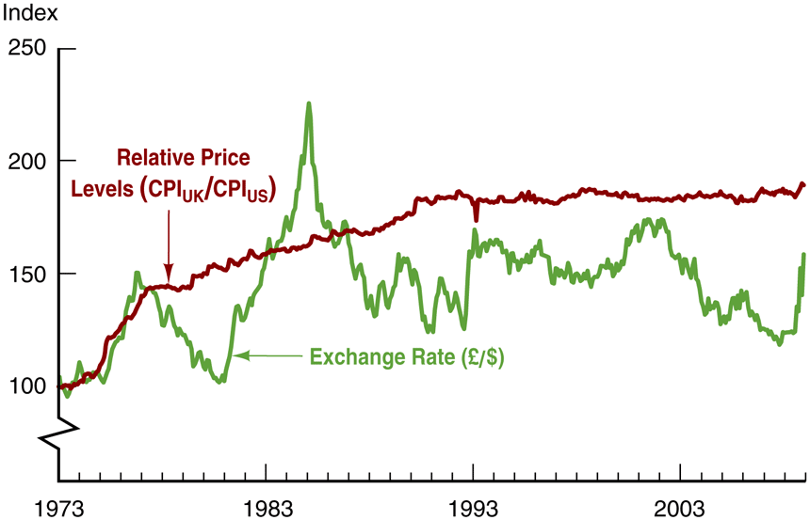
FIGURE 2 Purchasing Power Parity, U.S./U.K., 1973–2008 (Index: March 1973 = 100.)
British price level rose 89% relative to that of the U.S.
The dollar appreciated by 58%
Source: ftp.bls.gov/pub/special/requests/cpi/cpiai.txt.

Slide 35
Exchange Rates in the Short Run: A Supply and Demand Analysis
An exchange rate is the price of domestic assets in terms of foreign assets
Supply curve for domestic assets
  Assume amount of domestic assets is fixed (supply curve is vertical)
Demand curve for domestic assets
  Most important determinant is the relative expected return of domestic assets
  At lower current values of the dollar (everything else equal), the quantity demanded of dollar assets is higher

Slide 36
Financial Institutions

Slide 37
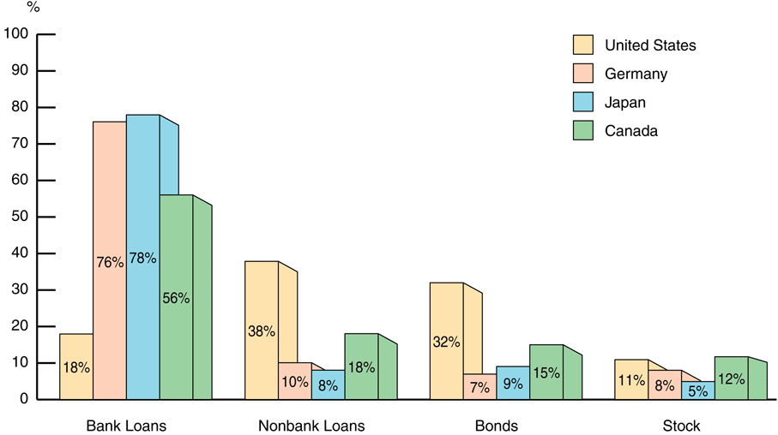
FIGURE 1 Sources of External Funds for Nonfinancial Businesses: A Comparison of the United States with Germany, Japan, and Canada
Source: Andreas Hackethal and Reinhard H. Schmidt, “Financing Patterns: Measurement Concepts and Empirical Results,” Johann Wolfgang Goethe-Universitat Working Paper No. 125, January 2004. The data are from 1970–2000 and are gross flows as percentage of the total, not including trade and other credit data, which are not available.

Slide 38
8 Basic Facts
Stocks are not the most important sources of external financing for businesses
Issuing marketable debt and equity securities is not the primary way in which businesses finance their operations
Indirect finance is many times more important than direct finance
Financial intermediaries, particularly banks, are the most important source of external funds used to finance businesses.

Slide 39
8 Basic Facts
The financial system is among the most heavily regulated sectors of the economy
Only large, well-established corporations have easy access to securities markets to finance their activities
Collateral is a prevalent feature of debt contracts for both households and businesses.
Debt contracts are extremely complicated legal documents that place substantial restrictive covenants on borrowers

Slide 40
Transaction Costs
Financial intermediaries have evolved to reduce transaction costs
  Economies of scale: the reduction in transaction costs per dollar of investment as the size of transactions increases
  Expertise

Slide 41
Asymmetric Information
Adverse selection occurs before the transaction
Moral hazard arises after the transaction
Agency theory analyses how asymmetric information problems affect economic behavior

Slide 42
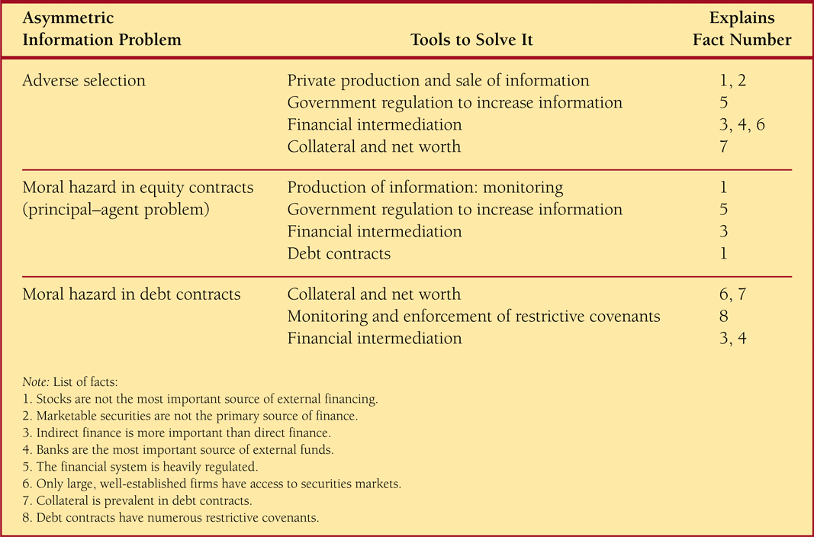
Summary Table 1 Asymmetric Information Problems and Tools to Solve Them

Slide 43
Central Banking

Slide 44
8 Aspects of
Banking Regulation
Government safety net
Restrictions on bank asset holdings
Capital requirements
Chartering and bank examination
Assessment of risk management
Disclosure requirements
Consumer protections
Restriction on competition

Slide 45
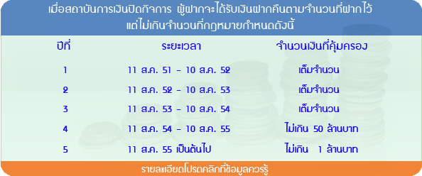
สถาบันคุ้มครองเงินฝาก (สคฝ.)
Deposit Protection Agency (DPA)
Source: www.dpa.or.th

Slide 46
Financial Crisis

Slide 47
Deciphering the liquidity and credit crunch 2007-2008 (Brunnermeier, 2009)
U.S. Housing Bubble
Securitization: The “originate and distribute” banks
Maturity Mismatch (Sometimes through “shadow” banking system)
It was perceived to be more profitable to ride the wave than to lean against it. (Similar to behavioral finance?)
“When the music stops, in terms of liquidity, things will be complicated. But as long as the music is playing, you’ve got to get up and dance. We’re still dancing.”

Slide 48
The Unfolding of the Crisis
The Subprime Mortgage Crisis
  The trigger was an increase in subprime mortgage defaults, which was first noted in February 2007
  Subprime tranches were downgraded
Asset-Backed Commercial Paper
  July 2007
  How to value structured products
  A reduction in confidence in the reliability of ratings
  The market for short-term asset-backed commercial paper began to dry up

Slide 49
The Unfolding of the Crisis (cont.)
Lehman Brothers
  Lehman Brothers had survived the fallout in March 2008, but only narrowly
  It made heavy use of the Fed’s new credit facility, but did not issue new equity to strengthen its balance sheet
  It felt that issuing the new shares was a bad signal
  Other institutions refused to take over Lehman Brothers, the government refused to guarantee
  Consequently, Lehman had to declare bankruptcy in the mid September 2008

Slide 50
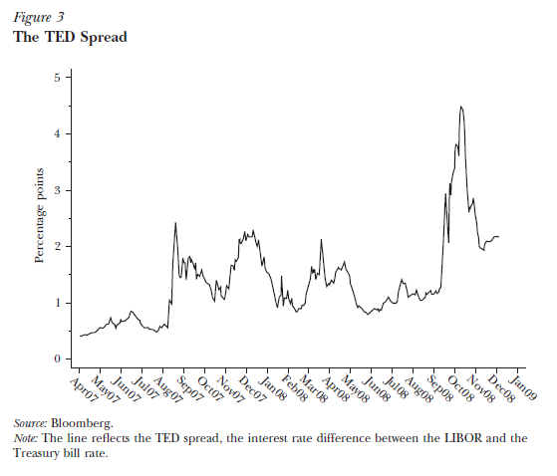
The Unfolding of the Crisis (cont.)
The LIBOR, Repo, and Fed Funds Markets

Slide 51
Amplifying Mechanisms and Recurring Themes
Market Liquidity
  Describe the ease of turning assets into money
Market liquidity is low when selling the asset significantly decreases the sale price
The mechanisms that explain why liquidity can suddenly evaporate operate through the interaction of market liquidity and funding liquidity

Slide 52
Borrower’s Balance Sheet Effects
Loss Spiral
  A decline in the value of assets decreases the investors’ net worth quickly, and the amount they can borrow falls
  The leveraged investors may be forced to sell their assets when the price is low
  The sales depress the price further, inducing more selling and so on

Slide 53
Borrower’s Balance Sheet Effects
Margin/Haircut Spiral
  As margins rise, the investor has to sell even more because the investor needs to reduce its leverage ratio
  Margins and haircuts spike in times of large price drops, leading to a general tightening of lending
These two spirals reflects what we call “fire-sale externality”

Slide 54
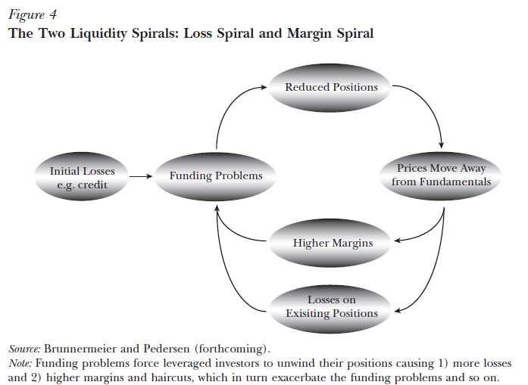
Borrower’s Balance Sheet Effects

