Slide 1
Substantive Law of the WTO
Part I: Core principles
Non-Trade Discrimination: Most-Favoured Nation and National Treatment Principles
Like Products and the Environment
By Assistant Prof. Dr. Jaruprapa Rakpong

Slide 2
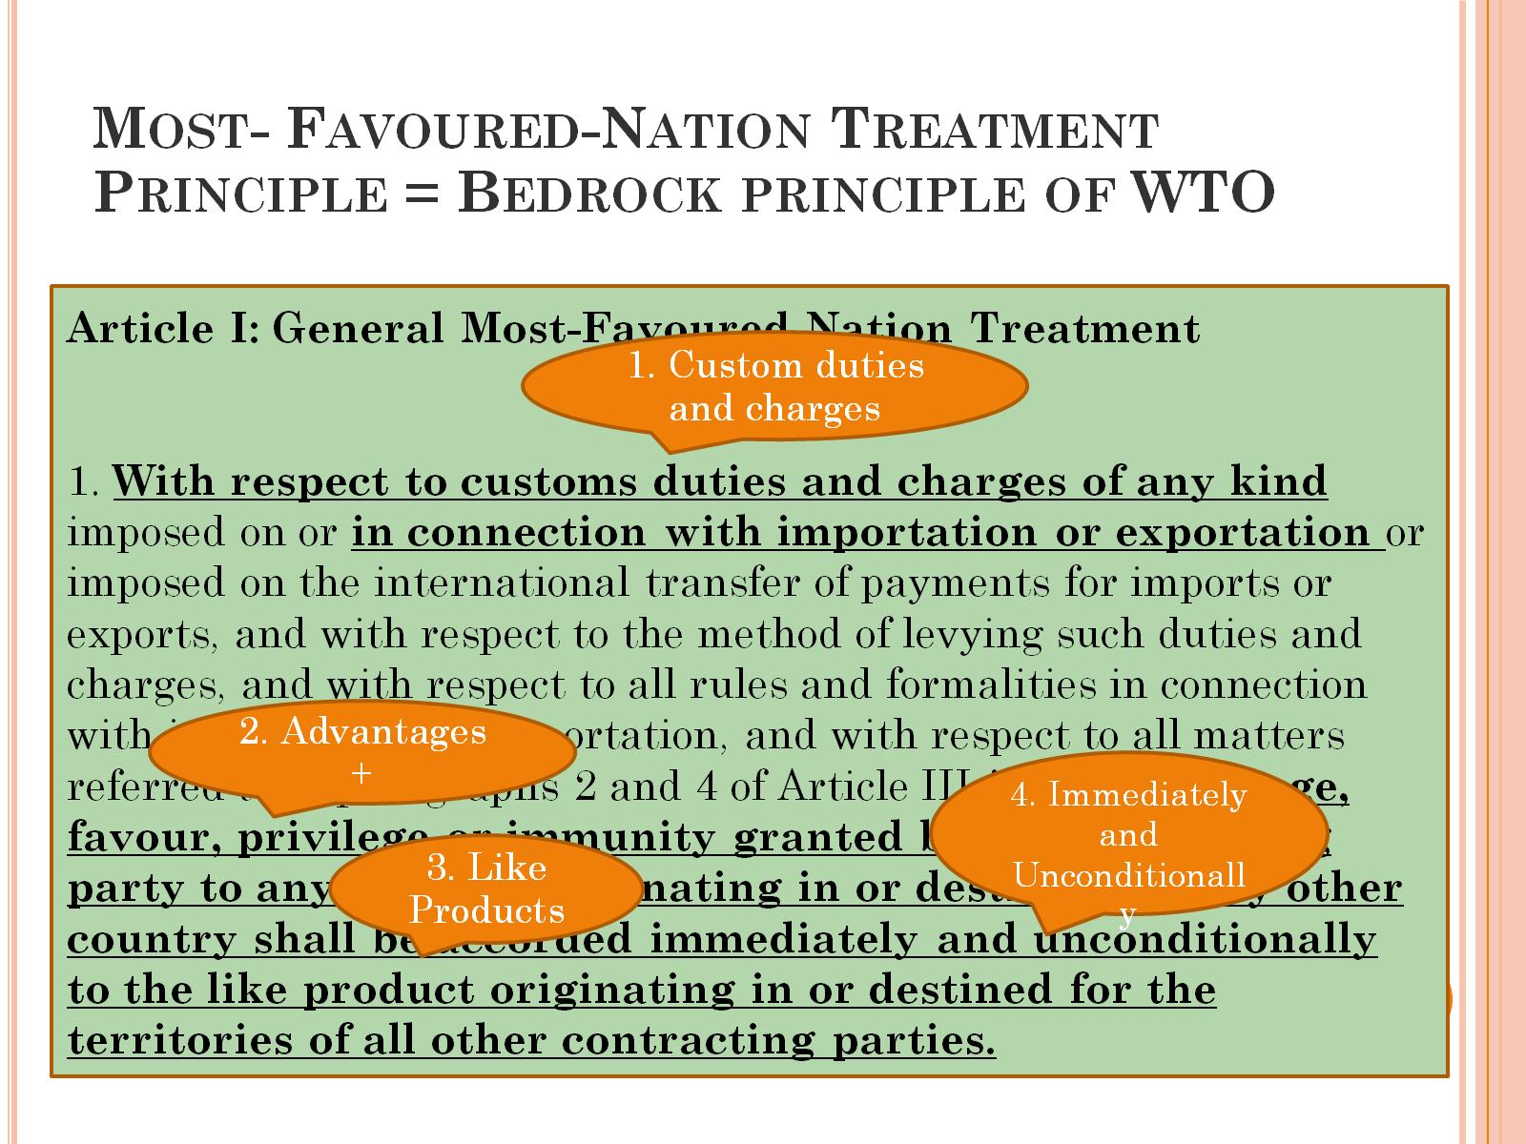
Most- Favoured-Nation Treatment Principle = Bedrock principle of WTO

Slide 3

Country B
Country A
MFN = Catalyst for Trade Liberisation
MFN= a cornerstone/ central pillar of trade policy.
MFN = Reciprocity
MFN = Non-Discriminatory
C
D
F
E

Slide 4
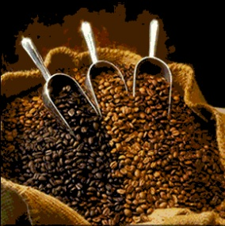
MFN in Operation Like Products : advantages only need to grant to “like” imported products
Spain: Unroasted Coffee
-Spain vs. Brazil (Panel 1981)
- Spain imposed different rates of tariff duties for different types of unroasted coffee:
-
Coffee Type | Tariff Duty | Exporting Country
Columbia mild, other mild | Duty free | Other countries
Unwashed Arabica, Robusta | 7% | Mainly Brazil

Slide 5
Criteria of Like Product in this case
Physical characteristic (exclude organoleptic properties)
Consumers’ tastes and habits
Custom Category

Slide 6
National Treatment
Country B
C
Country A must give
same tax rate (Art. III: 2) & same treatments (Art. III:4) to “like products” from other countries
B
C
A
A
A
F
D
E
D
F
E

Slide 7
National Treatment
Country B
C
NT = Catalyst for Trade Liberlisation
MFN= another level of non-trade discrimination
NT = usually on a reciprocity basis
Country A must give
same tax rate (Art. III: 2) & same treatments (Art. III:4) to “like products” from other countries
B
C
A
A
A
F
D
E
D
F
E

Slide 8
National treatment in operation: Art III GATT
Article III:2 = NT regarding tariff barriers
Can be directly + indirectly
Internal taxes /charges
2. The products of the territory of any contracting party imported into the territory of any other contracting party shall not be subject, directly or indirectly, to internal taxes or other internal charges of any kind in excess of those applied, directly or indirectly, to like domestic products. Moreover, no contracting party shall otherwise apply internal taxes or other internal charges to imported or domestic products in a manner contrary to the principles set forth in paragraph 1.
In excess of
Like Product (as before?)
Article III:2 must be read with Art. III:1
1. The contracting parties recognize that internal taxes and other internal charges, and laws, regulations and requirements affecting the internal sale, offering for sale, purchase, transportation, distribution or use of products, and internal quantitative regulations requiring the mixture, processing or use of products in specified amounts or proportions, should not be applied to imported or domestic products so as to afford protection to domestic production.*
Not to afford protection

Slide 9
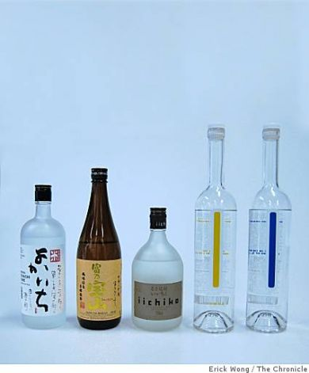
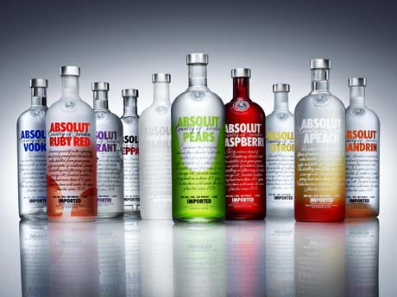
Japan Alcoholic Beverages
(1996)
- Japan vs. US, EC, Canada
- Japanese law imposed different
tax rate for different kinds of liquors.
- Japanese sochu was tax at a much rate lower than imported whisky, cognac, vodka and other kinds of liquors.
- Sochu was predominantly domestic products (only produced in Japan).
- Almost all imported liquors
were subject to higher tax rates.

Slide 10
Japan Alcoholic beverages (Cont’)
The issues were;
Was does it mean by a tax in excess of “like” domestic products,
how the term “like product” would be construed?

Slide 11
Japan Alcohol (Cont’)
Article Art. III: 2 and III:1 are inter-connected
As these are read together, there are two obligations

Slide 12
Japan alcoholic beverages (cont’)
AB (p.19-20)
- Like products would be construed narrowly on a case-by-case basis
- Follow the approach adopted by Working Party on Borders Tax Adjustments (all CPs are parties)
1st obligation: “like” imported products should not be subject to taxes/internal charges “in excess of” “like” domestic product

Slide 13
Japan Alcoholic beverages (Cont’)
In excess of”??? (AB: p. 23)
Even the smallest amount was too much.
No requirements of “trade effect”
No requirement of “de minimis” (insubstantial) standard
Very strict! → because the drafter wanted to prohibit of internal taxes or charges
So in this case there was a breach
Even the breach was established, the AB went on further to address the second obligation of Art. III:2

Slide 14
Japan alcoholic beverages (cont’)
Not only like products but also directly competitive or substitutable (DCS) products (สินค้าที่ใช้ทดแทนกันได้)
4 criteria which can help are: 1) physical characteristic 2) common end users 3) tariff classification 4) market place (i.e. cross price elasticity)
The idea behind the DCS = high cross- price elasticity of demand (ความยืดหยุ่นไขว้). As products are substitute, when price of one product increases, the demand of other product increases. E.g...... Liquid detergent vs. powder detergent.
2nd Obligation : internal taxes/charges shall not be applied to imported products so as to afford protection.

Slide 15

Japan Alcoholic beverages (cont’)
2.2 “So as to afford protection” (par 109-110)
This is not the issue of intention but the effect
Here “the design, architecture and revealing structure” of the measure would be considered
Case-by-case basis and looking at the scheme as a whole
Here → overall tax scheme was applied so as to afford protection
Notes:
More specifically, the purpose of Article III "is to ensure that internal
measures 'not be applied to imported and domestic products so as to
afford protection to domestic production'". Toward this end, Article III
obliges Members of the WTO to provide equality of competitive
conditions for imported products in relation to domestic products. …
Article III protects expectations not of any particular trade volume but
rather of the equal competitive relationship between imported and
domestic products.

Slide 16
Japan Alcoholic beverages (cont’)
Here → overall tax scheme cannot be applied so as to afford protection because....
Absence of ad valorem taxes on shochu cf. high taxes on imported products which was actually more than de minimis Requirement on de minimis
Shochu was almost exclusively produced in Japan
High substitutability of liquors

Slide 17
National treatment in operation: Art III GATT
Article III:4 = NT regarding non-tariff barriers
There are 3 main elements :
4. The products of the territory of any contracting party imported into the territory of any other contracting party shall be accorded treatment no less favourable than that accorded to like products of national origin in respect of all laws, regulations and requirements affecting their internal sale, offering for sale, purchase, transportation, distribution or use. The provisions of this paragraph shall not prevent the application of differential internal transportation charges ...
There is a fiscal regulation or requirements (issued by govt) affecting ...
Like products
The treatment of imports is less favourable than domestic products.

Slide 18
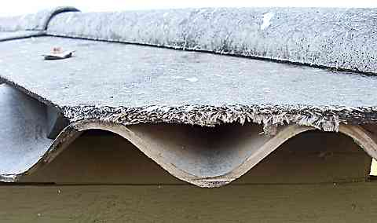
II) Like product in article III:4
EC- Asbestos (2001)
Facts:
French decree banned the sale, use and import of all Asbestos fibres but not other kinds of insulated fibres
Aimed to protect public health
Canada which produced & import a lot of asbestos fibres claimed the violation of Article III:4 arguing that Asbestos fibres and other kind of fibres were “like products”

Slide 19
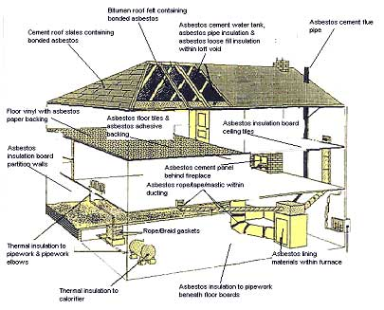
EC- Asbestos (cont’)

Slide 20
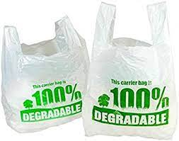

Slide 21
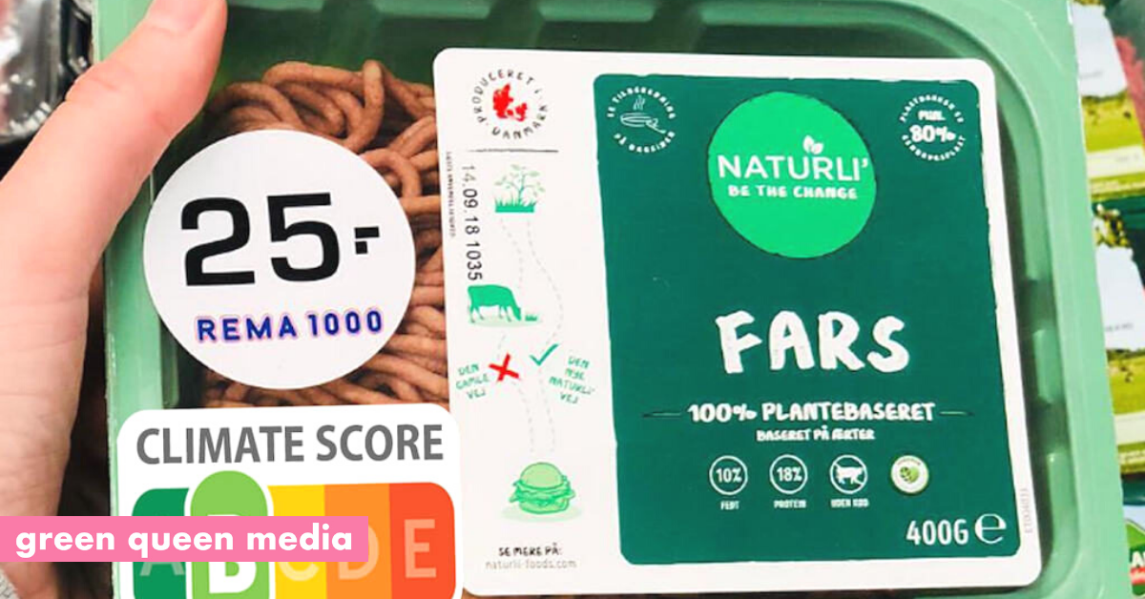
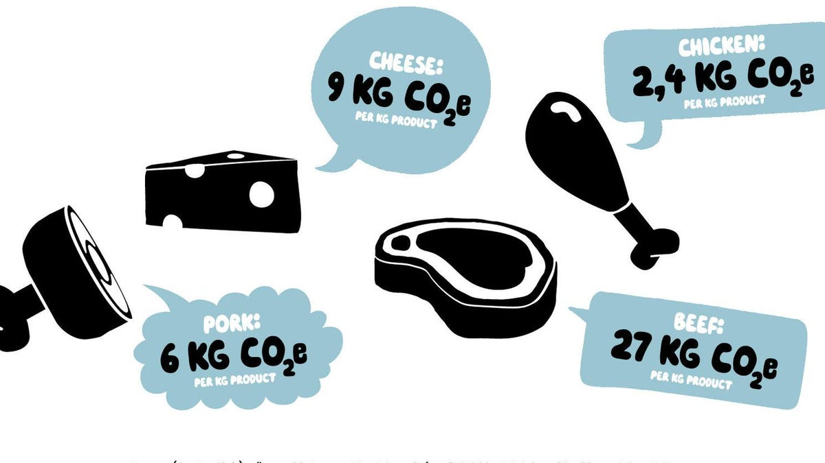

Slide 22
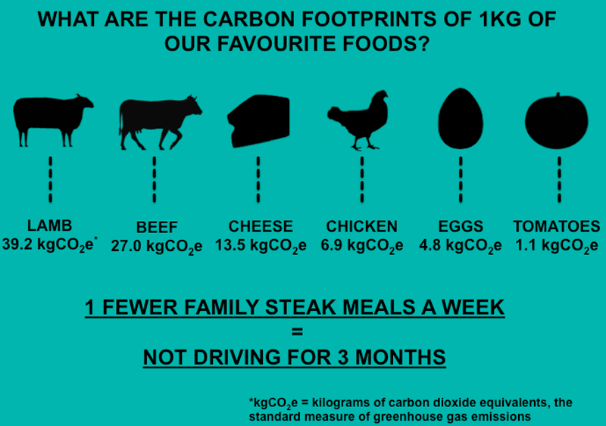
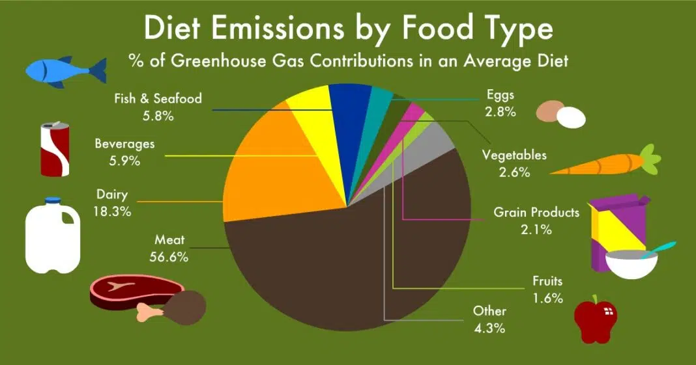
Sources: https://www.barnsleyhospital.nhs.uk/about/sustainability/attachment/food-carbon-footprint/
Sources: https://carboncredits.com/food-carbon-footprint/

Slide 23
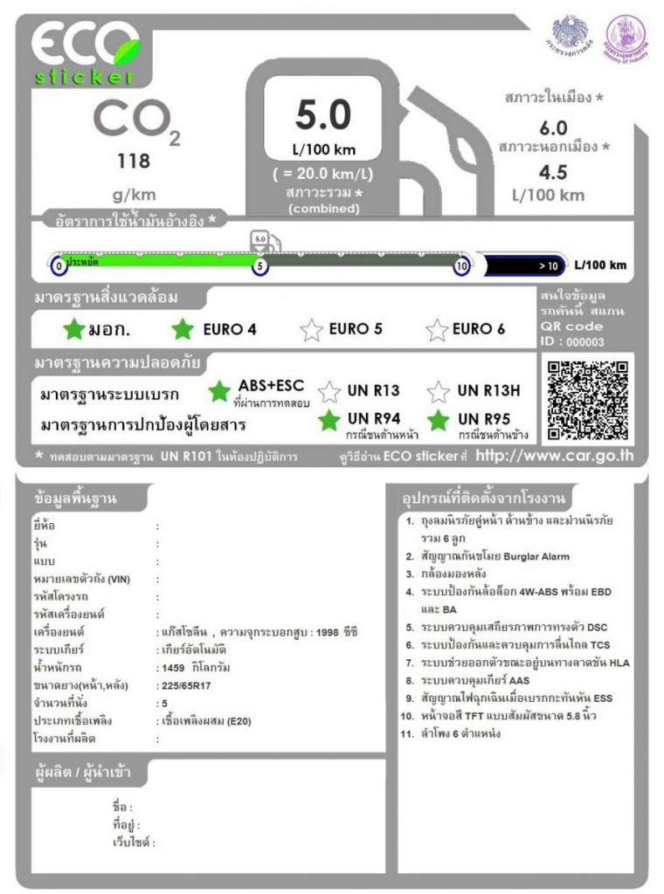
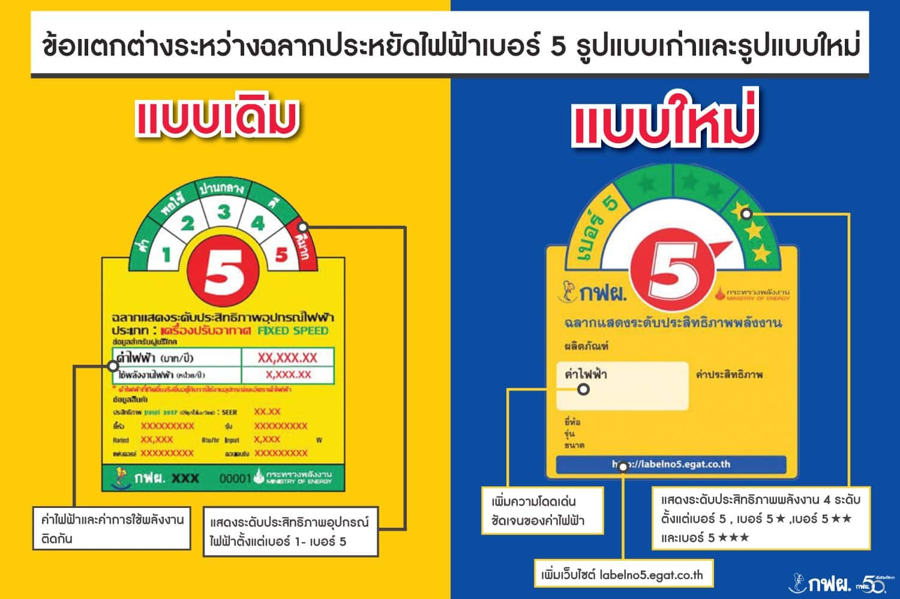

Slide 24


