Slide 1


MK 333/326
SRC & Ethnocentrism
By Ajarn Suwalya K.

Slide 2

MK 333/326 Group Assignment 2: Chapter 1 on SRC and Ethnocentrism
Each group please prepare a 1 slide presentation on SRC and Ethnocentrism of your country
Please be specific as possible. You may use graphs, visuals and examples to illustrate your point across to me.
Also please address what impact with SRC and Ethnocentrism have on other countries. Have fun ka ☺
Notes:
1

Slide 3
The Self-Reference Criterion and Ethnocentrism
Both impede ability to accurately assess foreign market
Self-Reference Criterion (SRC)
  Unconscious reference to own cultural values, experiences, knowledge
  Problematic when used as basis for decisions
Ethnocentrism
  One’s own country, culture, or country is best
  Most problematic when affluent countries work with less affluent

Slide 4


McDonalds in India: Example of SRC

Slide 5
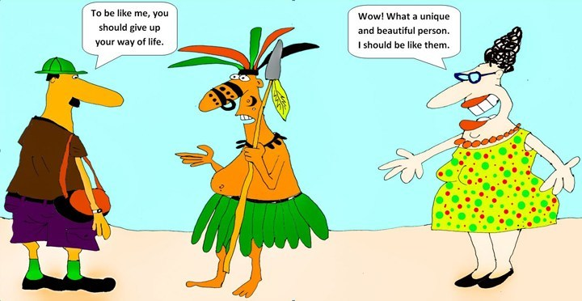

Slide 6

11 Countries for MK 333/326
Sequence
1.Germany
2.India
3.New Zealand
4.Switzerland
5.Spain
6.France
7.Sweden
8.Russia
9.Italy
10.Portugal
11.Canada

Slide 7
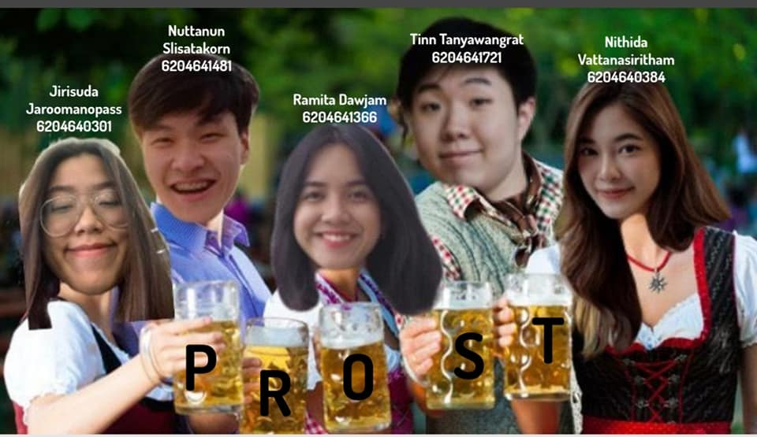
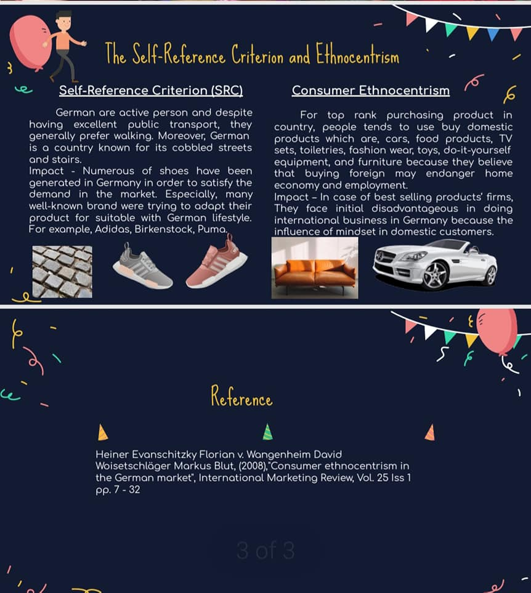
Germany

Slide 8

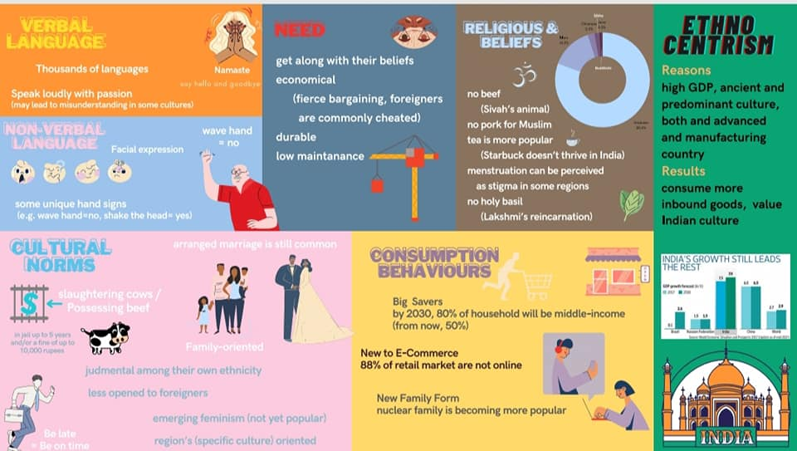
India

Slide 9

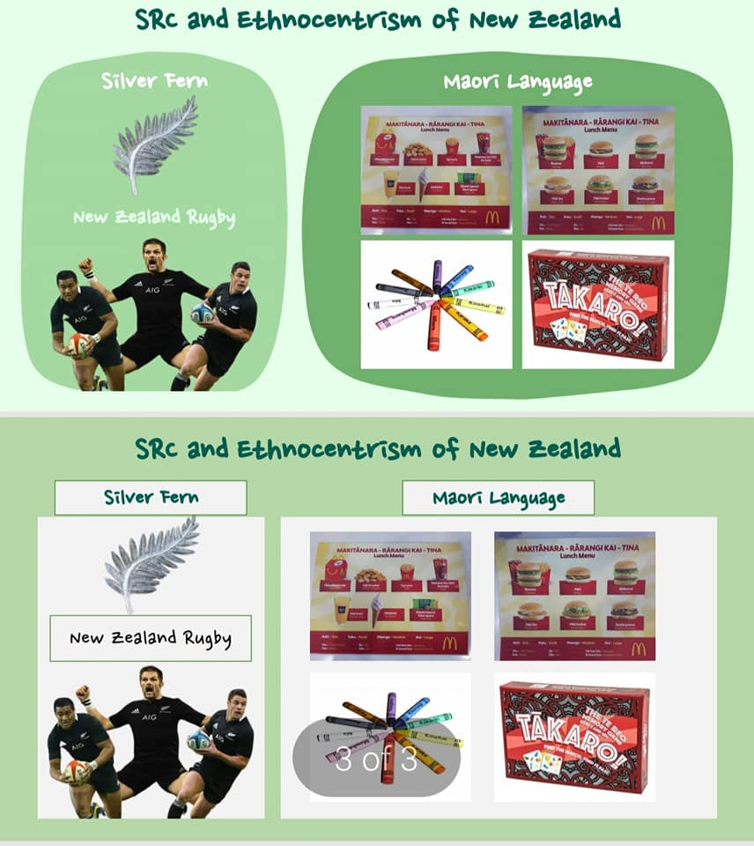
New Zealand

Slide 10

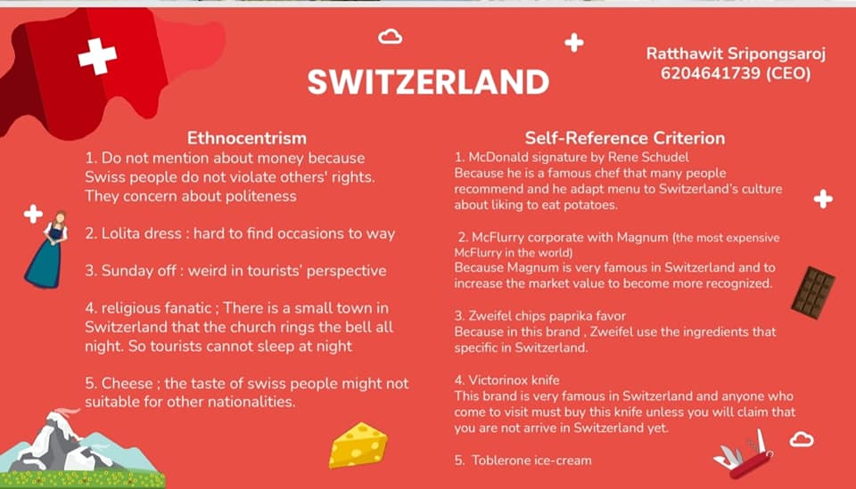
Switzerland

Slide 11
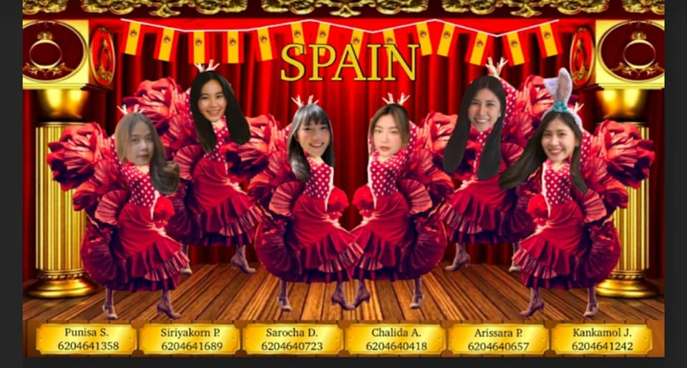

Spain

Slide 12

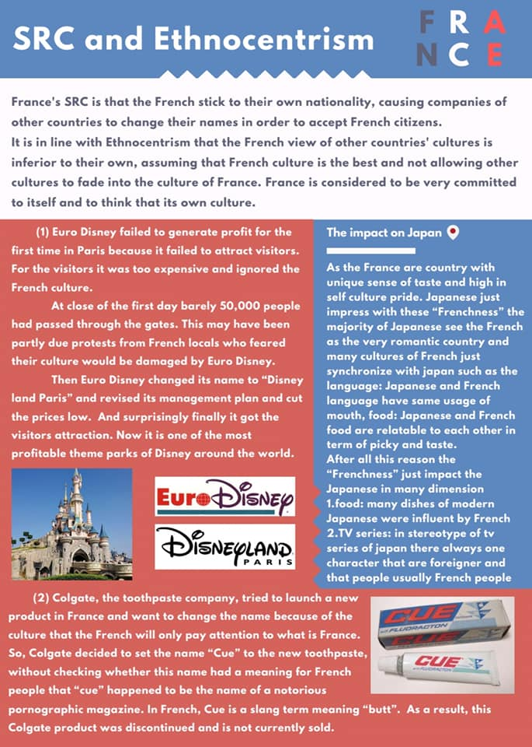
France

Slide 13
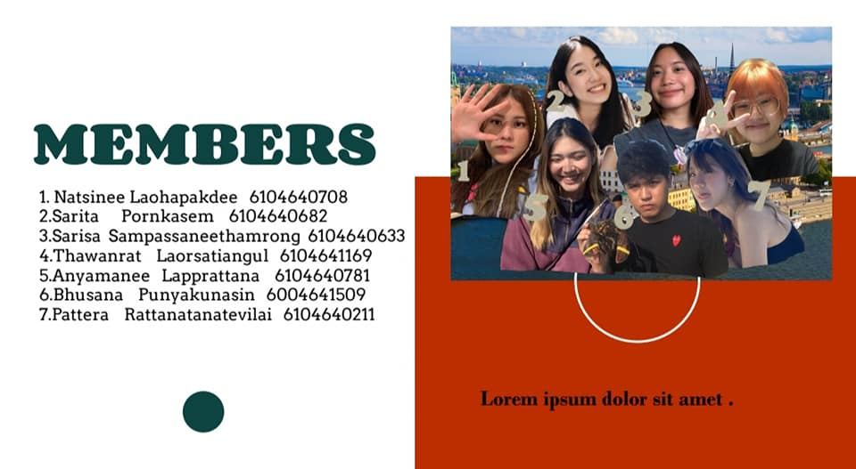
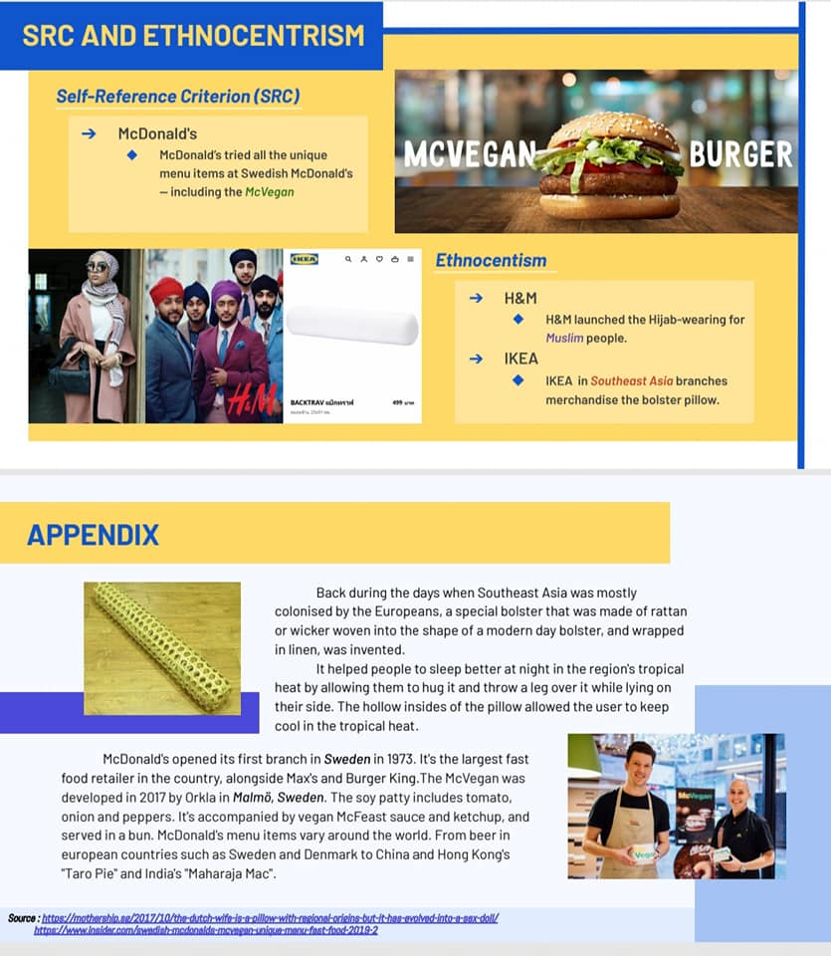
Sweden

Slide 14

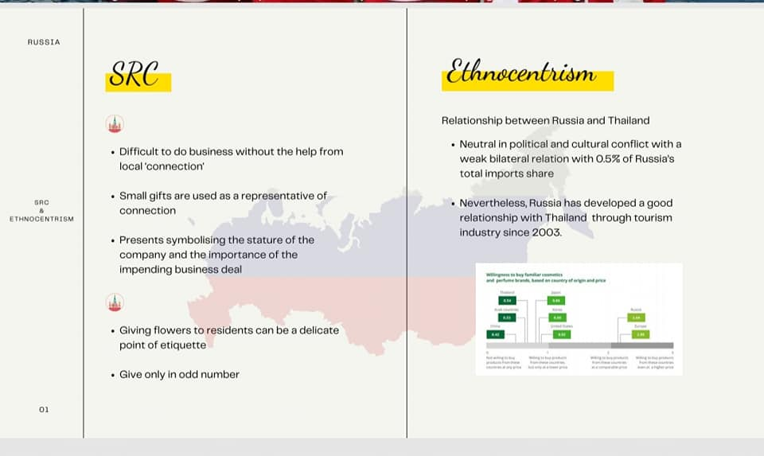
Russia

Slide 15
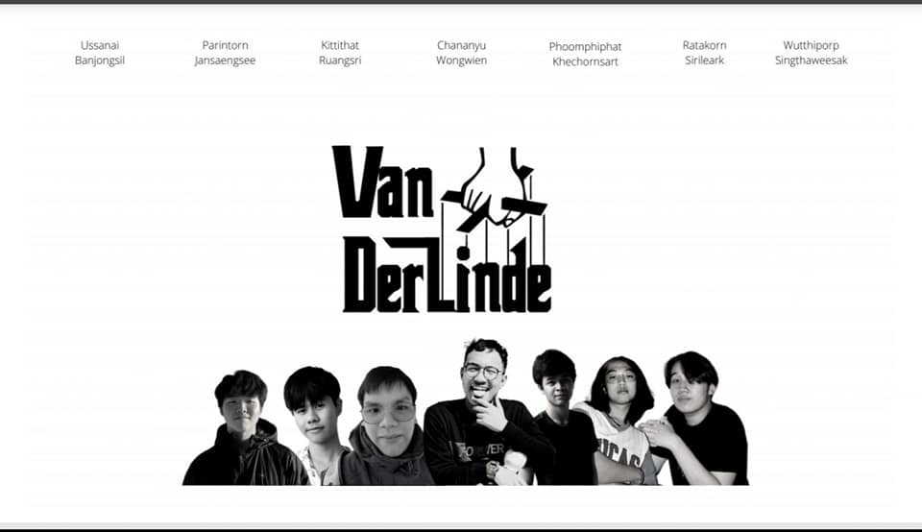
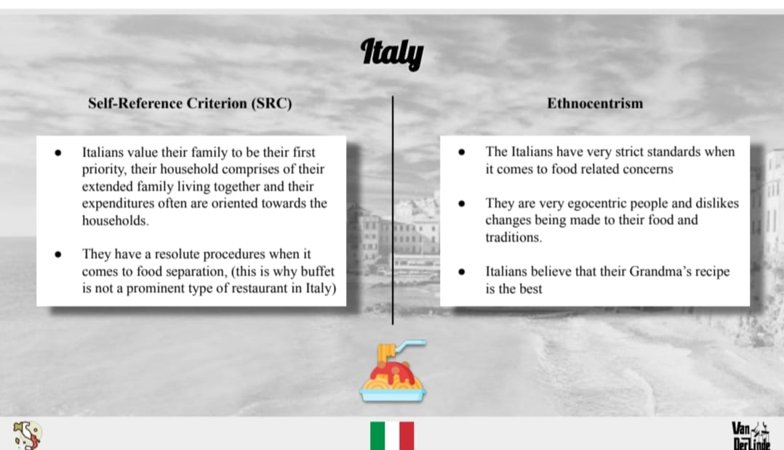
Italy

Slide 16

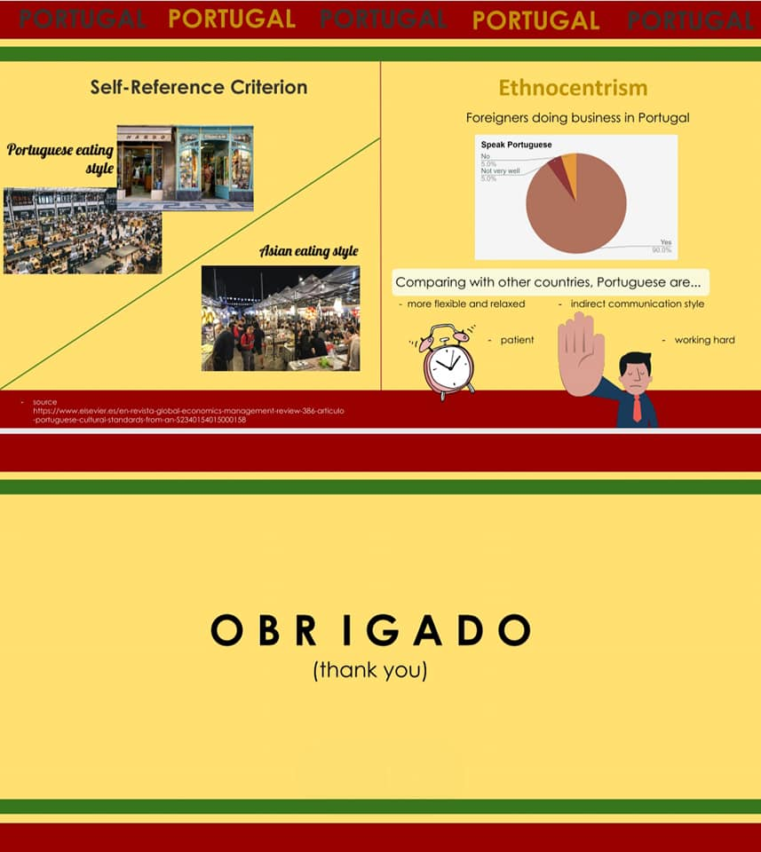
Portugal

Slide 17

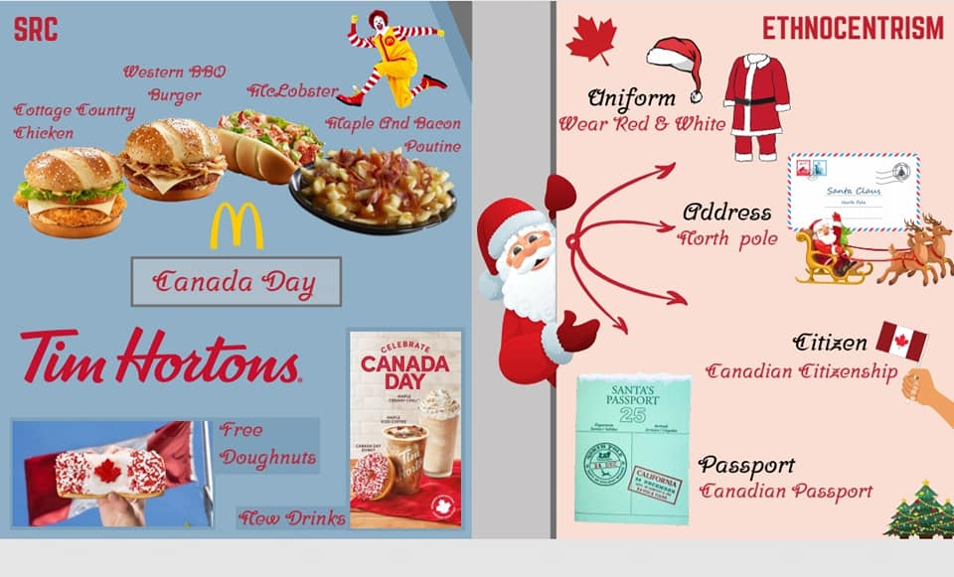
Canada

Slide 18


