Slide 1
International Capital Structure and the Cost of Capital
Chapter Seventeen
Notes:
This chapter discusses the cost of capital for the multinational firm.

Slide 2
Chapter Outline
Cost of Capital
Cost of Capital in Segmented vs. Integrated Markets
Does the Cost of Capital Differ Among Countries?
Cross-Border Listings of Stocks
Capital Asset Pricing Under Cross-Listings
The Effect of Foreign Equity Ownership Restrictions
The Financial Structure of Subsidiaries
Summary
17-2

Slide 3
Cost of Capital
The cost of capital is the minimum rate of return an investment project must generate in order to pay its financing costs.
For a levered firm, the financing costs can be represented by the weighted average cost of capital:
K = (1 – λ)K_{l} + λ(1 – t)i
Where
  K = weighted average cost of capital
  λ = debt to total market value ratio
  K_{l} = cost of equity capital for a levered firm
  t = marginal corporate income tax rate
  i = pretax cost of debt
17-3

Slide 4
The Firm’s Investment Decision and the Cost of Capital
A firm that can reduce its cost of capital will increase the profitable capital expenditures that the firm can take on and increase the wealth of the shareholders.
Internationalizing the firm’s cost of capital is one such policy.
cost of capital (%)
K _{local}
K _{global}
IRR
I_{local}
I_{global}
Investment ($)
17-4
Notes:
Note: Kl and Kg represent, respectively, the cost of capital under local and international capital structures; IRR
represents the internal rate of return on investment projects; Il and Ig represent the optimal investment outlays under
the alternative capital structures.

Slide 5
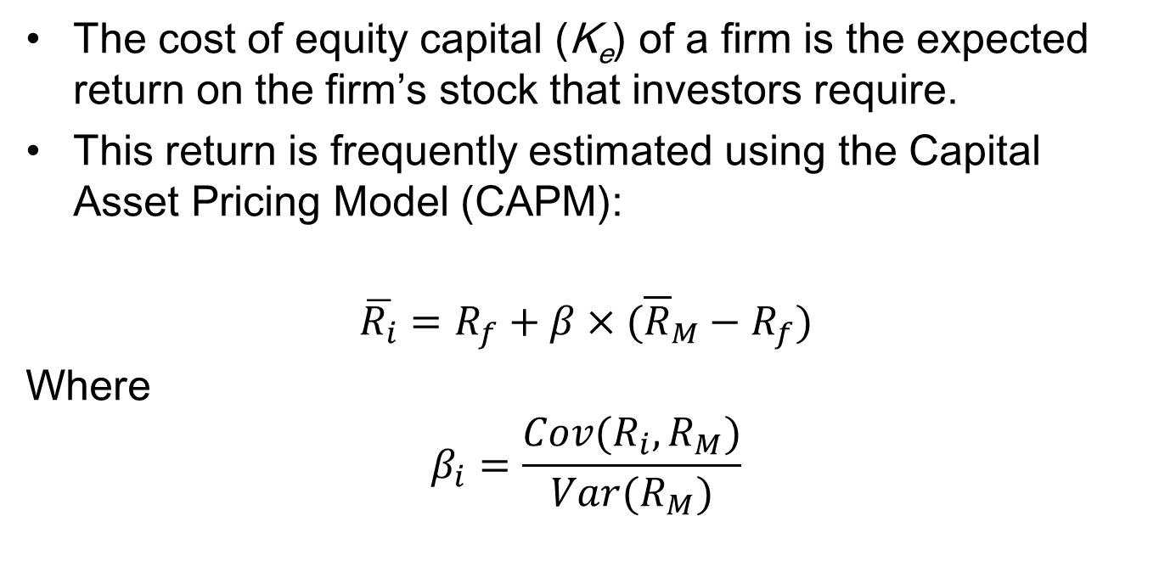
Cost of Capital Estimated Using the CAPM
The cost of equity capital (K_{e}) of a firm is the expected return on the firm’s stock that investors require.
This return is frequently estimated using the Capital Asset Pricing Model (CAPM):
$$\overline{R_{i}}=R_{f}+β×({\overline{R}}_{M}−R_{f})$$
Where
$$β_{i}=\frac{Cov(R_{i},R_{M})}{Var(R_{M})}$$
17-5

Slide 6
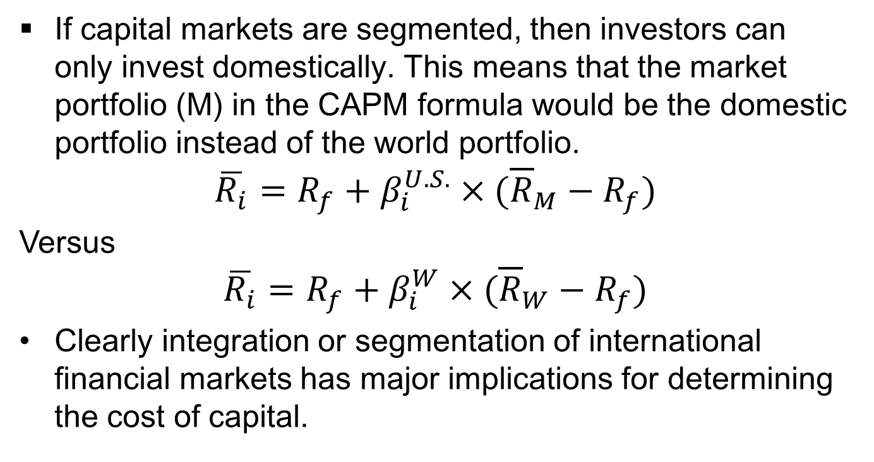
Cost of Capital in Segmented vs. Integrated Markets
If capital markets are segmented, then investors can only invest domestically. This means that the market portfolio (M) in the CAPM formula would be the domestic portfolio instead of the world portfolio.
$$\overline{R_{i}}=R_{f}+β_{i}^{U.S.}×({\overline{R}}_{M}−R_{f})$$
Versus
$$\overline{R_{i}}=R_{f}+β_{i}^{W}×({\overline{R}}_{W}−R_{f})$$
Clearly integration or segmentation of international financial markets has major implications for determining the cost of capital.
17-6

Slide 7
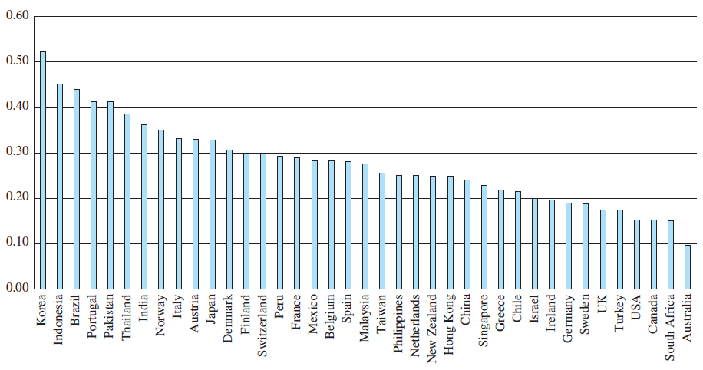
EXHIBIT 17.1 Median Debt Ratios of Firms across Countries

Slide 8
Does the Cost of Capital Differ Among Countries?
There do appear to be differences in the cost of capital in different countries.
When markets are imperfect, international financing can lower the firm’s cost of capital.
One way to achieve this is to internationalize the firm’s ownership structure.
17-8

Slide 9
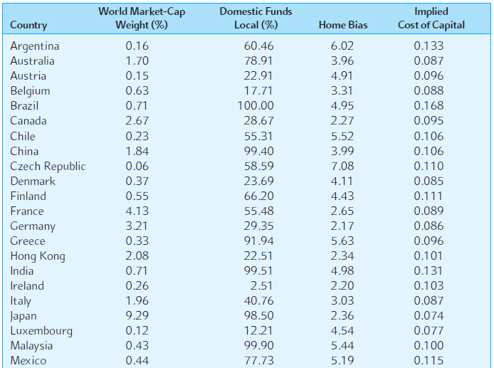
EXHIBIT 17.3 (Excerpt)
The Cost of Capital Around the World
17-9

Slide 10
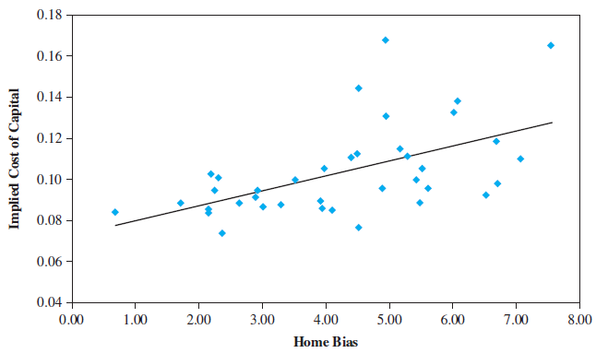
EXHIBIT 17.4
Implied Cost of Capital versus Home Bias
17-10
Notes:
Theoretical arguments suggest that as the degree of a country's home bias increases, the global risk sharing between domestic and foreign investors will be reduced and thereby the country's cost of capital will increase. The empirical evidence implies that countries may enjoy a significantly lower cost of capital by reducing the extent of their home bias and hence increasing global risk sharing.

Slide 11
Cross-Border Listings of Stocks
Cross-border listings of stocks have become quite popular among major corporations.
The largest contingent of foreign stocks are listed on the London Stock Exchange.
U.S. exchanges attracted the next largest contingent of foreign stocks.
17-11

Slide 12
Benefits of Cross-Border Listing
Cross-border listings of stocks benefit a company:
  The company can expand its potential investor base, which will lead to a higher stock price and lower cost of capital.
  Cross-listing creates a secondary market for the company’s shares, which facilitates raising new capital in foreign markets.
  Cross-listing can enhance the liquidity of the company’s stock.
  Cross-listing enhances the visibility of the company’s name and its products in foreign marketplaces.
17-12

Slide 13
Costs of Cross-Border Listing
Cross-border listings of stocks do carry costs:
  It can be costly to meet the disclosure and listing requirements imposed by the foreign exchange and regulatory authorities.
  Controlling insiders may find it difficult to continue to derive private benefits once the company is cross-listed on foreign exchanges.
  Once a company’s stock is traded in overseas markets, there can be volatility spillover from these markets.
  Once a company’s stock is made available to foreigners, they might acquire a controlling interest and challenge the domestic control of the company.
17-13

Slide 14
Cross-Border Listing: Costs vs. Benefits
On average, cross-border listings of stocks appears to be a profitable decision
The benefits outweigh the costs.
17-14

Slide 15
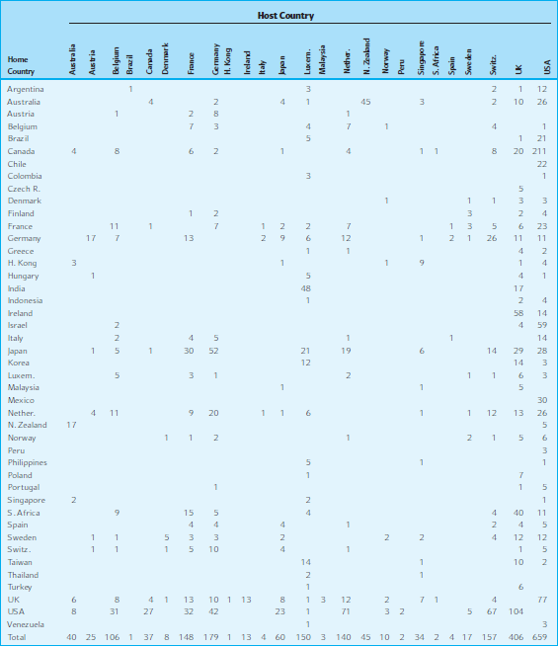
EXHIBIT 17.7 Country-to-Country Frequency Distribution of Foreign Listings
17-15

Slide 16
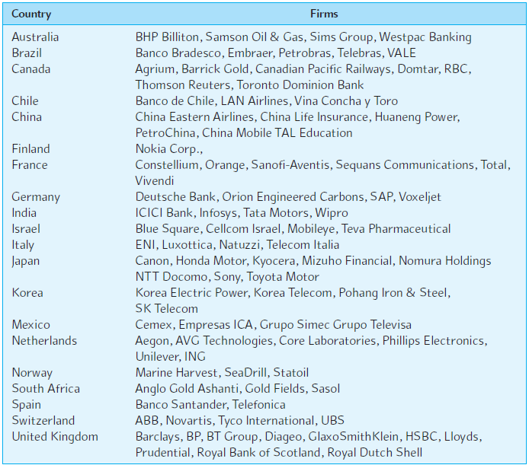
EXHIBIT 17.8 Foreign Firms Listed on the New York Stock Exchange (selected)
17-16

Slide 17
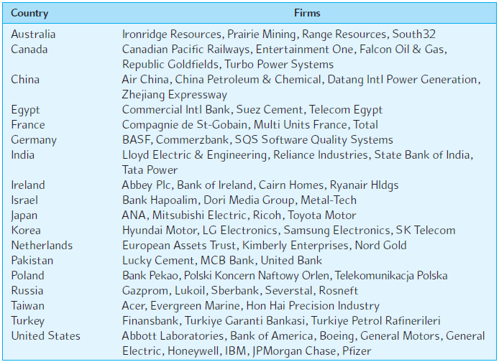
EXHIBIT 17.9 Foreign Firms Listed on the London Stock Exchange (selected)
17-17

Slide 18
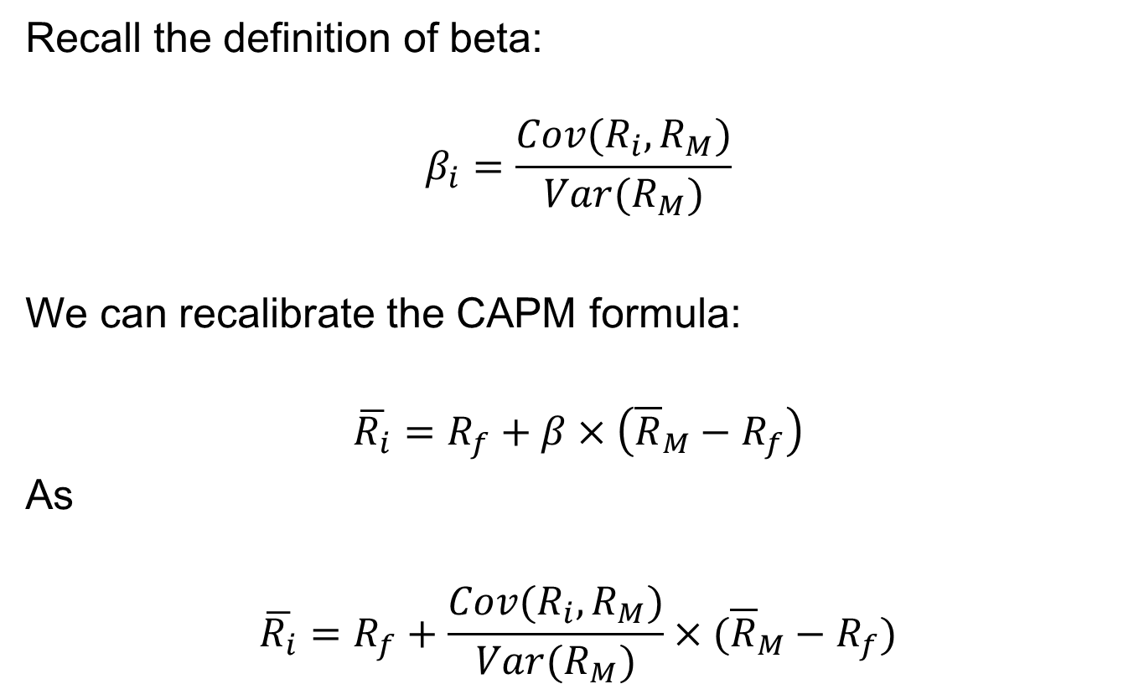
Capital Asset Pricing Under Cross-Listings
Recall the definition of beta:
$$β_{i}=\frac{Cov(R_{i},R_{M})}{Var(R_{M})}$$
We can recalibrate the CAPM formula:
$$\overline{R_{i}}=R_{f}+β×\left({\overline{R}}_{M}−R_{f}\right)$$
As
$$\overline{R_{i}}=R_{f}+\frac{Cov(R_{i},R_{M})}{Var(R_{M})}×({\overline{R}}_{M}−R_{f})$$
17-18

Slide 19
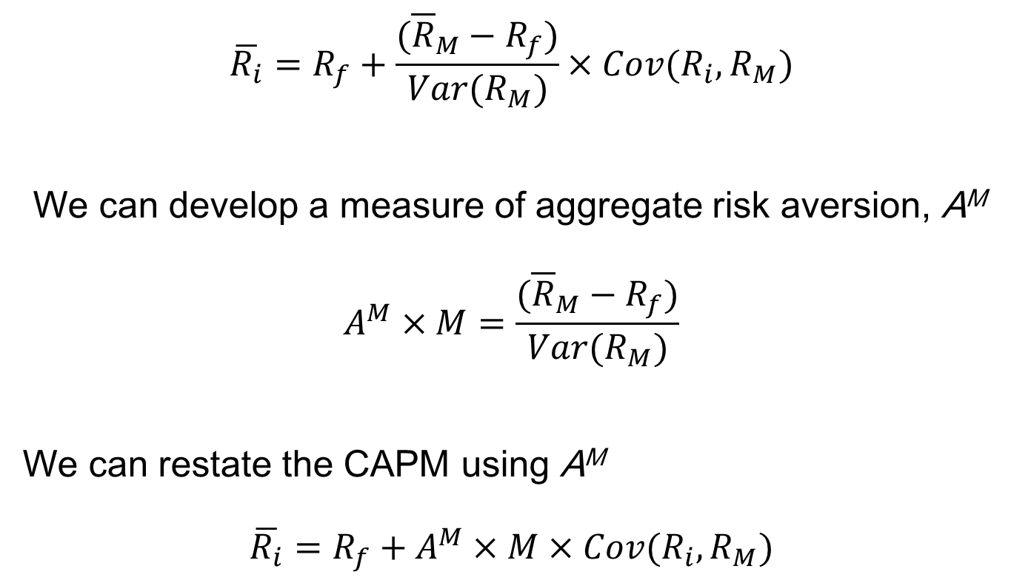
Capital Asset Pricing Under Cross-Listings
(continued)
$$\overline{R_{i}}=R_{f}+\frac{({\overline{R}}_{M}−R_{f})}{Var(R_{M})}×Cov(R_{i},R_{M})$$
We can develop a measure of aggregate risk aversion, A^{M}
$$A^{M}×M=\frac{({\overline{R}}_{M}−R_{f})}{Var(R_{M})}$$
We can restate the CAPM using A^{M}
$$\overline{R_{i}}=R_{f}+A^{M}×M×Cov(R_{i},R_{M})$$
17-19

Slide 20
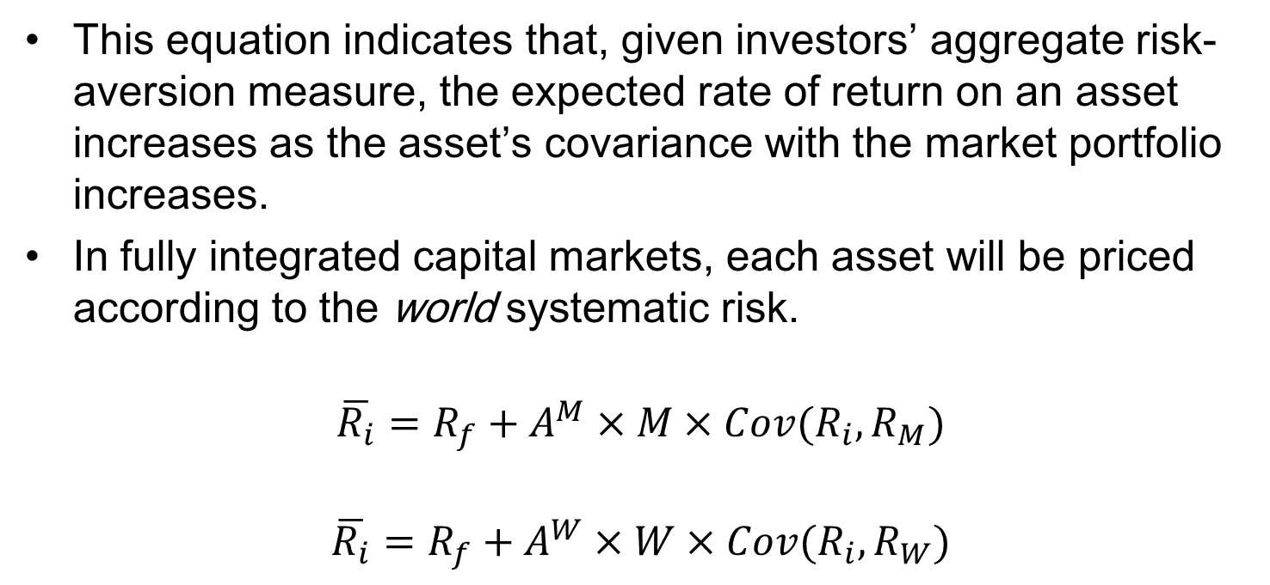
Capital Asset Pricing Under Cross-Listings:
The International Asset Pricing Model
This equation indicates that, given investors’ aggregate risk-aversion measure, the expected rate of return on an asset increases as the asset’s covariance with the market portfolio increases.
In fully integrated capital markets, each asset will be priced according to the world systematic risk.
$$\overline{R_{i}}=R_{f}+A^{M}×M×Cov(R_{i},R_{M})$$
$$\overline{R_{i}}=R_{f}+A^{W}×W×Cov(R_{i},R_{W})$$
17-20

Slide 21
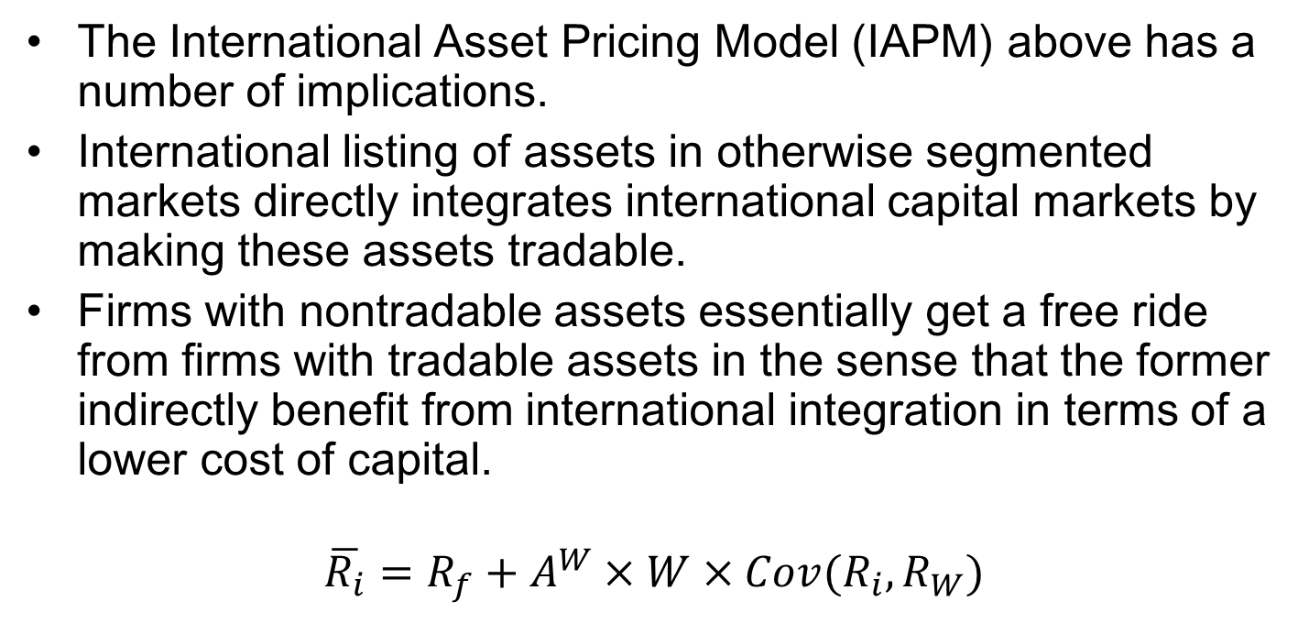
The International Asset Pricing Model
The International Asset Pricing Model (IAPM) above has a number of implications.
International listing of assets in otherwise segmented markets directly integrates international capital markets by making these assets tradable.
Firms with nontradable assets essentially get a free ride from firms with tradable assets in the sense that the former indirectly benefit from international integration in terms of a lower cost of capital.
$$\overline{R_{i}}=R_{f}+A^{W}×W×Cov(R_{i},R_{W})$$
17-21

Slide 22
The Effect of Foreign Equity Ownership Restrictions
While companies have incentives to internationalize their ownership structure to lower the cost of capital and increase market share, they may be concerned with the possible loss of corporate control to foreigners.
In some countries, there are legal restrictions on the percentage of a firm that foreigners can own.
These restrictions are imposed as a means of ensuring domestic control of local firms.
17-22

Slide 23
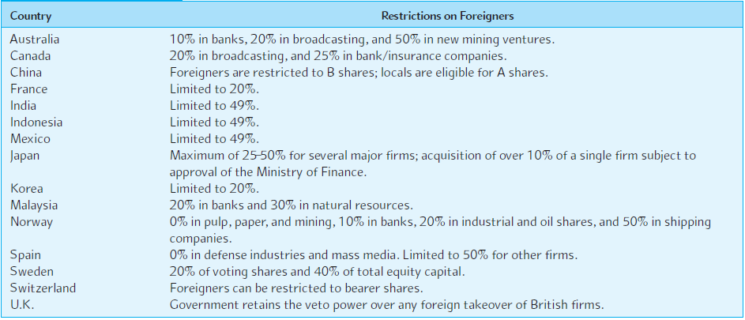
EXHIBIT 17.11 Restrictions on Equity Ownership by Foreigners: Historical Examples
17-23

Slide 24
Pricing-to-Market Phenomenon
Suppose foreigners, if allowed, would like to buy 30 percent of a Korean firm.
But because of ownership constraints imposed on foreigners, they can purchase at most 20 percent.
Because this constraint is effective in limiting desired foreign ownership, foreign and domestic investors many face different market share prices.
This dual pricing is the pricing-to-market phenomenon.
17-24

Slide 25
Asset Pricing under Foreign Ownership Restrictions
An interesting outcome is that the firm’s cost of capital depends on which investors, domestic or foreign, supply capital.
The implication is that a firm can reduce its cost of capital by internationalizing its ownership structure.
17-25

Slide 26
An Example of Foreign Ownership Restrictions: Nestlé
Nestlé used to issue two different classes of common stock: bearer shares and registered shares.
  Foreigners were only allowed to buy bearer shares.
  Swiss citizens could buy registered shares.
  The bearer stock was more expensive.
On November 18, 1988, Nestlé lifted restrictions imposed on foreigners, allowing them to hold registered shares as well as bearer shares.
17-26

Slide 27
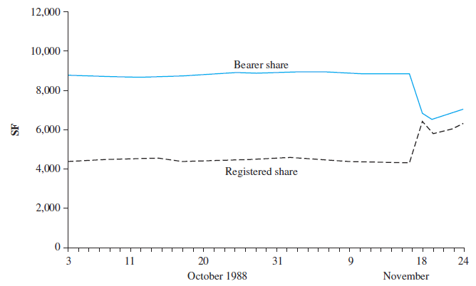
EXHIBIT 17.12 Price Spread between Bearer and Registered Shares of Nestlé
Source: Financial Times, November 26, 1988 p.1. Adapted with permission.
17-27

Slide 28
An Example of Foreign Ownership Restrictions: Nestlé
Following this, the price spread between the two types of shares narrowed dramatically.
  This implies that there was a major transfer of wealth from foreign shareholders to Swiss shareholders.
  The price of bearer shares declined about 25 percent.
  The price of registered shares rose by about 35 percent.
Because registered shares represented about two-thirds of the market capitalization, the total value of Nestlé increased substantially when it internationalized its ownership structure.
Nestlé’s cost of capital therefore declined.
17-28

Slide 29
An Example of Foreign Ownership Restrictions: Nestlé
Foreigners holding Nestlé bearer shares were exposed to political risk in a country that is widely viewed as a haven from such risk.
The Nestlé episode illustrates:
  The importance of considering market imperfections.
  The peril of political risk.
  The benefits to the firm of internationalizing its ownership structure.
17-29

Slide 30
The Financial Structure of Subsidiaries
There are three different approaches to determining a subsidiary’s financial structure:
  Conform to the parent company's norm.
  Conform to the local norm of the country where the subsidiary operates.
  Vary judiciously to capitalize on opportunities to lower taxes, reduce financing costs and risk, and take advantage of various market imperfections.
In addition to taxes, political risk should be given due consideration in the choice of a subsidiary’s financial structure.
17-30

Slide 31
Summary
International comparison of the cost of funds indicates that while the costs of funds are converging among major countries in recent years, international financial markets are less than fully integrated. This suggests that firms can increase their market values by judiciously raising capital overseas.
When a firm is operating in a segmented capital market, it can reduce the negative effects by cross-listing its stock on foreign stock markets, thereby making the stock internationally tradable.
17-31

Slide 32
Summary (continued)
A firm can benefit from international cross-listings in terms of a lower cost of capital and a higher stock price, and access to new sources of capital.
When a firm’s stock is cross-listed on foreign exchanges in an otherwise segmented capital market, the stock will be priced according to the world systematic risk as if international capital markets were fully integrated.
Many countries still maintain restrictions on investment by foreigners. Under an ownership constraint, foreign and domestic country investors may face different share prices, resulting in the pricing-to-market phenomenon generally raises the firm’s overall cost of capital.
17-32

