Slide 1
The Thai Village Economy in the Past
(Chattip Nartsupha)
Thorn Pitidol
Thai Economic History
1/2018

Slide 2
Topics
Primordial village communities
Subsistence village communities under the Sakdina system (1455-1855)
Shifting away from subsistence economy (post-Bowring)

Slide 3
Primordial village communities

Slide 4
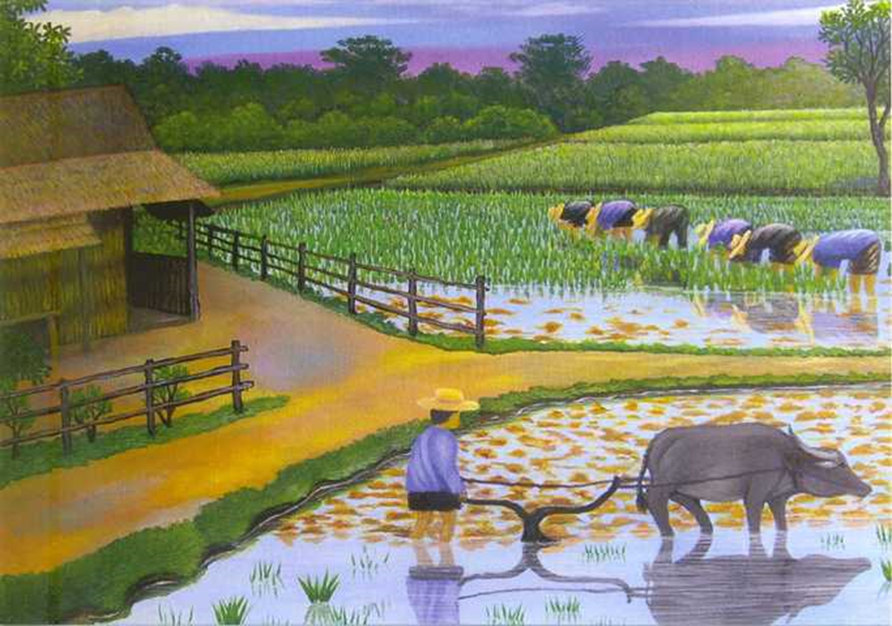
Primordial village communities
Characteristics
  Rice producers occupying low-land basin. Contrast with tribal communities

Slide 5
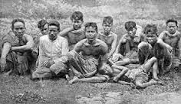
Social structure of primordial communities
Social structure
  Common ownership of land & own inner ruling system
  The importance of self-rule is shown by later peasant rebellions

Slide 6
Subsistence village communities under the Sakdina system (1455-1855)

Slide 7
Sakdina system and the villages
Sakdina system & village communities.
  Sakdina establishing control over communities
    Claiming ownership of land.
    Commoners only have entitlement to use, but not to own and sell.
    Commoners lost entitlement to use land when?
  But Sakdina system was not actually interested in owning the land
    But they claimed ownership to legitimate extraction.

Slide 8
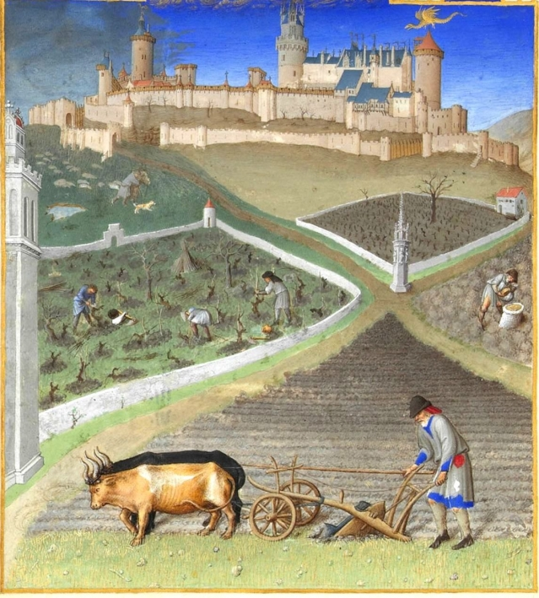

Sakdina system and the villages
The sakdina system did not penetrate into the village. This contrasted with Western feudalism.
  This helped prolonged the Thai sakdina system.

Slide 9
Thai village communities under sakdina
Thai villages communities under the sakdina system continued to be self-reliance.
Evidences
  Lack in use of technology in agricultural production.
  Other activities as evidences of self-reliance

Slide 10
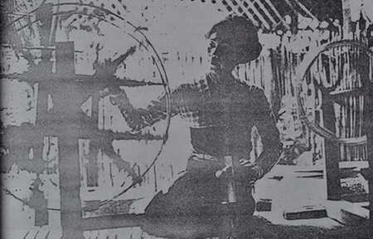
Thai village communities under sakdina
    Textile weaving was an important activity. Women had to be able to do weaving. Each village weaved their textile for their own use.

Slide 11
Thai village communities under sakdina
Village subsistence economy
  Self-consumption & limited exchange.
  Only activity beyond self-reliance was collecting forest products
Implications
  Ammar Siamwalla’s observation “international trade co-existed with subsistence economy”.

Slide 12
Villages' production under sakdina
Production in village economy
  Most crucial factor: labour
  But no division of labour & labour market
  Abundance of land enabled continued subsistence
Villages' production relations were also characterised by (1) inner cohesion; and (2) state's extraction.

Slide 13
Villages' production under sakdina
Villages' inner cohesion
  Moving together
  Allocation of land.
  Family ties
The strength of inner cohesion meant there was not much division in villages.
  Divisions was mainly villages/state and peasants/nobles.

Slide 14
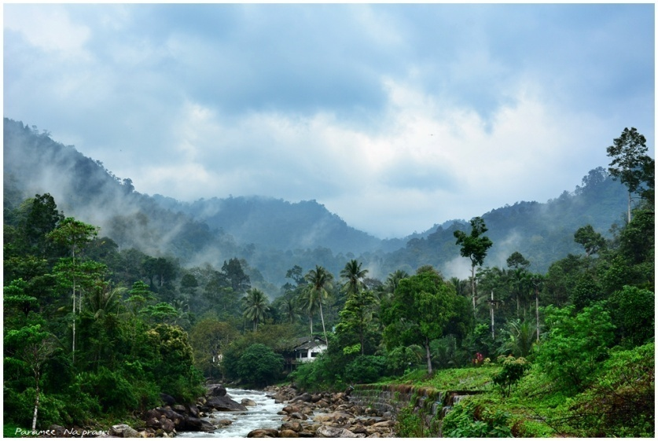
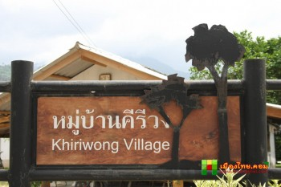
Villages' production under sakdina
The extraction of labour and reactions

Slide 15
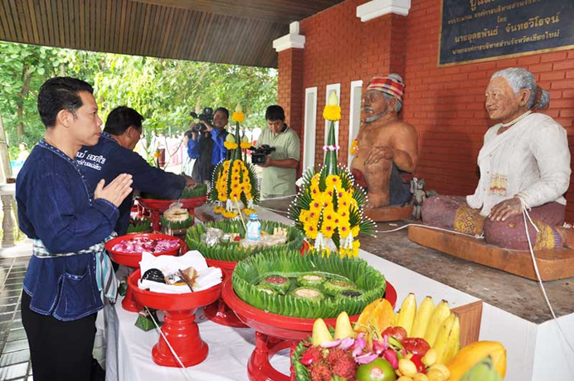
Villagers’ Beliefs
Villagers' beliefs indicate the significance of their self-reliance and self-rule.
  “Ghosts of ancestors“ VS "national-level ghosts".
  Buddhism beliefs VS Non-Buddhist beliefs.

Slide 16
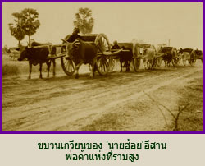
Implications of villages under Sakdina
Bourgeoisies & village communities.
  Villages did not produce merchants or craftsmen.
  How about travelling traders
  Limited interaction between villages
  It was only until the Chinese settled that the domestic trade grew, still.

Slide 17
Chattip VS Baker and Phongpaichit (2017)
While Chattip focuses on self-reliance and agrarian nature of Thai villages, Baker and Phongpaichit (2017) “Ayutthaya” portrayed Ayutthaya as urban society that lacked agrarian base.

Slide 18
Chattip VS Baker and Phongpaichit (2017)
Baker and Phongpaichit (2017) “Ayutthaya” also not emphasizing on separation between peasants and state, but portrayed Ayutthaya as cosmopolitan city
Different in the time that they portray likely the explanation.
  Chattip’s Thai villages likely appeared later than Baker and Phongpaichit (2017) “Ayutthaya”

Slide 19
Shifting away from subsistence economy (post-Bowring)

Slide 20
Post-Bowring central region
Impact of Bowring Treaty
  Increased rice production.
    From 5% of export to 50%
    From 5.8 millions rai in 1850 to 9.2 millions in 1905
The central plain was the main production area.
  Production was increased through expanding land use. Farmers were brought to settle along newly dig canals.

Slide 21
Post-Bowring central region
Impact on cultivating farmers
  The replacement of corvee by cash payment
  Losing significance of common ownership
But evidence suggested that Thai village communities tried to remain subsistence, and did not fully embrace the market system.
  Continuing to produce for self-use & limited introduction of new production technology.

Slide 22
Post-Bowring central region
Market system dominated more by Chinese
  Chinese as the middle man, linking the villages to the market system
  The Chinese played role as lender
  Chinese causing the emergence of landless farmers
Parasitic-capitalism, therefore, was the main threat to the self-sufficiency of village communities.

Slide 23
Post-Bowring in other regions
Northern region
  Export of timbers and forest products, but these did not affect village communities.
  Difficulty in transportation a factor
Southern region
  Main export was tin. But operation of tin-mine was owned by outsiders (Chinese and Western capitals).
  Subsistence economy existed until WWII

Slide 24
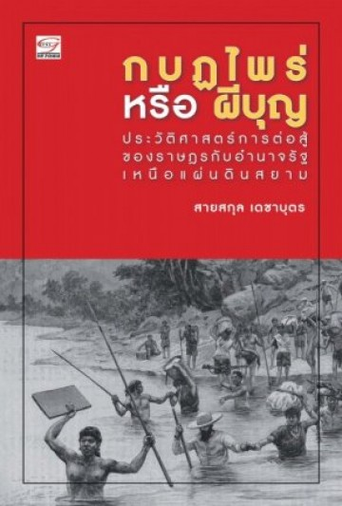
Post-Bowring in other regions
Isan region
  Highest degree of subsistence. Trade in Isan was mostly trade in forest product. The access of Chinese merchants were limited.
  Isan peasants the most rebellious

Slide 25
Summary
Village economy in the past was subsistence economy.
  Village communities were dragged into capitalism, but they resisted.
State and markets were aliens to the village communities.
  Villagers resisted the extrusion of state and market.
Thai capitalism was parasitic of state. Their extraction relied on privilege, and limited their effect in changing rural communities.

Slide 26
Counter-arguments to Chattip

Slide 27
Overall criticism
Romanticising rural life by putting too much emphasis on persistence, rather than on transformation and adaptation.
  His stressing of the value of “subsistence” too normative.
The timeline (400 years+) and the source of information (oral history) are loose.

Slide 28
J.Kemp (The dialectics of village and state in modern Thailand)
Village communities was in fact more of the unit of public administration that began after Rama V reform.
The system actually born out of the reform of public administration, and were means to rule peasants.

Slide 29
K.Bowie (Unravelling the myth of subsistence economy)
A closer look at weaving in the 18 century Northern Region.
Found the emphasis on subsistence to underplay
  Division of labour
  Class division
  Poverty
  Internal trade
  And the changing dynamics of production and consumption

