Slide 1
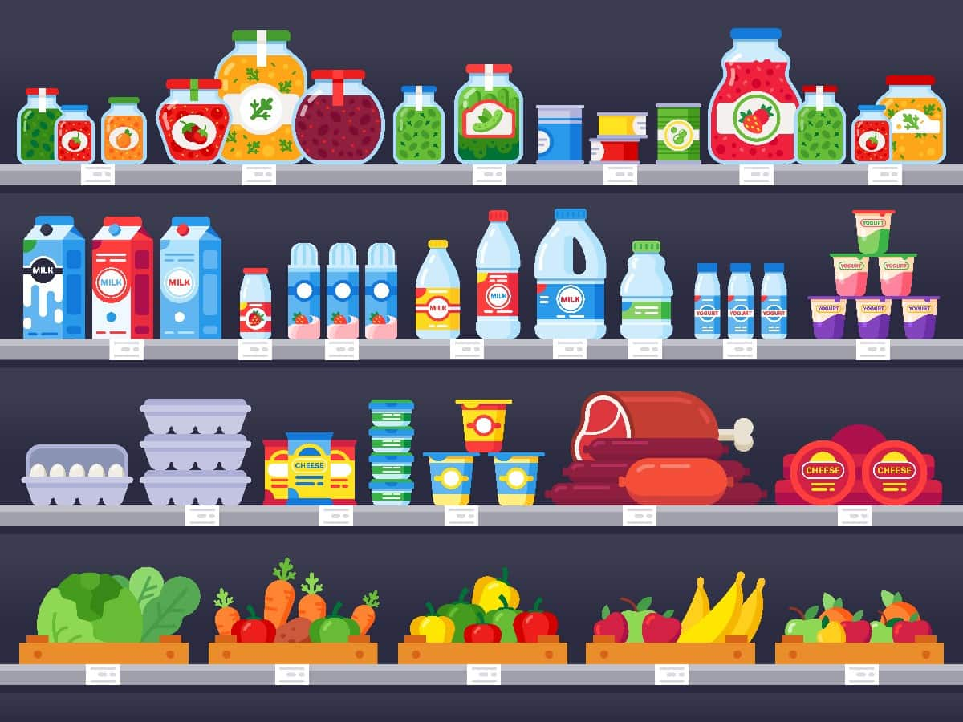
Group Assignment 9
Retail Merchandising Planogram & Design

Slide 2
MK 322 Merchandising Planogram Assignment
(Draft version)
Please list the category form what type of merchandise your store carries and products/Models under them.
Remember store merchandising will reflect its positioning
You are to price your merchandise, please consider special promotions, etc.
Design a merchandising planogram for your store
(design corner of store or entire store in detail )
Please note: Focus on the merchandising detail. Next week we will cover store layout and visuals.
Draft version will be due next week, we will discuss in team break out rooms later on (workable). No need to submit. It will be finetuned to be presented in your final project.
Enjoy designing 😊

