Slide 1
1997 Economic Crisis
EE301 Thai Economic History
Thorn Pitidol
1/2018

Slide 2
Agenda
Financial Liberalization
1997 Financial Crisis
Aftermath of the 1997 Crisis

Slide 3
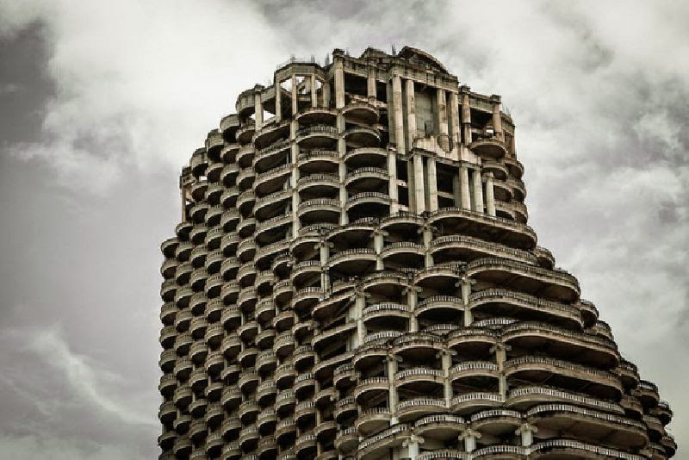

Slide 4
Background
The blurred division between bureaucrats and businesses from 1980s had also deteriorated the technocrats independence and ability. The impact was felt particularly during the 1997 crisis.

Slide 5
Financial Liberalization
While the growth in 1980s was driven by exports, the growth in 1990s was driven by financial liberalization
  Factors contributing to financial liberalization
    Capitals from developed countries sought new markets
    IMF and World Bank supported free capital movement - suggested Thailand to open its capital and banking markets
Thai technocrats also saw problems with protection and monopolies
  Thailand positioned as the "financial center" of SEA

Slide 6
Financial Liberalization
Anan and Chuan started the process
  Reduced control over foreign exchanges
  Allowed foreign banks to enter the competition
  Enabled foreign loans (from off-shore banks)
With the economies in EU and Japan slowed down, capitals flooded to Thailand
  Thai and foreign banks borrowed in foreign markets to give loans domestically, Thai firms borrowed abroad
  Overall, financial liberalization totally shifted sources of capital from domestic to foreign market

Slide 7
1997 Financial Crisis
From mid 1990s, the Thai economy entered a period of stagnation. Labour cost were rising, more competition came from other countries. As a result, export slowed.
  Thai businesses shifted attention to domestic markets, especially the real estates.
    Free capital inflow led to real estate bubbles
    Lacks of control over lending led to speculative investments in real estates and stock market

Slide 8
1997 Financial Crisis
In 1996, Bangkok Bank of Commerce went to bankruptcy, provoked fear of crisis in real estates
  But lack of response from BOT and gov't
  Fixed exchange rate regime criticised but kept.

Slide 9
1997 Financial Crisis
With a weakened fundamentals, mismanaged liberalization, speculators attacked the Baht.
  Early waves of attacked fended-off
  But as Thai economy weakened further from slowed exports, more crisis in real estates and financial companies
  A big wave of currency attack in 1997 led to the depletion of BOT reserves
  In July 1997s, the gov't announced the floating of the Baht

Slide 10
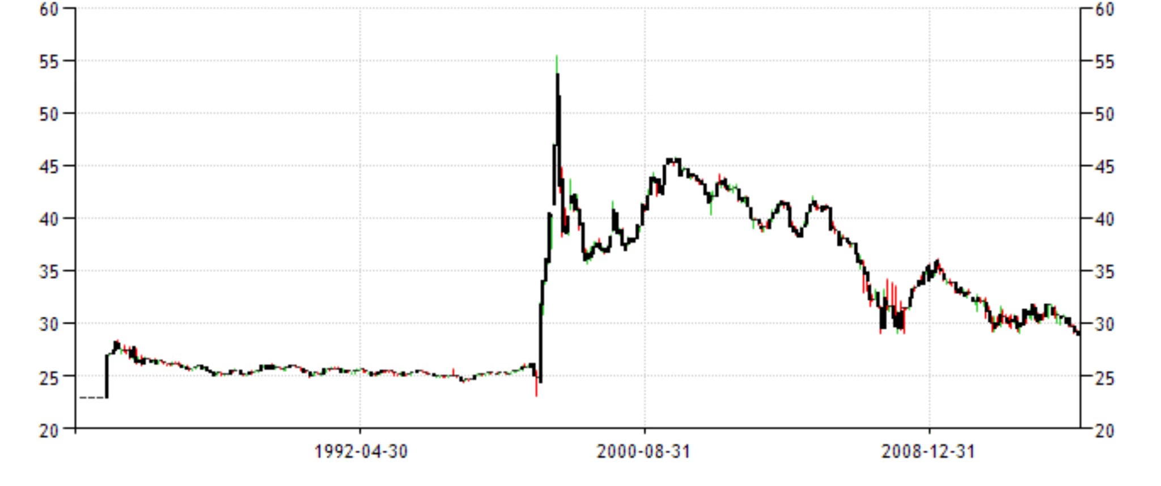
Baht/Dollars Exchange Rates
https://highschool.latimes.com/fairmont-preparatory-academy/look-back-on-george-soros-and-his-attack-on-thai-baht/

Slide 11
1997 Financial Crisis
In sum, the crisis was contributed largely by the Thai businesses own behaviors
  They turned to high risks investments, financed by short-term loans from foreign sources
  They demanded for fixed currency, and kept the growing problems hidden
  They neglected all the warnings, lobbied regulators against changes

Slide 12
Aftermath of the 1997 Crisis
The crisis turned Thailand toward the IMF, who provided Thailand with the emergency loan
But the loan came with the restructuring package, similar to ones adopted in Latin America
  Austerity measures: raised VAT, cut gov't spending, raise interest rates
  The measures caused further recessions, and further outflow of capitals
  Impact spread to other countries in the region

Slide 13
Aftermath of the 1997 Crisis
IMF also pressed for the reform of financial institutions and privatization of SOEs
  Suspension and closure of financial institutions
  Enabled foreign ownership, especially in financial sector
  Liquidation of troubled assets by selling to foreign investors
Further economic recession prompted more criticism of Thai gov't for being the IMF's good boy.

Slide 14
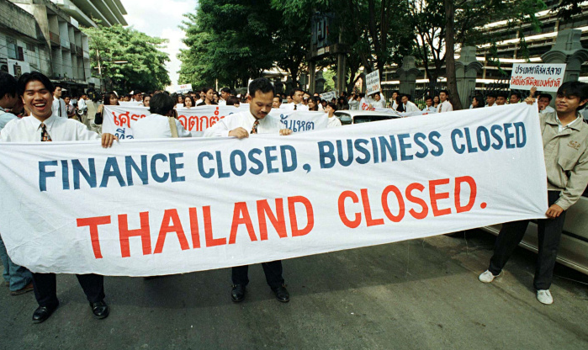

Slide 15
Aftermath of the 1997 Crisis
The crisis has left Thailand with several wounds and permanent changes
  Thai gov't decided to carry the burden of debt from financial sector (FIDF fund)
  Many Thai banks sold to foreign banks, the rest faced difficult time
    Asia Bank --> ABN AMRO, Nakornthon--> Standard Charter
  Some major businesses group dissolved or sold
    Sukri's Textile, Sondhi's media, Sahawiria Steel, etc.
  Foreigners raised their ownership in joint-ventures

Slide 16
Aftermath of the 1997 Crisis
The crisis ended a period of prosperity enjoyed by large number of Thai-Chinese merchants. For many, their capitals were transferred into the hands of the foreign multinational companies. Thai banks effectively lost their dominance.
However, there were also a small number of domestic capitals that survived (for example, CP, AIS, some real estates, some major banks). Faced with even less domestic competitions, these groups gain further strength and power.

