Slide 1
Politics and Economics of Mid 1970s-1990s
EE/EC301
Thai Economic History
Thorn Pitidol

Slide 2
Topics
Politics of 1970s-1980s: The End of Sarit-Thanom Regime
  Revolt
  Repression and New Hegemonic Ideas
Economics of 1980s: From import-substitution to export-oriented
  Recession and devaluation
  Golden Age
  Industrial relocation and the development of export industries
  The changing shape of domestic capitals

Slide 3
Context for the revolt
Transformation from the alliance between bureaucrats and business in Sarit's development era.
  The expansion of upland frontier
  The penetration of agribusiness
  The disintegration of agrarian society
  The rural migration to urban

Slide 4
Context for the revolt
But the achievement of economic growth came with exploitation
  Tariff and rice premium, land rights, landlessness, and low wages
In 1970s, reactions came in a wave of protests
  Peasant's movement, workers' strikes
Situation complicated further by the cold war and the expansion of communism

Slide 5
Context for the revolt
Together with wave of protests, the alliance between business and bureaucrats also weakened
  Domestic capitals grew, allowing business to be less dependent on bureaucrats
  The business leaders doubted dictatorship and repression, and the role of US
  The growth in number of university students
All the changes culminated in 14 October uprising
  Thai society opened up briefly before ending in 6th October repression.

Slide 6
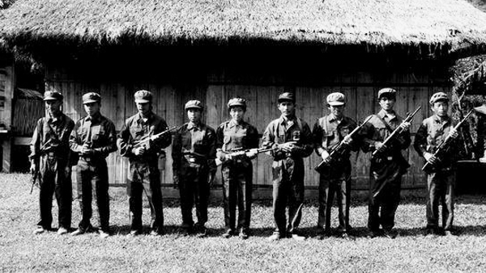
Communist Party of Thailand (CPT)

Slide 7
Communist Party of Thailand (CPT)
History related to Chinese immigrants in Bangkok, but Sarit’s repression push them to rural based strategy
From 1961, the center of CPT rural organization was in NE, in Phuphan Hills
Army initial reaction – CPT essentially external creation. But CPT bounded more to problems of upland farmers.
  Violence crack down only led to more expansion
  US involved in setting up ISOC (กอ.รมน.) and supported village based strategy
  Early 1970s, CPT expended their influence in the city, especially with students

Slide 8

ถังแดง
ปัง ปัง โวยวาย เสียงเจ้านายรบกวน ค่ำมืดลมหวน เสียงมันชวนครางครัน กระโดดลงใต้ถุนหลบกระสุนนาย กลิ่นความตายโชยมา เขาว่าพัทลุงสบาย ฉันว่าอันตรายแท้เชียว จะไปทางไหนให้หวาดเสียว มันโกรธเรานิดเดียวเราก็ตาย จับไปลงถัง ราดน้ำมันแล้วจุดไฟ ข้อหาคอมมิวนิสต์ มันคิดไป จับพี่น้องเราใส่เตา แล้วเผาไฟ แล้วมันก็ป้ายสีแดง บ้างเมียก็เสียผัว ถูกตัดหัวเสียบประจาน มันขี้หกลูกหลาน ว่าสันดานเป็นคอมฯ แท้จริงมันคือ เจ้านาย หัวหน้าตัวร้ายไอ้สอพลอ มึงต้องออกไปไอ้หัวหมอ ไอ้พวกหัวดอ ต้องออกไป ชีวิตคนไทย มันขาย เป็นทาสรับใช้ไอ้กัน พรากลูกเมียเขาเพื่อเอาเงิน แร่ไทยมันขนกัน สุดประเมิน แล้งยังสรรเสริญเยินยอ
https://www.youtube.com/watch?v=Ymph6n2x8Dg

Slide 9
Student and Peasants Movements
The early 1970s also saw outbreaks of protests by peasants
  Major causes of protests range from the problems of indebtedness, land loss, and high rent
Students helped bring local protests out of the villages and onto the national stage.
  Thousands of students went to the country side in volunteering programs.
    They observed problems, injustice, and poverty.
In 1974, peasants and their student supporters mobilised their protests, resulting in the gov't responding through setting up price support scheme and establishing committees to solve land problems.

Slide 10
Student and Peasants Movements
The peasants later were able to form Peasants Federation of Thailand (FDT) as a result.
  Membership of FPT as large as 1.5 millions. FPT operated at the village level, but were seen as illegal by the gov't.
In a very short time, the peasant movement had dramatized the problems of peasants on a national scale.
  But to the gov't, the phenomenon was frightening.
Student assisted the movements. Influenced by leftist and Marxist ideas, their protests focused on the causes of problems in Thailand ranging from foreign influence (esp. the US), the role of the military, and the power of capitalism

Slide 11

Jit Poumisak's Chomna Sakdina
Thai

Slide 12
The end of Sarit-Thanom regime
The business community had grown richer and stronger under Sarit's regime. As the growth decelerated in late 1960s, they became more politically assertive.
  They started criticizing the political structure that encourage monopolies and take from them special "taxes".
  They criticised the military's monopoly of power, questioning their capacity to deal with rising insurgency.

Slide 13
The end of Sarit-Thanom regime
In the mid 1960s, the King became more concern with the prospect of continuing military dictatorship. He encouraged the military to restore the Parliament.
The King eventually became more openly critical of Thanom-Praphat regime.
  Royal addresses criticised violence and corruption.
  Seeking to balance military-bureaucrats' power.

Slide 14
The end of Sarit-Thanom regime
Thanom-Prapart control over the military faced inner conflict, especially with the controversial role of Thanom's son, Narong.
As the coalition between bureaucracy, military, royalists, and business was falling apart, the student protests pressed the fragility.
  The students' demonstration in October 1973 escalated and led had more than 400,000 involved.
  On 14 October 1973, students clashed with riot police, resulting in more than 100 killed.

Slide 15
The end of Sarit-Thanom regime
The military rulers resigned but was prepare to used force, only to be rejected by the army leader.
After an address by the King, Thanom, Prapart, and Narong leave the country. Sanya Thammasak was chosen as the new PM.
Post 14 October saw the student demonstrations continued, but the palace, its royalist allies in bureaucracy and politics, and the business actually took the roles in reshaping the political process.

Slide 16
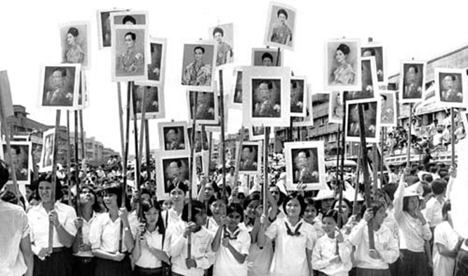

Slide 17
The end of Sarit-Thanom regime
Post 14 October saw the attempt to exclude officials and military from the parliament. Kukrit gov't came to power.
  Signifying the new alliance between the royalists, businessmen, and the military group opposing Thanom-Prapart.
Kukrit turned attention to 2 main issues: (1) turning Thai foreign affairs away from US; (2) pacifying the countryside.
  Price support scheme for rice farmers, funds to Tambons.

Slide 18
Repression
In the early 1975, CPT’s activeness raised concerns for the right, conservatives, and the businesses. The first stage of repression against students came, organized by the army.
  ISOC assisted right wing movements – Nawaphon, Krating-daeng, Village Scouts. Nationalist-Royalist ideology was mobilized.
Anti-communist propaganda became more intense, together with uses of violence. Situation culminated in 6 October massacre.
The army staged a coup, return its control over the parliament, and expand the suppression. Books were banned, thousands were arrested.

Slide 19
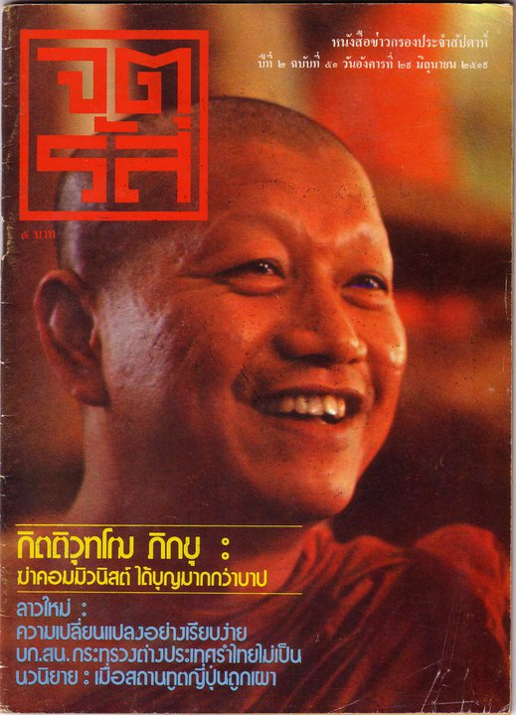
Kittivuttho

Slide 20
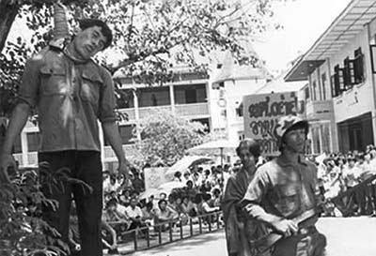
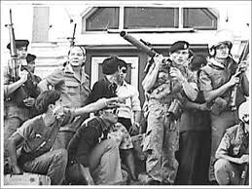

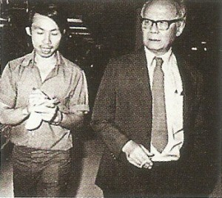
6 October

Slide 21
Students and CPT
Post-6 October, 2000-3000 students joined CPT in the forest.
  But they would be disappointed in fitting in with CPT’s own politics, many eventually left.
CPT eventually faced wider conflicts between Vietnam and China. Thailand offered China help in return for it stopping support for CPT.
The use of Order 66/2523 drew out CPT members. And in 1983, the ISOC announced total victory over CPT

Slide 22
Reasserting the hegemonic ideology
In response to 1970s, members in the circle of bureucracy and old aristocracy felt the need to strengthen the ideology of nation, religion, and king.
  King had established his position as the development King.
  An idea was published that the Thai monarch is ruled by the consent of his peers. The King is judged by the happiness and benefit he bring to the country.
The military and bureaucracy projected an enlarged role for the King and the royal family in the national culture.

Slide 23
Reasserting the hegemonic ideology
The gov't set out to renew "Thai" and "Thainess"
  Essential to Thai identity are the institution of nation, religion, and king, which "create the unity within the nation, enabling the preservation of independence and sovereignty".
Thai society portrayed as having a pyramid structure. The King at the top, and the village as the base.
  Villages are peaceful, content, not seeking wealth, not seeking changes. Thai society had no conflicts, insurgency, gaps, etc.
  Thailand as the nation of peaceful peasants who are loyal to nation, religion, king.

Slide 24
Economics of 1980s: From Import-Substitution to Export-Oriened Strategy

Slide 25
Overview
In the late 1970s, the growth slow down, Sarit’s growth strategy was facing its limit.
  Growth based on domestic protection seen as no longer working.
The business community and the World Bank pressed for changes in economic strategy.
  But the gov't resisted changes for many years, until it faced economic recession in early 1980s
The change in strategy came with a dramatic result. Thailand's growth became one of the fastest in the world. Thai economy became fully capitalism.

Slide 26
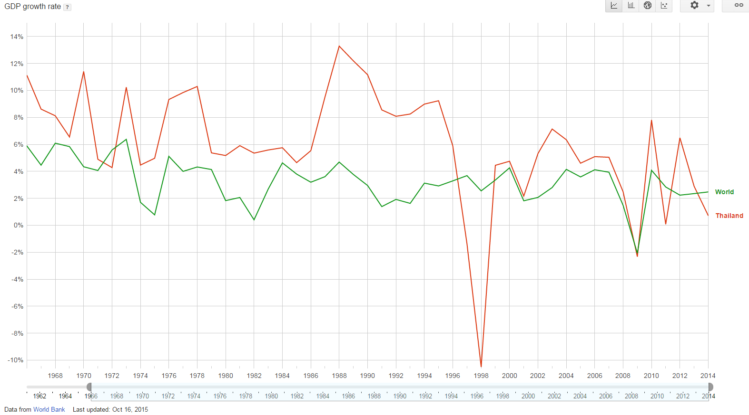
Thai GDP Growth

Slide 27
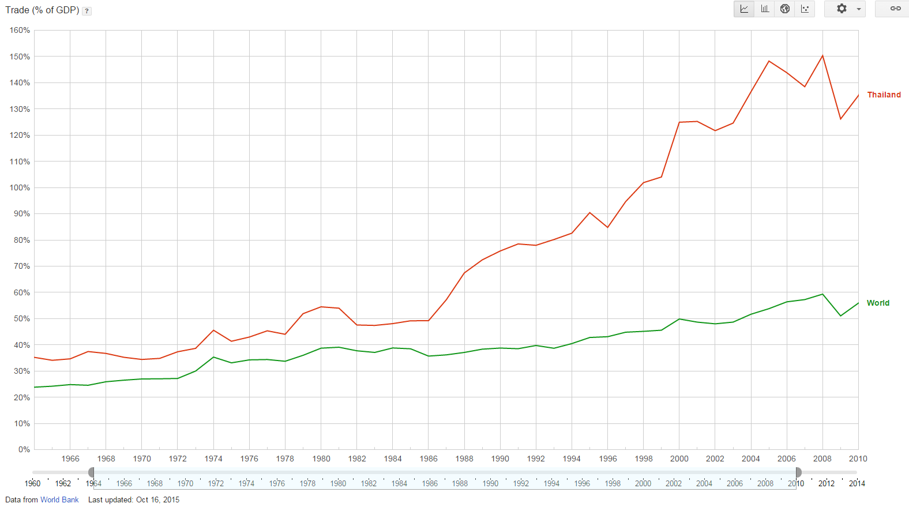
Thailand’s Trade (% of GDP)

Slide 28
Transition: import-substitution to export-oriented
In Sarit's era, the economy was driven by 2 engines: (1) expansion of agricultural exports; (2) the inflow of foreign aid and investment
Domestic economy expanded through domestic market
  Good world agricultural prices helped
Yet, the growth depended on the expansion of domestic market

Slide 29
Transition: import-substitution to export-oriented
At the global level, the failure of Latin American's import-sub strategy was contrasted with the success of East Asian's export-oriented strategy
  Export-oriented strategy, advocating lower tariff and undistorted factor markets.
  The changing ideas also influenced some of Thai technocrats.

Slide 30
Transition: import-substitution to export-oriented
Despite showing interests in export-oriented strategy, Thai gov't actualy could not turn away from import-substitution.
  NESDB recognised the need for export-oriented, but stated that protection could not be abandoned.
Constraints
  Import-sub fundamentally worked against export, as tariffs raised the costs
  The Baht was tied to Dollar
  MOF wanted import tariff as tax revenue.
  The army wanted strong baht to reduce price of arms.

Slide 31
Transition: import-substitution to export-oriented
Ministries also sought power from giving protection, while firms look for more protection as the easy solution to the fall in profits.
Instead, from 1970-1980, gov't actually raised protection.
  In 1975, to aid recovery from the oil crisis, gov't economic packaged combined higher tariff with policies to increase rural incomes.
  Gov't also sought to expand import-sub into capital and intermediate goods

Slide 32
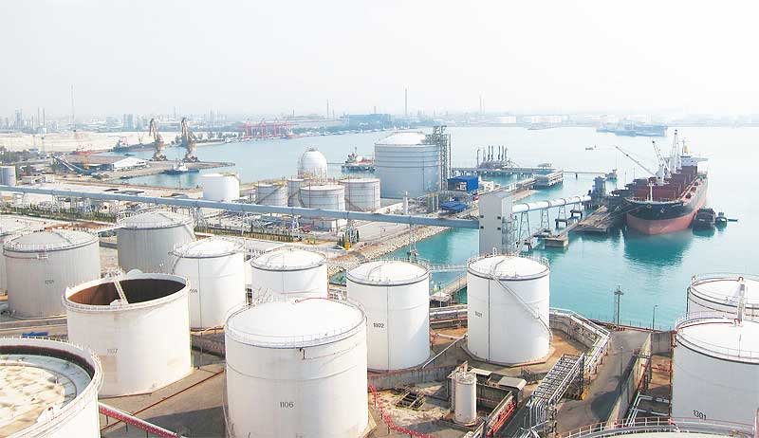
Eastern Seaboard

Slide 33
Transition: import-substitution to export-oriented
In the late 1970s, the underpinning of Thailand's import-sub economy started to shake loose.
  From 1974, world's market for agriculture in decline. Terms of trade that Thailand faced deteriorated.
  Problems added by (1) the gov't decision to carry the burden of oil price rise, resulting in budget deficit; (2) the withdrawal of US from the region, leading to the fall in foreign aid.

Slide 34
Transition: import-substitution to export-oriented
To deal with problems, public sector's borrowing from foreign sources grew.
  Military borrow to substitute the reduction of aid.
  Gov't borrowed to invest in large infrastructure to replace energy imports.
Another oil crisis in 1979-80 contributed further to the problems.
  Oil bill rose to 30% of import.
  External foreign debt grew from 21% to 38% between 1973-1986

Slide 35
Transition: import-substitution to export-oriented
To solve the growing problems, Thailand asked for the World Bank’s loans. The World Bank pushed Thailand to restructure its economy toward export-oriented.
Yet, even in the early 1980s, the adjustment was slow.
  Baht was not devalued in the fear of rising debt.
  Gov't still tried to deal with problems by reducing imports.
  Gov't also promoted export of labour and tourism

Slide 36
Recession and devaluation
Thai business community pressed the gov't to adopt strategy of supporting exports.
  Thai Bankers Association
  Thai Association of Industries
  Chamber of Commerce
Until mid 1970s, domestic capitals concentrated on opportunities from domestic market. But this changed

Slide 37
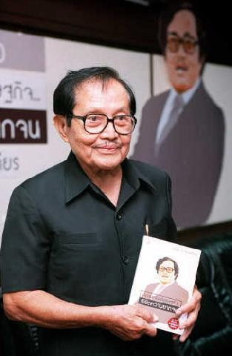
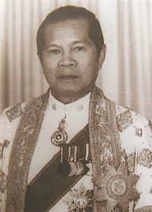
Boonchu and Pramarn

Slide 38
Recession and devaluation
The textile industry pushed government for direct concession to improve export.
  BOT to give credit for export. MOF to grant refund of taxes and tariffs.
  Other industries followed.
In 1980, after an election was held, Boonchu and Pramarn joined the coalition gov't headed Prem.
The Joint Public Private Consultative Committee (Kor Ror Or) was formed to pressured for changes in export procedure.

Slide 39
Recession and devaluation
The final push for change arrived in 1983-4, as gov't dealt with oil crisis by restraining demand through strict fiscal discipline
The gov't devalued the baht in November 1984. Baht also separated from Dollar.
  The devaluation signaled the complete shifted toward export-oriented strategy.

Slide 40
Recession and devaluation
In addition to devaluation of Baht, the gov't also introduced other reforms.
  Taxes for input to exports were reduced, as well as several export taxes. BOT and BOI gave support for exporters.
Other two crucial factors also contributed to reorientation of Thai economy at this time
  1) The oil price dropped
  2) The appreciation of Yen: 100% devaluation of Baht against Yen b/w 1986-1989

Slide 41
The Effects of Change: the Golden Age
The combination of the change in gov't strategy, the fall in oil price, and the adjustment of Yen led to the "golden age" of the Thai economy.
  From 1985, Thai economy changed gear. Growth was more than 10% until the end of the decade.
  Growth driven by exports of manufacture and services.
    Export of labour and tourism also grew strongly.

Slide 42
The Effects of Change: the Golden Age
During 1980s, Thailand changed from an exporter of agriculture to become an exporter of manufacture and services.
But the rapid rise of GDP growth did not provoke much inflation and wage rises
  Reduced oil prices
  Millions were drawn out from their villages into urban-workforce. Even as labour supplies tightened in early 1990s, additional supplies came from illegal workers from neighboring countries, and child labour.

Slide 43
The Effects of Change: the Golden Age
In a broader sense, the role of the gov't in the economy was in retreat.
  Businesses lobbied to end Sarit's apparatus of license and control.
  NESDB relieved of role in supervising of all gov't investments.
Thai economy was also left more to the market forces.
  For example, NESDB stepped away from the policy of dispersing industrial growth away from Bangkok, allowing industries to choose their location freely.

Slide 44
Industrial relocation
The devaluation of Baht against Yen in 1980s made Thailand attractive for industries moving from East Asia searching for lower costs
  In 1970, Japan first choices in moving their production were Taiwan, Singapore, and HK.
  The change in Yen also affected other currencies in East Asia, leading to the moving of Japanese firms toward new destination like Thailand, Malaysia, Indonesia, and Sri Lanka.

Slide 45
Industrial relocation
Relocation came in different forms.
  Relocating production of parts requiring high labour input OR relocating assembly operation
  Transfer of production to subsidiary companies established originally to avoid import-sub, and encourage sub-contractors to also move.
By 1987, the number of Japanese firms establishing overseas subsidiaries or joint venture risen to over 1400.

Slide 46
Industrial relocation
After mid 1980s, Japan capital led the rising flow of investment into Thailand, followed by other East Asian countries.
Thailand attractive not just by low wages, but
  The experiences of Japanese firms in Thailand, Thai gov't careful fiscal management, good infrastructure, openness to foreign investment, free-market attitudes, and political stability.

Slide 47
Industrial relocation
The new wave of Japanese direct investment diversified into intermediate goods industries and exports.
  Share of Japanese direct investment devoted to manufacturing rose from 32% in 1984-5 to 72% in 1988
  Most went to metal products, electrical products, machinery and transport goods, etc.

Slide 48
Industrial relocation and Thai capitals
The influx of foreign investment after mid 1980s also correlated with high rate of capital accumulation of Thai domestic capitals.
  Big businesses benefited further from the joint venture with incoming capitals
  Thai firms could access their partners' export market, technology, and skills.
Capitals market also developed new institutions that helped capital mobilisaiton.
  Finance and securities companies emerged and grew faster than banks
  From 1987, Thai Stock Exchange also grew rapidly.

Slide 49
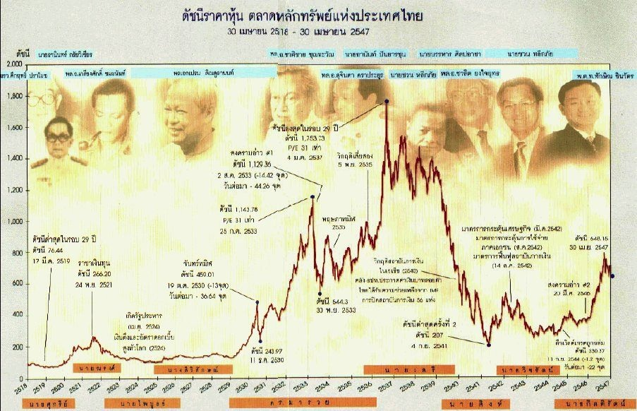
Thai Stock Exchange

Slide 50
The development of export industries
The relocation of foreign industries facilitated development in Thai export industries
Labour-intensive segment of high-tech industries, such as semi-conductor production, rose quickly in 1980s.
  Minibea from Japan. Seagate and IBM
  Other manufacturing moved to Thailand include toys and footwear.

Slide 51
The development of export industries
The joint ventures were transformed from serving domestic markets into production platform for export.
  Japanese electronic and automotive firms spreadeed their production network across different SEA countries.
From 1988, the fastest export growth came from medium tech products such as computer components, auto-parts, and electrical goods.

Slide 52
Domestic market boom
By 1988, the growth in exports and influx of foreign investment created a secondary boom in domestic urban market.
  From 1986-1990, per capita real GNP rose 44%. In 1980s, GDP of Bangkok grew at double of the rate of the rest of country.
  Increased urban spending fuelled booms in real estate and retailing, also indirectly sparked growth in sectors such as financial services and telecommunications

Slide 53
Domestic market boom
Bangkok real estate market started to grow rapidly from 1987.
  The Karnchanapas family (Muang-Thong Thani).
  Anant Asavabokin’s Land and House Company.
The retailing boomed with department stores, supermarkets, shopping malls, and convenient store.
  Japanese shopping malls like Daimaru, Sogo, Isetan, etc. Central Department Store, and CP's Seven Eleven.

Slide 54


Thai businesses taking on the world
Domestic capitals also began to moved overseas. A few Thai firms were able to use their skills and experience from domestic market to enter foreign markets.
Hotel business including those of Imperial, Central, and Dusit Thani Group.

Slide 55
Thai businesses taking on the world
From 1980s, technological change led to world-wide market in computer, telephone, and television.
  Gov’t opened new telecommunication projects for privatisation.
    Shinnawatra's computers and satellite businesses
    Samart's satellite dishes. Jasmine and Ucom.
    CP's Telecom Asia.
All expanded to neighboring countries, and countries such as Indonesia, India, and China.

Slide 56


Thai businesses taking on the world

Slide 57
The Changing Shape of Domestic Capitals
In Sarit's era, the growth of Thai domestic capitals was dominated by banks and a small number of large conglomerates
But the post-1985 boom caused this structure to change.
  Domestic market was replaced by foreign markets

Slide 58
The Changing Shape of Domestic Capitals
The financial sector has changed
  Big banks found new source of competition from the new types of financial companies, and also from overseas.
  Thai banking industries adapted by turning themselves into portfolio investment companies
    They entered the stock market, and shirted their funds into investment companies taking stakes in real estates, retailing, etc.

Slide 59
The Changing Shape of Domestic Capitals
The expansion of domestic businesses stemmed from strong export demand, new sources of capitals, and from easier availability of technology
  Joint venture still provide important route. But new ways also include reverse engineering, and buying of technology.
  The new wave of entreprenuers (Pin, Anan, Thaksin) had skills to operate in a more internationally oriented economy
  Some older generation like CP adapted, but many failed behind

Slide 60
The Changing Shape of Domestic Capitals
The new nature of domestic capital caused a shift in the relationship between business and the government
  In Sarit era, businesses relied on political connections and protection from international competition
  But business in export-oriented economy wanted improvement of infrastructure, good management of foreign relations and confidence, upgrade of education system, fiscal and political stability, etc.

Slide 61
The Changing Shape of Domestic Capitals
The business-bureaucrat relations also underwent changes. Their separation began to dissolved.
  The two groups used to be separated, having different culture.
  Descendants of business spread into bureaucrats. The two built connections through marriage, friendship, education.
The growing connections allowed new channel to lobby policies without relying on cabinets, parliaments, and electoral politics

