Slide 1



Slide 2

Introduction

Slide 3

Mission Statement
“To organize the world's information and make it universally accessible and useful"

Slide 4

Core Value
"Search is our core technology, ads are our central business proposition, and apps are the umbrella over our web-based software that you can access anywhere, any time"

Slide 5
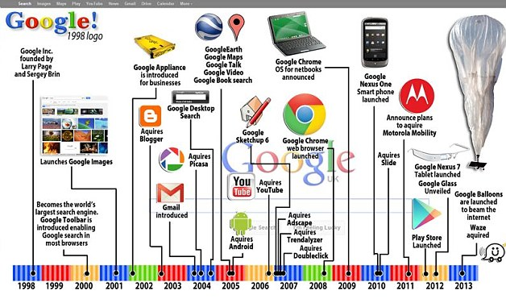

Slide 6
Timeline
Galaxy Nexus
2011
l
l
l
Google
Established
1998
l
G1
2008
l
Nexus1
2010
l
Nexus5
2013
l
I
l
G2
2009
l
NexusS
2010
l
Nexus4
2012
l
Nexus6
2014
Apple
Iphone4
2010
Established
1976
l
Iphone3G
2008
l
Iphone4S
2011
l
Iphone5S
2013
l
l
Iphone3GS
2009
Iphone1
2007
l
Iphone5
2012
l
Iphone6
Iphone6+
2014

Slide 7
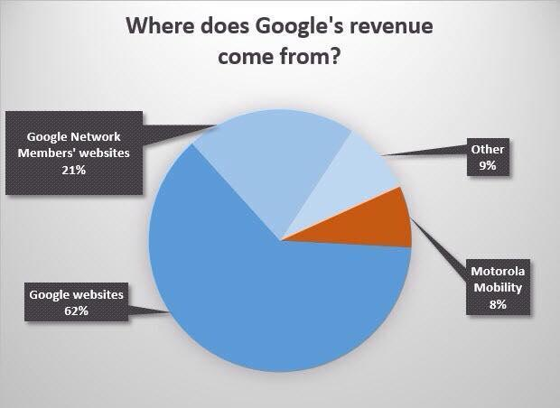
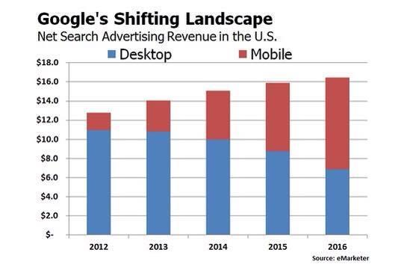
Google’s Performance

Slide 8

Performance

Slide 9

Advantage
 | Android OS | IOS
Resolution | 720p – 4k Ultra HD | True HD
In-app Operating | faster | slower
Accessibility | more | less
Function | Better | Worse
Battery life | Longer | Shorter
Innovation | More | Less

Slide 10

Disadvantage
 | Android OS | IOS
Responsiveness of Touch Screen | Slower | Faster
Design | Less Attractive | More attractive

Slide 11
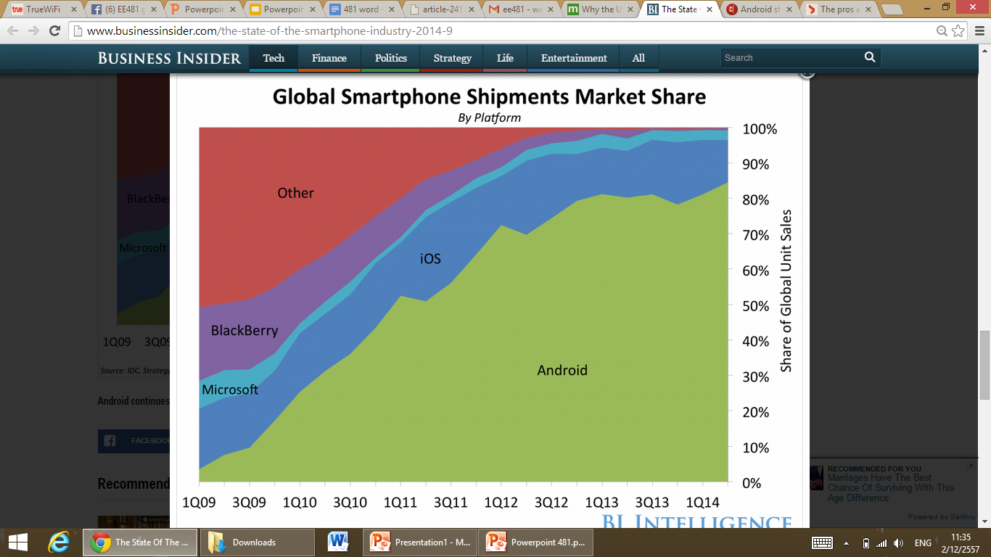
13%
84%

Slide 12

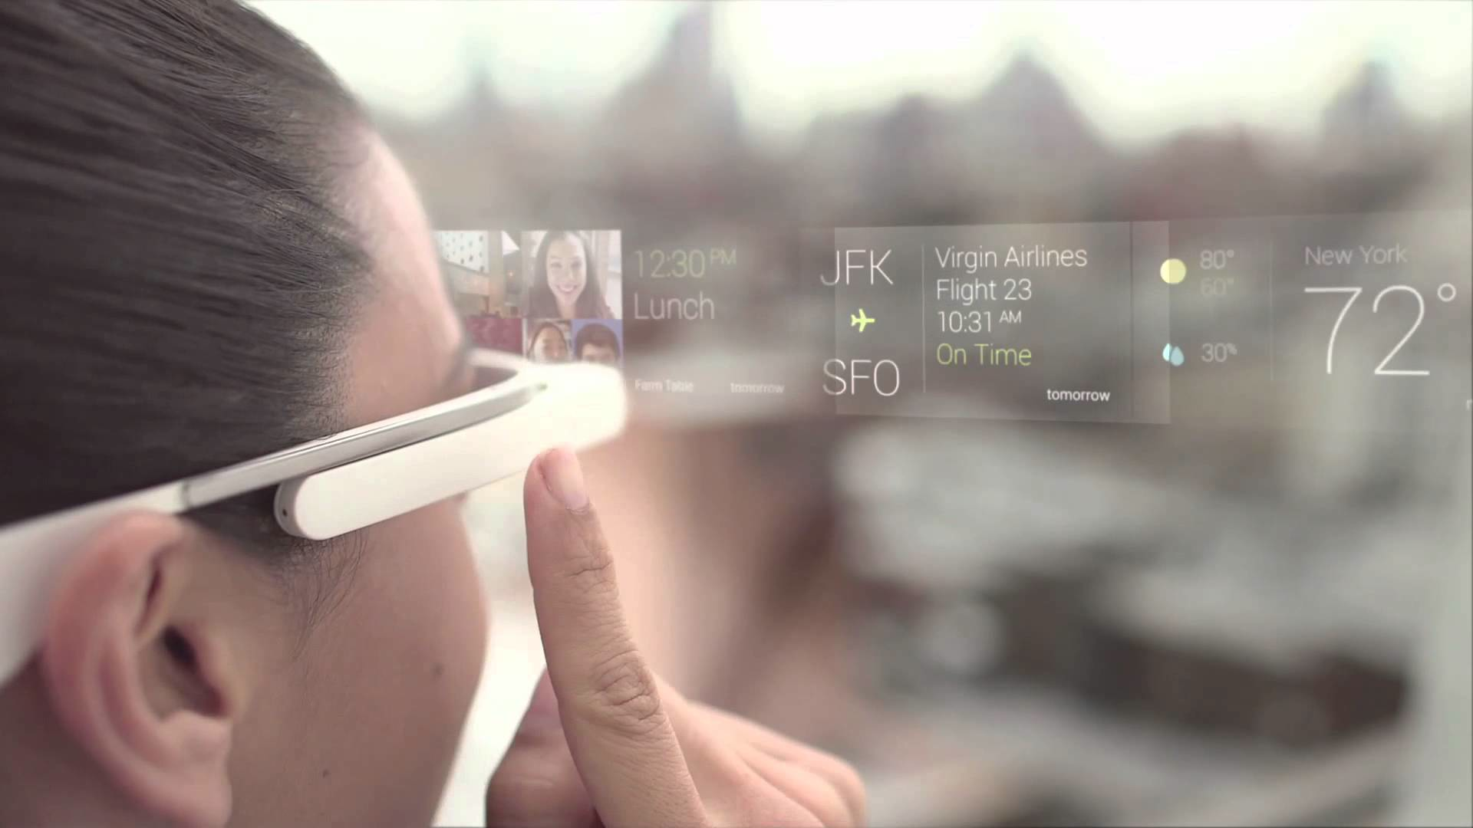

Target Market of Android
High type
Low type

Slide 13
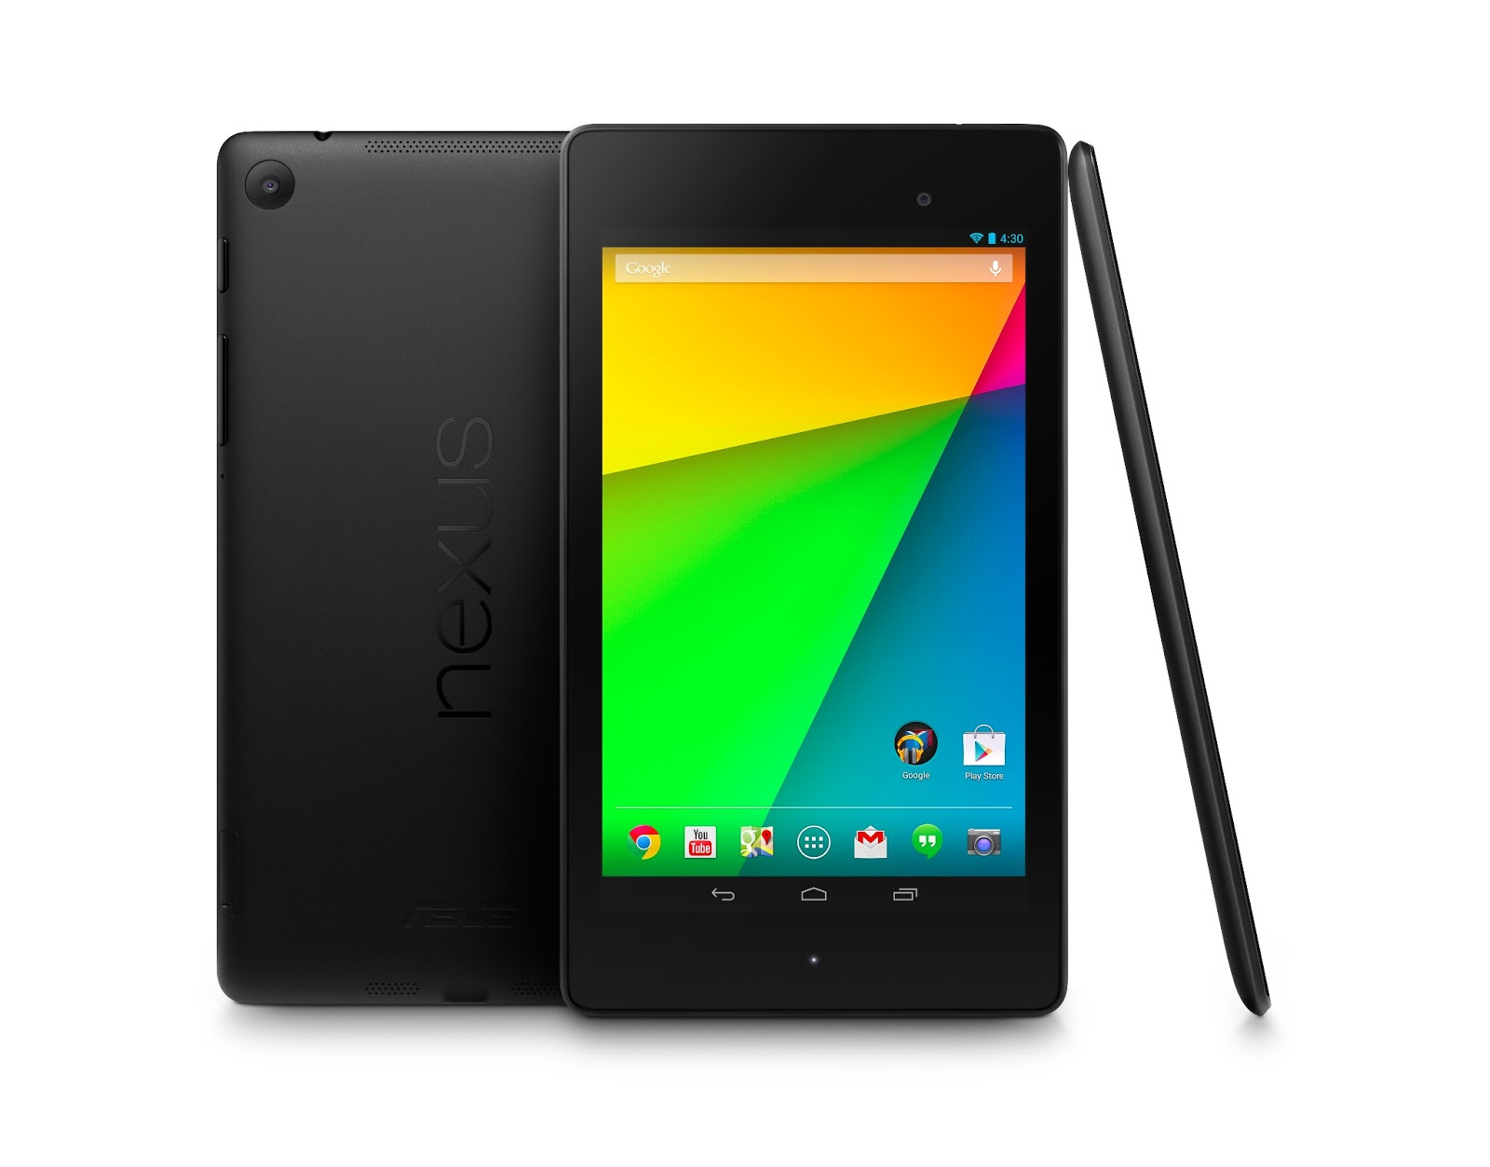
Google’s Smartphone
Nexus 7
Latest Google’s smartphone product
With new design and features
Android Lollipop
Sharp increase in revenue

Slide 14

The Future

Slide 15


What’s Next…?
Continue their Android Business
Produce their own Smartphone
Reasons
1. Cost Advantage
2. Business Immunization
3. Space in Potential Market

Slide 16
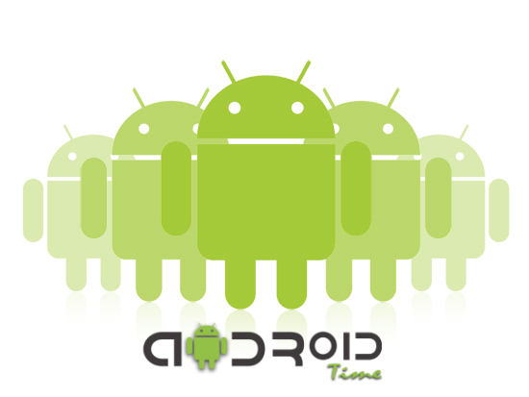
Cost Advantage
Economy of Scope
R&D and cost for Android - Fixed Cost

Slide 17




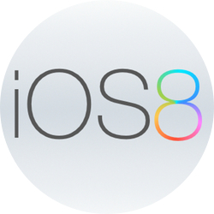
Business Immunization
Dependent > independent
Samsung - Tizen Operation System
Huawei - ‘New’ Operation System

Slide 18
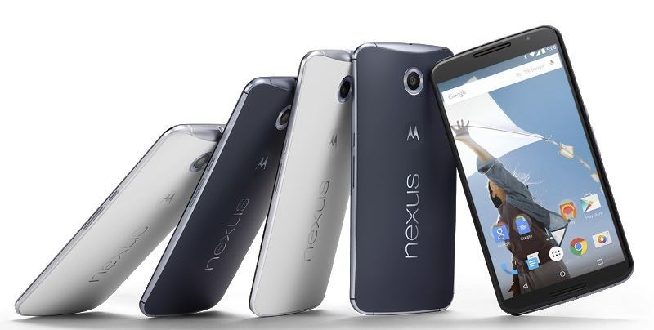
The Smartphone Market
Price of the smartphone in the market are high Ex. Iphone
Unaffordable
Tie-in-sale

Slide 19
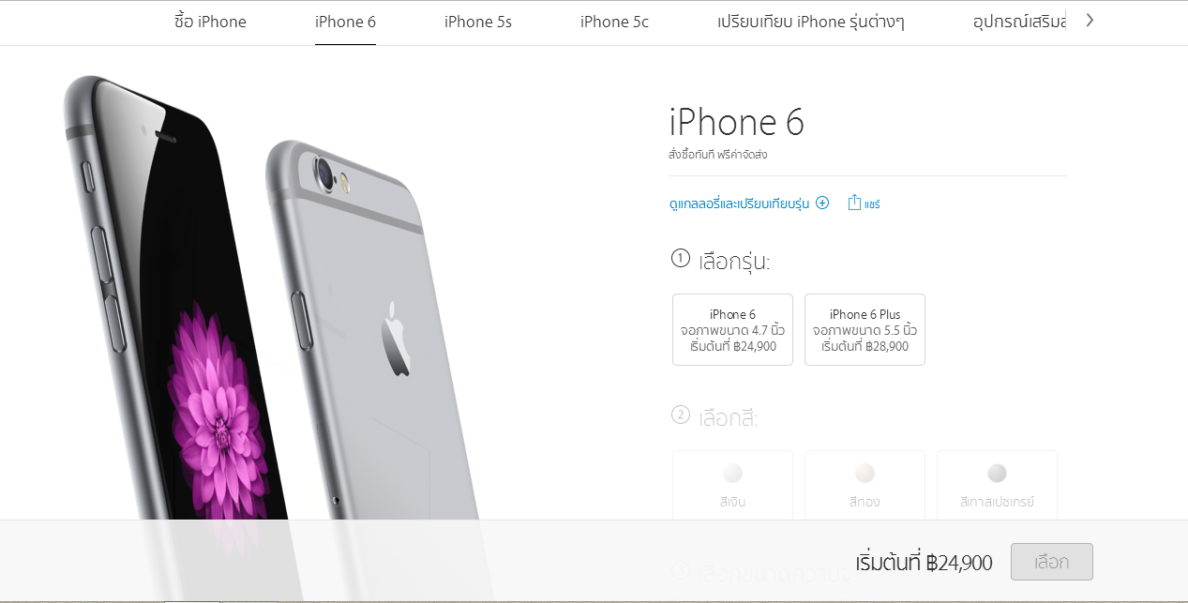

Slide 20
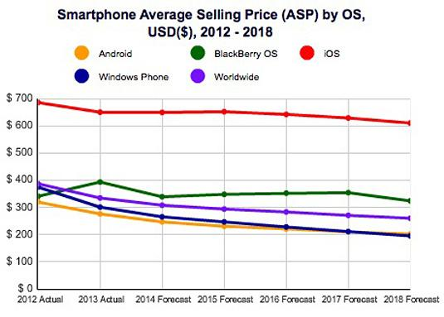

Slide 21
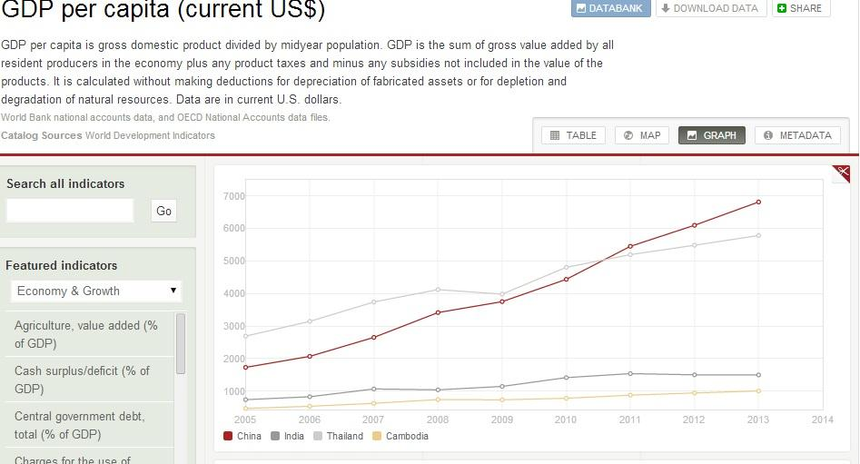

Slide 22
Smartphone Potential Market
Emerging market - INDIA
Low average income Emerging market - India
Approximately 1.75 billion people accessed to the smartphone today
Approximately 5 billion people have no access to smartphone

Slide 23
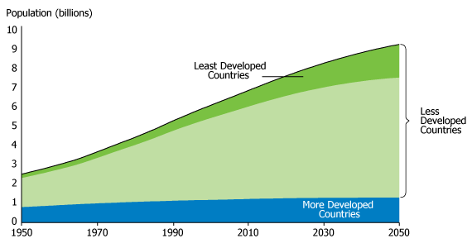

Slide 24
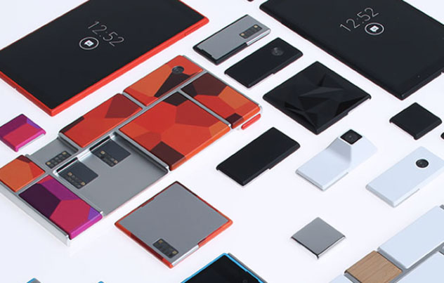
The Ara Project
The future Google’s modular smartphone
The customization phone
New function and design

Slide 25

In Conclusion
Google should produce their own Smartphone
More product usage in the economy
Stay competitive in the market

Slide 26


Thank You

