Slide 1
Economic Model of Farm Households

Slide 2
The Physiocrats
a group of economists who believed that the wealth of nations was derived solely from the value of "land agriculture" or "land development."
Francois Quesnay (1694-1774)
preceded the first modern school, classical economics, which began with the publication of Adam Smith's The Wealth of Nations in 1776

Slide 3
The Physiocrats
The first school of political economy
All economic surplus derived from agriculture
  Conceived in physical terms (corn)
  Both input & output (I<O)
  Consumed by consumers or landlords
  Saved and invested in expanded production
  Diverted to government/Church in the form of taxes/tithes
  Transformed to other goods through trades in the market

Slide 4
The Physiocrats
Three technique of agricultural production
  Cultivation of land with human labor alone
    No surplus, subsistence farming, low standard of living
  Cultivation with ox-drawn ploughs
    Most common technique, but less returns on capital than horse-drawn
  Cultivation with horse-drawn ploughs
    More efficient, greater returns on capital

Slide 5
The Physiocrats
With no horse or ox, no surplus → starvation and depopulation
Peasants could not pay rents to the landowners, contribute to State or Church,
Scarce in capital, no borrowing
Inefficient “métayage” system

Slide 6
The Physiocrats
‘Horse’ → Growth of wealth increase the numbers of men in profitable occupations
Unable to find nearby skilled ploughmen capable of handling horse,
they had to come from a distance at considerable expenses
Make the masters too much dependent on employees/too much control

Slide 7
The Physiocrats
Oxen → work slowly, spent lots of time grazing, reduced land productivities
Métayers: neglect its cultivation, only pulling carts for their own profits, most of the land stands fallow
But be profitably stocked with sheep, beef cattle calves, pigs, and poultry
The manures from these herds could double grain yields

Slide 8
The Physiocrats
Policy implication:
  A nation will prosper only if capital is allowed to accumulate in the hands of entrepreneurial farmers who will employ peasants as agricultural laborers
  Growing wealth → population growth
  Kingdom where revenues are growing attract the new habitats

Slide 9
Malthusianism
Thomas Robert Malthus (1766-1834)
Malthus thought that the dangers of population growth would preclude endless progress towards a utopian society:
"The power of population is indefinitely greater than the power in the earth to produce subsistence for man”

Slide 10
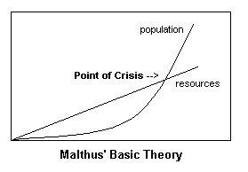
Malthusianism

Slide 11
Classical School
  Adam Smith (1776) The Wealth of Nations
    “It is not from the benevolence of the butcher, the brewer, or the baker, that we expect our dinner, but from their regard to their own interest. We address ourselves, not to their humanity but to their self-love, and never talk to them of our own necessities but of their advantages”

Slide 12
Classical School
David Ricardo
defined a theory of rent in his Principles of Political Economy (1817).
Ricardo regarded rent as value in excess of real production—something caused by incident of ownership rather than by fundamental economic value imparted by free and equal trade.
rent represented a kind of negative money that landlords could pull out of the production of the land by measure of land's scarcity

Slide 13
Classical School
David Ricardo
defined a theory of rent in his Principles of Political Economy (1817).
Ricardo regarded rent as value in excess of real production—something caused by incident of ownership rather than by fundamental economic value imparted by free and equal trade.
rent represented a kind of negative money that landlords could pull out of the production of the land by measure of land's scarcity

Slide 14
Classical School
Alfred Marshall (1842-1927)
“Principle of Economics”
Demand & Supply, Marginal Utility, Cost of Production

Slide 15
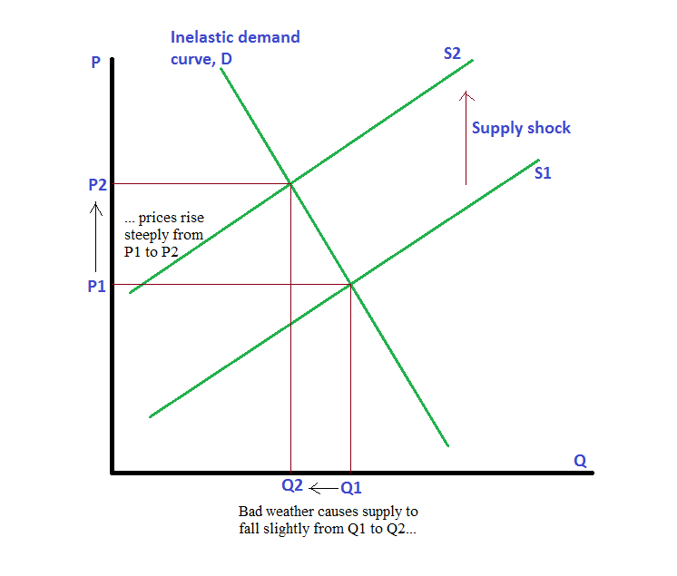
Classical School

Slide 16
Neo-Classical School
People have rational preferences among outcomes that can be identified and associated with a value.
Individuals maximize utility and firms maximize profits.
People act independently on the basis of full and relevant information.

Slide 17
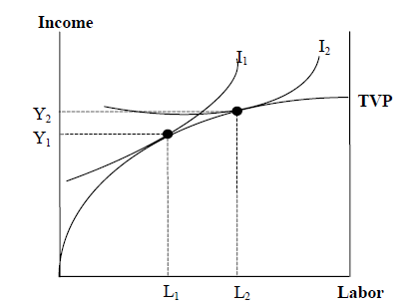
Farm-household Model
Alexander Chayanov (1888 –1937)

Slide 18
Farm-household Model
Difference between neo-classical production and agricultural production??
  Biological effects
    Uncertainty/ complexity
  Time effects
    Time-dependent of output/ flexibility effects/ carryover effects/ decision making over time
  Resource-portfolio effects
    Proportionally higher fixed costs/ asset-fixity effects/ guardianship responsibility (for land and water)/ more confronting law of diminishing returns

Slide 19
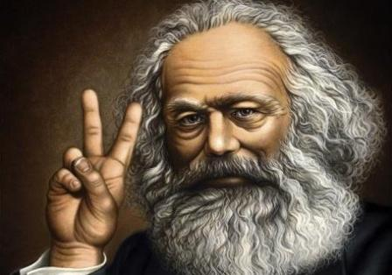
Marxian Political Economy
Karl Heinrich Marx (1818 – 14 March 1883)
Marx's theories about society, economics and politics—collectively known as Marxism—hold that all societies progress through the dialectic of class struggle: a conflict between an ownership class which controls production and a lower class which produces the labour for goods.

Slide 20
Marxian Political Economy
Karl Heinrich Marx (1818 – 14 March 1883)
Heavily critical of the current socio-economic form of society, capitalism, he called it the "dictatorship of the bourgeoisie", believing it to be run by the wealthy classes purely for their own benefit;
He predicted that, like previous socioeconomic systems, capitalism would inevitably produce internal tensions which would lead to its self-destruction and replacement by a new system: socialism.
Under socialism society would be governed by the working class in what he called the "dictatorship of the proletariat", the "workers' state" or "workers' democracy".
Socialism would, in its turn, eventually be replaced by a stateless, classless society called communism.

Slide 21
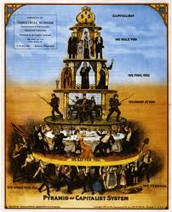
Marxian Political Economy

Slide 22
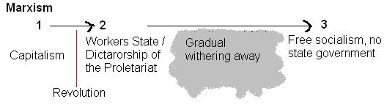
Marxian Political Economy
Karl Heinrich Marx (1818 – 14 March 1883)

Slide 23
Marxian Political Economy
Mode of production
  Means of production
    Productive resource: land, variable inputs, instrument resources
  Social relationship
    Who possesses effective control over productive resources/ who are the laborers
    What happen to the output created with those resource
      Simple reproduction
      Expanded reproduction

Slide 24
Marxian Political Economy
Mode of production
  Capitalist mode of production
    Expanded reproduction → Surplus
    Reinvestment in new means of production
    Social classes: Workers vs. Capitalists
      Capitalists have command over resources
      Labors sell their powers to the capitalist class
    Surplus generating
      Production for exchange in the market; not for direct use
      Competition between capitalists which continuously force them to seek new ways of individual capacity to generate surplus

Slide 25
Marxian Political Economy
Family farm?
  HH production is never a mode of production in itself, but is always a part of a larger economic system
  Feudalism: non-market surplus extraction

Slide 26
Marxian Political Economy
Social differentiation
  Peasants → two social classes
    Capitalist farmers
    Rural wage labours
  Land institutions/ cultivation practices
Surplus appropriation (rents/ price squeeze/ taxes)
  “Simple reproduction squeeze”

Slide 27
Marxian Political Economy
Resistance to the capitalism
  Capacity to maintain their needs of simple reproduction
  Social norms of reciprocity > profit maximizing (moral economy)
  Demographic factors → subdivision of land
  Functional advantages: Cheaper food/ less risks
  Intensification: “self-exploitation”
  Flexibility between on-farm and off-farm activities

Slide 28
New Institutional Economics
  Transaction Costs Economics (TCEs)
  Village peasant economics (Yujiro Hayami)
  Market Governance (Oliver Williamson)

