Slide 1
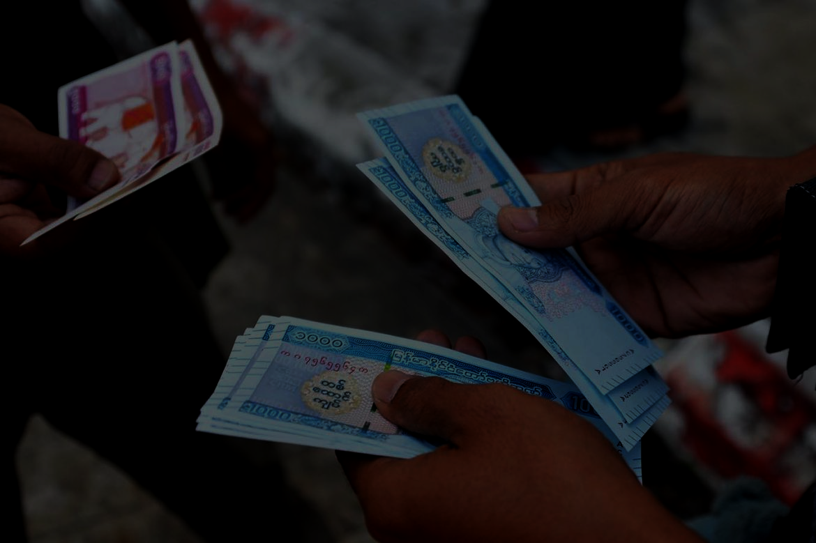
Opportunities of development in Myanmar

Slide 2
Motivation
Since we have learnt about the CLMV countries from this class. We have seen the inequality among countries and so that we would like to know why, in specific, Myanmar,which is a part of CLMV countries, is still so far away from “developed country”. What are the factors that cause those problems.
Comparing to Thailand and Singapore since both countries are considered more advanced than Myanmar in development sector.

Slide 3


Executive Summary
Why Myanmar is so far away from “developed country”?
Study the success factors and the drawback factors from both Singapore and Thailand
Study
Analysis
Analyze what problems that Myanmar is facing
Recommendation
Use specific frameworks to clear out the problems.

Slide 4
Part 1: Study the factor that we interested in each countries
Colonization/Modernization effect
Foreign Direct Investment
Education

Slide 5
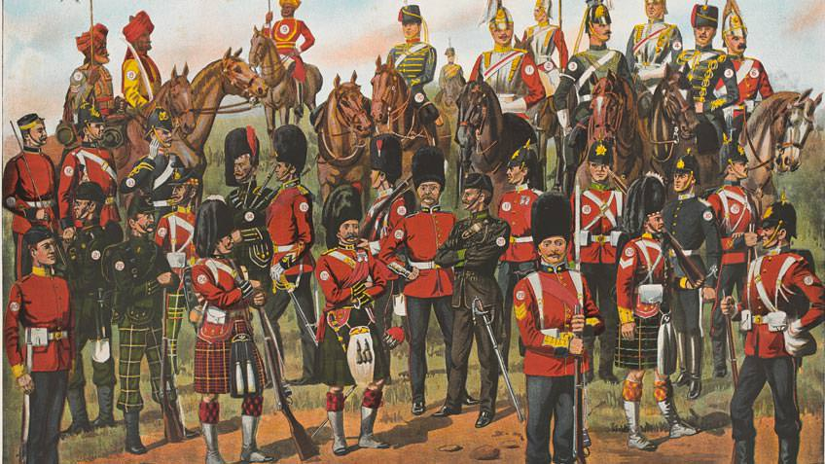
Colonization/
Modernization

Slide 6

Singapore’s Success as a British Colony
Singapore citizens also learn English language as the colony of Britain.
Sir Thomas Stamford Raffles open the first free school in Singapore & made a clever move for the economy which opened up Singapore as a free trade zone.
British soldiers helped and protected singapore from the invasion of japan around 1962-1965
Britain gave Singapore a larger degree of self-authority which it can establish itself as the one country.
Source : https://education.stateuniversity.com/pages/1343/Singapore-HISTORY-BACKGROUND.html
Study
Analysis
Recommendation

Slide 7

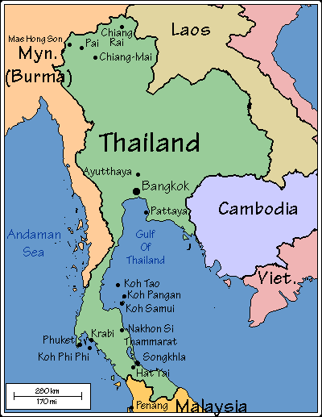

The Modernization in Thailand
Thailand's economic development has not been successful in the areas of human development and income distribution.Even though economic growth in Thailand is positive, income inequality is rising and the uneven development can be seen as a trade-off between the agricultural and industrial sectors.The rural poor have been trying to migrate to seek work in Bangkok and other big cities, particularly in the so-called "informal sectors". However, international news organizations ignores these inequality and focuses on Thailand’s economic growth.
Source : Industrialisation and Inequality in Thailand (Somboon Siriprachai)
Study
Analysis
Recommendation

Slide 8
Colonization period in Myanmar
The arrival of British,occupied all the area of present-day Myanmar, making the territory a Province of British India on 1 January 1886. They fundamentally undermined Myanmar government system.
The British made southern Myanmar into one of the world’s largest rice exporting regions. They also exploited rubies and other products that Myanmar sold on the world market.British also transformed the education system during the mid-19th to early 20th centuries(1824-1948)(colonization period). It can be said that British totally took advantages over Myanmar.
However, Myanmar achieved its independence from British on January 4, 1948. Unfortunately, there was a conflict within Myanmar’s government afterward.The civil war occured and it went on until 1989 and then everything was solved.
Source : https://uca.edu/politicalscience/dadm-project/asiapacific-region/burmamyanmar-1948-present/
Study
Analysis
Recommendation

Slide 9
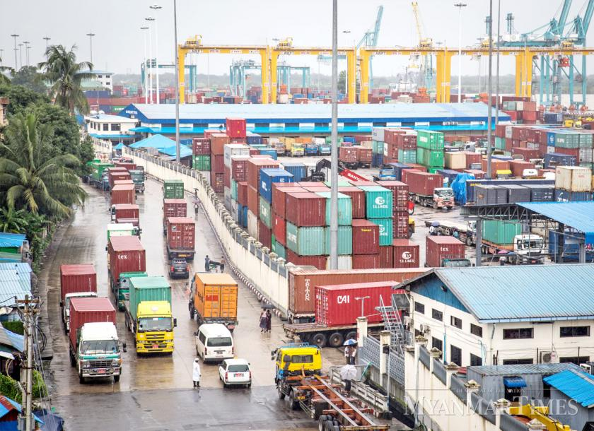
Foreign Direct Investment

Slide 10
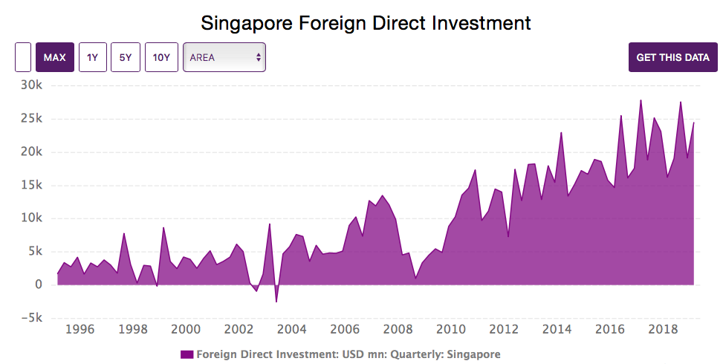
Factor affect on Singapore FDI
Source : CEICDATA (Singapore)
Study
Analysis
Recommendation
Notes:
weaker performance in the advanced economies has led to lower FDI inflows to Singapore. In 1998, 2001 and 2008, advanced economies experienced economic slowdowns, and Singapore’s FDI inflows fell significantly. There appears to be a weak inverse relationship between the corporate bond/treasury spread and Singapore’s FDI inflows. For instance, the high spread in 2002 corresponded with a low FDI inflow in the same year, while the 2003-2007 period of low spreads seemed to correspond with a general increase in FDI inflows to Singapore.
some developing economies in Asia have emerged as important direct investors

Slide 11



Factor affect on Singapore FDI
Determinant
Interest rate
Investors will move the funds from countries with lower interest rates to countries with higher interest rates.
The higher the GDP, the bigger the market size and ability to produce, purchase, and consume, the more attractive a country to investors.
GDP
Trade openness
The more open a country to trade and investment, the higher the FDI inflows coming
Source : http://globalbizresearch.org/Indonesia_Conference_2017_May1/docs/doc/PDF/J735.pdf
Study
Analysis
Recommendation
Notes:
Higher interest rate increases supply of loans..As GDP catches the ability of a country to produce goods as a whole, it perceives the ability of a country to consume goods as well.
The higher the GDP, the bigger the market size, the more attractive a country to investors.
the relationship between trade openness and FDI inflows exists as the international trade between countries emerged. The higher the trade volume of the host country, the more liberalized its economy to outside participation, the easier foreign investors to penetrate the market
trading activity expanded to a foreign investment, which is classified into two categories; international portfolio investment (IPI) and FDI.

Slide 12
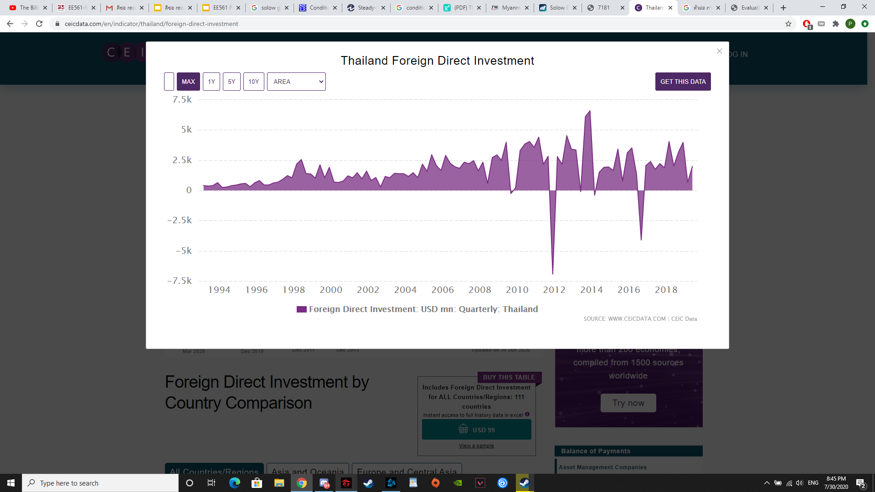
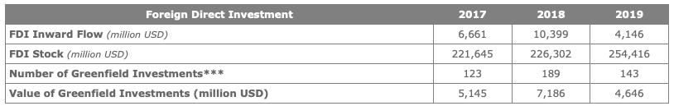
FDI in Thailand
Source : CEICDATA (Thailand)
Study
Analysis
Recommendation

Slide 13
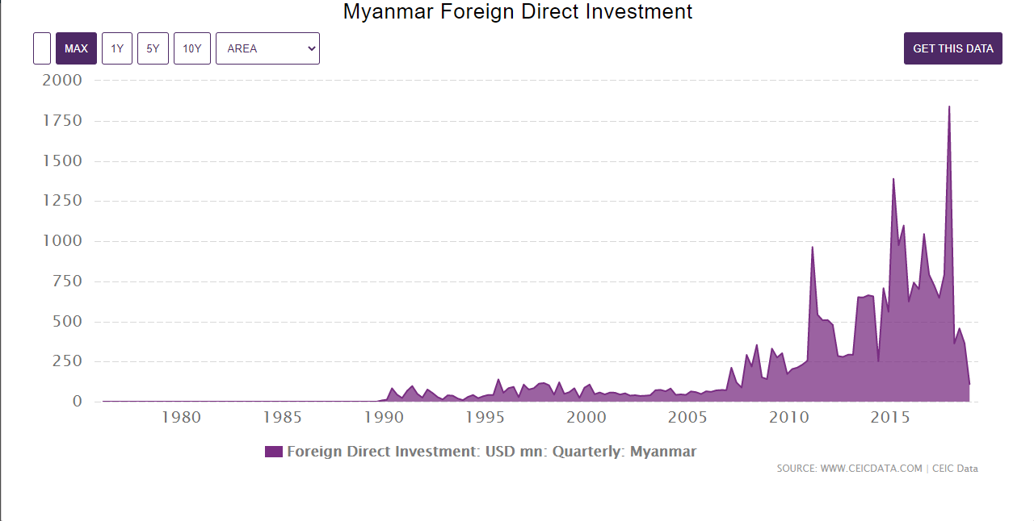
FDI in Myanmar from March 1976 to December 2019
Source : CEICDATA (Myanmar)
Study
Analysis
Recommendation

Slide 14
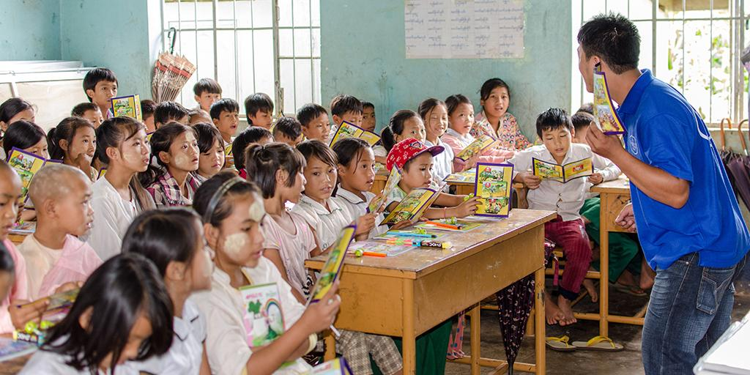
Education

Slide 15

The historical of the education in Singapore
Singapore embraces an English-based bilingual education.
the brunt of the responsibility for primary and secondary education was assumed by missionaries: the London Missionary Society, the American Board of Commissioners of Foreign Missions, and the French Society of Foreign Missions.
Pre-Independence
(1819-1962)
Survival-driven period : the aim is about producing and training workers which educated the students for the workforce through linguistic and technical skills that they will be sufficient skilled workers for an export-oriented economy in the early years of Singapore’s independence & industrialisation.
Efficiency-driven period: the aim is about fine-tuned the system in order to produce skilled workers for the economy in the most efficient way. In addition, the government demands workers for various sectors of the economy .
Ability-driven period: the goal is to nurture thinking and committed citizens who actively engage in long-term learning within a national culture of learning which now students can choose to study based on what they interested.
Post-Independence
(1965–now)
Source : Tan, C., Koh, K. & Choy, W. (2016). The education system in Singapore. In Juszczyk, S. (Ed.), Asian Education Systems (pp. 129-148). Toruñ: Adam Marszalek Publishing House.
Study
Analysis
Recommendation

Slide 16
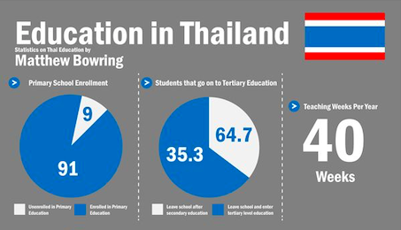
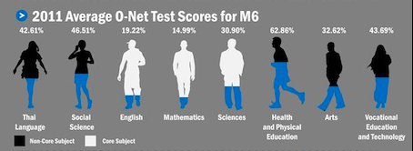
The Education in Thailand
Thai government, past and present have failed to provide universal basic education.
Lack of education funding and rural schools lack education supplies and more developed technology to support teaching.
In public and rural schools, teachers receive low pay, therefore people avoid taking these jobs and low-quality teachers fill the spaces.
The poverty and wealth gap in Thailand has also caused families to not be able to afford private schools and depend more on public schools in which their quality is far worse.
Source : http://www.edu.ru.ac.th/images/edu_pdf/thai-ed11.pdf
Study
Analysis
Recommendation

Slide 17


The historical of the education in Myanmar
Reconstruction with the concept of homogeneous system of schools in 1947.
Encourage Bilingual instruction in Primary and Post school.
They need to have a good knowledge of English language, and then they are able to enter government service and profession.
Before Independence
(1945-1948)
The curriculum that prioritize practical and prevocational subjects and activity programmes ( Gardening, Art)
After Independence
(1948-1962)
Discrimination
Children’s examination results at an early age determined the shape of their adult life ( A-list student, B-list student)
More focus on Science, but less focus on Art.
Under Military Rule
(1962-1988)
Source : Education in Burma (1945-2000) (Thein Lwin, 2000)
Study
Analysis
Recommendation

Slide 18
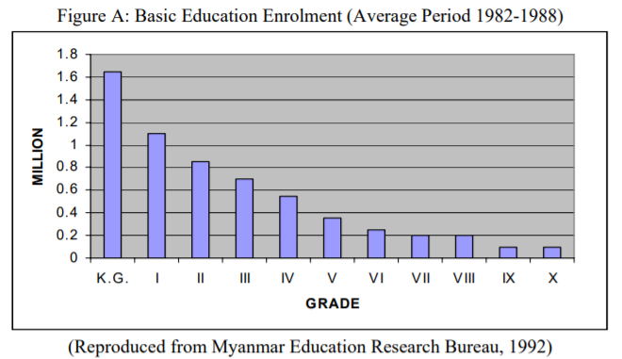
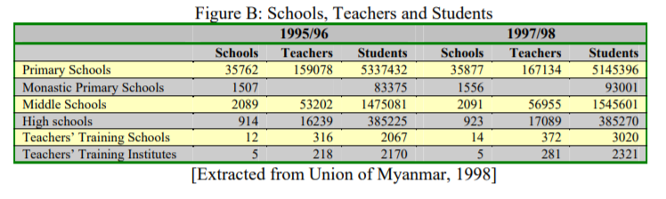
Source : Education in Burma (1945-2000) (Thein Lwin, 2000)

Slide 19
Part 2: Analyze the problem of Myanmar that we have been studied from the previous part

Slide 20
Increase in the number of the student who drop out from the school.
Corruption
Part 2: Analyze the problem of Myanmar that we have been studied from the previous part

Slide 21




The current education problem in Myanmar
Problem
Restriction in the quality of education services, bad school infrastructure, outdated teaching method, and lack of qualified teachers.
Mostly, children affected from the conflict-affected area including Kachin, Rakhine, and northern shan states.
Fees is one of the major issues for several children to give up on schooling.
the salary gap between the public school teacher and the private school teacher.
Source : https://www.unicef.org/myanmar/education
Study
Analysis
Recommendation

Slide 22
Part 3: Recommendation and Framework

Slide 23
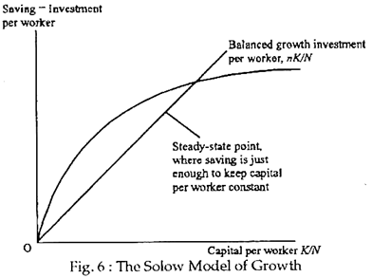
Solow growth model
Sustainable growth based on technological progress
szf(k)
(1-d)k
(1+n)
(1+n)
Current capital(K)
Current labor input(N)
Total output(Y)
Capital stock in the future period(K’)
Saving rate(s)
Total factor productivity(z)
Rate of population growth(n)
Source : EE312 Macroeconomic Theory and CFI
Study
Analysis
Recommendation

Slide 24
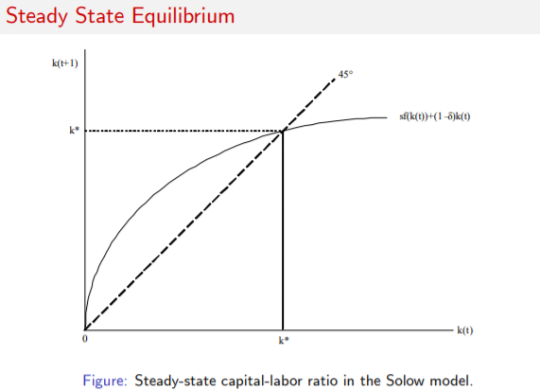
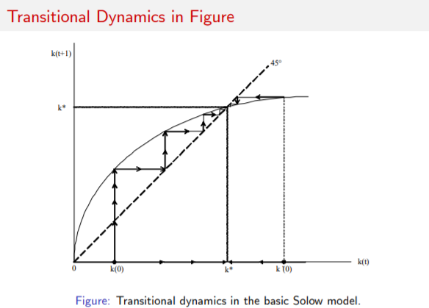
Steady-state point
Steady-state is reached when output, capital and labour are all growing at the same rate, so output per worker and capital per worker are constant.
Source : EE312 Macroeconomic Theory and The Solow Growth (Daron Acemoglu, 2011)
Study
Analysis
Recommendation

Slide 25
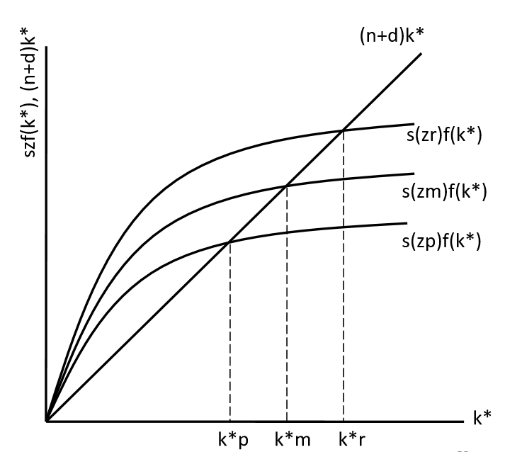
Conditional Convergence growth model
-Implication of Solow-type neoclassical growth models
-disparity among countries due to different value of n,z and s
-technological progress(z) is the key
.
.
.
Applying to current problems
As mentioned before, technological progress is the key to reach the steady-state so what would us recommend to Myanmar would be that they should advance their technological progress and use more technology to solve the problem for instant in education and manufacturing.
Different y* and k*
Source : EE312 Macroeconomic Theory, https://economics.mit.edu/files/7181
Study
Analysis
Recommendation

Slide 26
Recommendation
Modernising
Prioritize the learning environment
Technology Progress
Education
The curriculum that related to their real life, especially in the rural area
Reform
Source : Case Study in Denmark (ComputerWeekly.com)
Study
Analysis
Recommendation

Slide 27
Recommendation
Corruption
Introduce the anti-corruption as a subject in school
Integrity, Honesty and Trustworthiness are the key factor to stop a person from being corrupt
Source: Article about Teach kids to fight corrupt values in schools, urges Lee
Study
Analysis
Recommendation

Slide 28
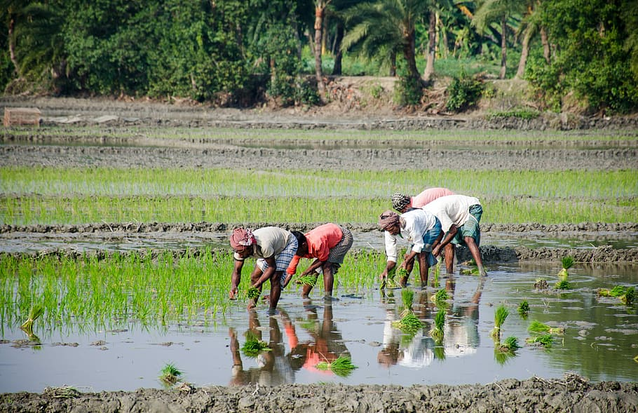
Q&A

