Slide 1
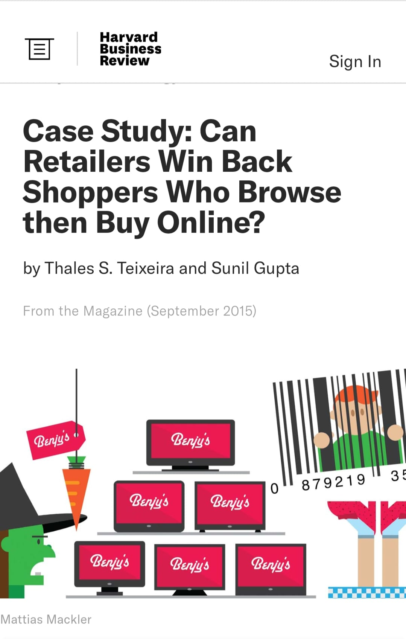
Group Assignment 3:
Brick and Mortar vs. Online shopping

Slide 2
Group Assignment: Please refer the assignment to your group project category
What is showrooming and how does it apply to your retail industry?
What is the physical store (brick-and-mortar) shops current situation?
What is the future outlook and your suggestions to address this challenge?
Please create one page ppt. slide to be due next Tuesday Feb.16th. Please design the one page by using photos, graphs, charts, visuals to make one page interesting ka.
Notes:
1

Slide 3
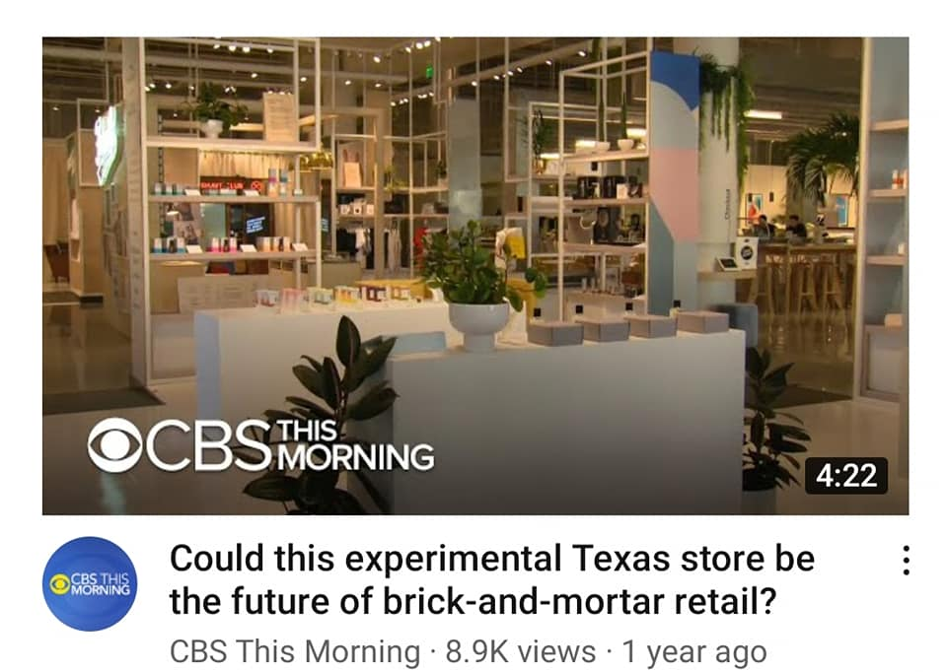


Slide 4
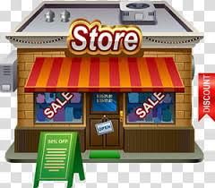
6 Retailers for MK 322
Sequence
Pekaboo
Black white
Rainbow (bookstore)
JJ+
Savage
BLACKCARD

Slide 5

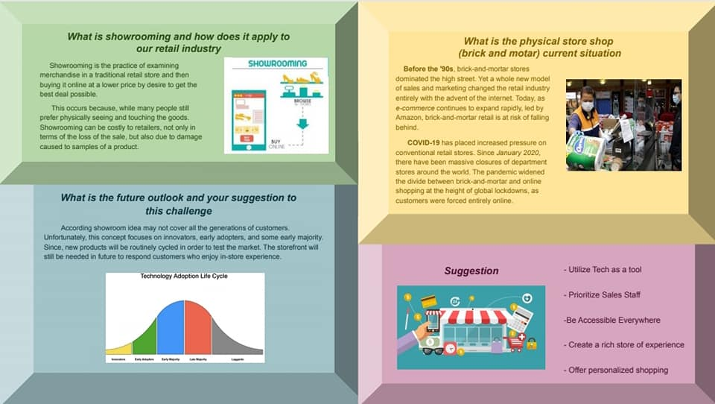
Pekaboo

Slide 6
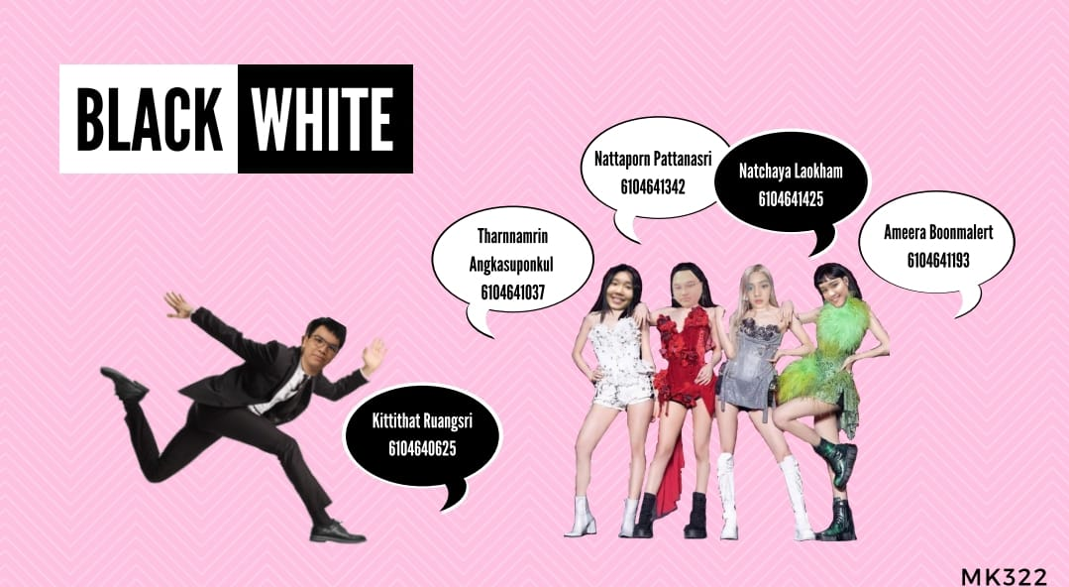
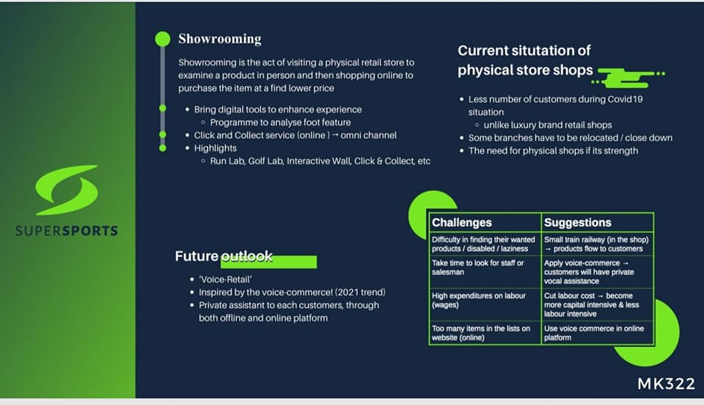
Black White

Slide 7

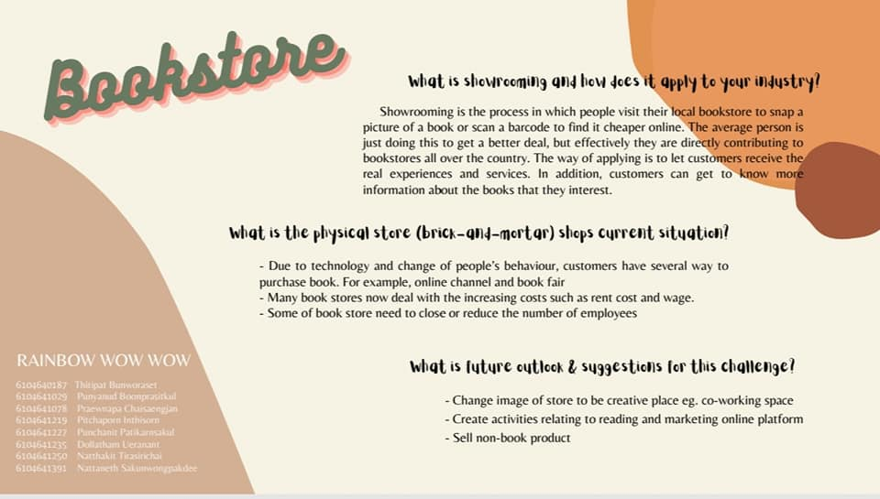
Rainbow

Slide 8

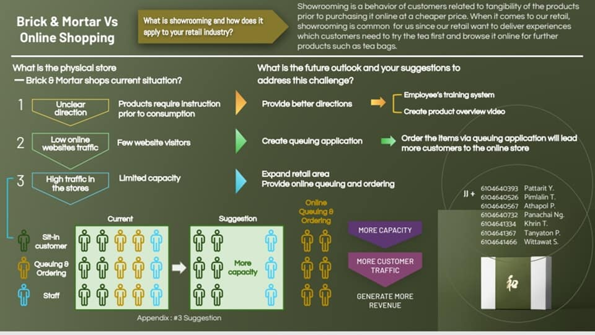
JJ+

Slide 9
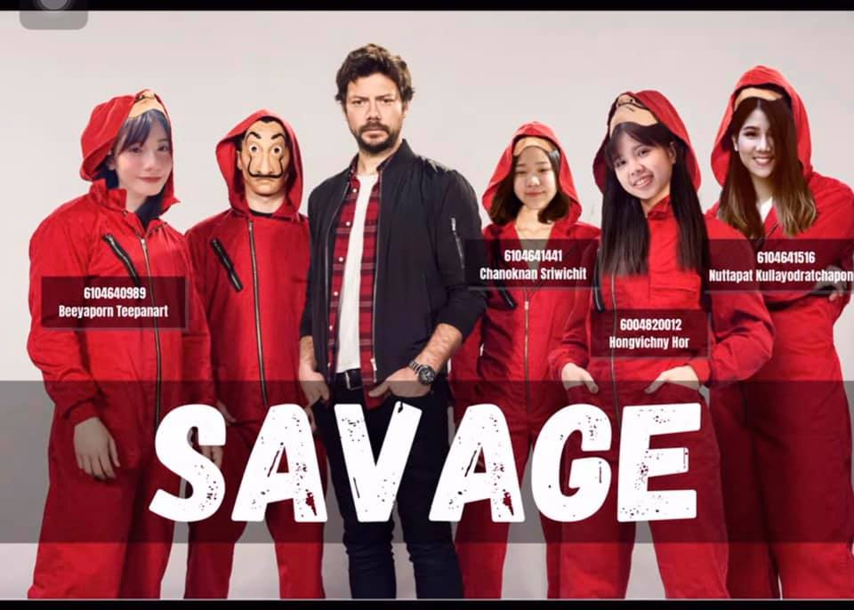
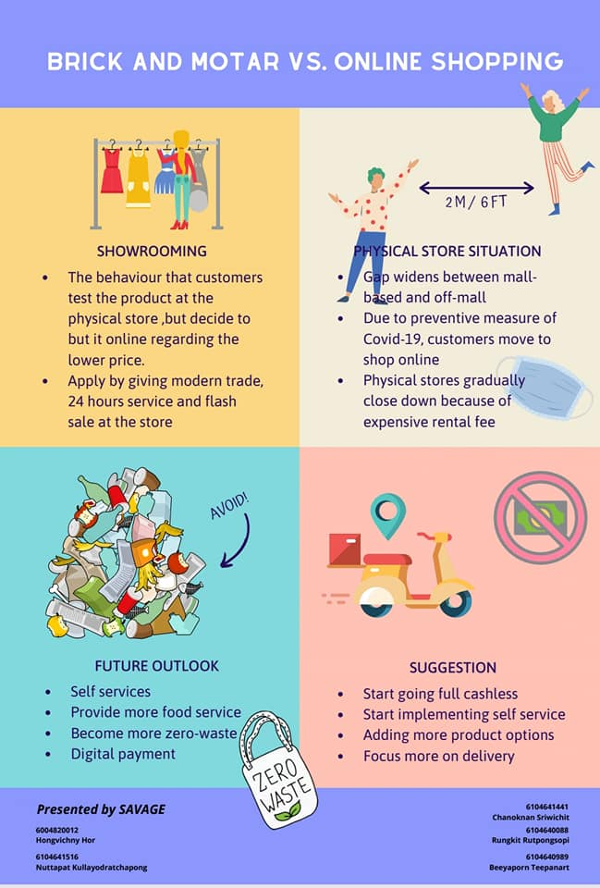
Savage

Slide 10
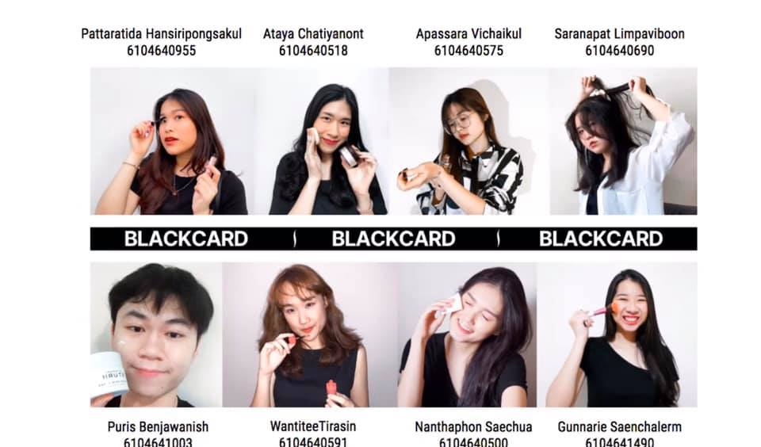
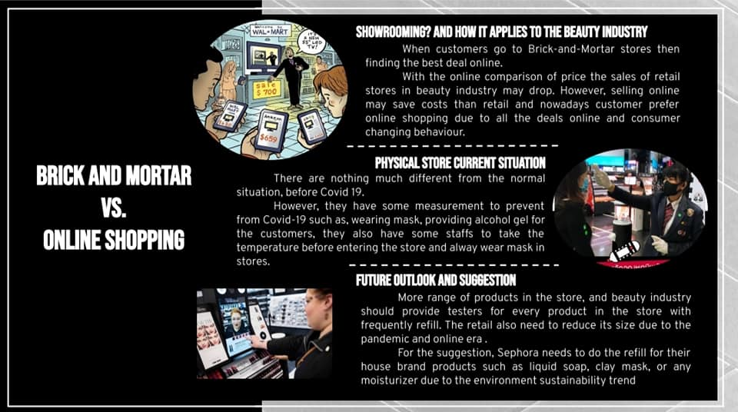
BLACKCARD

Slide 11


