Slide 1
Topic 8 Part 1
Monopoly
(Chapter 11)

Slide 2
Monopoly
Definition: A Monopoly Market consists of a single seller facing many buyers.
The monopolist's profit maximization problem:
Max π(Q) = TR(Q) - TC(Q)
where: TR(Q) = QP(Q) and
P(Q) is the (inverse) market demand curve.
The monopolist's profit maximization condition:
ΔTR(Q)/ΔQ = ΔTC(Q)/ΔQ OR MR(Q) = MC(Q)

Slide 3
Monopoly vs Perfect Competition
In perfect competition, there are infinitely many buyers and sellers, selling homogeneous products.
As a result, perfectly competitive firms are price takers: they take price as given, and face a perfectly elastic demand curve.
In contrast, a monopolist is a price maker. It sets the market price to maximize its profit.
However, we often state the monopolist’s profit maximization problem in terms of setting quantity rather than price.
This is because TR(Q) and TC(Q) are functions of Quantity.

Slide 4
Demand Curve
Price
Price
Competitive Firm Monopolist
Demand Demand
P₀
P₀
P₁
q q+1
Output
Q₀ Q₀+1
Output

Slide 5
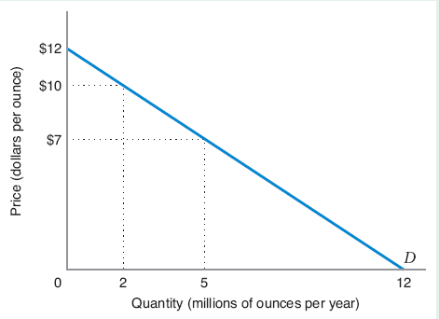
A Monopoly – Profit Maximizing
The Monopolist’s Demand Curve is downward-sloping:
the higher P, the lower Q, and vice versa.
Along the demand curve, different revenues for different quantities
Profit maximization problem is the optimal trade-off between volume (number of units sold) and margin (the differential between price).

Slide 6
A Monopoly – Profit Maximizing
Demand Curve:
Total Revenue:
Total Cost:
Profit-Maximization: MR(Q) = MC(Q)

Slide 7
A Monopoly – Profit Maximizing
Given the inverse demand and MC, what is the profit maximizing Q and P for the monopolist?
P = 12 – Q MC = Q MR = 12 – 2Q
Setting MC = MR ; 12 – 2Q = Q
Q* = 4 P* = 12 – 4 = 8

Slide 8
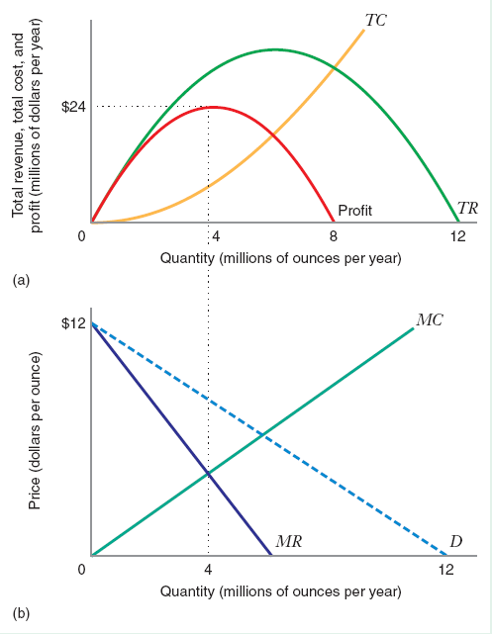
A Monopoly – Profit Maximizing
As Q increases TC increases, TR increases first and then decreases.
Profit Maximization is at MR = MC.

Slide 9
A Monopoly – Profit Maximizing
MR > MC, firms can increase Q and increase profit. Firms should sell as long as MR > MC.
MR < MC, firms can decrease quantity and increase profit.
MR = MC , firms cannot increase profit.

Slide 10
MR and AR
Price
Price
Competitive Firm Monopolist
Demand = AR = MR = P Demand = AR
P₀
P₀
P₁
q q+1
Output
Q₀ Q₀+1
Output

Slide 11
Marginal Revenue Curve and Demand
Price
The MR curve lies below the demand curve.
P(Q₀)
MR(Q₀)
P(Q) (the inverse demand curve)
and also AR(Q)
MR(Q)
Quantity
Q₀

Slide 12
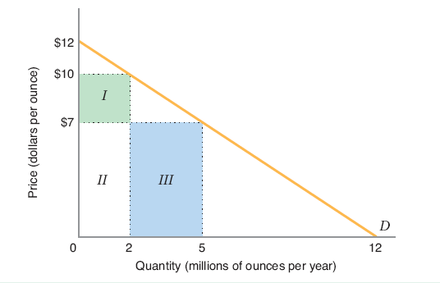
Marginal Revenue Curve and Demand
The extra 3m ounces is called Marginal Units.
The prior 2m ounces is called Inframarginal Units.
To sell more units, a monopolist has to lower the price.
At the lower P, the increase in TR is Area III.
The TR sacrificed is Area I.
∆TR = Area III – Area I

Slide 13
Marginal Revenue
Area III = price x change in quantity = P(ΔQ)
Area I = - quantity x change in price = -Q(ΔP)
Change in TR = ∆TR = P(ΔQ) + Q(ΔP)
∆P/∆Q = slope of the inverse demand curve.

Slide 14
Marginal Revenue
Marginal revenue has two parts:
P: increase in TR due to higher Q, i.e. the marginal units.
Q(ΔP/ΔQ): decrease in TR due to lower P of the inframarginal units.
Since Q(ΔP/ΔQ) < 0, MR is less than the price any Q > 0, i.e. MR(Q) lies below P(Q).

Slide 15
Average Revenue
Since
the monopolist’s AR curve coincides with the market inverse demand curve:

Slide 16
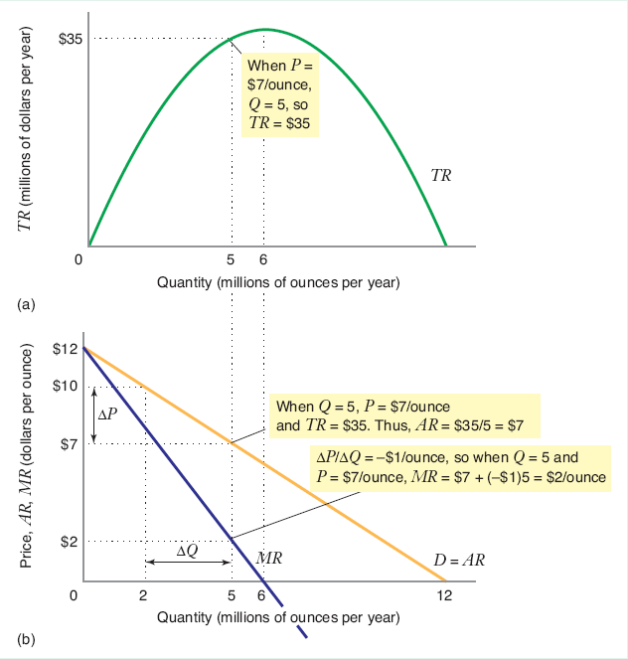
MR and AR
The demand curve and the AR curve coincide.
(For Q > 0)
Since MR < P, we have MR < AR, i.e. MR lies below the demand curve and AR curve.

Slide 17
MR and AR
When P decreases by $3 per ounce (from $10 to $7),
Q increases by 3 million ounces (from 2 million to 5 million).

Slide 18
MR and AR

Slide 19
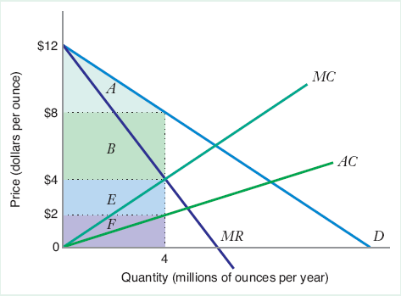
Profit Maximization
Profit-Maximizing output is at MR = MC.
Monopolist will make 4 million ounces and sells at $8 per ounce.
TR = Areas B + E + F.
Profit (TR-TC) is B + E.
Consumer surplus is Area A.

Slide 20
Shutdown Condition
In the short run, the monopolist shuts down if the most profitable price does not cover AVC: P < AVC.
In the long run, the monopolist shuts down if the most profitable price does not cover AC: P < AC.
Here, P* exceeds both AVC and AC.

Slide 21
Positive Profits for Monopolist
This profit is positive. Why?
Because the monopolist takes into account the price-reducing effect of increased output so that the monopolist has less incentive to increase output too much.
Profit can remain positive in the long run. Why?
Because we are assuming that there is no possible entry in this industry, so profits are not competed away.

Slide 22
Monopolist’s Supply Curve
A monopolist does not have a supply curve (i.e. an optimal output for any exogenously-given price) because price is endogenously-determined by demand: the monopolist picks a preferred point on the demand curve.
One could also think of the monopolist choosing output to maximize profits subject to the constraint that price be determined by the demand curve.

Slide 23
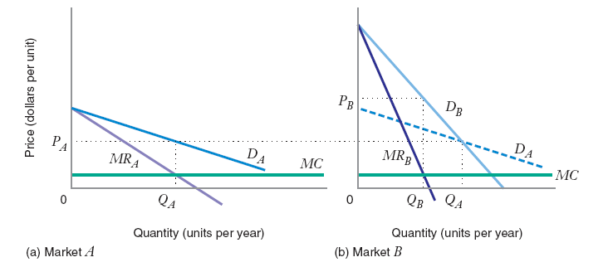
Inverse Elasticity Pricing Rule
Market A: profit-maximizing price is P_{A}.
Market B: profit-maximizing price is P_{B}.
Demand is less elastic in Market B.

Slide 24
Inverse Elasticity Pricing Rule
We can rewrite the MR curve as follows:
MR = P + Q(ΔP/ΔQ) = P(1 + (Q/P)(ΔP/ΔQ)
MR = P(1 + 1/ε)
where: ε is the price elasticity of demand, (P/Q)(ΔQ/ΔP)

Slide 25
Inverse Elasticity Pricing Rule

Slide 26
Elasticity Region of the Demand Curve
Price
a
Elastic region (ε < -1), MR > 0
Unit elastic (ε = -1), MR = 0
Inelastic region (0 > ε > -1), MR < 0
Quantity
a/2b a/b

Slide 27
Inverse Elasticity Pricing Rule
Profit maximizing condition:
Rearranging:

Slide 28
Inverse Elasticity Pricing Rule
Inverse Elasticity Pricing Rule (IEPR)
Monopolist’s optimal markup of price above marginal cost expressed as a percentage of price is equal to minus the inverse of the price elasticity of demand.
IEPR tells us about how much P* the monopolist should charge, given the PED.
High PED implies that P* should be low.

Slide 29
Inverse Elasticity Pricing Rule
In Market A, P* = P_{A}. In Market B, P* = P_{B}.
According to IEPR, since Mkt A is more elastic, it should charge lower price.

Slide 30
Inverse Elasticity Pricing Rule

Slide 31
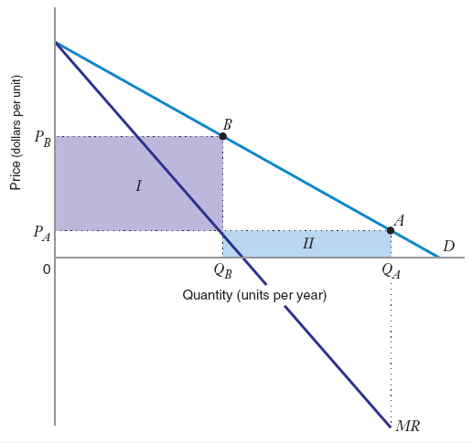
Elasticity Region of the Demand Curve
Monopolist operates at the elastic region of the market demand curve.
Increasing price from P_{A} to P_{B}, ∆TR = Area I – Area II.
The total cost also goes down because Q is smaller.
As demand becomes more elastic, MR approaches P.

Slide 32
The Lerner Index of Market Power
Definition: An agent has Market Power if he can affect the market price.
Sometimes, this is thought of as the degree to which a firm can raise price above marginal cost.
Definition: The Lerner Index of market power is the price-cost margin, (P*-MC)/P*.
This index ranges between 0 (for competitive firms) and 1 (for a monopolist facing a unit-elastic demand).

Slide 33
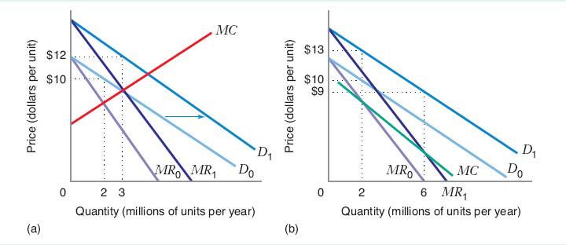
Comparative Statics – Shifts in Demand
Rightward shift in the demand curve causes an increase in profit-maximizing quantity.
  (a) MC is increases as Q increases
  (b) MC decreases as Q increases

Slide 34
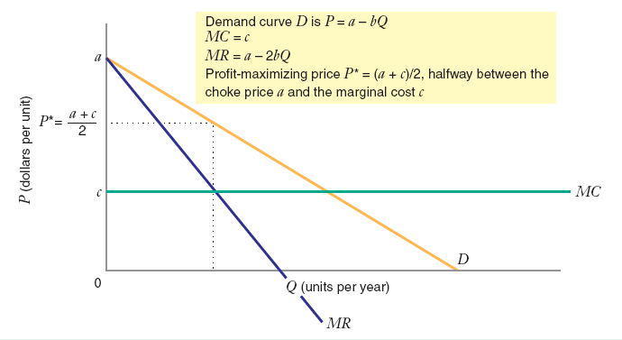
Comparative Statics – Midpoint Rule
For a constant MC, P* is found using the midpoint rule:
P* is halfway between the vertical intercept of the demand curve a (choke price) and vertical intercept of the MC curve c.

Slide 35
Comparative Statics – Midpoint Rule

Slide 36
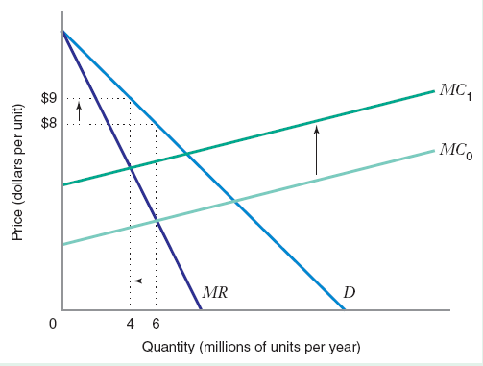
Comparative Statics – Shifts in MC
When MC shifts up, Q* falls and P* increases.

Slide 37
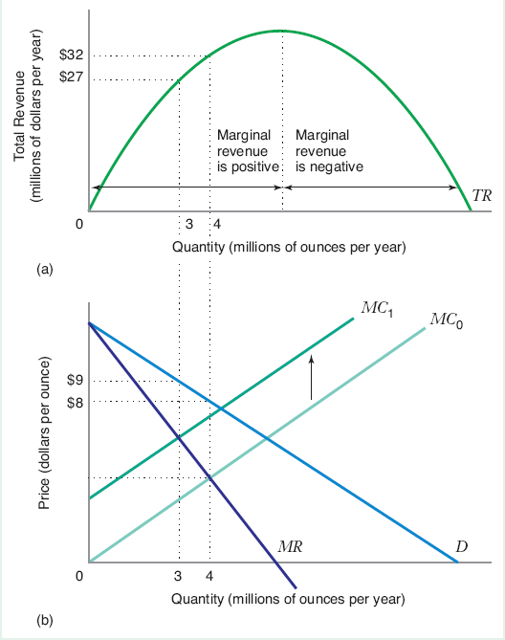
Comparative Statics – Shifts in MC
Upward shift of MC decreases the profit maximizing monopolist’s total revenue.
Downward shift of MC increases the profit maximizing monopolist’s total revenue.

Slide 38
The Welfare Economies of Monopoly
Since the monopoly equilibrium output does not, in general, correspond to the perfectly competitive equilibrium, it entails a dead-weight loss.
Suppose that we compare a monopolist to a competitive market, where the supply curve of the competitors is equal to the marginal cost curve of the monopolist.

Slide 39
The Welfare Economies of Monopoly

Slide 40
Why does Monopoly exist?
Definition: A market is a natural monopoly if the total cost incurred by a single firm producing output is less than the combined total cost of two or more firms producing this same level of output among them.

Slide 41
Why does Monopoly exist?

Slide 42
Why does Monopoly exist?
Definition: Barriers to Entry are factors that allow an incumbent firm to earn positive economic profits while making it unprofitable for newcomers to enter the industry.
  Structural Barriers to Entry – occur when incumbent firms have cost or demand advantages that would make it unattractive for a new firm to enter the industry
  Legal Barriers to Entry – exist when an incumbent firm is legally protected against competition
  Strategic Barriers to Entry – result when an incumbent firm takes explicit steps to deter entry

