Slide 1
FN 331: Financial Institutions Management
Class 10
Copyright © 2014 by the McGraw-Hill Companies, Inc. All rights reserved.
Notes:
1

Slide 2
Overview – Individual Loan Risk
This chapter discusses types of loans, and the analysis and measurement of credit risk on individual loans
Important for purposes of:
  Pricing loans and bonds
  Setting limits on credit risk exposure
Ch 10-2

Slide 3
Credit Quality Problems
Problems with junk bonds, LDC loans, and residential and farm mortgage loans
Late 1990s, credit card and auto loans
Crises in other countries such as Argentina, Brazil, Russia, and South Korea
2006-2007: Mortgage delinquencies and subprime loans
Emphasizes importance of managing credit risk
Ch 10-3
Notes:
3

Slide 4
Credit Quality Problems
Over the early to mid 1990s, improvements in NPLs for large banks and overall credit quality
Late 1990s and early 2000s: Telecom companies, tech companies
Mid 2000s, economic growth accompanied by reduction in NPLs
Mortgage crisis
Increased emphasis on credit risk evaluation
Ch 10-4

Slide 5
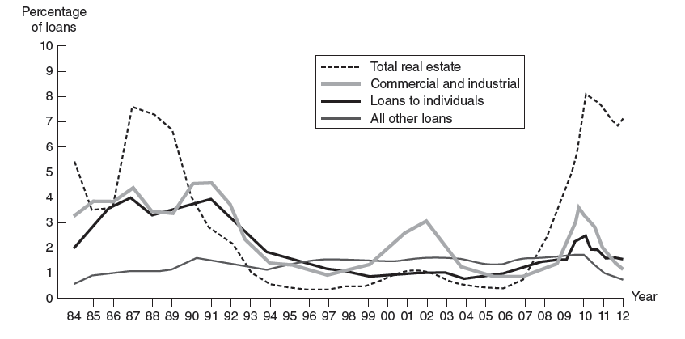
Nonperforming Asset Ratio for U.S. Commercial Banks
Ch 10-5
Notes:
5

Slide 6
Types of Loans
C&I loans: Secured and unsecured
  Syndication
  Spot loans, loan commitments
  Decline in C&I loans originated by commercial banks and growth in commercial paper market
  Downgrades of Ford, General Motors, and Tyco
  Effect of financial crisis on commercial paper market
RE loans: Primarily mortgages
  Fixed-rate, ARM
  Mortgages can be subject to default risk when loan-to-value rises
Ch 10-6

Slide 7
Consumer Loans
Individual (consumer) loans: personal, auto, credit card
  Nonrevolving loans
    Automobile, mobile home, personal loans
  Growth in credit card debt
    Visa, MasterCard
    Proprietary cards such as Sears, AT&T
  Consolidation among credit card issuers
    Bank of America and MBNA
  Risks affected by competitive conditions and usury ceilings
  Bankruptcy Reform Act of 2005
Ch 10-7
Notes:
7
Purchase of MBNA by BoA occurred subsequent to the revision of the text.

Slide 8
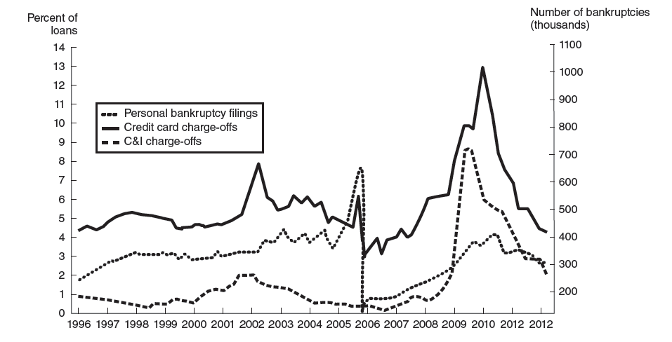
Annual Net Charge-Off Rates on Loans
Ch 10-8
Notes:
8
Note the run up in declarations of bankruptcy just prior to the Bankruptcy Reform Act.

Slide 9
Other loans
Other loans include:
  Farm loans
  Other banks
  Nonbank FIs: Broker margin loans
  Foreign banks and sovereign governments
  State and local governments
Ch 10-9
Notes:
9

Slide 10
Return on a Loan
Factors: Interest rate, fees, credit risk premium, collateral, and other requirements such as compensating balances and reserve requirements
Return = inflow/outflow
1+k = 1+(of + (BR + m ))/(1-[b(1-RR)])
Expected return: 1 + E(r) = p(1+k) where p equals probability of repayment
Note that realized and expected return may not be equal
Ch 10-10
Notes:
10
k is the promised gross return
of = direct fees (origination fees)
BR= base rate
m= risk premium
b= Compensating balance
RR = Reserve Rate
Note that the text displays 1+ E(r) = p(1+k) + (1-p)0 but this simplifies to the form displayed above.

Slide 11
Lending Rates and Rationing
At retail
  Usually a simple accept/reject decision rather than adjustments to the rate
  Credit rationing
  If accepted, customers sorted by loan quantity
  For mortgages, discrimination via loan to value rather than adjusting rates
At wholesale
  Use both quantity and pricing adjustments
Ch 10-11
Notes:
11

Slide 12
Measuring Credit Risk
Availability, quality, and cost of information are critical factors in credit risk assessment
  Facilitated by technology and information
Qualitative models
  Borrower specific factors are considered as well as market or systematic factors
Specific factors include reputation, leverage, volatility of earnings, covenants, and collateral
Market specific factors include business cycle and interest rate levels
Ch 10-12

Slide 13
Credit Scoring Models
Linear probability models:
  Statistically unsound since the values obtained are not probabilities at all
  Since superior statistical techniques are readily available, there is little justification for employing linear probability models
Ch 10-13

Slide 14
Other Credit Scoring Models
Logit models
  Overcome weakness of the linear probability models using a transformation (logistic function) that restricts the probabilities to the zero-one interval
Other alternatives include Probit and other variants with nonlinear indicator functions
Quality of credit scoring models has improved providing positive impact on controlling write-offs and default
Ch 10-14

Slide 15
Altman’s Linear Discriminant Model
Z=1.2X₁+ 1.4X₂ +3.3X₃ + 0.6X₄ + 1.0X₅
  Critical value of Z = 1.81
  X₁ = Working capital/total assets
  X₂ = Retained earnings/total assets
  X₃ = EBIT/total assets
  X₄ = Market value equity/ book value LT debt
  X₅ = Sales/total assets
Ch 10-15

Slide 16
Linear Discriminant Model
Problems:
  Only considers two extreme cases (default/no default)
  Weights need not be stationary over time
  Ignores hard to quantify factors including business cycle effects
  Database of defaulted loans is not available to benchmark the model
Ch 10-16

Slide 17
Term Structure Based Methods
  If the risk premium is known, we can infer the probability of default
  Risk premium can be computed using Treasury strips and zero coupon corporate bonds
  p (1+ k) = 1+ i
Ch 10-17

Slide 18
Term Structure Based Methods
  May be generalized to loans with any maturity or to adjust for varying default recovery rates
  The loan can be assessed using the inferred probabilities from comparable quality bonds
Ch 10-18

Slide 19
Mortality Rate Models
  Similar to the process employed by insurance companies to price policies; the probability of default is estimated from past data on defaults
  Marginal Mortality Rates:
  MMR₁ = (Value Grade B default in year 1) (Value Grade B outstanding yr.1)
  MMR₂ = (Value Grade B default in year 2) (Value Grade B outstanding yr.2)
  Has many of the problems associated with credit scoring models, such as sensitivity to the period chosen to calculate the MMRs
Ch 10-19

Slide 20
RAROC Models
  Risk adjusted return on capital
    One of the most widely used models
  RAROC =
  (one year net income on loan)/(loan risk)
  Loan risk estimated from loan default rates, or using duration
Ch 10-20

Slide 21
Using Duration to Estimate Loan Risk
  For denominator of RAROC, duration approach used to estimate loss in value of the loan:
  ΔLN /LN = -D_{LN} x (ΔR/(1+R))
Ch 10-21

Slide 22
Option Models
  Employ option pricing methods to evaluate the option to default
  Used by many of the largest banks to monitor credit risk
  KMV Corporation markets this model quite widely
Ch 10-22

Slide 23
Overview – Loan Portfolio and Concentration Risk
Management of credit risk in a loan (asset) portfolio
Setting credit exposure limits
Regulatory approaches to measuring credit risk
NAIC limits for different types of assets and borrowers in insurers’ portfolios

Slide 24
Simple Models of Loan Concentration
Migration analysis
  Track credit rating changes within sector or pool of loans
  Rating transition matrix reflects history of ratings changes
Widely applied to commercial loans, credit card portfolios, and consumer loans

Slide 25
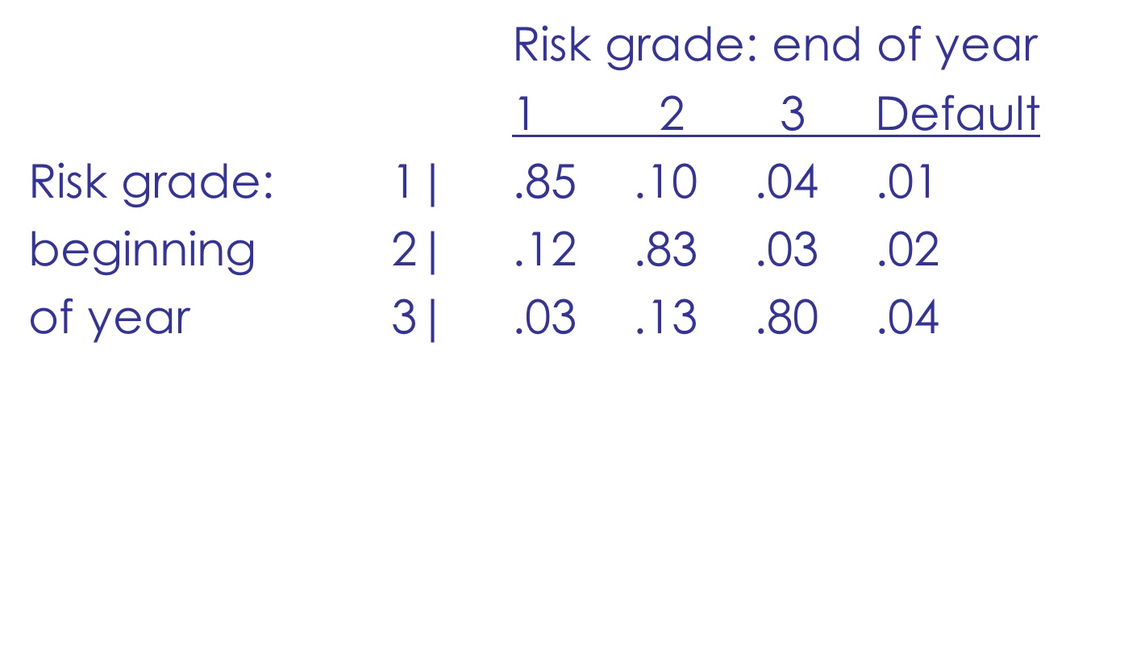
Rating Transition Matrix

Slide 26
Simple Models of Loan Concentration
Concentration limits
  On loans to individual borrower or sector
  Concentration limit = maximum loss ÷ loss rate
    Maximum loss expressed as percent of capital
  FIs typically set geographic concentration limits

Slide 27
Diversification & Modern Portfolio Theory
Applying portfolio theory to loans
  Using loans to construct the efficient frontier
  Minimum risk portfolio
    Low risk
    Low return

Slide 28
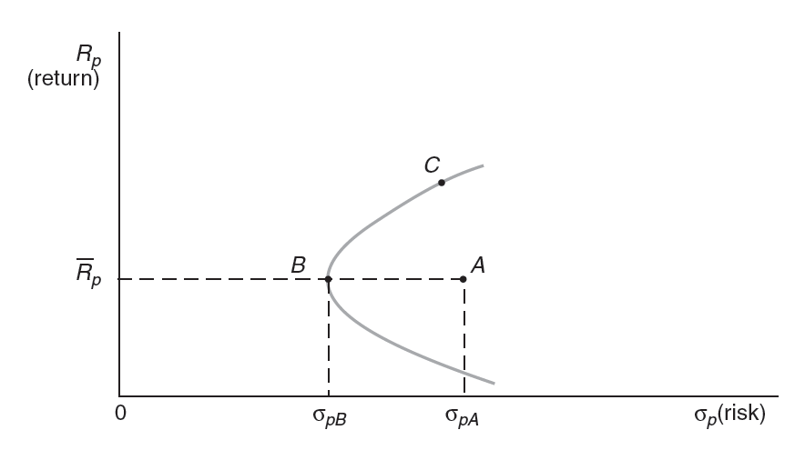
FI Portfolio Diversification

Slide 29
Applying Portfolio Theory to Loans
Requires:
  (i) Expected return on loan
  (ii) Loan risk
  (iii) Correlation of loan default risks

Slide 30
Modern Portfolio Theory
Expected Return:
Variance:

Slide 31
Moody’s Analytics (KMV) Portfolio Manager Model
  Moody’s Analytics (KMV) approach:
  R_{i} = AIS_{i} - E(L_{i}) = AIS_{i} - [EDF_{i} × LGD_{i}]
  σ_{i} = UL_{i} = σ_{Di} × LGD_{i} = [EDF_{i}(1-EDF_{i})]^{½} × LGD_{i}
  ρ_{ij} = correlation between systematic return components of equity returns of borrower i and borrower j
Notes:
Return on the loan (R_{i} ) measured by All In Spread (AIS) minus the expected loss on the loan.
EDF is expected default frequency and LGD is the amount of the loss given default has occurred.
Risk of the loan σ_{i} is the volatility of the loan’s default rate times the LGD. Recall that the variance of a binary random variable is the product of the probability of the event occurring and 1 minus the probability of the event occurring. In this case, that means EDF times (1-EDF). The standard deviation, σ_{Di} , is the square root of the variance.

Slide 32
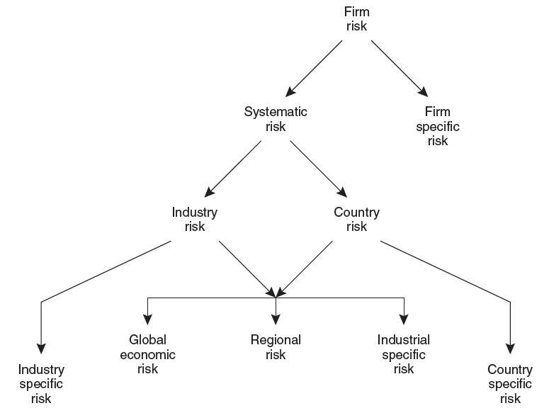
Moody’s Analytics (KMV) Asset Level Correlation

Slide 33
Partial Applications of Portfolio Theory
Loan volume-based models
  Commercial bank call reports
    Can be aggregated to estimate national allocations
  Data on shared national credits
    National database that breaks commercial and industrial loan volume into 2-digit SIC codes
  Commercial databases
Notes:
Individual banks then compare their allocations to the benchmark.

Slide 34
Partial Applications
Loan volume-based models
  Provide market benchmarks
    Standard deviation measure of individual FI’s loan allocations deviation from the benchmark allocations

Slide 35
Loan Loss Ratio-Based Models
Estimate loan loss risk by SIC sector
  Time-series regression:
  [sectoral losses in ith sector]
  [ loans to ith sector ]
  = α + β_{i} [total loan losses]
  [ total loans ]
Notes:
As an example, the time series of historical fractions of loan losses for agricultural loans, could be regressed on the corresponding time series of overall fractions of loan losses for the FI.

Slide 36
Regulatory Models
Credit concentration risk evaluation largely subjective and based on examiner discretion
  Quantitative models were rejected by regulators because the methods were not sufficiently advanced and available data were not sufficient
Life and PC insurance regulators propose limits on investments in securities or obligations of any single issuer
  General diversification limits

Slide 37
*CreditMetrics
If next year is a bad year, how much will I lose on my loans and loan portfolio?
VAR = P × 1.65 × σ
Neither P, nor σ observed
Calculated using:
  (i)Data on borrower’s credit rating; (ii) Rating transition matrix; (iii) Recovery rates on defaulted loans; (iv) Yield spreads.

Slide 38
* Credit Risk+
Developed by Credit Suisse Financial Products
  Based on insurance literature:
    Losses reflect frequency of event and severity of loss
  Loan default is random
  Loan default probabilities are independent
Appropriate for large portfolios of small loans
Modeled by a Poisson distribution

Slide 39
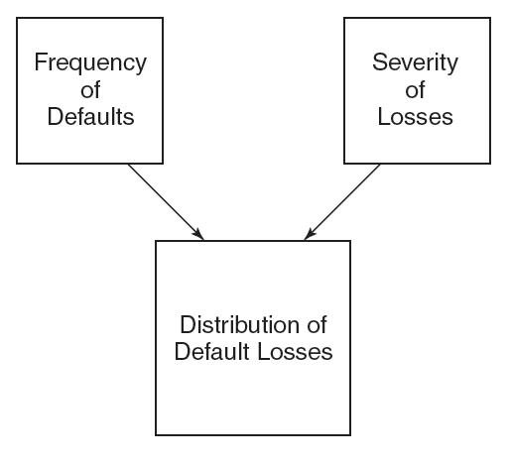
*Credit Risk+ Model: Determinants of Loan Losses

