Slide 1
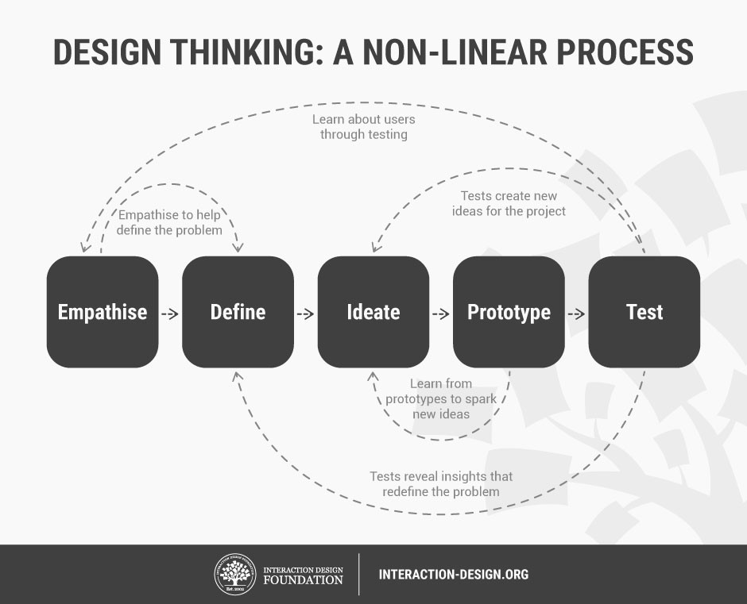
Class Assignment 2 (5%)
Design a New Product
Author/Copyright holder: Teo Yu Siang and Interaction Design Foundation. Copyright licence: CC BY-NC-SA 3.0

Slide 2
Class Assignment 2 (5%)
Design a New Product
Instructions
1. Team up 4-5 students per group.
2. After reading the paper of “Design Thinking: A 5 Stage Process”, the
group discussion is freely conducted for 50 min:
2.1 To gain an empathic understanding of the problem you are trying to solve.
2.2 To define a problem statement in a human-centered manner. (establishing features, functions, other elements to solve the problems)
2.3 To think outside the box in order to identify new solutions to the problem statement. (brainstorming)
2.4 To sketch a prototype of your new product.
3. Prepare your presentation. (10 min)
4. Present your work. (5-10 min/group)

