Slide 1
The fall of absolutism and 1932 revolution
Thai Economic History
Thorn Pitidol
1/2017

Slide 2
Topics
The fall of absolutism
Opposition to absolutism and 1932 revolution
The shifting political landscape after 1932

Slide 3
The fall of absolutism
Rama V’s death 1910 → 1932 Revolution
  The bureaucratic reform and the change in economy led to the new social groups that resented the royal monopoly of power
The challenges stemmed from
  The monopoly of power
  The mismanagement of the economy

Slide 4
Problems with absolutism
Royal monopoly of power
  Top positions given only to the members of royal family and top aristocrats families
What about Rama VII plan ? → Supreme Council of the State, and Prime Minister.
  Members of Supreme Council of the State consisted only senior members of royal family
  The appointment of PM was opposed by all sides

Slide 5
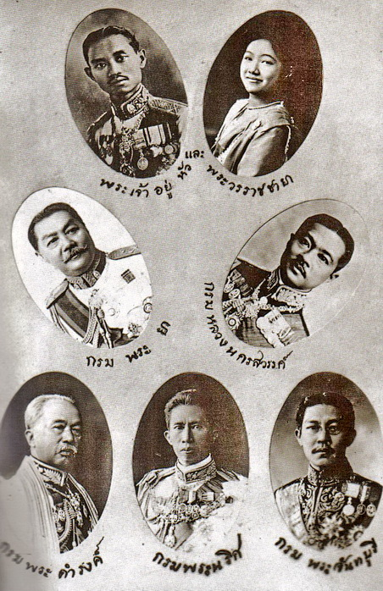

Slide 6
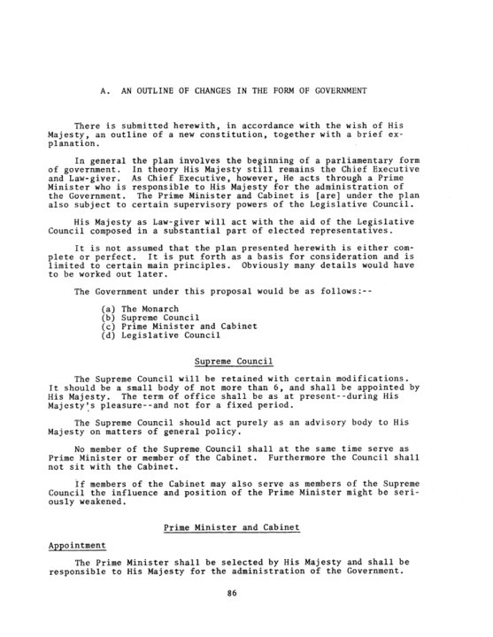
Rama VII’s Constitution
Siam not ready for representatives
From both drafts (1926 and 1932)
  King appoints PM
  King held legistlative power
  Parliament members came from appointments and indirect elections
  King held veto power

Slide 7
Problems with absolutism
The monopoly of power meant the King had the responsibility in managing the economy
  Taxation, government expenditure, and international economic policies
  Seen as incapable, especially during recession.
Extravagant spending a trend since Rama V
Although Rama VII restrained the spending, he faced a more difficult challenge
  Declining trade, currency standard management

Slide 8
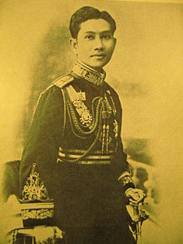
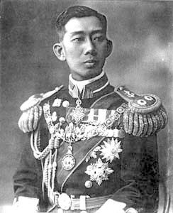
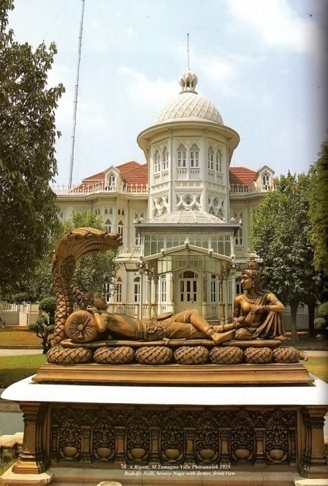
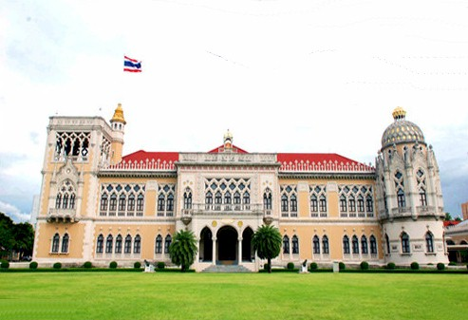
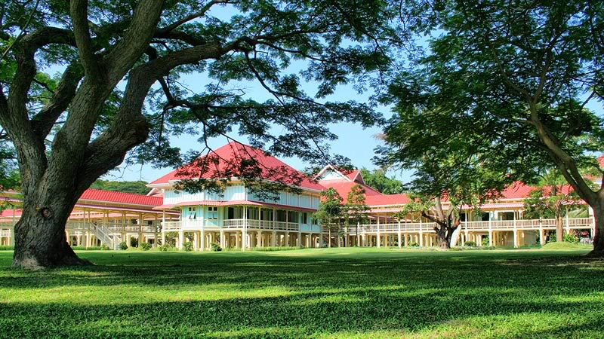
Rama VI’s spendings

Slide 9
Problems with absolutism
Rama VII’s responses to recession
  Taxes raised from salaries of bureaucrats and employees of private firms
  But not from profits made from trade and land
  Military budget cut to one-third
    Leading to lay-off and resentment from military
  Continuting taxation on farmers
Depression exposed the King's role as the manager of national economy

Slide 10
Oppositions to absolutism
From 1900-1930, two main lines of resistance to absolutism developed in Bangkok
  The first came from the urban-based businesses who were frustrated by the advantages held by Western businesses
  The second from the middle-level bureaucrats.

Slide 11
Oppositions to absolutism
The new group of bureaucrats came from commoners or minor nobles.
  Rose through education (abroad)
  Found contradictions between lak-wicha and lak-ratchakarn
    Values of merit and achievements in modern administration VS the subordination of bureaucracy to absolute monarch
    Theimportance principles and rules, and expectation of returns for professional capability and efficiency VS priorities given rather to birth, patronage, and loyalty.

Slide 12
Oppositions to absolutism
Resentments of absolutism also came from the ideas of “humanism” and “nationalism”
  Humanism → lack of emphasis on human talents and education.
  Nationalism → detrimental to Siam development, and its ability to compete with other nations.
Oppositions found its space in the growing circles of Bangkok educated elites, especially through newspaper.

Slide 13
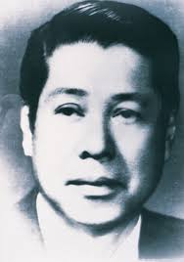
Kularb Saipradit (Sriburapa) and his Kana-Suparb-Burut
  ความเป็นลูกผู้ชายไม่ได้ขึ้นอยู่กับยศศักดิ์ แต่อยู่ที่ความมานะบากบั่นเพียรพยายามใยการสร้างตนเอง เป็นผู้มีคุณธรรม เสียสละ มีความยุติธรรม
  ต่อต้านขนบธรรมเนียมคนชั้นสูง และแสดงความรู้สึกจากมมุมของคนชั้นกลางใหม่ที่ไม่ได้มีชาติกำเนิดที่สูง แต่มีกริยามารยาท การศึกษา และคุณธรรม และรักในเสรีภาพ

Slide 14
1932 Revolution
Resistances to absolutism led to a number of attempts to overthrew absolute monarchy
  Two earlier attempts from the military
    1912 rebel consist of mostly military officers. The core of the group was junior officers.
      Resent royal monopoly of power
      Nation, Religion, King => Nation, Religion, People
      Humanist values as opposed to absolutism
    1917 rebel also from military

Slide 15
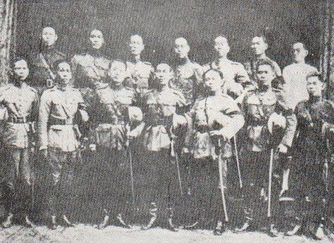
1912 Rebel

Slide 16
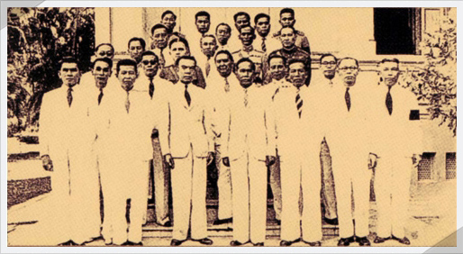
1932 Kana-Ratsadorn

Slide 17
1932 Revolution
1932 revolution had a wider network of supporters
  Although started by young bureaucrats, the movement drew in established members of bureaucrats and military officers, businessmen, intellectuals, and organised labour.

Slide 18
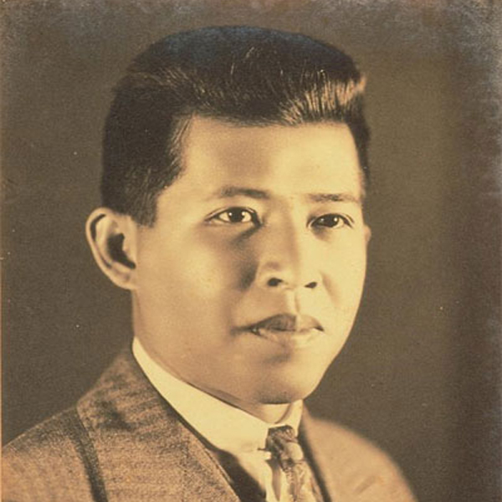
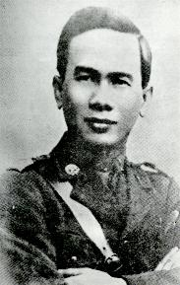
The core of 1932 movement was French-educated young civilian and military officials
  Pridi Banomyog, a young lawyer with some Chinese blood, came from a mixed of peasants and bureaucrat background
  Plaek Kitasungka (Phibulsongkram) came from farmers background, but excelled in his time at the military academy.

Slide 19
1932 Revolution
Khana Ratsadorn’s ideas combined economic nationalism with humanism. They sought to change absolutism to Constitutional Monarchy
  Absolutism seen as barrier to nationalism
  Promoted equality. Rejected privilege by birth.
Connection with “senior military officials” crucial for 1932 Revolution
  Also dissatisfied with royal's hold of power in military, and the cut on military spending and pay

Slide 20
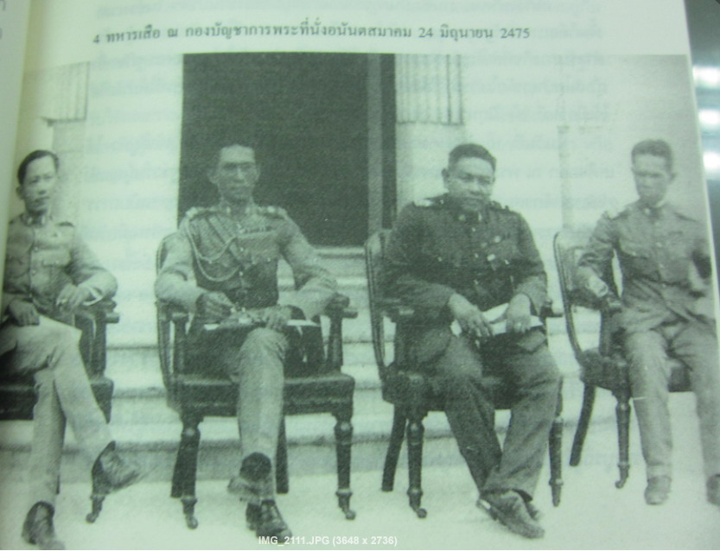
4 Taharn-Sua

Slide 21
The shifting political landscape after 1932 revolution
Following 1932, senior royal princes fled or withdrew from politics.
  Senior bureucrats and military officials from old regime removed.
  Provisional constitution limited the King's power.
  The first constitution, drafted 6 months after the revolution, barred anyone above the rank of mhom jao from membership of assembly or government.

Slide 22
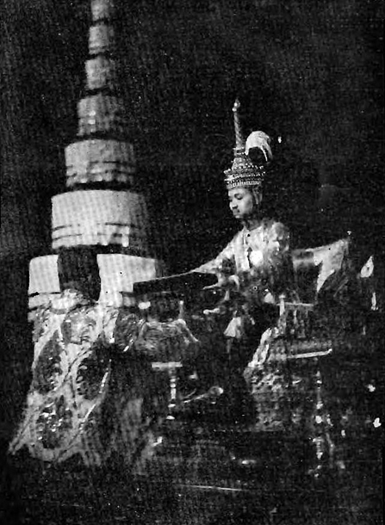
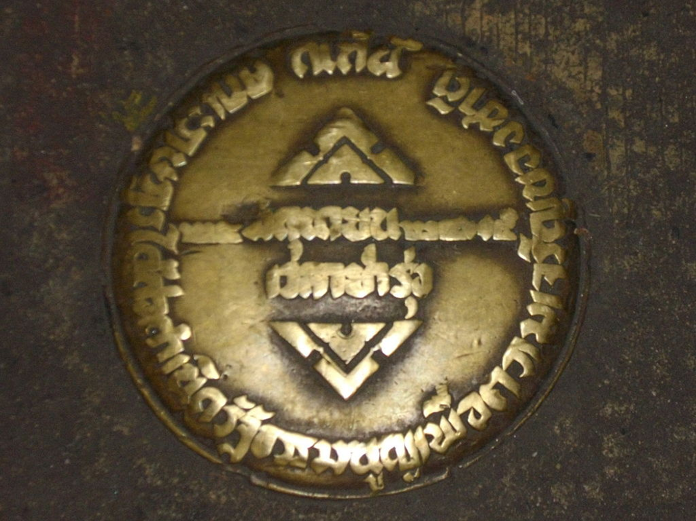
Provisional/Permanent Constitution
24 June 1932
10 December 1932

Slide 23
The shifting political landscape after 1932 revolution
The merchants and labour group sought participation in reforming the economy.
  Proposals made such as property taxes on aristrocrats, promotion of domestic industries, and government supports to rice farmers.

Slide 24
The shifting political landscape after 1932 revolution
But the old power tried to strike back
  Many bureaucrats sided with the people's party only due to their dissatisfactions with the monopoly of power by the royal family.
  But still want to maintain the bureaucrats’ power.
  And they were also not totally opposed to the monarchy as the ideological cornerstone.

Slide 25
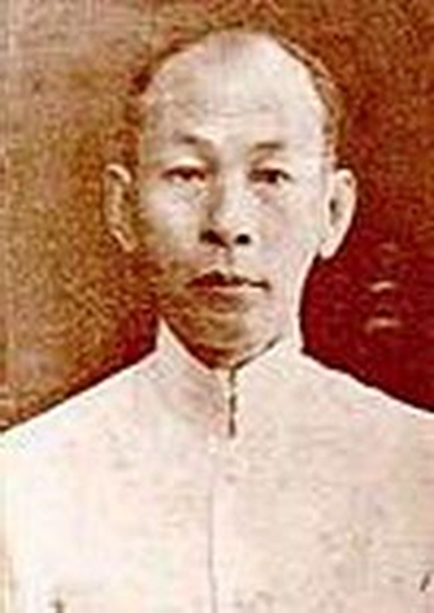
The shifting political landscape after 1932 revolution
To gain acceptance from the bureaucrats Khana Ratsadorn sought cooperation from the monarchy.
  They sought royal pardoned
  Allowed some high-ranking figures from previous administration to take leading positions
The most notable one was “Phraya Manopakorn”

Slide 26
The shifting political landscape after 1932 revolution
Khana Ratsadorn's accommodation of the King and conservative bureaucrats provided opportunities for counter revolution.
  Manopakorn and other senior bureaucrats sought alliance from senior generals
  The seniors only supported 1932 due to short-term discontent distrusted the young members of Khana Ratsadorn.
  Rama VII also backed this alliance.

Slide 27
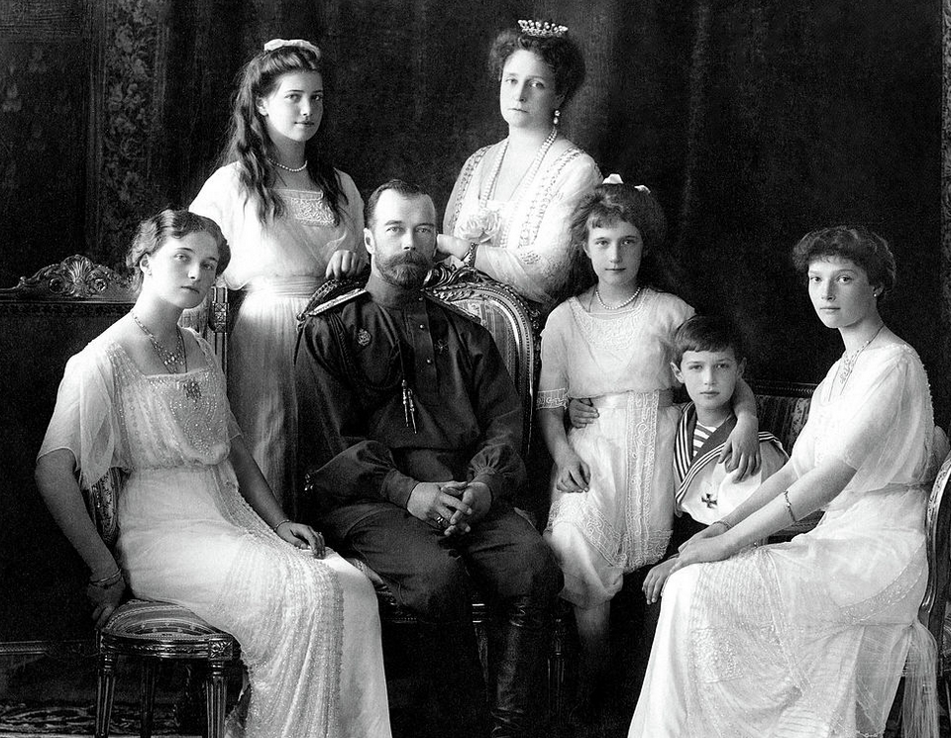
The shifting political landscape after 1932 revolution
Accusations of Khana Ratsadorn for being "communists"
  Stories of Thailand being turned to Stalin Dictatorship
  Horrors of what happened in Russia

Slide 28
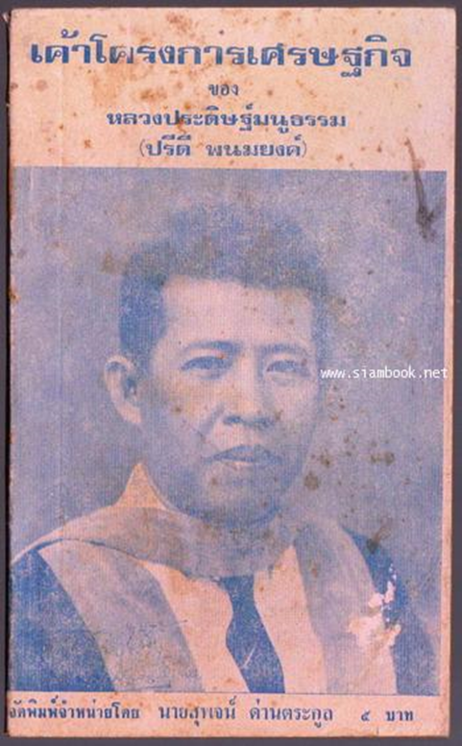
The shifting political landscape after 1932 revolution
The clash reached height with Pridi’s economic plan
  Phraya Manopakorn accused Pridi for being communist. The Assembly was closed. Pridi had to leave the country.
Mano passed law against communism
  Communism defined as attempts that affect property ownership
  Mano brought back generals from the old regime

Slide 29
The shifting political landscape after 1932 revolution
In 1933, Pahol and Phibul staged a coup to sustain the revolution. Pridi was called back.
Prince Baworadet staged a failed rebellion in 1933.
  Rama VII left Siam after Baworadet rebel. And abdicated in 1935.
The government chose Ananda Mahidol as the new King. But Thailand would be without the King residing in the country for 15 years.

Slide 30
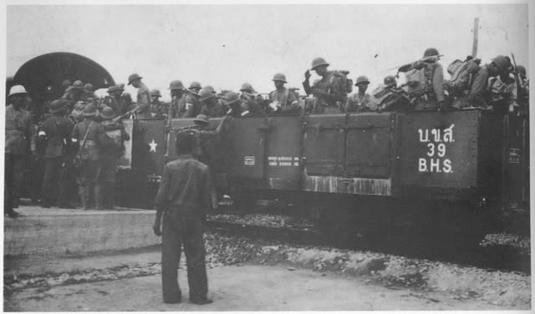
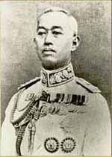
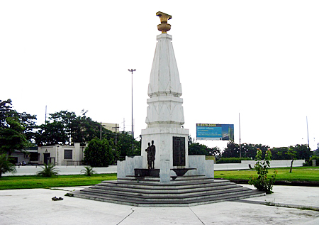
Baworadet Rebel (1933)

Slide 31
The shifting political landscape after 1932 revolution
The defeat of Baworadet rebel allowed Phibul and Pridi to attain commanding positions.
10 years after 1932, Thai politics became dominated by 2 fractions
  1) Phibul and his military fraction
  2) Pridi and his bureaucrat fraction
  They cooperated against the royalists. But actually had different ideas.
Under the political volatility of WWII, the two fractions started to openly clashed.

