Slide 1

MK 322 Retail Management
Chapter 3: Multichannel Retailing
By Ajarn Suwalya K.

Slide 2
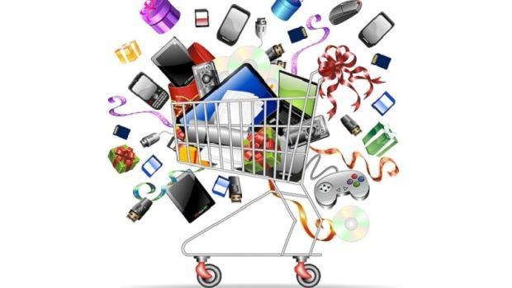
Multichannel Retailing

Slide 3
Multichannel Retailing
Retail Channel: the way a retailer sells and delivers merchandise and services to its customers.
The most common channel used by retailers is a store.
Retailers also use a variety of nonstore channels, including the Internet, mobile, catelogs and direct mail, direct selling, television home shopping, direct-response TV, and automated retailing (vending machines) to make sales to customers.
Notes:
1

Slide 4
Multichannel Retailing
Mulichannel retailing: involves using more than one channel to sell and deliver merchandise and services to customers.
Omniretailing:is frequency used when discussing multichannel retailing;it refers to a coordinated multichannel retail offering that provides a seamless customer experience when using all of the retailer's shopping channel
Notes:
1

Slide 5
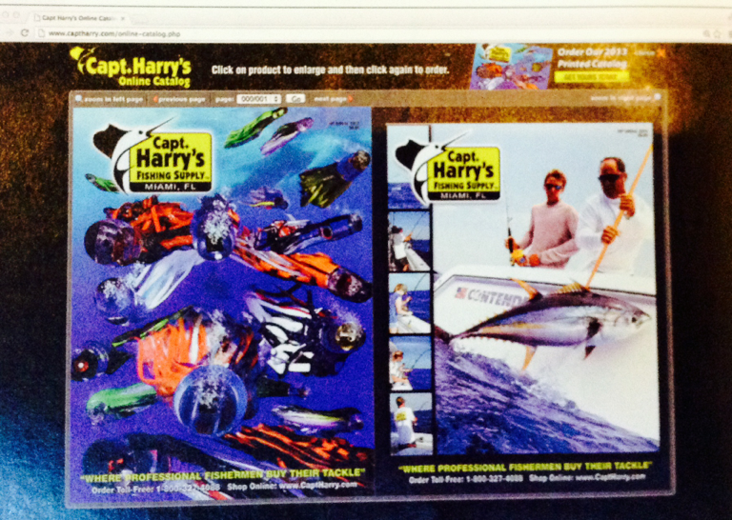
Multichannel Retailing
Even small, single-store retailers like Harry's Fishing Supply Interact with their customers through muliple channels
Notes:
1

Slide 6
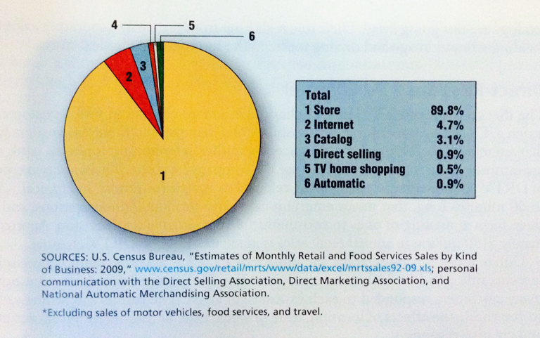
Nonstore Retail Channels
Exhibit 3-1
U.S. Retail Sales by Channel
Notes:
1

Slide 7
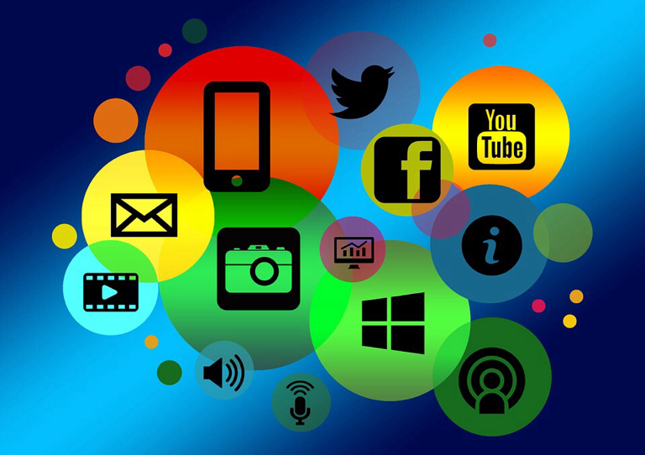
Internet Retailing Channels- Electronic and Mobile Retailing
Internet Retailing is the fastest growing channel.
Involves interacting with consumers via the Internet, whether they use a traditional computer or a laptop, a variety of sizes of tablets or a smartphone.
Notes:
1

Slide 8
Internet Retailing Channels- Electronic and Mobile Retailing
Mobile channel ( also called mobile retailing, mobile commerce, or m-commerce) involves accessing the Internet using a smartphone.
The Internet is a facilitating rather than transformational, technology with respect to most sectors of the retail industry.
75% of us consumers use internet to search for information about clothes, shoes, toys, health and beauty aids before go to store to buy
Notes:
1

Slide 9
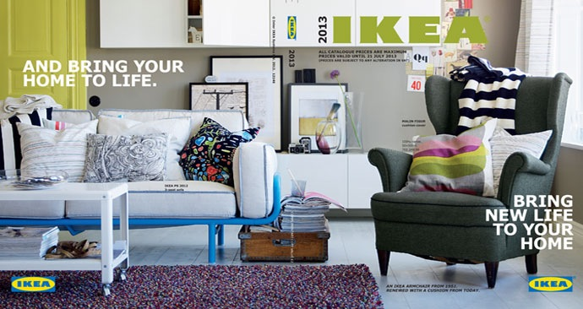
Catalog Channel
The Catalog channel: a non store retail channel in which the retail offering is communicated to customers via catelog mailed to customers
Their role is shifting from primarily generating sales to building a brand image and driving taffic to the Internet and physical stores
Notes:
1

Slide 10
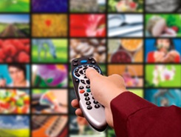
Direct-Response TV (DRTV) Channel
DRTV channel: a retail channel in which customers watch a TV advertisement that demonstrates merchandise and then place orders for that merchandise ( by phone operations or accessing internet to use company's website)
Notes:
1

Slide 11
Direct-Response TV (DRTV) Channel
2 types
1. Informercial : 30-60 mins long mixing entertainment with demonstrations
2. Short one-to-two minute adversting on TV
US. $150 million annual retail sales
Notes:
1

Slide 12
Television Home Shopping Channel
Television home shopping: a retail channel in which customers watch TV network with programs that demonstrate merchandise then place an order
US annual sales is $20 billion
Also embraces social media, as today consumers is interacting with TV home shopping channels on multiple screens.
Notes:
1

Slide 13
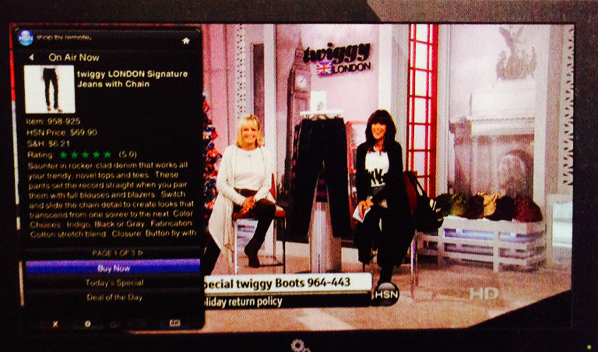
Television Home Shopping Channel
HSN's sales have more than doubled after it started selling more well-known brands.
Notes:
1

Slide 14
Automated Retailing(Vending Machines) Channel
Automated retailing: retail channel in which merchandise or services are stored in a machine and dispensed to customers when they deposit cash or credit card
Automated retailing machines or known as vending machines are typically places at convenient, high-traffic locations.
Notes:
1

Slide 15
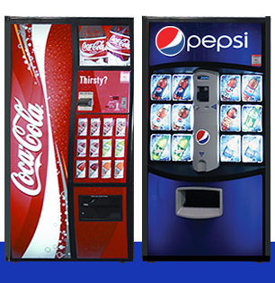
Automated Retailing(Vending Machines) Channel
Notes:
1

Slide 16
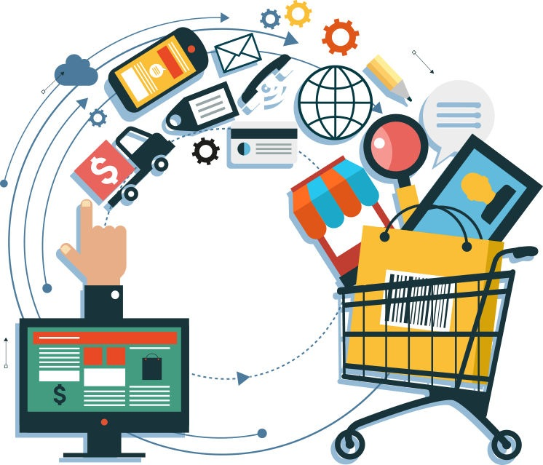
Relative Benefits of Retail Channels

Slide 17
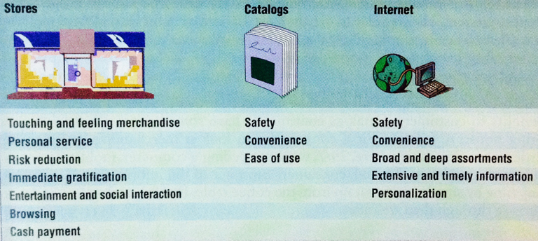
Benefits of Store Channels
Exhibit 3-2
Benefits Provided by Different Channels
Notes:
1

Slide 18
Benefits of Catalog Channels
Consumers can look at merchandise and place order anywhere 24/7
Consumer can refer to information in catelog any time by simply picking up from coffe table
Catalogs are easier to browse than websites
IKEA's 2013 catelog good example
Dramatically improved the content and user experience by including augmented reality
Notes:
1

Slide 19
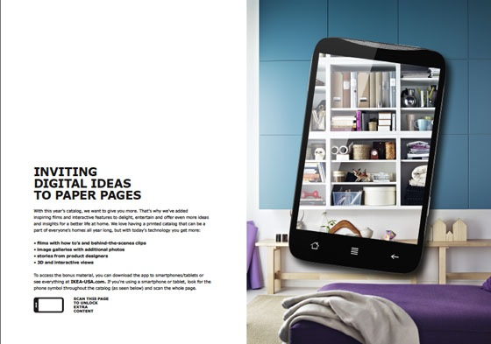
Benefits of Catalog Channels
Notes:
1

Slide 20
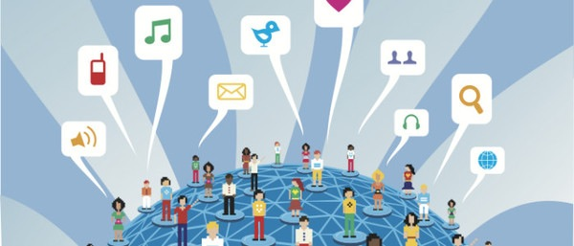
Benefits of the Internet Channel
Notes:
1

Slide 21
Benefits of the Internet Channel
The addition of the Internet channels has potential to offer a greater selection of products.
They allow retailers to provide more information.
They enable retailers to provide customers with more personalized information about products and services.
Notes:
1

Slide 22
Benefits of the Internet Channel
They offer sellers the unique opportunity to collect information about consumer shopping.
Internet channels provide an opportunity for retailers to enter new markets economically.
They provide information that they can use to improve the shopping experience across channels.
However increase consumer's risks in security
Notes:
1

Slide 23
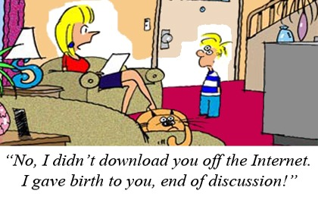
Benefits of the Internet Channel
Notes:
1

Slide 24
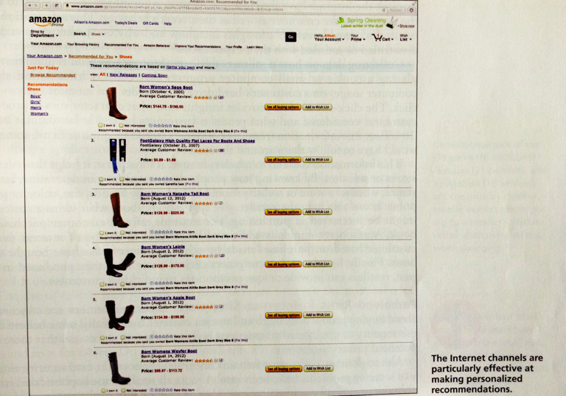
Benefits of the Internet Channel
Notes:
1

Slide 25
Benefits
Comparison of Electronic and Mobile Phone Internet Channels
Convenience- carry device
Customer-retailer interactions can be location sensitive
Disadvantage- smaller screen, slower download speeds
Notes:
1

Slide 26
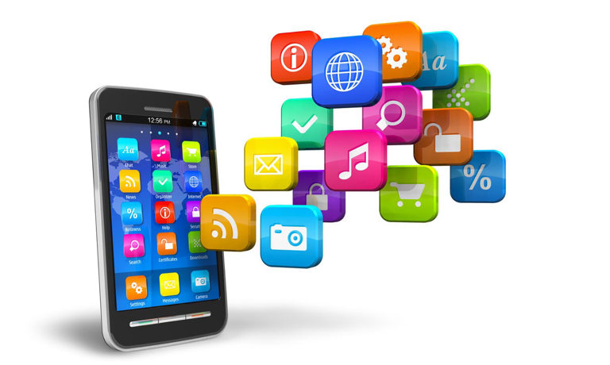
Benefits
Comparison of Electronic and Mobile Phone Internet Channels
Apps:software applications designed to improve customer shopping experience when using smart phones and tablets
Notes:
1

Slide 27
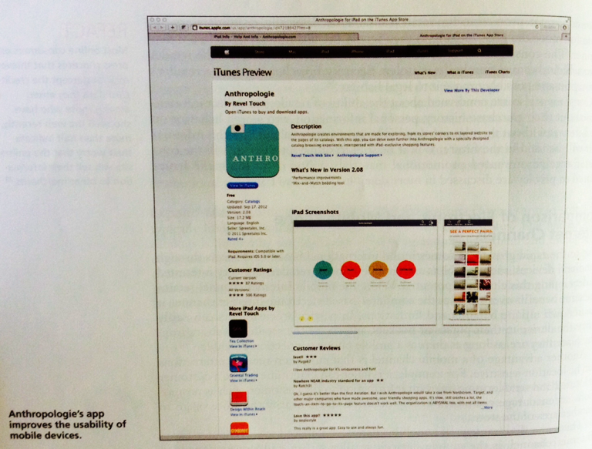
Benefits
Comparison of Electronic and Mobile Phone Internet Channels
Notes:
1

Slide 28


