Slide 1
The development of welfare system in Thailand
EE460
From Research work by
Dr Thorn Pitidol
November 2016

Slide 2
Topics
Explaining the development of welfare system
The development of welfare system in Thailand
Questions on the future

Slide 3
Questions
What is a “good life”?
  How can a good life be achieved?
  Should a good life be available to everyone in our society?

Slide 4
Well-being
Good health
Good education
Social security
Individual liberty
Aesthetics

Slide 5
The Welfare System
Bodies of activities designed to enable individuals, families, groups, and communities to deal with changing conditions, particularly social risks.
  Building capability, and pursuing redistribution.
The state seen as a major player, particularly in the Western context
  State intervene in market to provide minimum income, reducing insecurity in life, and offering social services to all.

Slide 6
Explaining the development of welfare states
The need of modernized and industrialized economy
  Industrialized economy needs state to provide the safety nets previously provided by families and communities (Kerr et al. 1960)
  Welfare system promoted capital accumulation and enhance legitimacy of the ruling classes (O’Connor 1973)
  Welfare states emerge from numerous aspects of modernity (Flora and Aber 1981)
Class struggles or class coalition
  Welfare system emerged as labor movements and leftist political parties gained power-resources (Korpi, 1989)
  Or emerged from coalition between the working class and middle class/employers.

Slide 7
Explaining the development of welfare states
The characteristics of the state (and related political institutions)
  State-centered approach (Skocpol 1985) put the focus on the nature of the state in itself.
  Political institutions, however, can shape the nature of the state
The development of “rights” consciousness.
  Marshall (1950) foresees rights consciousness as progressing from civil rights, to political rights, and to social rights.

Slide 8
Explaining the development of welfare states
The context of developing countries
  Additional factors
    Colonial legacy, international organizations
    Communities and families play more prominent roles
    Weak states and unstable democracy
    Large informal sector
  Haggard and Kaufman (2009)
    Nature of welfare system in developing countries depending on the legacies of leftist parties and the nature of recent democratization

Slide 9
The development of welfare system in Thailand
And how can we explain it?

Slide 10

The “Tragedy of San-Sab”
What was behind the tragedy?

Slide 11
The development of welfare system in Thailand
3 periods
  Pre-developmental state (1900-1950)
  Authoritarian developmental state (1950-1990)
  Democratization (1990-2000)
Major aspects of welfare policies to consider
  Social security and pension
  Health
  Education

Slide 12
  Pre-developmental state (1900-1950)

Slide 13
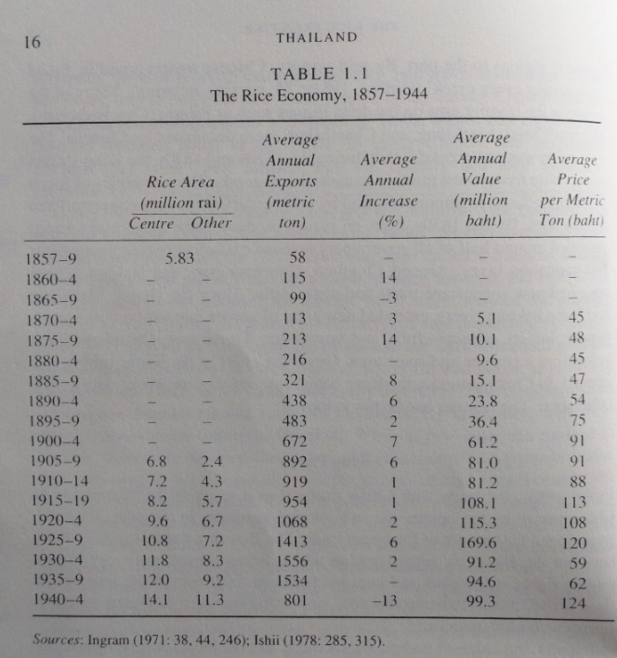
  Welfare system in Thailand:
  Pre-developmental state (1900-1950)
The boom in rice trade provided the basis for Thailand’s modern economy
The life of “rural villagers” became the issue of government’s interests for the first time during Rama V’s modernization of Siam.

Slide 14
  Development of welfare system in Thailand: Pre-developmental state (1900-1950)
The emergence of “small peasants” in Siam
  The emergence of rice as a major commodity
  Small peasants dominated the rice economy due to
    Limited emergence of the “landlord” class
    Limited capital accumulation of merchants
    Limited support from the government on technology and irrigation
    Large supply of land
  For a long-time, society of small and poor peasants dominated the Thai rice-based economy

Slide 15
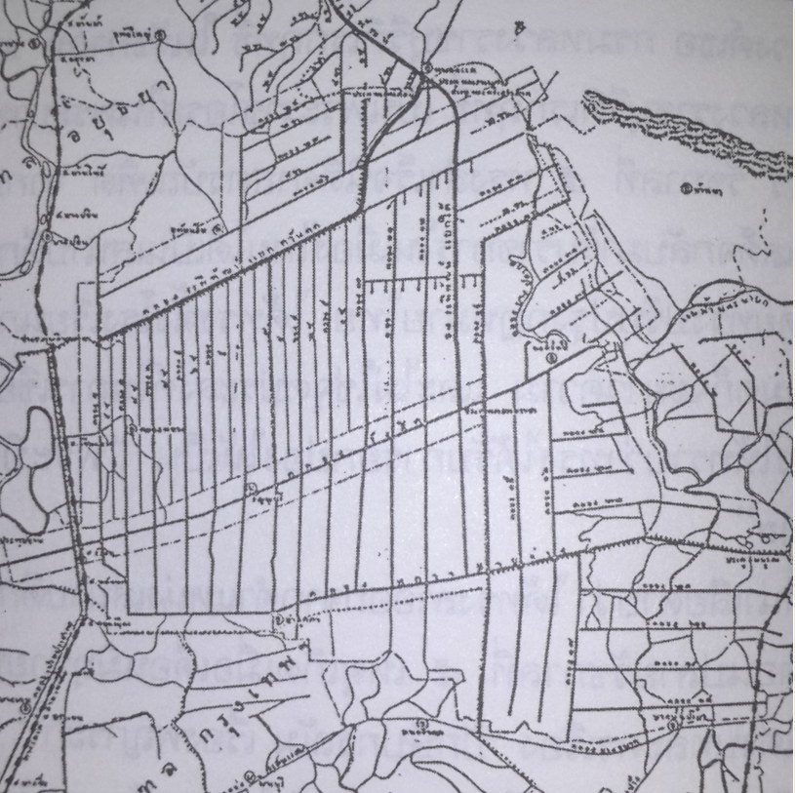
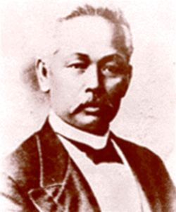
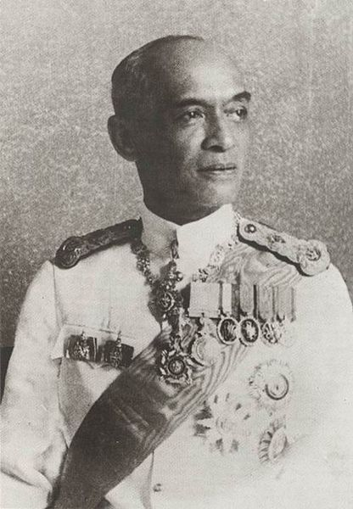
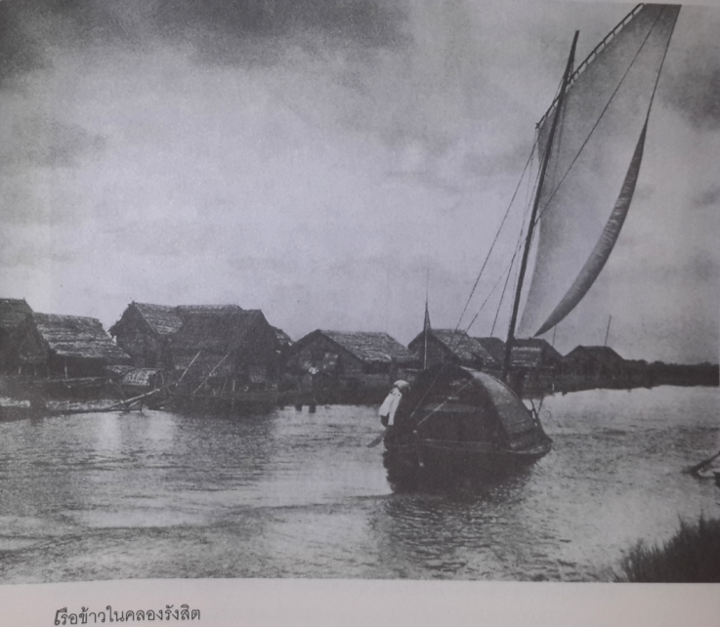
The Rangsit Canal
  A project by Royal Company

Slide 16

Welfare system in Thailand:
Pre-developmental state (1900-1950)
Prince Dilok Nopparat’s PhD Thesis “Agriculture in Thailand: The Analysis of the Economic History of Thailand”
  A very first survey of rural poverty in Thailand.
  Proposing the government to provide access to land and credit

Slide 17
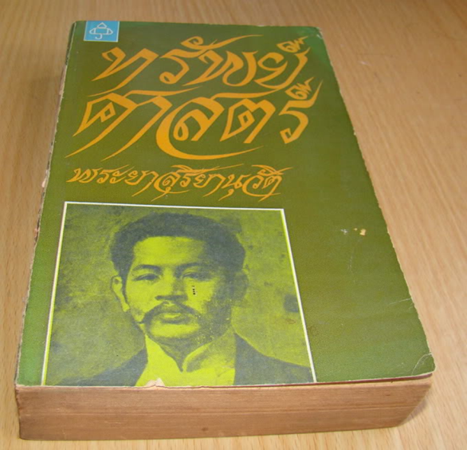
Welfare system in Thailand:
Pre-developmental state (1900-1950)
Praya Suriyanuwatra “Sapa-Sart”
  Poverty among farmers came as a result of the lack of access to capitals
  Proposed the redistribution of capitals as the solution
  Rama VI responded with the statement “self-sufficiency is the best”

Slide 18
Development of welfare system in Thailand: Pre-developmental state (1900-1950)
Facing the changes
  Economic recession during 1920s-1930s led to a dramatic rise of dramatic rise in farmers’ Petitions to Crown
  The Royal (mis)management of recession also led to frustrations among (1) the middle rank bureaucrats; (2) urban-based Chinese merchants; and (3) the military
  The People’s Party 1932 revolution led to new economic plan with the focus on using the state-led politics to improve the life of Thai peasants

Slide 19
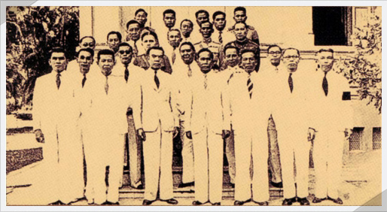
The People’s Party

Slide 20

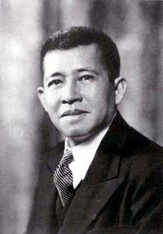
Welfare system in Thailand:
Pre-developmental state (1900-1950)
1932 Revolution and Pridi’s Economic Plan
  Proposal for “minimum income for all Thais”
  But plan for all Thais (especially peasants) to be employed by the state/cooperatives.
  Plan failed through resistance from conservative forces.

Slide 21
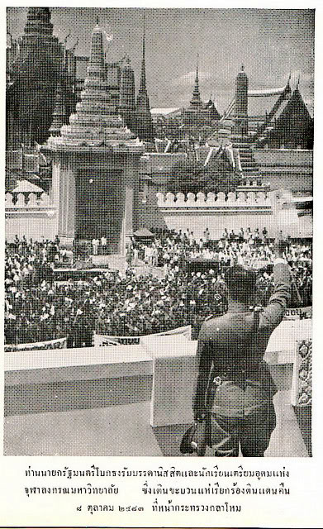
Welfare system in Thailand:
Pre-developmental state (1900-1950)
Phibun’s nationalist economic and education policies
  State-own enterprises in distributing rice and consumer products
  The Chinese were identified as “outsiders”.
    Welfare system in the context of the urban economy was objected on the ground of leaking benefits to the Chinese.

Slide 22
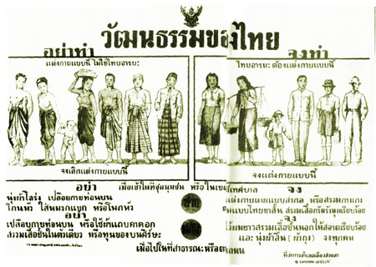
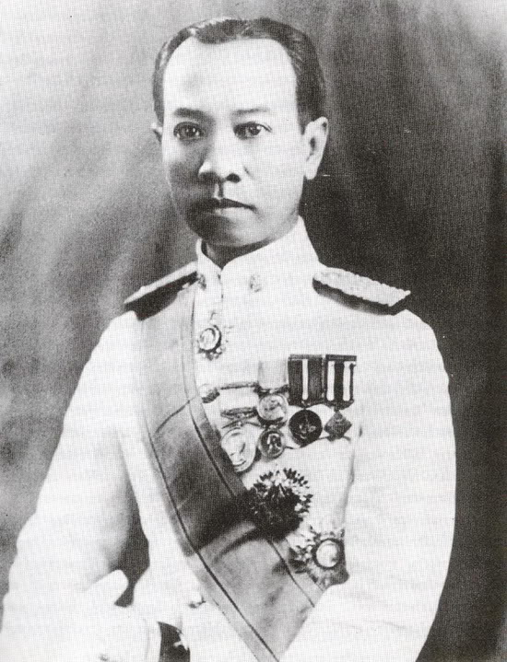
Welfare system in Thailand:
Pre-developmental state (1900-1950)
Policies on education also became the focus.
Broad investment in “primary education” to build the sense of Thainess.
Luang Wichitwathakan

Slide 23
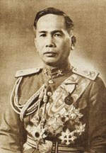
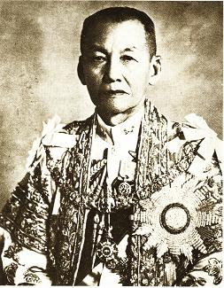
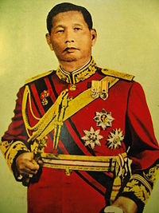
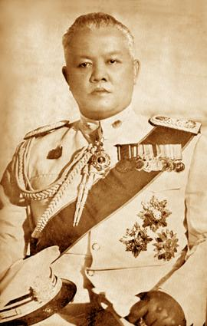
Welfare system in Thailand:
Pre-developmental state (1900-1950)
Phibun’s final years in power led to an effort to develop a social security system
  Seeking to re-established his power, Phibun turned to the labour and the left movements (Pridi’s power bases).
  But his attempt was short-lived.

Slide 24
Welfare system in Thailand:
Pre-developmental state (1900-1950)
Overall conditions of the pre-developmental state period
  Attempts to develop welfare system never materialised due to;
    Resistance from old established elites
    Political instability
    Overshadowed by nationalism

Slide 25
  Authoritarian developmental state (1950-1990)

Slide 26
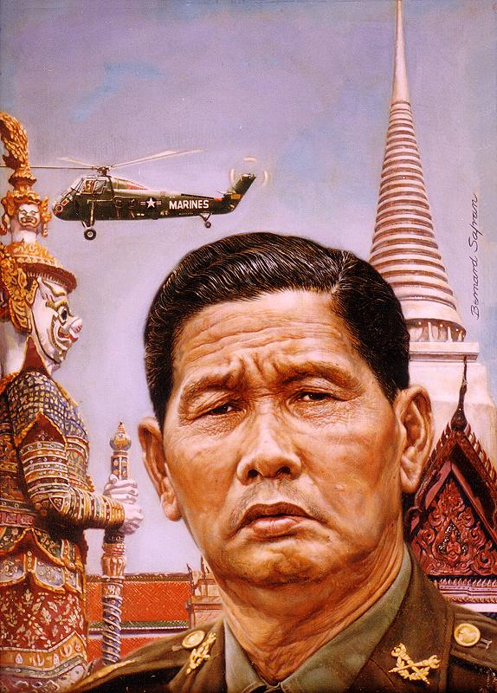
Welfare system in Thailand:
Authoritarian developmental state (1950-1990)
Sarit’s developmental regime
  The US intervention in politics
  The suppression of the left and labour
  The return of the monarchy

Slide 27
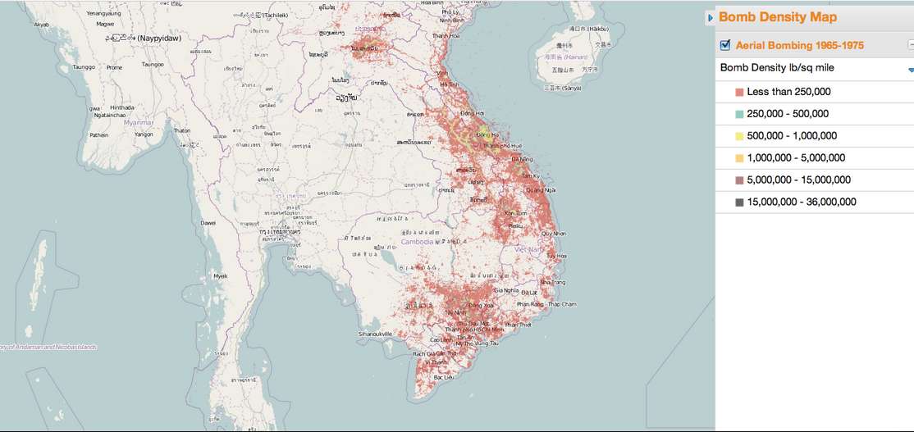
US Bombing of Indochina
Source: http://mangomap.com/maps/user/bomb%20density%20map

Slide 28

Welfare system in Thailand:
Authoritarian developmental state (1950-1990)
Sarit’s developmental regime and the priortising of economic growth
  Sarit’s legitimacy was based on his promise for “development”
  Domestic capitals were promoted, but the role of the state in the economy was restricted.
  New coalitions between the military and the domestic capitals
    The “rent-allocating” regime

Slide 29
Welfare system in Thailand:
Authoritarian developmental state (1950-1990)
“The minimalist welfare” in Sarit’s regime
  Domestic import-sub. industries and large agri-business were selected as the engine of growth
  But it was the labor and the rural farmers who paid the price, ad wages and prices of food were kept low.
  Agricultural factors of production, and domestic consumer products were protected to have higher price.

Slide 30
Welfare system in Thailand:
Authoritarian developmental state (1950-1990)
The era of limited welfare expansion
  Social security bill was kept in the military appointed assembly for decades.
  Limited public health services in the rural area
    The monarchy and the US supported rural health stations and also rural doctors programe
    More public health spending on curative health care in the urban area
  Education spending mainly on the primary and the university levels. Lack of spending and enrollment on the secondary level.

Slide 31
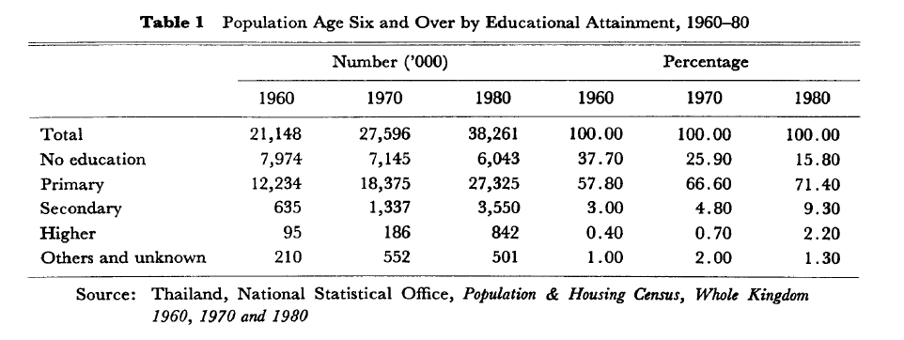

Slide 32
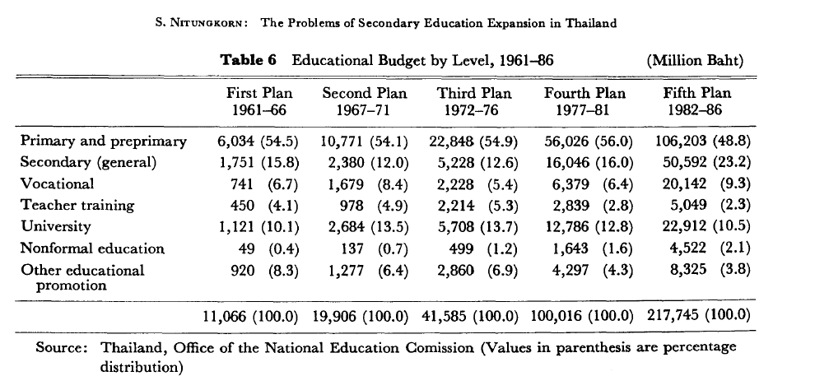

Slide 33
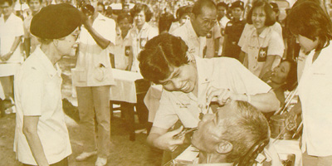

Slide 34
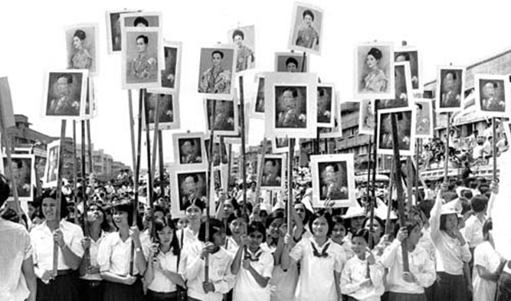
Welfare system in Thailand:
Authoritarian developmental state (1950-1990)
1973 uprising against Thanom Kittikachorn
  The end of Sarit’s authoritarian developmental state (and the movements appeared)

Slide 35
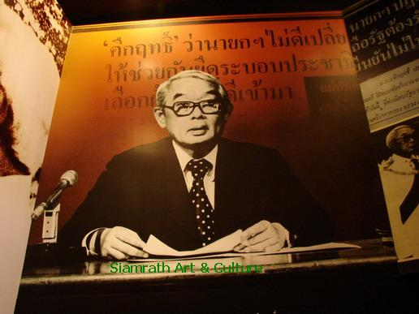
Welfare system in Thailand:
Authoritarian developmental state (1950-1990)
1973-1976: Brief period of democratization
  Number of policies made to deal specifically with the problems of rural farmers
    Most famously, “Ngen-Pun (เงินผัน)”
    This eventually raised the importance of answering the need of rural areas.
  Other welfare developments included health cards policy, and the constructions of secondary schools.

Slide 36
  Democratization (1990-2000)

Slide 37
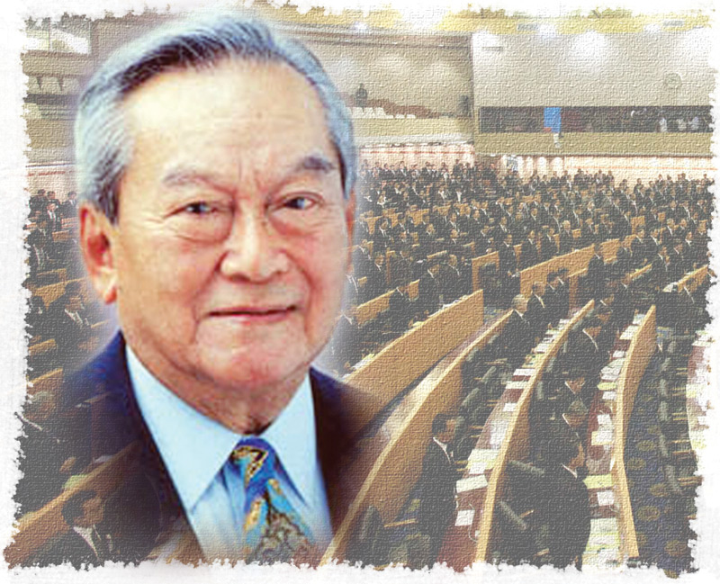
Welfare system in Thailand:
Democratization (1990-2000)
Chatchai and the post 1992 context
  Social security act finally passed, in the context of parliament with local politicians and businessmen
  Health cards became active policy in helping the poor and the disadvantages

Slide 38
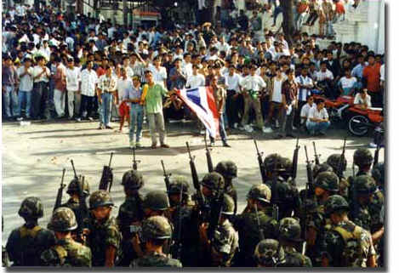
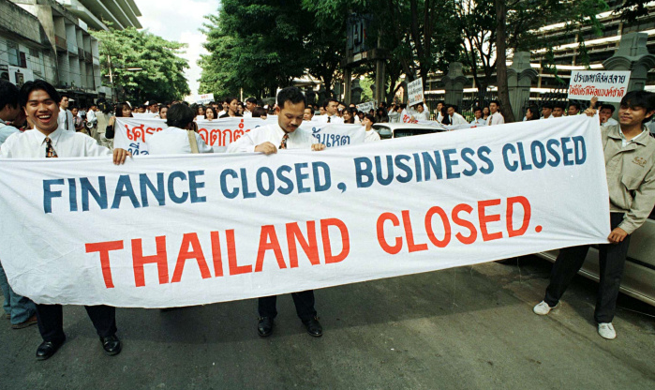
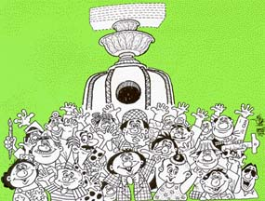
Welfare system in Thailand:
Democratisation (1990-2000)
The movement for political reform and the 1997 economic crisis altered the political landscape

Slide 39
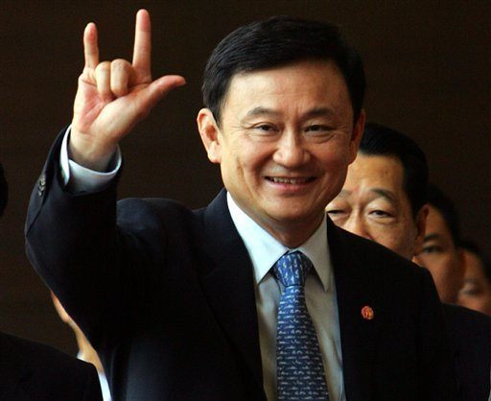
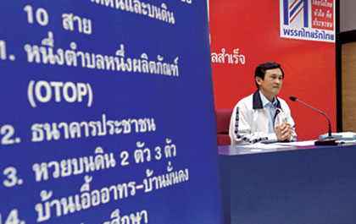
Welfare system in Thailand:
Democratisation (1990-2000)
Thaksin’s era and the expansion of welfare (or populism?)
  Policies targeting the rural poor became crucial to his political popularity.
  But also expansion in health and education
    30 baht program as the universal coverage scheme
    12 years free education.

Slide 40
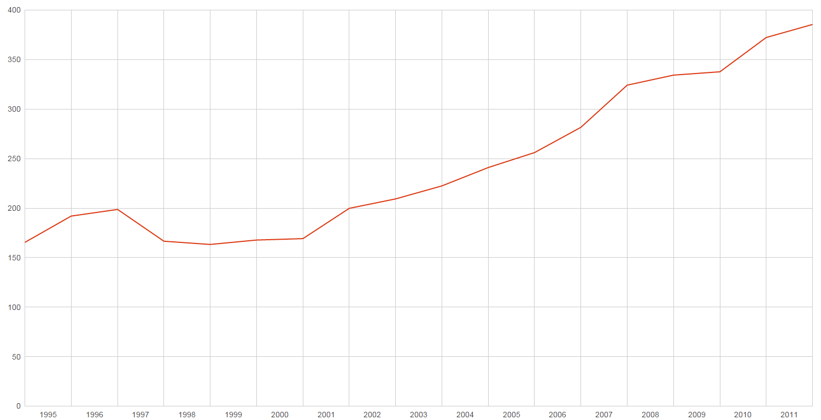
Thailand’s health expenditure per capita, PPP constant 2005 international $

Slide 41
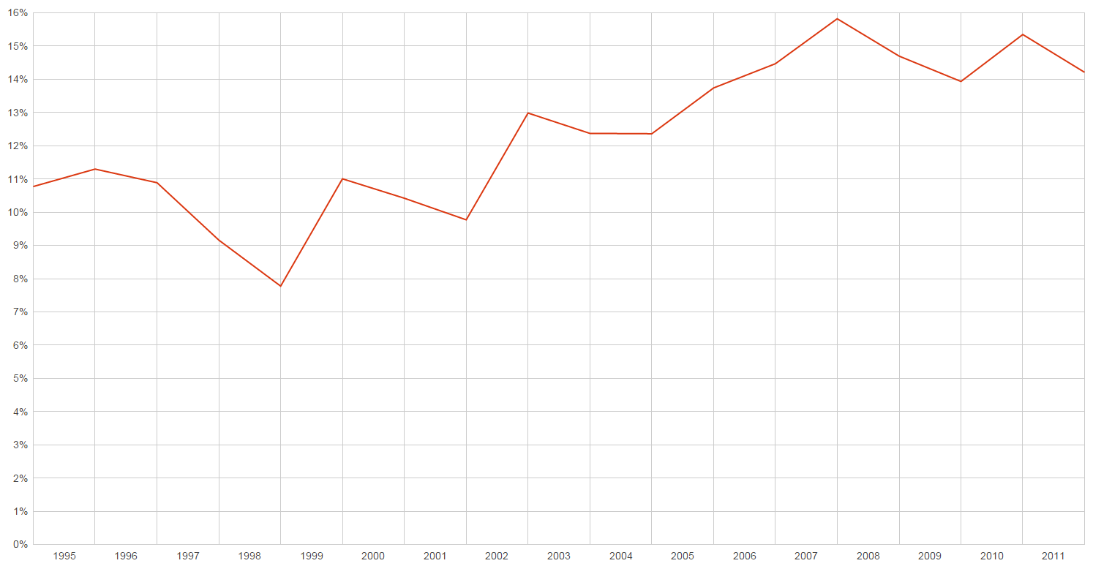
Thailand’s public health expenditure, % of government expenditure

Slide 42
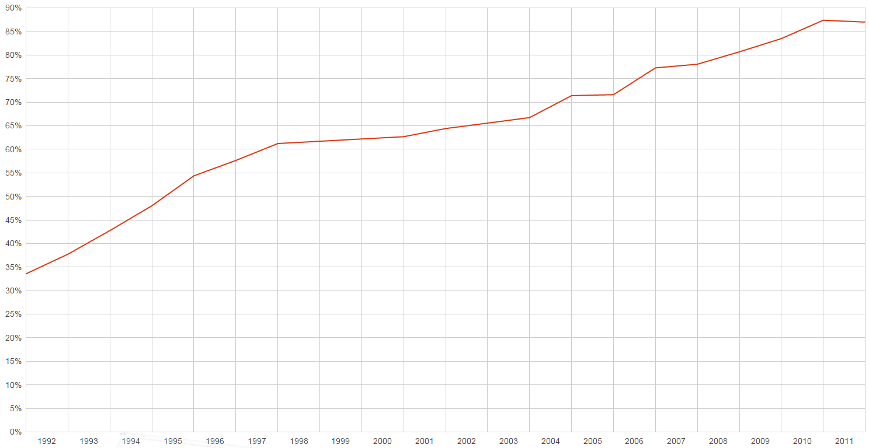
Thailand’s secondary school enrolment

Slide 43
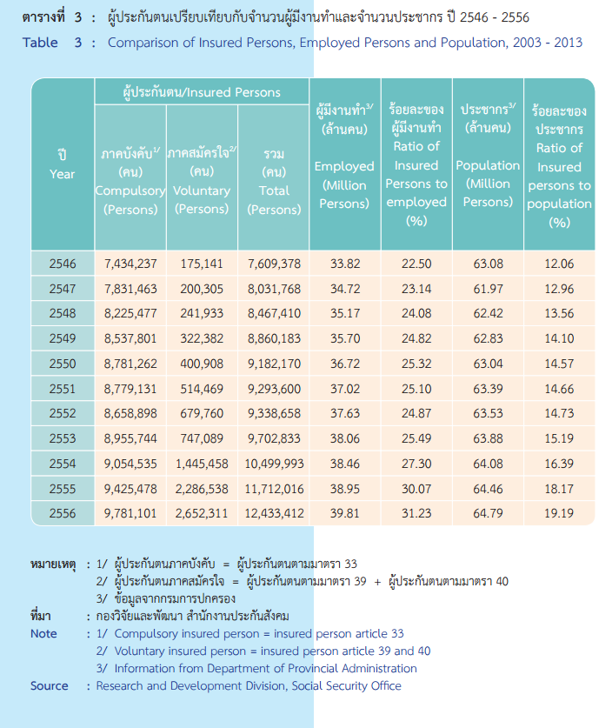

Slide 44
Welfare system in Thailand:
Democratisation (1990-2000)
Re-evaluating the expansion of welfare during the democratisation period
  The prior lack of welfare expansion meant there were lots of unanswered needs.
  The country, particularly when Thaksin came in to power, had strong fiscal capacity to pursue welfare policies.
  The rural farmers already became an important and symbolical political force.
    The nature of politics also influenced the clientelistic nature of pro-poor policies.

Slide 45
The welfare system in Thailand
Summing important features
  Development contributed by democratisation
  Rural farmers as a crucial welfare stakeholder, while the labour have had limited presence.
  At the present state, a number of overlapping services serving different groups.
    Welfare for the civil servant, social security for the private sector, and the pro-poor programme aiming at the rural poor
    Apart from the universal health care, others programme are still oriented toward “productivism”

Slide 46
Questions remain
Welfare with/without populism?
Turning away from targeting the poor to universalism?
Implications of our current political crisis?

