Slide 1
Perfect Competition
EE311
Chayun Tantivasadakarn
Faculty of Economics, Thammasat University

Slide 2
Perfectly Competitive Markets
The model of perfect competition can be used to study a variety of markets (Agricultural products, stock market, exchange rate)
Basic assumptions of Perfectly Competitive Markets
  Many small firms -->Price taking
  Product homogeneity
  Free entry and exit
  Perfect information
Notes:
4

Slide 3

Perfectly Competitive Markets
Price Taking
  The individual firm sells a very small share of the total market output and, therefore, cannot influence market price.
  Each firm takes market price as given – price taker
  The facing demand curve of each firm is horizontal.
Notes:
4

Slide 4
Facing demand curve for a competitive firm
P
A firm
P
Market
S
d
4
4
D
100
200
ผลผลิต
100
ผลผลิต (ล้านหน่วย)

Slide 5

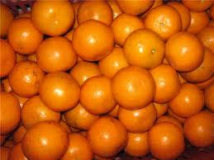
Perfectly Competitive Markets
Product Homogeneity
  The products of all firms are perfect substitutes.
  Product quality is relatively similar as well as other product characteristics
  Example: Agricultural products, copper ore, lumber
  Heterogeneous products, such as brand names, can charge higher prices because they are perceived as better
Notes:
4

Slide 6

Perfectly Competitive Markets
Free Entry and Exit
When there are no special costs that make it difficult for a firm to enter (or exit) an industry (no laws or regulations, free factor mobility)
  Buyers can easily switch from one supplier to another.
  Suppliers can easily enter or exit a market.
    Pharmaceutical companies not perfectly competitive because of the large costs of R&D required
Notes:
4

Slide 7
Perfectly Competitive Markets
Perfect Information
  No information cost for buyers and sellers
  Perfect information and homogenous products imply one market price.
  Perfect information and free entry and exit imply zero profit in the long run.
    Excess profits attract new entry which increases market supply. Price is then decreased until profit is zero.
    Losses force firms to exit which decreases market supply. Price is then increased until profit is zero.
Notes:
4

Slide 8
Profit Maximization
We can study profit maximizing output for any firm whether perfectly competitive or not
  Profit (π) = Total Revenue - Total Cost
  If q is output of the firm, then total revenue is price of the good times quantity
  Total Revenue (TR) = TR(q)
Notes:
8

Slide 9
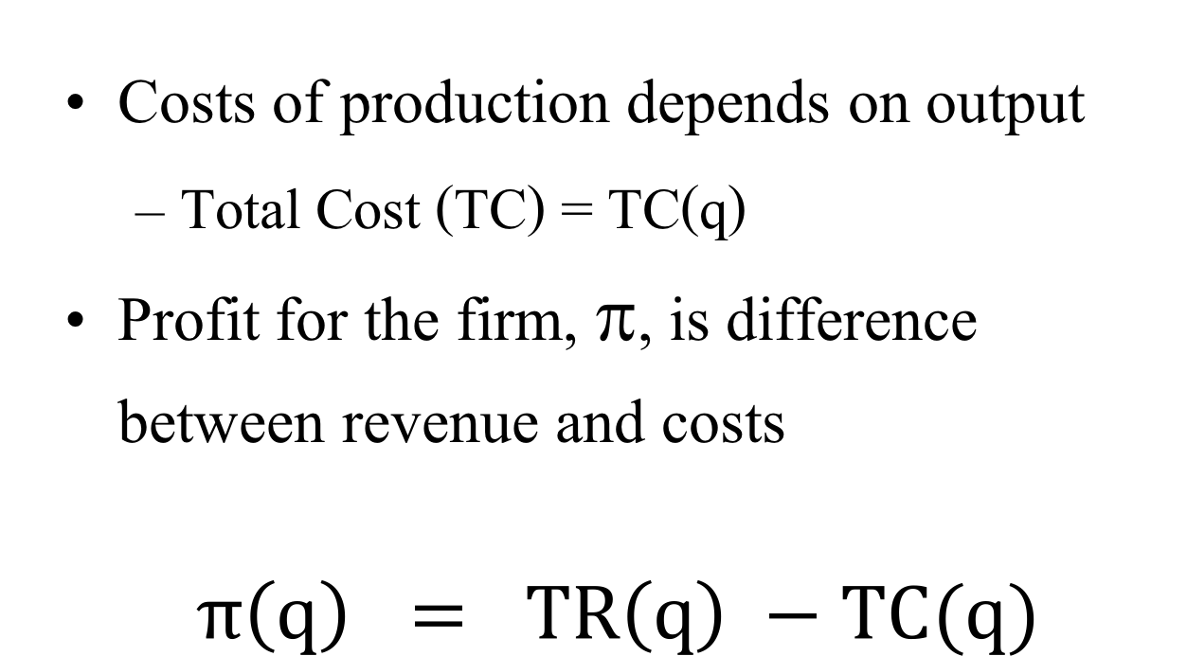
Profit Maximization
Costs of production depends on output
  Total Cost (TC) = TC(q)
Profit for the firm, π, is difference between revenue and costs
$$π\left(q\right) = TR\left(q\right) −TC(q)$$
Firm selects output to maximize the difference between revenue and cost

Slide 10
Profit Maximization – Short Run
Profits are maximized where MR (slope at A) and MC (slope at B) are equal or slope of π(q) = 0
Cost,
Revenue,
Profit
($s per year)
TR
Profits are maximized where R(q) – C(q) is maximized
TC
A
B
0
Output
q₀
q₁
q*
π(q)

Slide 11
Profit Maximization
If the producer tries to raise price, sales are zero.
Profit is negative to begin with since revenue is not large enough to cover fixed and variable costs
As output rises, revenue rises faster than costs increasing profit
Profit increases until it is maxed at q*
Profit is maximized where MR = MC or where slopes of the TR(q) and TC(q) curves are equal

Slide 12
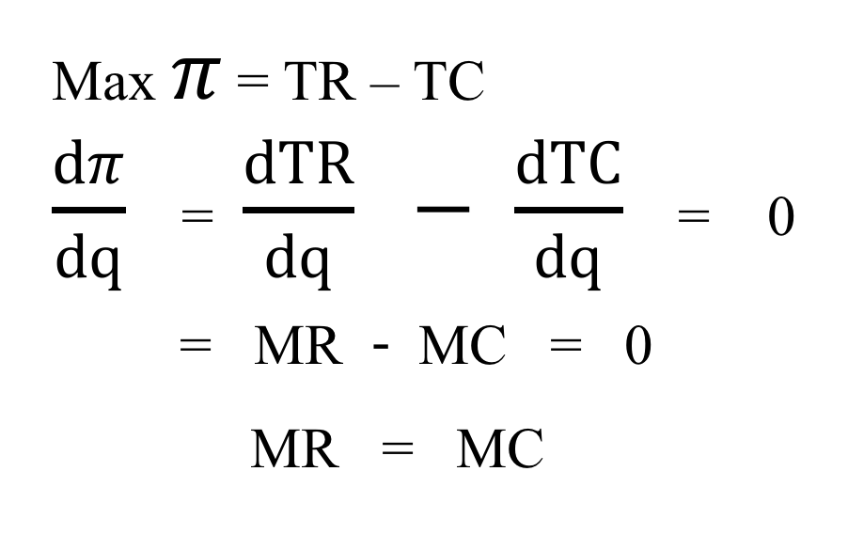
Profit Maximization
Profit is maximized at the point at which an additional increment to output leaves profit unchanged
Max $π$ = TR – TC
$\frac{dπ}{dq}$ = $\frac{dTR}{dq} − \frac{dTC}{dq}$ = 0
= MR - MC = 0
MR = MC

Slide 13
Profit Maximization: MR = MC
MC
MC > MR, TC rises faster than TR, should decrease q to q*
Price
MR > MC, TR rises faster than TC, should increase q to q*
50
A
AR=MR=P
40
30
q₁ : MR > MC
q₂: MC > MR
q*: MC = MR
20
10
0
1
2
3
4
5
6
7
8
9
10
11
Output
q₁
q*
q₂

Slide 14
Choosing Output: Short Run
The point where MR = MC, the profit maximizing output is chosen
  MR=MC at quantity, q*, of 8
  At a quantity less than 8, MR > MC so more profit can be gained by increasing output
  At a quantity greater than 8, MC > MR, increasing output will decrease profits

Slide 15
Choosing output: Positive Profits
Total Profit
= ABCD
MC
Price
50
D
A
AR=MR=P
40
ATC
30
C
B
AVC
Profits are determined by profit per unit times quantity
Profit per unit = P - AC(q) = A to B
20
10
Output
0
1
2
3
4
5
6
7
8
9
10
11
q*

Slide 16
Choosing output: Losses
A firm does not always make profits
It is possible for a firm to incur losses if the P < AC at the profit maximizing quantity
  Still measured by profit per unit times quantity
  Profit per unit is negative (P – AC < 0)

Slide 17
Choosing output: Losses
MC
ATC
Price
B
C
D
P = MR
A
At q*: MR = MC and P < ATC
Losses = (P- AC) x q* or area ABCD
AVC
q*
Output

Slide 18
Choosing output: Losses
Why would firm produce at a loss?
  Might think price will increase in near future
  Shutting down and starting up could be costly
  The loss may be smaller than when shut down
Firm has two choices in short run
  Continue producing
  Shut down temporarily
  Will compare profitability of both choices

Slide 19
$
TC
TR
$500
TVC
$400
Minimize Loss
$300
$200
Loss if shut down
$100
Quantity of Output
Q
0
1
2
3
4
5
6

Slide 20
Choosing output: Losses but should operate
Price
MC
ATC
Losses
B
C
D
P = MR
A
P < ATC but > AVC so firm will continue to produce in short run
AVC
F
E
q*
Output

Slide 21
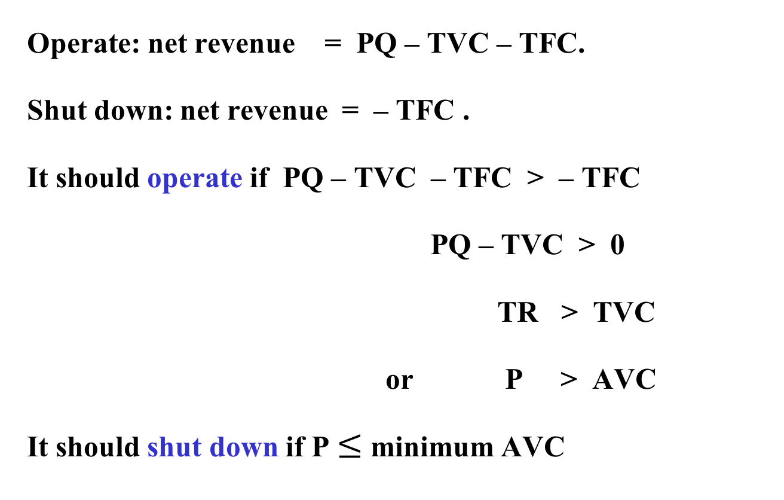
When should the firm shut down?
Operate: net revenue = PQ – TVC – TFC.
Shut down: net revenue = – TFC .
It should operate if PQ – TVC – TFC > – TFC
PQ – TVC > 0
TR > TVC
or P > AVC
It should shut down if P $≤$ minimum AVC

Slide 22
When should the firm shut down?
When should the firm shut down?
  If AVC < P < ATC the firm should continue producing in the short run
    Can cover all of its variable costs and some of its fixed costs
  If P < AVC < ATC the firm should shut-down.
    Can not cover even its variable costs

Slide 23

Choosing output: Losses and should shut down
Price
Losses if shut down
P < AVC < ATC
Should shut down temporary
MC
ATC
B
C
AVC
Losses if operates
D
P = MR
A
q*
Output
Notes:
39

Slide 24
Competitive Firm – Short Run Supply
Supply curve tells how much output will be produced at different prices
Competitive firms determine quantity to produce where P = MC
  Firm shuts down when P < AVC
Competitive firms supply curve is portion of the marginal cost curve above the AVC curve

Slide 25
A Competitive Firm’s Short-Run Supply Curve
Price
($ per
unit)
The firm chooses the
output level where P = MR = MC,
as long as P > AVC.
Supply is MC above AVC
MC
S
ATC
P₂
AVC
P₁
P = AVC
q₁
q₂
Output

Slide 26
Choosing Output in the Long Run
In short run, one or more inputs are fixed
  Depending on the time, it may limit the flexibility of the firm
In the long run, a firm can alter all its inputs, including the size of the plant.
We assume free entry and free exit.
  No legal restrictions or extra costs

Slide 27
Choosing Output in the Long Run
In the short run a firm faces a horizontal demand curve
  Take market price as given
The short-run average cost curve (SAC) and short run marginal cost curve (SMC) are low enough for firm to make positive profits (ABCD)
The long run average cost curve (LRAC)
  Economies of scale to q₂
  Diseconomies of scale after q₂

Slide 28
Output Choice in the Long Run
Price
LMC
LAC
SMC
SAC
D
A
$40
P = MR
C
B
$30
In the short run, the
firm is faced with fixed
inputs. P = $40 > ATC.
Profit is equal to ABCD.
q₁
Output

Slide 29
Output Choice in the Long Run
In the long run, the plant size will be
increased and output increased to q₃.
Long-run profit, EFGD > short run
profit ABCD.
Price
LMC
LAC
SMC
SAC
D
A
E
$40
P = MR
C
B
G
F
$30
q₁
q₂
q₃
Output

Slide 30
Long-run Competitive Equilibrium
For long run equilibrium, firms must have no desire to enter or leave the industry
Zero-Profit
  A firm is earning a normal return on its own resources
  Doing as well as it could by using its resources elsewhere
  Normal profit is firm’s opportunity cost of using its own resources instead of using them elsewhere

Slide 31
Long run Equilibrium: New Entry
P = ATC
No new entry
normal π
Economic Profits
New entry
Yes
No
If P > ATC
Total supply increases
Price falls

Slide 32
Long run Equilibrium: Exit
P = ATC
No firm exit
normal π
Loss making
Firms exit
Yes
No
If P < ATC
Total supply decreases
Price Increases

Slide 33
Long-Run Competitive Equilibrium – Profits
Profit attracts firms
Supply increases until profit = 0
$ per
unit of
output
Firm
$ per
unit of
output
Industry
S₁
LMC
S₂
$40
P₁
S_{n}
LAC
$35
P₂
$30
P_{n}
D
q_{n}
Output
Q₁
Q₂
Q_{n}
Output

Slide 34
Long-Run Competitive Equilibrium – Losses
Losses cause firms to leave
Supply decreases until profit = 0
$ per
unit of
output
Firm
$ per
unit of
output
Industry
LMC
S_{n}
LAC
S₂
$30
P_{n}
S₁
$25
P₂
$20
P₁
D
q_{n}
Output
Q₂
Q₂
Q₁
Output

Slide 35
Long-Run Competitive Equilibrium
All firms in industry are maximizing profits
  P = MR = LMC = LAC
No firm has incentive to enter or exit industry
  Earning zero economic profits

Slide 36
Efficiency
Perfectly competitive market is the most efficient market
Produce at the lowest possible cost
  P = Minimum LAC or
  It has productive efficiency
Generate the highest social welfare
  D = S and CS + PS are largest
  P = LMC, marginal benefit = marginal cost
  It has allocative efficiency

