Slide 1
Financial Markets and Institutions
Chapter 2
The Capital Allocation Process
Financial Markets
Financial Institutions
Stock Markets and Returns
Stock Market Efficiency

Slide 2
Objectives
Identify the different types of financial markets and financial institutions, and explain how these markets and institutions enhance capital allocation.
Explain how the stock market operates, and list the distinctions between the different types of stock markets.
Explain how the stock market has performed in recent years.
Discuss the importance of market efficiency, and explain why some markets are more efficient than others.

Slide 3
What is a market?
A market is a venue where goods and services are exchanged.
A financial market is a place where individuals and organizations wanting to borrow funds are brought together with those having a surplus of funds.

Slide 4
Types of Financial Markets
Physical assets vs. Financial assets
Spot vs. Futures
Money vs. Capital
Primary vs. Secondary
Public vs. Private
Notes:
-Explanation of each types; one for one slide

Slide 5
Types of Financial Institutions
Commercial banks
Investment banks
Notes:
-Definition and examples.
http://www.investopedia.com/ask/answers/061615/whats-difference-between-investment-banks-and-commercial-banks.asp

Slide 6
The Capital Allocation Process
In a well-functioning economy, capital flows efficiently from those who supply capital to those who demand it.
Suppliers of capital: individuals and institutions with “excess funds.” These groups are saving money and looking for a rate of return on their investment.
Demanders or users of capital: individuals and institutions who need to raise funds to finance their investment opportunities. These groups are willing to pay a rate of return on the capital they borrow.

Slide 7
How is capital transferred between savers and borrowers?
Direct transfers
Investment banks
Financial intermediaries
Notes:
-Explanation of each type

Slide 8
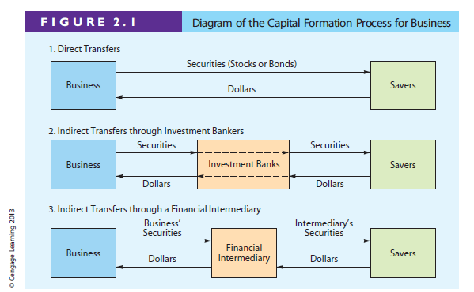

Slide 9
Securitization and Its Importance to a Bank
Solution to banks’ limited funds and local market conditions
Help banks to diversify their risks
An agent bank buy a large no. of loans from other banks
Issue securities backed by these loan payments
Notes:
-May be some clearer explanation? simplier?

Slide 10
Leading U.S. Stock Exchanges
New York Stock Exchange
Nasdaq
Notes:
-Explain differences of each roughly

Slide 11
East Asian Stock Markets
Japan
  Tokyo Stock Exchange / Japan Exchange Group
  Nikkei Stock Average and TOPIX
Mainland China
  Shanghai (SSE) and Shenzhen (SZSE) stock exchanges
  “A” shares in RMB
  “B” shares in USD (SSE) and HKD (SZSE)
  QFII program
Notes:
Not really that important

Slide 12
East Asian Stock Markets (continued)
Hong Kong
  Hong Kong Securities Exchange / HKEx
  Hang Seng Index
Taiwan
  Taiwan Stock Exchange Corporation (TSEC)
  Taiwan Stock Index (TAIEX)
Notes:
Not really that important

Slide 13
What is an IPO?
An initial public offering occurs when a company issues stock in the public market for the first time
“Going public” enables a company’s owners to raise capital from a wide variety of outside investors.
Once issued, the stock trades in the secondary market
Public companies are subject to additional regulations and reporting requirements.

Slide 14
S&P 500 Index, Total Returns: Dividend Yield + Capital Gain or Loss, 1968-2010
Notes:
Why do we show this?

Slide 15
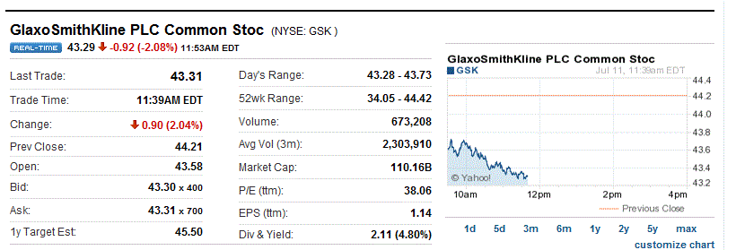
Where can you find a stock quote, and what does one look like?
Stock quotes can be found in a variety of print sources (The Wall Street Journal or the local newspaper) and online sources (Yahoo!Finance, CNNMoney, or MSN MoneyCentral).
Stock Quote for GlaxoSmithKline, July 11, 2011
Source: GlaxoSmithKline (GSK), finance.yahoo.com.

Slide 16
Stock Market Transactions
Applesauce Computer decides to issue additional common stock. An investor purchases some of the newly issued shares from the underwriter. Is this a primary market transaction or a secondary market transaction?
  Since new shares of stock are being issued, this is a primary market transaction.

Slide 17
Types of Financial Institutions
Pension funds
Mutual funds
Exchange traded funds (ETFs)
Hedge funds
Private equity companies

Slide 18
What is meant by stock market efficiency?
Securities are normally in equilibrium and are “fairly priced.”
Investors cannot “beat the market” except through good luck or better information.
Efficiency continuum
Highly
Inefficient
Highly
Efficient
Small companies not followed by many analysts. Not much contact with investors.
Large companies followed by many analysts. Good communications with investors.

Slide 19
What are derivatives? How can they be used to reduce or increase risk?
A derivative security’s value is “derived” from the price of another security (e.g., options and futures).
Can be used to “hedge” or reduce risk. For example, an importer, whose profit falls when the dollar loses value, could purchase currency futures that do well when the dollar weakens.
Notes:
May spend some more time to explain these

Slide 20
What are derivatives? How can they be used to reduce or increase risk?
Also, speculators can use derivatives to bet on the direction of future stock prices, interest rates, exchange rates, and commodity prices. In many cases, these transactions produce high returns if you guess right, but large losses if you guess wrong. Here, derivatives can increase risk.
Notes:
May spend some more time to explain these

