Slide 1

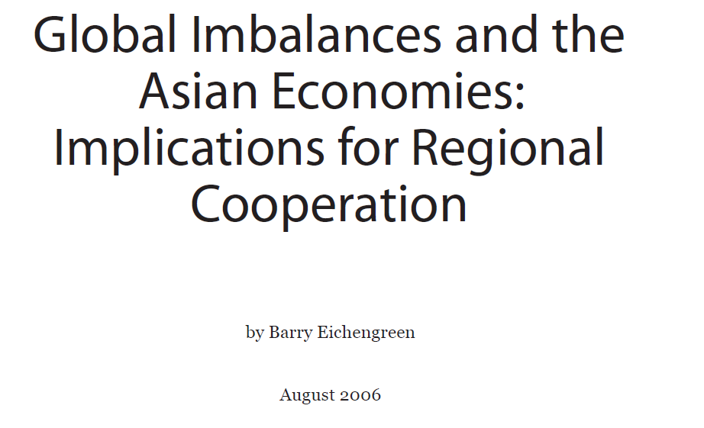

Slide 2
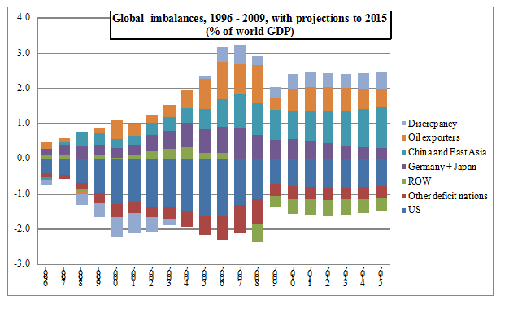

Slide 3
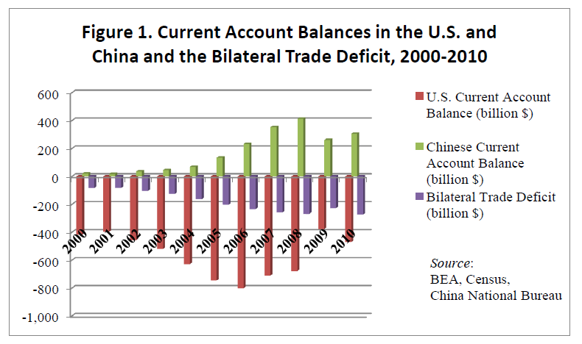

Slide 4
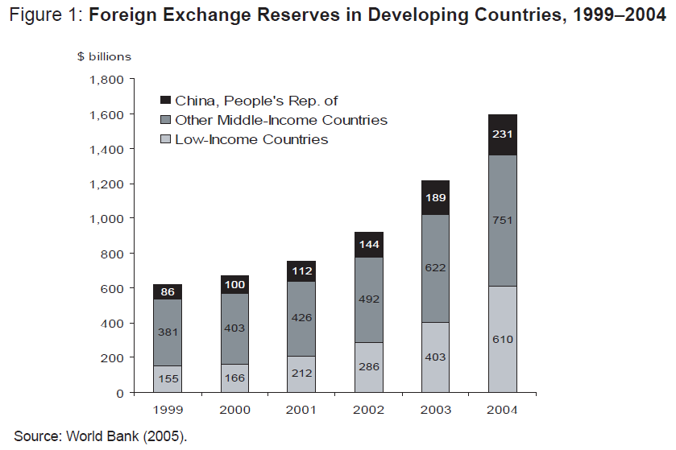

Slide 5
Is Current Account Misleading?
A related story, due to Hausmann and Sturzenegger (2005), is that the current situation is sustainable because the current account statistics are misleading.
For Hausmann and Sturzenegger, the explanation for this anomaly is that unrecorded US exports of managerial, organizational, and technological expertise (“dark matter”) show up in increases in the market value of US foreign investments relative to their official recorded value.
The failure of the balance-of-payments statistics to capture the value of this exported know-how creates a gap between official valuations at the time the foreign investment occurs and the subsequent market valuation of US foreign investments that seems to persist over a period of decades.
In this view, the US current account deficit is not a problem because the recorded deficit is systematically understates the value of US production and savings.

Slide 6
Is Current Account Misleading?
Within the general category of FDI, it is no longer clear that US foreign investments should be more productive than their foreign counterparts.
As Setser (2005) puts it, “It is sort of hard to believe that Toyota’s US operations are massively less profitable than GM’s European operations.” And even where this has been the case in the past, it is hard to believe that it will remain the case in the future.

Slide 7
What an orderly correction would look like?
The implications of the preceding discussion for exchange rate dynamics depend in part on which story or combination of stories one believes.
A range of models based on alternative assumptions (see for example Obstfield and Rogoff, 2005, Caballero, Farhi, and Gourinchas, 2005, Blanchard, Giavazzi, and Sa, 2005) all point to a dollar depreciation of about 30% relative to the levels prevailing at the end of 2004. All of these models suggest that, in a well-behaved perfect foresight equilibrium, this adjustment can be spread out over a number of years.

Slide 8
What an orderly correction would look like?
Since it will take time for dollar depreciation to crowd in US exports, assume that the entire swing comes in the form of US imports.
Assume also that the dollar falls by the same amount against all foreign currencies (this restrictive assumption will relaxed momentarily). The impact on other regions will then depend on the importance of exports to the US as a share of regional GDP.
In data for 2004 this share varies from a high of 23% in the small highly-open East Asian economies (Hong Kong, China; Singapore; and Taipei, China) to a low of 4% in the euro area and Japan
In between, one finds the Anglo Saxon economies (Australia, Canada, New Zealand, and the United Kingdom), the larger East Asian economies (Indonesia, Malaysia, Philippines, Republic of Korea, and Thailand) and the PRC at the high end, at 15%, 13%, and 15% respectively, and Latin America atthe low end, at 7%

Slide 9
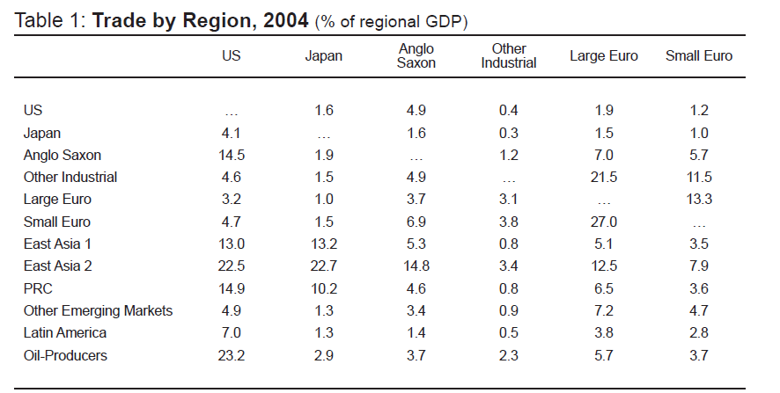

Slide 10
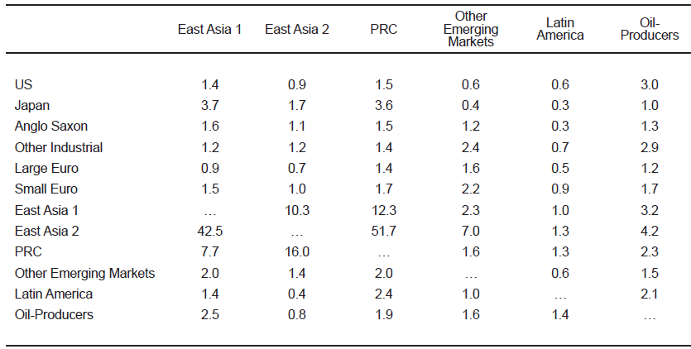
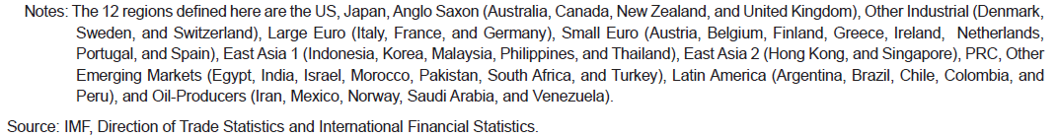

Slide 11
Alternative correction: Appreciation of Asian Currencies
Alternatively, one can imagine a scenario in which Asian countries are more inclined than countries in other parts of the world to allow their currencies to appreciate against the dollar, reflecting the relatively robust health of the Asian economies.
While Asian currencies then appreciate unambiguously, the magnitude of their effective appreciation will depend on the share of the exports of the issuing country destined for the US.

Slide 12
Alternative correction: Appreciation of Asian Currencies
Truman (2005a) has proposed the contrasting scenario in which imposes the rise in the euro against the dollar is limited to 20%, while the Asian currencies are allowed to appreciate against the dollar by 40% and the Latin American currencies continue to rise against the greenback by 15%.
In this case, export growth slows across virtually all of Asia and other policy adjustments are needed to compensate for the demand shortfall.

Slide 13
Asian Countries’ Responses
If a disorderly correction nevertheless occurs, what policies should be implemented to minimize the danger of damaging consequences?
In particular, how should Asian countries respond to a sharp fall in the level of the dollar if and when this occurs?

Slide 14
Asian Countries’ Responses
Domestically, this means using macroeconomic policies to stimulate consumption and implementing structural reforms designed to further reduce dependence on exports.
(1) Exchange Rate Policy (local currency vs. US dollar)
A tighter exchange-rate-cum monetary policy will create pressure for Asian currencies to appreciate against the dollar and foreign currencies in general.
(2) Monetary Policy
Demand will then begin to rotate away from exports in favor of domestically-produced goods, narrowing the region’s current account surplus. But to avoid precipitating a significant slowdown in economic growth, this monetary tightening should be implemented.
(3) Fiscal Policy
Expansionary fiscal policy should be conducted, in order to maintain the overall level of demand.

Slide 15
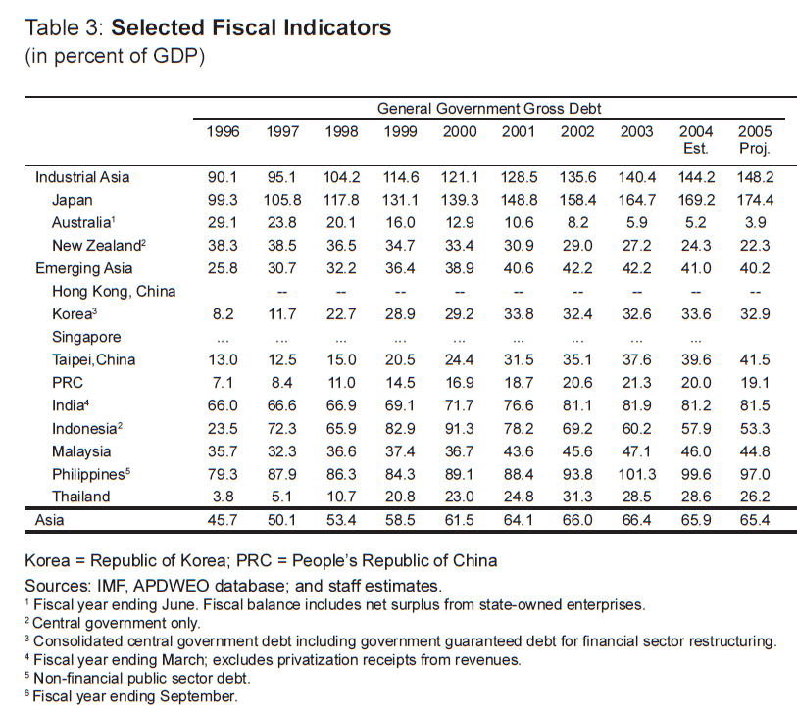

Slide 16
Asian Countries’ Responses (cont’d)
(4) Trade liberalization and regional market integration
Assuming these policies are implemented and that Asian demand rotates away from exports in favor of domestic markets, there remains the danger that the accompanying shift supply could lag.
Shifting resources from production for export to production for domestic markets entails adjustment costs for producers.
Enterprises in PRC cannot shift overnight from producing textile exports to producing restaurant meals and from producing DVD players for export to producing refrigerators for the domestic market.
It takes time to retool assembly lines and for workers to acquire new skills.
A key recommendation is that Asian countries should redouble their pursuit of trade liberalization.
If governments liberalize both imports and exports, it will be possible for individual Asian economies to remain specialized in a limited, narrow range of exports in which they have a comparative advantage.

Slide 17
Asian Countries’ Responses (cont’d)
(5) Regional exchange rate arrangement
Debate on the optimal exchange rate regime for Asian countries is ongoing: authors like McKinnon and Schnabl (2004) argue that relatively open, export-dependent Asian economies have good reasons to prefer pegging their currencies,
While others like Eichengreen (2003) counter that managed flexibility is no impediment to exports and that Asian countries will appreciate the policy autonomy conferred by greater exchange rate flexibility.
This longstanding debate cannot be resolved here. The point is that in an uncertain global environment, where there is the possibility of a sharp shift in the level of the dollar and a significant change in the level of global demand, Asian countries have special reason to value monetary autonomy.
In principle, Asian countries will allow their currencies to appreciate together—and therefore they will appreciate at all—can be bolstered by the adoption of an exchange rate framework for the region: a common basket peg, for example, or a common basket, bank and crawl (BBC) regime.
Verifying that Asian countries are complying with the terms of their agreement to cooperate would then require monitoring only the behavior of exchange rates themselves, as opposed to ascertaining the consistency of the entire range of national policies. Free riding would be easier to detect.

Slide 18
On the framework for macroeconomic policy coordination
This raises the question of whether Asian countries have adequate institutional arrangements in place for coordinating regional trade, monetary and fiscal adjustments.
ASEAN+3 already possess a variety of mechanisms for consultation, information sharing, and financial assistance. Since 2000 they have negotiated a network of regional swap lines and credits, the Chiang Mai Initiative (CMI), to provide external assistance to countries whose financial markets and exchange rates are perturbed. At the time of writing some $40 billion of bilateral swaps have been arranged under the CMI aegis.

Slide 19
On the framework for macroeconomic policy coordination
ASEAN continues to make progress in constructing its free trade area, currently scheduled for completion by 2010.
ASEAN has concluded a framework agreement with the PRC on trade in goods; negotiations on trade in services and investment rules are ongoing.
ASEAN is also pursuing a trade-in-goods agreement with the Republic of Korea and FTAs with Hong Kong, China and New Zealand.
The negotiation of bilateral agreements between ASEAN and India and Japan is proceeding more slowly.

Slide 20
On the framework for macroeconomic policy coordination
On an alternative track, Japan is pursuing bilateral agreements with a number of individual Asian countries (Malaysia, Philippines, and Thailand).
Given the desirability of bolstering intraregional trade, a more comprehensive approach would be desirable. To put it another way, if Asian countries are going to export less to the US, it becomes all the more important that they be able to export freely to one another.

