Slide 1
B. Income Distribution

Slide 2
B. Income Distribution
Measurement : Lorenz Curve
Lorenz curve shows the distribution of income of a group of people where the number of people is cumulatively staggered from poorest to richest, from 0 to 100 %, and plotted on the horizontal axis of a unit square, and the cumulative income of these people is plotted on the vertical axis. The curve that joins all these coordinates is called the Lorenz Curve.

Slide 3
B. Income Distribution
Measurement : Lorenz Curve
Three cases of the Lorenz curve (Perfect Equality, Perfect Inequality and Real World) in an Excel file “Lorenz Curve_Eng.xls”

Slide 4
Measurement of income inequality
Lorenz Curve
Perfect equality line
(% of income)
Gini coefficient = A/(A+B)
100
A
B
(% of population)
0
100
4

Slide 5
Gini Ratio or Gini Coefficient
Measures income distribution as a ratio of area between the Lorenz curve and the “perfect equality” line, and the triangle under the diagonal line of perfect equality.

Slide 6
Gini Ratio or Gini Coefficient
G = A/(A+B)
G = 0 means perfectly equal income distribution;
G = 1 (or 100%) means perfectly unequal income distribution
In the real world, G is between 25% and 70%

Slide 7
  Another measure of inequality: Income share by quintile group (five groups of 20% of people)
  Annual income or life-time income?
  Including capital gains and income in kind?

Slide 8
Functional income distribution (factors of production) VS
Size income distribution (individuals)

Slide 9
The Kuznets Hypothesis
Simon Kuznets concludes from his studies of the relationship between economic growth and income distribution that in the early stage of economic development when the national income is growing, the distribution of income will worsen first but will later improve as the economy has grown past a certain level.

Slide 10
The Kuznets Hypothesis
Simon Kuznets Reasoning:
In the early stage, society concentrates on growth of a small “pie”
Later on, more concern and better policy tools to reduce inequality and larger “pie” to share

Slide 11
Kuznets Curve
Gini ratio
50
49
48
47
46
45
1000
2000
3000
4000
Per capita income
11

Slide 12
Income Inequality in Thailand
Two measures of income inequality:
Income share by quintile group
Gini coefficient
1986 – 2009 period

Slide 13
Thailand Income Inequality Indicators
 |  |  |  |  |  |  | Gini
Year | Bottom 20% | Second 20% | Middle 20% | Fourth 20% | Top 20% | Top/Bottom | Coefficient
1986 | 4.53 | 7.90 | 12.36 | 20.37 | 54.84 | 12.11 | 0.496
1988 | 4.58 | 8.05 | 12.38 | 20.62 | 54.37 | 11.88 | 0.487
1990 | 4.29 | 7.54 | 11.70 | 19.50 | 56.97 | 13.28 | 0.515
1992 | 3.96 | 7.06 | 11.11 | 18.90 | 58.98 | 14.90 | 0.536
1994 | 4.07 | 7.35 | 11.67 | 19.68 | 57.23 | 14.07 | 0.520
1996 | 4.18 | 7.55 | 11.83 | 19.91 | 56.53 | 13.52 | 0.513
1998 | 4.30 | 7.75 | 12.00 | 19.82 | 56.13 | 13.06 | 0.507
2000 | 3.95 | 7.27 | 11.50 | 19.83 | 57.45 | 14.55 | 0.522
2002 | 4.23 | 7.72 | 12.07 | 20.07 | 55.91 | 13.23 | 0.507
2004 | 4.54 | 8.04 | 12.41 | 20.16 | 54.86 | 12.10 | 0.493
2006 | 4.03 | 7.69 | 12.13 | 20.04 | 56.11 | 13.92 | 0.511
2007 | 4.41 | 8.04 | 12.42 | 20.20 | 54.93 | 12.47 | 0.497
2009 | 4.79 | 8.36 | 12.57 | 20.08 | 54.19 | 11.31 | 0.485

Slide 15
Gini coefficients in Different Regions of Thailand (Income)
Year | Whole Country | Bangkok | Central | North | North East | South | Urban | Rural
1988 | 0.487 | 0.388 | 0.435 | 0.439 | 0.454 | 0.463 | 0.434 | 0.439
1990 | 0.515 | 0.420 | 0.480 | 0.468 | 0.434 | 0.469 | 0.478 | 0.447
1992 | 0.536 | 0.457 | 0.462 | 0.476 | 0.471 | 0.481 | 0.494 | 0.439
1994 | 0.520 | 0.405 | 0.461 | 0.468 | 0.472 | 0.498 | 0.473 | 0.457
1996 | 0.513 | 0.401 | 0.468 | 0.458 | 0.470 | 0.470 | 0.479 | 0.440
1998 | 0.507 | 0.415 | 0.443 | 0.462 | 0.460 | 0.491 | 0.465 | 0.450
2000 | 0.522 | 0.417 | 0.448 | 0.469 | 0.483 | 0.476 | 0.471 | 0.468
2002 | 0.507 | 0.438 | 0.437 | 0.467 | 0.469 | 0.464 | 0.473 | 0.448
2004 | 0.493 | 0.422 | 0.433 | 0.478 | 0.448 | 0.445 | 0.461 | 0.445
2006 | 0.511 | 0.452 | 0.443 | 0.483 | 0.494 | 0.473 | 0.478 | 0.479
2007 | 0.497 | 0.468 | 0.422 | 0.469 | 0.468 | 0.460 | 0.473 | 0.457
2009 | 0.485 | 0.468 | 0.414 | 0.446 | 0.463 | 0.477 | 0.477 | 0.440

Slide 16
Income Inequality in Thailand
Over past 20 years, no clear sign of improvement
Inequality among different regions (particularly Bangkok VS others) is worse than inequality within each region

Slide 17
Kuznets Curve and Thai Development
Gini ratio
50
49
48
47
46
45
1000
2000
3000
4000
Per capita income
17

Slide 18
Kuznets Curve and Thai Development
Gini ratio
50
49
48
47
Thailand’s growth and inequality
have not quite followed the
Kuznets curve pattern
46
45
1000
2000
3000
4000
Per capita income
18

Slide 19
Rank | Country | Survey year | Gini index | Percentage share of income or consumption
 |  |  |  | Lowest 10% | Lowest 20% | Second 20% | Third 20% | Fourth 20% | Highest 20% | Highest 10%
1 | Namibia | 1993 ^{c,d} | 70.7 | 0.5 | 1.4 | 3.0 | 5.4 | 11.5 | 78.7 | 64.5
2 | Lesotho | 1995 ^{a,b} | 63.2 | 0.5 | 1.5 | 4.3 | 8.9 | 18.8 | 66.5 | 48.3
8 | Brazil | 2001 ^{c,d} | 59.3 | 0.7 | 2.4 | 5.9 | 10.4 | 18.1 | 63.2 | 46.9
11 | Colombia | 1999 ^{c,d} | 57.6 | 0.8 | 2.7 | 6.6 | 10.8 | 18.0 | 61.8 | 46.5
12 | Chile | 2000 ^{c,d} | 57.1 | 1.2 | 3.3 | 6.6 | 10.5 | 17.4 | 62.2 | 47.0
16 | Mexico | 2000 ^{a,b} | 54.6 | 1.0 | 3.1 | 7.2 | 11.7 | 19.0 | 59.1 | 43.1
19 | Argentina^{e} | 2001 ^{c,d} | 52.2 | 1.0 | 3.1 | 7.2 | 12.3 | 21.0 | 56.4 | 38.9
26 | Malaysia | 1997 ^{c,d} | 49.2 | 1.7 | 4.4 | 8.1 | 12.9 | 20.3 | 54.3 | 38.4
34 | Philippines | 2000 ^{a,b} | 46.1 | 2.2 | 5.4 | 8.8 | 13.1 | 20.5 | 52.3 | 36.3
35 | Bolivia | 1999 ^{a,b} | 44.7 | 1.3 | 4.0 | 9.2 | 14.8 | 22.9 | 49.1 | 32.0
36 | China | 2001 ^{a,b} | 44.7 | 1.8 | 4.7 | 9.0 | 14.2 | 22.1 | 50.0 | 33.1
42 | Thailand | 2000 ^{a,b} | 43.2 | 2.5 | 6.1 | 9.5 | 13.5 | 20.9 | 50.0 | 33.8
47 | Singapore | 1998 ^{c,d} | 42.5 | 1.9 | 5.0 | 9.4 | 14.6 | 22.0 | 49.0 | 32.8
51 | United States | 2000 ^{c,d} | 40.8 | 1.9 | 5.4 | 10.7 | 15.7 | 22.4 | 45.8 | 29.9
60 | Portugal | 1997 ^{c,d} | 38.5 | 2.0 | 5.8 | 11.0 | 15.5 | 21.9 | 45.9 | 29.8

Slide 20
Rank | Country | Survey year | Gini index | Percentage share of income or consumption
 |  |  |  | Lowest 10% | Lowest 20% | Second 20% | Third 20% | Fourth 20% | Highest 20% | Highest 10%
65 | Lao PDR | 1997 ^{a,b} | 37.0 | 3.2 | 7.6 | 11.4 | 15.3 | 20.8 | 45.0 | 30.6
66 | Vietnam | 2002 ^{a,b} | 37.0 | 3.2 | 7.5 | 11.2 | 14.8 | 21.1 | 45.4 | 29.9
72 | New Zealand | 1997 ^{c,d} | 36.2 | 2.2 | 6.4 | 11.4 | 15.8 | 22.6 | 43.8 | 27.8
73 | Italy | 2000 ^{c,d} | 36.0 | 2.3 | 6.5 | 12.0 | 16.8 | 22.8 | 42.0 | 26.8
74 | United Kingdom | 1999 ^{c,d} | 36.0 | 2.1 | 6.1 | 11.4 | 16.0 | 22.5 | 44.0 | 28.5
76 | Israel | 1997 ^{c,d} | 35.5 | 2.4 | 6.9 | 11.4 | 16.3 | 22.9 | 44.3 | 28.2
79 | Australia | 1994 ^{c,d} | 35.2 | 2.0 | 5.9 | 12.0 | 17.2 | 23.6 | 41.3 | 25.4
82 | Indonesia | 2002 ^{a,b} | 34.3 | 3.6 | 8.4 | 11.9 | 15.4 | 21.0 | 43.3 | 28.5
88 | Canada | 1998 ^{c,d} | 33.1 | 2.5 | 7.0 | 12.7 | 17.0 | 22.9 | 40.4 | 25.0
91 | France | 1995 ^{c,d} | 32.7 | 2.8 | 7.2 | 12.6 | 17.2 | 22.8 | 40.2 | 25.1
93 | India | 1999-00 ^{a,b} | 32.5 | 3.9 | 8.9 | 12.3 | 16.0 | 21.2 | 43.3 | 28.5
98 | Bangladesh | 2000 ^{a,b} | 31.8 | 3.9 | 9.0 | 12.5 | 15.9 | 21.2 | 41.3 | 26.7
99 | Korea, Rep. | 1998 ^{c,d} | 31.6 | 2.9 | 7.9 | 13.6 | 18.0 | 23.1 | 37.5 | 22.5
100 | Russian Federation | 2002 ^{a,b} | 31.0 | 3.3 | 8.2 | 12.7 | 16.9 | 23.0 | 39.3 | 23.8
101 | Netherlands | 1999 ^{c,d} | 30.9 | 2.5 | 7.6 | 13.2 | 17.2 | 23.3 | 38.7 | 22.9
111 | Germany | 2000 ^{c,d} | 28.3 | 3.2 | 8.5 | 13.7 | 17.8 | 23.1 | 36.9 | 22.1
118 | Norway | 2000 ^{c,d} | 25.8 | 3.9 | 9.6 | 14.0 | 17.2 | 22.0 | 37.2 | 23.4
122 | Sweden | 2000 ^{c,d} | 25.0 | 3.6 | 9.1 | 14.0 | 17.6 | 22.7 | 36.6 | 22.2
123 | Japan | 1993 ^{c,d} | 24.9 | 4.8 | 10.6 | 14.2 | 17.6 | 22.0 | 35.7 | 21.7
124 | Denmark | 1997 ^{c,d} | 24.7 | 2.6 | 8.3 | 14.7 | 18.2 | 22.9 | 35.8 | 21.3

Slide 21
International Comparison
Thailand’s income inequality ranks moderately among developing countries, but fares much worse than all developed countries

Slide 22
C. Policies Affecting Poverty

Slide 23
C. Policies Affecting Poverty
Four groups of policy:
Macroeconomic policy
Sectoral policy
Institutional development policy
Specific, target-group oriented policy

Slide 24
C. Policies Affecting Poverty
Macroeconomic policy:
  Overall economic growth reducing poverty
  Export, FDI, tourism
  Fiscal policy through progressive tax and poverty-target spending
  Trickle-down effect in reducing poverty

Slide 25
C. Policies Affecting Poverty
Sectoral policy
  Agricultural policy: credit, R&D, price support, land reform
  Industrial policy: export promotion, rural industrialization
  Education policy

Slide 26
C. Policies Affecting Poverty
Institutional development policy
  Rural community development
  Administrative reform

Slide 27
C. Policies Affecting Poverty
Specific, target-group oriented policy
  Water development in target villages
  Social welfare for the ultra poor

Slide 28
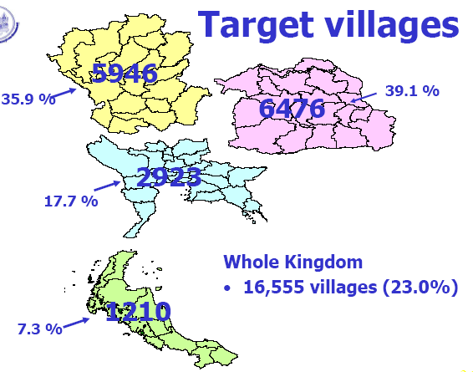

Slide 29
Past Policies Affecting Poverty in Thailand
The Rural Job Creation Program (โครงการ “เงินผัน”)
- Starting in 1975 for off-season employment
- Biased towards non-poor farmers , but still useful.

Slide 30
The poverty Eradication policies (1982-86)
- Cover over 12,000 villages in 38 provinces
- Provision of government services.
- Increase self-reliance, and people participation.

Slide 31
The poverty Eradication policies (1982-86)
- Basic and low – cost technologies.
- Four ministries : Interior, Health, Agri., and Education
- NESDB : Poverty declined by half of villages

Slide 32
The Green Esarn Project (1987)
- Natural resource development
- Income and employment
- Basic needs , mainly water supply

Slide 33
Rural credit through BAAC
- Reducing the role of unorganized creditors from 90% to 50% during 1997-87.
- Most benefit to middle-income farmers
- Some trickle-down effect to the poor

Slide 34
Infrastructure investment , particularly transport
➔ market access for agricultural products
Industrial policy
- Bias towards industry , against agriculture
- BOI privileges for capital-intensive industries

Slide 35
Trade policy
- Tariff , and import substitution
- Export promotion
- Trade agreements for freer trade in agriculture

Slide 36
Exchange rate policy
  Value of the baht ➔ competitiveness in international trade of agriculture
Agriculture pricing policy
- Rice premium and export taxes
- Price support and subsidies

Slide 37
Other Policies for Poverty Reduction
- Agriculture productivity promotion
- Promotion of industries in rural/provincial areas
- Training and education to increase labor skills

Slide 38
Other Policies for Poverty Reduction
- Social services (health , welfare) for the poor
- Macroeconomic management for sustainable economic growth

Slide 39
Thaksin’s Populist Policy for the Poor (2001 – 2006)
A set of policy measures for the “grass roots” to win votes
Various types of subsidies and benefits to the poor
Extra-budgetary spending (quasi fiscal) without parliamentary approval

Slide 40
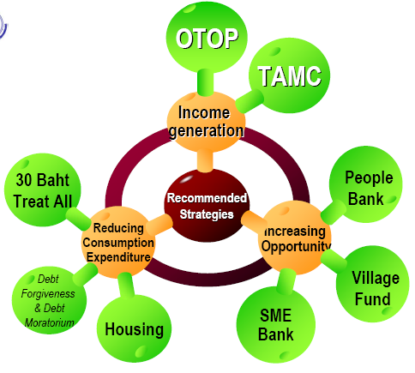
Thaksin
Populist
Initiatives

Slide 41
One Tambon One Product (OTOP)
• Claimed Output:
– 6,932 products, with quality improvement & guarantee.
– Sales increased from 24.5 million baht in 2001 to 42.93 million baht in 2003
– Job creation in 26,000 communities;
• Outcome: double household income

Slide 42
Debt Moratorium & Debt forgiveness
• Beneficiaries: (claimed output)
– Debt moratorium: 2.31 million persons, 53,000 million baht;
– Debt forgiveness (Hair cut and interest reduction): 4.13 million persons;
– Rehabilitation & restructuring to improve production: 0.85 million persons;
• Outcome: income increased by
10,185 baht/year/household

Slide 43
Village & Community Funds
• Beneficiaries: (claimed output)
– 13.9 million persons;
– Loan: 168 billion baht
• Outcome:
– Reducing informal sector loan that charged extremely high interest rate;
– Income increased 5,900
baht/year/ household

Slide 44
Thaksin’s Populist Policy
Criticisms:
Too political, vote-buying
Spoil the poor, encourage lack of financial discipline
Reach the “really poor”?

Slide 45
Thaksin’s Populist Policy
Criticisms:
Corruption
Not fiscally transparent, avoiding scrutiny by parliament
Fiscal burden, not sustainable

Slide 46
Thaksin’s Populist Policy
Increasing “populist” trend in the last election (2011)
All political parties adopted “populist” campaign : subsidies on oil, electricity, bus, train; increasing minimum wage; lower taxes; more village fund; women development fund, etc.

Slide 47
Policy Alternatives for Poverty Reduction (by TDRI, 2009)
Three alternatives:
    Liberalism
    Populism and
    Welfare State

Slide 48
TDRI Policy Alternatives
Liberalism, free enterprise: promote market mechanism, with no specific objective on poverty and distribution, but expect poverty declines with economic growth

Slide 49
TDRI Policy Alternatives
Populism:
Mainly to gain votes by giving “assistance” to the “grass roots”, relying on both budget and extra-budget spending, creating long term burden, but no clear impact on poverty

Slide 50
TDRI Policy Alternatives
Welfare State:
Government’s role in providing systematic, comprehensive and continuous welfare to the population, including child birth, sickness, unemployment, old age, disabilities and other risks

Slide 51
TDRI Policy Alternatives
Welfare State:
  “Social safety net”, based on the “From Womb to Tomb” concept by Dr. Puey Ungpakorn
  Need very high welfare expenditure by government (through social security payments and taxes)

Slide 52
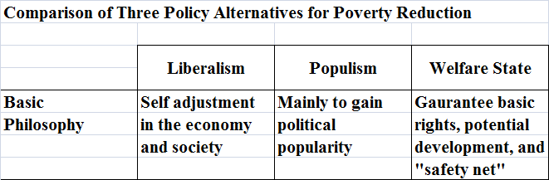

Slide 53
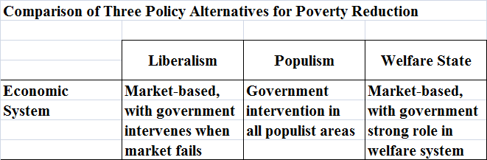

Slide 54
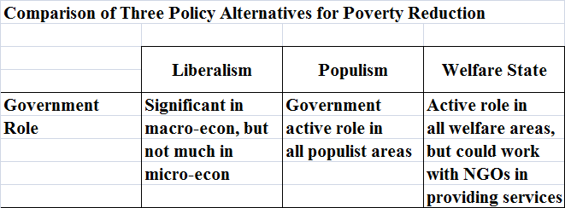

Slide 55
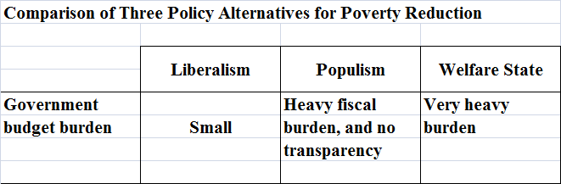

Slide 56
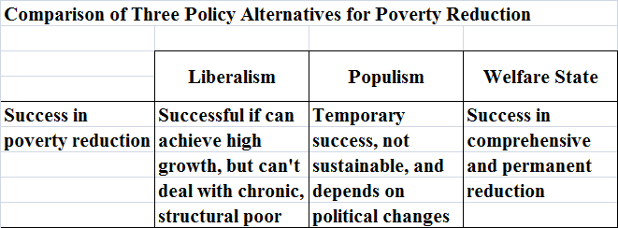

Slide 57
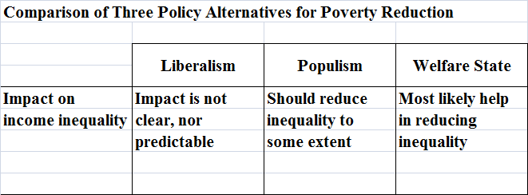

Slide 58
TDRI Policy Alternatives
TDRI Suggestions:
  A mixture of the three alternatives
  Rely mainly on the Welfare State
  Foster Liberalism to create growth and enough resources for poverty reduction
  Use Populism in market failure cases

Slide 59
TDRI Policy Alternatives
TDRI Suggestions:
  Targets for the poor should be clearly defined:
    Temporary poor (Use Welfare State)
    Structural poor e.g. old, disability (Use Welfare State)
    Chronic poor (Use Populism)

Slide 60
Sufficiency Economy
• A concept (philosophy) proposed by the King
• 3 middle paths + 2 conditions
Middle paths: moderation, rationality (reasonableness), and self-immunity
Conditions: knowledge and morality

