Slide 1

INTERNATIONAL MONEY TRANSFER
1.Jitlada Sethakomut 5504640383
2.Kornkanok Laiadrachatakit 5504640508
3.Pongpran Korawis 5504641290
4.Prawrawee Nakmai 5504641357
5.Ramon Chuichai 5504641431
6.Vasini Phokai 5504642025
7.Tanyatorn Suppakittiwong 5504641845

Slide 2
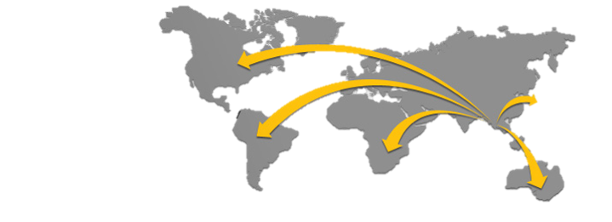




What is International money transfer service?
The service for executing Money Transfer Transactions; and related services to be offered by the Bank to its customers who have concluded an International Money Transfer Service Agreement with the Bank.

Slide 3
Types of money transfer providers
Foreign Exchange Providers
(FX Brokers or Money Transfer Providers)
Prepaid Money Cards
Online Money Transfer Services/
Internet Money Transfer
Peer-to-Peer Money Transfer Providers
Money Transfer Operators( MTOs)
High Street Banks/ Building Societies/
Credit Unions/ Community Banks

Slide 4




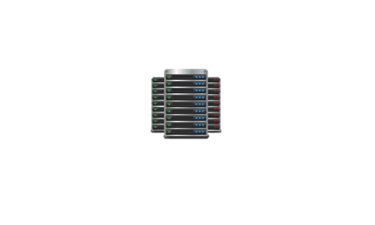
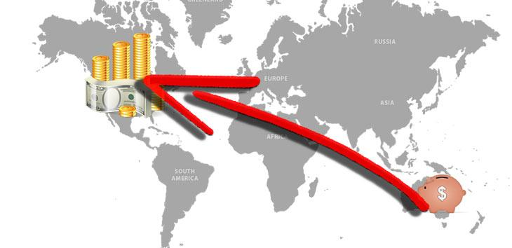
Foreign Exchange Providers (FX Brokers or Money Transfer Providers)
FX brokers are companies who specialise in international money transfer.
Transferring large amounts of money for purchasing a property, starting up a business, or sending regular payments abroad.
Benefit is that you can make specific arrangements for your individual needs such as fixed exchange rates for a set period.
FX Brokers
Money Transfer Operators (MTOs)
Companies only offer money transfer services, usually through agents, and only send money between countries.
Generally no requirement to you to open an account.
Examples - Western Union, MoneyGram, Chequepoint, Coinstar

Slide 5
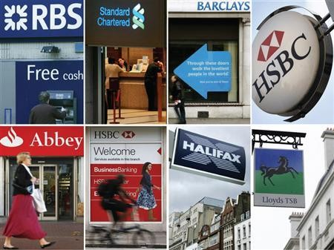

High Street Banks/Building Societies/Credit Unions/Community Banks
You must either apply for or hold an account with the bank you wish to use.
Banks tend to be more expensive and take longer to transfer your money.
Banks offer additional security and this can open doors for access to various other financial products such as loans, mortgages and savings accounts.
Online Money Transfer Services/Internet Money Transfers
Money can be sent over the internet through secure online services
Very small fee.
Need to have a bank account or credit card and access to the internet, or at least an e-mail address, to transfer the money.
.

Slide 6
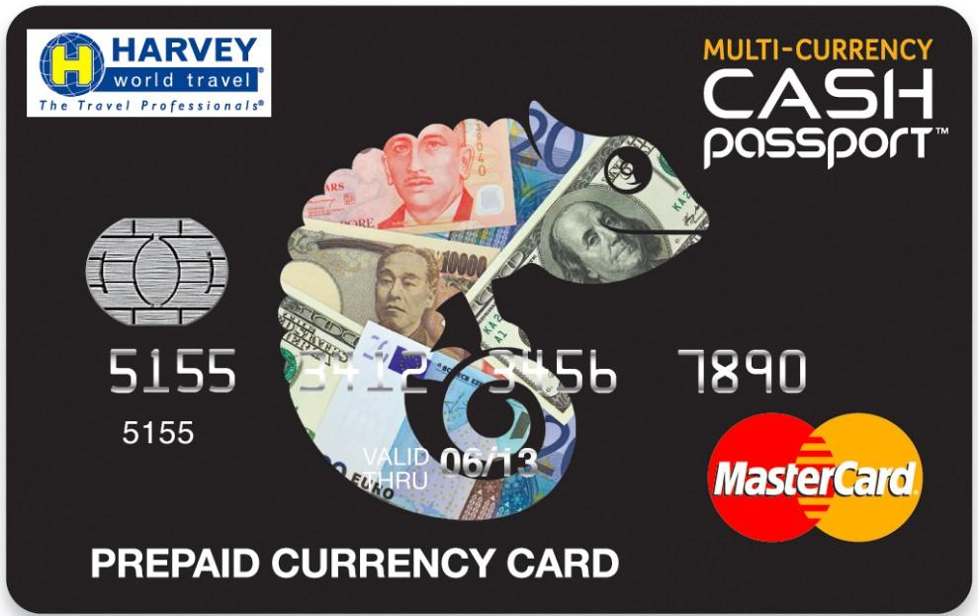
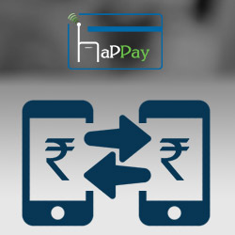
Prepaid Money Cards
Alternative to the traditional methods when a small amount of foreign currency is required.
Operates in the same way as a credit card or debit card.
Benefits: available in selected shops, can be ordered through the companies online, useful for sending money overseas,can be used instead of travel money when travelling and for online purchases, are accepted at ATM's globally for withdrawing funds.
Peer-to-Peer Money Transfer Providers
A new type of company to the world of foreign currency exchange.
Allowing senders and receivers of different currencies to set their own rates and trade directly with each other, cutting out the banks’ fees and exchange rate margins in the process.
Example, CurrencyFair and Transferwise.

Slide 7
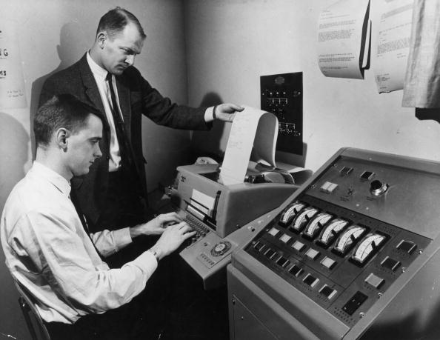
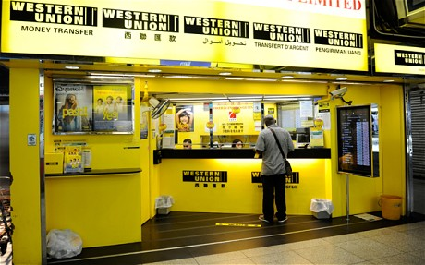
International money transfer ’s system
Telegraphic Transfer (TT)
Wire Transfer
A mode of electronic funds transfer
It had been used before 1990s
Telegraphic Transfer of money was effected by a cable message service from one bank to another
Money had been transferred directly between banks via a Telex message
A method of electronic funds transfer
Nowadays we use wire transfer system to transfer money from…
  One individual or organization to another
  One bank account to another
  Transfer of cash at cash office
Eg. Western Union Money Transfer
Notes:
ยีนๆ เราควรใส่รูปปะ ใส่ๆ วางมาเลย เดี๋ยวข้ามไปทำอันอื่นก่อน 5555

Slide 8
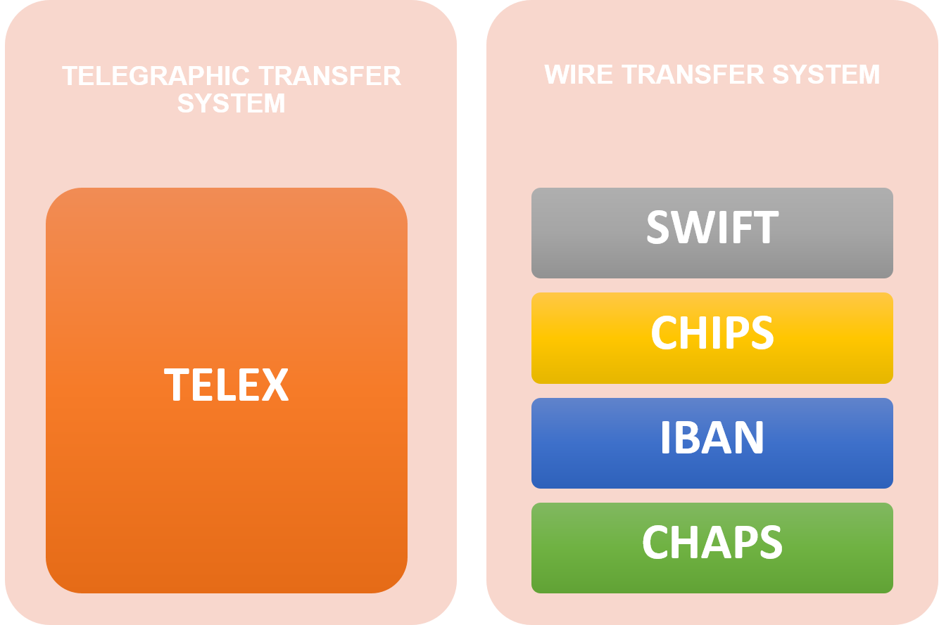

International money transfer ’s system
WHY WE USE SWIFT ?
Speed
Standardized
Secured
Reliable
WHY TELEX SYSTEM SERVICE DOES NOT EXIST TODAY?
Because…
Too slow
No standardized format
Inefficient system
Insecurity

Slide 9
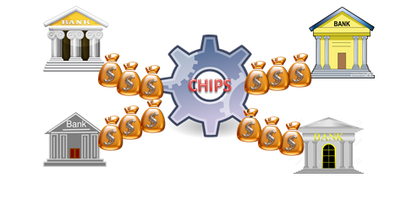
CHIPS
Introduction
The Clearing House Interbank Payments System (CHIPS)
A bank-to-bank transfer.
Large value transaction
The largest private-sector U.S.-dollar funds-transfer system in the world.
Intraday Netting Process

Slide 10
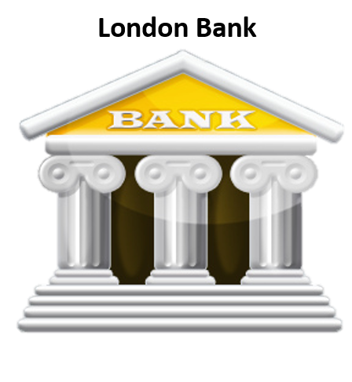
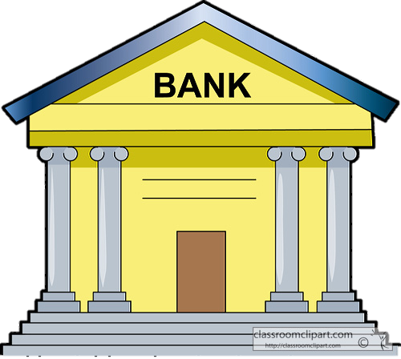




CHIPS
How it works?
New York Bank
Intraday Netting Process
From 9 pm- 5 pm
The process that Banks use to send and receive payment
Real-time system
The payments are netted bilaterally and multilaterally
Notes:
which is a bank-to bank payment transfer system for large- value transaction.
Together with the Fedwire Service, CHIPS forms the largest private-sector US dollar funds transfer system in the world. On average it settling well over US$1 trillion a day for around 300,000 interbank payments.

Slide 11
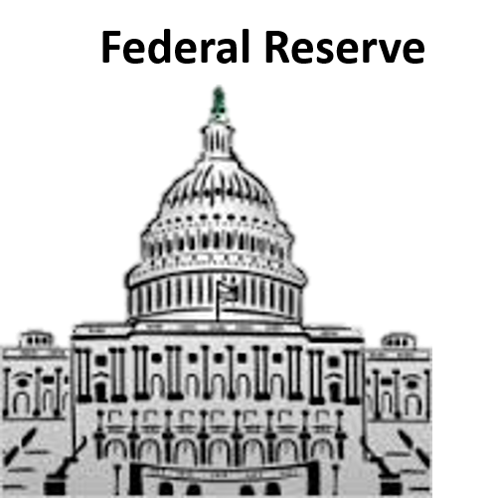


CHIPS
Pre-Funding
Pre-Funding
Pre-Funding is the security deposit which the participating banks put in their CHIPS accounts at the Federal Reserve Bank before any payment occurs
Notes:
the process that Banks can send and receive payment by conducted all of its settling at the end of the business day.
It means that CHIPS provides intraday payment finality through a real-time system
paid with the banks’ available balances. The payments are netted bilaterally and multilaterally
(e.g., when London Bank has to pay $15 million to New york Bank, but on the same day, New york bank has to pay $10 million to London Bank, by the netting payment process, London bank will actually pay New York bank by only $5 million.

Slide 12
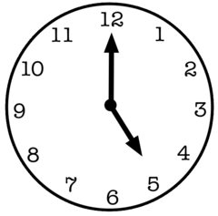
CHIPS
At 5.00pm, CHIPS uses these deposits to settle any still-unsettled transactions.
From 5.00pm-5.30pm is the period for negative closing positions,
(The Final Pre-Funding)
Notes:
With CHIPS, all the bank has to do is pre-funding the security deposit in their CHIPS accounts at the Federal Reserve bank before making any payment
In order to smooth the working of the intraday netting system,
At 5 in the afternoon, CHIPS uses these deposits to settle any unsettled transactions. If the prefunding amount is not enough to cover the actual payment, CHIPS will notify the Bank and they have 30 minutes to make up the leftover amount of transaction.
If the banks miss this period, they will have to settle the unsettled payment outside of CHIPS.

Slide 13
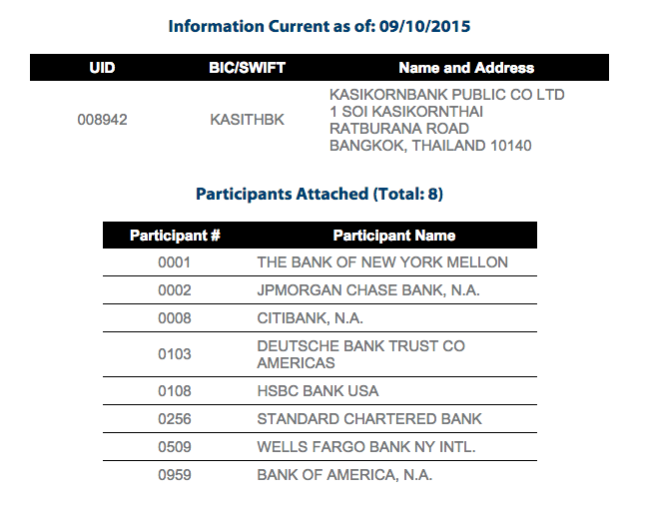
CHIPS
Identification Codes
UID Universal Identifier
Each Customer is assigned an identifier.
Verify and match customers with their bank account information
PN Participant Number
Unique four digit number assigned to an institution
Clearing house member number

Slide 14




CHIPS
How good it is?
Liquidity efficiency
20-hour processing day
Netting engine
Safe, Secure, Reliable

Slide 15
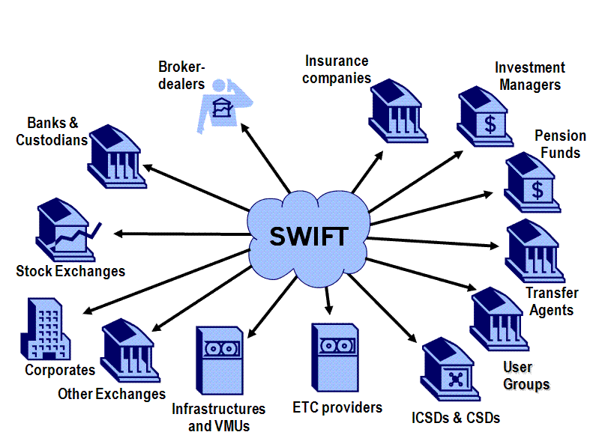
SWIFT
Introduction
Society for Worldwide Interbank Financial Telecommunication (SWIFT)
Founded in Brussel, 1973
established to promote standards for global interactivity and financial transfers.
most popular type of international bank transfer
A globally accepted standard platform
Notes:
The vast majority of international bank money transfers are executed through SWIFT. Founded in Brussels in 1973, the Society for the Worldwide Interbank Financial Telecommunication, or SWIFT, was established to promote standards for global interactivity and financial transfers. Furthermore, SWIFT is the most popular type of international bank transfer used today.
SWIFT is merely a secure financial messaging network that sends banks payment orders. The payment order tells the bank that an account holder is trying to transfer funds to another third party. Today, these financial messages are sent every day

Slide 16
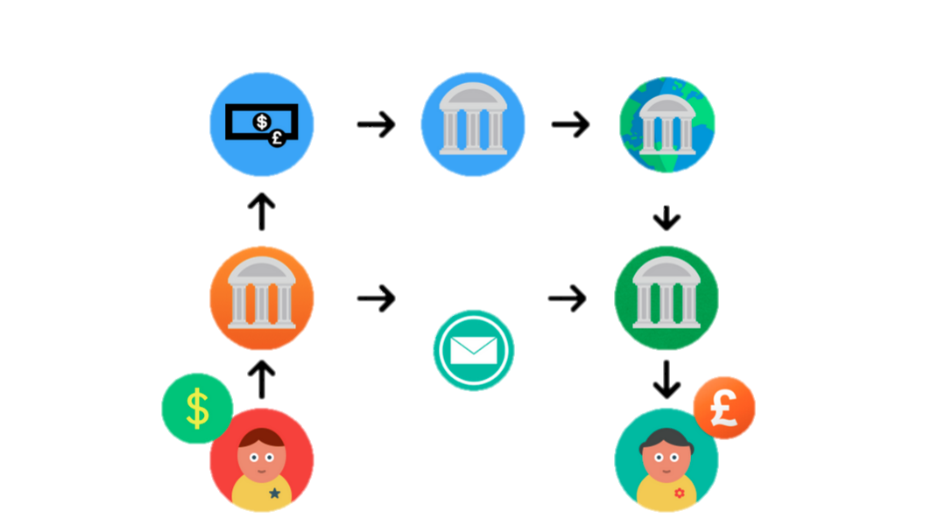

SWIFT
How it works?
John’s Bank
Exchange rate
Interbank Clearing House
John’s local branch
Tina’s Bank
Notes:
To explain it clearly, John wants to send money to Tina, who lives in England. Assuming both are in SWIFT’s network,John goes to his local bank and requests to send money to Tina. John’s bank then sends a SWIFT message to Tina’s bank.The SWIFT message arrives pretty quickly (even though, money transfer typically takes place at the end of the business day and can sometimes take multiple days. After John submits his transfer, his bank will then convert his dollars into British Pounds at a retail rate. This conversion is done below the market rate to account for any fluctuations and as a fee for the service. Once the conversion is completed, John’s bank will tell the Clearing House that it needs to give Tina’s bank some money. The Clearing House acts an intermediary between the two banks. The Clearing House helps offset the risk of clearing transactions and also reduces the amount of money that has to be transferred. (This is because if all the customers at John’s Bank need to send all the customers at Tina’s bank $1000, but all the customers at Tina’s bank need to send all the customers at John’s bank $800, then only $200 needs to be transferred from John’s Bank to Tina’s Bank. ไม่ต้องพูดก็ได้มั้ง). After that, Waiting for all the customers at each bank to submit their transfer orders which takes a long time since the accounts are settled at the end of business day.

Slide 17
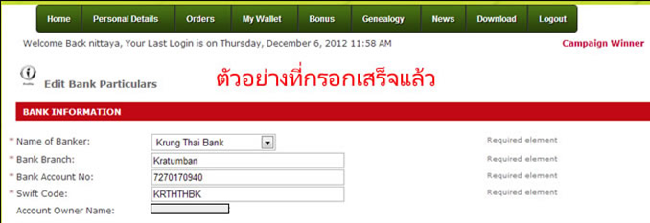
SWIFT
Identification Codes
A standard format of Bank Identifier Codes approved by International Organization for Standardization
UNCR
IT
MM
institute code
country code
city code
KASI TH BK
Notes:
As banks are provided with a specific SWIFT code or bank identifier code(BIC), so
Swift code is a standard format of Bank Identifier Codes approved by International Organization for Standardization. It is eight characters long and are unique to the member banking institution.

Slide 18


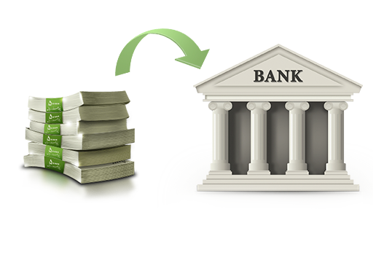

SWIFT
Information required
Receiver’s account name, account number and address
The name and address of the receiver’s bank
The SWIFT address of the bank that they have an account with (if any)
Supporting documents
Notes:
supporting document: Thai citizens – A document stating the purpose of the fund transfer;
Foreigners - A document stating the source of the income

Slide 19
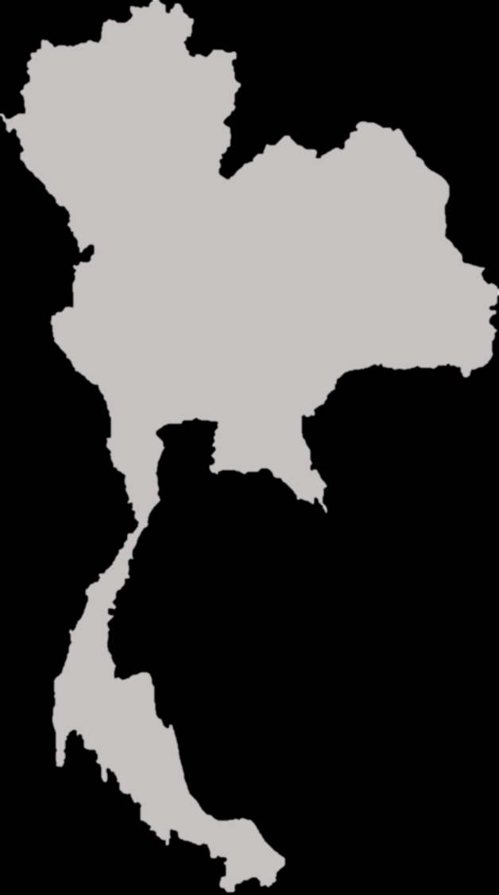

SWIFT
Condition & Restriction
2 types of condition and restrictions
Global Outward
Global Inward

Slide 20
SWIFT
Condition & Restriction
(Global Inward)
For inward remittances of at least USD 50,000 or the equivalent in other currencies,
Indicate “KASITHBK” every time when you want to receive an inward money transfer.
Fill out your personal information on the Global Inward Form
Indicate the destination of the inward remittance to your account
the recipient is required to submit the following documents:
Foreign Exchange Transaction form
Other relevant documents depending on the purpose of the funds transfer
For foreign currencies less than USD20,000, or the equivalent in other currencies,
the Bank shall reserve the right to credit the funds immediately without prior notice.

Slide 21
SWIFT
The sender may correct or cancels a transfer instruction erroneously sent, but the sender shall be responsible for telecommunication fees and/or other relevant expenses.
The time required for a funds transfer differs with the time zone being transferred to and the business hours of commercial banks in each country.
Condition & Restriction
(Global Outward)
Submit a global outward application with the required documents.
Some types of Global Outward funds transfers require approval from the BOT before being sent abroad.
For the conversion of Baht into other foreign currencies, Bank will apply the spot or forward rate.
the recipient is required to submit a Foreign Exchange Transaction form.
For outward remittances of at least USD 50,000 or the equivalent in other currencies,

Slide 22

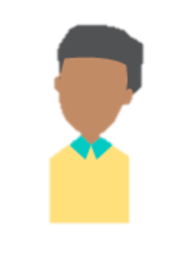

SWIFT
Fee
Charge Our
“You pay all transfer charges, we receive full amount you send”
Charge Ben
“You do not pay any charge, we receive your payment minus all transfer charges”
Receiver
Sender
Notes:
you = sender, we = receiver
Charge Ben.(beneficiary) = Senders do not pay any charge. Receiver receives your payment minus all transfer charges.
Charge Our = All fees will be charged to the sender and the receiver gets the full amount that you send. Any charges applied by the receiving bank will be billed to the sender (usually sometime after sending the payment).
Please choose option “OUR” as all fees relating to the transfer should be charged to the sender, at the request of the sender.

Slide 23




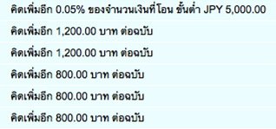
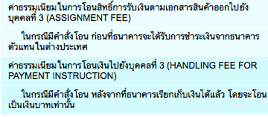
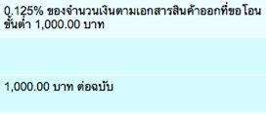


SWIFT
Fee
Notes:
Global outward:
charge ben : fee = B500/transfer
Charge our: depends on the foreign currency
Global Inward: will be charged 0.25% of the inward amount. The lowest fee is B200 and the highest is B500.

Slide 24







SWIFT
How good it is?
Convenient
Reach the receivers in all over the world
Inclusive
Eliminating annual maintenance concerns
Efficiency
Straight processing
Reducing operational cost
Notes:
reach the receiver in all over the world -- even for small banks
inclusive : Access to more than 9 thousand FIs, Market of infrastructure, and corporates in more than 200 countries
convenient to customers: Fast track investigations resolution on mass payment
increase operational efficiency
Achieve Straight through processing
Reduce operational cost
Eliminate annual maintenance concerns
Reach the receivers in all over the world
Inclusive
Convenient to customers

Slide 25

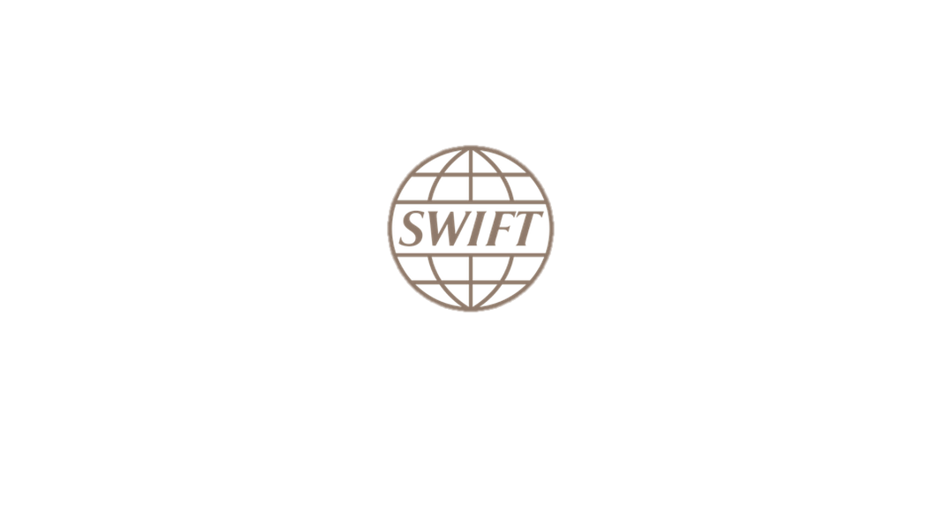


SWIFT
SWIFT just provides a network to send secure interbank messages.
Notes:
As powerful as SWIFT is, keep in mind that it is only a messaging system—SWIFT does not hold any funds or securities, nor does it manage client accounts.

Slide 26
Q&A

Slide 27
THANK YOU

